Slide 1
EIGRP
Three tables
Neighbour table
Hello packets
Hello interval and hold timer
Topology table
Successor
Lowest feasible distance (FD)
FD = link cost plus reported distance (RD)
Feasible successor (FS)
Feasibility condition
RD of a potential FS must be less than FD of the current successor
Routing table

Slide 2
EIGRP
Packet types
Hello
Update
Query
Reply
Acknowledgement

Slide 3
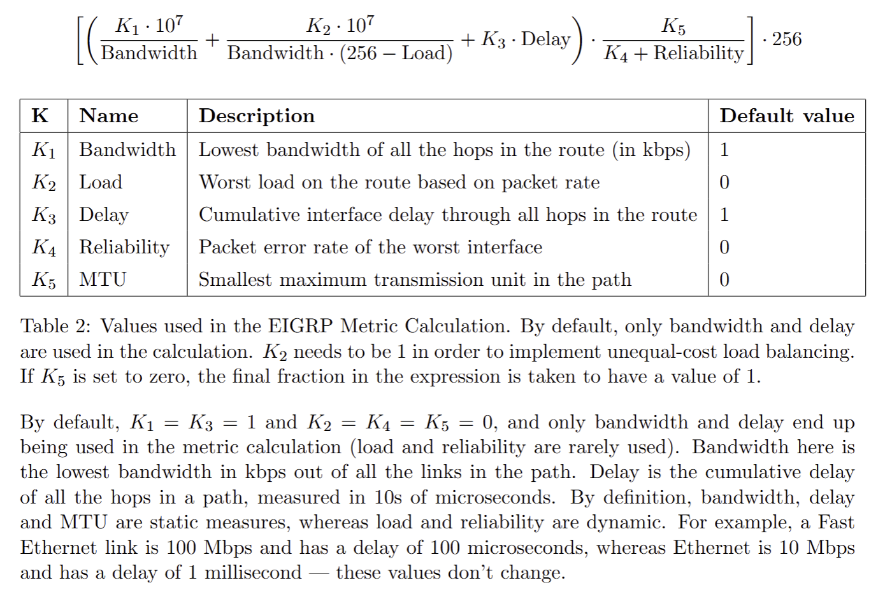

Slide 4
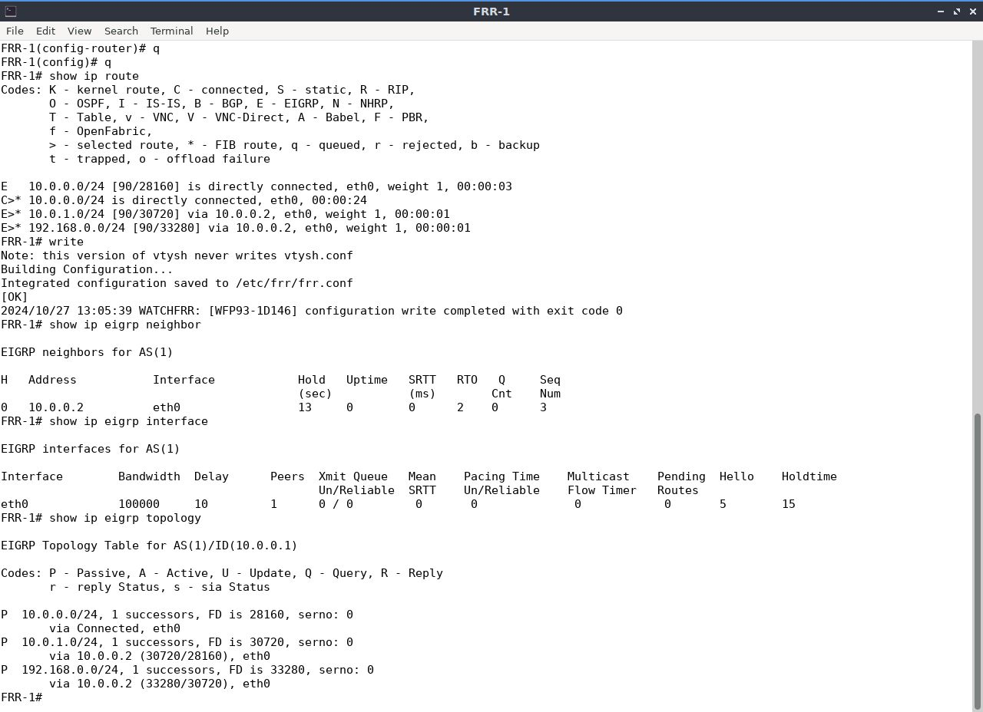
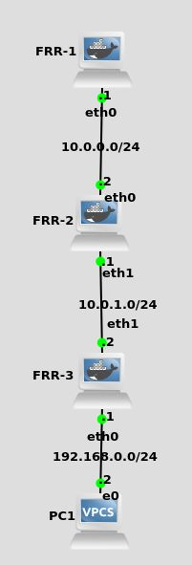

Slide 5
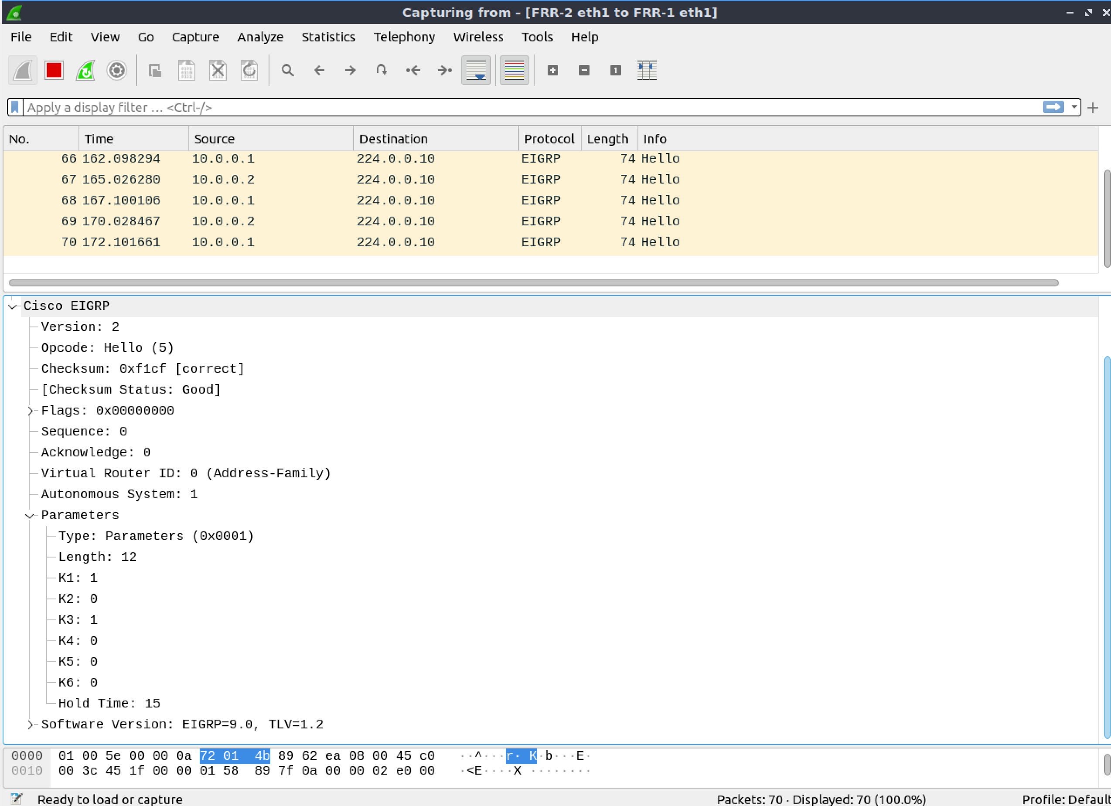

Slide 6
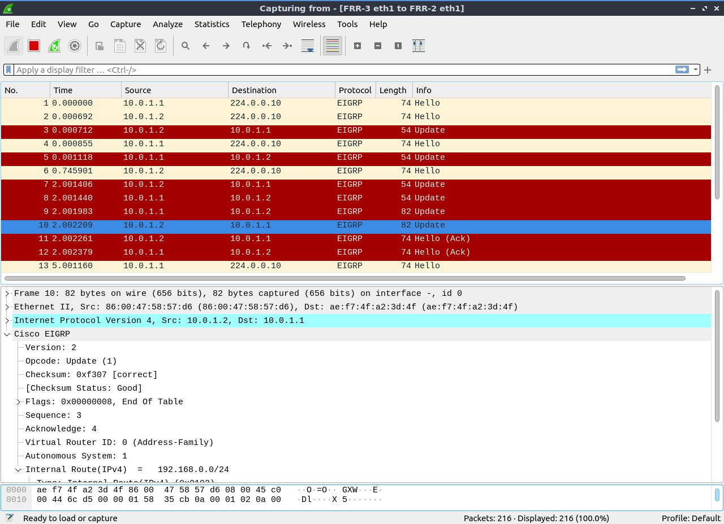

Slide 7
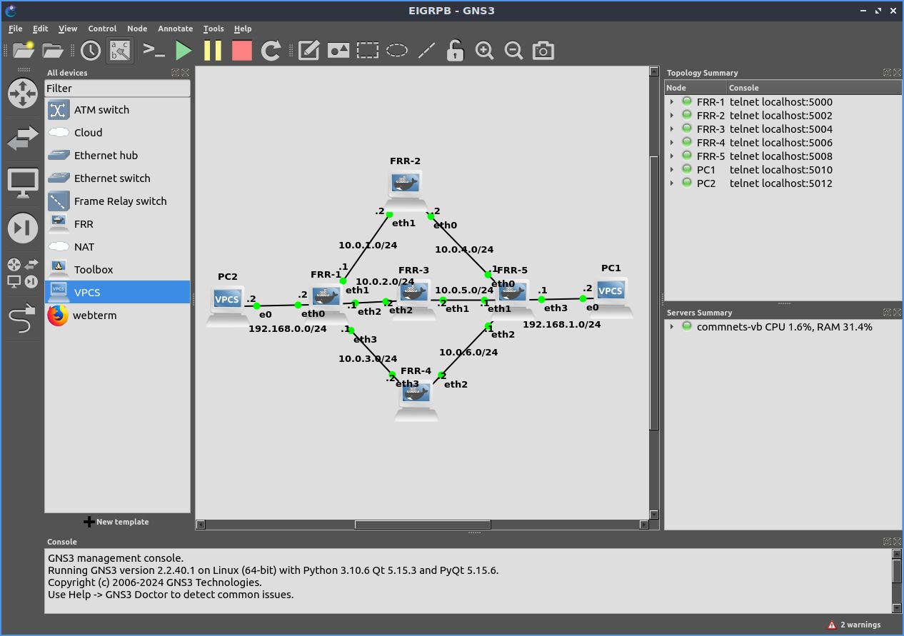

Slide 8
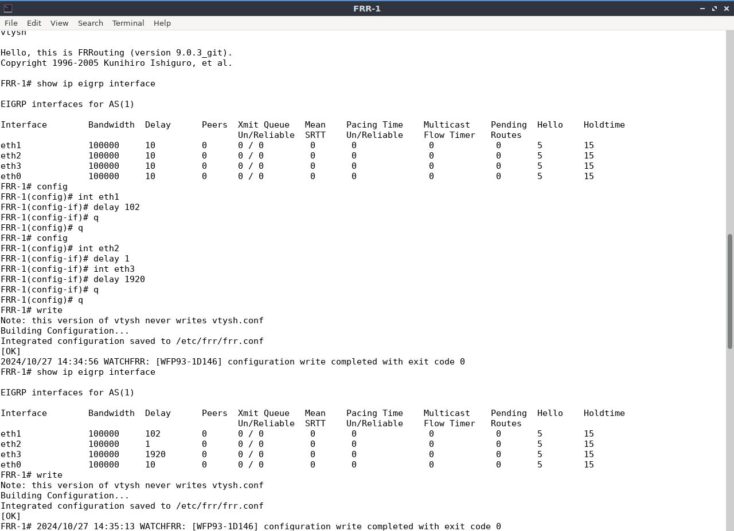

Slide 9
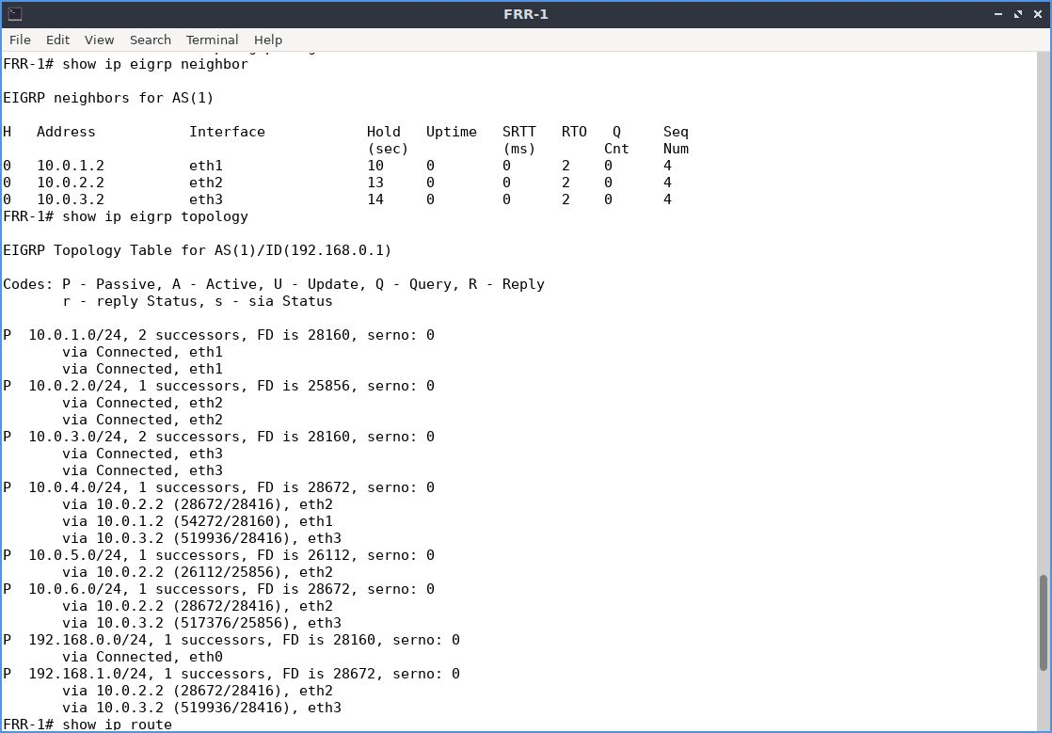

Slide 10
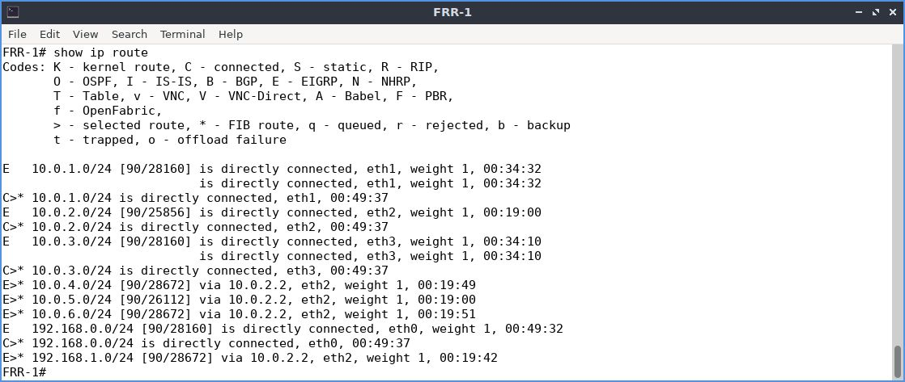

Slide 11
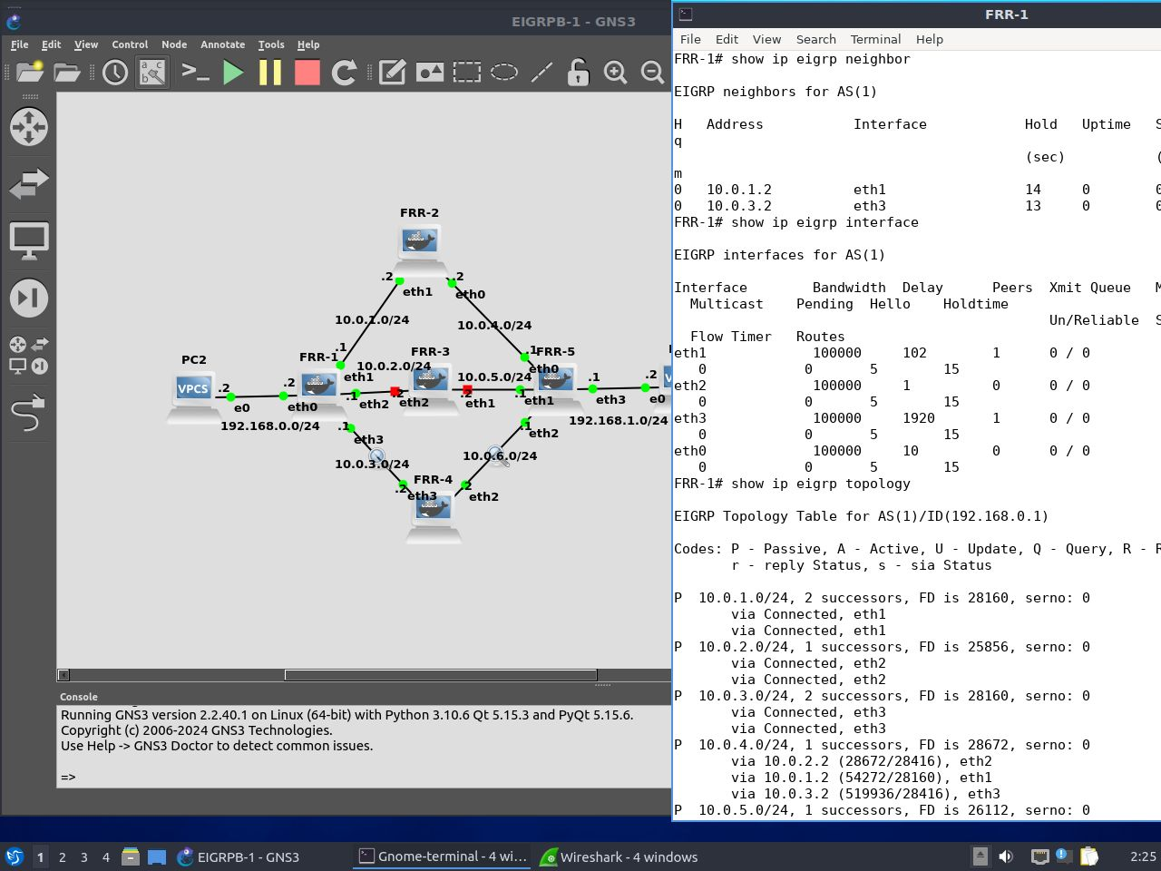

Slide 12
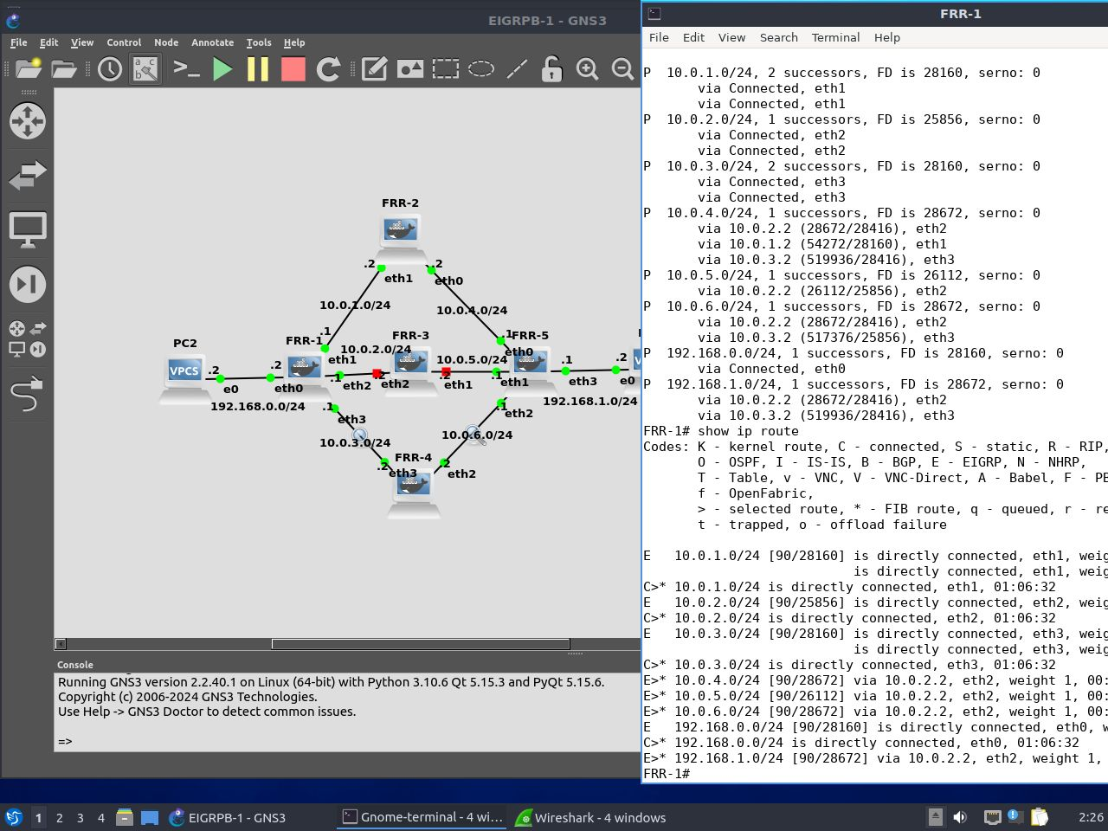

Slide 13
