Slide 1
2021SM2 Workshop Week 9 Exercise 1
Comp20008

Slide 2
1 – What is classification? What is regression? What is the difference between the two:
Answer:
Classification: Attempting to map from input variables (x) to discrete or categorical output variables (y)
Regression: Attempting to map from input variables (x) to numerical or continuous output variables (y)
Main difference: attempting to predict a discrete category vs a continuous number

Slide 3
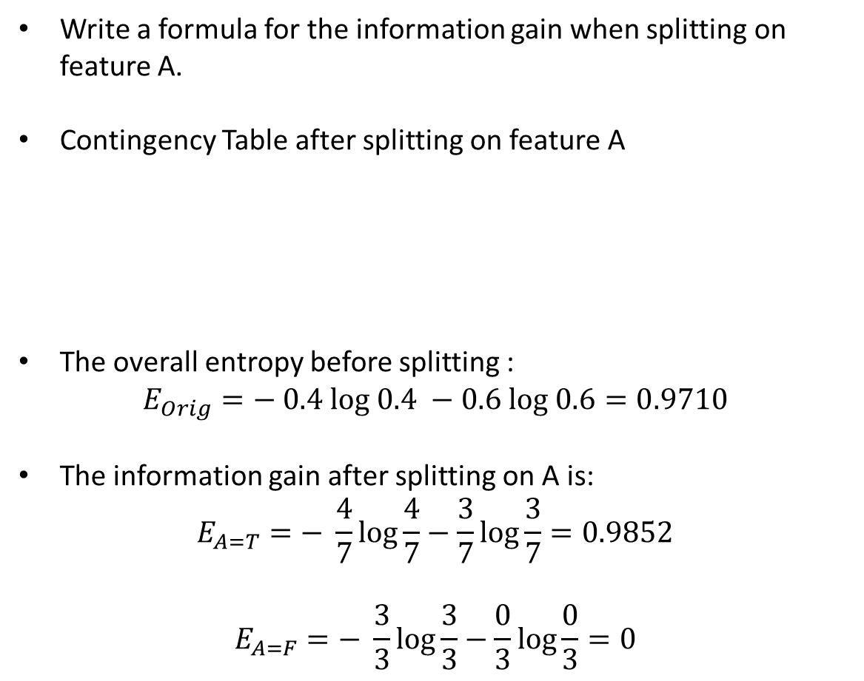

1- Consider the following data set for a binary class problem and consider building a decision tree using this data.
Write a formula for the information gain when splitting on feature A.
Contingency Table after splitting on feature A
The overall entropy before splitting :
$$E_{Orig}=− 0.4 log 0.4 −0.6 log 0.6=0.9710$$
The information gain after splitting on A is:
$$E_{A=T}=− \frac{4}{7}log\frac{4}{7}−\frac{3}{7}log\frac{3}{7}=0.9852$$
$$E_{A=F}=− \frac{3}{3}log\frac{3}{3}−\frac{0}{3}log\frac{0}{3}=0$$
Feature A | Feature B | Class Label
T | F | +
T | T | +
T | T | +
T | F | -
T | T | +
F | F | -
F | F | -
F | F | -
T | T | -
T | F | -
 | A = T | A = F
+ | 4 | 0
- | 3 | 3
$∆ = E_{Orig}− \frac{7}{10}E_{A=T}−\frac{3}{10}E_{A=F}=0.2813$

Slide 4
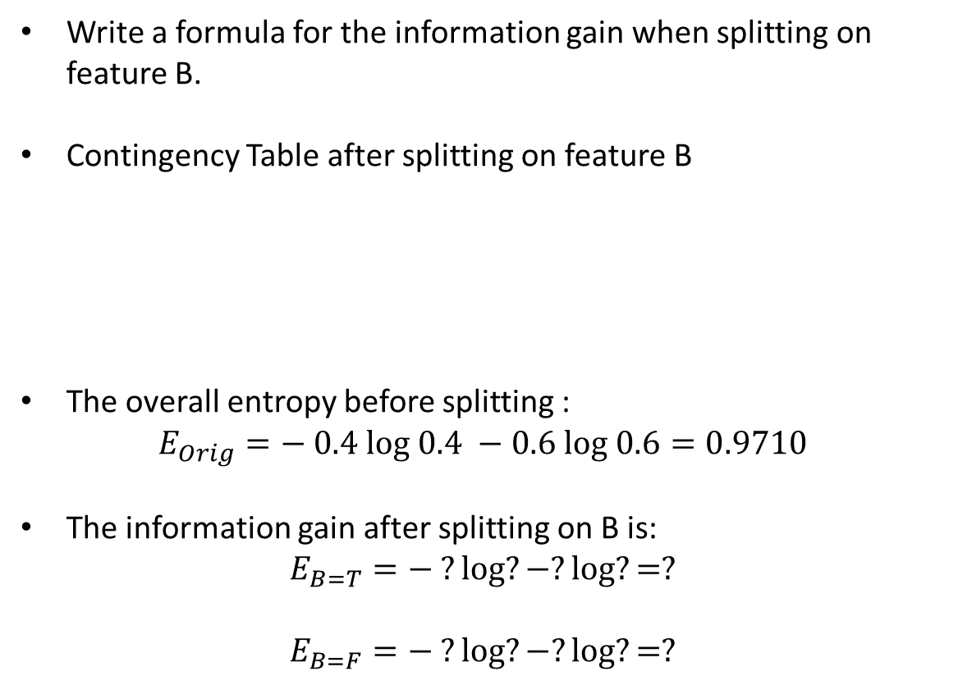

1- Consider the following data set for a binary class problem and consider building a decision tree using this data.
Write a formula for the information gain when splitting on feature B.
Contingency Table after splitting on feature B
The overall entropy before splitting :
$$E_{Orig}=− 0.4 log 0.4 −0.6 log 0.6=0.9710$$
The information gain after splitting on B is:
$$E_{B=T}=− ?log?−?log?=?$$
$$E_{B=F}=− ?log?−?log?=?$$
Feature A | Feature B | Class Label
T | F | +
T | T | +
T | T | +
T | F | -
T | T | +
F | F | -
F | F | -
F | F | -
T | T | -
T | F | -
 | B = T | B = F
+ | ? | ?
- | ? | ?
$∆ = E_{Orig}− ?E_{B=T}−?E_{B=F}=?$

Slide 5
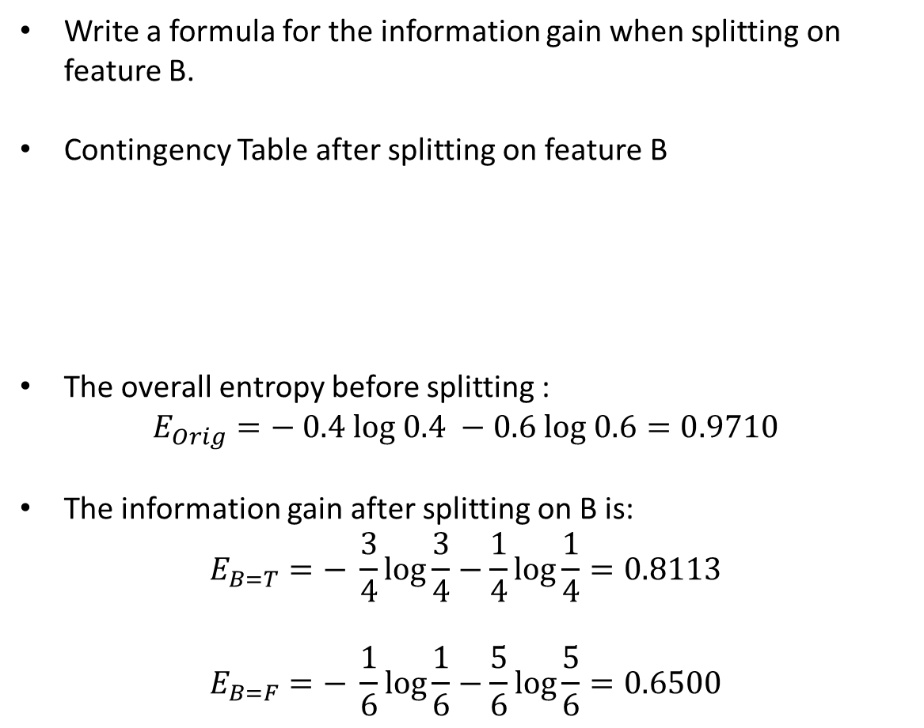

1- Consider the following data set for a binary class problem and consider building a decision tree using this data.
Write a formula for the information gain when splitting on feature B.
Contingency Table after splitting on feature B
The overall entropy before splitting :
$$E_{Orig}=− 0.4 log 0.4 −0.6 log 0.6=0.9710$$
The information gain after splitting on B is:
$$E_{B=T}=− \frac{3}{4}log\frac{3}{4}−\frac{1}{4}log\frac{1}{4}=0.8113$$
$$E_{B=F}=− \frac{1}{6}log\frac{1}{6}−\frac{5}{6}log\frac{5}{6}=0.6500$$
Feature A | Feature B | Class Label
T | F | +
T | T | +
T | T | +
T | F | -
T | T | +
F | F | -
F | F | -
F | F | -
T | T | -
T | F | -
 | B = T | B = F
+ | 3 | 1
- | 1 | 5
$∆ = E_{Orig}− \frac{4}{10}E_{B=T}−\frac{6}{10}E_{B=F}=0.2565$

Slide 6
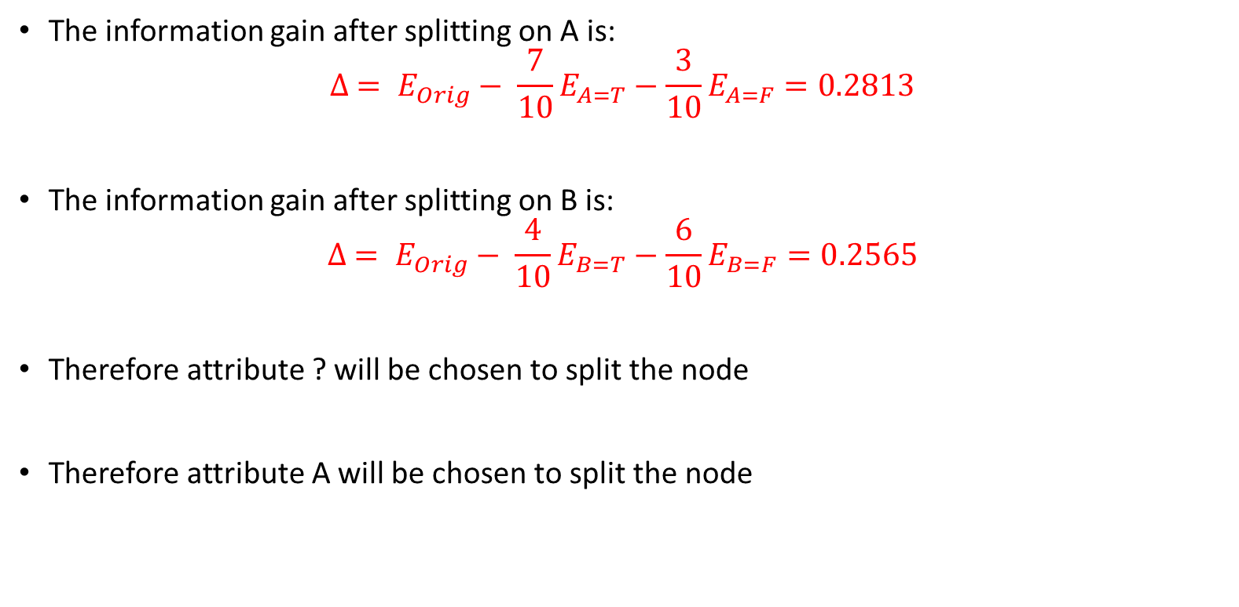
The information gain after splitting on A is:
$$∆ = E_{Orig}− \frac{7}{10}E_{A=T}−\frac{3}{10}E_{A=F}=0.2813$$
The information gain after splitting on B is:
$$∆ = E_{Orig}− \frac{4}{10}E_{B=T}−\frac{6}{10}E_{B=F}=0.2565$$
Therefore attribute ? will be chosen to split the node
Therefore attribute A will be chosen to split the node

