Slide 1
Workshop week 8 Correlation
COMP20008 2021 S2

Slide 2
What is Correlation?
Correlation is used to detect pairs of variables that might have some relationship.
Visually can be identified via inspecting scatter plots

Slide 3
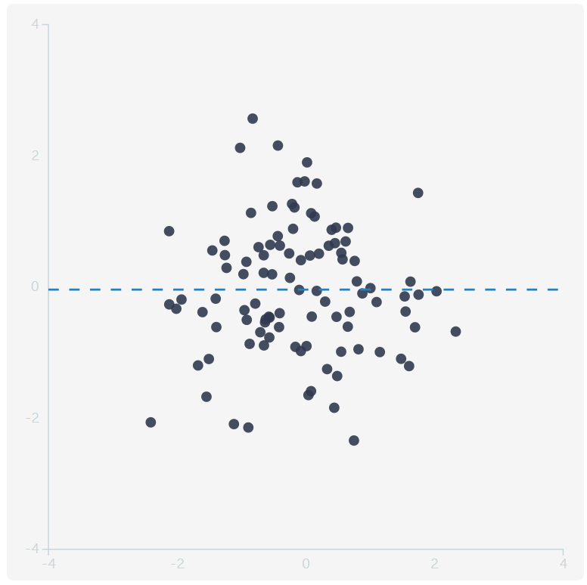
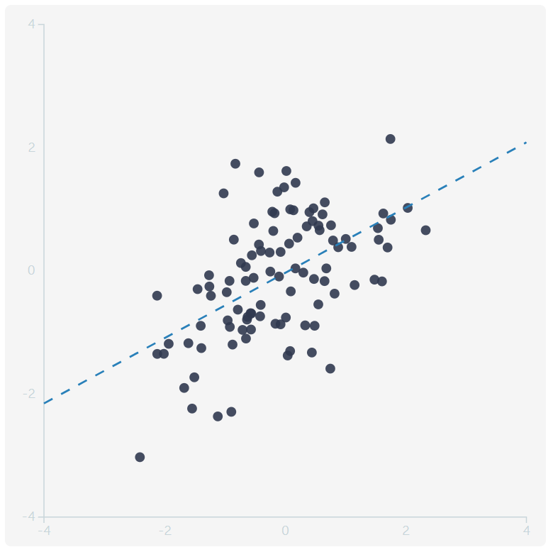
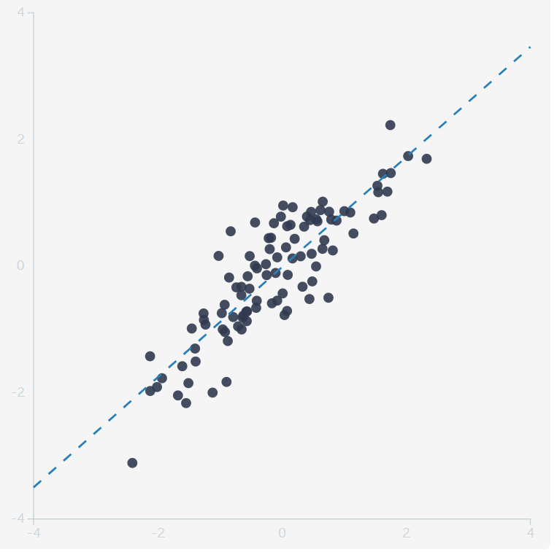
Remember!
Correlation does not necessarily imply causality!
Feature ranking: select the best features for building better predictive models:
A good feature to use, is a feature that has high correlation with the outcome one is trying to predict
https://rpsychologist.com/d3/correlation/

Slide 4
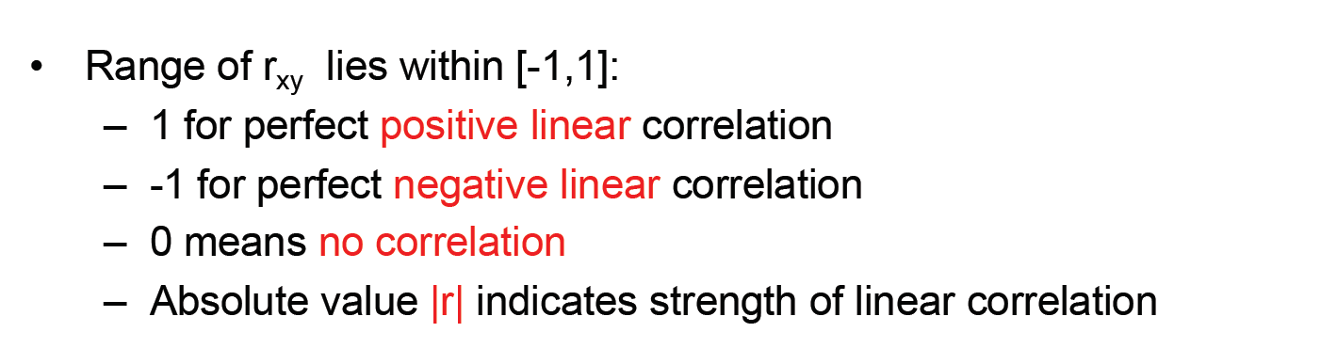
Assessing linear correlation – Pearson correlation
Assess how close their scatter plot is to a straight line (a linear relationship)

Slide 5
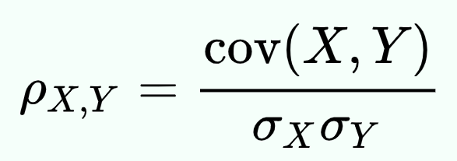
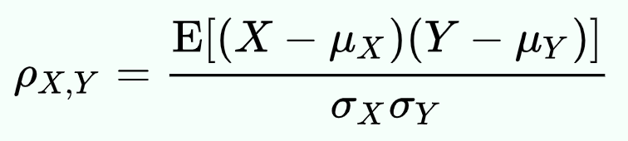
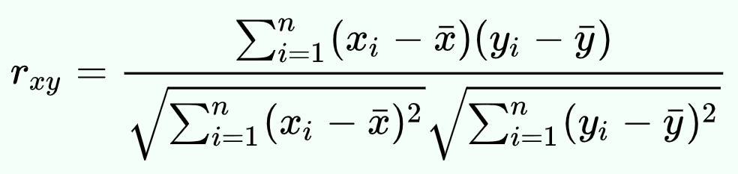
Calculation

Slide 6
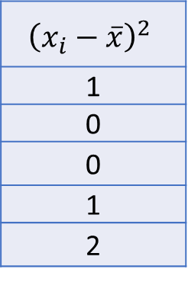
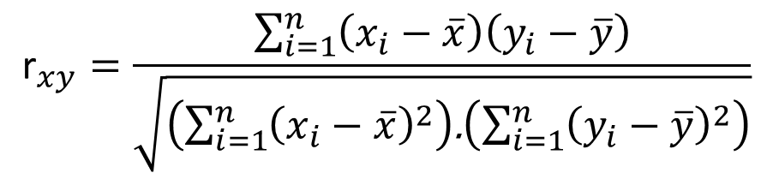
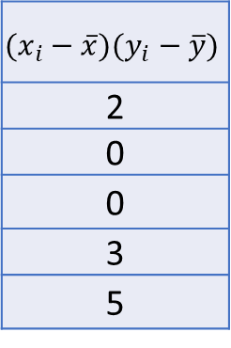
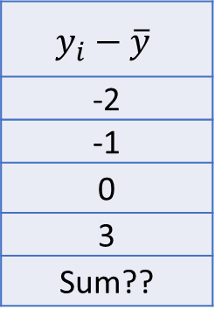
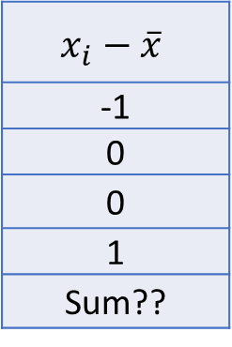

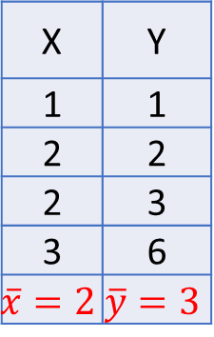
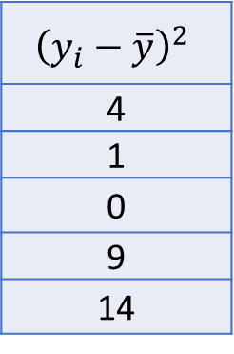
Micro Example (Warm Up)
x | y
1 | 1
2 | 2
2 | 3
3 | 6
Calculate Pearson Correlation Coefficient between X and Y
$${\text{r}}_{xy}=\frac{\sum_{i=1}^{n}{\left(x_{i}−\overline{x}\right)\left(y_{i}−\overline{y}\right)}}{\sqrt{\left(\sum_{i=1}^{n}{{\left(x_{i}−\overline{x}\right)}^{2}}\right)\text{.}\left(\sum_{i=1}^{n}{{\left(y_{i}−\overline{y}\right)}^{2}}\right)}}$$
X | Y
1 | 1
2 | 2
2 | 3
3 | 6
$$\overline{x}=2$$ | $$\overline{y}=3$$
$$x_{i}−\overline{x}$$
-1
0
0
1
Sum??
$$y_{i}−\overline{y}$$
-2
-1
0
3
Sum??
$$(x_{i}−\overline{x})(y_{i}−\overline{y})$$
2
0
0
3
5
$${\left(x_{i}−\overline{x}\right)}^{2}$$
1
0
0
1
2
$${\left(y_{i}−\overline{y}\right)}^{2}$$
4
1
0
9
14
$$r_{xy}=\frac{5}{\sqrt{2×14}}=0.9449$$

Slide 7
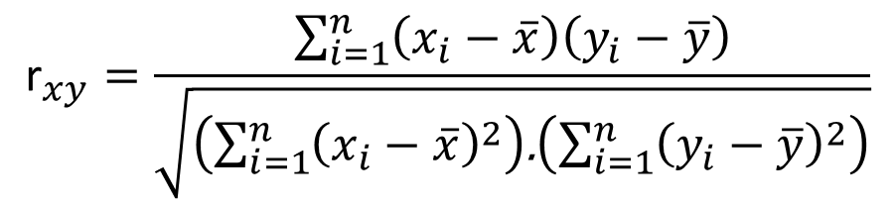
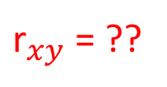
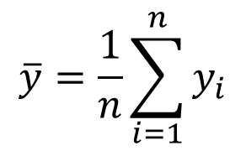
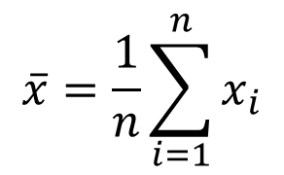
Compute the Pearson correlation between Average Steps per day and Average Resting Heart Rate. Show your working. How would you interpret this correlation value?
Person ID | Average Steps per day | Average Resting Heart Rate
1 | 1000 | 100
2 | 2500 | 105
3 | 3000 | 80
4 | 5000 | 77
5 | 6000 | 74
6 | 9000 | 70
7 | 11000 | 65
8 | 14000 | 63
9 | 18000 | 62
10 | 19000 | 61
11 | 19500 | 60.5
12 | 22000 | 55
$${\text{r}}_{xy}=\frac{\sum_{i=1}^{n}{\left(x_{i}−\overline{x}\right)\left(y_{i}−\overline{y}\right)}}{\sqrt{\left(\sum_{i=1}^{n}{{\left(x_{i}−\overline{x}\right)}^{2}}\right)\text{.}\left(\sum_{i=1}^{n}{{\left(y_{i}−\overline{y}\right)}^{2}}\right)}}$$
$$\overline{x}=\frac{1}{n}\sum_{i=1}^{n}{x_{i}}$$
$$\overline{y}=\frac{1}{n}\sum_{i=1}^{n}{y_{i}}$$
${\text{r}}_{xy}$ = ??

Slide 8
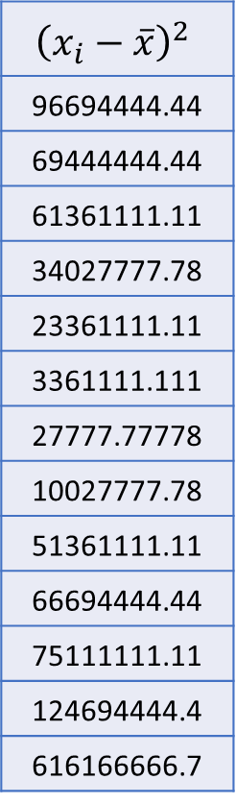
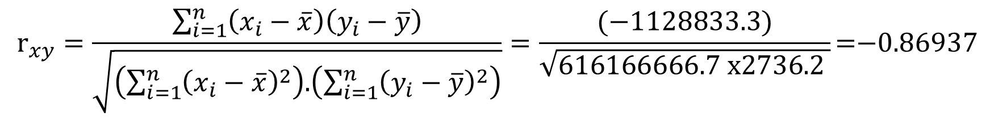
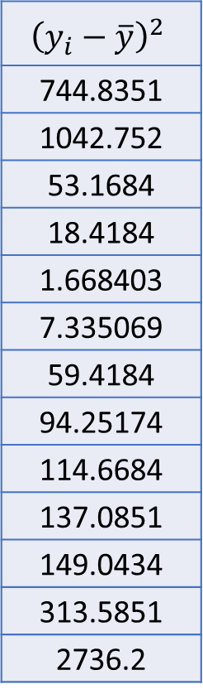
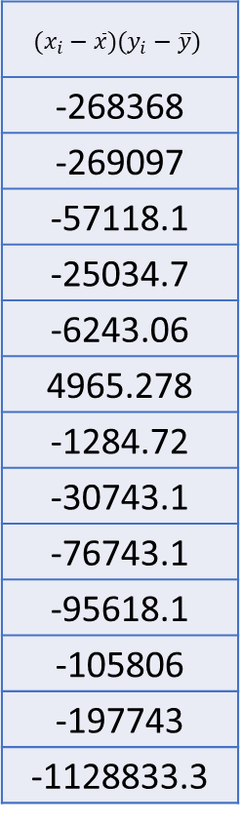
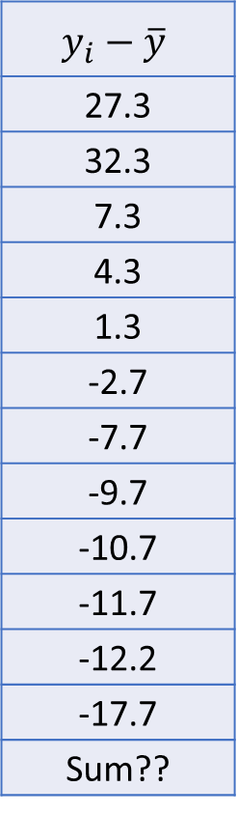
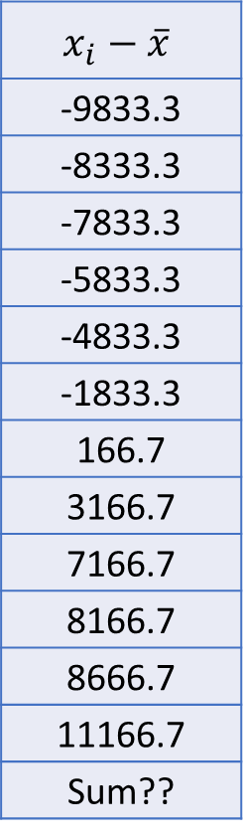
$${\text{r}}_{xy}=\frac{\sum_{i=1}^{n}{\left(x_{i}−\overline{x}\right)\left(y_{i}−\overline{y}\right)}}{\sqrt{\left(\sum_{i=1}^{n}{{\left(x_{i}−\overline{x}\right)}^{2}}\right)\text{.}\left(\sum_{i=1}^{n}{{\left(y_{i}−\overline{y}\right)}^{2}}\right)}}=\frac{\text{(}\text{−1128833.3)}}{\sqrt{\text{616166666.7 }\text{x}\text{2736.2 }}}\text{=−0.86937}$$
Person ID | Average Steps per day | Average Resting Heart Rate
1 | 1000 | 100
2 | 2500 | 105
3 | 3000 | 80
4 | 5000 | 77
5 | 6000 | 74
6 | 9000 | 70
7 | 11000 | 65
8 | 14000 | 63
9 | 18000 | 62
10 | 19000 | 61
11 | 19500 | 60.5
12 | 22000 | 55
mean | 10833.3 | 72.7
$$x_{i}−\overline{x}$$
-9833.3
-8333.3
-7833.3
-5833.3
-4833.3
-1833.3
166.7
3166.7
7166.7
8166.7
8666.7
11166.7
Sum??
$$y_{i}−\overline{y}$$
27.3
32.3
7.3
4.3
1.3
-2.7
-7.7
-9.7
-10.7
-11.7
-12.2
-17.7
Sum??
$$(x_{i}−\overline{x})(y_{i}−\overline{y})$$
-268368
-269097
-57118.1
-25034.7
-6243.06
4965.278
-1284.72
-30743.1
-76743.1
-95618.1
-105806
-197743
-1128833.3
$${\left(x_{i}−\overline{x}\right)}^{2}$$
96694444.44
69444444.44
61361111.11
34027777.78
23361111.11
3361111.111
27777.77778
10027777.78
51361111.11
66694444.44
75111111.11
124694444.4
616166666.7
$${\left(y_{i}−\overline{y}\right)}^{2}$$
744.8351
1042.752
53.1684
18.4184
1.668403
7.335069
59.4184
94.25174
114.6684
137.0851
149.0434
313.5851
2736.2

Slide 9
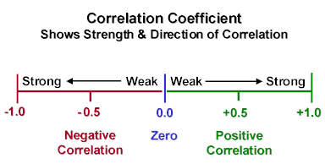

2. Based on the Pearson correlation value, can one conclude that doing more steps per day will cause one's average resting heart rate to decrease? How else might it be interpreted?
$${\text{r}}_{xy}\text{=−0.86937}$$
There is a relationship between the two factors, but can’t conclude it is causal.
Data sample is very small, could be a biased sample.
Could also be a 3rd factor controlling both (e.g. high blood pressure could cause high heart rate, high blood pressure could also cause a person to be less physically active (and thus take lower steps)
THM: Correlation does not imply Causality
Limitation of Pearson Correlation Coefficient

Slide 10
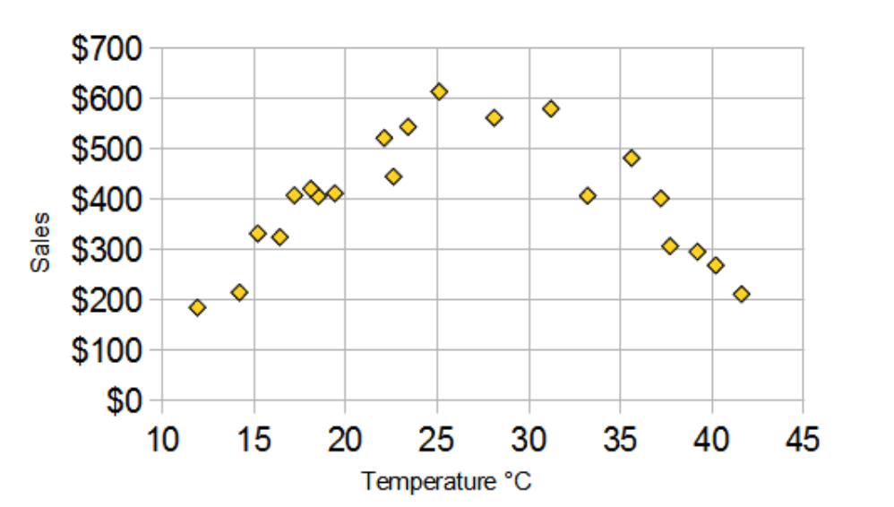
How do we measure non-linear correlation
High
Med
Low
Cold
Normal
Hot

Slide 11
Variable discretization: Techniques
Domain knowledge
Equal-length bin
Equal frequency bin

Slide 12
3. Discretise the data as follows: Apply 3 bin equal frequency discretisation to Average Steps per day and 4 bin equal frequency discretisation to Average Resting Heart Rate. Show the values of the discretised features.
Discretization techniques: Manual thresholds (domain knowledge), Equal-width bin and Equal-frequency bin
Column 1 = Sorted
Discrete
Person ID | Average Steps per day | Disc Average Steps per day | Average Resting Heart Rate | Disc Average Resting Heart Rate
1 | 1000 | 1 | 100 | 4
2 | 2500 | 1 | 105 | 4
3 | 3000 | 1 | 80 | 4
4 | 5000 | 1 | 77 | 3
5 | 6000 | 2 | 74 | 3
6 | 9000 | 2 | 70 | 3
7 | 11000 | 2 | 65 | 2
8 | 14000 | 2 | 63 | 2
9 | 18000 | 3 | 62 | 2
10 | 19000 | 3 | 61 | 1
11 | 19500 | 3 | 60.5 | 1
12 | 22000 | 3 | 55 | 1
1000
2500
3000
5000
6000
9000
11000
14000
18000
19000
19500
22000
1
1
1
1
2
2
2
2
3
3
3
3

Slide 13
3. Discretise the data as follows: Apply 3 bin equal frequency discretisation to Average Steps per day and 4 bin equal frequency discretisation to Average Resting Heart Rate. Show the values of the discretised features.
Discretization techniques: Manual thresholds (domain knowledge), Equal-width bin and Equal-frequency bin
Column 2
Sorted
Discrete
Person ID | Average Steps per day | Disc Average Steps per day | Average Resting Heart Rate | Disc Average Resting Heart Rate
1 | 1000 | 1 | 100 | 4
2 | 2500 | 1 | 105 | 4
3 | 3000 | 1 | 80 | 4
4 | 5000 | 1 | 77 | 3
5 | 6000 | 2 | 74 | 3
6 | 9000 | 2 | 70 | 3
7 | 11000 | 2 | 65 | 2
8 | 14000 | 2 | 63 | 2
9 | 18000 | 3 | 62 | 2
10 | 19000 | 3 | 61 | 1
11 | 19500 | 3 | 60.5 | 1
12 | 22000 | 3 | 55 | 1
100
105
80
77
74
70
65
63
62
61
60.5
55
55
60.5
61
62
63
65
70
74
77
80
100
105
1
1
1
2
2
2
3
3
3
4
4
4

Slide 14
Entropy and Mutual Information
Entropy
Quantify the amount of uncertainty in an entire probability distribution
The entropy of a variable is the “amount of information” contained in the variable
Describe it in the sense of randomness, surprise
Conditional entropy
H(Y|X) Measures how much information needed to describe outcome Y, given that outcome X is known
Mutual Information
a measure of correlation, the amount of information shared between two variables X and Y
MI(X,Y)>=0, large → highly correlated

Slide 15
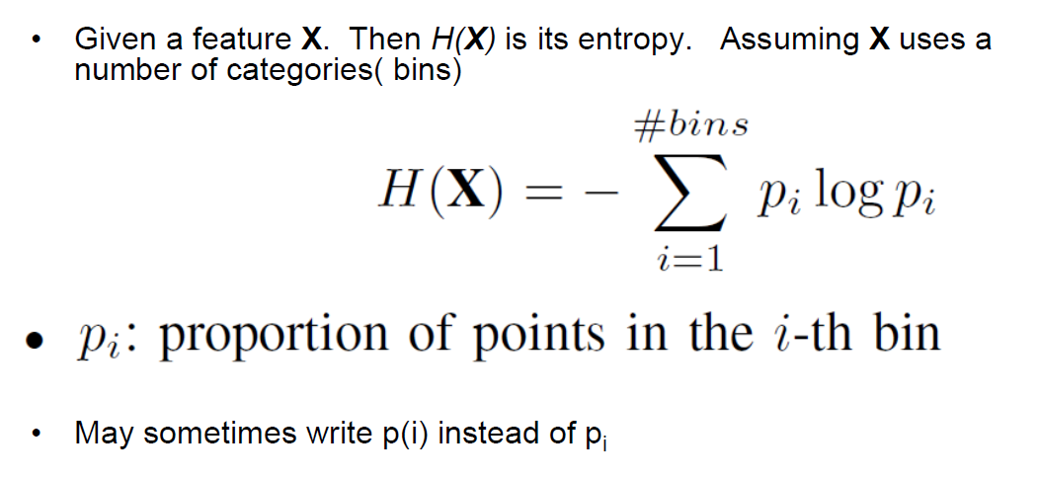

Slide 16
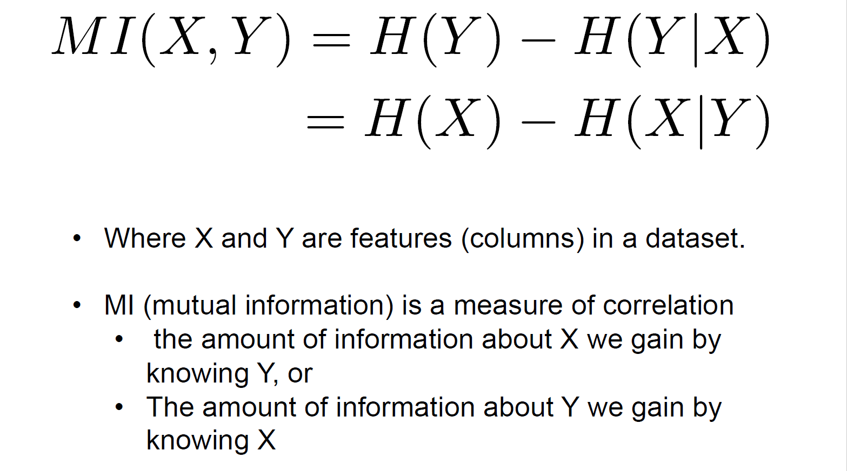

Slide 17

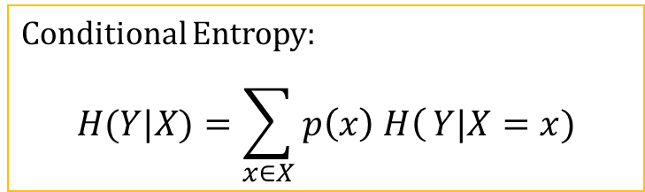
4. Using the discretised features, compute the entropies:
H(Average Steps per day)
H(Average Resting Heart Rate)
H(Average steps per day | Average Resting Heart Rate)
H(Average Resting Heart Rate | Average Steps per day).
Person ID | Disc Average Steps per day | Disc Average Resting Heart Rate
1 | 1 | 4
2 | 1 | 4
3 | 1 | 4
4 | 1 | 3
5 | 2 | 3
6 | 2 | 3
7 | 2 | 2
8 | 2 | 2
9 | 3 | 2
10 | 3 | 1
11 | 3 | 1
12 | 3 | 1
Entropy:
$$H\left(p\right)=−\sum_{i=1}^{k}{\left.p(i\right)}log p(i)$$
Conditional Entropy:
$$H(Y|X)=\sum_{x∈X}{\left. p\left(x\right) H\right(}Y|X=x)$$

Slide 18

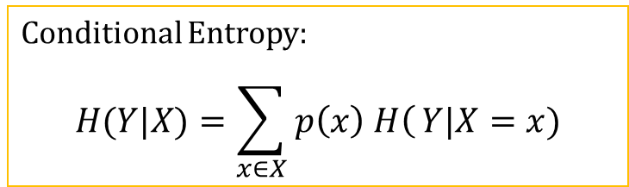

4. Using the discretised features, compute the entropies:
H(Average Steps per day)
$=−\sum_{i=1}^{k}{\left.p(i\right)}log p\left(i\right)$
$=−\left(\frac{4}{12}\log{\frac{4}{12}}\right)−\left(\frac{4}{12}\log{\frac{4}{12}}\right)−\left(\frac{4}{12}\log{\frac{4}{12}}\right)$
$=−3\left(\frac{4}{12}\log{\frac{4}{12}}\right)$
$=−3\left(\frac{1}{3}∗−1.585\right)=1.585$
Person ID | Disc Average Steps per day | Disc Average Resting Heart Rate
1 | 1 | 4
2 | 1 | 4
3 | 1 | 4
4 | 1 | 3
5 | 2 | 3
6 | 2 | 3
7 | 2 | 2
8 | 2 | 2
9 | 3 | 2
10 | 3 | 1
11 | 3 | 1
12 | 3 | 1
Entropy:
$$H\left(p\right)=−\sum_{i=1}^{k}{\left.p(i\right)}log p(i)$$
Conditional Entropy:
$$H(Y|X)=\sum_{x∈X}{\left. p\left(x\right) H\right(}Y|X=x)$$

Slide 19


4. Using the discretised features, compute the entropies:
H(Average Resting Heart Rate)
$=−\sum_{i=1}^{k}{\left.p(i\right)}log p\left(i\right)$
$=−\left(\frac{3}{12}\log{\frac{3}{12}}\right)−\left(\frac{3}{12}\log{\frac{3}{12}}\right)−\left(\frac{3}{12}\log{\frac{3}{12}}\right)−\left(\frac{3}{12}\log{\frac{3}{12}}\right)$
$=−4\left(\frac{3}{12}\log{\frac{3}{12}}\right)$
$=−4\left(\frac{1}{4}∗−2\right)=2$
Person ID | Disc Average Steps per day | Disc Average Resting Heart Rate
1 | 1 | 4
2 | 1 | 4
3 | 1 | 4
4 | 1 | 3
5 | 2 | 3
6 | 2 | 3
7 | 2 | 2
8 | 2 | 2
9 | 3 | 2
10 | 3 | 1
11 | 3 | 1
12 | 3 | 1
Entropy:
$$H\left(p\right)=−\sum_{i=1}^{k}{\left.p(i\right)}log p(i)$$
Conditional Entropy:
$$H(Y|X)=\sum_{x∈X}{\left. p\left(x\right) H\right(}Y|X=x)$$

Slide 20

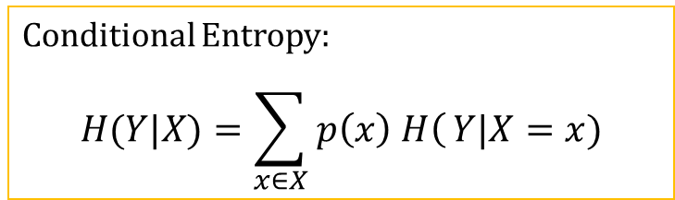
4. Using the discretised features, compute the entropies:
H(Average Steps per day | Average Resting Heart Rate)→ H(S|R)
$=\sum_{r∈R}{\left. p\left(r\right) H\right(}S|R=r)$
$=p\left(R=4\right)H\left(S | R=4\right)+p\left(R=3\right)H\left(S | R=3\right)+p(R=2) H(S|R=2)+p(R=1) H(S|R=1)$
$=\frac{3}{12}H\left(S | R=4\right)+\frac{3}{12}H\left(S | R=3\right)+\frac{3}{12}H\left(S | R=2\right)+\frac{3}{12}H\left(S | R=1\right)$
$H\left(S | R=4\right)=−1\log{1}=0$
$H\left(S | R=3\right)=−(\frac{1}{3}\log{\frac{1}{3})−(\frac{2}{3}\log{\frac{2}{3})}}=.918$
$H\left(S | R=2\right)=−(\frac{2}{3}\log{\frac{2}{3})}−(\frac{1}{3}\log{\frac{1}{3})}=.918$
$H\left(S | R=1\right)=−1\log{1}=0$
$=.25 \left(0+0+.918+.918\right)=0.459$
Person ID | Disc Average Steps per day (S) | Disc Average Resting Heart Rate (R)
1 | 1 | 4
2 | 1 | 4
3 | 1 | 4
4 | 1 | 3
5 | 2 | 3
6 | 2 | 3
7 | 2 | 2
8 | 2 | 2
9 | 3 | 2
10 | 3 | 1
11 | 3 | 1
12 | 3 | 1
ID | S | R=4
1 | 1 | 4
2 | 1 | 4
3 | 1 | 4
ID | S | R=2
7 | 2 | 2
8 | 2 | 2
9 | 3 | 2
ID | S | R=3
4 | 1 | 3
5 | 2 | 3
6 | 2 | 3
ID | S | R=1
10 | 3 | 1
11 | 3 | 1
12 | 3 | 1
Entropy:
$$H\left(p\right)=−\sum_{i=1}^{k}{\left.p(i\right)}log p(i)$$
Conditional Entropy:
$$H(Y|X)=\sum_{x∈X}{\left. p\left(x\right) H\right(}Y|X=x)$$

Slide 21

4. Using the discretised features, compute the entropies:
H(Average Resting Heart Rate | Average Steps per day) → H(R|S)
$=\sum_{s∈S}{\left. p\left(s\right) H\right(}R|S=s)$
$=p\left(S=1\right)H\left(R | S=1\right)+p\left(S=2\right)H\left(R | S=2\right)+p\left(S=3\right)H\left(R | S=3\right)$
$=\frac{4}{12}H\left(R | S=1\right)+\frac{4}{12}H\left(R | S=2\right)+\frac{4}{12}H\left(R | S=3\right)$
$H\left(R | S=1\right)=−\left(.75\log{.75}\right)−(.25\log{.25})=$ 0.311+0.5
$H\left(R | S=2\right)=−\left(.5\log{.5}\right)−\left(.5\log{.5}\right)=.5+.5=1$
$H\left(R | S=3\right)=−\left(.25\log{.25}\right)−\left(.75\log{.75}\right)=0.5$ +0.311
$=\frac{1}{3}\left(1+.811+.811\right)=0.874$
ID | S=2 | R
5 | 2 | 3
6 | 2 | 3
7 | 2 | 2
8 | 2 | 2
Person ID | Disc Average Steps per day (S) | Disc Average Resting Heart Rate (R)
1 | 1 | 4
2 | 1 | 4
3 | 1 | 4
4 | 1 | 3
5 | 2 | 3
6 | 2 | 3
7 | 2 | 2
8 | 2 | 2
9 | 3 | 2
10 | 3 | 1
11 | 3 | 1
12 | 3 | 1
ID | S=1 | R
1 | 1 | 4
2 | 1 | 4
3 | 1 | 4
4 | 1 | 3
ID | S=3 | R
9 | 3 | 2
10 | 3 | 1
11 | 3 | 1
12 | 3 | 1
Entropy:
$$H\left(p\right)=−\sum_{i=1}^{k}{\left.p(i\right)}log p(i)$$
Conditional Entropy:
$$H(Y|X)=\sum_{x∈X}{\left. p\left(x\right) H\right(}Y|X=x)$$

Slide 22
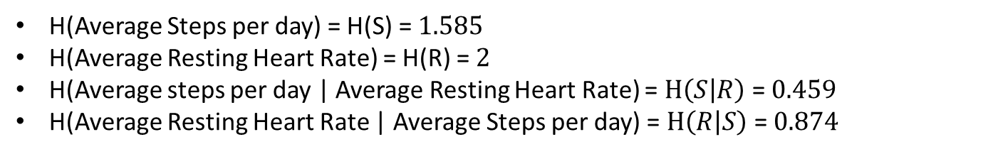
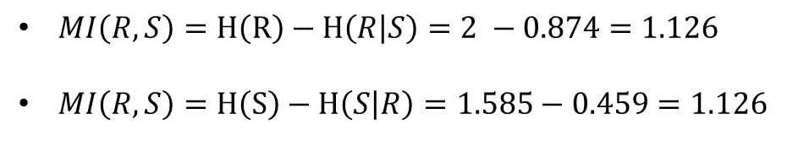
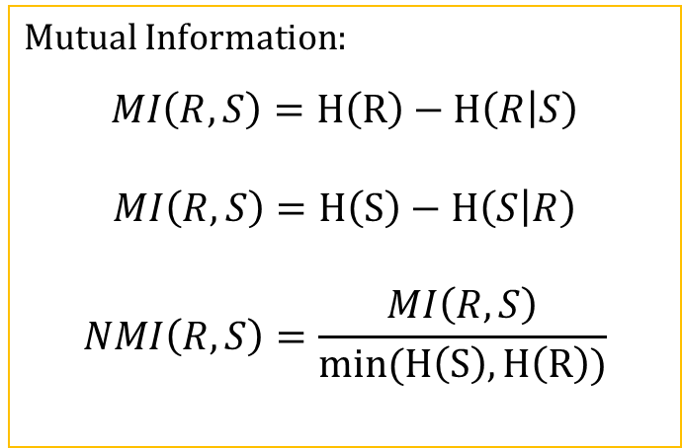
5. Using the above information, compute the mutual information between Average Steps per day and Average Resting Heart Rate.
H(Average Steps per day) = H(S) = $1.585$
H(Average Resting Heart Rate) = H(R) = $2$
H(Average steps per day | Average Resting Heart Rate) = $H\left(S | R\right)$= $0.459$
H(Average Resting Heart Rate | Average Steps per day) = $H\left(R | S\right)$= $0.874$
Mutual Information:
$$MI\left(R,S\right)=H\left(R\right)−H\left(R | S\right)$$
$$MI\left(R,S\right)=H\left(S\right)−H\left(S | R\right)$$
$$NMI\left(R,S\right)=\frac{MI\left(R,S\right)}{min⁡(H\left(S\right),H\left(R\right))}$$
$MI\left(R,S\right)=H\left(R\right)−H\left(R | S\right)=2 −0.874=1.126$
$MI\left(R,S\right)=H\left(S\right)−H\left(S | R\right)=1.585−0.459=1.126$
Notes:
• MI (mutual information) is a measure of correlation
• the amount of information about X we gain by knowing Y, or
• The amount of information about Y we gain by knowing X
MI(X,Y)
– large: X and Y are highly correlated (more dependent)
– small: X and Y have low correlation (more independent)
• 0 ≤ MI(X,Y)
NMI(X,Y) = MI(X,Y) / min(H(X),H(Y))

Slide 23
