Slide 1
Analysis of Customer Database for United Bank
Lighthouse Labs Mini Project
By : Leah Lourenco & Nitin Kohli

Slide 2

Project Outcomes :
Segmentation of customers
Identify patterns in the clusters
To introduce targeted marketing based upon the findings.
For Fraud Detection.

Slide 3
Features considered to segment and analyse the database:
‘Years with Bank’ - to reward loyal customers with incentives.
‘Income’ - increased credit card limits, business accounts, line of credit.
‘Age’ - retirement package, student loans
‘Money Spent’ - to find spending habits of customers.
‘Type of Account’ - to promote investing portfolios.

Slide 4
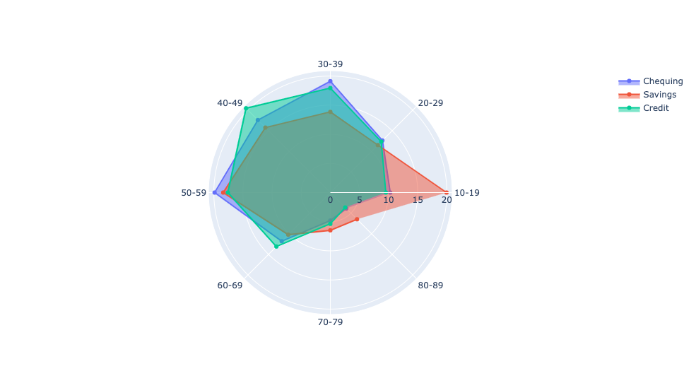
Transaction Types per Age Group

Slide 5
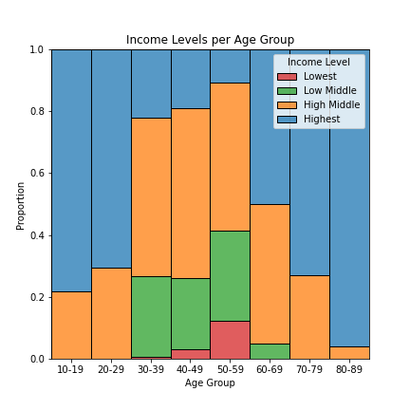
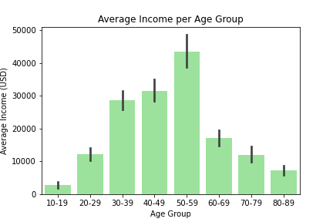
Cluster Findings Visualised:

Slide 6
Cluster Findings Interpreted:
1
Age Group : 20-29
2
Age Group:30-39
3
Age Group : 40-49
Relatively new customers .
Lesser income ($10 - $15K )
Majority of transactions from Credit Account.
Most of customers are with the bank for < 5 years.
Income of > $30K.
Transactions divided between Credit and Chequing account.
More loyal customers than new ones.
Income between $30-$35K.
Transactions mainly from Credit account.

Slide 7
Cluster Findings Interpreted:
1
Age Group : 50-59
2
Age Group:60-69
3
Age Group : 70-79
Least amount of new customers.
Highest earning group. (>$40)
Majority of transactions from Savings account.
Most loyal customers in the database.
Income from $15-20K.
Most of the transactions from Chequing account.
Majority of customers with the bank for >5 yrs.
Income between $10-$15K.
Least amount of transactions overall.

Slide 8
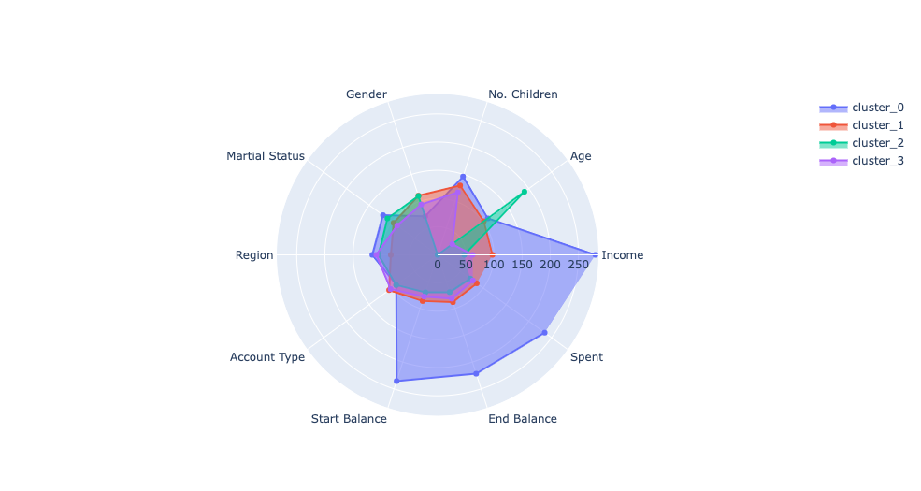
Comparing Clusters
Age x Income

Slide 9
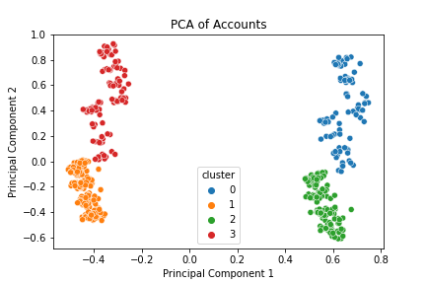
PCA

