Slide 1
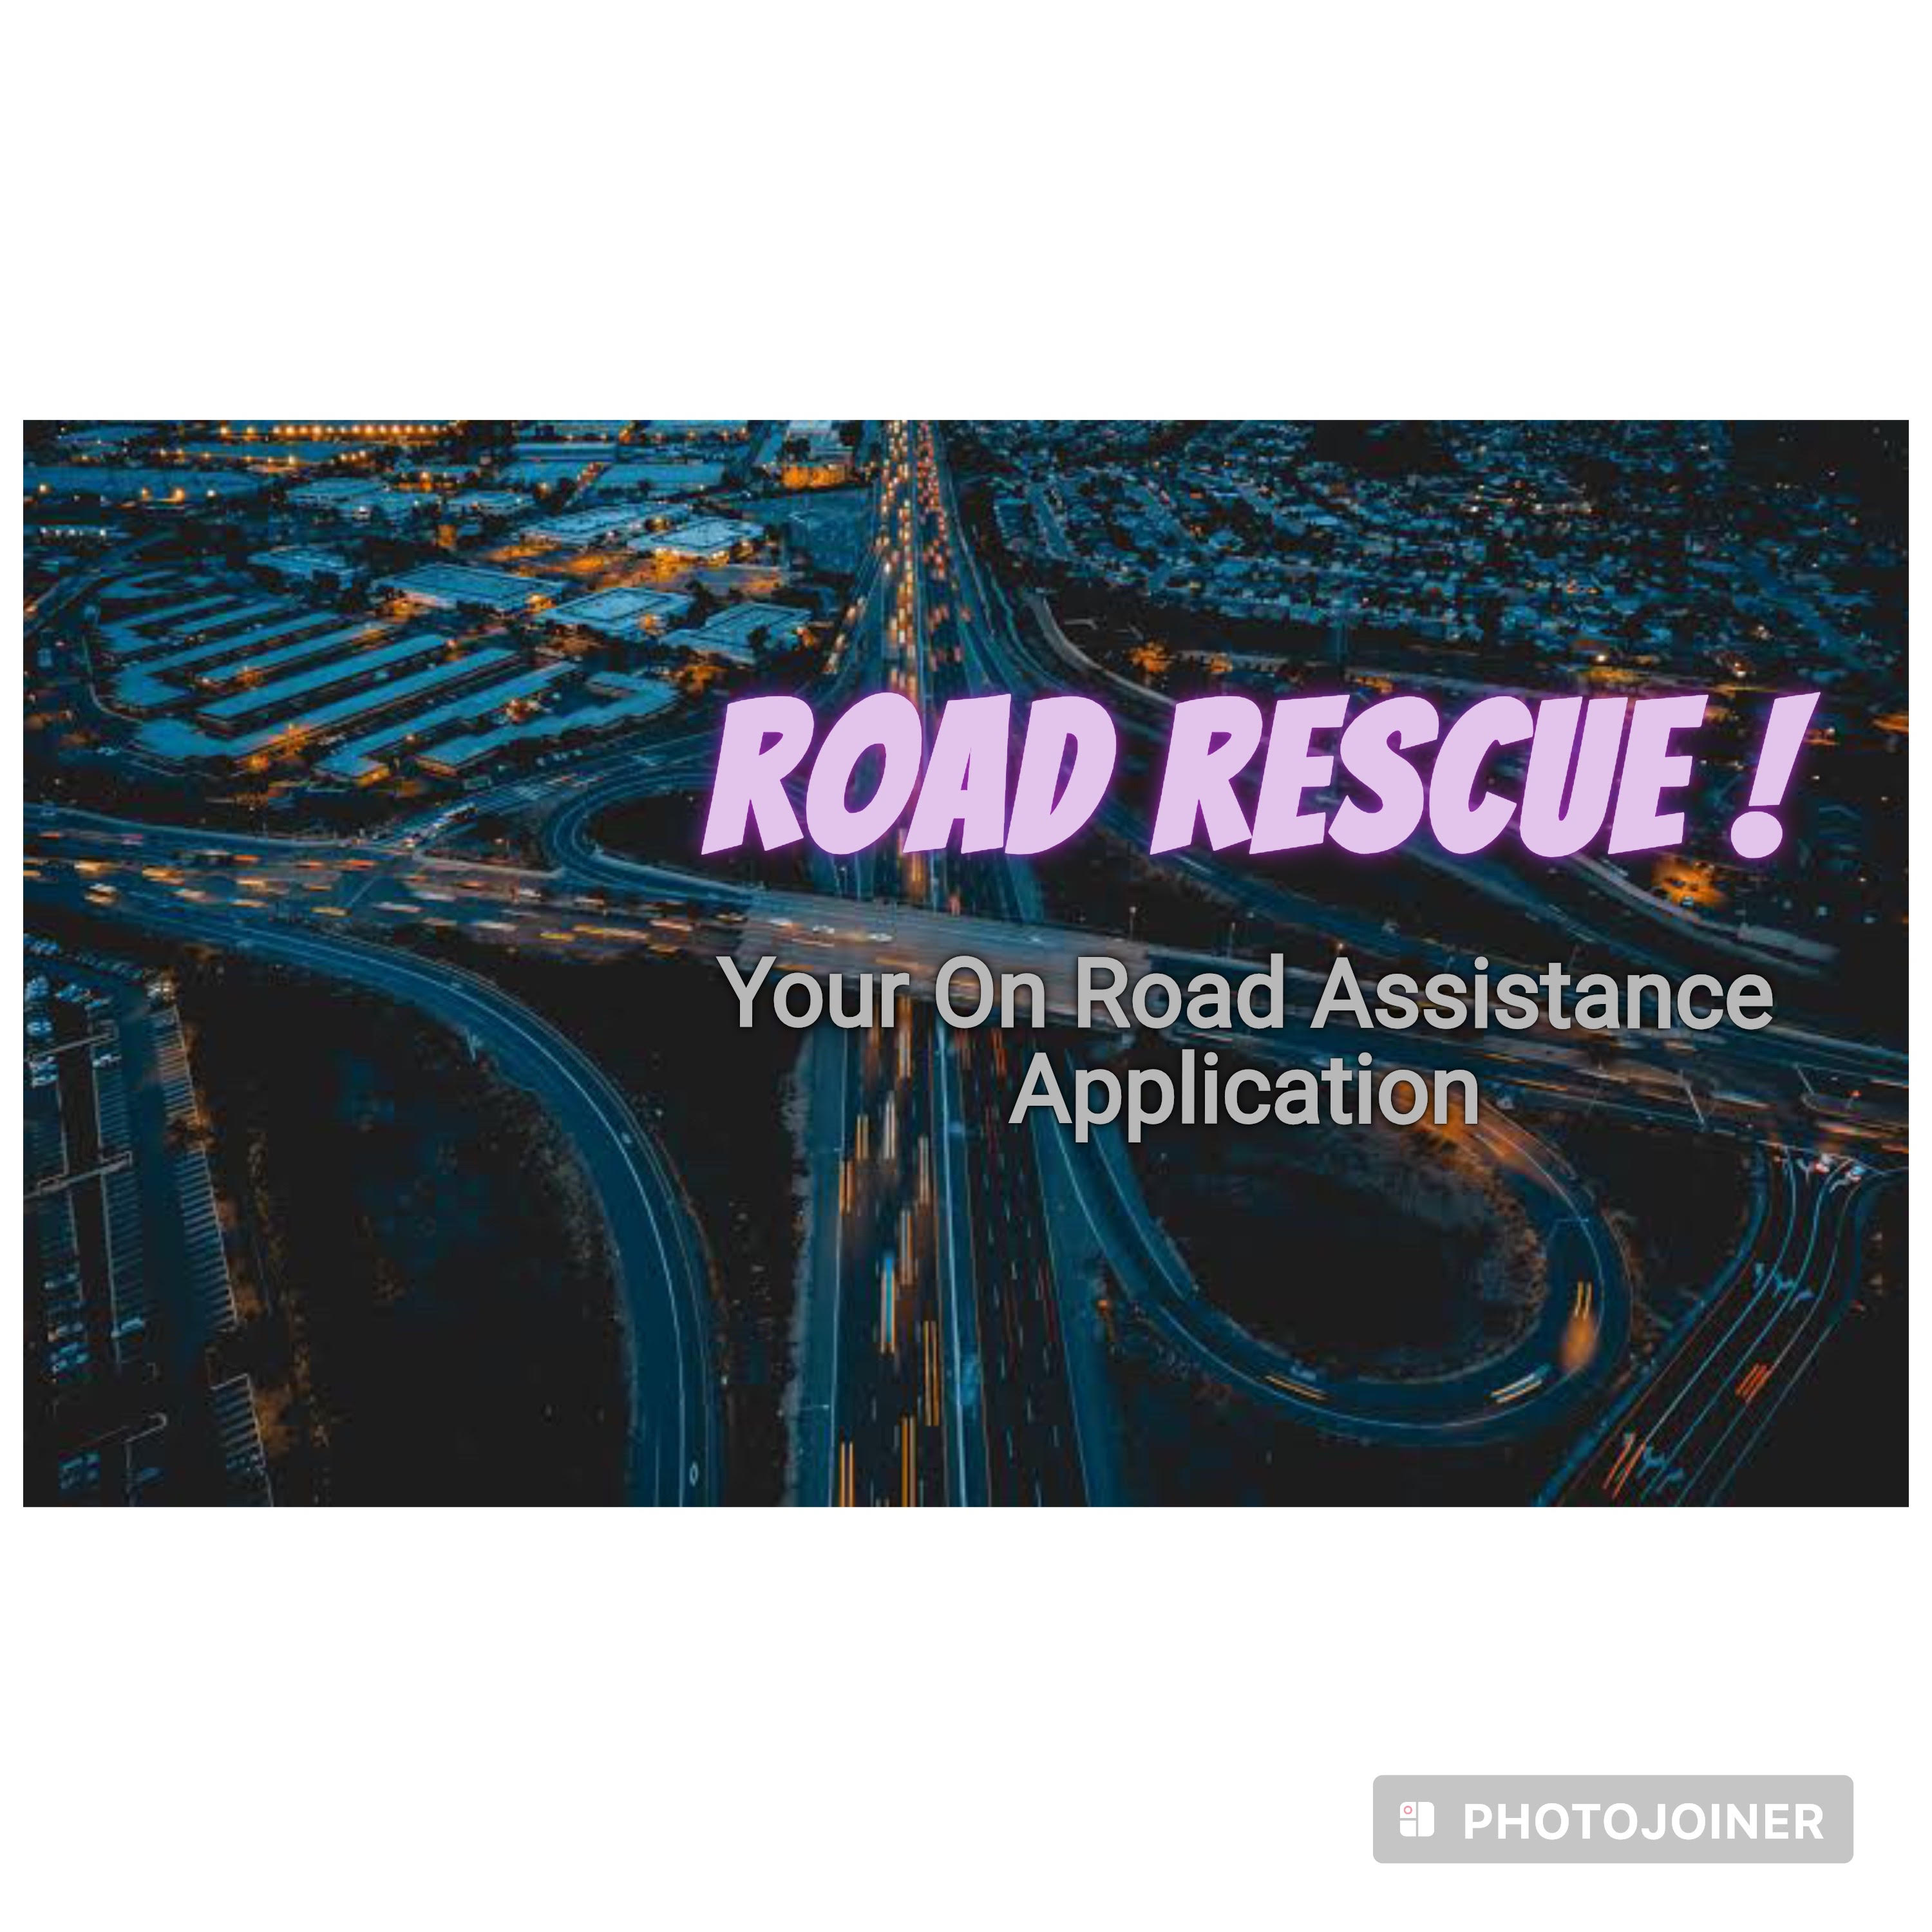
Project Title: Road Rescue:
On-Road Assistance Companion
Team Members:
Tarbia Hasan 2022512642
Rasa Jebin Hossain 1921698642
Md. Mudachir Uddin 1921849042

Slide 2

Road Rescue aims to:
Provide instant support during breakdowns, emergencies, or accidents.
Ensure access to essential services for a safer and secure journey.
Offer easy navigation, information, and aid for a stress-free travel experience.
Enhance road safety and convenience for drivers.

Slide 3
Problems on Bangladeshi Roads
Poor Road Infrastructure:
Broken roads and inadequate maintenance leading to accidents and vehicle damage.
Navigational Challenges:
Difficulty in finding routes and essential services in unfamiliar or remote areas.
Safety Concerns:
Increased risk of accidents due to road conditions and lack of immediate assistance.
Limited Connectivity:
Inadequate access to emergency services or support in remote regions.

Slide 4
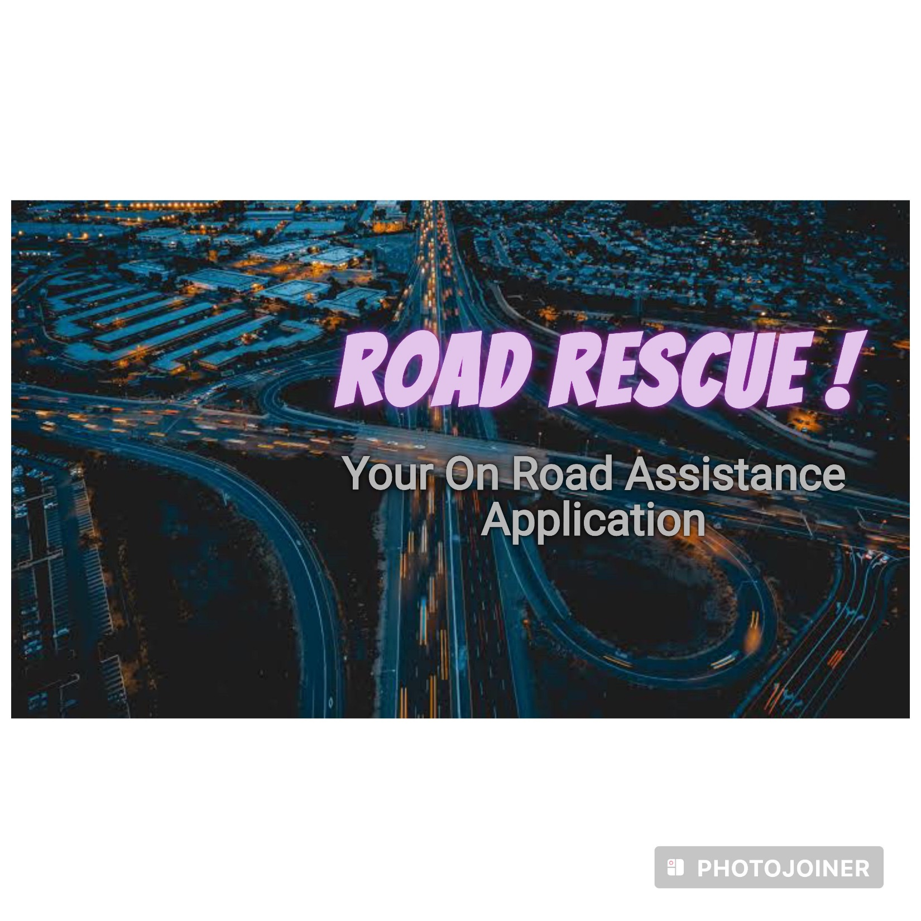

Slide 5
Features:
Basic Car Repair Tutorial
Chat Bot
Weather Updates
SOS Call
Find Nearby Services: Locate workshops, hotels, hospitals, gas stations.
Medical Information: Diagnostic tests, Doctors
Carpooling Support

Slide 6
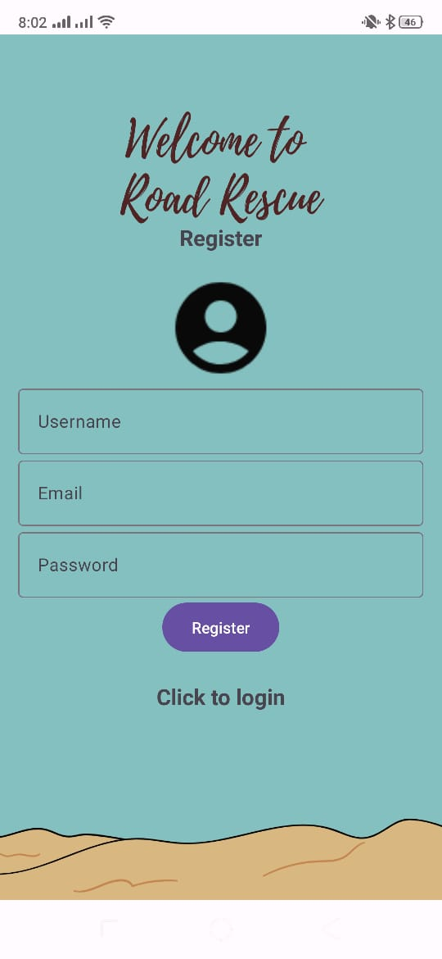
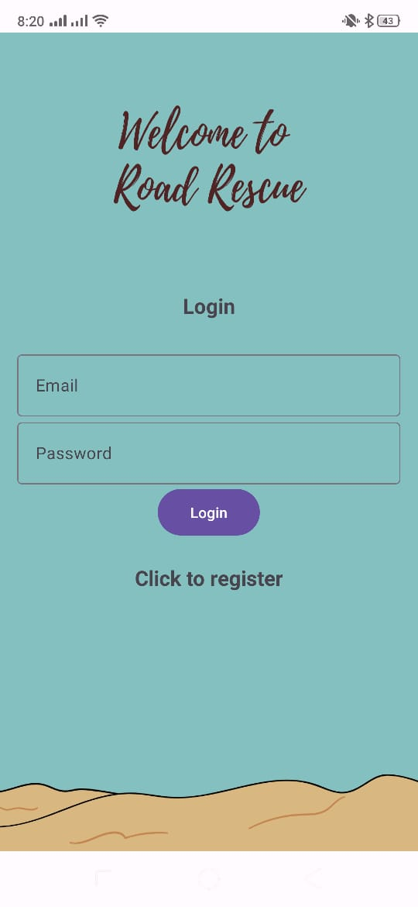
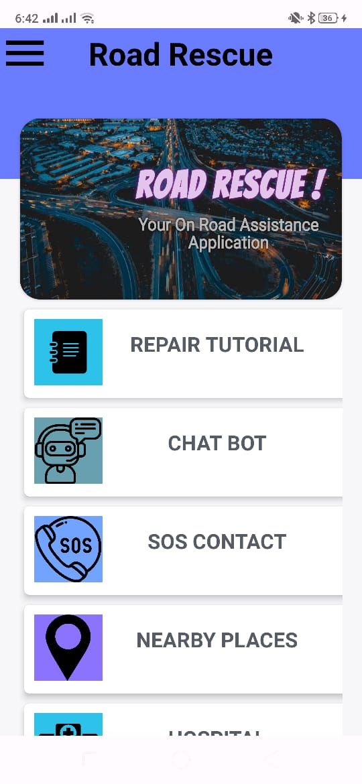
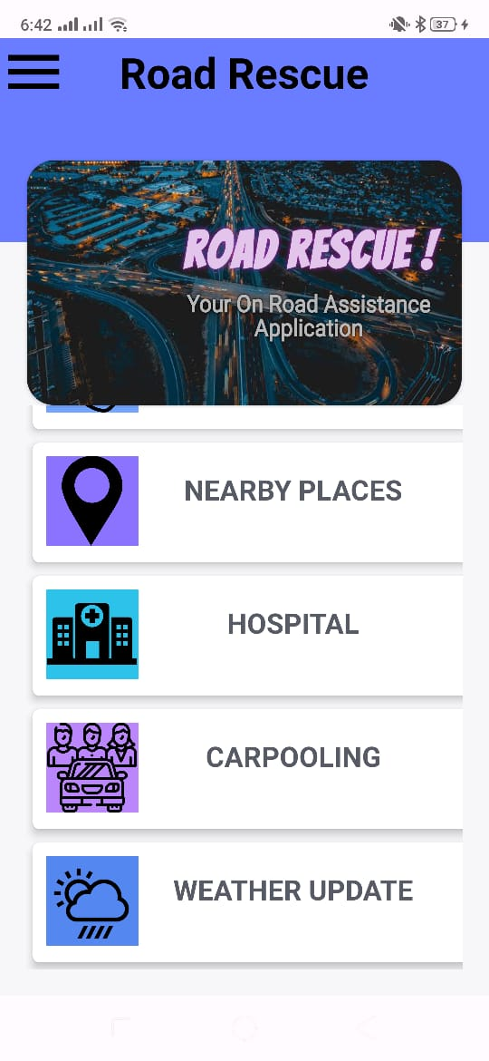

Slide 7
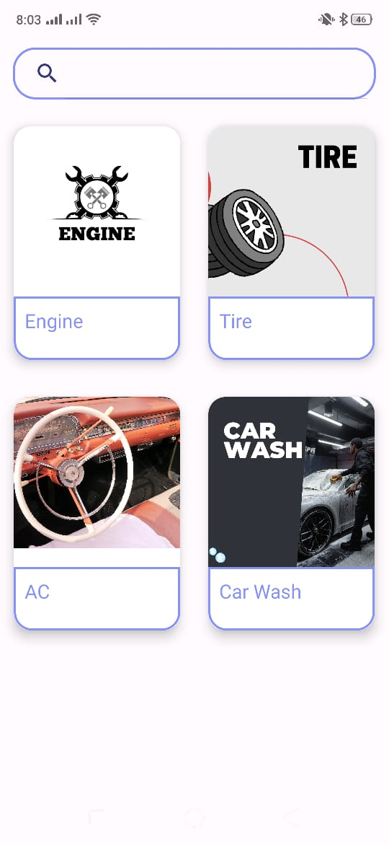

Basic Car Repair Tutorial
Step-by-step guidance for minor car repairs
Potentially reducing repair costs
Equips drivers with essential knowledge to address common issues on broken roads
minimizing the risk of accidents due to sudden breakdowns.

Slide 8
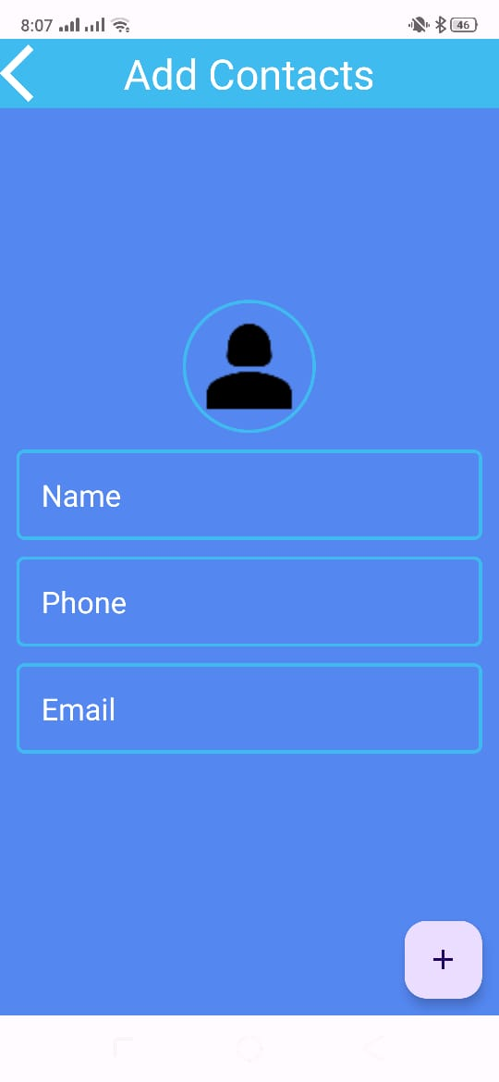



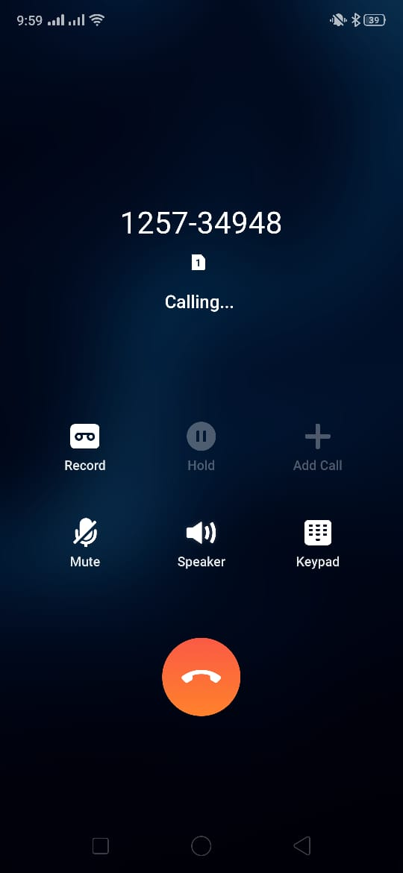
SOS Call
Allows users to quickly reach out to pre-saved emergency contacts
users can save, edit or delete entries as needed
Facilitates direct calling to emergency contacts

Slide 9

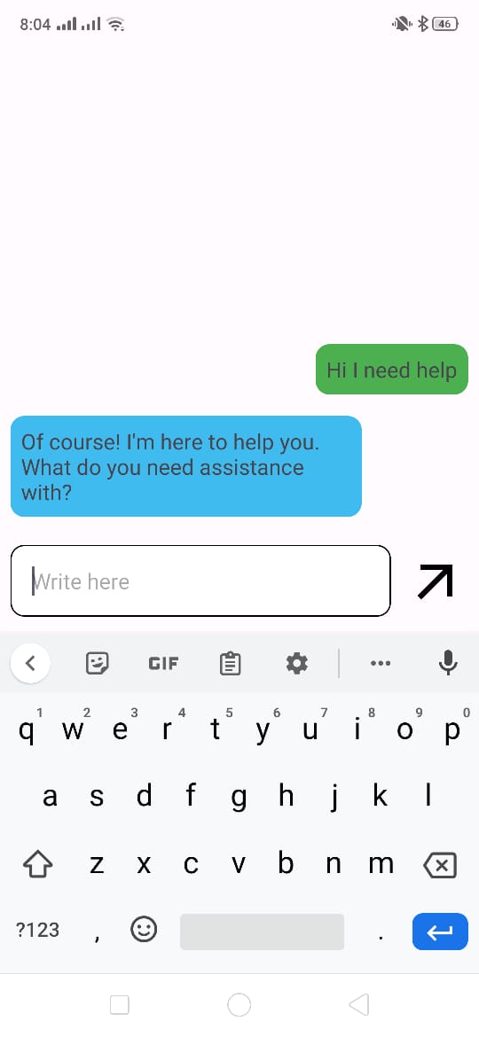
Chat Bot
Immediate Assistance
Offers access to essential information and guidance
Addressing the challenges faced by drivers on Bangladeshi roads

Slide 10
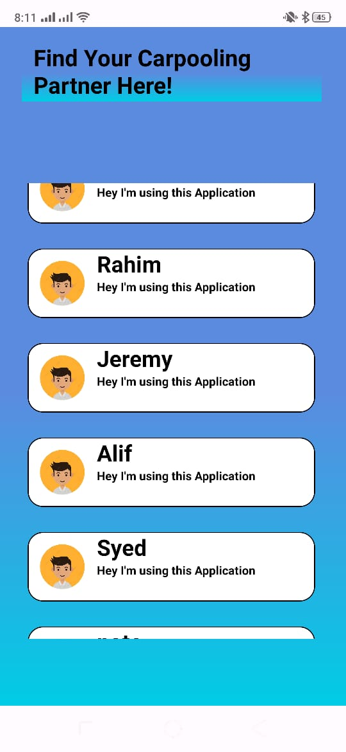

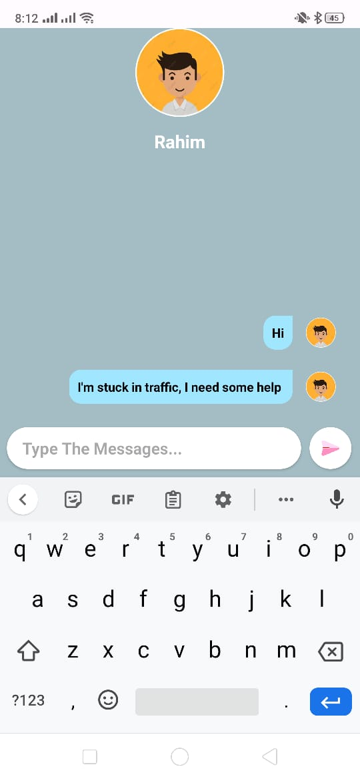
Carpooling Support
Connects users for ride-sharing
users that have signed up in the app can see other users
reduces individual travel costs by sharing expenses

Slide 11
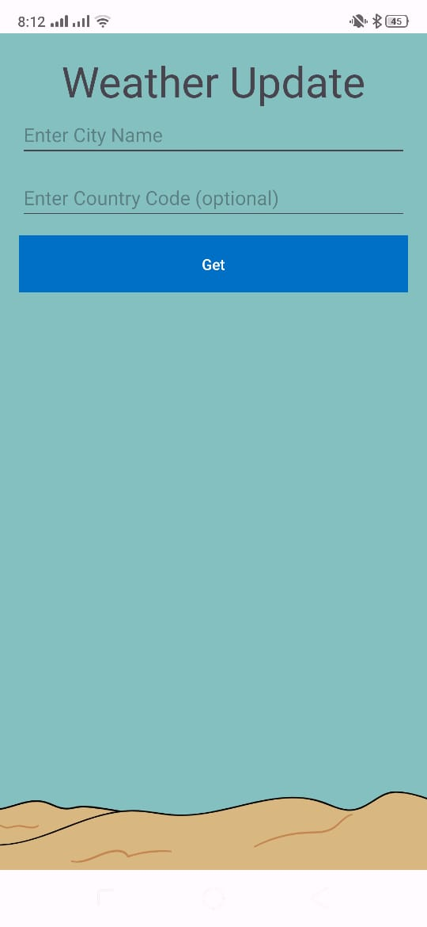
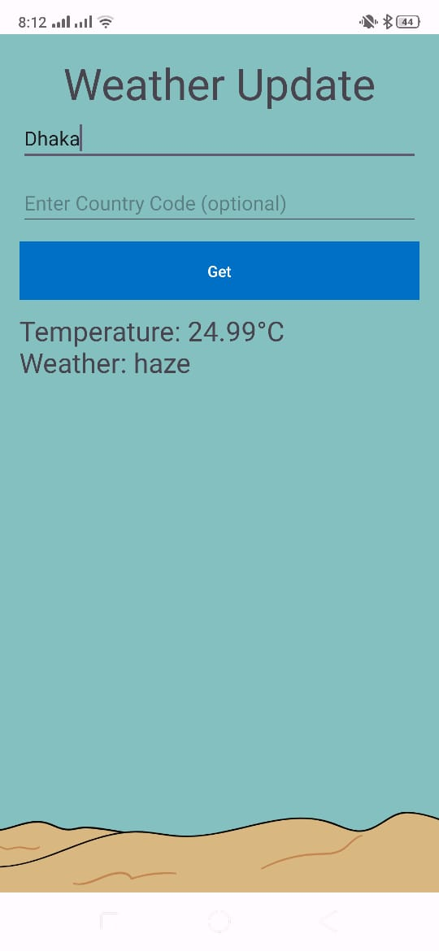
Weather Update
Provides real-time weather updates
Enable drivers to plan for alternative routes
Shows weather update for any city in any country.

Slide 12
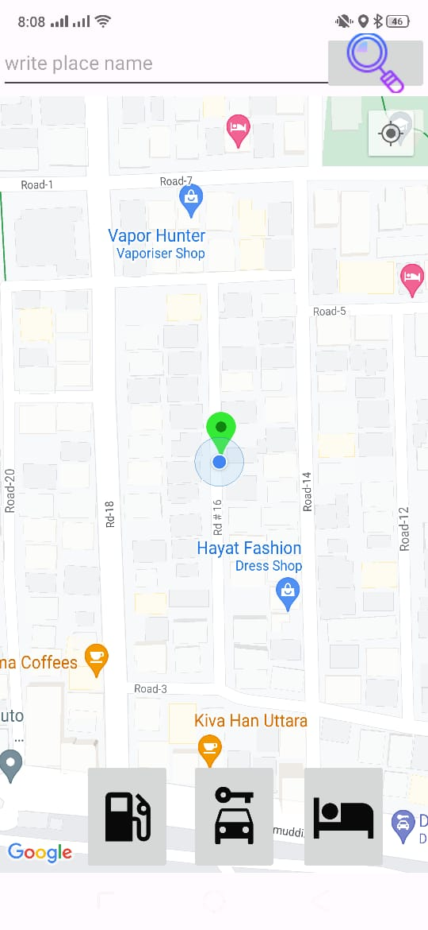
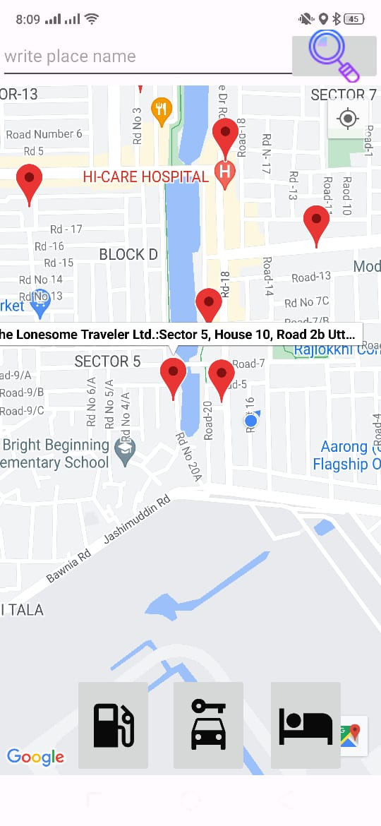
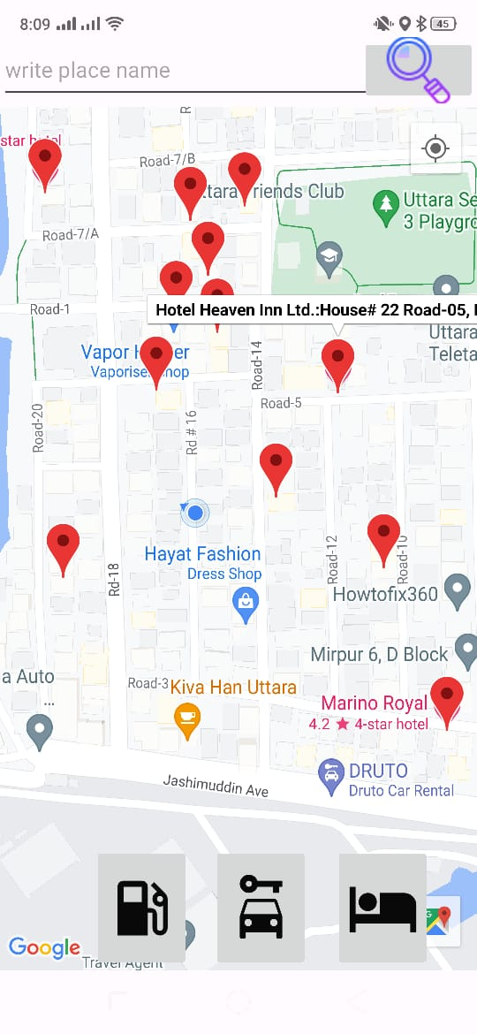
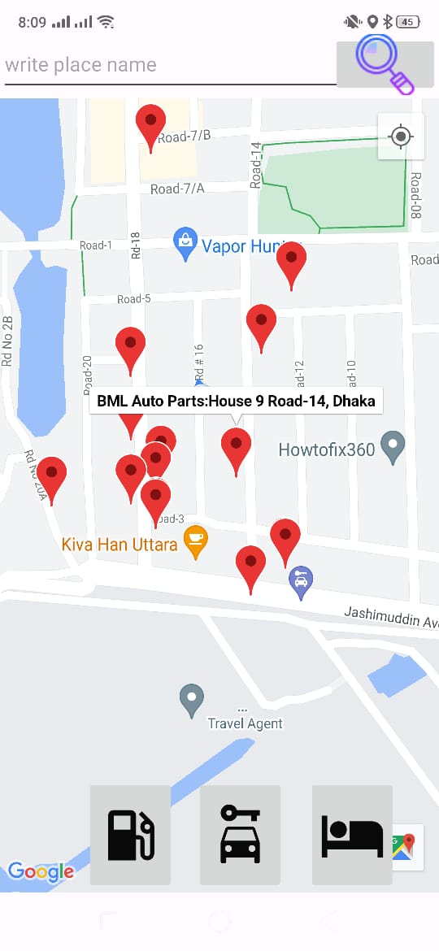
Find Nearby Services
Accessibility to Services: Assists drivers in locating nearby service centers
Convenience for Travelers: Helps users find accommodations or hotels
Fueling Accessibility: Locates nearby refueling stations

Slide 13
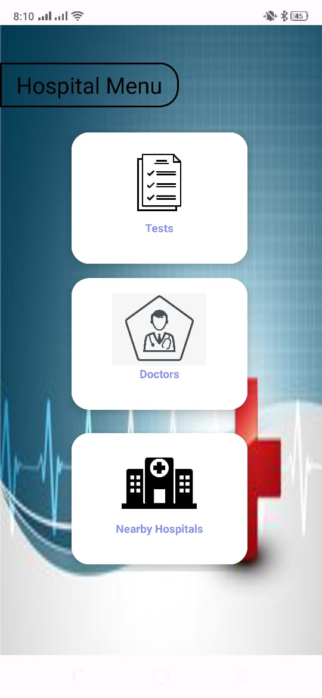
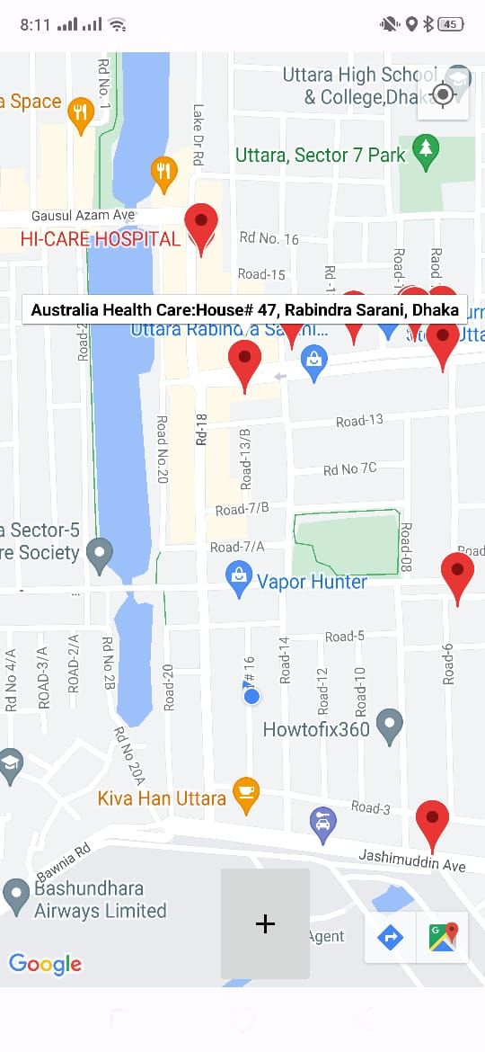
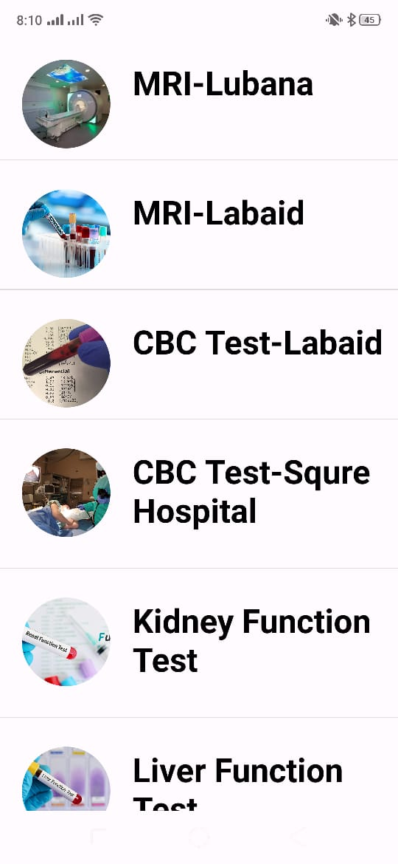

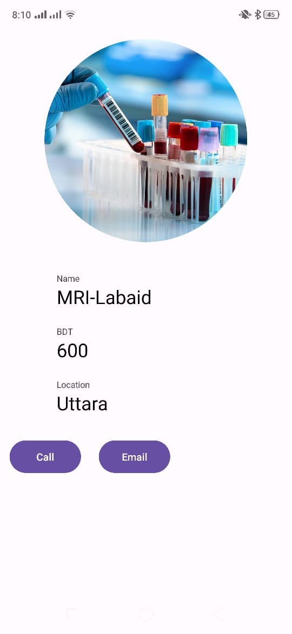
Medical Information:
Provides information about diagnostic tests and prices.
Offers a list of doctors.
Empowering users to make informed decisions. regarding healthcare services.
Find nearby hospitals.

Slide 14
Technologies Used:
(IDE) used for development: Android Studio
Database: Firebase
Language/Framework: Java

Slide 15
Conclusion:
RoadRescue redefines on-road assistance, offering a robust solution to Bangladeshi road challenges. Through technology-driven features, it ensures safety, accessibility, and convenience for drivers, revolutionizing their travel experience.

Slide 16
THANK YOU !

