Slide 1


Secure Coding Best Practices: An Example
This presentation explores secure coding principles using a common example: a vulnerable login function and its secure alternative.
by Mudasir Jamali

Slide 2
Vulnerable Login Function
import sqlite3
def login(username, password):
conn = sqlite3.connect("users.db")
cursor = conn.cursor()
query = "SELECT \* FROM users WHERE username = '" + username + "' AND password = '" + password + "'"
cursor.execute(query)
result = cursor.fetchone()
conn.close()
return result
username = input("Enter username: ")
password = input("Enter password: ")
if login(username, password):
print("Login successful!")
else:
print("Invalid credentials.")
The Flaw
This code constructs the SQL query by concatenating user input with the query string. This makes the code vulnerable to SQL injection attacks. An attacker can input malicious SQL code, potentially gaining access to the database.

Slide 3
Secure Login Function
import sqlite3
def login(username, password):
conn = sqlite3.connect("users.db")
cursor = conn.cursor()
query = "SELECT \* FROM users WHERE username = ? AND password = ?"
cursor.execute(query, (username, password))
result = cursor.fetchone()
conn.close()
return result
username = input("Enter username: ")
password = input("Enter password: ")
if login(username, password):
print("Login successful!")
else:
print("Invalid credentials.")
Protection
This code uses parameterized queries. The query is separate from the user input, preventing attackers from injecting malicious SQL. The input is treated as a parameter, not as part of the query.

Slide 4
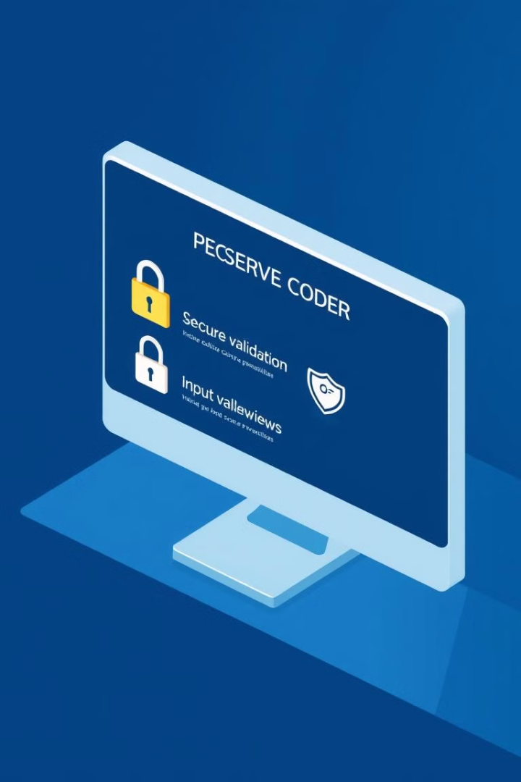
Secure Coding Practices
1
Use Parameterized Queries
2
Validate User Input
Check user input against expected formats and patterns. This helps prevent data corruption and security vulnerabilities.
Separate the SQL code from user input. Use parameterized queries to prevent SQL injection attacks.
3
Use Secure Password Storage
4
Keep Software Up-to-Date
Store passwords securely using a strong hashing algorithm and a suitable salt. This makes it difficult to steal passwords even if the database is compromised.
Regularly update software dependencies and frameworks. Security patches fix vulnerabilities and protect your applications.

Slide 5




Why Secure Coding Matters
Data Security
1
Protecting sensitive information from unauthorized access.
System Integrity
2
Ensuring systems operate correctly and reliably.
User Trust
3
Maintaining user confidence in the security of your applications.
Business Continuity
4
Preventing disruptions and ensuring business operations continue.

Slide 6
Beyond Code: A Holistic Approach
Code Reviews
Security Testing
Security Awareness Training
Regularly review code for potential vulnerabilities. A fresh set of eyes can identify issues that the original developer might have missed.
Perform regular security testing to identify and mitigate vulnerabilities. This can include penetration testing, vulnerability scanning, and code analysis.
Educate developers and other team members about secure coding practices. This helps them understand the importance of security and how to prevent vulnerabilities.

Slide 7
Shifting the Security Mindset
Proactive Approach
1
Incorporate security considerations into all stages of the development lifecycle.
Secure by Design
2
Build security into applications from the ground up, rather than trying to add it later.
Continuous Security
3
Regularly monitor, assess, and adapt security practices to keep up with evolving threats.

Slide 8

Key Takeaways
1
Secure coding is essential
2
Prevention is key
Focus on preventing vulnerabilities in the first place rather than fixing them after they've been exploited.
It's not just an afterthought; it's a core principle for building secure and reliable applications.
3
Collaboration is crucial
Involve security professionals and other team members to ensure a holistic approach to security.

