Slide 1



Slide 2
LOGO
COLOUR
TYPEFACE
IMAGERY
GUIDELINES

Slide 3

BMU
LOGO
ALWAYS GIVE THE LOGO ROOM
TO BREATH WHEN POSSIBLE.
USE ‘BMU’ AS A MINIMUM.
THE EXCEPTION IS WHEN THE
LOGO IS CONSTRICTED TO
SPACES LESS THAN 150px WIDE.
HERE USE THE LETTER ‘B’.
USE BALCK AND WHITE VERSION ONLY
WHEN LOOKING FOR CONTRAST
BMU
BMU
BMU
B
B
B
B

Slide 4



LOGO TO BE USED AS DEFAULT ON HEADER
LOGO

Slide 5
FOREGROUND
#000000
TEXT
#FFFFFF
HEADINGS AND HIGHLIGHTS
#70AD46
TEXT
#FFFFFF
COLOUR
BACKGROUND
#E4E4E4
TEXT
#000000
HEADER AND FOOTER
#000000
TEXT
#FFFFFF
BUTTONS
#70AD46
TEXT
#FFFFFF

Slide 6
TYPEFACE
HEADLINES ARE
MONTSERRAT, UPPERCASE
AND ALWAYS BOLD
Paragraphs are Montserrat, sentence case and
always bold

Slide 7
TYPEFACE
HEADLINES ARE
MONTSERRAT, UPPERCASE
AND ALWAYS BOLD
Paragraphs are Montserrat, sentence case and
always bold

Slide 8


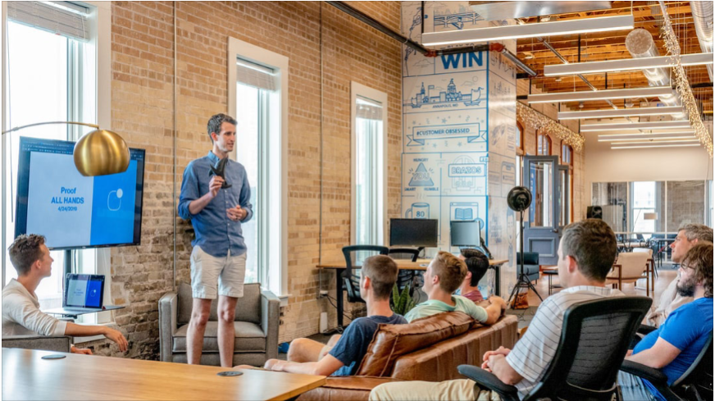
IMAGERY
OUR BRAND IS BUSINESS BUT NOT TO SERIOUS
USE IMAGES THAT
COMMUNICATE A START UP CULTURE.
AVOID IMAGES WITH LOOK OF GOVERMENTAL OR FINACIAL.

