Slide 1
BIDIRECTIONAL SIGN LANGUAGE COMMUNICATION SYSTEM
MOHAMMED MUDASIR AHMED
MUFFAKHAM JAH COLLEGE OF ENGINEERING AND TECHNOLOGY
160422748012@mjcollege.ac.in

Slide 2
OVERVIEW
01
04
INTRODUCTION
RESULTS
02
05
BACKGROUND OF THE STUDY
CONCLUSION
03
06
METHODOLOGY
REFERENCES

Slide 3

INTRODUCTION
Communication between hearing and deaf or mute communities is often impeded by language barriers.
Over 63 million people in India suffer from hearing impairment (WHO).
Lack of awareness of sign language among the general public leads to social isolation and communication gaps.
ISL is linguistically distinct and remains underrepresented due to the absence of standardized datasets and its complex gestures.

Slide 4
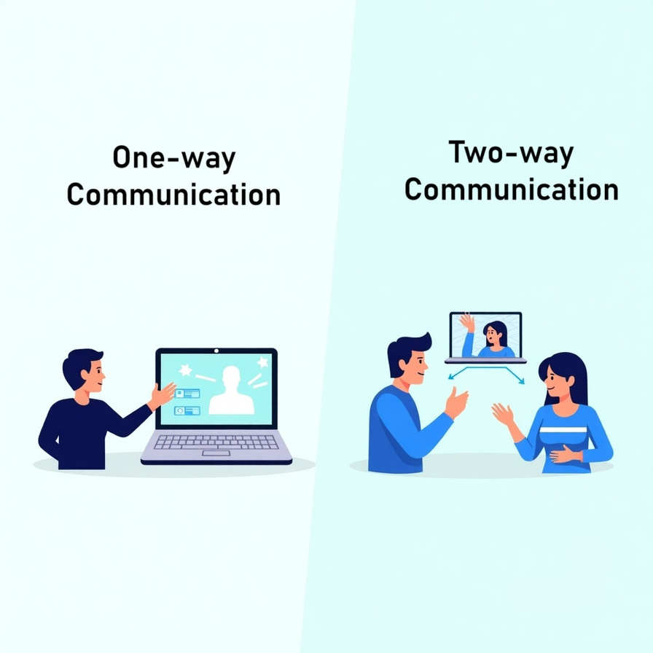
INTRODUCTION
Existing systems translate are mostly unidirectional — one-way communication or limited in real-time capability.
There is a need for an intelligent, bidirectional system that can translate sign language to text/speech and text/speech to sign language in real time.
Our system bridges this gap by allowing for real-time, two-way communication, making it more inclusive, practical, and impactful.

Slide 5
BACKGROUND OF THE STUDY
Study | Method | Result | Drawbacks
CNN + Kinect (2015) | CNN on depth images via Kinect | High accuracy for predefined gestures | Limited gestures; hardware dependency
Wearable Electronics (2020) | Sensor-based motion tracking + k-NN | Effective gesture recognition | Needs wearables; less user-friendly Uncomfortable hardware, sensor maintenance
Deep Learning (2021) | Skin color segmentation + SVM | Real-time ISL gesture recognition | Highly sensitive to lighting, noisy backgrounds

Slide 6
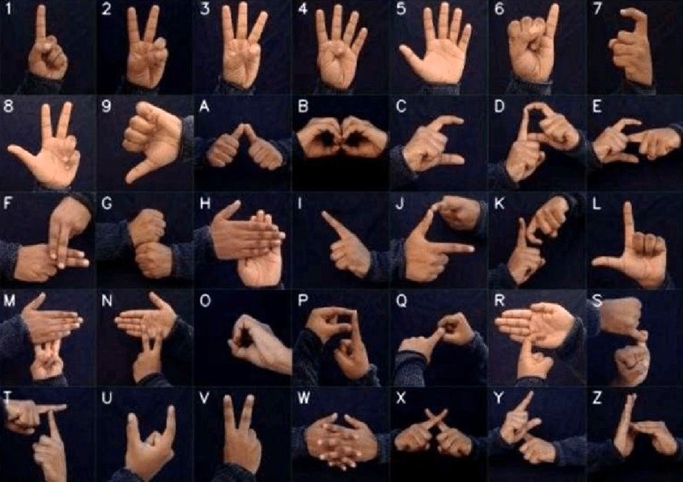
METHODOLOGY
1. DATASET CREATION
The dataset includes hand gesture images representing: 26 ISL alphabets, 10 ISL digits (0–9)
1000 images per sign, captured under different lighting and angles.

Slide 7
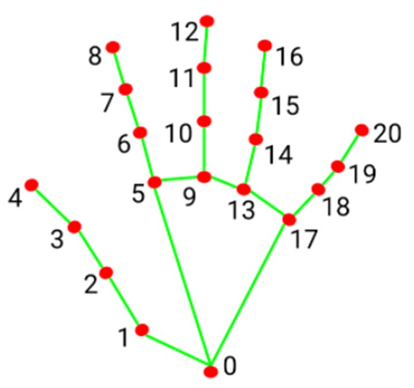
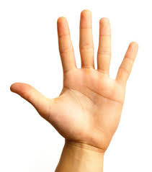
2. FEATURE EXTRACTION & PREPROCESSING
MediaPipe used for extracting hand landmarks (x, y coordinates).
Landmark Features: 42-single hand and 84-dual hand.
Normalization applied to account for variations in hand size, orientation, and camera distance.
Landmark
Extraction

Slide 8
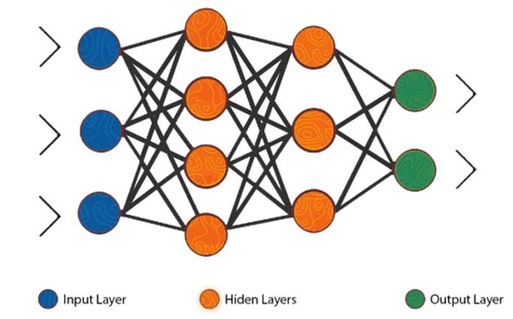
4. MULTI-LAYER PERCEPTRON (MLP) CLASSIFIER
MLP Architecture:
Input layer: 21 (single hand) or 42 (dual hand) features.
Hidden layers: Two layers – 128 neurons & 64 neurons with ReLU activation.
Output layer: Softmax activation for multi-class classification.
Two model variants:
🖐️ Single-Hand Model: For simpler gestures.
✋✋ Dual-Hand Model: For complex ISL signs.

Slide 9
TEXT/SPEECH-TO-SIGN
Input is either typed or converted from speech using Speech-to-Text (STT).
A rule-based model maps recognized letters to ISL gesture animations.
Pre-recorded gestures are shown as animations for the user.
Text/Speech
Rule-based mapping
ISL
Animation

Slide 10
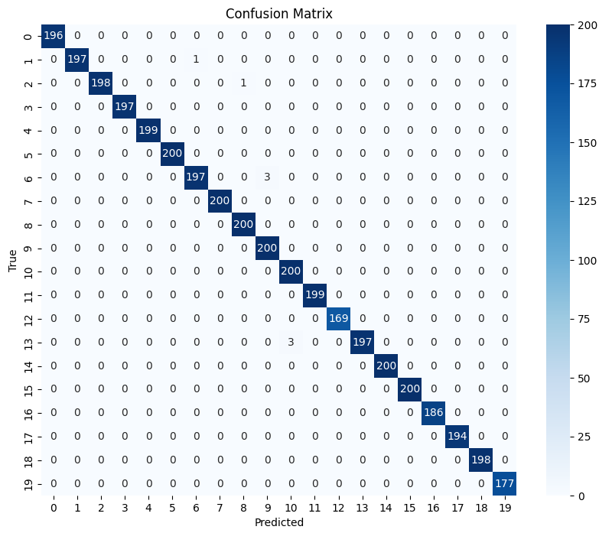
RESULTS
Model Performance:
Accuracy: 98.7%
Precision: 93.5%
Recall: 94.7%
F1-Score: 94.1%
Confusion matrix shows strong diagonal dominance, indicating high class-wise accuracy.
Latency: ~120 ms per frame

Slide 11
COMPARATIVE ANALYSIS
S. No. | System | Accuracy | Latency (ms) | Hardware Dependency | Computational Requirements
1 | Proposed ISL System | 98.7% | 120 | Webcam | Moderate
2 | CNN + Kinect (2015) | 91.7% | 500 | Kinect Sensor | High
3 | MediaPipe + LSTM (2023) | 92.5% | 300 | Webcam | High
4 | Deep Learning + SVM (2021) | 90.5% | 150 | Webcam | Moderate
5 | Wearable Sensors (2020) | 92.1% | 100 | Wearable Devices | Moderate

Slide 12

CONCLUSION
Developed a real-time bidirectional Indian Sign Language (ISL) communication system.
Achieved high accuracy (98.7%) in gesture recognition.
Implemented text/speech-to-sign translation.
Eliminated the need for expensive hardware.
Addresses key limitations of existing systems: hardware dependency, latency, and unidirectional communication.

Slide 13
REFERENCES
Nair, A. V., & Bindu, V. (2013).,”A Review on Indian Sign Language Recognition”. International Journal of Computer Applications. ...........................
Pigou, M., Dieleman, S., Kindermans, P., & Schrauwen, B. (2015).,“Sign Language Recognition Using Convolutional Neural Networks”. Lecture Notes in Computer Science, 9119, Springer, Cham, 572–578. .............................
Moin, A. K., Zhou, A., Rahimi, A., et al. (2020).,“Sign Language Recognition Using Wearable ElectronicsI”. Sensors, 20(14), 3879. .........................
Putra, I. A., Nurhayati, O. D., & Eridani, D. (2023).,”Dynamic Sign Language Recognition Using MediaPipe Library and Modified LSTM Method”. International Journal on Advanced Science, Engineering and Information Technology, 13(2).

Slide 14
THANK YOU

