Slide 1
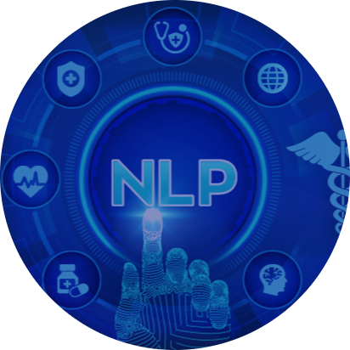
NLP · HEALTHCARE · AI RESEARCH
Domain-Specific Medical
Spell Correction
Context-Sensitive NLP for Medication Names in Clinical Text
Natural Language Processing
📄 Inspired by -> Kim, Weiss & Ravikumar (2022) - PMLR
🔗 github.com/MudasirNaeem1/Domain-Specific-Medical-Spell-Correction
01

Slide 2




THE PROBLEM
02
Why Clinical Spell Correction Fails
Noisy Clinical Text
Drug Name Complexity
Abbreviations, shorthand & frequent typos are inherent in EHRs and clinical notes
Medication names are long, rare, and domain-specific - far outside general vocabulary
High Stakes Errors
Resource Constraints
Incorrect drug corrections can cascade into dangerous downstream healthcare decisions
Hospital systems need lightweight, low-resource models - not billion-parameter LLMs
⚠️ General NLP spell checkers achieve < 40% accuracy on unseen medication names - making domain-specific solutions critical

Slide 3

RESEARCH FOUNDATION
03
Paper Analysis: CIM Framework
Kim, Weiss & Ravikumar (2022) · PMLR · Context-Sensitive Spelling Correction of Clinical Text
Core Insight
Gaps We Identified
Separates context modeling (language model) from noise modeling (corruption process)
Medication names are underemphasized in original evaluation benchmarks
Uses Conditional Independence to combine both signals without joint training
Severely misspelled drug terms (edit distance > 3) cause significant accuracy drop
Avoids expensive fine-tuning - works with off-the-shelf clinical LMs
Computationally heavy models impractical for real-time hospital deployment
Achieves strong accuracy on general clinical terms via probability factorization
No domain-constrained candidate generation - risk of over-correction

Slide 4




OUR APPROACH
04
6-Stage Medication Correction Pipeline
1
2
3
Tokenize & Filter
Medication Lexicon
Candidate Generation
Segment clinical sentences; remove non-alphabetic tokens
Curated drug dictionary prevents non-medical corrections
BK-Tree + edit distance + phonetic similarity
4
5
6
Corruption Modeling
Contextual Scoring
Final Selection
Estimates real-world clinical typing error patterns
BioClinicalBERT scores candidates via sentence context
Combines corruption P + contextual likelihood

Slide 5
TECHNICAL DEEP DIVE
05
Key Technical Components
🔍 Robust Candidate Generation
🧠 CIM Scoring Formula
Edit-distance matching for surface similarity
P(candidate | context) ∝
BK-Tree indexing for sub-linear approximate search
P_noise(error→correct) × P_LM(correct | context)
Metaphone phonetic encoding for pronunciation-based errors
Domain constraint: candidates filtered to medication lexicon only
Noise model × Language model - decoupled, no joint training required
🏥 BioClinicalBERT - Contextual Backbone
Pre-trained
Masked LM
No fine-tuning
Integration
On MIMIC-III clinical notes — understands medical language
Scores how natural a candidate fits the surrounding clinical sentence
Zero-shot deployment - plug and play on any clinical corpus
Probability piped directly into CIM final scoring module

Slide 6




WHAT WE BUILT
06
Our Key Contributions
Medication-Focused Framework
Extended CIM Architecture
First framework to specifically target medication name spell correction - filling a critical gap in clinical NLP literature
Enhanced the base CIM with improved candidate generation, domain constraints, and practical deployment considerations
BK-Tree + Phonetic Hybrid
Low-Resource Design
Combined BK-Tree indexing with Metaphone encoding for efficient and robust candidate retrieval under severe corruption
Zero supervised training required — works with curated lexicon + pre-trained BioClinicalBERT out of the box
Strong Evaluation Results
Real-World Deployment Path
Demonstrated reliable token-level accuracy even on heavily corrupted drug names without domain-specific training data
Lightweight architecture designed for hospital-scale integration with minimal infrastructure overhead

Slide 7
EVALUATION RESULTS
07
What We Achieved
Token-Level
Zero-Shot
Severe
Accuracy Metric
No Training Needed
Corruption Handled
Primary focus on correctly identifying & fixing individual medication tokens
No supervised data required - pure lexicon + pre-trained models
Handles heavily corrupted names (edit distance ≥ 3) that break general checkers
Evaluation Highlights
Tested against both known and unseen medication names with varying corruption levels
Outperforms standard edit-distance baseline on drug name correction tasks
BK-Tree retrieval ensures sub-linear candidate search - scales efficiently with large lexicons
Phonetic component recovers brands with pronunciation-based misspellings that pure edit-distance misses

Slide 8


FUTURE ROADMAP
08
What Comes Next
Phase 1
Phase 2
Ontology Integration
Typo Pattern Learning
Integrate RxNorm & UMLS medical ontologies
Mine real clinical logs for typing error distributions
Expand lexicon to 100,000+ drug entities
Train lightweight noise model on hospital data
Add drug-class semantic constraints
Adaptive correction per department/specialty
Phase 3
Phase 4
Semantic Constraints
Production Deployment
Semantic-type filtering to prevent over-correction
Model compression via distillation or pruning
Drug interaction awareness in candidate ranking
Real-time API for EHR integration
Context-aware disambiguation for look-alike names
Benchmark on i2b2 and MIMIC-IV datasets

Slide 9
IMPACT & SIGNIFICANCE
09
Why This Matters
Patient Safety
Project Summary
Correct drug names in clinical notes prevent dangerous dosage & prescribing errors downstream
Problem:
Medication spell correction in noisy clinical NLP
NLP Pipeline Quality
Foundation:
Extended CIM paper (Kim et al. 2022, PMLR)
Upstream correction improves NER, ICD coding, and clinical decision support accuracy
Innovation:
Drug-focused lexicon + BK-Tree + phonetic + BERT
Healthcare AI
Approach:
Zero-shot, no supervised training required
Enables more reliable AI applications in EHRs where data quality is notoriously poor
Outcome:
Robust token-level correction under heavy corruption
Low-Resource NLP
Provides a reproducible, accessible framework for under-resourced clinical settings globally
Next Steps:
RxNorm, UMLS, distillation, EHR API integration

Slide 10
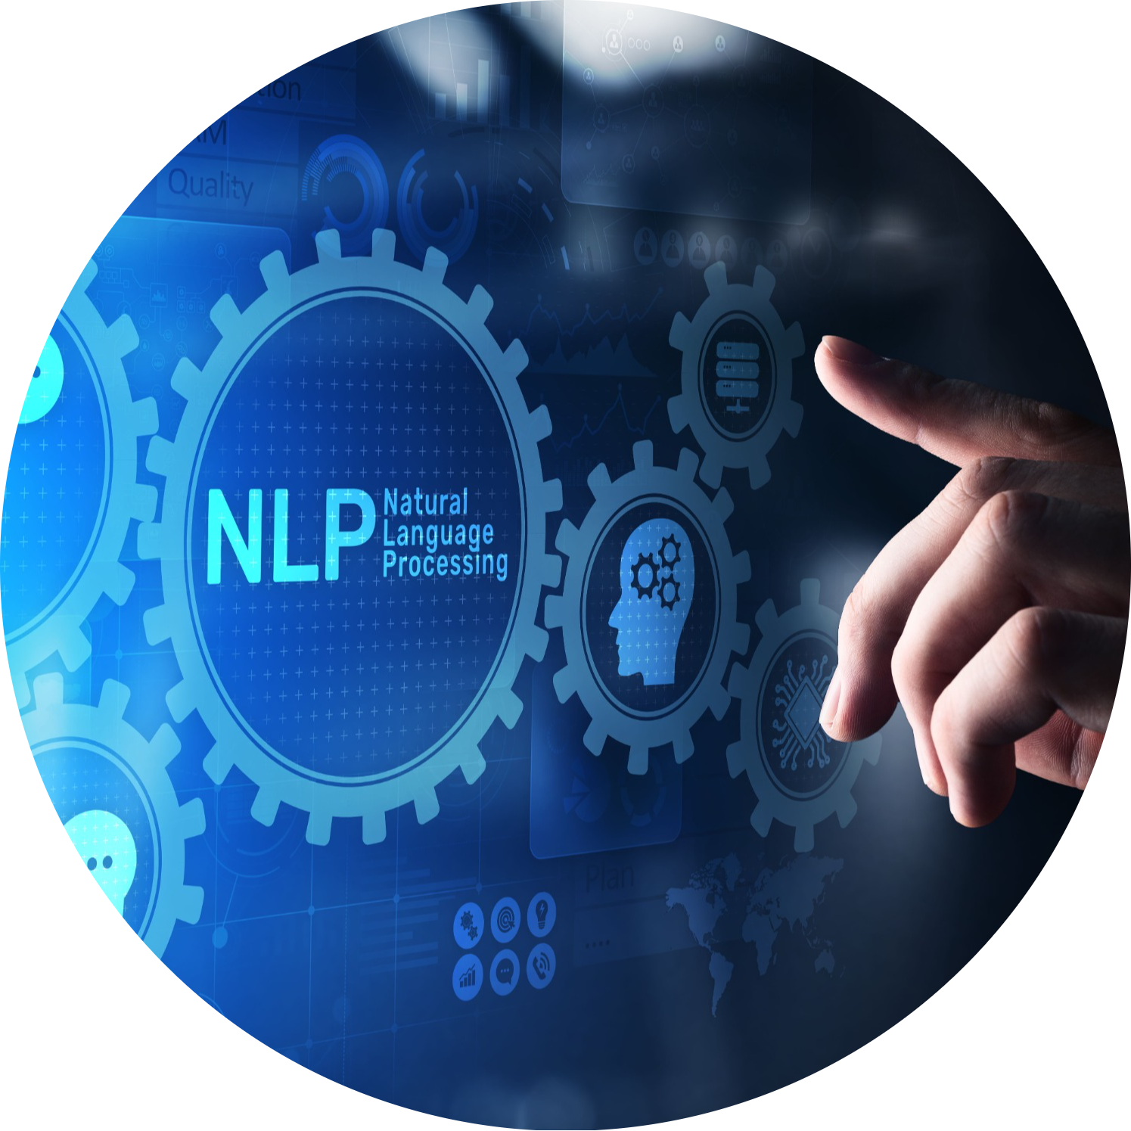
COLLABORATORS
Muhammad Basim Baqai
Nihal Ali
Domain-Specific Medical
Spell Correction using Context-Sensitive NLP
Bridging the gap between general NLP and life-critical healthcare applications
🔗 GitHub Repository
📄 Research Paper (PMLR)
github.com/MudasirNaeem1/Domain-Specific-Medical-Spell-Correction-using-Context-Sensitive-NLP
NLP · Healthcare AI · Clinical Text · BioClinicalBERT · BK-Tree · Spell Correction

