Slide 1
HTML

Slide 2
Introduction to HTML
What is HTML?
HTML (HyperText Markup Language) is the standard language for creating web pages or structure web pages.
Uses tags to define content structure.
Key Features:
Easy to learn.
Used to structure and display content on the web.

Slide 3
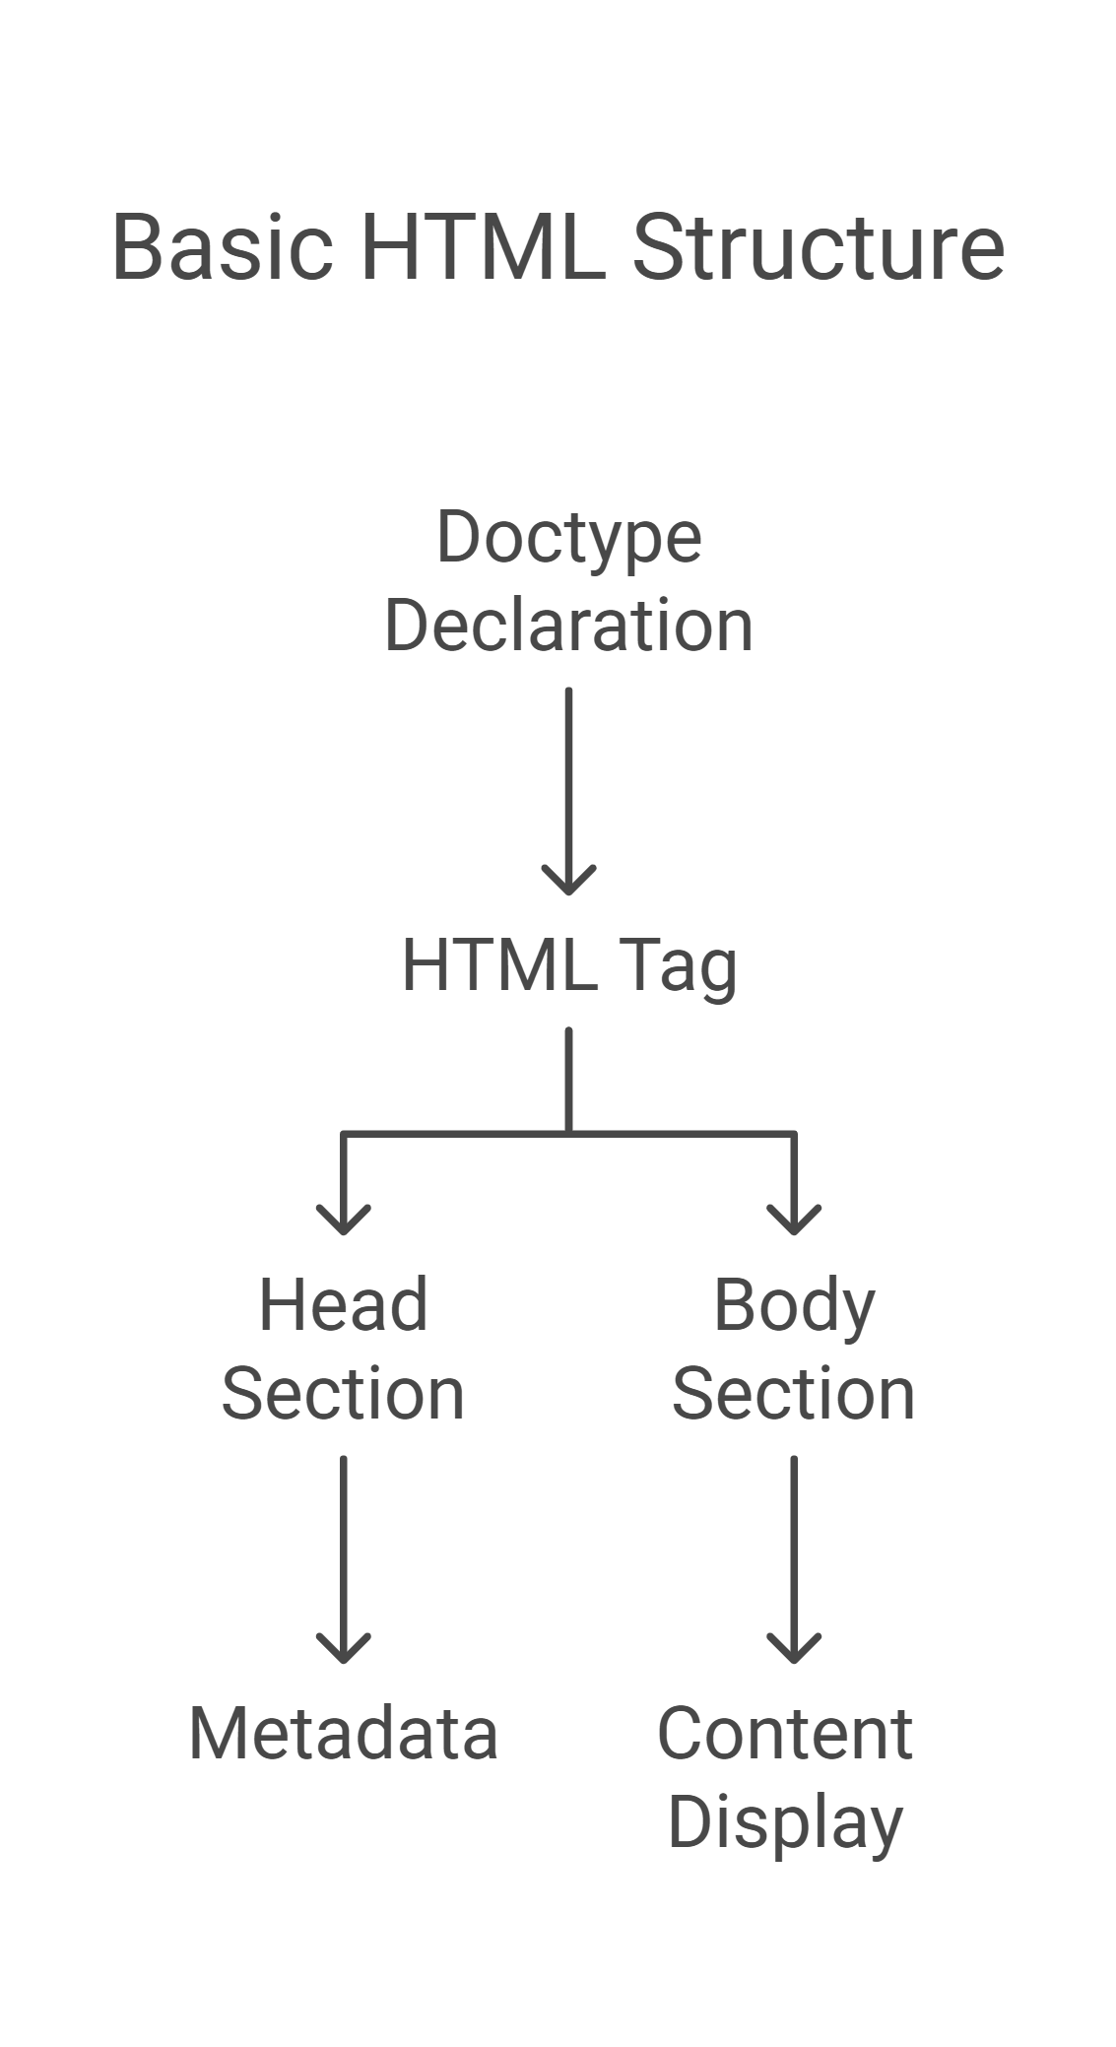
Basic Structure:
<!DOCTYPE html>
<html>
<head>
<title>My First Page</title>
</head>
<body>
<h1>Welcome to HTML!</h1>
<p>This is a paragraph.</p>
</body>
</html>

Slide 4
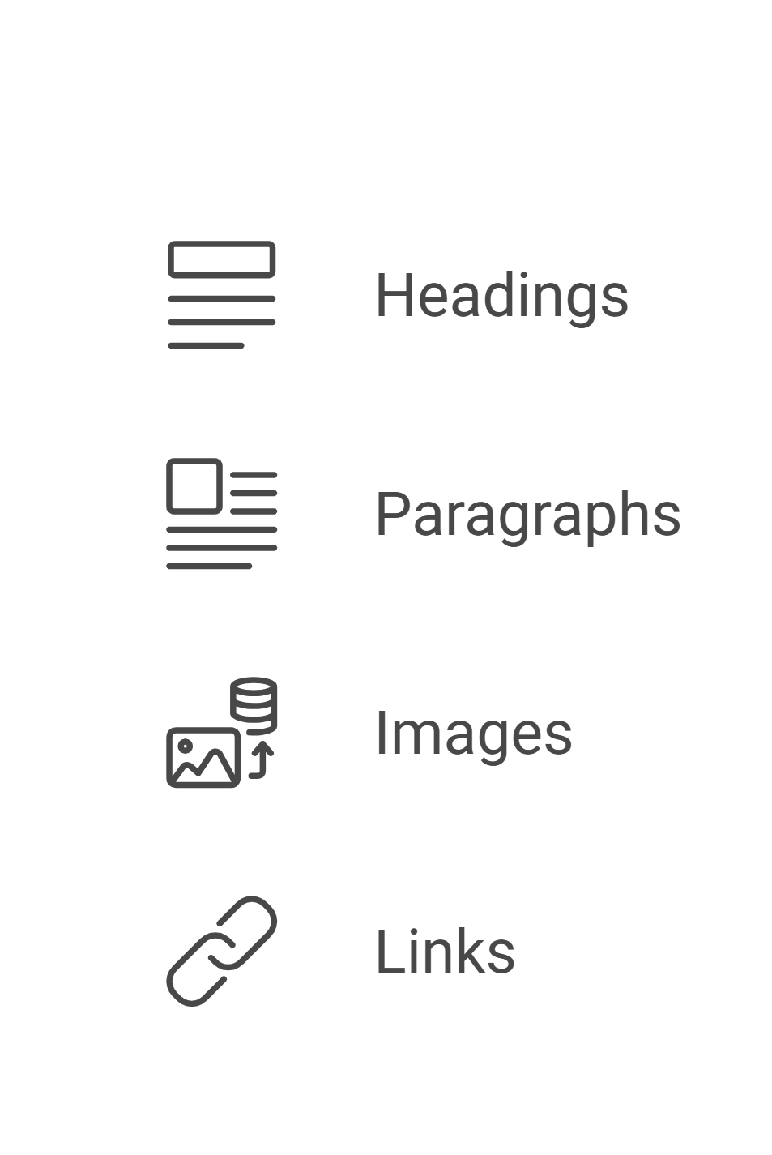
HTML Tags/ Elements and Attributes
Tags:
Define the structure of the content.
Examples: <p>, <h1>, <img>.
Attributes:
Provide additional information about tags.
Example:
<img src="image.jpg" alt=“this is a image of super car." width="300">
Improves accessibility and SEO.
Common Tags Overview:
Headings: <h1> to <h6>
Paragraphs: <p>
Images: <img>
Links: <a>

Slide 5
Block Elements vs. Inline Elements in HTML
What are Block Elements?
Block elements/ tag create a new line (or block) of content.
They occupy the full width of their container by default.
Commonly used for structural layout.
Examples of Block Elements:
<div>: General container.
<p>: Paragraph.
<h1> to <h6>: Headings.
<ul> and <ol>: Lists.
<table>: Tables.
<div>
<h1>This is a heading</h1>
<p>This is a paragraph inside a block-level element.</p>
</div>

Slide 6
What are Inline Elements?
Inline elements do not start on a new line and occupy only as much width as necessary.
They are used to style or format content inside block elements.
Examples of Inline Elements:
<span>: Generic inline container.
<a>: Anchor (link).
<img>: Image.
<b> and <i>: Bold and italic text.
<strong> and <em>: Emphasized text.
<p>This is <strong>bold</strong> and <em>italic</em> text inside a paragraph.</p>

Slide 7
Text, Headings, and Links
Text Elements/Tag:
Bold: <b>
Italic: <i>
Underline: <u>
Example:
<p>This is <b>bold</b> and <i>italic</i> text.</p>
Headings:
Define different levels of headings.
Example:
<h1>Main Heading</h1>
<h2>Subheading</h2>

Slide 8
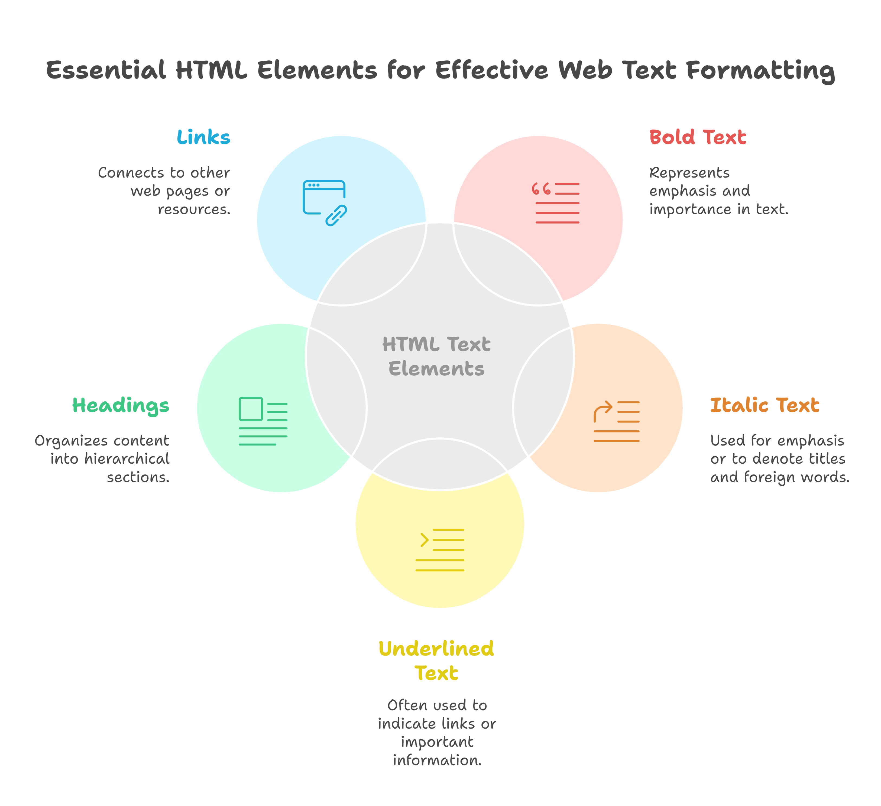
Links:
Create hyperlinks using the <a> tag.
Example:
<a href="https://www.example.com">
Visit Example
</a>
<a href="https://example.com"
target="_blank“
title="Visit Example">
Click Here
</a>

Slide 9
Images and Lists
Images:
Embed images using the <img> tag.
Example:
<img src="path/to/image.jpg" alt="Description">
Lists:
Ordered List: <ol>
Unordered List: <ul>
Nested Lists:
<ol>
<li>Item 1</li>
<li>Item 2</li>
</ol>
<ul>
<li>Item A</li>
<li>Item B</li>
</ul>
<ul>
<li>Fruits
<ul>
<li>Apple</li>
</ul>
</li>
<li>Vegetables</li>
</ul>

Slide 10
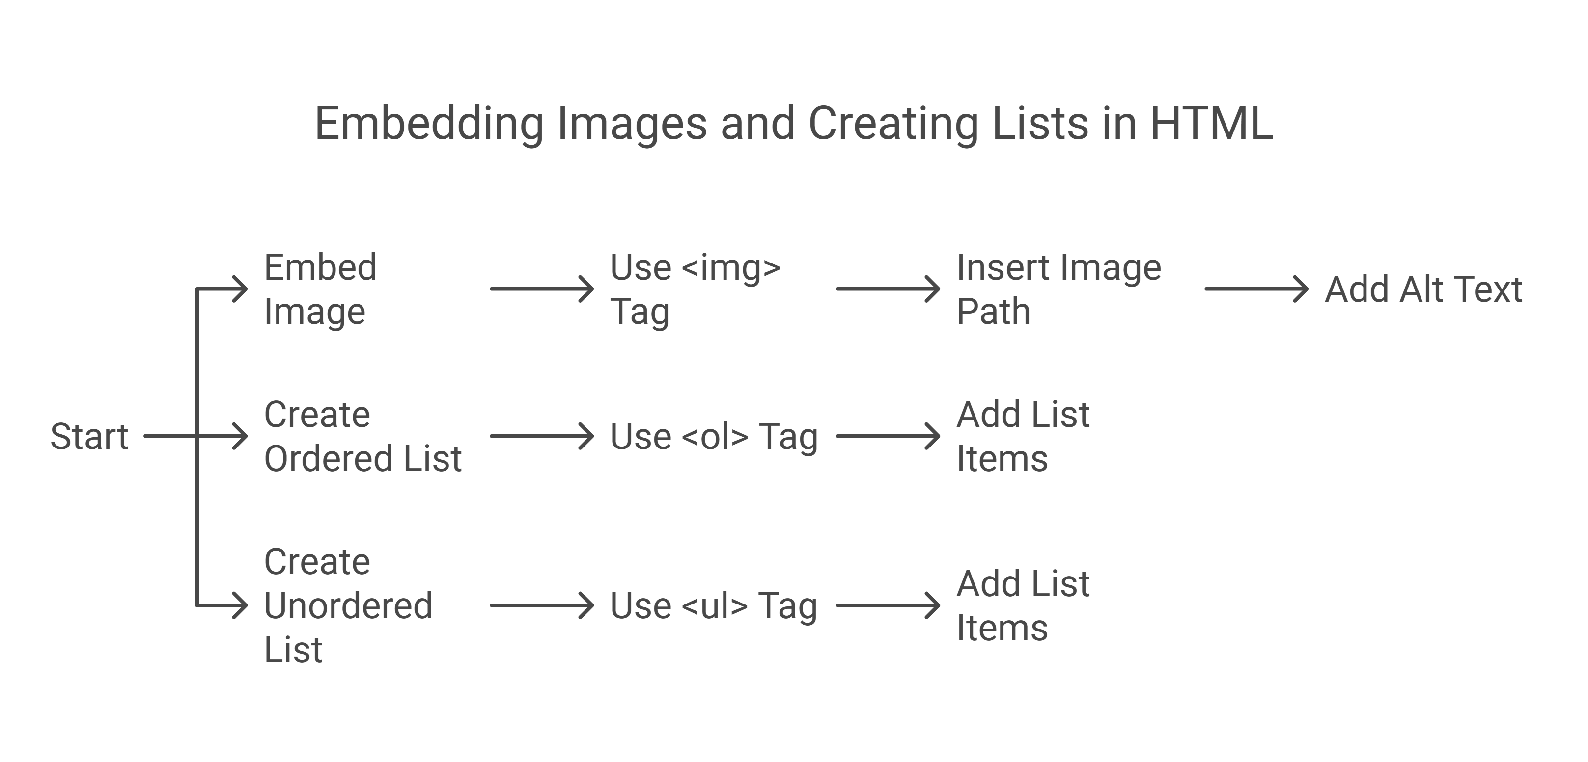

Slide 11
Activity
HTML Practice: Personal Profile Page
Install IDE to your Local System.
Create your first HTML file.
Create a simple HTML page introducing yourself.
Use headings, paragraphs, links, and images.
Explore extensions(live server, prettier, HTML, CSS support).

Slide 12
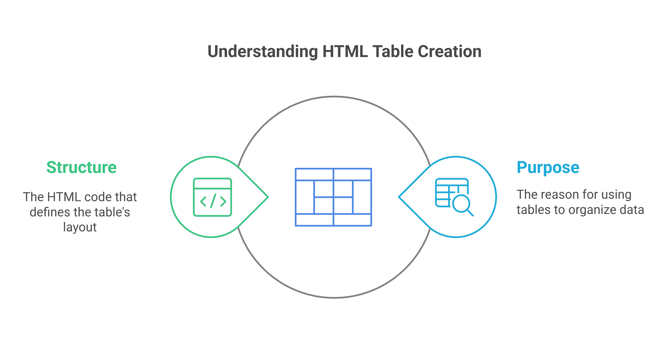
Tables
Purpose:
Used to organize data in rows and columns.
Structure:
<table border="1">
<tr>
<th>Header 1</th>
<th>Header 2</th>
</tr>
<tr>
<td>Data 1</td>
<td>Data 2</td>
</tr>
</table>

Slide 13
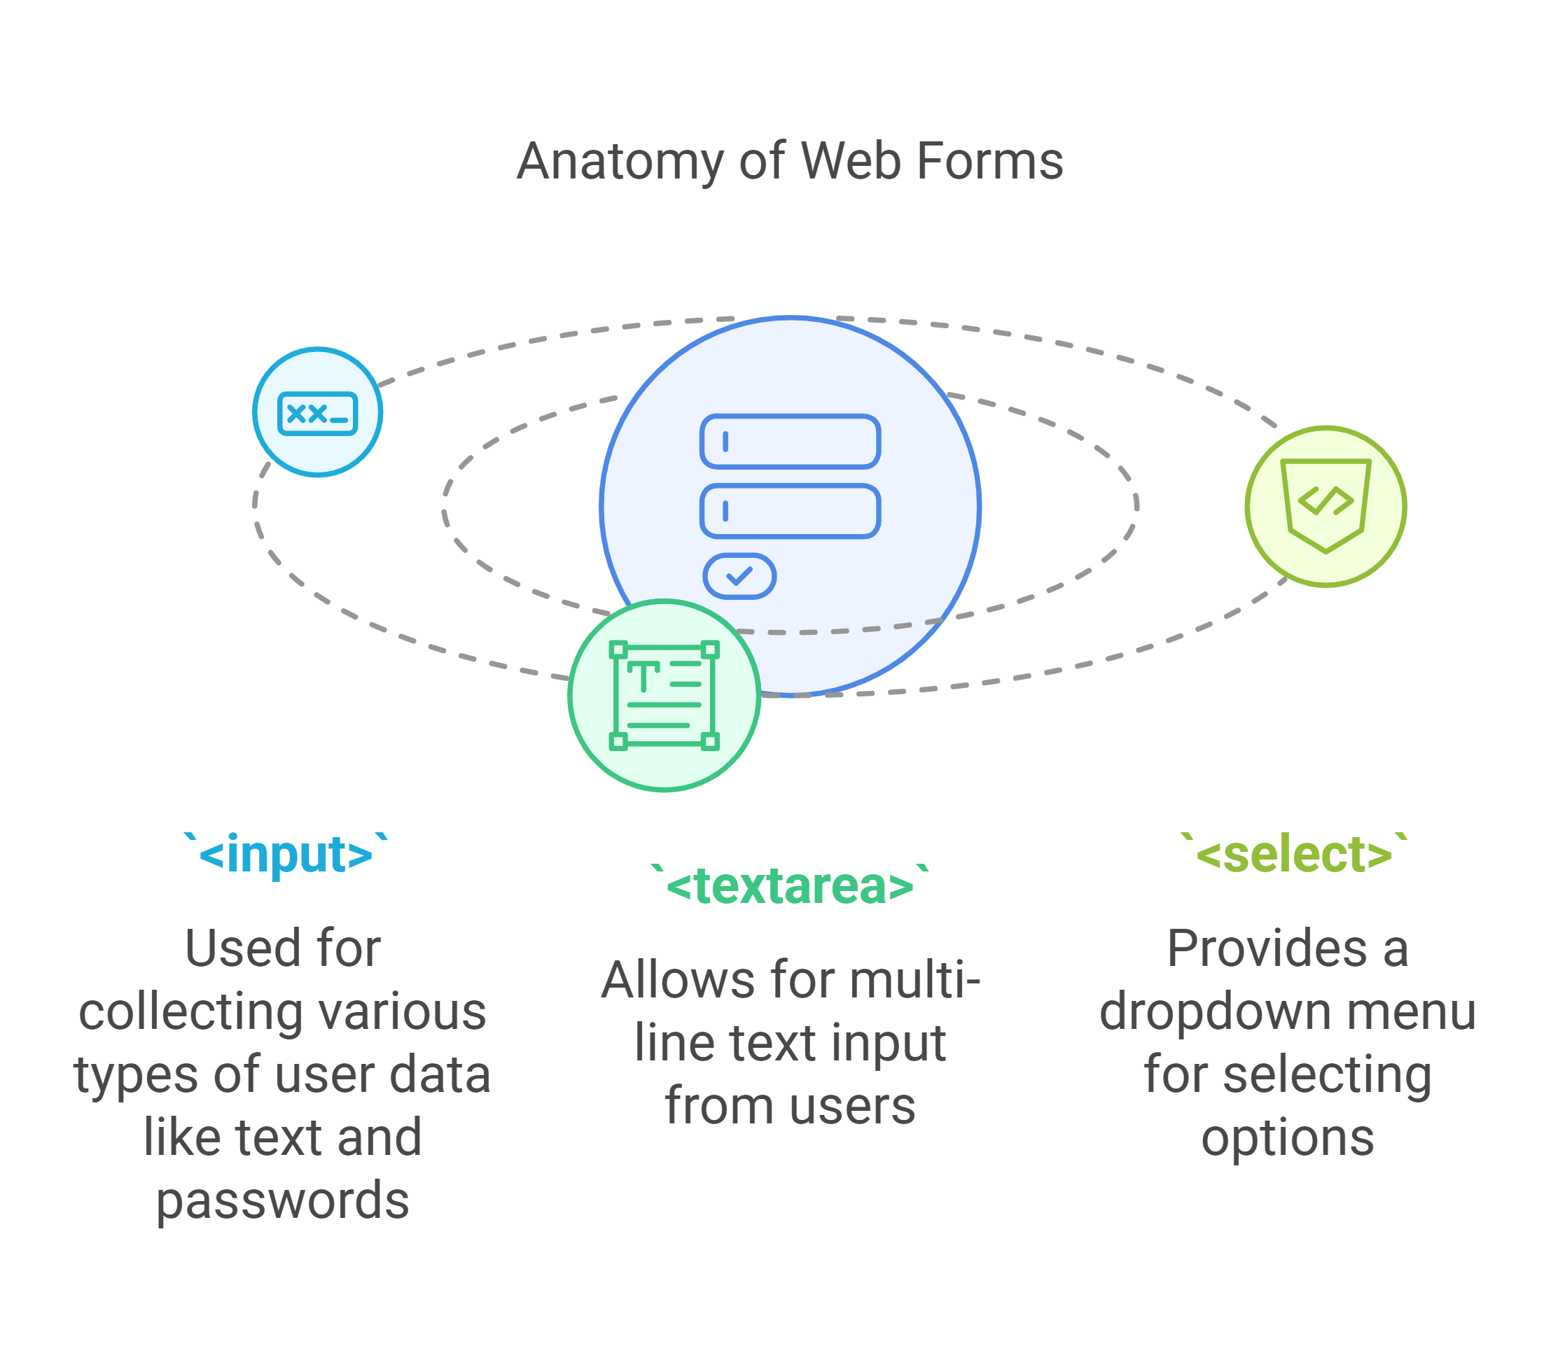
Forms and Form Elements:
Purpose:
Used to collect user input.
Common Elements/ tag:
<input>: Collects text, passwords, etc.
<textarea>: Multi-line input.
<select>: Dropdowns.
Example:
<form>
<label for="name">Name:</label>
<input type="text" id="name" name="name">
<input type="submit" value="Submit">
</form>

Slide 14
HTML Forms Input Types & Validation
Common Input Types
text - For single-line text input.
email - Ensures only valid email addresses are entered.
password - Hides user input.
number - Allows only numeric values.
date - Provides a date picker.
checkbox - Enables multiple selections.
radio - Allows a single selection from multiple choices.
file - Allows file uploads.
range - Creates a slider input.

Slide 15
Form Validation Attributes
required - Ensures a field must be filled.
maxlength="10" - Limits the number of characters.
pattern="[A-Za-z]+" - Specifies an input format using regex.
placeholder="Enter your email" - Shows a hint in the input field.
Example:
<form>
<label for="email">Email:</label>
<input type="email" id="email" name="email" required>
<input type="submit" value="Submit">
</form>

Slide 16
Best Practices
Use proper labels for accessibility.
Combine required with pattern for strong validation.
Ensure mobile-friendly input fields.

Slide 17
Containers (div, section, footer, etc.)
What are Containers?
Used to group content for styling and structure.
Common Tags:
<div>: General-purpose container.
<section>: Defines sections of a document.
<footer>: Defines the footer area.
Example:
<section>
<div>
<h2>About Us</h2>
<p>This is some content.</p>
</div>
</section>
<footer>© 2025 My Website</footer>

Slide 18
Activity 2: Create a List and a Table
Objective: Learn how to organize data using lists and tables.
Instructions:
Create an ordered list of your top 5 favorite movies.
Create a table with 2 rows and 3 columns, listing details about any three fruits (e.g., Name, Color, Taste, season, origin).

Slide 19
Semantic HTML
What is Semantic HTML?
Tags that provide meaning to content (e.g., <article>, <aside>, <nav>).
Improves accessibility and SEO.
<header>
<h1>My Website</h1>
</header>
<nav>
<a href="#home">Home</a>
<a href="#about">About</a>
</nav>
<article>
<h2>Welcome!</h2>
<p>This is an article.</p>
</article>

Slide 20
Multimedia Elements
Audio and Video Tags:
<audio controls>
<source src="audio.mp3" type="audio/mpeg">
</audio>
<video controls>
<source src="video.mp4" type="video/mp4">
</video>
iframes in HTML
An iframe (inline frame) is an HTML element used to embed another HTML page or external content within a web page.

Slide 21
Why Use iframes?
To display external content, such as:
Videos (e.g., YouTube embeds).
Maps (e.g., Google Maps).
Another webpage or application.
<iframe src="https://www.example.com" width="600" height="400"></iframe>
Attributes:
src: URL of the page to embed.
width and height: Dimensions of the iframe.
title: Improves accessibility for screen readers.
frameborder: Controls the border (0 = no border).
allow: Controls permissions (e.g., autoplay for videos).

Slide 22
HTML Best Practices
1. Use Semantic HTML
Bad: <div class="header">
Good: <header>
2. Write Clean & Readable Code
Bad:
<h1>Title</h1><p>Paragraph</p><img src="image.jpg">
Good:
<h1>Title</h1>
<p>Paragraph</p>
<img src="image.jpg" alt="Description">

Slide 23
3. Accessibility Matters
Use alt attributes for images.
Use label for form inputs.
Ensure proper contrast & font sizes.
4. SEO Best Practices
Use descriptive meta tags.
Organize headings (<h1>, <h2>, <h3>).
Optimize images with alt attributes.

Slide 24
Activity 1: Build a Personal Bio Page
Objective: Use semantic tags to create a structured bio page.
Instructions:
Use <header>, <nav>, <section>, and <footer> tags.
Include a short biography, a list of hobbies, and a footer with contact information.
Activity 2: Add Multimedia to Your Page
Objective: Enhance your bio page with multimedia elements.
Instructions:
Add a video about one of your hobbies.
Add an audio clip of your favorite song or a podcast.

Slide 25
Submission Notes
Capture Evidence:
Take screenshots or record a short video for each task.
Ensure your evidence clearly shows the completed task.
Upload Tasks:
Upload each task as a separate folder or file in your GitHub repository.
Follow also on github
LinkedIn Post:
Create a short post summarizing what you learned and how you completed the tasks.
Highlight your key takeaways.
Mention the following account in your post:
Shahzad khan

Slide 26
Thank You

