Slide 1
Class No: 05

Slide 2
Introduction to the DOM
What is the DOM?
The DOM (Document Object Model) is a representation of the structure of an HTML document as a tree of nodes. It allows JavaScript to access, manipulate, and modify the structure and content of web pages.
DOM Structure:
HTML elements are represented as nodes (e.g., <html>, <body>, <div>, etc.). Text content is also represented as text nodes.

Slide 3
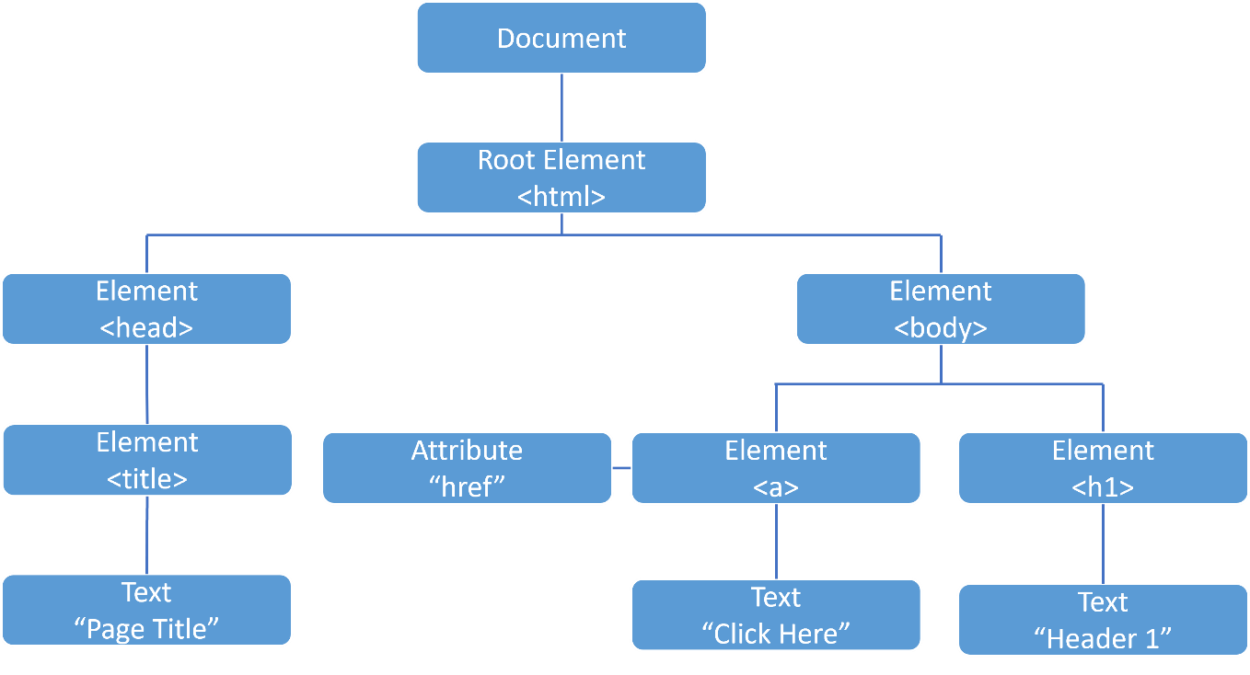

Slide 4
Example (HTML and its DOM Structure):
<body>
<h1 id="heading">Hello</h1>
<p>This is a paragraph.</p>
</body>
DOM Tree Structure:
body
h1 (with id heading)
p (Text: "This is a paragraph.")

Slide 5
Parts of the Document
console.log(document.title); // Shows the page title
console.log(document.URL); // Shows the page URL
console.log(document.body); // Shows the body element
console.log(document.head); // Shows the head element
console.log(document.images); // Shows all images on the page
console.log(document.links); // Shows all links on the page
Modify the Document in Real-Time
document.title = "Hello, Students!"; // Changes the title dynamically
document.body.style.backgroundColor = "lightblue"; // Changes background color
document.body.innerHTML += "<h2>Welcome to JavaScript DOM!</h2>"; // Adds a heading

Slide 6
Accessing DOM Elements
We can use JavaScript methods to access elements and manipulate them.
document.getElementById()
Retrieves an element by its id.
html
<h1 id="heading">Hello, World!</h1>
javascript
let heading = document.getElementById("heading");
console.log(heading.innerText); // Output: Hello, World!

Slide 7
document.getElementsByClassName()
Retrieves elements by their class name (returns an HTMLCollection).
html
<div class="box">Box 1</div>
<div class="box">Box 2</div>
javascript
let boxes = document.getElementsByClassName("box");
console.log(boxes[1].innerText); // Output: Box 1

Slide 8
document.getElementsByTagName()
Retrieves all elements with the specified tag name.
html
<p>Paragraph 1</p>
<p>Paragraph 2</p>
javascript
let paragraphs = document.getElementsByTagName("p");
console.log(paragraphs[1].innerText); // Output: Paragraph 2

Slide 9
querySelector()
Selects the first element that matches the CSS selector.
html
<h1 id="heading">Hello!</h1>
javascript
let heading = document.querySelector("#heading");
console.log(heading.innerText); // Output: Hello!

Slide 10
querySelectorAll()
Selects all elements that match the CSS selector (returns a NodeList).
html
<div class="box">Box 1</div>
<div class="box">Box 2</div>
javascript
let boxes = document.querySelectorAll(“.box");
console.log(boxes[0].innerHTML);

Slide 11
Modifying the DOM
Change Text Content:
Using innerText or innerHTML, we can change the text inside an element.
html
<h1 id="heading">Original Text</h1>
javascript
let heading = document.getElementById("heading");
heading.innerText = "Updated Text"; // Changes text to "Updated Text"

Slide 12
Change Attributes:
Using setAttribute(), we can modify the attributes of an element.
html
<img id="image" src="old-image.jpg" > // old car image
javascript
let img = document.getElementById("image");
img.setAttribute("src", "new-image.jpg"); // Changes the image source

Slide 13
Change Styles:
Using the style property, we can modify the element’s CSS.
javascript
heading.style.color = "blue"; // Changes text color to blue
heading.style.fontSize = "24px"; // Changes font size

Slide 14
Home Task 5
Access elements using getElementById(), getElementsByClassName(), and querySelector().
Change the text content of a paragraph element.
Change the background color of a div when a button is clicked.
Add a border to an image on mouse hover.
Create a form with two inputs and a submit button. Display the entered values when the button is clicked.

Slide 15
Thank You

