Slide 1
Semester Project (Graph Theory)
Mudassar Ali (2021-CS-635)
Ahmad Murtaza (2021-CS-629)

Slide 2
Introduction
Document classification is the task of automatically assigning predefined categories or labels to text documents based on their content.
Classical methods for document classification:
Traditional machine learning algorithms such as SVM (Support Vector Machines), Naive Bayes, and Decision Trees.
NLP-based methods for document classification:
Techniques like TF-IDF (Term Frequency-Inverse Document Frequency), word embeddings (e.g., Word2Vec, GloVe), and deep learning models (e.g., CNNs, LSTMs) that leverage NLP techniques.

Slide 3
Introduction
Graph-based approaches represent documents as graphs, where nodes represent words or phrases, and edges represent relationships between them.
By modeling documents as graphs, we can capture the semantic and structural information present in text data, which may lead to more effective document classification algorithms.
Graph-based methods offer advantages such as the ability to handle complex relationships between words, robustness to noise, and interpretability.

Slide 4
Problem Statement
Project Description:
Our project focuses on document classification using graph-based methods.
The goal is to develop a system that can accurately categorize text documents into predefined classes or topics automatically.
Method Used for Document Classification:
The primary method used for document classification in our project is the Graph-based Approach inspired by the paper "Classification of Web Documents Using a Graph Model" (IEEE, 2003).
This approach involves representing documents as graphs, calculating similarity between graphs using MCS, and using a KNN classifier for classification based on graph similarities.

Slide 5
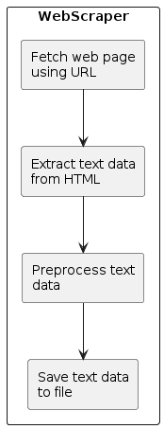
Methodology
Web Scraping
Utilizing the requests library to fetch web pages.
Utilizing BeautifulSoup from bs4 for parsing HTML content and extracting data.
Notes:
Details:
The script initiates an HTTP GET request to the specified URL using the requests.get() method.
The response content is then parsed using BeautifulSoup to extract relevant text data.
HTML elements such as <script> and <style> are removed from the parsed content.
The extracted text is processed to remove extra white spaces and limit the text to the first 520 words.
Finally, the processed text is saved to a text file with a sequentially incremented filename.

Slide 6
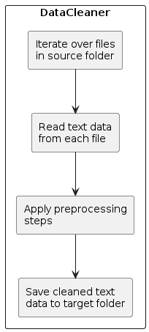
Methodology
Data Cleaning
Cleaning the text data to remove noise and unwanted characters.
Standardizing the text format for consistency and ease of processing.
Notes:
Details:
The script applies various cleaning operations to the text data:
Conversion to lowercase to standardize case usage.
Removal of special characters that can't be copied using regular expressions.
Elimination of punctuation marks using regular expressions from the string module.
Tokenization of the text into words using the nltk.word_tokenize() method.
Removal of stopwords from the English language using a predefined list from the nltk.corpus.stopwords module.
The cleaned and processed text is then saved to separate text files.

Slide 7
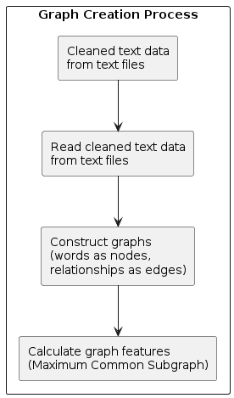
Methodology
Graph creation
Representing text data as graphs, where words are nodes and relationships between words are edges.
Capturing semantic and structural information present in the text.
Notes:
Details:
After cleaning and processing, the text data is converted into a graph representation.
Each word in the text becomes a node in the graph.
Relationships between words (e.g., adjacency) are represented as edges in the graph.
The graph captures both the semantic meaning of words and their structural arrangement within the text.

Slide 8
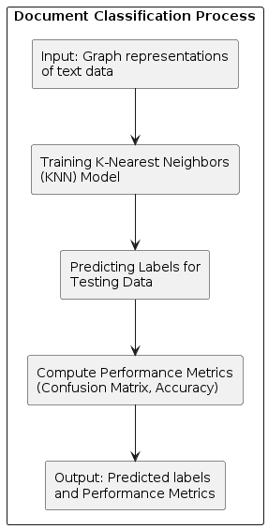
Methodology
Implementation of Paper / method
Preprocessing text data to create graph representations.
In graph nodes represent words and edges represent relationships between them.
Calculating similarity between graphs using Maximum Common Subgraph (MCS).
Training a K-nearest neighbors (KNN) classifier using the graph features.
Evaluating the performance of the classifier using metrics such as accuracy and confusion matrix.

Slide 9
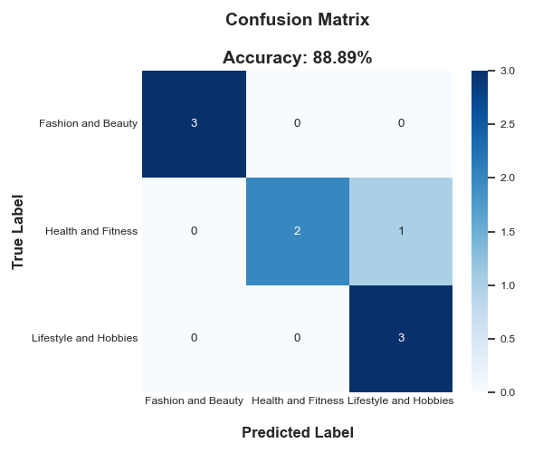
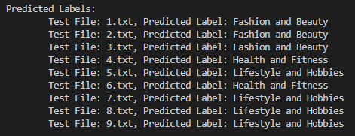
Results

Slide 10
Future Work
Suggestions for modifications in the current method:
Explore additional graph-based features or representations to enhance the model's performance.
Experiment with different graph construction techniques and algorithms to improve classification accuracy.
Any new idea for document classification?
Discuss potential research directions and areas for future exploration in document classification.

Slide 11

Q & A

