Slide 1

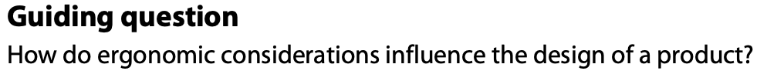
Design in theory
Ergonomics

Slide 2
Contents
Ergonomics | Describe how ergonomics is used to improve the design of a product by making a design more efficient, usable, functional, effective and safe.
Anthropometrics | Explain and use static and dynamic anthropometric data to design for different people and able to discuss how factors such as age, gender, ethnicity and disability affect the anthropometric data.` k
Percentile and percentile range | Identify where the 5th, 50th and 95th percentiles are appropriate for a design scenario. Explain the reason why designers choose adjustability and/or range of sizes for a product and identify products that use one or both strategies.
Workspace envelope, adjustability, reach, clearance and range of sizes | Explain the importance of workspace envelope, adjustability, reach and range of sizes in relation to percentiles and how they are used when designing products.
Physiology | Explain limiting aspects of user’s capabilities, including users’ visual accuracy, colour perceptions, strengths, fatigue, muscle control and hearing thresholds.
Psychology | Discuss how human senses(smell, sound, touch, taste and vision) are used to influence the design and development of products.

Slide 3
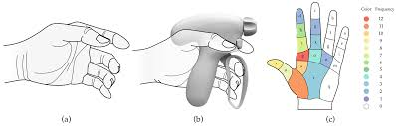

Ergonomics
A 1.1.1 Ergonomics is the relationship and interaction between people (aspects of the human body) and the products, systems and environments they use.
Ergonomics: from the Greek word “ergon” meaning “work” and “nomoi” meaning “natural laws”. Ergonomics is the science of refining the design of products to optimise them for human use.
Definition: Ergonomics is the study of how products, systems, and environments can be designed to fit human needs, abilities, and limitations.
It’s about making things comfortable, safe, and efficient for people to use.
Think of a chair that supports your back, a phone that fits in your hand, or a car dashboard that’s easy to read while driving—that’s ergonomics at work.

Slide 4
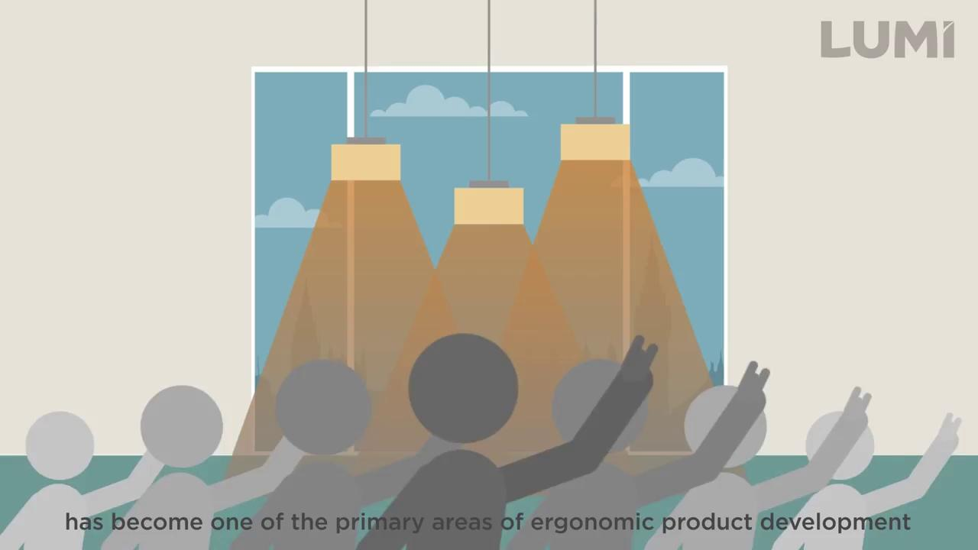
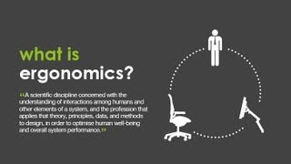

A 1.1.1 Ergonomics is the relationship and interaction between people (aspects of the human body) and the products, systems and environments they use.
Ergonomics is the application of scientific information concerning the relationship of human beings and the design of objects (products), systems (processes) and environments (where they are used).
The relationship between human and product might be related to:
Shape, form, colour and texture.
Ease of use.
Comfort in use.
Mapping and user interfaces.
Affordance and logic of user.
User experience.
These areas will be covered as we move through this topic.
Ergonomics emerged as a scientific discipline in the 1940’s. In 1949, in a meeting of distinguished psychologists and psychologists, they formed the Ergonomics Research Society (ERS) which became the first such society in the world.

Slide 5
Why is Ergonomics Important in Design?
A 1.1.1 Ergonomics is the relationship and interaction between people (aspects of the human body) and the products, systems and environments they use.
Prevents discomfort and injury (e.g., wrist pain from a badly designed keyboard).
Improves efficiency (a tool designed to reduce effort means faster, easier work).
Enhances user experience (a comfortable handle makes you want to keep using a product).
Safety (reduces accidents—think of seat belts and car seat designs).
Ergonomics links to Human Factors, Usability, and Design Specifications.

Slide 6
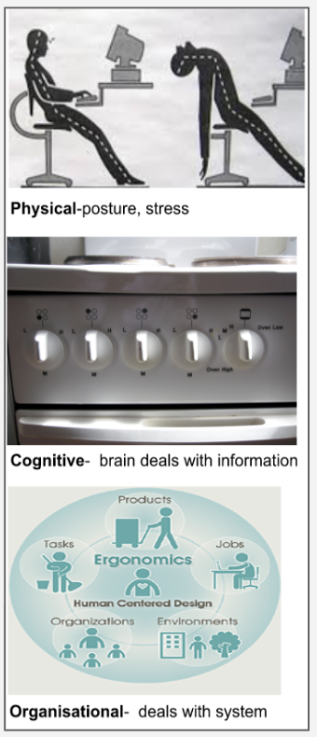
Types of Ergonomics
A 1.1.1 Ergonomics is the relationship and interaction between people (aspects of the human body) and the products, systems and environments they use.
Physical ergonomics often deals with the related subjects of posture, worksite development, operational layout, material handling, repetitive stress and movement. Repetitive stress injuries and musculoskeletal disorders and occupational health safety.
Fit between body and product
Example: Chair height matching desk height. Uses anthropometric data (measurements of
human body sizes).
2. Cognitive ergonomics is concerned with mental processes such as perception, memory,
reasoning and motor responses as they affect the interactions amongst humans and other
elements of a system.
Fit between mind and product.
Example: A smartphone interface that’s easy to navigate. Involves memory, perception, and
reaction times.
3. Organisational ergonomics includes subjects such as communication, work design, work
hours management, team work, virtual organisation, telework and quality management.
Fit between systems and people.
Example: Workflow in an office or factory. Reduces stress, improves teamwork and productivity.

Slide 7
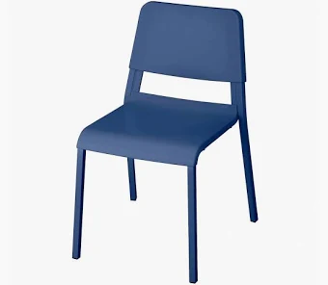
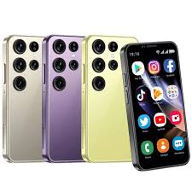
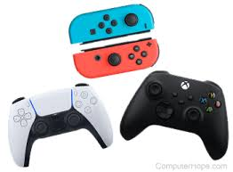
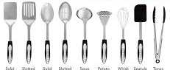
Examples
A 1.1.1 Ergonomics is the relationship and interaction between people (aspects of the human body) and the products, systems and environments they use.
School chairs and desks (why some feel comfortable, others don’t).
Smartphones (size of buttons, screen readability).
Game controllers (designed for long use without strain).
Kitchen utensils (handles shaped for grip).
Software interfaces (buttons, navigation bar layout)
Airplane cockpits (controls, levers, power lever)

Slide 8

Designing a cafe an example of which type of ergonomics?
A 1.1.1 Ergonomics is the relationship and interaction between people (aspects of the human body) and the products, systems and environments they use.
Physical ergonomics is involved in chair/table height, comfort, and accessibility.
Cognitive ergonomics is present in menu design, signage, and how easy it is for customers to order and pay.
Organisational ergonomics is present in the layout of the kitchen, coffee machines, and serving counters affects how staff move, interact, and serve customers.Organizing seating for customers, entry/exit paths, and ordering queues.

Slide 9
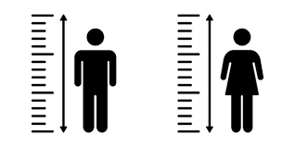

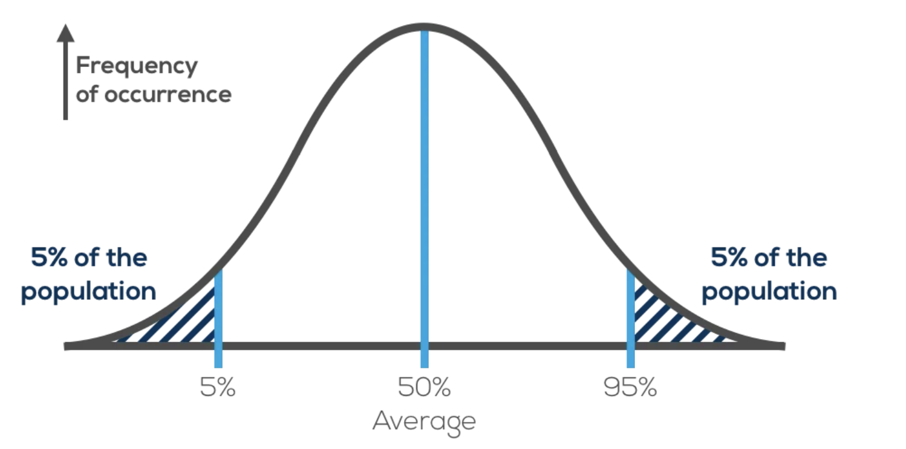
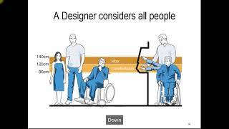
A 1.1.2 Anthropometrics involves the measurement of human physical dimensions expressed in the percentile range. This method specifically focuses on determining and presenting the range of individuals’ physical characteristics.
Anthropometrics is the study of different sizes of people. Knowing the size of people and their body parts, aids designers to develop products and spaces which are comfortable or adjustable and increase the ease of use.
freepik.com
Design should be human/user centred so designers need to ensure that the products they design are the right size for the user and comfortable to use - what would happen if this wasn’t taken into consideration?
“You don’t think about a chair being a design product until you sit on a badly designed chair”
Anthropometrics: from the Greek word “anthropos” meaning “man” and “metron” meaning “measure”. Anthropometry refers the measurement of the human individual. It is an aspect of ergonomics that deals with body measurements, particularly the areas of size, strength and capacity.
Designers have access to data and drawings that state measurements of human beings of all ages and sizes. Designers will need to consider which group will interact with the product or service to use the appropriate data group. Use and misuse of this data is an important consideration. The graph to the left shows a typical “percentile range” of anthropometric data. We will go into more detail later.
Percentile range graphs show the proportion of a certain population or ethnic group with a particular dimension. These then detail the “average” range (50th percentile) along with the 5th and 95th percentile. We will go into much further detail later in this topic.

Slide 10
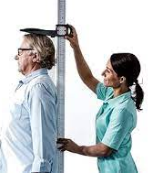
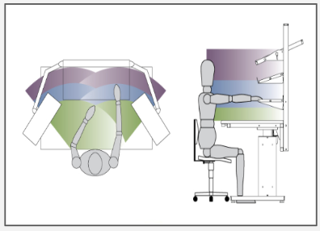
A 1.1.2 Anthropometrics involves the measurement of human physical dimensions expressed in the percentile range. This method specifically focuses on determining and presenting the range of individuals’ physical characteristics.
Anthropometric data is more than a simple measurement. It can be subclassed into two categories, Static and Dynamic data.
Static Data (also known as Structural data) refers to measurements taken while the subject is in a fixed or standard position, i.e Height, arm length etc.
Dynamic data (also known as Functional data) refers to measurements taken during physical activity or movement. I.e crawling height, table reach length, overhead clearance.
Static data is much easier to gather as people are asked to remain still throughout the process.
Dynamic data collection involves subjects performing tasks. People also carry out similar tasks in different ways to each other. While static data is more reliable, dynamic data can be more useful to the designer.
stadiometer.com
Types of Static measurements:
Skeletal dimensions: measurements of length of bones between joint centres.
Static or stationary physical measurements: weight, height, ear size.
Soft tissue measurement: the wobbly stuff that covers our bodies...muscle, fat, skin etc.
Types of Dynamic measurements:
Reach: (e.g, could be arm plus extended torso)
Clearance: (two people through a doorway)
Volumetric data: or kinosphere. Defined as “the space that can be reached by easily extending limbs”. This concept has been widely and variously described as “gesture reach” or “zone of reach”.
Static data: the subject at rest or still.
Dynamic data: the subject is in motion.

Slide 11

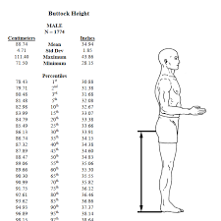

A 1.1.3 Percentiles aid in the selection of appropriate anthropometric data to satisfy the majority of a user population.
Percentile range: The proportion of the population with a dimension at or less than a given value. For a given demographic (age, gender, race etc) the 50th percentile is the “average” value.
The 5th percentile mark is the point below which 5% of the population or study group is represented on the graph.
For example, if you are designing an airplane cockpit, and need to make sure everyone could reach all the required controls, you would need to choose the 5th percentile arm length.
Why would that be?
Designing for the 5th percentile can be challenging, but if this group can reach the controls, then everyone else can also reach them.
The 95th percentile group represents the top 5% range of the population or study group.
This percentile range is easier for a design because the vast majority of the population will be able to use your products. Obviously there are some exceptions…. Can you think of any?
Here is one example. Door height, you would choose the 95th percentile mark as you are in reality designing it for tall people. You would not have to worry about the average height or 5th percentile group as they will easily fit.
There is a vast amount of anthropometric data available to the modern designer. The are many reputable and reliable sources available on the internet, and the data will generally be represented in either table or graphical form.
Life at the 95th percentile.
5th percentile range in fashion design.
In the study and analysis of anthropometrics the 2.5th, 97.5th and the 5th to 95th percentile range are also considered important.

Slide 12
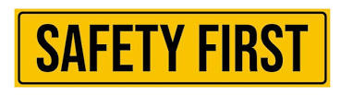
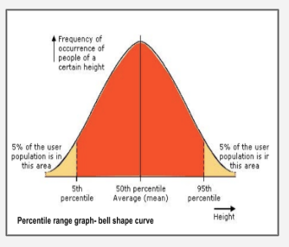
A 1.1.3 Percentiles aid in the selection of appropriate anthropometric data to satisfy the majority of a user population.
Predictably the 50th percentile is where 50% of the population or study group can be found. The line down the middle of bell curve graph is the most common measurement found for that study. This would be the modal value. Since the curve is symmetrical, the average value is shown in the middle, so the mean value coincides with the “median”.
Of course it doesn’t always follow that the curve will be a “normal” bell shape - it may be “skewed” to one side or the other.
For example, the distribution curve of people in a primary school were studied for height. As there would be many small children as well as adults, the curve would be “skewed” towards the “shorter” end. So aiming a product at this particular group would need a detailed study at the anthropometric data.
Methods of extremes:
Sometimes you can’t accommodate all your users because there are conflicting solutions for your design. In this case, you would to make a judgement on what is the most important feature.
You must never compromise on safety though, and if there any real risk of injury, you may have to use more extreme percentile ranges (method of extremes) in your design (2.5th or 97.5th) to make sure everyone is protected, not just 95% of people.
There is a great deal of anthropometric data available to you as a designer and you would be expected to:
Interpret percentile tables - in order to calculate dimensions related to your product.
Consider how products can be adapted - for different markets or adjusted to cater for a specific market.
Consider the 5th, 50th and 95th percentiles - in particular, but also the 2.5th, 97.5th and the 5 to 95th range should also be considered.
Interpret percentile tables - based on different national and international populations, gender and age - yes, they can vary massively.

Slide 13
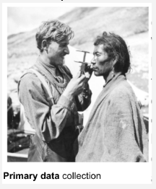

A 1.1.3 Percentiles aid in the selection of appropriate anthropometric data to satisfy the majority of a user population.
Primary anthropometric data
Secondary anthropometric data
Primary data collection (also called field research) involves the collection of data that does not already exist.
Secondary data collection (also known as desk research) involves the summary, coalition,and synthesis of existing data.
Examples:
Chinese head shape differs from western head shapes (see the video below). To design products that fit the Chinese population you need to consider these anthropometric differences as a designer. SizeChina offered to do a 3D anthropometric scans to create a landmark database of sizes.
What issues can you think of when conducting a study like this?
Secondary sources of anthropometric data are available, both in print and online. As a designer this is where most of your data will come from. However, if you have a particular client or access to the user population you wish to design for, you may wish to collect the measurements yourself and generate your own primary data.
It is important to consider the user group or target audience you are designing for. The anthropomorphic data varies greatly around the world. A wide selection of data is published and regionalised. For example, Asian versus western European data.
Think of designing children's clothing. Asian and American children for example are very different sizes. Choose your data wisely, you wouldn't want to get these mixed up.
For example: If it was a cold day when taking measurements, subjects would be reluctant to remove hats or bulky clothing. This can impact or the accuracy of the measurements and affect the data’s reliability.
Primary data: Data collected by the user for a specific purpose.
Secondary data: Data collected by someone other than the user.

Slide 14
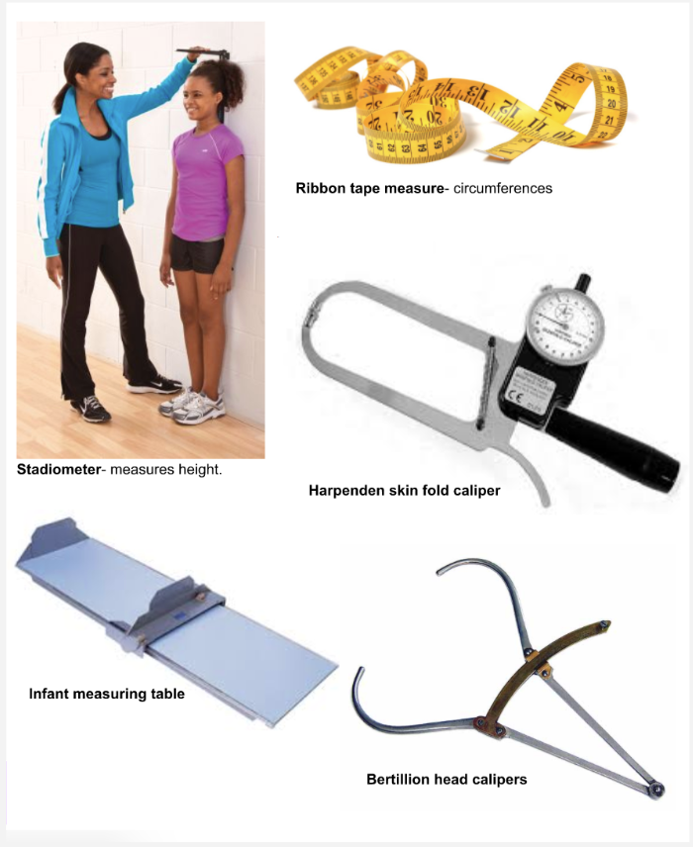
Collecting Static Anthropometric data
A 1.1.3 Percentiles aid in the selection of appropriate anthropometric data to satisfy the majority of a user population.
When collecting Static anthropometric data a range of tools to measure the subjects. These can include sliding calipers, skinfold calipers, fabric tapes etc.
It can sometimes be difficult to accurately collect anthropometric data mainly due to the reliability and limitations which are described below:
Tools used: unreliability of the actual tools and the calibration and maintenance of the tools.
Personnel training: The accuracy and consistency of where measurements are taken on the subjects is directly linked to the level of training of the people taking the measurements.
Time of the day: because the cartilaginous disc in the spine get compressed by body weight throughout the day. We can be upto 2.2mm shorter in the evening.
Subjects body shape: Due the physical size or shape of some of the subject it may be difficult to collect measurement from a defined specific area.
User does not carry out tasks in the same way: This is linked to personnel training, but consistency in measuring is also key to accurate data.
Obtaining static data is not straight forward: subjects are human and move dynamically and are not always compliant.

Slide 15
A 1.1.4 To ensure products are appropriate to a range of percentiles, designers can choose to design products to be adjustable and/or to be produced in a range of sizes.
Designers need to consider differences in users' body dimensions and anthropometric measurements when developing products. Percentiles, such as the 5th, 50th, and 95th, help designers understand the range of body sizes within a target population. Designing only for the average user may exclude smaller or larger users.
One approach is to make products adjustable, allowing users to modify dimensions to suit their individual needs. Examples include adjustable office chairs, car seats, bicycle seats, and desks. Adjustable products can accommodate a wider range of users while improving comfort, ergonomics, and usability.
Another approach is to produce products in a range of sizes, such as shoes, clothing, helmets, or school furniture. This can provide a good fit but requires manufacturers to produce and stock different sizes. Designers therefore choose between adjustability and multiple sizes depending on the product, users, cost, manufacturing complexity, and intended range of percentiles.

Slide 16

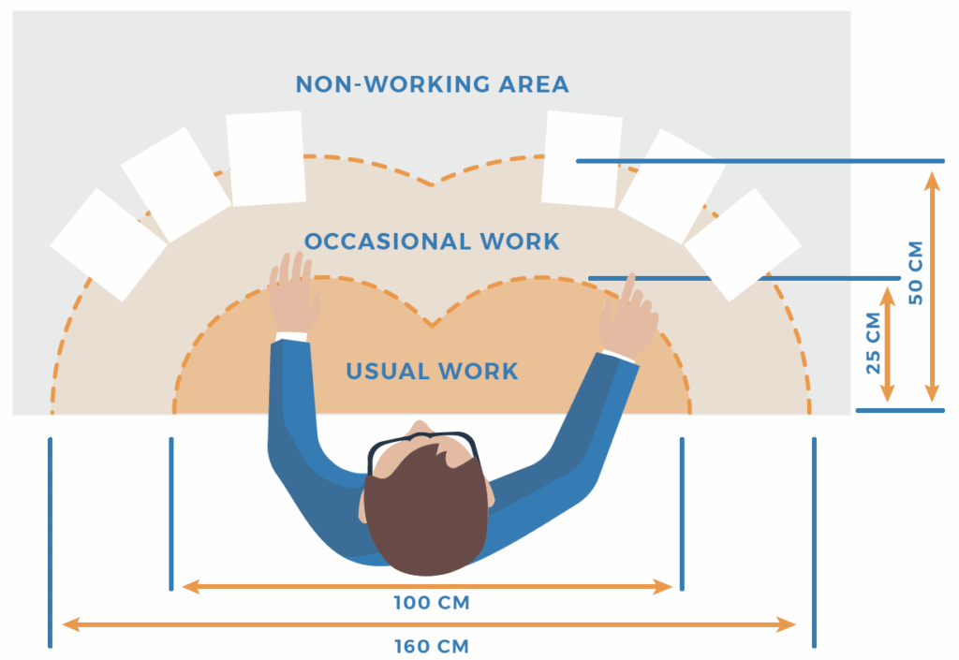
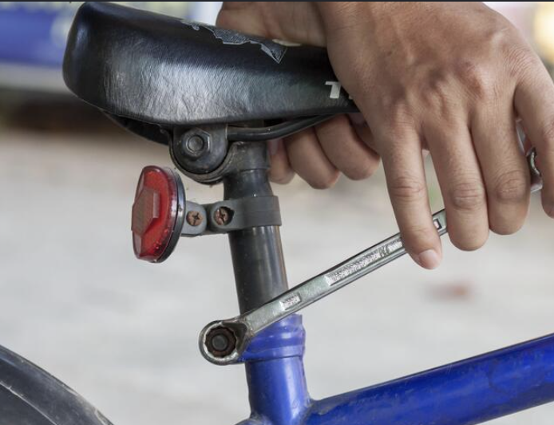
A 1.1.5 In design, consideration must be given to work envelopes, reach, clearance, adjustability and range of sizes.
Clearance:
People and machines sometimes have to work or move through restricted spaces, for example, maintenance work on large production machinery. Clearance can be seen as the minimum required to the user into or through an area. Clearance is especially important when designing emergency exists, access panels, or safety hatches.
Clearance examples:
The minimum vertical space between the floor and an overhead obstruction must allow for the tallest user plus their footwear and PPE gear.
The minimum horizontal space between obstructions must allow for the widest plus room for movement and equipment - think of wheelchair users.
An unprotected hazard must be out of reach for the user with the longest arm length - think of guards on large machine presses.
Grill opening must not be wide enough to get your fingers in.
What other examples can you think of?
Reach:
Reach is also known as the “workspace envelope”. This is a 3-dimensional space within which you carry out your physical work activities when in a fixed position.
The limits of the envelope are determined by the users functional arm reach, which in tern, is influenced by the direction of reach and the nature of the task being performed. Most of the things you need to carry out your tasks should be arranged within the primary and secondary zones.
Workspace envelopes should be designed for the 5th percentile of the user population, that means 95% of people will be able to reach everything in that envelope.
Adjustability:
Certain features of equipment or facilities can be designed so they can be adjusted to the individuals that use them. The 5th to 95th percentile range of a population group should be considered for adjustability, as manufacturing for the more extreme groups can create expensive and manufacturing difficulties. Other accommodations, such as add ons or extensions can be provide for these groups.

Slide 17
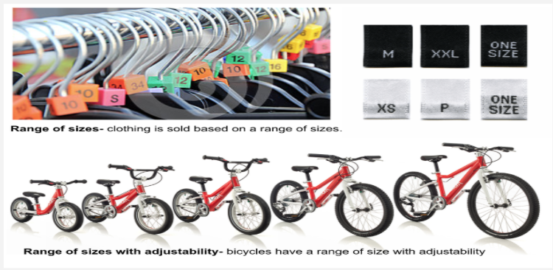
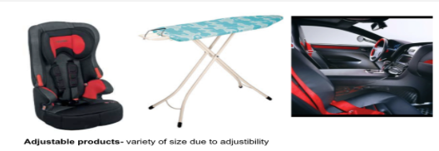
A 1.1.5 In design, consideration must be given to work envelopes, reach, clearance, adjustability and range of sizes.
Products are specifically designed to allow a variety of users to access and utilise them. This is based around the idea of providing a range of sizes or the adjustability of the product to accommodate the users, and therefore access a larger user market.
Range of sizes:
When talking about this category the obvious area of manufacturing and design that comes to mind is fashion. However, for clothes manufacturers to make clothes to fit every individual variance would not be economically possible, thus clothes tend to come in a range of sizes based on percentile ranges. There are also a number of other types of design and manufacturing that produce a “range of sizes”,
what ones can you think of?
Adjustability:
There is a clear distinction between a product produced for a “range of sizes” and “adjustability” - Can you describe the difference?
People have different proportions, even people of similar sizes. So as a designer this needs to be taken into consideration so users can “adjust” the product to suit their own proportions.
Multivariate accommodation (fitting in several variables) - for example, in a car, you need to consider sitting height, sitting leg length, arm reach, viewing angle, hip breadth, thigh length. This means that accepting the upper and lower 5% of people from the percentile range being designed out of your product is not viable. Also, different people will be designed out for each different variable. This is where “adjustability” comes into design. The user can alter the product to best suit them, therefore appealing to a larger user market.
Range of sizes: A selection of sizes of a product is made to cater for the majority of the market.
Adjustability: The ability of a product to be changed in size. Commonly used to increase the range of percentiles the product is appropriate for.

Slide 18
Anthropometrics: Clearance, Reach and Adjustability: Design Context
What is it your are aiming for with your design? | Design examples: | Measurements to be considered: | User groups your design should accommodate:
Easy reach. | Vehicle dashboard. Shelving. | Arm length Shoulder height | Smallest user: 5th percentile.
Adequate clearance to avoid unwanted contact or trapping. | Inspection covers. Cinema seats. | Shoulder or hip width Thigh length | Largest user: 95th percentile.
A good match between the user and the product. | Seats. Cycle helmets. Pushchairs. | Knee -floor height Head circumference weight | Maximum range: 5th to 95th percentile
A comfortable and safe posture. | Lawnmowers. Monitors. Work surface height. | Elbow height Sitting eye height Sitting or standing elbow height | Maximum range: 5th to 95th percentile
Easy operation. | Screw bottle tops. Door handles. Light switches. | Grip strength Hand width Height | Smallest or weakest user: 5th percentile.
To ensure an item can not be reached or operated by mistake. | Machine guarding mesh. Barrier to hazard. | Finger width Arm length | Smallest user: 5th percentile. Largest user: 95th percentile.
Clearance: Physical distance between two objects.
Reach: a distance a person can stretch to or grasp an object from a specified position.
Adjustability: The ability of a product to be changed to accommodate the users specific characteristics.

Slide 19

Physiological Factors: Physiological factor data.
A 1.1.6 Physiology is the study of systems and biomechanics within the human body, their responses, limitations and capabilities.
Human Factors Design takes into consideration:
Effectiveness - completeness and accuracy.
Efficiency - speed and effort.
Engagement - pleasantness, satisfaction.
Error tolerance - error prevention and recovery.
Learnability - predictability and consistency.
Physiological factors data is a very important tool available to designers and used in many ways to develop new products or improve existing designs. The data is generally collected to evaluate and optimise the user’s safety, health, comfort, and performance when using products or services. We will cover how and why this is achieved in this section.
Here are a few examples of how Physiological data is collected:
Performance tests.
User trials and observations.
The collection of anthropometric data.
These have been covered in detail previously.
When creating new products or redesigning existing designs, designers should always be aware of the “little everyday problems” consumers encounter.
When collecting this data, the following physical limitations of the subjects need to be taken into consideration, and how they may impact on the data collected.
Human factors and Ergonomics considers the activities carried out by humans and how this impacts on their quality of life, will help improve their safety, reduce fatigue and stress. While also trying to increase comfort levels and enhance satisfaction levels.
By collecting Physiological factor data it gives a designer an opportunity to make things better and improve the human condition.
How the body moves.
Hand/eye coordination.
Strength.
Size.
Stamina - muscular strength or endurance in different positions.
Visual sensitivity - to light.
Tolerance to extremes of temperature.
Frequency and range of human hearing.
Body tolerances - how much the body can withstand when using or working with a product.

Slide 20

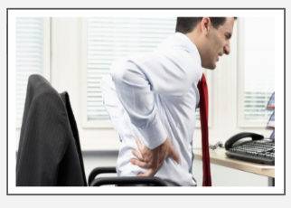

A 1.1.6 Physiology is the study of systems and biomechanics within the human body, their responses, limitations and capabilities.
Comfort: This comes in a couple of forms that are outlined below. Comfort of the user is a primary concern for designers. It determines how effective a design is and how well a human can intact with a product - what would happen if this brokedown?
Physical comfort: Designers need find innovative ways to increase the utility and usability of their products. Making a product more intuitive and comfortable to use will ensure its success in the marketplace, therefore increase its success and profitability. Can you think about any product that is uncomfortable to use?
Psychological comfort: comes in the form of feedback from the product and it can influence our desire and comfort to use that product. A quality product should feel as if it is made out of quality materials. The feedback your brain gets from using the product: touch, feel, texture, materials, build quality etc will all impact on our psychological comfort - this will then affect our future or prolonged relationship with that product. Can you think of anything that would be an example of this topic?
Video 1
Video 2
Fatigue is a person’s sense of physical or psychological tiredness that informs affects decisions and can impact negatively on performance.
Fatigue is the consequence of some discomfort experienced by the user and can lead to a loss of productivity, product satisfaction, and result in the perception that the product has been poorly designed.
When a designer takes into consideration and accounts for the physiological factor of comfort, then fatigue and its negative associations will be reduced or removed completely.
Video 1: Shows what is taken into consideration for user comfort.
Video 2: Shows how to reduce factors that can cause fatigue.
The aim of designing for physical and psychological comfort is to prevent or reduce fatigue.
Comfort is a person’s sense physical or psychological ease when using a product.
Fatigue is a person’s sense of physical or psychological tiredness.

Slide 21
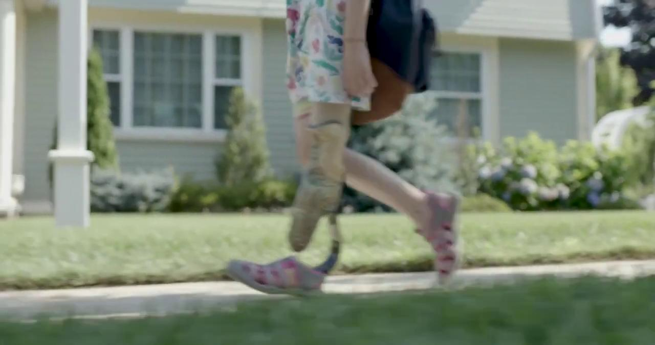


A 1.1.6 Physiology is the study of systems and biomechanics within the human body, their responses, limitations and capabilities.
Understanding how humans move and interact with products in different situations has always been an important part of the design process. With the advent of modern technology and especially with the advancements in motion capture technology, how designers and design teams can access and analyse this data has dramatically improved. Why would a designer want to lessen the impacts of these four areas below in their designs?
Biomechanics in human factors design focus in on four key criteria:
What is Biomechanics
Force | How much force the user has to impart when using the product. Excessive impact jolts the user’s joints and causes the muscles to tense in response. This can eventually lead to pain or discomfort. | Repetition | How often a user has to repeat a set task. A job is considered highly repetitive if the task cycle time is 30 seconds or less. Repeated tasks can lead to a number of painful injuries. Can you think of any?
Duration | The length of time the user is engaged with the product. Duration refers to continuous muscular effort. Even small exertions over a prolonged period can become stressful for users. | Posture | Posture refers to how you hold your body as a whole and where your arms and legs are in relation to your body. Holding an awkward body position or stance for any period of time can be painful
Motion capture and product design
Motion capture in sport
Biomechanics relates to the mechanism of living things (how they move). Biomechanics includes research into the operation of muscles, joints and tendons, force, repetition, duration and posture.

Slide 22
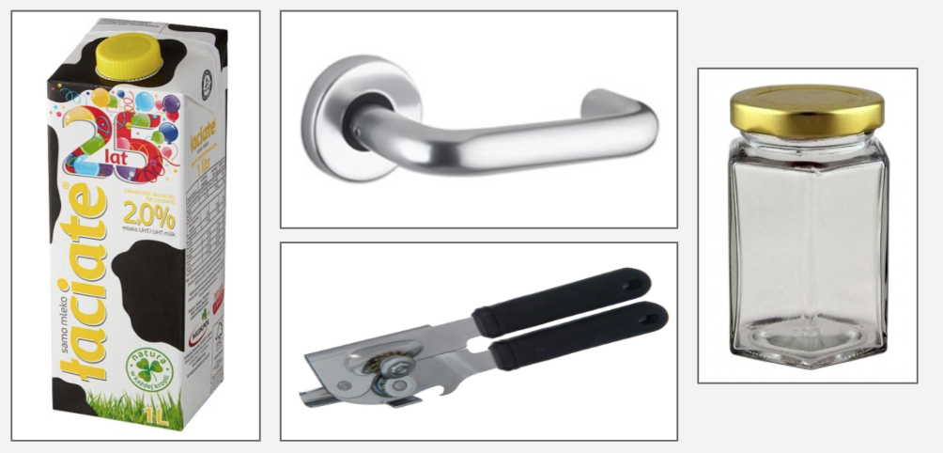
A 1.1.6 Physiology is the study of systems and biomechanics within the human body, their responses, limitations and capabilities.
Choose one of these objects and devise an experiment to find out the force required to open or operate it.
You may require this formula:
Torque - T= F x d
T - torque in Newton-metres (Nm)
F - handgrip force required to overcome friction in Newtons (N)
D - diameter of cap in metres (m)
While conducting your experiment please consider what ergonomic, anthropometric, physiological and psychological factors are involved with the task.
Please also report what potential injuries could occur when completely the task, and what user groups would have issues using these products, and what could you do to counteract them.

Slide 23
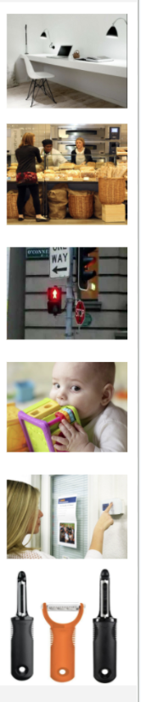
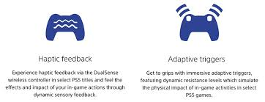
Psychological Factors: Psychological factors data
A 1.1.7 Psychology is concerned with the study of the human mind and involves the study of all the human senses that may be involved in sending information to the brain
Psychological ergonomics is an interdisciplinary field which discovers and applies information about human behaviours. It also looks at abilities and limitations, and other characteristics to the design and evolution of products, systems, tools, jobs and environments for enhancing productive, safe and comfortable human use.
Psychological factors need to considered when designing a good user-product interface (how and where humans interact with a product) includes simplicity, ease of use, intuitive logic, organisation, low-memory burden, visability, feedback, affordance, mapping and constraints provide opportunities for designers to ensure their products are logical and easy to use. These are all covered in more detail in User-centred Design (Topic 7).
Psychological factor data contribute to good user interfaces and are commonly influenced by the environment the product is used in, and factors such as light, smell, sound/noise, taste, temperature and texture.
Psychological data can be collected via user observation. This data will then enable the designer to think about the issues the user has, and then use this data to improve their products.
User reactions whilst engaging with designed products have an impact on the user experience - Psychological data can help understand this.
Psychological factors in design:
Light: provides ease of visibility, making reading text easier whether ambient, direct, or screen light.
Smell: An olfactory response to an environment, being one of the most powerful senses a human processes, and very important to the whole design process.
Noise: Being able to hear sound adequately so users can receive feedback from them.
Taste: Important for young children’s products who explore the world with their mouths. Toxins are and issue and must be factored into any design.
Temperature: Extremes of temperature can adversely affect human productivity.
Texture: Provides valuable feedback and information for the user related to touch and grip. Not only relevant to the visually impaired.
Psychological factor data: Related to physical characteristics used to optimise the user’s safety, health, comfort, performance and experience.
bit-tech.net

Slide 24
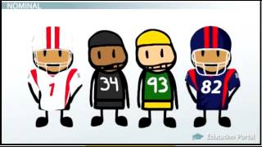
A 1.1.7 Psychology is concerned with the study of the human mind and involves the study of all the human senses that may be involved in sending information to the brain
Psychology is a science; therefore, it relies upon scientific data to study behaviours and mental processes. Research in psychology is based on scientific methods that involve; conceptualizing a problem, collecting data, analysing the data and drawing conclusions. Designers can use a variety of methods to represent psychological data and these can be broken down into four main areas for representing the data; Nominal, Ordinal, Interval and Ratio data scales. These are way of showing measurement variables, these are outlined below.
Nominal scales: Non numeric or where the numbers have no value - can be put in any order and it wouldn’t matter. Data represented on a nominal scale can be gender, race, location, hair colour, favourite pet etc.
Ordinal scales: The order in which the data is show matters, but the differences between the values doesn’t - think of the word “order” - the order in which it is shown is important, like a ranking system. “Rate how awesome Design is from 1 to 10” - obviously its 10, but this is an ordinal scale of showing this data - other forms: difficult, position in a race, wellbeing (happy/sad)
Interval scales: The order in which the data is show now matters - or in posh words, “the order and differences between levels of a variable matter, but they are not in ration”. Interval scales are in reality the distance between values. For example, rise in temperature.
Ratio scales: The number tell us how much of one thing we have in comparison to another thing. - with a ratio scale the order, differences, and ratio are all meaningful. For example; weight, height, length etc are all ratio scales as can directly compare them to other measurements - remember percentile ranges?
Ordinal scales are generally used for non-numeric concepts like satisfaction, happiness, comfort, likability, discomfort.
Ordinal data can be qualitative and can include: taste, smell, texture etc
Interval data can be quantitative and include: sound, temperature, light etc.

Slide 25
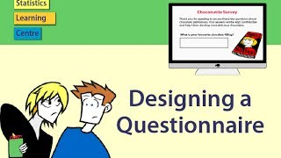

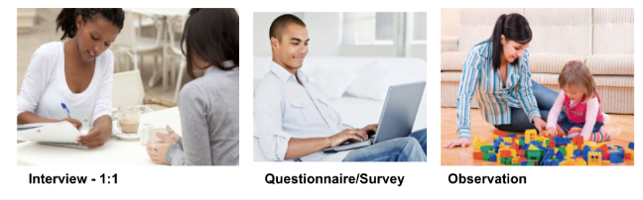
Method of collecting psychological data.
A 1.1.7 Psychology is concerned with the study of the human mind and involves the study of all the human senses that may be involved in sending information to the brain
Research in psychology is based on the scientific method of collecting data for analysis. The type of psychological data that is collected is based on the conceptualization (forming a concept or idea of something) of the design problem. The researcher selects a research method that will be appropriate to explore the issue (design problem) or design concept. An important aspect of collecting data is selecting an appropriate method and sample group that represents the target audience or user group of the population you are designing for.
Methods of collecting data:
Interviews: involves asking people questions to find out about their experiences and attitudes. These often require a pre written set of questions.
One problem with interviewing people is the concern that participants will not be truthful and tell the interviewer what they think is socially acceptable or desirable.
Surveys and Questionnaires: These require subjects to read questions and mark their answers. Some psychologists observe behaviour and mental processes outside of the questions by administering standardised test.
Observation: In naturalistic observation, the psychologist observes behaviours in real world settings and makes no attempt to manipulate or control the situation. However many psychological observations take place in a lab or controlled environment where they can control variables.
Standardised tests: these allow the researcher to measure some aspect of the participant’s behaviour and/or mental processes, and compare each individuals results to others that have completed the same test.
Case study: Provides and indepth examination of a single individual. This is great if you have a specific client in mind, but the results can not be generalised to the wider population. This is covered in more detail in User-centred Design.

Slide 26
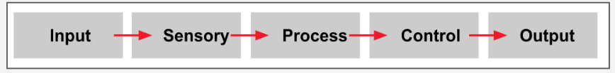
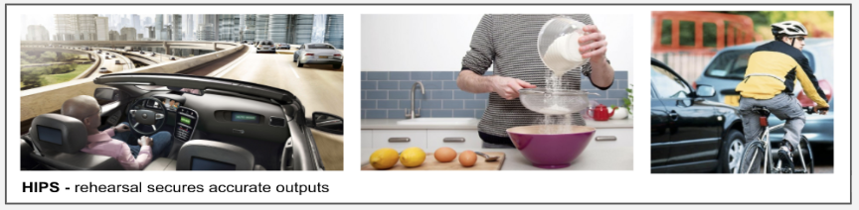
A 1.1.7 Psychology is concerned with the study of the human mind and involves the study of all the human senses that may be involved in sending information to the brain
The Human Information Processing System is related to how humans deal with all the information that surrounds them in their daily lives. The human sense of sight, hearing, touch, taste and smell all provide valuable information and feedback to humans.
Human information processing systems (HIPS) theory compares the human brain to a computer, suggesting that we too are information processors, and it possible and desirable to study the internal cognitive processes in humans to find design opportunities.
The Information Processing approach characterises thinking as “the environment providing data, which is then transformed by our senses. The information can be stored, retrieved and transformed using “mental programmes”, with the result being behaviour responses”. Why would a designer need to understand this process, and what use would it be for the designer?
The computer gave psychologists a simple everyday object to use as a metaphor, or analogy to which they could compare human mental processing. The use of a computer as a tool for thinking and how the mind handles information is known as the Computer Analogy.
The Human Information Processing system is an automatic system that a person uses to interpret and react to stimuli. It normally comprises of inputs, processes (sensory, central, or motor) and outputs

Slide 27
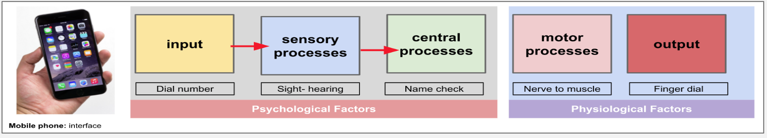
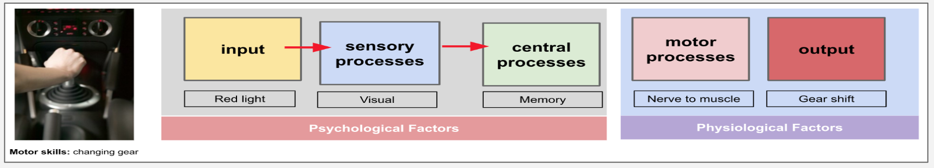
A 1.1.7 Psychology is concerned with the study of the human mind and involves the study of all the human senses that may be involved in sending information to the brain
Scenario 1: Using a Mobile phone. Below is the information flow diagram for making a call on the mobile.
Scenario 2: Driving a manual car. Below is the information flow diagram for slowing down in a manual transmission car.
What scenarios can you think of? Writing them out in information flow diagrams.

Slide 28
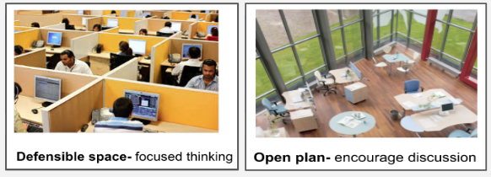
A 1.1.7 Psychology is concerned with the study of the human mind and involves the study of all the human senses that may be involved in sending information to the brain
Uncomfortable working environments can affect productivity and impact upon physical and mental health. As designers, why would you want to improve or reduced these conditions? Incorporating psychological, physiological and cognitive ergonomic theories into the workplace can remedy any uncomfortable environments. A few simple changes to the working environment can decrease stress levels, improve employee performance, reduce absenteeism and contribute to the well being and moral of individuals.
Light: Lighting can determine the visual sharpness that objects can be seen at. There are obvious safety issues associated with this. Alertness, productivity and performance can be affected by the light and particularly the source of that light.
Noise: Excessive noise in the workplace can cause a number of issues for the employees. Tinnitus (permanent ringing) is a particularly nasty problem. The level at which an employer must assess the risk to their workers from noise, and provide information, PPE and training is 80dB in the UK. How loud is 80dB?
Air quality: Temperature and humidity.
Thermal comfort describes a person’s psychological state of mind and involves a range of environmental factors which contribute to the thermal comfort of the workplace:
Air temperature - The heat from the sun or radiating from heat sources.
Radiant temperature - the heat transferred from human bodies.
Air velocity - The movement of air and the rate it moves at. Still air makes people feel stuffy. Moving air increases heat loss.
Humidity - The moisture level of the air.
Spatial issues: The space, colour and even the smell of the working environment can affect personal productivity and performance. Colour is be related to personal and aesthetic preference, while neutral smells are preferable.
Open plan offices encourages collaboration and communication, while “defensible spaces” are required for focused thinking - which do you prefer?
Environment factors:
A set of psychological factors that can affect the performance of an individual that came from the environment that the individual is situated in.

Slide 29
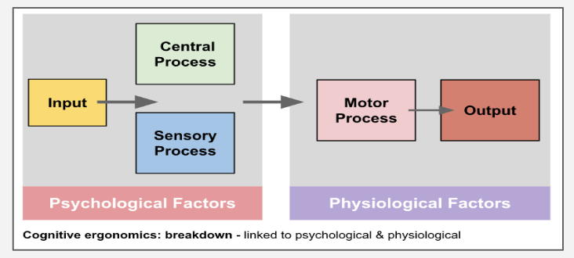
A 1.1.7 Psychology is concerned with the study of the human mind and involves the study of all the human senses that may be involved in sending information to the brain
It is worth considering the causes, effects and reasons for a breakdown in the human information processing system. The flow process may break down when the information inputs may be incompatible with the sensory receptors. At the process stage, the incoming information (input) may be incorrect, corrupted or a suitable response to the input may not be available. The output stage may be unable to perform the actions required by the central processing unit.
Can you give some real world examples?
Human Error:
Human error has been cited as a primary cause or contributing factor in numerous disasters and accidents. We will go into more detail with some examples on the next slide.
Possible causes of the flow process breakdown:
Age, skill level, disability, infirmity or frailty.
- Young children may not have the size, strength or fine motor skills to perform the task.
- Older people may not have the strength, manoeuvrability or flexibility to perform the task.
- People with disabilities such as arthritis or Parkinson’s disease may not have the fine motor skills to perform the task quickly or accurately.
- Physical condition of the human - lack of hearing, sight, inquiry, pre existing condition can contribute to the breakdown of the process.
Psychological and Physiological: Breakdown.
Breakdown at the psychological and physiological level can be attributed to the ability a human to adequately process sensory information. For example this may be due to a change in the humans ability to recognise and quickly process a particular sound or visual alarm, especially if this warning signal is not regularly seen or heard.
If the information is compromised coming into the central processing stage, a suitable or timely response may be lost, and at the output stage the well fail at the psychological level, therefore affect the physical response may not be adequate to complete the task.

Slide 30



A 1.1.7 Psychology is concerned with the study of the human mind and involves the study of all the human senses that may be involved in sending information to the brain
Human error has been seen as a key factor and associated with almost every major accident. Some of these has had huge catastrophic consequences for the people, property or environments where the incident occurred. As designers is it possible to design out human error with our products or systems?
Accidents that humans have contributed towards are not limited to any part of the world, or any particular industry. There are examples to be found from all over the world and history, here are a few examples:
The Bhopal disaster, also known as the Union Carbide disaster, was a major gas leak in India, and is considered the world’s worst industrial accident.
It occured over night on 2nd of December 1984 at the Union Carbide Pesticide plant in Bhopal. Union Carbide is an American company. Over 500,000 people were exposed to methyl isocyanate (MIC) gas and other chemicals.
The Chernobyl disaster was considered worst nuclear power plant accident in history in terms of monetary cost and casualties. This event is widely attributed to human error.
It is one of only two events classified as a level 7 event (7 is the max) on the National Event Scale. The other being the Fukushima disaster in 2011.
While the Southall train disaster is by no means the worst train accident ever, its link to human error and how this accident could have easily been avoided is well documented.
Out of the 212 passengers on the train 139 were seriously injured and 7 people tragically died.
More incidents from around the world can be seen here - LINK
Mistakes made by users (humans) are considered key contributors to major accidents or disasters. These can result in catastrophic consequences for people, property, and the environment. This would be considered a breakdown in the human information processing system.

Slide 31
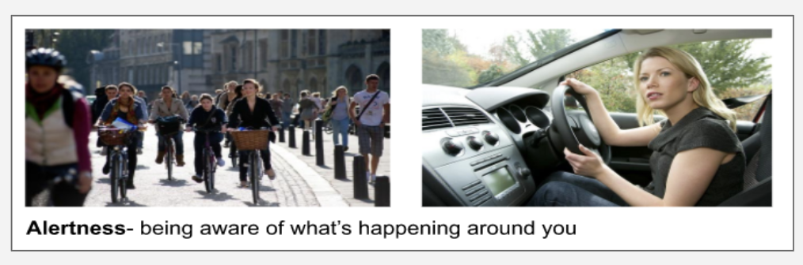
A 1.1.7 Psychology is concerned with the study of the human mind and involves the study of all the human senses that may be involved in sending information to the brain
Alertness has been recognised critical, foundation for successful decision making. Alertness is particularly important in complex and time sensitive activities such as air traffic control, health care, aviation, emergency response, military and police command etc. However, alertness is also a very important factor is less “high pressure” situation, but still complex difficult tasks such as driving a car or riding a bicycle - what other tasks can you think of?
In its basic form alertness means “being aware of what is happening in your vicinity, recognising any potential threats or dangers, in order to understand how information, events and one’s own actions will impact goals and objectives, both immediately and in the near future” - but what does this mean in the real world?
People with a high level of alertness could be described as having an adept situational awareness, generally has a high degree of knowledge and understand of the information system they need to respond to (the inputs and outputs of the system), and is able to respond to a situation in a controlled and timely manner. This type of alertness does not have to describe working in high stress dangerous situations but can also be used to describe how humans live their everyday lives.
Lacking in adequate alertness has been identified as one of the primary factors in accidents attributed to human error. Can you think of a situation you have been in that alertness or lack of it has caused you problems?
Alertness: The level of vigilance, readiness, or caution of an individual.

Slide 32
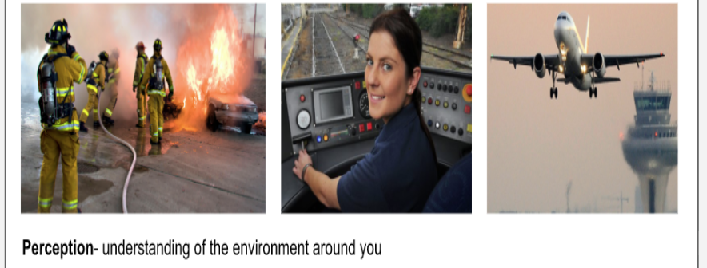
Perception.
A 1.1.7 Psychology is concerned with the study of the human mind and involves the study of all the human senses that may be involved in sending information to the brain
Perception differs from alertness as it relates to physical environment of a situation and how you prioritise and order the information you receive from it. Alertness is how aware you are of what is going in in these situations.
The official definition of perception is, “Perception is the organization, identification, and interpretation of sensory information in order to represent and understand the presented information or environment”.
The mind is programmed and designed to create order when confronted with many objects or obstacles. The consequences of this is that human beings when using a product or service generally do not focus on the product itself, but see classes, groups or patterns of control and feedback when they are comfortable with the task.
Professional drivers, air traffic controllers, firefighters are required to have total and accurate situational awareness. They need to know what is going on in that environment and understand what to do in all circumstances. This means they have a high level of perception for the situations they are in.
Perception has three levels of situational awareness:
Perception - refers to the awareness of relevant objects, people, systems or other environmental factors.
Comprehension - understanding the meaning of what was perceived: recognising, interpreting and evaluating the significance of that information.
Projection - the ability to predict what will happen in the near future, based on past experience, knowledge and understanding the dynamic elements of the situation or environment. Situational awareness is a complex phenomenon that depends on several basic and higher level cognitive processes.
Perception: The way in which something is regarded, understood or interpreted.

Slide 33
