Slide 1


CMOS Bandgap Voltage Reference Design(Pakistan 3) Team Members: Engr. Faizan Khan Engr. Mudassir Ali Engr. Uzair Ahmed Engr. Jaffar Hussain Engr. Mubashir Saleem Engr. Muhammad Uzair
National University of Computer and Emerging Sciences (FAST-NU),
A.K. Brohi Road, H-11/4,
Islamabad-44000, Pakistan

Slide 2
Outline of Presentation
Detailed Design
Simulations Results

Slide 3
Outline of Presentation
Detailed Design
Simulations Results

Slide 4
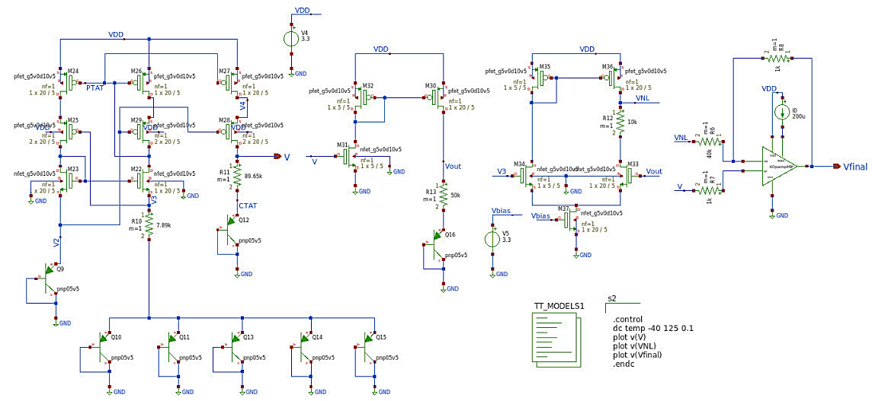
Detailed Design
Complete Schematic:

Slide 5
Outline of Presentation
Detailed Design
Simulations Results

Slide 6
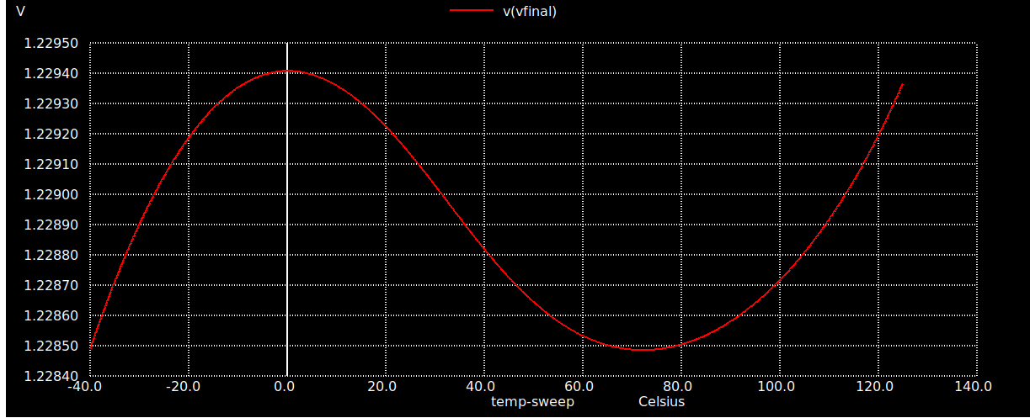
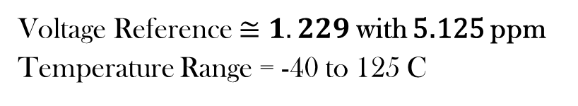
Reference Voltage
Voltage Reference $≅1.229$with 5.125 ppm
Temperature Range = -40 to 125 C

Slide 7
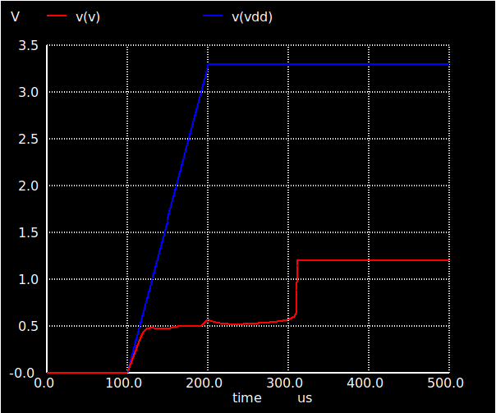
Start-up Simulation
Fig . Start-up Simulation by applying square pulse as a Supply Voltage

Slide 8
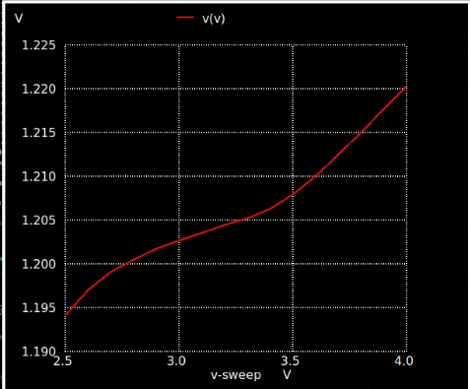

Supply Voltage Variation
Line Regulations $≅26mV$
Fig . BGR behaviour w.r.t supply voltage variation

Slide 9
Thank you

