Slide 1










English Year 5
Starter Unit- FREE TIME

Slide 2






Objectives
By the end of the lesson, most of the pupils will be able to:
Listen and match pictures correctly.
Read and fill the gaps correctly.
Give detailed information based to their partner correctly.
Write detailed information correctly.

Slide 3
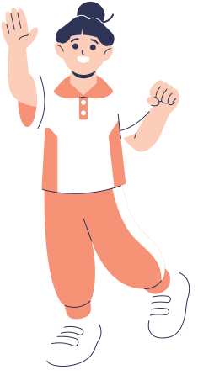

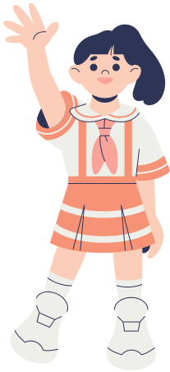

Welcome to Class!
Today's Class is About
Present simple: affirmative and negative, possessive adjectives.
Preposition of Place
Adjectives

Slide 4




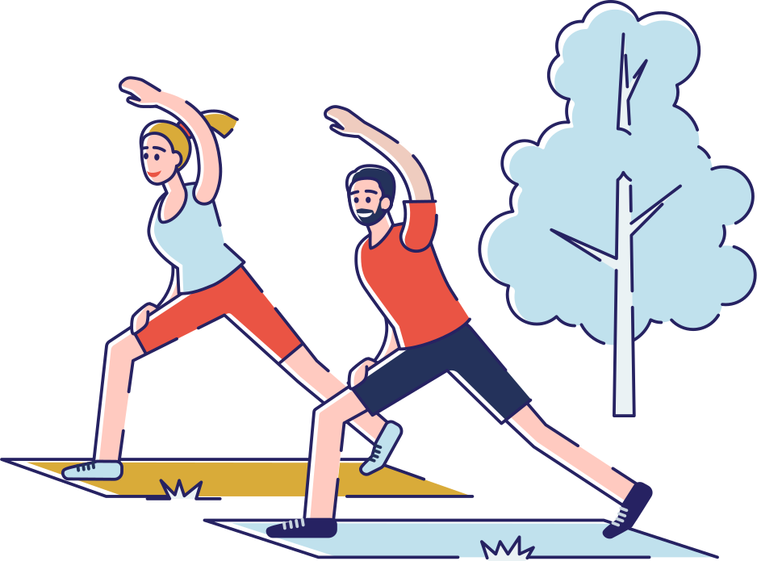
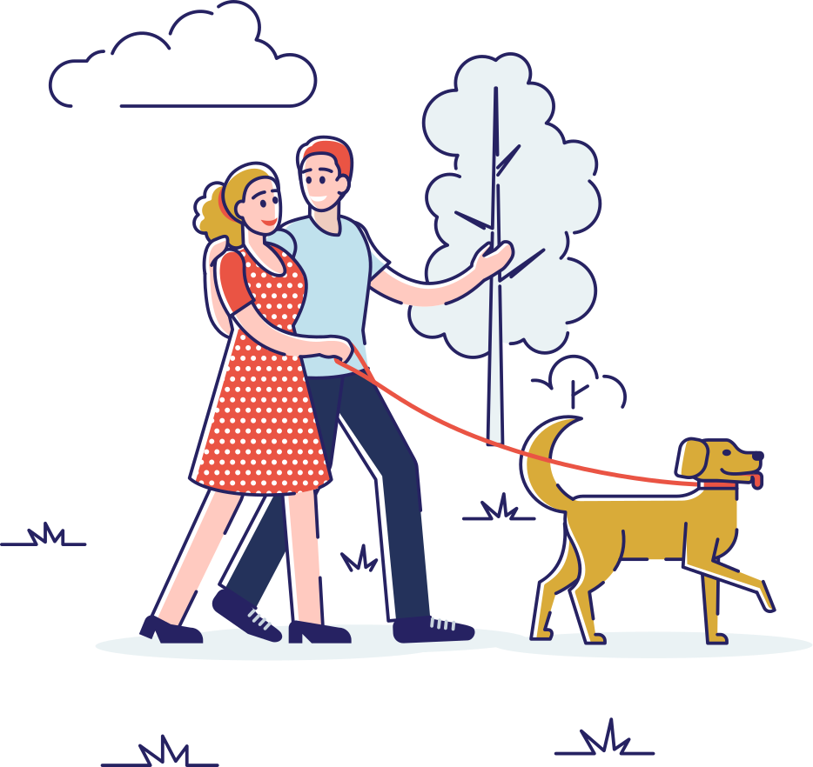



Let's Discuss!
WHAT DO YOU DO DURING YOUR FREE TIME?

Slide 5






Present Simple Tense
Definition: The present simple tense is used to talk about things that are always true, habitual actions, or general facts.
I play football every Saturday.
She always brushes her teeth before bed.
The sun rises in the east.

Slide 6


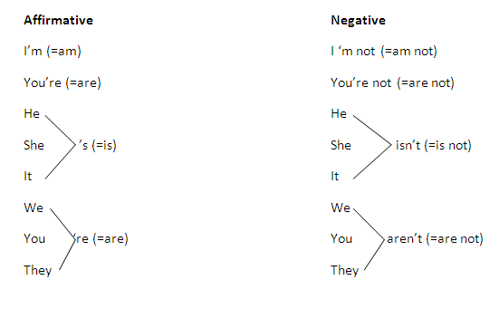



Understanding the Lesson

Slide 7



In present simple negative sentences, we use the auxiliary verb "do not" or "does not" before the base form of the verb.
Subject + Auxiliary Verb + Not + Verb + Object
Look at the
Definitions
In present simple affirmative sentences, we use the base form of the verb.
Subject + Verb + Object

Slide 8






Prepositions of place
Definition: Prepositions are words that show the relationship between a noun or pronoun and other words in a sentence.
Prepositions of place describe the position or location of something.
Examples: in, on, under, above, beside, behind, between, among.

Slide 9










LOOK AT MR.OWL, CAN YOU TELL ME WHERE MR.OWL IS STANDING?

Slide 10



BASIC ADJECTIVES
Adjectives are words that describe or modify nouns or pronouns.They provide more information about the noun or pronoun.
Examples: big, small, happy, sad, tall, short.

Slide 11

Thank you

