Slide 1
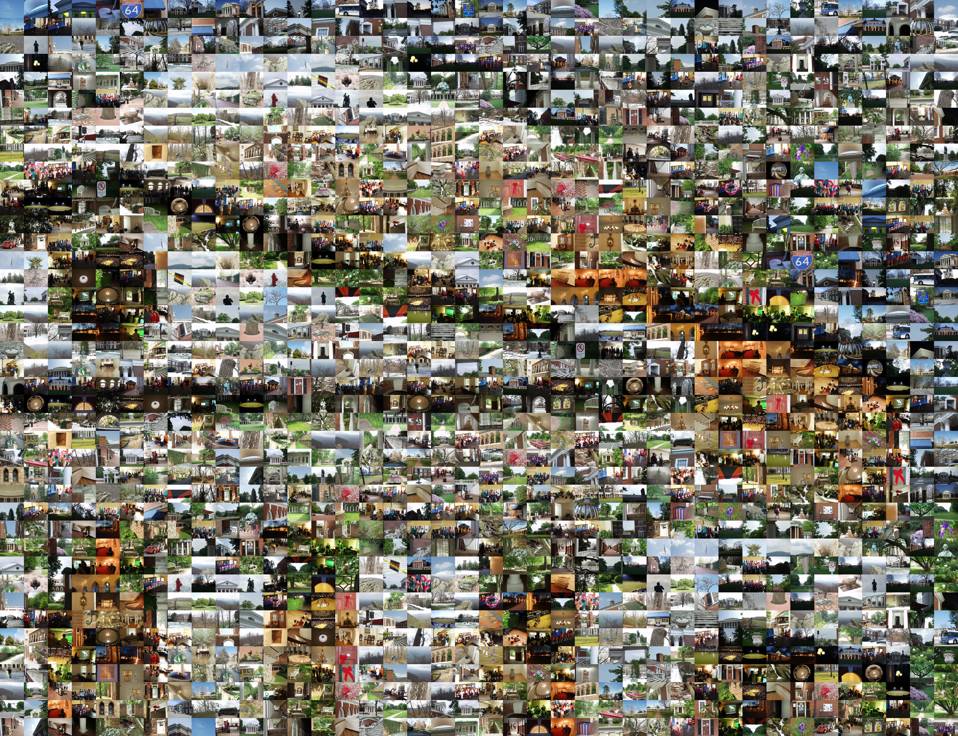
Class 1:
Introduction
CS150 Spring 2007
University of Virginia
Computer Science
David Evans
http://www.cs.virginia.edu/evans

Slide 2
What is
Computer Science?

Slide 3
Let AB and CD be the two given numbers not relatively prime. It is required to find the greatest common measure of AB and CD.
If now CD measures AB, since it also measures itself, then CD is a common measure of CD and AB. And it is manifest that it is also the greatest, for no greater number than CD measures CD.
Euclid’s Elements, Book VII, Proposition 2 (300BC)

Slide 4
The note on the inflected line is only difficult to you, because it is so easy. There is in fact nothing in it, but you think there must be some grand mystery hidden under that word inflected!
Whenever from any point without a given line, you draw a long to any point in the given line, you have inflected a line upon a given line.
Ada Byron (age 19), letter to Annabella Acheson (explaining Euclid), 1834

Slide 5
By the word operation, we mean any process which alters the mutual relation of two or more things, be this relation of what kind it may. This is the most general definition, and would include all subjects in the universe... Supposing, for instance, that the fundamental relations of pitched sounds in the science of harmony and of musical composition were susceptible of such expression and adaptations, the engine might compose elaborate and scientific pieces of music of any degree of complexity or extent.
  Ada Byron, 1843

Slide 6
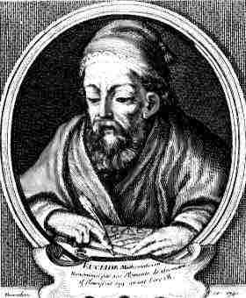
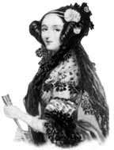
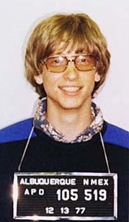
What is the difference between Euclid and Ada?
“It depends on what your definition of ‘is’ is.”
Bill Gates (at Microsoft’s
anti-trust trial)

Slide 7
Geometry vs. Computer Science
Geometry (mathematics) is about declarative knowledge: “what is”
  If now CD measures AB, since it also measures itself, then CD is a common measure of CD and AB
Computer Science is about imperative knowledge: “how to”
Computer Science has little to do with beige (or translucent blue) boxes called “computers” and is not a real science.

Slide 8
Computer Science
“How to” knowledge:
Ways of describing information processes (computations)
Ways of predicting properties of information processes
Language
Logic
What kinds of things do we want to predict?

Slide 9
Science, Engineering, Other?

Slide 10
Science?
Understanding Nature through Observation
  About real things like bowling balls, black holes, antimatter, electrons, comets, etc.
Math and Computer Science are about fake things like numbers, graphs, functions, lists, etc.
  Computer Science is a useful tool for doing real science, but not a real science

Slide 11
Engineering?
“Engineering is design under constraint… Engineering is synthetic - it strives to create what can be, but it is constrained by nature, by cost, by concerns of safety, reliability, environmental impact, manufacturability, maintainability and many other such 'ilities.' ...”
William Wulf

Slide 12
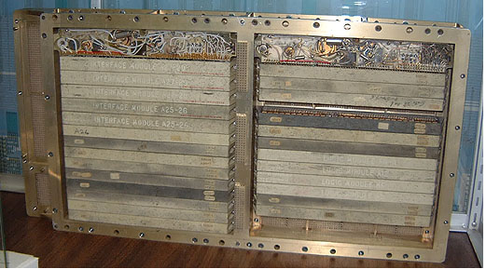
Apollo Guidance Computer, 1969
Why did they need to fit the guidance computer in the rocket?
1 Cubic Foot

Slide 13
Measuring Computers
1 bit = smallest unit of information
  True or False
  0 or 1
  If we start with 2 possible choices, and get 1 bit, we can eliminate one of the choices

Slide 14
How much power?
Apollo Computer: 30720 bits of changeable memory
Lab machines have 1 GB (RAM)
  1 Gigabyte = 1024 Megabytes,
  1 Megabyte = 1024 Kilobytes,
  1 Kilobyte = 1024 Bytes,
  1 Byte = 8 bits
  > (* 1024 1024 1024 8)
  8589934592 ~ 8.6 Billion bits
  > (round (/ (* 1024 1024 1024 8) 30720))
  279620
You will understand this
notation soon…but don’t worry
if you don’t now
You have 105 404 times more power than AGC
If Apollo Guidance Computer power is 1 inch, you have 4.4 miles!

Slide 15
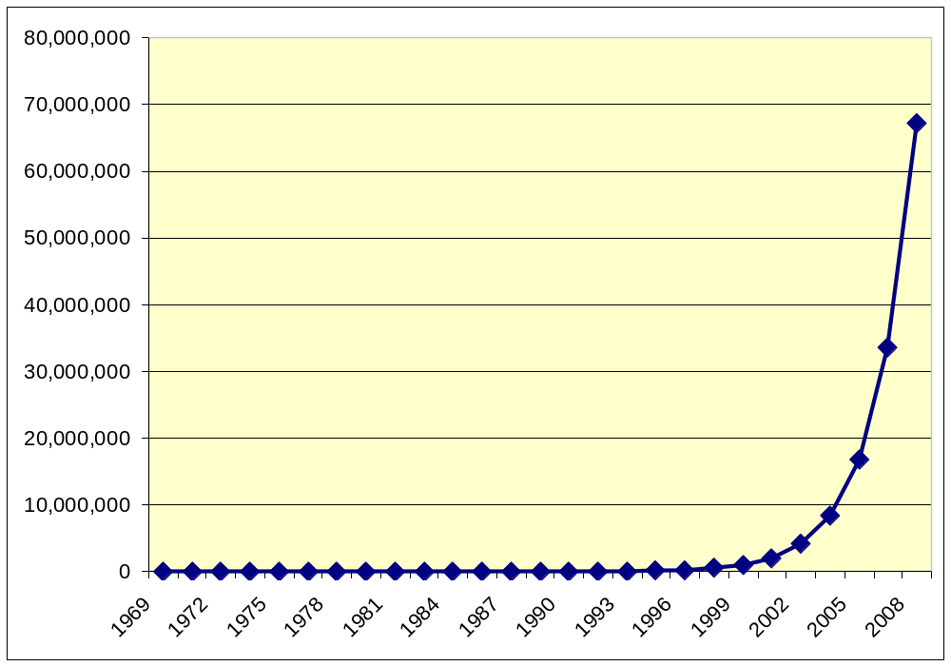
Computing Power 1969-2008
(in Apollo Control Computer Units)
Moore’s “Law”: computing power roughly doubles every 18 months!

Slide 16
Constraints Computer Scientists Face
Not like those for engineers:
  Cost, weight, physics, etc.
  If ~20 Million times what people had in 1969 isn’t enough for you, wait until 2010 and you will have 80 Million times…
More like those for Musicians and Poets:
  Imagination and Creativity
  Complexity of what we can understand

Slide 17
So, what is computer science?
Science
  No: its about fake things like numbers, not about observing and understanding nature
Engineering
  No: we don’t have to deal with engineering-type constraints
Liberal Art

Slide 18
Liberal Arts: ~1100
Illiberal Arts
  arts for the non-free: pursued for economic reasons
Liberal Arts
  arts for the free: pursued for intrinsic reasons

Slide 19
The Liberal Arts
language
numbers
Trivium (3 roads)
Quadrivium (4 roads)
Grammar
study of meaning in written expression
Logic
argument for discovering truth
Arithmetic
Music
number
in time
Rhetoric
comprehension of discourse
Geometry
quantification of space
Astronomy
We will see all of these in this class!

Slide 20
Course Expectations

Slide 21
Course Roadmap
Computer Science from Euclid and Ada
to
Quantum Computing and
the World Wide Web
1st Class
Liberal Arts
(Intellectual)
PS 1-6
Lecture
PS 7-8
Illiberal Arts
($$$$)

Slide 22
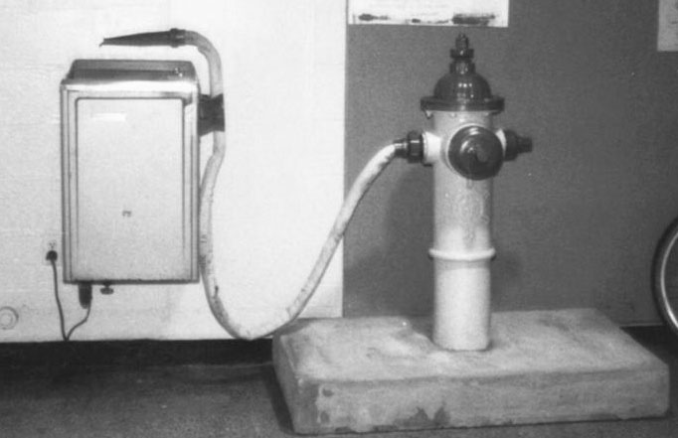
Like Drinking from a Firehose
Don’t be overwhelmed!
You will do fine.
It may hurt a little bit, and a lot of water will go by you, but you won’t go away thirsty!

Slide 23

Books
Computational Thinking
A Whirlwind Introduction
to the Third Millennial Liberal Art from Ada and Euclid
to Quantum Computing
and the World Wide Web
New Book!: written for course
Chapters 2 and 3 out today
Bonuses for helping me improve it:
- Less pretentious title (?)
- More exciting cover
- Notice any mistakes
- Improve the writing or presentation
“GEB”
“Course Book”

Slide 24
Help Available
Me: David Evans (Call me “Dave” or “Coach”)
  Office Hours will be posted (after your surveys)
  Always available by email, if I don’t reply in 24 hours, send again and complain
Assistant Coaches: Richard Hsu and Kinga Dobolyi
  Staffed lab hours in Small Hall
  Upcoming lab hours: Thursday 6-9pm; Friday after class
Web site: http://www.cs.virginia.edu/cs150
  Everything goes on the web, you should visit it often
Your classmates (read the course pledge carefully!)

Slide 25
What I Expect of You
Everything on the Course Pledge
  You should actually read it not just sign it
  (you will lose points on PS1 if your submission reveals that you didn’t read it!)
You are a “Jeffersonian Student”
Believe knowledge is powerful
Interested in lots of things, ahead of your time
Want to use what you learn to do good things
Care more about what you learn than grades and degree requirements

Slide 26
Background Expected
Language:
  Reasonable reading and writing in English
  Understanding of subject, verb and object
Math:
  Numbers, add, subtract, multiply, divide
  Exponentiation, logarithms (we will review)
Logic: and, or, not
Computer Literacy: read email, browse web
If I ever appear to expect anything else, stop me!

Slide 27
A Course for Everyone!
CLAS, SEAS, Commerce, Arch, etc.
1st, 2nd, 3rd, 4th, 5th Years, Community Scholars, Faculty
No background expected…but challenging even for students with lots of previous CS courses
Computer Science (future-) majors…but worthwhile even if you don’t take another CS course

Slide 28
First Main Theme:
Recursive Definitions

Slide 29
What is the longest word in the English language?

Slide 30
According to Guinness
    floccipoccinihilipilification
    the act of rendering useless

Slide 31
Making Longer Words
antifloccipoccinihilipilification
    the act of rendering not useless
antiantifloccipoccinihilipilification the act of rendering useless

Slide 32
Language is Recursive
No matter what word you think is the longest word, I can always make up a longer one!
word ::= anti-word
  If you have a word, you can always make up a new word by adding anti in front. Since the result is a word, you can make a longer new word by adding anti- in front again.

Slide 33
Recursive Definitions
We can define things in terms of themselves
Recursive definitions are different from circular definitions: they eventually end with something real
word ::= anti-word
word ::= floccipoccinihilipilification

Slide 34
Recursive Definitions
Allow us to express infinitely many things starting with a few.
This is powerful!
We will see lots of examples in this course.

Slide 35
Charge
Before 11:59pm Thursday:
  Registration survey (see course web site)
Reading Before Friday:
  Read Course Book Chapters 2 and 3
  GEB p. 3-41
    Anyone who can produce “MU”, gets an automatic A+ in the course
Don’t floccipoccinihilipilificate

Slide 36
Thanks!
2004, 2005 CS150 students, 2003 CS 200 students, 2002 CS200 students, 2001 CS655 students
2002 Assistant Coaches: Jon Erdman, Dante Guanlao, Stephen Liang, Portman Wills
2003 Assistant Coaches: Rachel Dada, Jacques Fournier, Spencer Stockdale, Katie Winstanley
2004 Assistant Coaches: Sarah Bergkuist, Andrew Connors, Patrick Rooney, Katie Winstanley
2005 Assistant Coaches: David Faulkner, Dan Upton
Guest Speakers: Radhika Nagpal (2002), Tim Koogle (2003); Alan Kay (2005)
Spring 2006: Greg Humphreys; Kristen Walcott, Gillian Smith
Teaching Resource Center: Marva Barnett, Freda Fretwell
2001-2 UTF Fellows: Phoebe Crisman, John Lach, Debra Lyon, Emily Scida, Brian Smith, David Waldner; UTF Mentor: Judith Shatin
6.001 teachers: Gerry Sussman, Bob Berwick
CS Department: Jim Cohoon, Ginny Hilton, Tom Horton, Greg Humphreys, Anita Jones, John Knight, Worthy Martin, Chris Milner, Brenda Perkins, Gabe Robins, Mary Lou Soffa, Jack Stankovic
Anna Chefter, Chris Frost, Thad Hughes, Jerry McGann, Shawn O’Hargan, Mike Peck

