Slide 1
Machine Learning statistical model using Transportation data

Slide 2
Introduction
As the world is growing rapidly the people and the vehicles we use to move from one palce to another, so the transportation is playing a vital role in making human lives easiest to travel from one place to another, everyday more and more vehicles are being produced and being bought by the people around the world, be it Electric, Hydrogen, petrol, diesel or solar powered. So, most importantly Road Transportation such as, Road transport can be classified as either transporting goods and materials or transporting people. The main advantage of road transportation is that it allows for door-to-door delivery of goods and materials while also being a very cost-effective mode of cartage, loading, and unloading. Road transport is sometimes the only option for transporting goods and people to and from rural areas that are not served by rail, water, or air transport. Road transportation has numerous advantages over other modes of transportation. Road transport requires significantly less investment than other modes of transportation such as railways and air transport. Roads are less expensive to build, operate, and maintain than railways.

Slide 3
Dataset Description
The dataset is collected from the Kaggle data repository,(US Accidents (2016 - 2021)
Dataset is in Comma Separated Value format, It consists of 2845342 entries, Ranging from 0 to 2845341, which has 47 columns.
Since the dataset is very huge and contains many columns, we are going to discuss about important columns over here.
Severity – Type(int), this columns explains about the severity of the accident, and importantly this is our target class for making prediction further in the project.
Start_time & End_time – Type(object), This shows the start and end time of the accident took palce at certain place, similarly, we have latitude and longitude coordinates of the accident place, since the dataset is about accidents taken place in US.
Distance – Length of the road extent affected by the accident occurred.
Description – Explains about the description of the accidents given by the fellow drivers who were driving along side with the accident victims.
City, State, County – Explains about the place where the accident took place, in which specific city, state and county.
Along with these, we also have other columns such as weather, temperature, traffic signal, sunrise_sunset, railway_line etc.

Slide 4
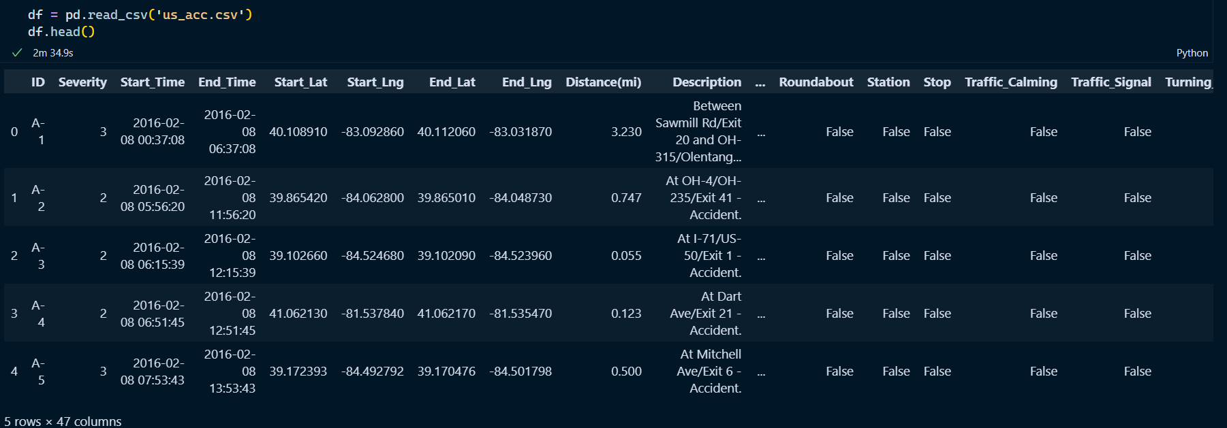
Dataset Overview.

Slide 5
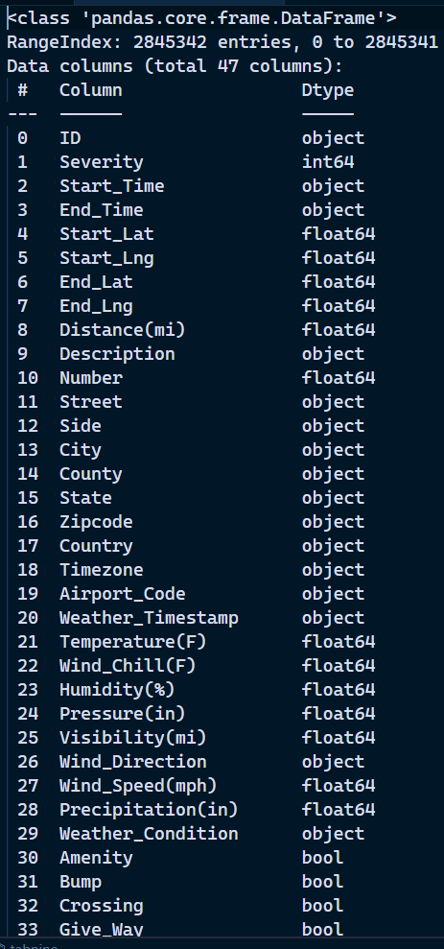
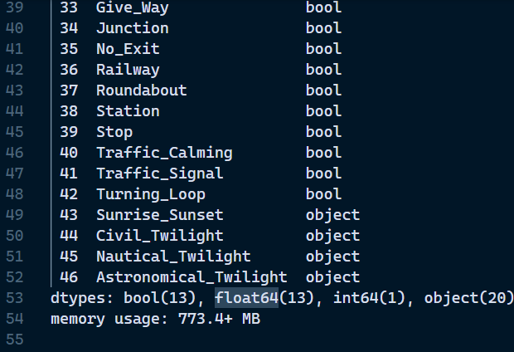
Dataset info

Slide 6
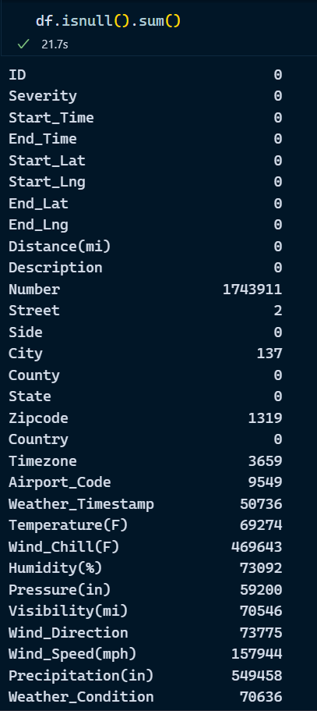
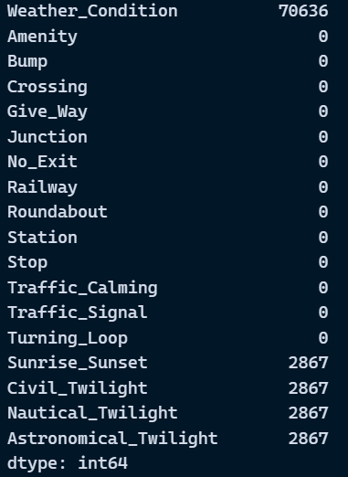
Missing Values

Slide 7
Descriptive Analysis
Here we are going to dive deep into the dataset and know some more information about it.
Below functions helps us to understand the insights of the data and also helps us to extract information which might help us to fill the null values.
df.info() -> information about the dataset, such as type of each column and the numebr of entries present in the dataset.
df.describe() -> helps us to understand the descriptive data of each column, note: the description for numerical and categorical will be different, by default we get the numerical column description.
df.isnull().sum() -> Count of Missing Values for each column.
df.head() -> Displays first 5 rows of the dataset, similarly df.tail displays last 5.

Slide 8
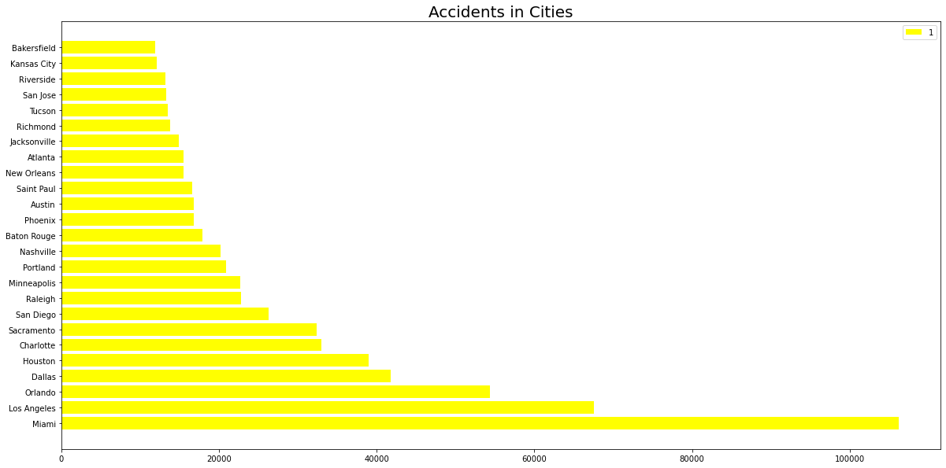
Top Cities with Highest Number of Accidents

Slide 9
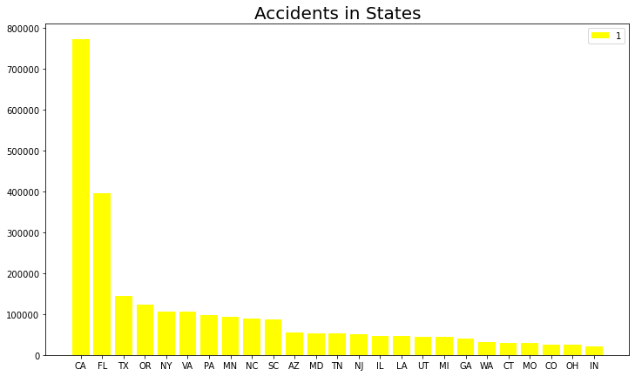
Top States with Highest Number of Accidents

Slide 10
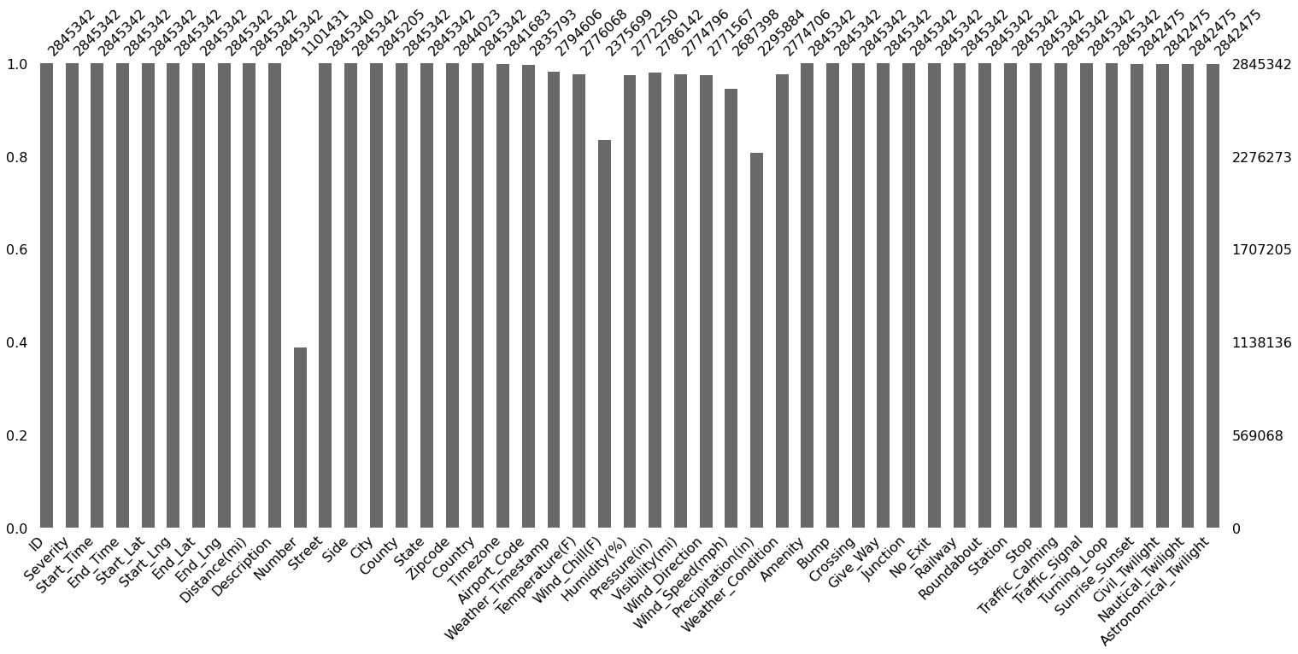
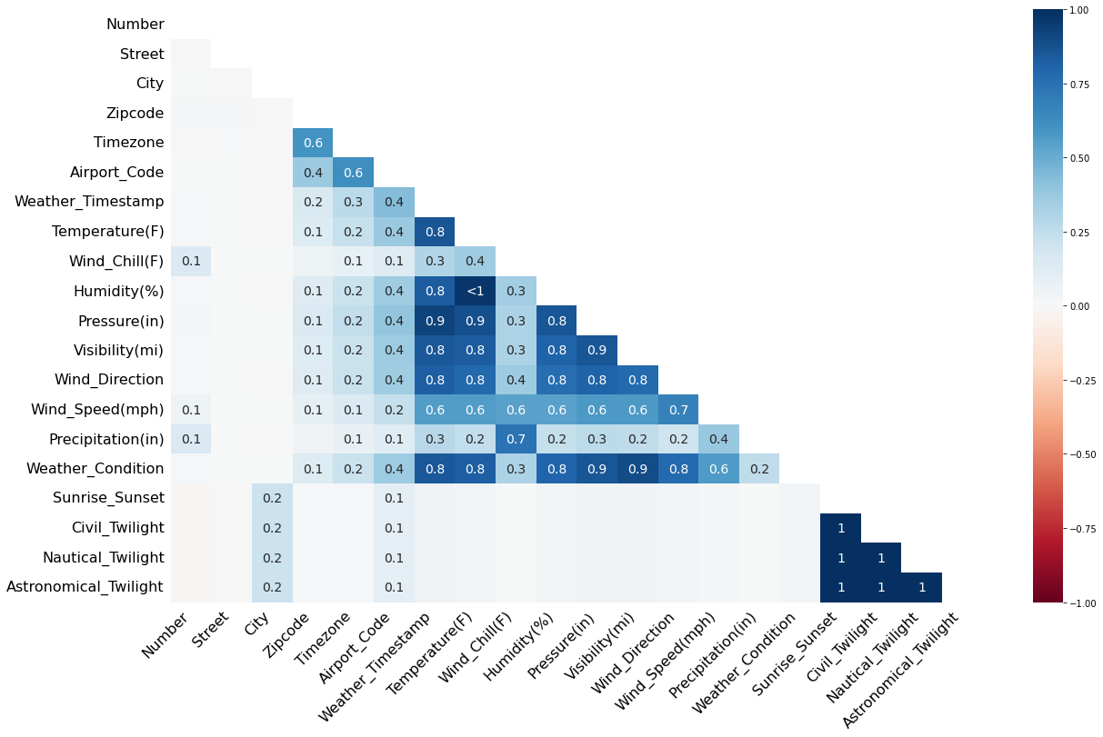
Missing Values Plots
Notes:
The above visualizations explains about the missing values present in our dataset, the first chart is a bar plot and second chart is a Heatmap where how 2 variables correspond to each other and how many missing values they have in common.

Slide 11
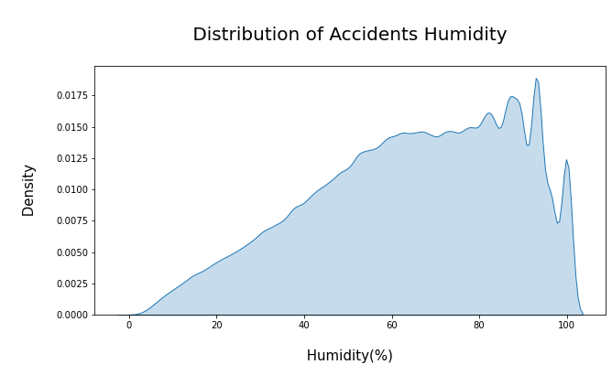
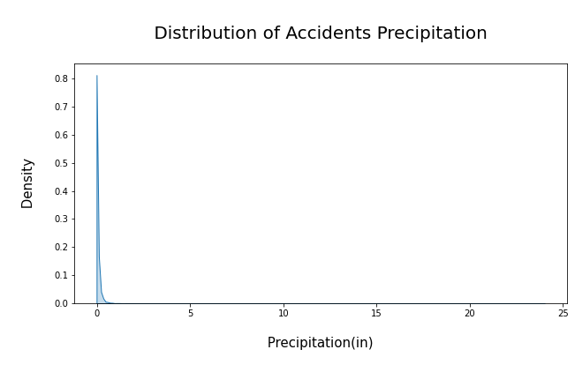
Notes:
How Humidity and Precipitation involved in accidents, this visualizations also helps us to fill in missing values in our data.

Slide 12
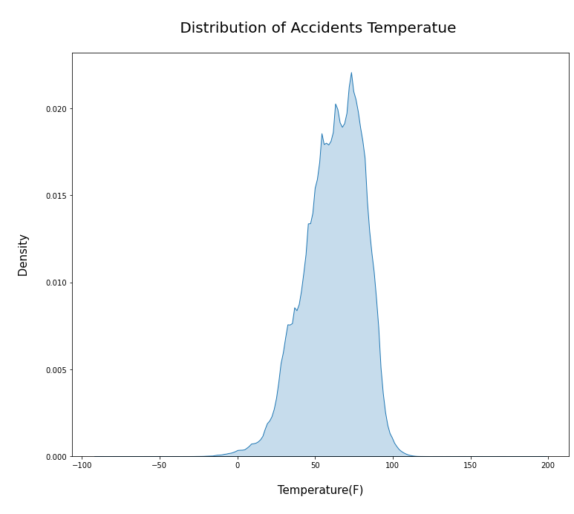
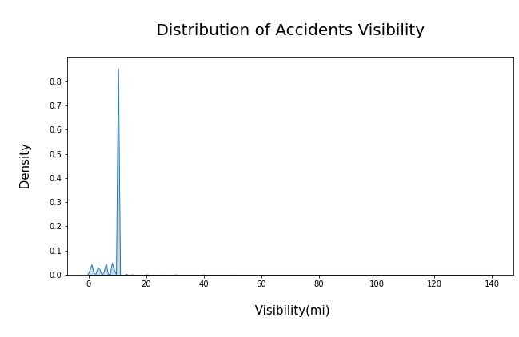

Slide 13
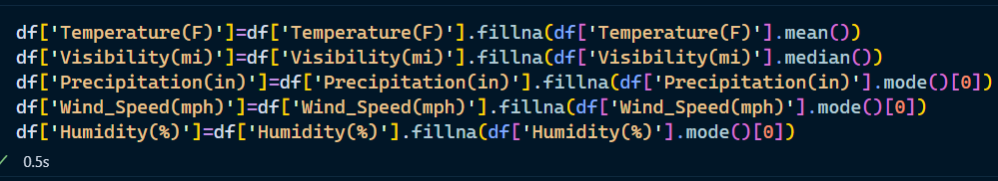
Since temperature has less than 10% null values of the total number of values and they appear to be normally distributed. It might be a good idea to fill these empty data with the mean value. Whereas for Visibility(mi), it's right skewed. So replacing null values with a median value is more suitable.
Since Precipitation(in), Wind_Speed(mph) have an right skewed distribution. It's better to use mode value to fill the Null value in these two columns. Humidity(%) though has a left skewed distribution. I still used the mode value to fill out the Null. It may not be accurate to fill out the Null value based on the previous or latter adjacent value, as every two accidents were hardly related.
Also, Most of the columns were Irrelevant and consisted of more than 60% of missing values, so I decided to drop those features.

Slide 14
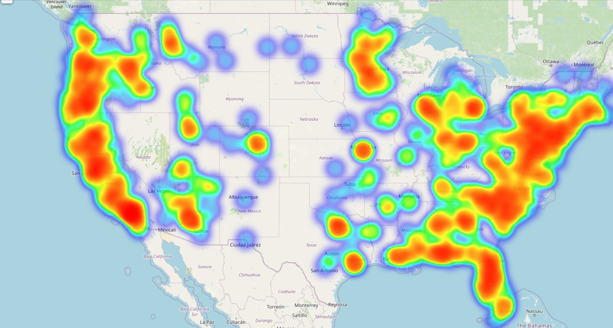
Geographical heatmap of accidents in each state

Slide 15
Predictive Analysis
Predictive analytics uses mathematical modeling tools to generate predictions about an unknown fact, characteristic, or event. “It’s about taking the data that you know exists and building a mathematical model from that data to help you make predictions about somebody not yet in that data set,” Goulding explains.
An analyst’s role in predictive analysis is to assemble and organize the data, identify which type of mathematical model applies to the case at hand, and then draw the necessary conclusions from the results. They are often also tasked with communicating those conclusions to stakeholders effectively and engagingly.
“The tools we’re using for predictive analytics now have improved and become much more sophisticated,” Goulding says, explaining that these advanced models have allowed us to “handle massive amounts of data in ways we couldn’t before.”
Example: Linear Regression, Logistic Regression, Decision Trees, Random Forest, Support Vector Machines etc.

Slide 16
Cluster Analysis
Clustering is the process of dividing a population or set of data points into groups so that data points in the same group are more similar to other data points in the same group and dissimilar to data points in other groups. It is essentially a collection of objects based on their similarity and dissimilarity.
Cluster analysis itself is not one specific algorithm but the general task to be solved. It can be achieved by various algorithms that differ significantly in their understanding of what constitutes a cluster and how to efficiently find them. Popular notions of clusters include groups with small distances between cluster members, dense areas of the data space, intervals or particular Statistical distributions.
Clustering can therefore be formulated as a multi-objective optimization problem. The appropriate clustering algorithm and parameter settings (including parameters such as the distance function to use, a density threshold or the number of expected clusters) depend on the individual data set and intended use of the results.

Slide 17
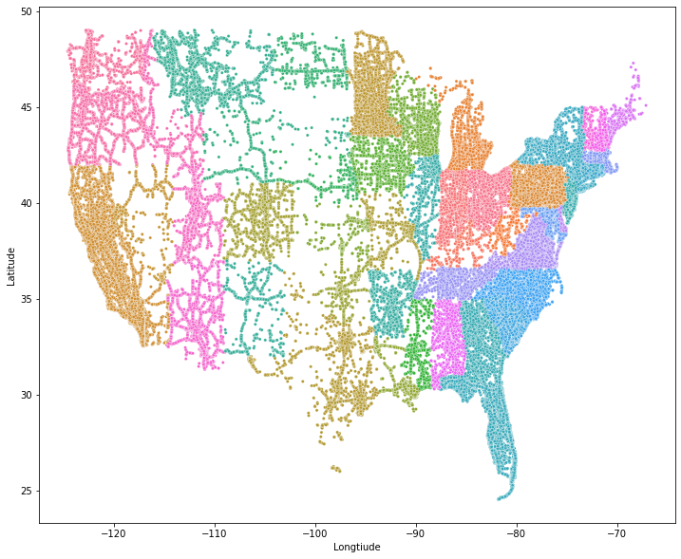
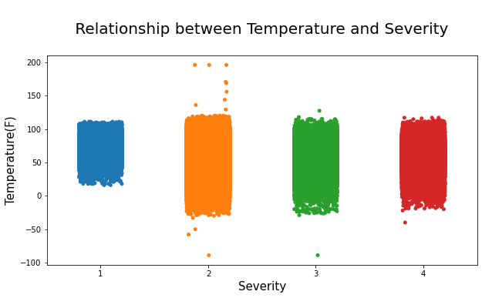

Slide 18
Random Forest
Random Forest is a supervised machine learning algorithm. This Technique can be used for both regression and classification tasks but generally performs better in classification tasks. As the name suggests, Random Forest technique considers multiple decision trees before giving an output. So, it is basically an ensemble of decision trees.
This technique is based on the belief that a greater number of trees would converge to the right decision. For classification, it uses a voting system and then decides the class whereas in regression it takes the mean of all the outputs of each of the decision trees.
It works well with large datasets with high dimensionality. The random forest algorithm is an extension of the bagging method as it utilizes both bagging and feature randomness to create an uncorrelated forest of decision trees. Feature randomness, also known as feature bagging or “the random subspace method generates a random subset of features, which ensures low correlation among decision trees.

Slide 19
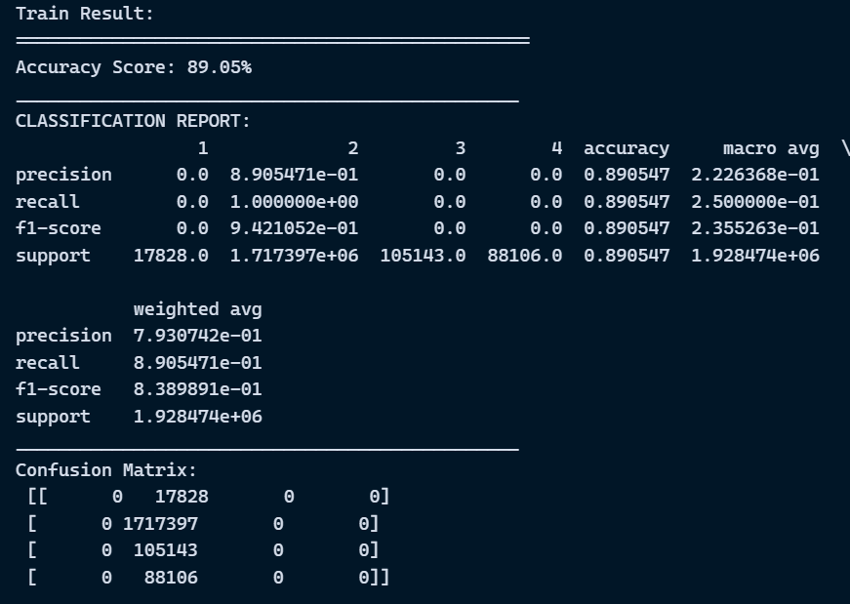
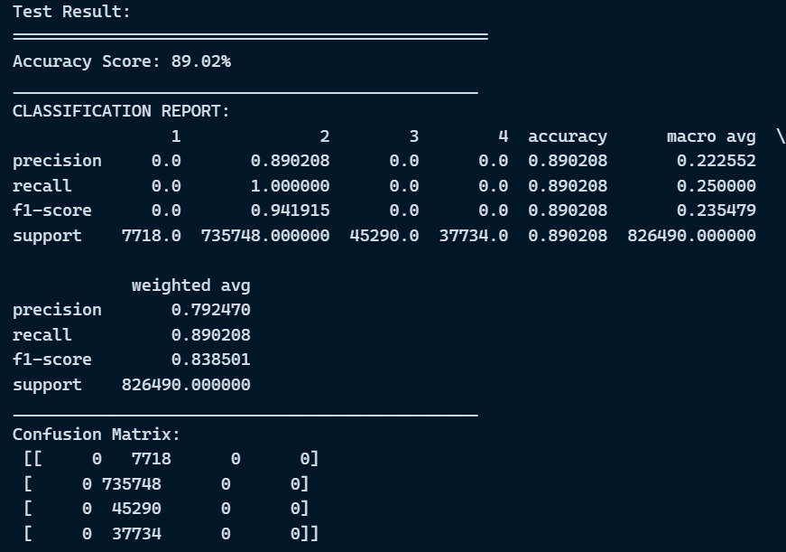
Random Forest Results

Slide 20
KNearest Neighbors
The k-nearest neighbor algorithm, also known as KNN or k-NN, is a non-parametric, supervised learning classifier that uses proximity to classify or predict the grouping of an individual data point. It can be used for both regression and classification problems, but it is most commonly used as a classification algorithm, based on the assumption that similar points can be found close together.
A majority vote is used to assign a class label to a classification problem that is, the label that is most frequently represented around a given data point is used. While technically this is referred to as "plurality voting," the term "majority vote" is more commonly used in literature.
The difference between these terms is that "majority voting" technically requires a majority of more than 50%, which only works when there are only two options. When there are multiple classes say, four categories you don't always need 50% of the vote to make a decision about a class; you could assign a class label with a vote of more than 25%.

Slide 21
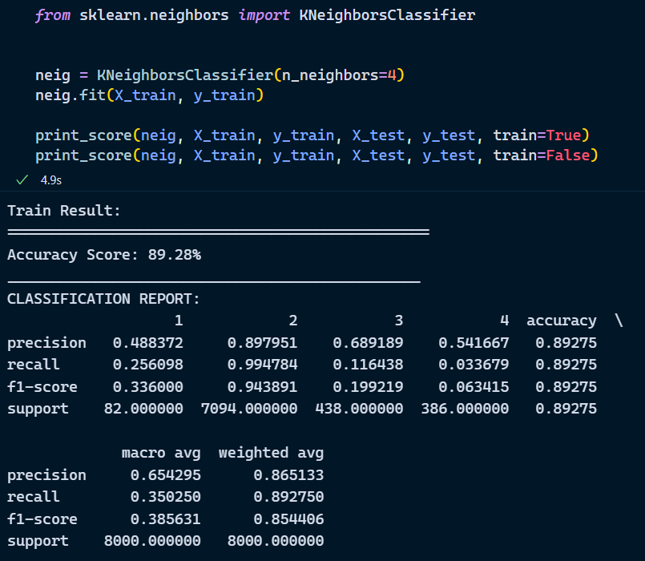
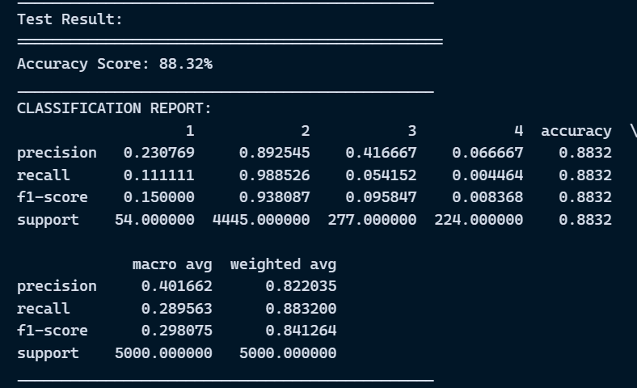
KNeighbors Classifier

Slide 22
Variable Selection Method
Feature or Variable selection methods are used to select specific features from our dataset, which are useful and important for our model to learn and predict. As a result, feature selection is an important step in the development of a machine learning model. Its goal is to identify the best set of features for developing a machine learning model.
Some popular techniques of feature selection in machine learning are:
Filter methods
Wrapper methods
Embedded methods
Filter Methods
These methods are generally used while doing the pre-processing step. These methods select features from the dataset irrespective of the use of any machine learning algorithm.
Techniques such as : Information gain, Chi-Square, Variance_Threshold, Mean_Absolute_Difference etc.
Wrapper methods:
Wrapper methods, also referred to as greedy algorithms train the algorithm by using a subset of features in an iterative manner. Based on the conclusions made from training in prior to the model, addition and removal of features takes place.
Techniques such as: Forward selection, Backward Elimination, Bi-Directional Elimination etc.
Embedded methods:
In embedded methods, the feature selection algorithm is blended as part of the learning algorithm, thus having its own built-in feature selection methods. Embedded methods encounter the drawbacks of filter and wrapper methods and merge their advantages.
Techniques such as: Regularization, tree based methods

Slide 23
Variable selection using SequentialFeatureSelection
Sequential feature selection algorithms are a type of greedy search algorithm that is used to reduce a d-dimensional feature space to a k-dimensional feature subspace, where k d. Feature selection algorithms are designed to automatically select a subset of features that are most relevant to the problem.
A wrapper approach, such as sequential feature selection, is especially useful when embedded feature selection, such as a regularization penalty like LASSO, is not applicable.
SFAs, in a nutshell, remove or add features one at a time based on classifier performance until a feature subset of the desired size k is reached.
There are basically 4 types of SFA’s such as:
Sequential Forward Selection (SFS)
Sequential Backward Selection (SBS)
Sequential Forward Floating Selection (SFFS)
Sequential Backward Floating Selection (SBFS)
The one we have employed in our project is the Sequential forward selection

Slide 24
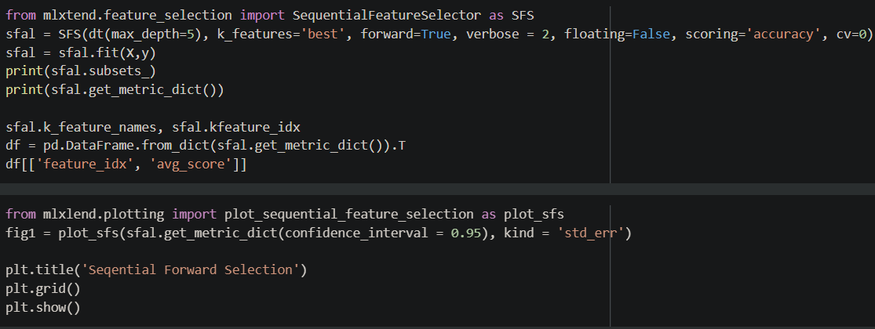
Mlxlend Feature selection library for selecting the best features for the model.

Slide 25
Testing the Model on Variables selected by algorithm. Decision Tree
A decision tree is a decision support tool that uses a tree-like model of decisions and their possible consequences, including chance event outcomes, resource costs, and utility. It is one way to display an algorithm that only contains conditional control statements. Decision trees are commonly used in operations research, specifically in decision analysis, to help identify a strategy most likely to reach a goal but are also a popular tool in machine learning. A decision tree is a flowchart-like structure in which each internal node represents a "test" on an attribute (e.g. whether a coin flip comes up heads or tails), each branch represent the outcome of the test, and each leaf node represents a class label (decision taken after computing all attributes). The paths from root to leaf represent classification rules. In decision analysis, a decision tree and the closely related influence diagram are used as a visual and analytical decision support tool, where the expected values (or expected utility) of competing alternatives are calculated.
A decision tree consists of three types of nodes
Decision nodes – typically represented by squares
Chance nodes – typically represented by circles
End nodes – typically represented by triangles

Slide 26
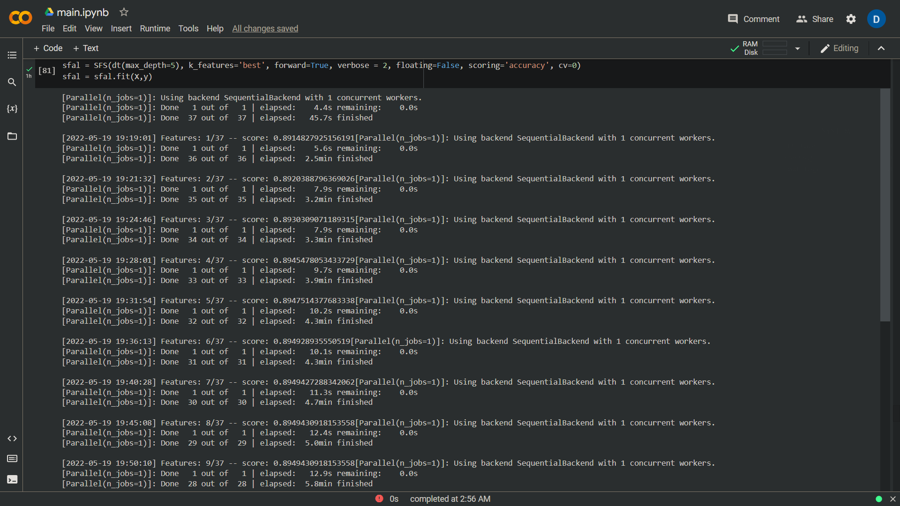
Using Decision Tree as a classifier, we have fitted a sequential feature selector model to extract the important features from the dataset.

Slide 27
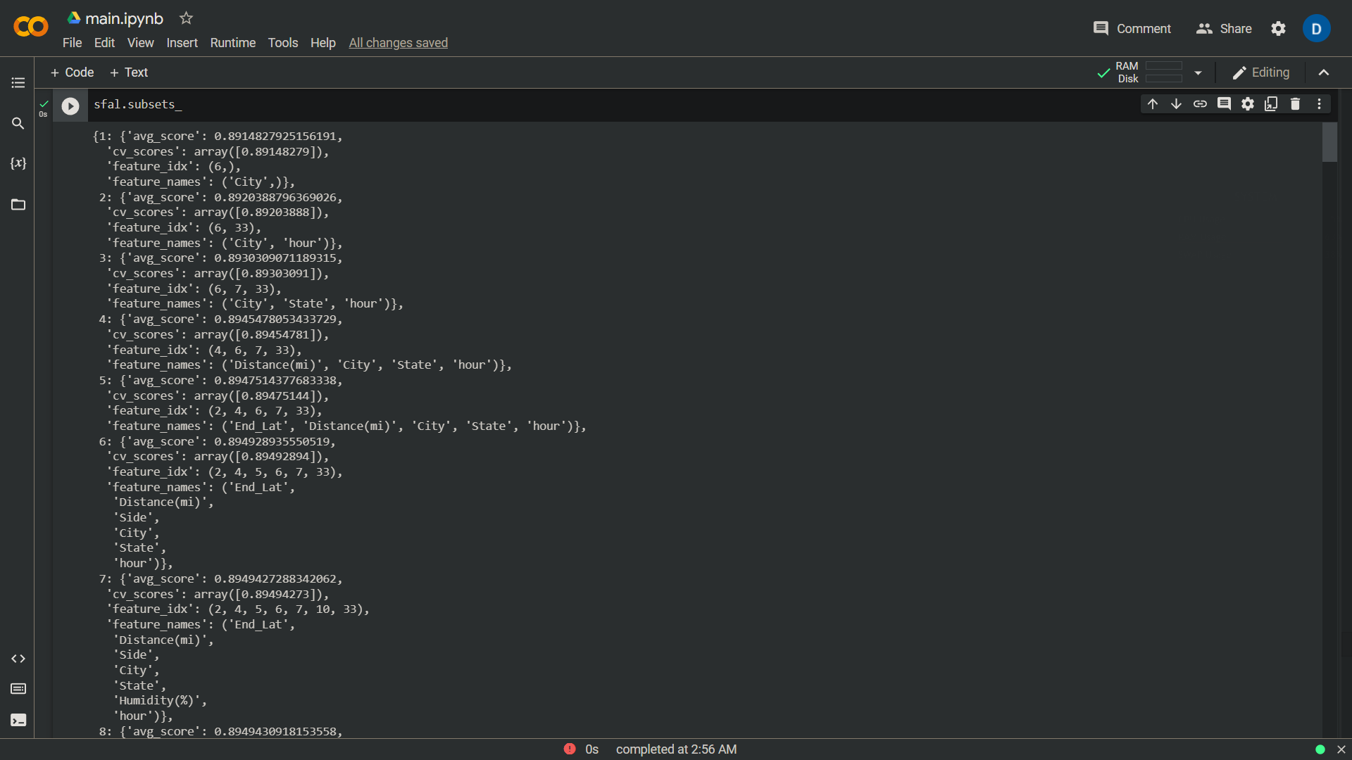
Sfal. Subsets_ -> Explains about the average accuracy we got by training the model for number of features in each step.

Slide 28
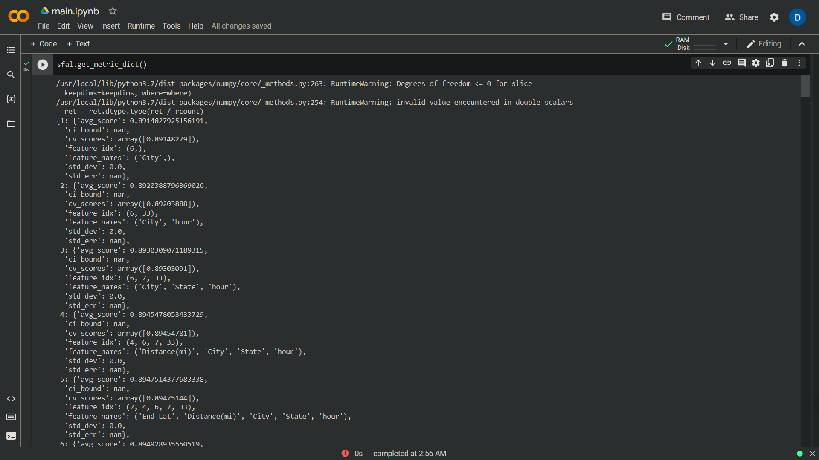

Slide 29
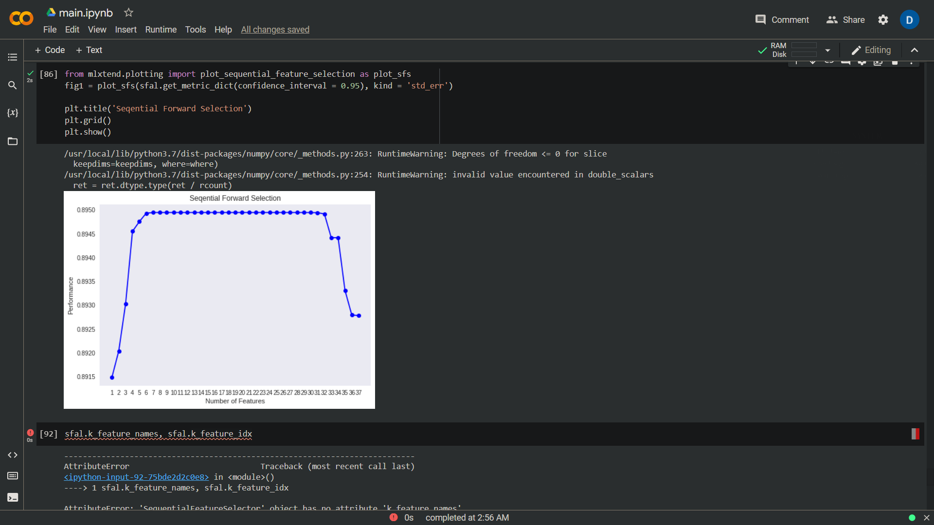
Plot about the important features extracted from Sequential Feature Selector, X axis represents numebr of features and Y axis represents prediction accuracy we got by selecting those specific features.

Slide 30
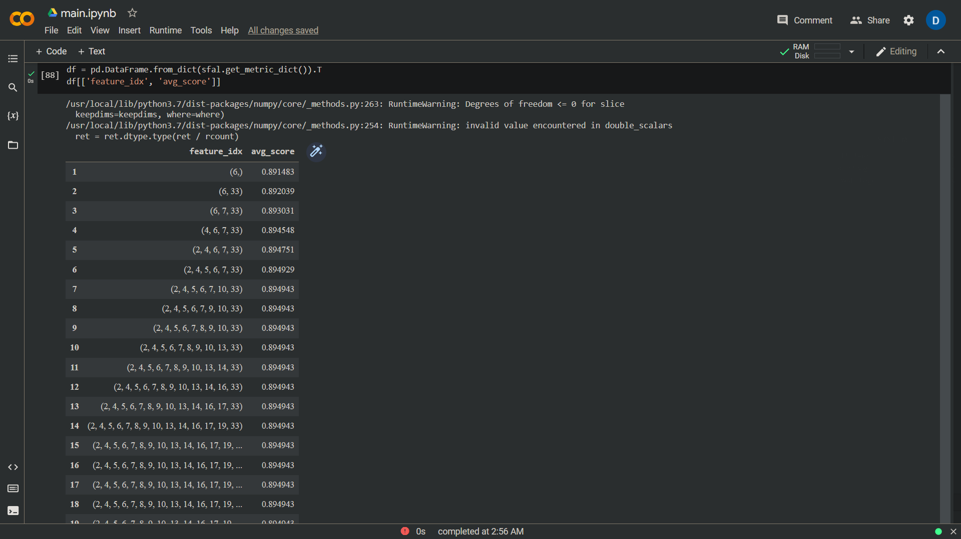
Results are converted into a dataframe where 1st column represents the number of features and 2nd column represents the accuracy we got from selecting those features.

Slide 31
Conclusion
In this project, we have done a lot of preprocessing and exploratory data analysis, since the main objective was to get insights from the road transportation data and do statistical analysis.
Data preprocessing has been performed by filling in the null vlaues and dropping of irrelevant columns based on how important they are for building an efficient model keeping computational cost in mind.
Predictive models such as Decision tree, Random Forest and KNearest Neighbors Classification algorithms has been applied to predict the target variable i.e Severity of the accident using the other independent features.
Variable selection methods such as SequentialFeatureSelector has been applied to the cleaned data to extract the most important features, and those features are trained and tested on the Decision tree model.

