Slide 1

Traffic Monitoring System using Python-OpenCV and YOLOv8
RAJIV GANDHI UNIVERSITY OF KNOWLEDGE TECHNOLOGIES, BASAR
DEPARTMENT OF COMPUTER SCIENCE ENGINEERING
PROJECT GUIDE:
External evaluator:
Mr. Garnepudi Ranjith Sir
Assistant Professor
CSE.Dept
Mr.Dheeraj Agshare Sir
Assistant Professor
ECE.Dept

Slide 2
Introduction
The existing traffic monitoring systems typically use radar, lidar, or cameras to detect vehicles. These systems are expensive to install and maintain, and they can only detect vehicles in a limited area.
The proposed system is a more cost-effective and efficient way to monitor traffic. It uses Python-OpenCV and YOLOv8 to detect, count and track vehicles in the video footage. The system can also detect vehicle speed and detects if a vehicle is violating the speed limit.

Slide 3
Goal of the Project
Main objective and goal of this project is to create a Traffic Monitoring System using Python-OpenCV and YOLOv8, which will be able to:
Detect, track, and count vehicles.
Detect vehicle speed.
Detect vehicle speed limit violations.

Slide 4
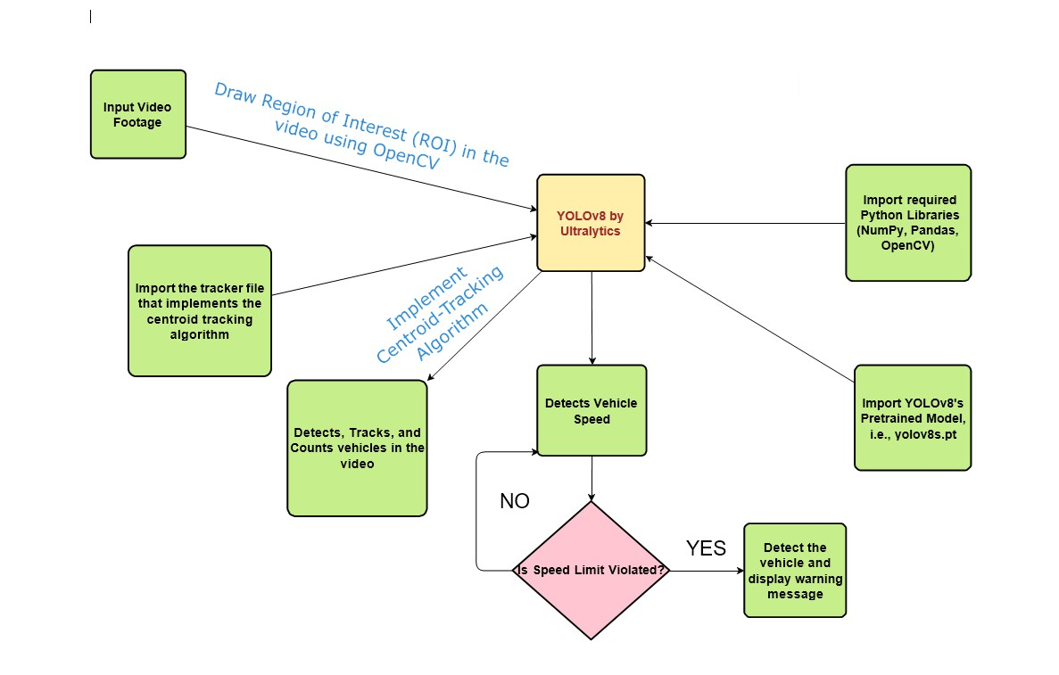
Design & Diagram (Flow Chart)

Slide 5
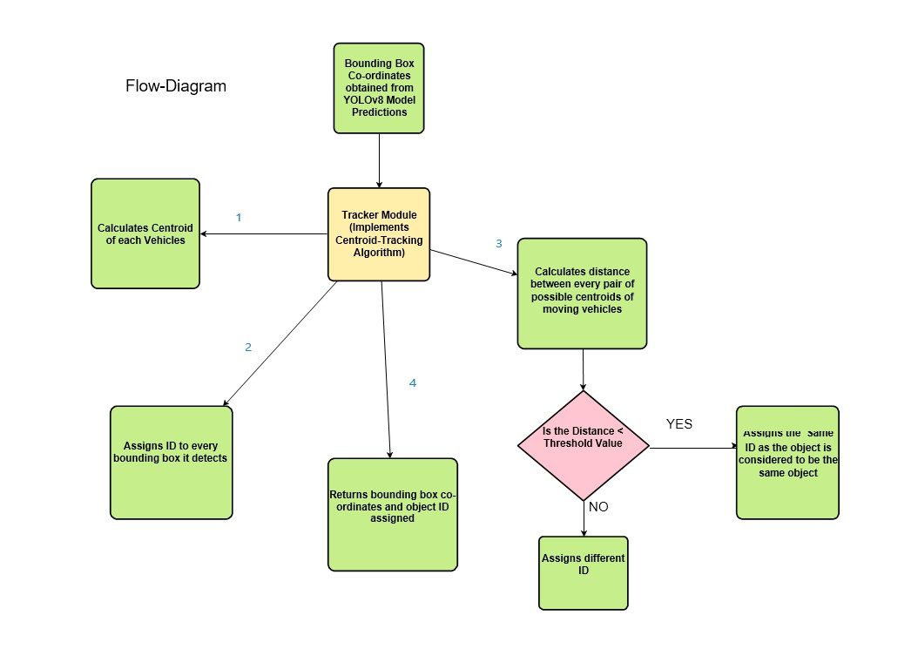
Design & Diagram (Flow Chart) (Contd.)

Slide 6
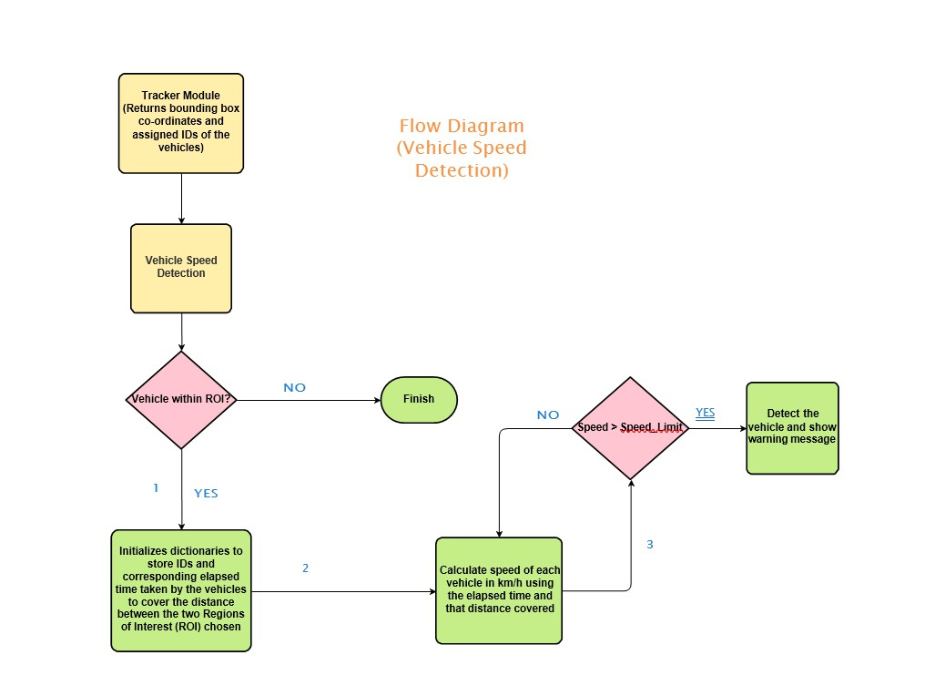
Design & Diagram (Flow Chart) (Contd.)

Slide 7
Convolutional Neural Networks (CNN)
A Convolutional Neural Network (CNN) is a type of Deep Learning model specially designed to analyze visual data like images or videos.
How it works (in simple words):It scans an image in small parts (like a sliding window).It detects features like edges, shapes, patterns.But it doesn’t automatically tell you where in the image an object is or what label it has.
It layers this information to understand complex things, like faces, vehicles, etc.

Slide 8
Introduction to YOLOv8
Technically speaking, YOLOv8 is a group of convolutional neural network models, created and trained using the PyTorch framework. YOLOv8 is the latest version of YOLO by Ultralytics. As a cutting-edge, state-of-the-art (SOTA) model, YOLOv8 builds on the success of previous versions, introducing new features and improvements for enhanced performance, flexibility, and efficiency. YOLOv8 supports a full range of vision AI tasks, including detection, segmentation, pose estimation, tracking, and classification. This versatility allows users to leverage YOLOv8's capabilities across diverse applications and domains.
YOLOv8 is the latest family of YOLO based Object Detection models from Ultralytics providing state-of-the-art performance. Leveraging the previous YOLO versions, the YOLOv8 model is faster and more accurate while providing a unified framework for training models for performing Object Detection, Instance Segmentation, and Image Classification.

Slide 9
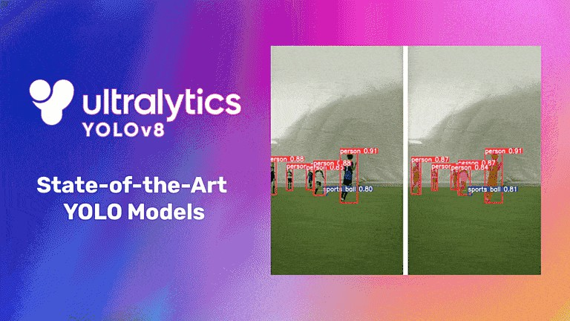

Slide 10
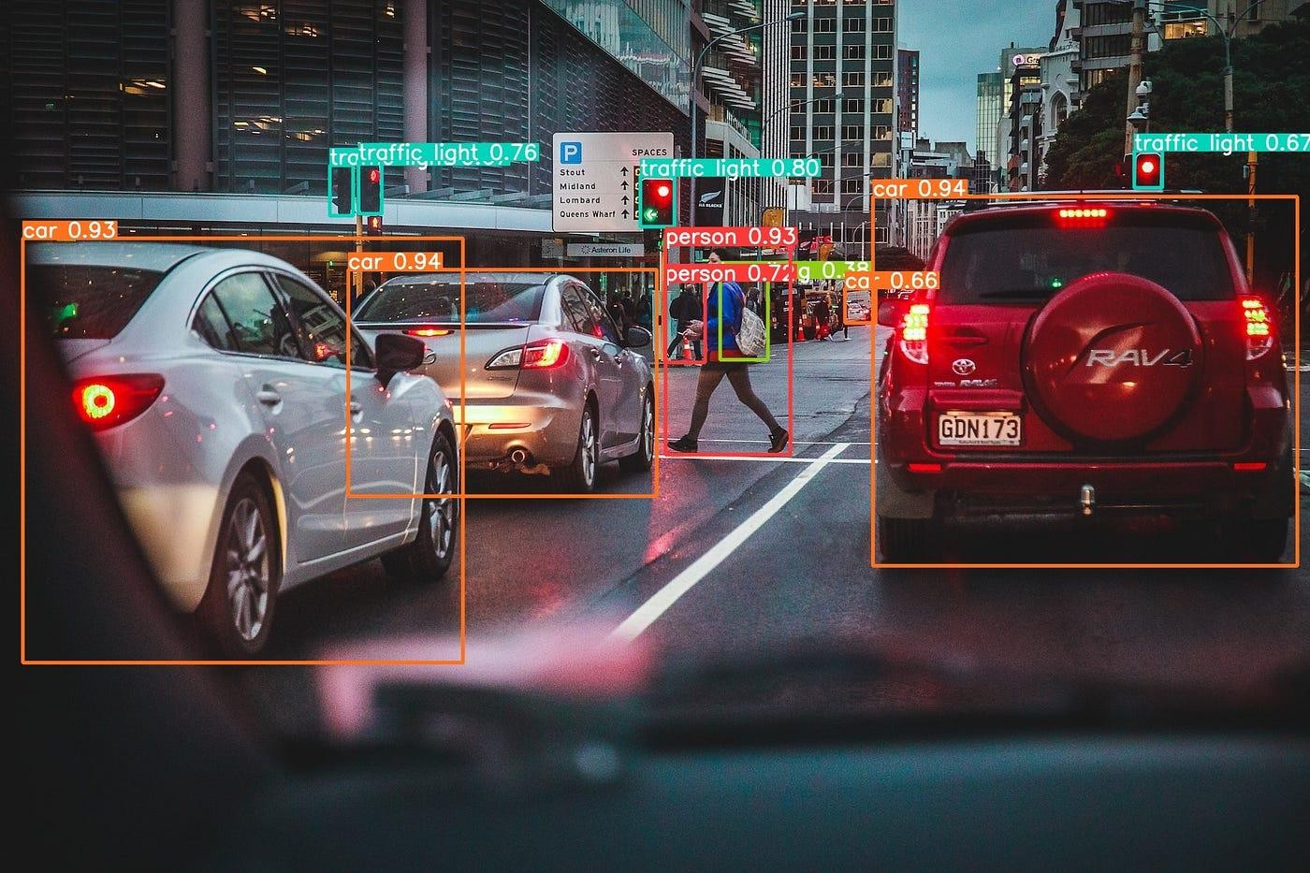
YOLOv8 comes bundled with the following pre-trained models:
Object Detection checkpoints trained on the COCO detection dataset with an image resolution of 640.
The pretrained YOLOv8 model (e.g., yolov8s.pt) can be downloaded from the YOLO website. All YOLOv8 models for object detection are already pre-trained on the COCO dataset, which is a huge collection of images of 80 different types. The custom dataset, if required, can also be created by collecting a set of images that contain vehicles. The images should be labelled with the bounding boxes of the vehicles.
YOLOv8 Object Detection from Traffic Video Footage

Slide 11
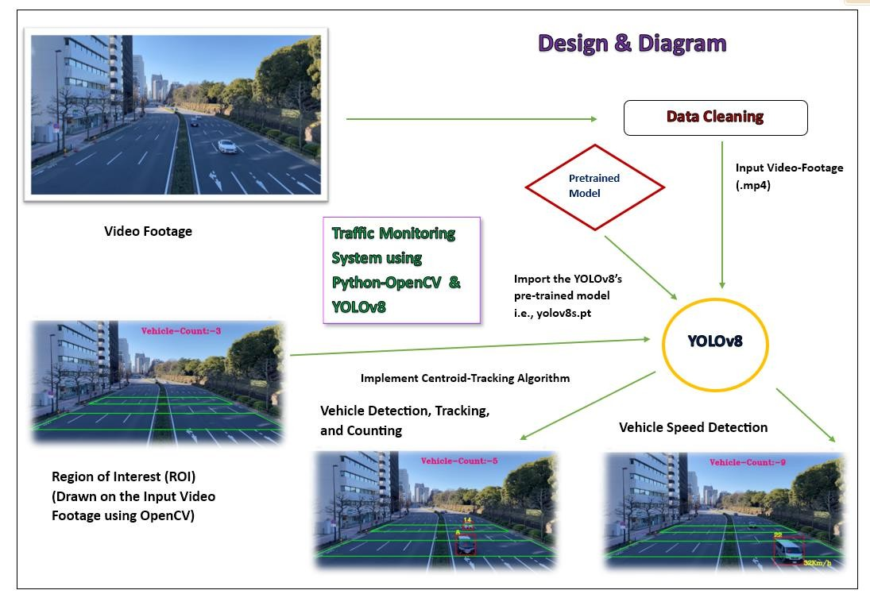
Design & Diagram

Slide 12
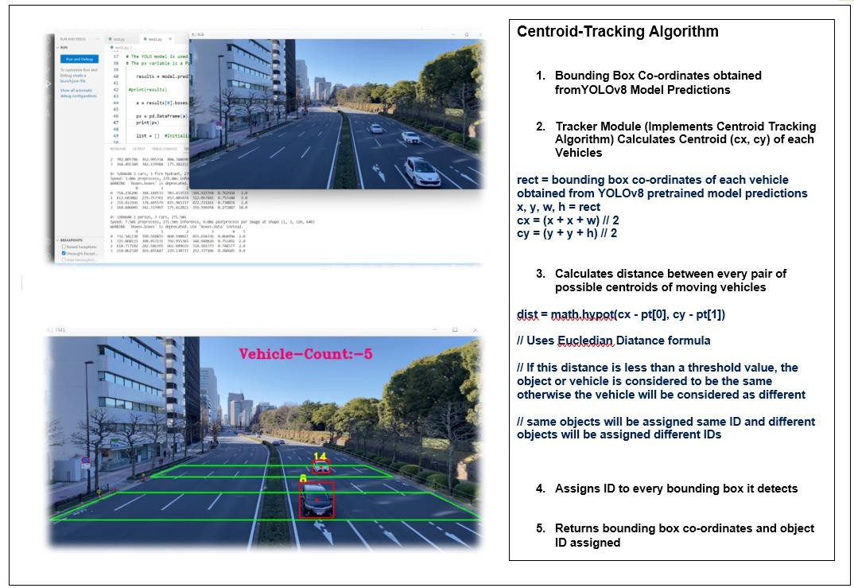
Design & Diagram (Contd.)

Slide 13
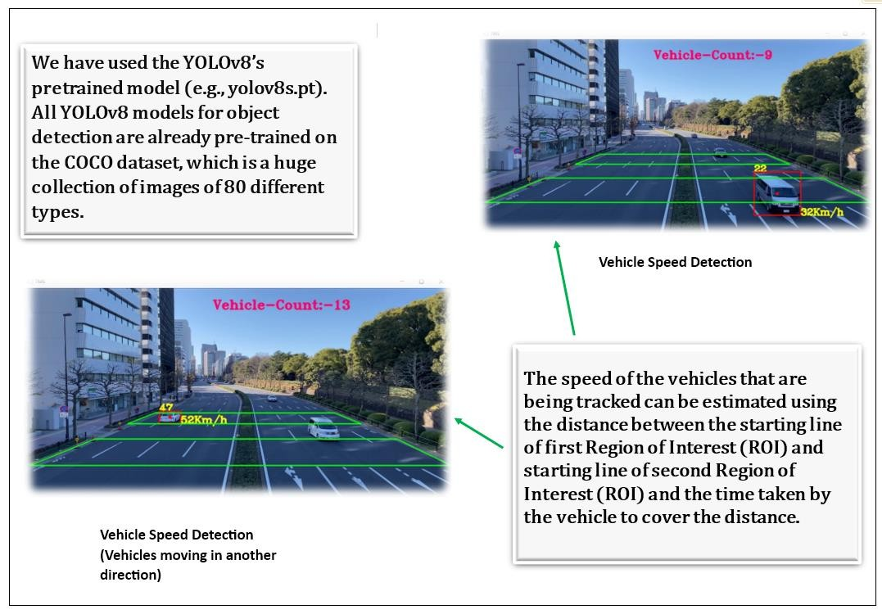
Design & Diagram (Contd.)

Slide 14
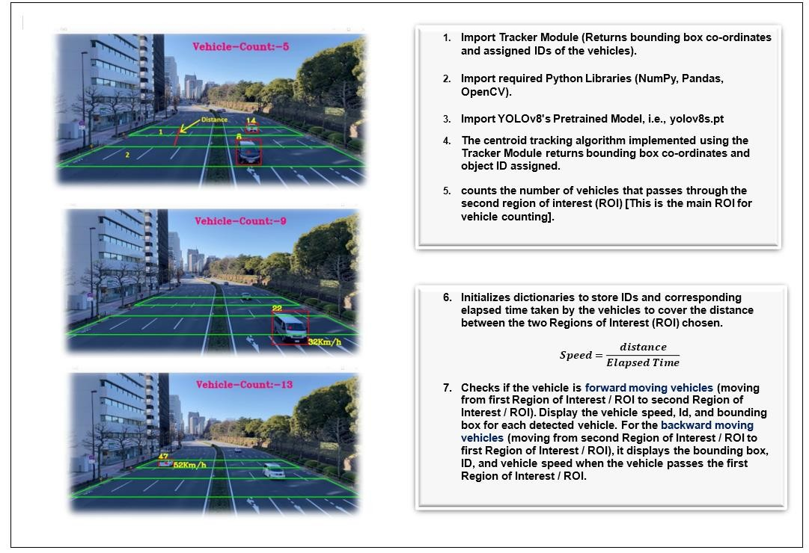
Design & Diagram (Contd.)

Slide 15
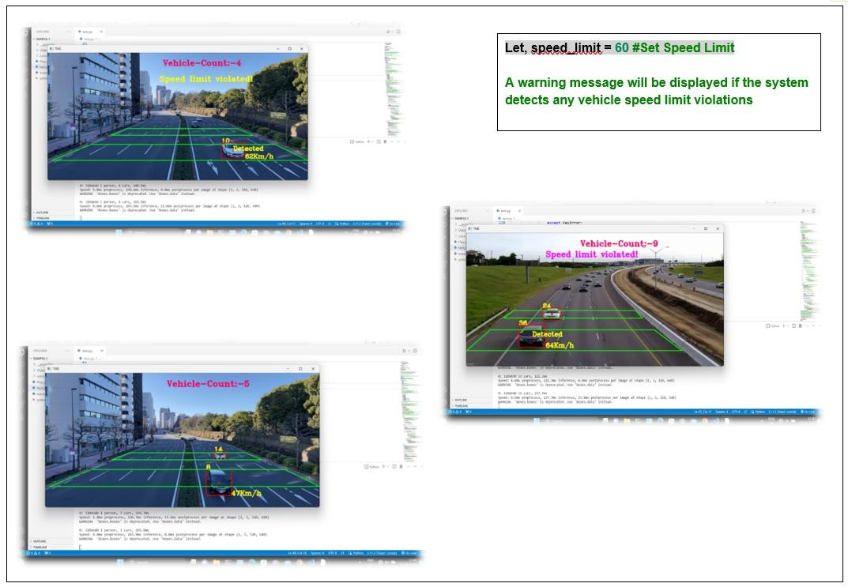
Design & Diagram (Contd.)

Slide 16
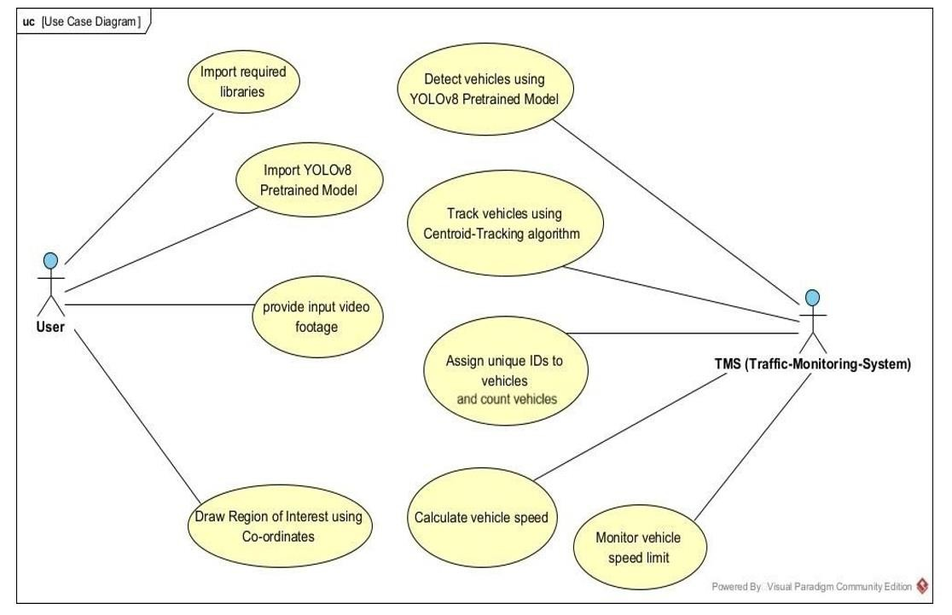
Design & Diagram (Use Case Diagram)

Slide 17
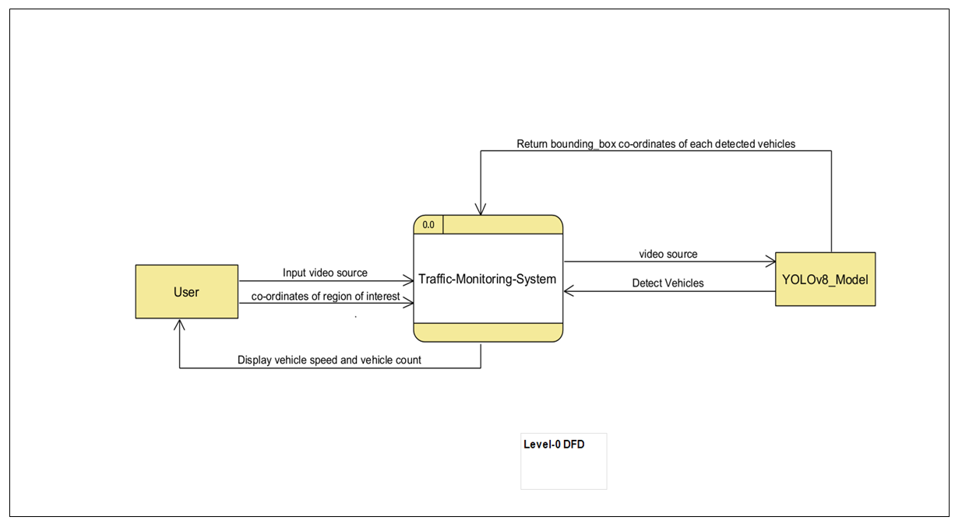
Design & Diagram (DFD)

Slide 18
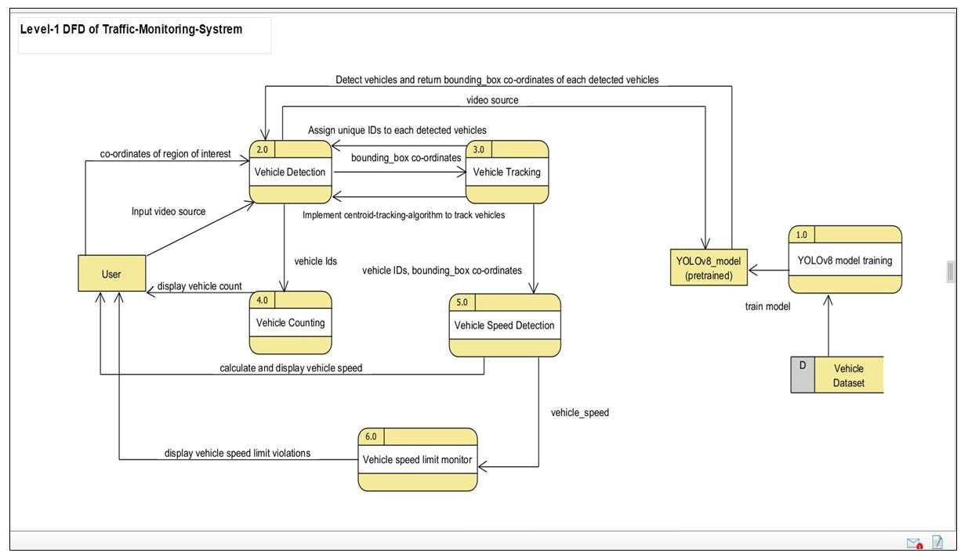
Design & Diagram (DFD)

Slide 19
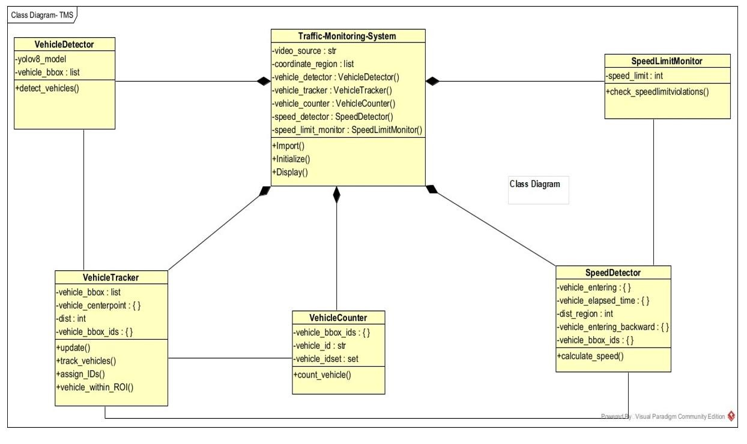
Design & Diagram (Class Diagram)

Slide 20
Modules that We Used in this Project
Module | Uses
Python-OpenCV | OpenCV is a Python open-source library, which is used for computer vision in Artificial intelligence, Machine Learning, face recognition, etc.
Pandas | Pandas is a library for python programming language. It is used for create, remove, edit and data manipulation in dataframe.
NumPy | NumPy is a library for the Python programming language, adding support for large, multi- dimensional arrays and matrices, along with a large collection of high-level mathematical functions to operate on these arrays.

Slide 21
Contd.
Module | Uses
Ultralytics YOLOv8 | YOLOv8 is designed to be fast, accurate, and easy to use, making it an excellent choice for a wide range of object detection and tracking, instance segmentation, image classification and pose estimation tasks.
Tracker | This is a custom module based on the Centroid tracking algorithm to track the vehicles.
Vehicle detection module | This module uses YOLOv8 to detect vehicles in the video footage. YOLOv8 is a deep learning algorithm that can detect objects in images and videos. The algorithm is trained on a dataset of images that contain vehicles. When the algorithm is applied to a video footage, it can detect the vehicles in the video.

Slide 22
Contd.
Module | Uses
Vehicle tracking module | This module tracks the vehicles that have been detected by the vehicle detection module. The module uses a centroid tracking algorithm to track the vehicles. The centroid tracking algorithm tracks the centre of mass of the vehicles in the video footage.
Vehicle speed detection module | This module estimates the speed of the vehicles that are being tracked. To estimate the speed of the vehicles, it uses the distance between the two regions of interest (ROI) chosen and the elapsed time taken by the vehicles to cover that distance.

Slide 23
Contd.
Module | Uses
Vehicle counting module | This module counts the number of vehicles that pass through a specific area in the video footage. The module uses a region of interest (ROI) to define the specific area. The module then counts the number of vehicles that enter and exit the ROI.
Vehicle speed violation detection module: | This module detects if a vehicle is violating the speed limit. The module uses the speed of the vehicles that are being tracked to determine if they are violating the speed limit.

Slide 24
Conclusion
This project proposes an approach to detect and track the moving vehicles and estimation of their speeds. The innovation of the approach lies in the selection of the Region of Interest for the vehicle detection. The traffic monitoring system developed in this project can be used for a variety of applications, such as traffic management, public safety, parking management, and smart cities. The system uses YOLOv8, a state-of-the-art object detection algorithm, which is known for its speed and accuracy. We also used the centroid tracking algorithm to track the vehicles. The centroid tracking algorithm works by tracking the centroids of the objects detected by YOLOv8. The centroids are the points at the center of the objects. The centroid tracking algorithm then tracks the movement of the objects by tracking the movement of their centroids. The system has several limitations, such as the difficulty of detecting vehicles in difficult conditions, such as occlusion or poor lighting. However, the system is a promising approach to traffic monitoring and can be improved in future work.

Slide 25
THANK YOU

