Slide 1
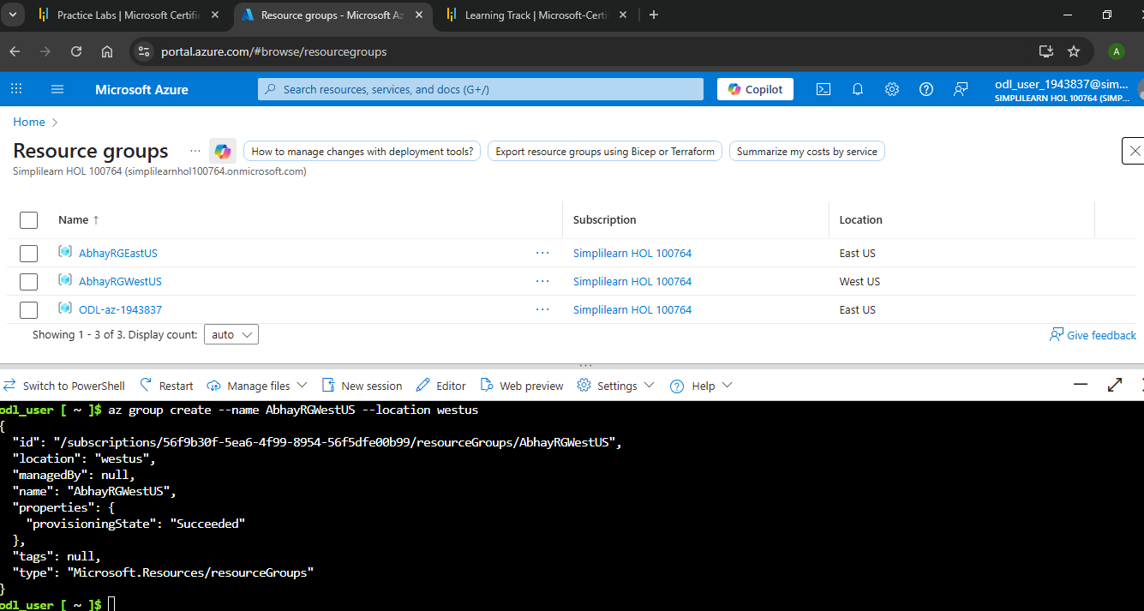
Step 1: Create Two ResourceGroups
CLI to create the resourceGroup az group create --name AbhayRGEastUS --location eastus
az group create --name AbhayRGWestUS --location westus

Slide 2
Abhay Mudawadkar 20-Sep to 26-Oct AZ-104 Project
Connecting Internet Workloads Using Vnet Peering and Assigning a Custom Role for Operating These Workloads

Slide 3
Step 2: Create Two Virtual Networks
Create VNet1- Name: VNet-East, Region: (e.g., East US), Address Space: 10.0.0.0/16, Subnet: 10.0.1.0/24
Create VNet2- Name: VNet-West, Region: (e.g., West US), Address Space: 10.1.0.0/16, Subnet: 10.1.1.0/24
CLI to create the Virtual Network
az network vnet create \
--resource-group AbhayRGEastUS \
--name VNet-East \
--address-prefix 10.0.0.0/16 \
--subnet-name Subnet-East \
--subnet-prefix 10.0.1.0/24 \
--location eastus
az network vnet create \
--resource-group AbhayRGWestUS \
--name VNet-West \
--address-prefix 10.1.0.0/16 \
--subnet-name Subnet-West \
--subnet-prefix 10.1.1.0/24 \
--location westus

Slide 4
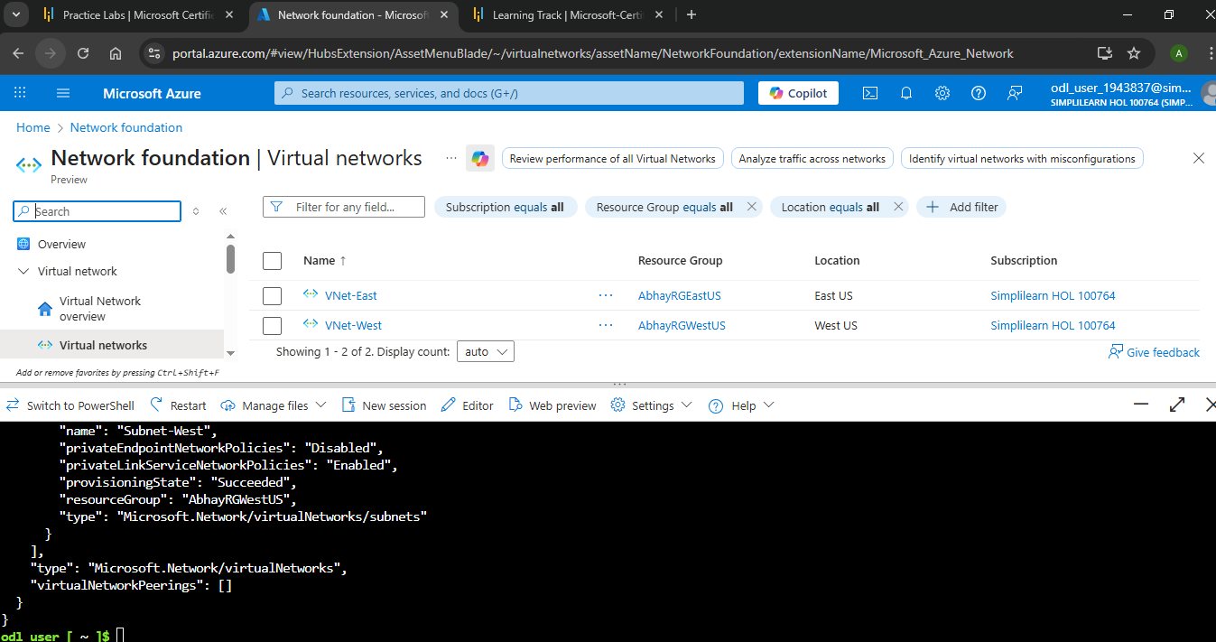
Step 2: Create Two Virtual Networks

Slide 5
Step 3: Deploy Virtual Machines in Each VNet
For each VM:
VM1 in VNet-East Name: VM-East, Image: "Windows Server, 2019 Datacenter - x64 Gen2"
Size: "Standard_D2s_v3 - 2 vcpus, 8 GiB memory (Price unavailable)“, "OS disk type":, “Standard HDD (locally-redundant storage)“, Network: VNet-East → Subnet 10.0.1.0/24
VM2 in VNet-West Name: VM-West, Image: "Windows Server 2019 Datacenter - x64 Gen2“, Size: "Standard_D2s_v3 - 2 vcpus, 8 GiB memory (Price unavailable)“, "OS disk type": "Standard HDD (locally-redundant storage)“, Network: VNet-West → Subnet 10.1.1.0/24
CLI to create the VM
az vm create \
--resource-group AbhayRGEastUS \
--name VM-East \
--location eastus \
--size "Standard_D2s_v5" \
--image MicrosoftWindowsServer:WindowsServer:2025-datacenter-g2:latest \
--admin-username vmadmin \
--admin-password "Password@123" \
--vnet-name VNet-East \
--subnet Subnet-East \
--os-disk-size-gb 127 \
--no-wait

Slide 6
Step 3: Deploy Virtual Machines in Each VNet
az vm create \
--resource-group AbhayRGWestUS \
--name VM-West \
--location westus \
--size "Standard_D2s_v5" \
--image MicrosoftWindowsServer:WindowsServer:2025-datacenter-g2:latest \
--admin-username vmadmin \
--admin-password "Password@123" \
--vnet-name VNet-West \
--subnet Subnet-West \
--os-disk-size-gb 127 \
--no-wait

Slide 7
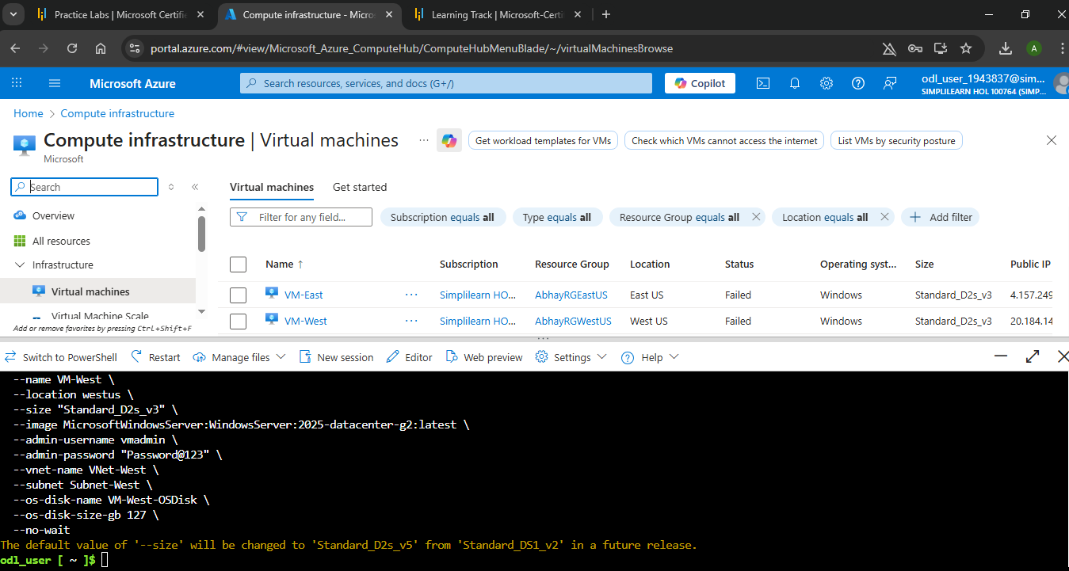
Step 3: Deploy Virtual Machines in Each VNet

Slide 8
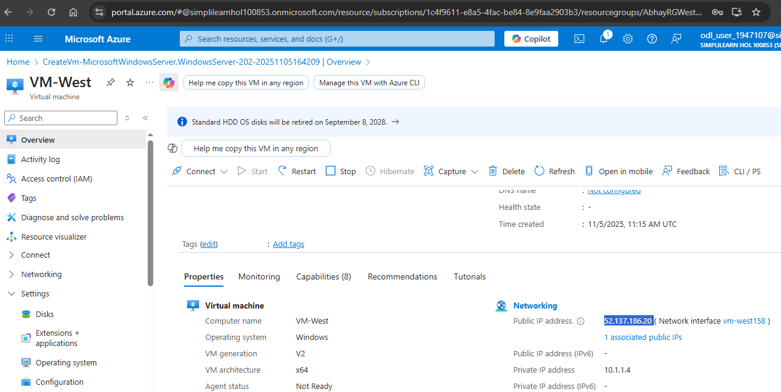
Step 4: Establish VNet Peering
VM West

Slide 9
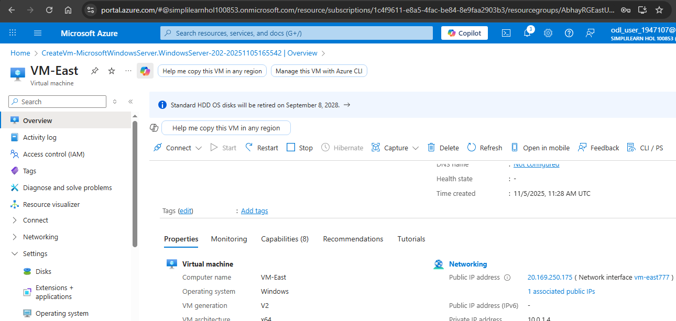
Step 4: Establish VNet Peering
VM East

Slide 10
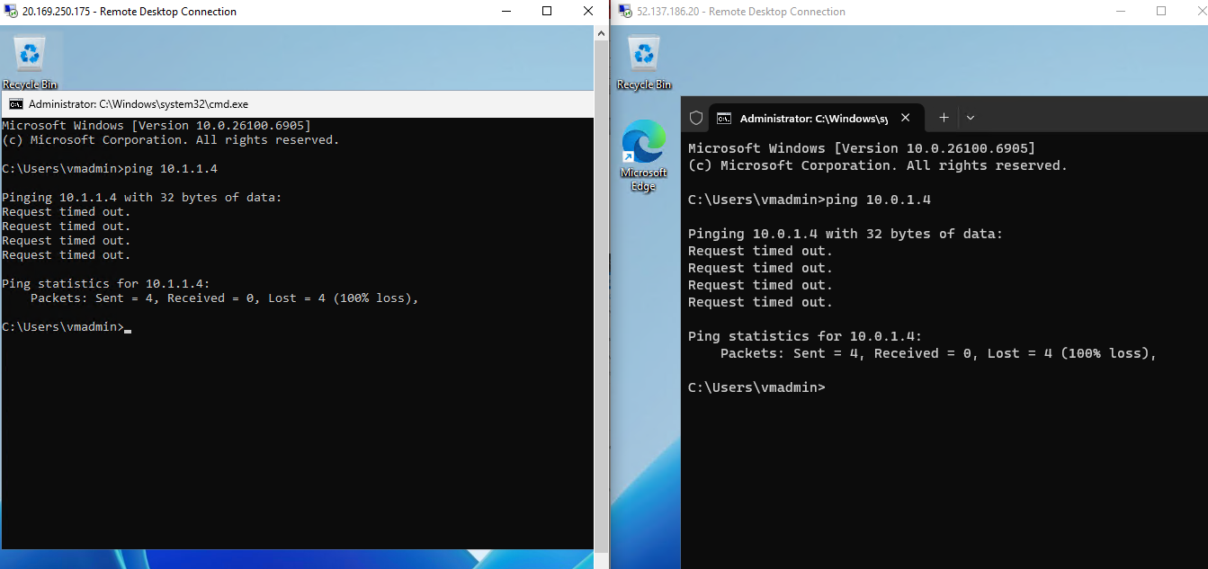
Step 4: Establish VNet Peering
Take Remote Desktop of both the VMs their private IPs are not able to ping see screen shot

Slide 11
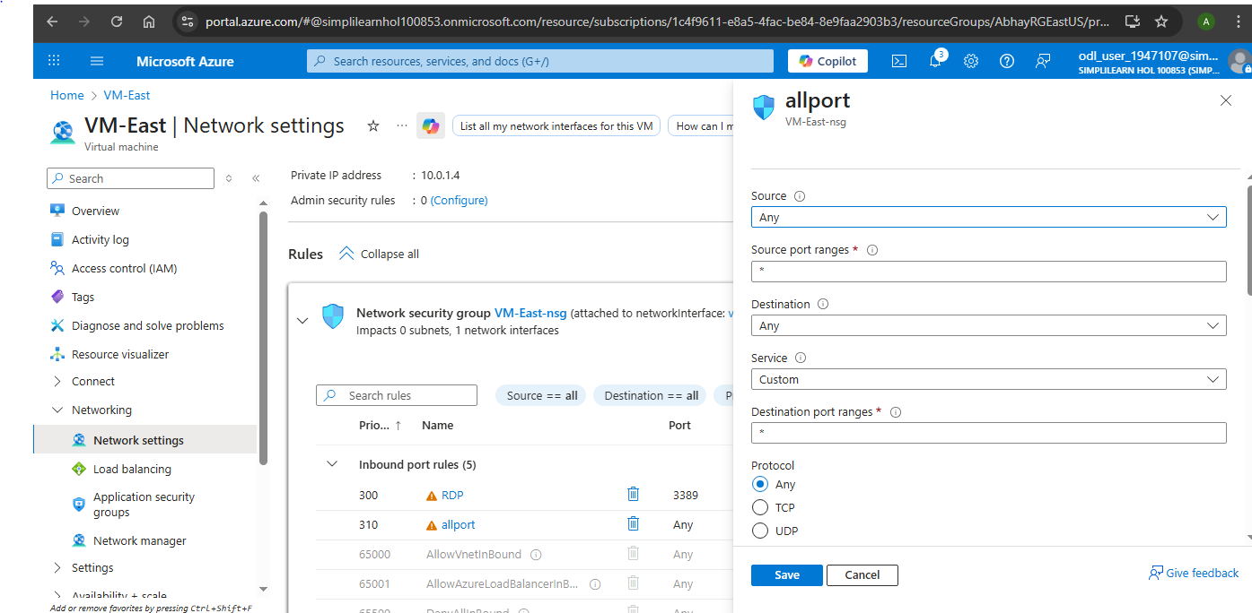
Step 4: Establish VNet Peering
A: Peering will enabled only Network-Path, but Windows Firewall still blocking RDP to enable that run following commands on PowerShell Enable-NetFirewallRule -DisplayGroup "File and Printer Sharing"
Enable-NetFirewallRule -DisplayGroup "Remote Desktop"
B: Create Port Rule for both the VMs

Slide 12
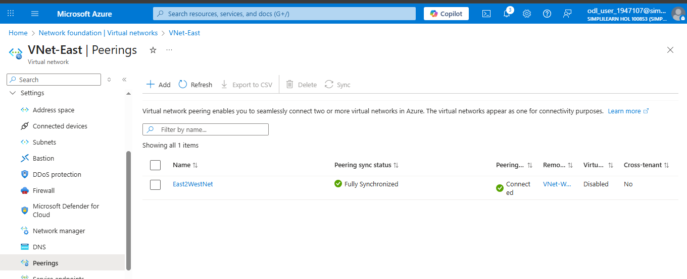
Step 4: Establish VNet Peering
C: Name: EastToWest-
Peering with remote VNet: VNet-West
Enable Allow virtual network access

Slide 13
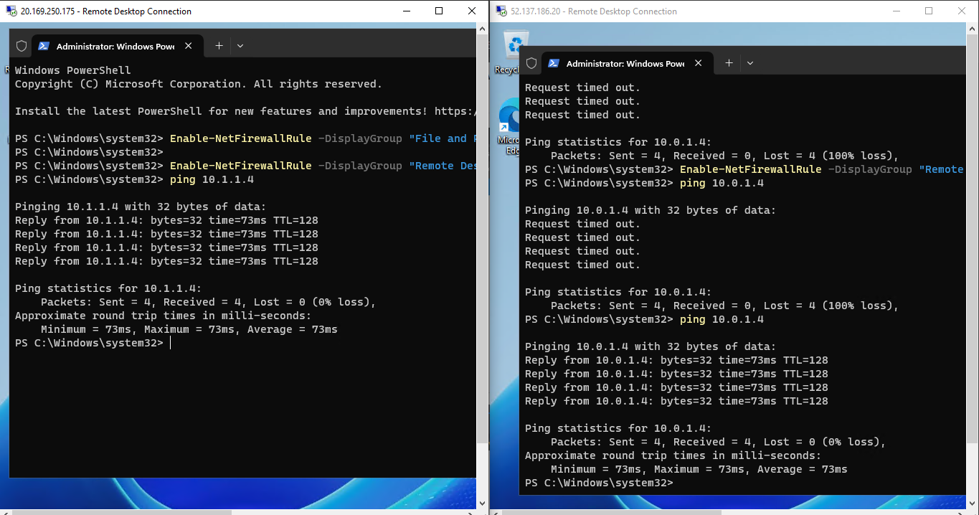
Step 4: Establish VNet Peering
Once peering is created in Virtual Network then following snippet depict both VM’s private can be ping from other

Slide 14
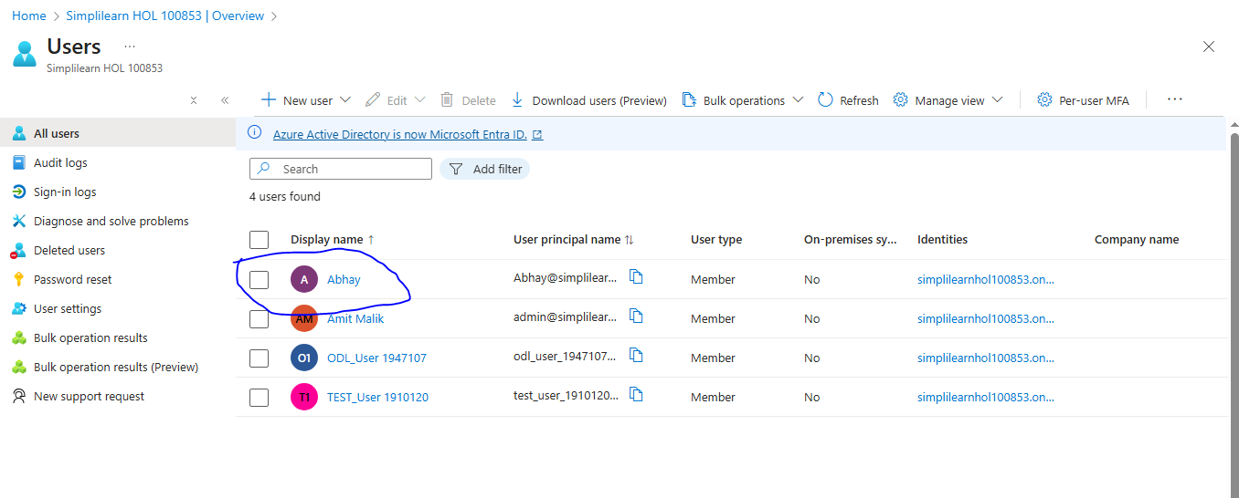
Step 5: Create user “Abhay” using Entra ID

Slide 15
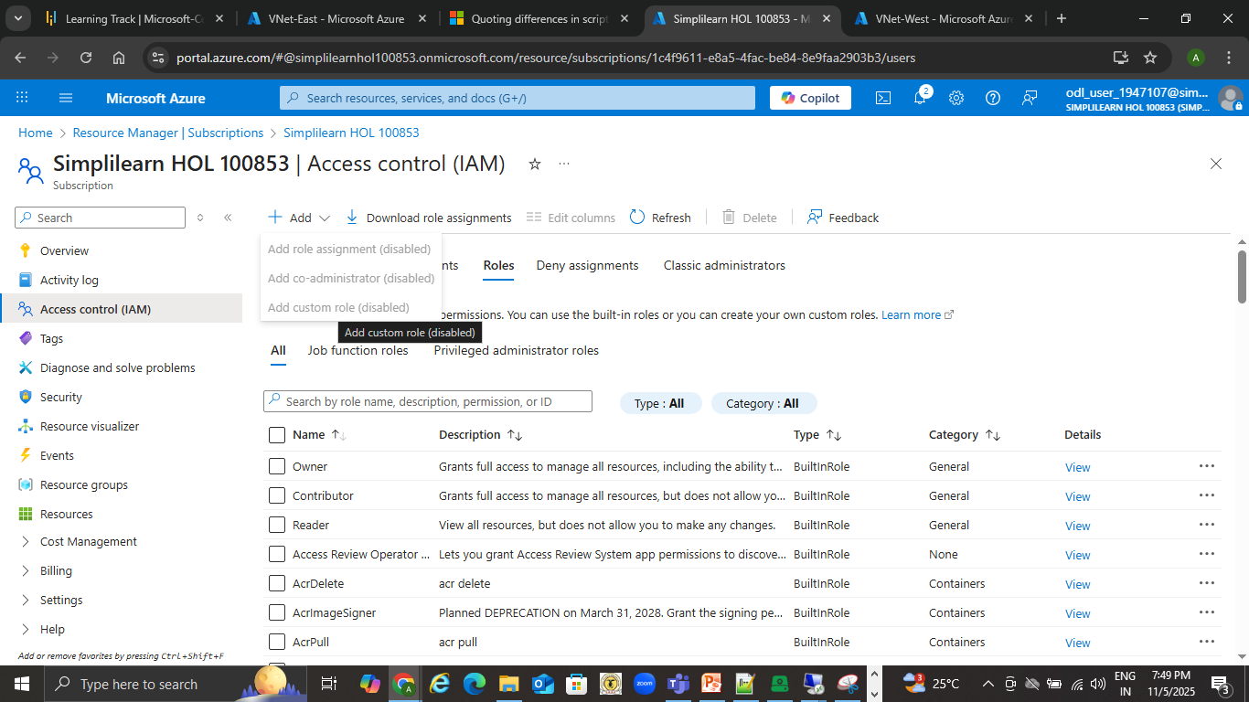
Step 6: Create custom role as “computer operator”
Since the Add New Role is Disabled, could not able to create the Role

