Slide 1
Classification Using Genetic Programming
Patrick Kellogg
General Assembly
Data Science Course (8/23/15 - 11/12/15)

Slide 2
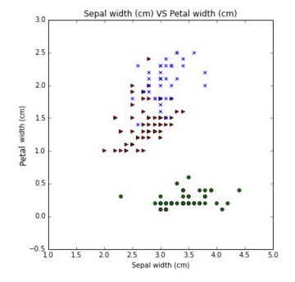
Iris Data Set

Slide 3
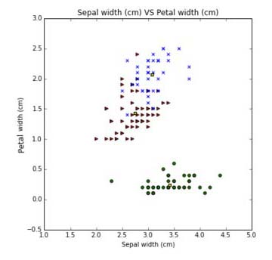
Iris Data Set

Slide 4
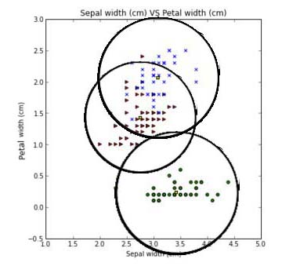
Iris Data Set

Slide 5
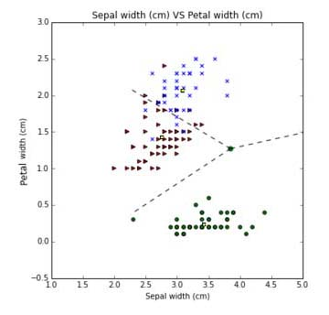
Iris Data Set

Slide 6
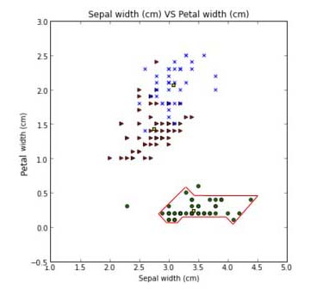
Iris Data Set
Create a geometrical boundary for the class “Setosa”

Slide 7

Automatically Creating Functions
def IsInClass(x,y):
if ( (y > (2*x + 10)) \
and (y > (0.3*x + 4.5)) \
...
and (x < 5)):
return true
else:
return false

Slide 8
Evolving Parameters
(y > (2x + 10) and
(y > (0.3x + 4.5)) ...

Slide 9
Evolving Parameters
(y > (2x + 10) and
(y > (0.3x + 4.5)) ...
y > β₁ x + α₁
y > β₂ x + α₂ . . .

Slide 10
Evolving Parameters
(y > (2x + 10) and
(y > (0.3x + 4.5)) ...
y > β₁ x + α₁
y > β₂ x + α₂ . . .
= Genetic Programming (GP)

Slide 11

Two-slide Introduction to Genetic Algorithms (Part 1)

Slide 12

Two-slide Introduction to Genetic Algorithms (Part 1)
Number legs = 6
N6

Slide 13

Two-slide Introduction to Genetic Algorithms (Part 1)
Number legs = 4
Length legs = 8
N4 L8

Slide 14

Two-slide Introduction to Genetic Algorithms (Part 1)
Number legs = 4
Length legs = 8
Size = 6
N4 L8 S6

Slide 15
Two-slide Introduction to Genetic Algorithms (Part 1)
Number legs = 0
Length legs = 8
Size = 3
Energy = 20
N0 L8 S3 E20

Slide 16
Two-slide Introduction to Genetic Algorithms (Part 2)
N6 L4 S3 E10
N4 L8 S3 E10
N4 L8 S6 E10
N0 L8 S3 E20
Initial Population

Slide 17
Two-slide Introduction to Genetic Algorithms (Part 2)
N6 L4 S3 E10
N4 L8 S3 E10
N4 L8 S6 E10
N0 L8 S3 E20
N6 L4 S3 E10 = 26
N4 L8 S3 E10 = 14
N4 L8 S6 E10 = 32
N0 L8 S3 E20 = 0
Fitness Function

Slide 18
Two-slide Introduction to Genetic Algorithms (Part 2)
N6 L4 S3 E10
N4 L8 S3 E10
N4 L8 S6 E10
N0 L8 S3 E20
N6 L4 S3 E10
N4 L8 S6 E10
N6 L4 S3 E10 = 26
N4 L8 S3 E10 = 14
N4 L8 S6 E10 = 32
N0 L8 S3 E20 = 0
Selection

Slide 19
Two-slide Introduction to Genetic Algorithms (Part 2)
N6 L4 S3 E10
N4 L8 S3 E10
N4 L8 S6 E10
N0 L8 S3 E20
N6 L4 S3 E10
N4 L8 S6 E10
N6 L4 S3 E10 = 26
N4 L8 S3 E10 = 14
N4 L8 S6 E10 = 32
N0 L8 S3 E20 = 0
N7 L4 S3 E10
Mutation

Slide 20
Two-slide Introduction to Genetic Algorithms (Part 2)
N6 L4 S3 E10
N4 L8 S3 E10
N4 L8 S6 E10
N0 L8 S3 E20
N6 L4 S3 E10
N4 L8 S6 E10
N6 L4 S3 E10 = 26
N4 L8 S3 E10 = 14
N4 L8 S6 E10 = 32
N0 L8 S3 E20 = 0
N7 L4 S3 E10
N6 L4 S6 E10
N4 L8 S3 E10
Crossover

Slide 21
Syntax Tree-Based GP
and
> β₁ x + α₁
< β₂ x + α₂
or
> β₃ x + α₃

Slide 22
Syntax Tree-Based GP
and
> β₁ x + α₁
< β₂ x + α₂
or
> β_{new} x + α₃
Mutation

Slide 23
Syntax Tree-Based GP
and
> β1 x + α3
< β₂ x + α₂
or
> β₃ x + α1
Crossover

Slide 24
My Python Code
Randomly create an initial population of 12 linear candidates
Run fitness function on all 12
Select top 2 candidates
Mutate each four times (+α, -α, +β, -β)
Crossover twice
Repeat until error is small enough for next step
(which is to add or remove a terminal from the tree)

Slide 25
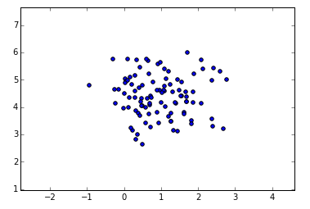
Sample Run of Hill-climbing

Slide 26
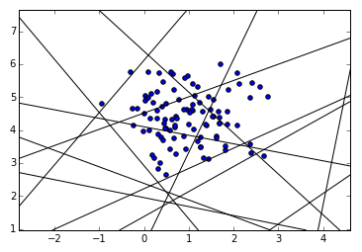
Sample Run of Hill-climbing

Slide 27
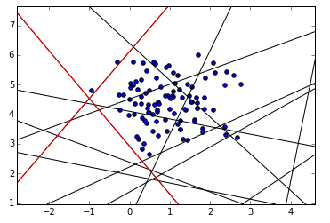
Sample Run of Hill-climbing

Slide 28
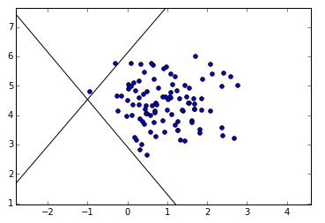
Sample Run of Hill-climbing

Slide 29
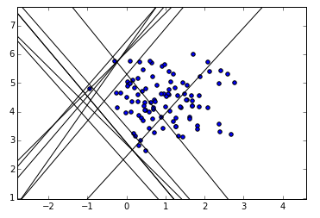
Sample Run of Hill-climbing

Slide 30
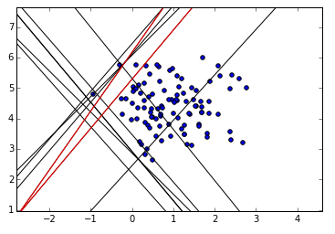
Sample Run of Hill-climbing

Slide 31
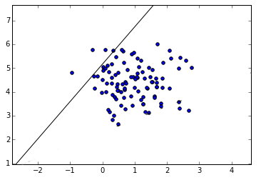
Sample Run of Hill-climbing

Slide 32
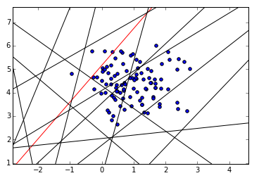
Sample Run of Hill-climbing

Slide 33
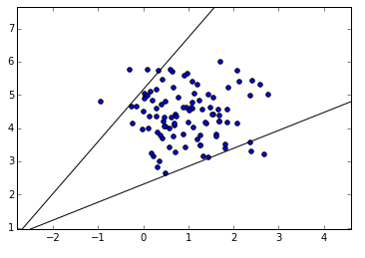
Sample Run of Hill-climbing

Slide 34
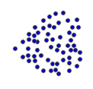
Future Work
Evolving other shapes that aren’t linear

Slide 35
Future Work
Evolving other shapes that aren’t linear

Slide 36
Future Work
Evolving other shapes that aren’t linear

Slide 37
Future Work
Evolving other shapes that aren’t linear
Definition of a circle: (x-h)² + (y-k)² = r².

Slide 38
Future Work
Evolving other shapes that aren’t linear
Definition of a circle: (x-h)² + (y-k)² = r².

Slide 39
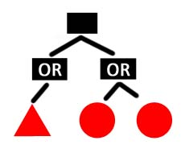
Future Work
Evolving other shapes that aren’t linear
Definition of a circle: (x-h)² + (y-k)² = r².

Slide 40
Future Work
Database look-up

Slide 41
Future Work
Database look-up

Slide 42
Future Work
Database look-up

Slide 43
Future Work
Database look-up
Enables
bi-directional
search

Slide 44
Future Work
Automatically turn results into python function
Recode for multi-dimensional data
Mutate parameters based on error delta
Speed up search (aka smash into centroid)
Concave shapes (“or” as well as “and”)
Study initial population size, distribution
Play with function size reward
Density
Look at Specificity vs. Sensitivity vs. size trade-off
A “three-legged stool” and difficult to tune

Slide 45
Backup Slides

Slide 46
Fitness Function
(((1-α) + (1-β)) / 2) * function size reward
((specificity + power (or sensitivity))/2) * size
more on this next ⬆
Where:
α = false positive rate
β = false negative rate
Function goes from 0 (worst) to 1 (best)

Slide 47
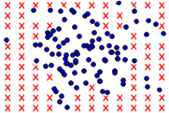
Creating Dummy Data Vs. Whitespace
First attempt: create dummy data (with same density as class data
Final solution: let the amount of “whitespace” determine the false positive rate (the specificity)

Slide 48
Crossover and Deleting/Adding Leaves
Adding leaves
Once the error reaches a steady state, a new linear candidate may be added
Deleting leaves
Or randomly, a candidate may be introduced that has a leaf (or an entire subtree) missing
Prevents overfitting

Slide 49
Mutation and Error Rate
Save the previous fitness value to calculate a good “next mutation”
Another good idea is to “smash” the line towards the centroid of the class until it hits the edge of the data

