Slide 1
Notes:
<number>

Slide 2
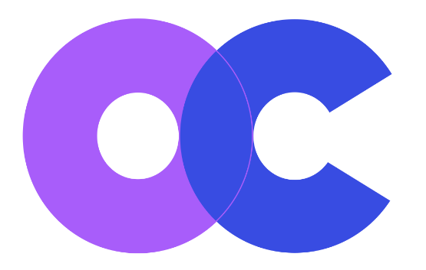

Welcome !
Two days of formal presentations and one hack day for experimentation
Those participating: 59 people from 12 countries,
of whom 24 are speakers and 7 are presenting posters
Organizers and host
Sponsors
Local organizing committee: Silvio Peroni and Marilena Daquino

Slide 3
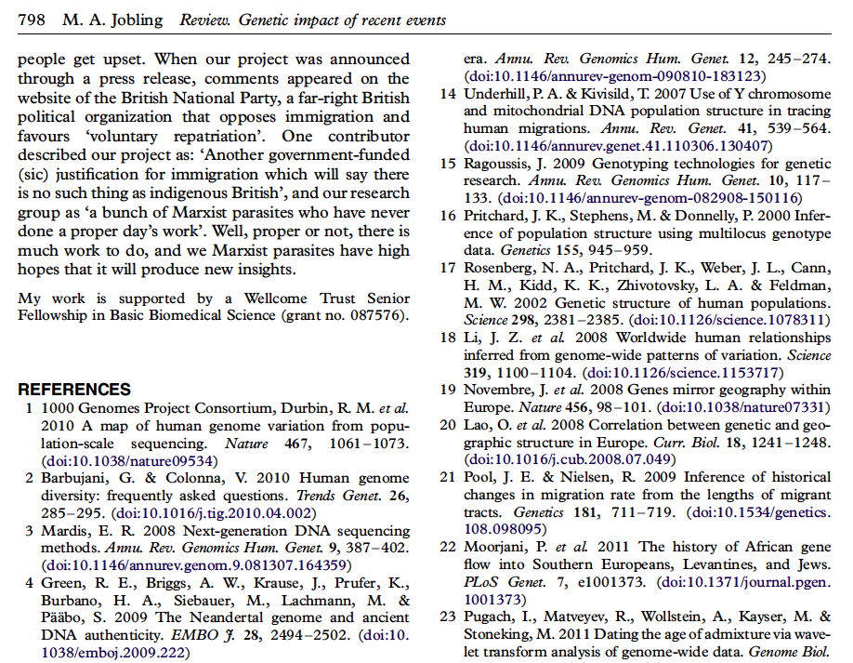
The importance of citations
Notes:
<number>

Slide 4
Creating citations is an essential scholarly activity
A citation is created by an author’s performative act of citing a published work that is relevant to the current work, typically made by including a bibliographic reference in the reference list of the current work
While the act of creation may for the author be the work of a moment, once created, a citation becomes a permanent directional conceptual link from the citing bibliographic work to a cited work
Notes:
<number>

Slide 5
Creating citations is an essential scholarly activity
A citation is created by an author’s performative act of citing a published work that is relevant to the current work, typically made by including a bibliographic reference in the reference list of the current work
While the act of creation may for the author be the work of a moment, once created, a citation becomes a permanent directional conceptual link from the citing bibliographic work to a cited work
It permits an author to give credit to another person's endeavours that have played a part in the development of the author’s own ideas or results
Direct citation is a key indicator of a publication’s significance
Notes:
<number>

Slide 6
Creating citations is an essential scholarly activity
A citation is created by an author’s performative act of citing a published work that is relevant to the current work, typically made by including a bibliographic reference in the reference list of the current work
While the act of creation may for the author be the work of a moment, once created, a citation becomes a permanent directional conceptual link from the citing bibliographic work to a cited work
It permits an author to give credit to another person's endeavours that have played a part in the development of the author’s own ideas or results
Direct citation is a key indicator of a publication’s significance
Citations also integrate our independent acts of scholarship into a global knowledge network
Bibliometric analysis of the flow of information and ideas through the citation network, and its changes over time, can reveal patterns of communication between scholars and the development and demise of academic disciplines
Notes:
<number>

Slide 7
Two of my heroes
Max Perutz
John Sulston

Slide 8
The four phases of Open Scholarship
Open source software, now ubiquitous – think Linux, Open Office, Firefox
Open access papers
Many funders, including NIH and NSF, the European Commission, the Wellcome Trust, and the Gates Foundation, now make Open Access mandatory for grantees
Open datasets on which scholarly articles are based
Much current effort to encourage deposit of research datasets
Historically, bioinformatics researchers have always been open, while others, notably chemists, have always been tight-fisted with their data
Open metadata - machine-readable descriptions of scholarly works
Metadata 2020 is a collaboration launched last autumn to promote open reusable metadata describing all research outputs, and several of its members are present at this meeting
At this workshop, we will concentrate on bibliographic and citation metadata

Slide 9
Requirements for Open Scholarship
FAIR principles (https://www.force11.org/group/fairgroup/fairprinciples)
To facilitate humans and machines in their discovery of, access to, integration and analysis of scholarly material, stuff should be
Findable
Accessible
Interoperable
Re-usable

Slide 10
Requirements for Open Scholarship
FAIR principles (https://www.force11.org/group/fairgroup/fairprinciples)
To facilitate humans and machines in their discovery of, access to, integration and analysis of scholarly material, stuff should be
Findable
Accessible
Interoperable
Re-usable
The Initiative for Open Citations goals (https://i4oc.org/#goals)
To facilitate reuse, stuff (citations) should be
Structured (accessible in common, machine-readable formats)
Separable (metadata available without access to source publications)
Open (freely accessible and re-usable)
The problem is that at present most stuff is not free to access, is subject to inconsistent, hard-to-parse licenses, and is not machine-readable

Slide 11
For citations, how is the present situation imperfect?
The present scholarly citation system inadequately exposes the knowledge networks that exist within the scholarly literature, linking papers, authors, funders, research projects and datasets
Citation data are hidden behind subscription firewalls of commercial companies
Academics are not free to use their own citation data as they please
Notes:
<number>

Slide 12
For citations, how is the present situation imperfect?
The present scholarly citation system inadequately exposes the knowledge networks that exist within the scholarly literature, linking papers, authors, funders, research projects and datasets
Citation data are hidden behind subscription firewalls of commercial companies
Academics are not free to use their own citation data as they please
In this Open Access age, it is a scandal that reference lists from journal articles, the core elements of the academic data cycle, are not (yet) freely available for use by the scholars who created them
Citation data now need to be recognized as a part of the Commons – those works that are freely and legally available for sharing
Notes:
<number>

Slide 13
Working towards open citations
We are late entering the fight for open citations, which has been dominated by commercial citation indexes charging very high subscriptions: WoS and Scopus
While other indexes - Google Scholar and Microsoft Academic – are free to search, all these commercial indexes impose severe restrictions on machine access and data download for reuse

Slide 14

Working towards open citations
We are late entering the fight for open citations, which has been dominated by commercial citation indexes charging very high subscriptions: WoS and Scopus
While other indexes - Google Scholar and Microsoft Academic – are free to search, all the commercial indexes impose severe restrictions on machine access and data download for reuse
The Initiative for Open Citations (https://i4oc.org), launched on 6th April 2017, has had remarkable success in persuading almost all the major scholarly publishers to open the reference lists they submit to Crossref
Crossref now hosts more than half a billion open journal article references!
I have recently called for research funders to mandate that their grant-holders publish in journals which make their citations open
David Shotton (2018). Funders should mandate open citations. Nature 553: 129. http://dx.doi.org/10.1038/d41586-018-00104-7

Slide 15
Working towards open citations
We are late entering the fight for open citations, which has been dominated by commercial citation indexes charging very high subscriptions: WoS and Scopus
While other indexes - Google Scholar and Microsoft Academic – are free to search, all the commercial indexes impose severe restrictions on machine access and data download for reuse
The Initiative for Open Citations (https://i4oc.org), launched on April 6 2017, has persuaded almost all the major scholarly publishers to open the reference lists they submit to Crossref
Crossref now hosts more than half a billion open journal article references!
I have recently called for research funders to mandate that their grant-holders publish in journals which make their citations open
David Shotton (2018). Funders should mandate open citations. Nature 553: 129. http://dx.doi.org/10.1038/d41586-018-00104-7
This is the first Workshop on Open Citations, and we are here to work . . .
Enjoy!

