Slide 1
Comparing bibliographic data sources
Ludo Waltman, Martijn Visser, Nees Jan van Eck
Centre for Science and Technology Studies (CWTS), Leiden University
Workshop on Open Citations
Bologna
September 3, 2018

Slide 2
Introduction
Increasing number of alternatives (Google Scholar, Microsoft Academic, Dimensions, Crossref, OpenCitations Corpus) to traditional bibliographic data sources (Web of Science, Scopus)
Some alternatives are more open than others
How do the various data sources compare in terms of the completeness and quality of their citation data?

Slide 3




Data sources
Scopus
May 2018
Requires subscription
Web of Science
SCIE, SSCI, AHCI, CPCI
June 2018
Requires subscription
Dimensions
June 2018
Openly available through web interface
Crossref
August 2017
Openly available through API

Slide 4
Coverage of publications
 | All publications |  | Publications with DOI |  | Publications with unique DOI
Web of Science | 40.06 | 100.0% | 18.79 | 46.9% | 18.77 | 46.9%
Scopus | 44.88 | 100.0% | 31.06 | 69.2% | 30.64 | 68.3%
Dimensions | 57.47 | 100.0% | 55.09 | 95.9% | 54.95 | 95.6%
Crossref | 53.81 | 100.0% | 53.81 | 100.0% | 53.81 | 100.0%
Publication counts in millions
Time period 1996-2017
Note that Crossref is incomplete in 2017

Slide 5
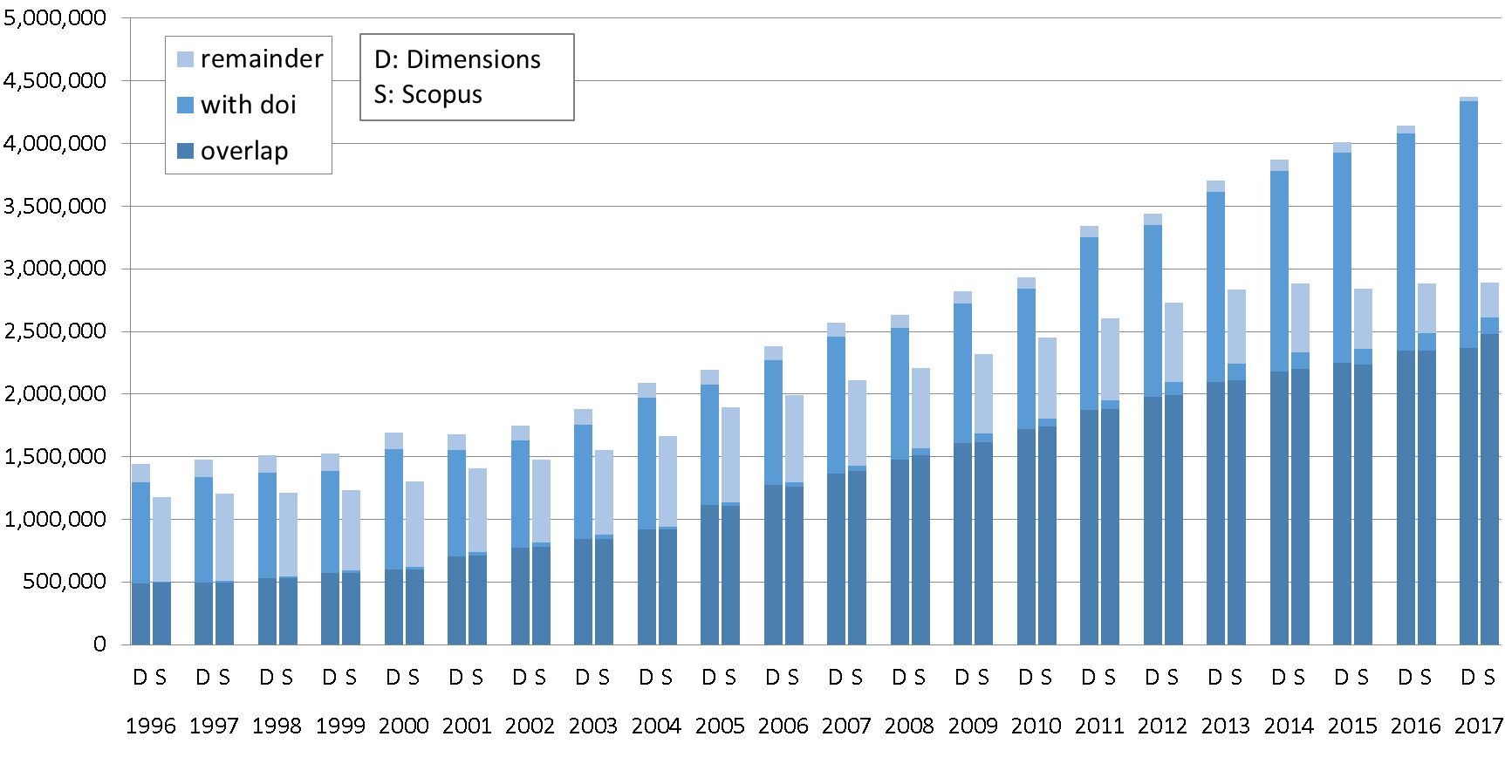
Coverage of publications: Dimensions vs. Scopus

Slide 6
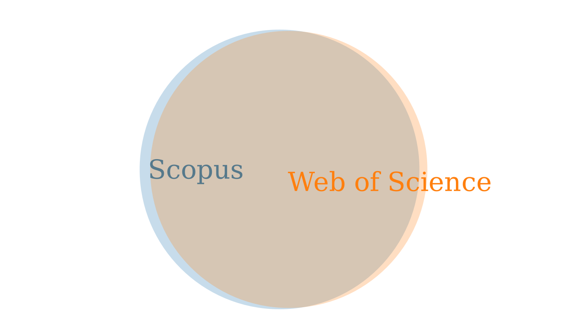
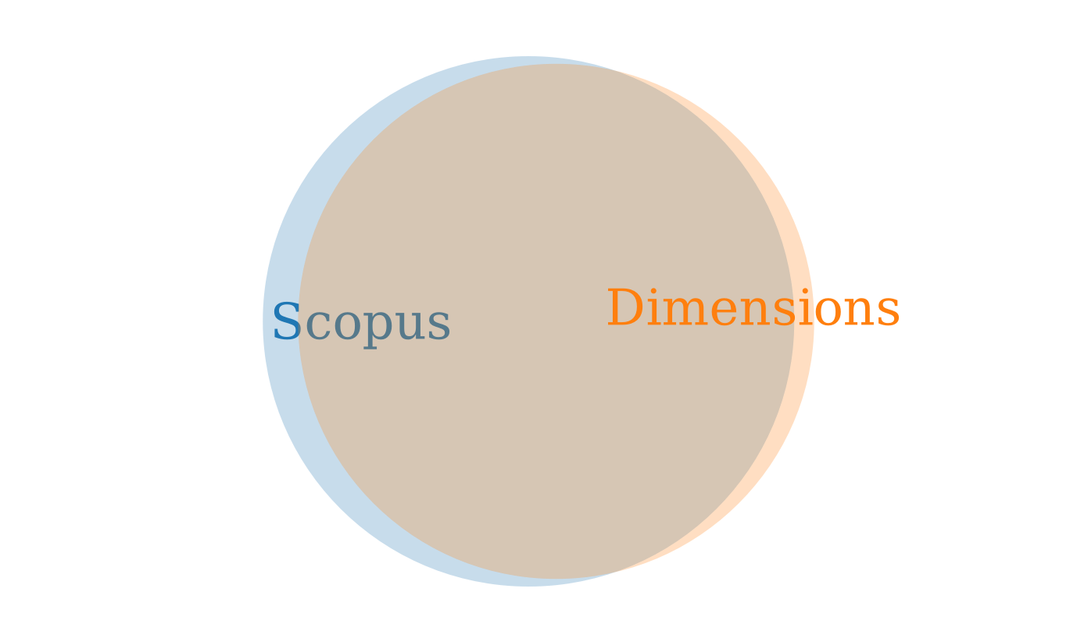
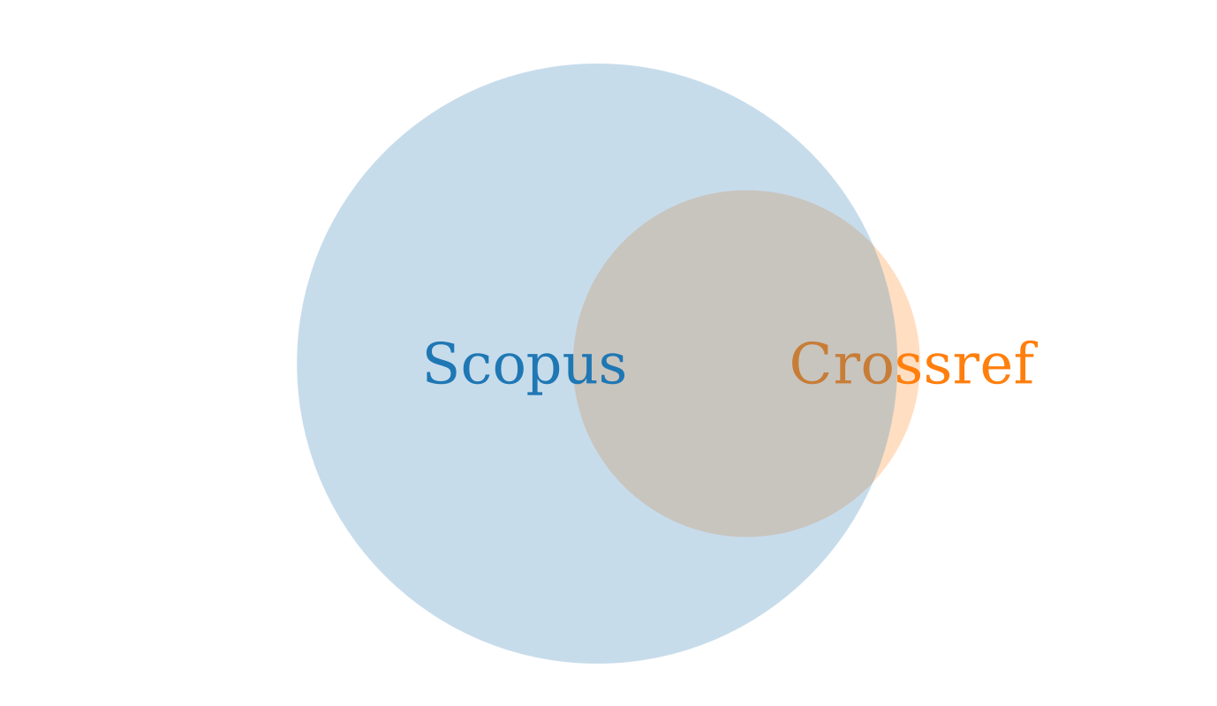
Comparison of citation data
Scopus-WoS overlap: | 460.0M
Only in Scopus: | 24.9M
Only in WoS: | 15.5M
Scopus-Dimensions overlap: | 414.3M
Only in Scopus: | 43.5M
Only in Dimensions: | 17.9M
Scopus-Crossref overlap: | 144.1M
Only in Scopus: | 305.1M
Only in Crossref: | 5.4M
In these pairwise comparisons of data sources, only citation links between citing and cited publications indexed in both data sources are considered

Slide 7
Causes of discrepancies between data sources
Inaccuracies in references
Inaccuracies in reference data
Inaccuracies in citation matching
Multiple versions of a publication
Multiple records for a publication
Citations being closed or not having been deposited

Slide 8
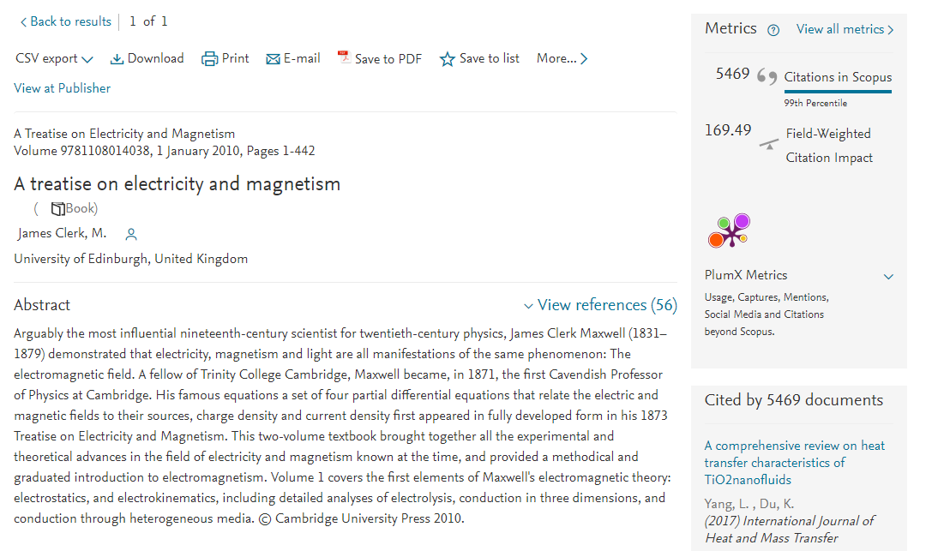
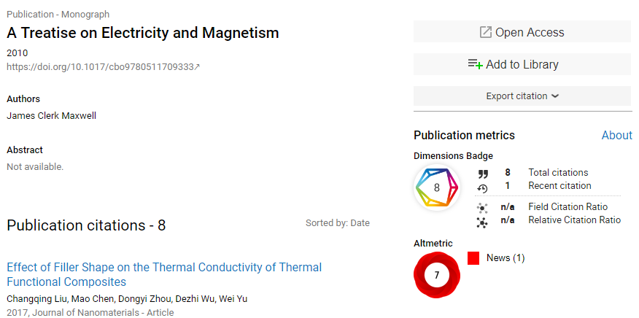
Example: Discrepancies between Scopus and Dimensions

Slide 9
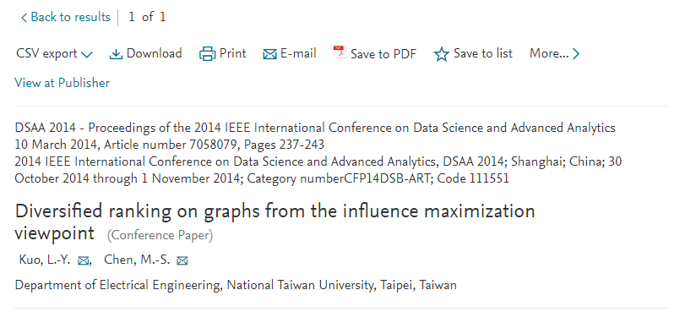
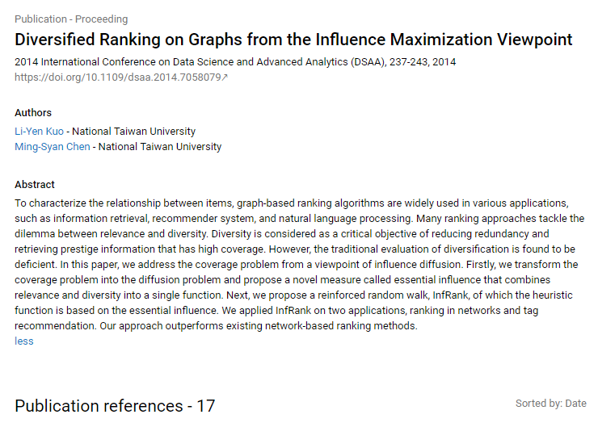
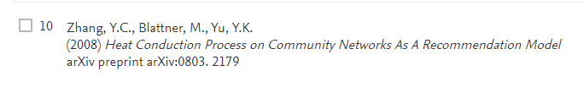
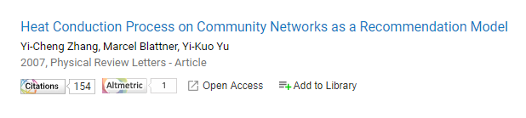
Example: Discrepancies between Scopus and Dimensions

Slide 10
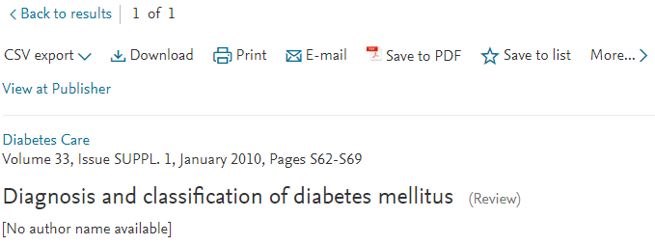
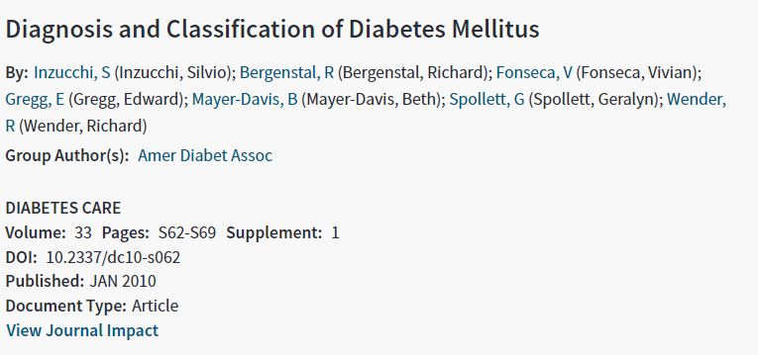
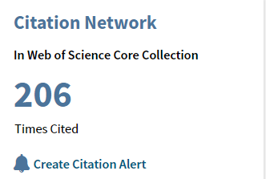
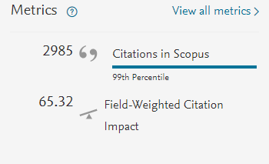
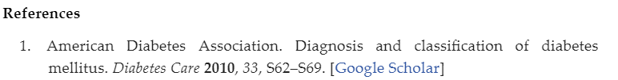
Example: Discrepancies between Scopus and Web of Science
Group author and/or supplement seem to cause problems in Web of Science
Notes:
It is not certain why so many citation links are missing in WoS. Some references that are very similar to the ones above are linked in WoS. Probably it has to do with group author and supplement,

Slide 11
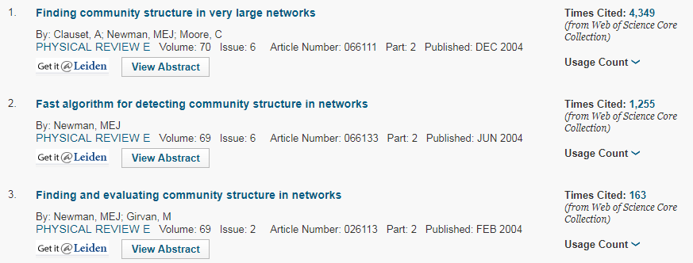
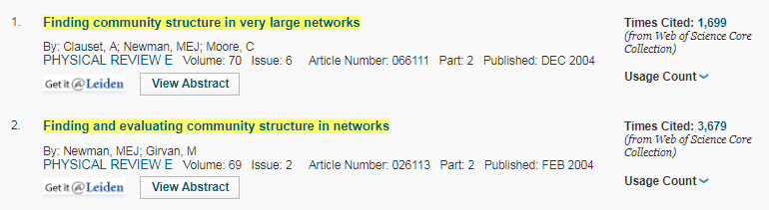
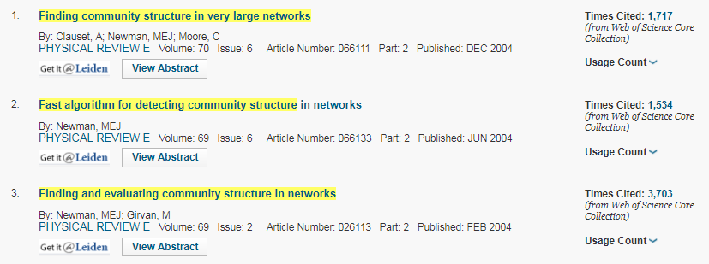
Example: Discrepancies within Web of Science
November 1, 2017
September 20, 2017
November 8, 2017

Slide 12
Conclusions
Substantial discrepancies between data sources
Reasonably complete citation data in Dimensions
Large gaps in citation data in Crossref, due to citations being closed or not having been deposited
Need for transparent high-quality citation matching algorithm
Completeness and quality of other metadata?

Slide 13
Thank you for your attention!

