Slide 1
Problematic Citations
Jodi Schneider
@jschneider
jschneider@pobox.com
Workshop on Open Citations
Bologna, Italy
2018-09-03
ISSA
Notes:
The structure of citation networks provides evidence about how scientific information is diffused. Problematic citation patterns include the selective citation of positive findings, citation bias, as well as the continued citation of retracted literature (i.e. literature formally withdrawn due to error, fraud, or ethical problems). For instance, there is some evidence that positive results tend to receive more citations. The public domain licensing of the Open Citations Corpus makes it possible, in principle, to estimate the likelihood that any network of research papers suffers from problematic citation. To-date, problematic citation been documented ad-hoc, in several striking studies. In Alzheimer's disease research, biased citation, ignoring critical findings, was used to support successful U.S. NIH grant proposals (Greenberg 2009). Mistranslation of obesity research has been used to justify exertion game research (Marshall & Linehan 2017). Citation of fraudulent research about Chronic Obstructive Pulmonary Disease continued after its retraction (Fulton et al. 2015). The data resulting from such studies is of great use to my lab in replicating and determining how to generalize the detection of problematic citation patterns. Previously, the detection of problematic citation patterns has been a side effect of astute researchers, noticing suspicious findings while conducting systematic literature reviews. This talk will describe work-in-progress in my lab detecting problematic citation patterns using natural language processing, combined with network analysis on the Open Citations Corpus.

Slide 2
Problematic Citation
Citation of retracted literature
Bibliographic ghosts
Misrepresenting cited work
Cherry picking
Ignoring related work outside a clique
Playing telephone with review papers

Slide 3
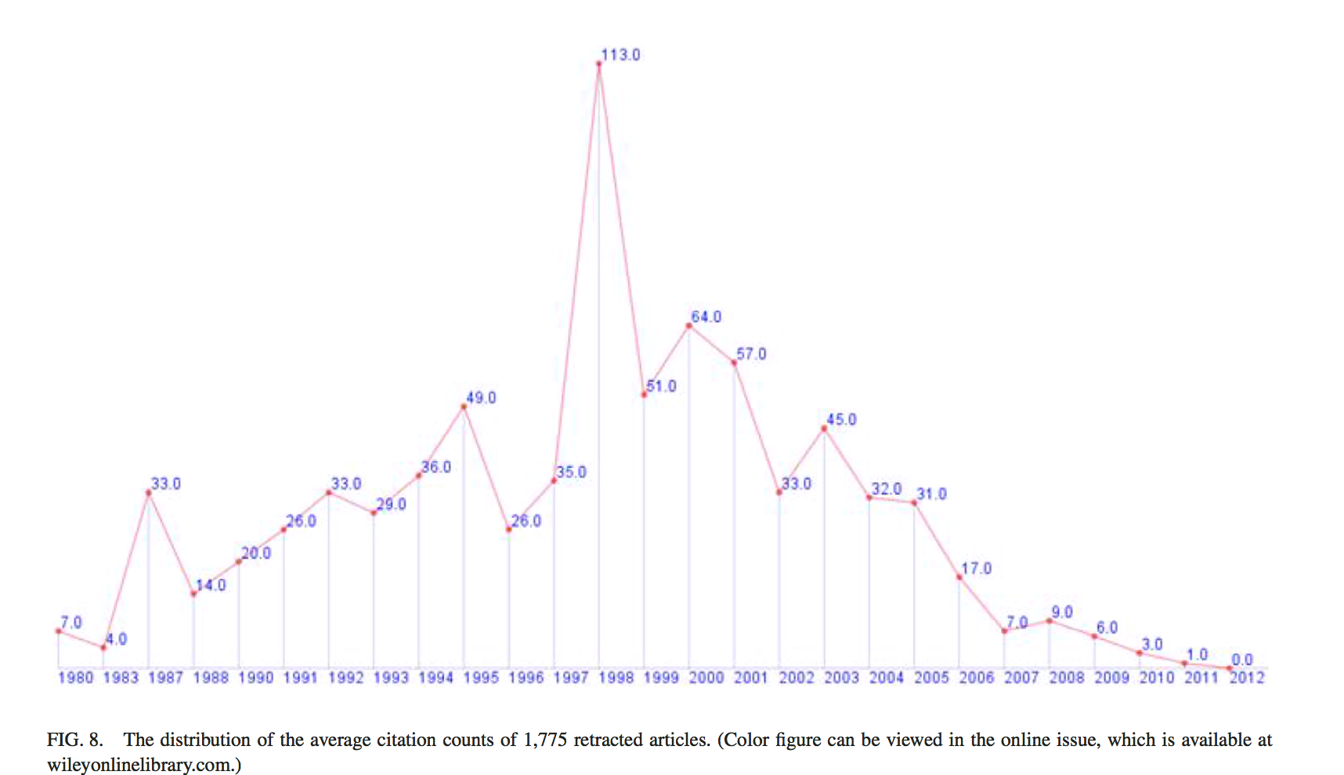
Citing retracted papers
A visual analytic study of retracted articles in scientific literature

Slide 4
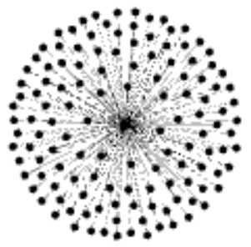
78 citations to a retracted clinical trial with faked data
Schneider & Yi in preparation, updating Fulton et al 2015

Slide 5
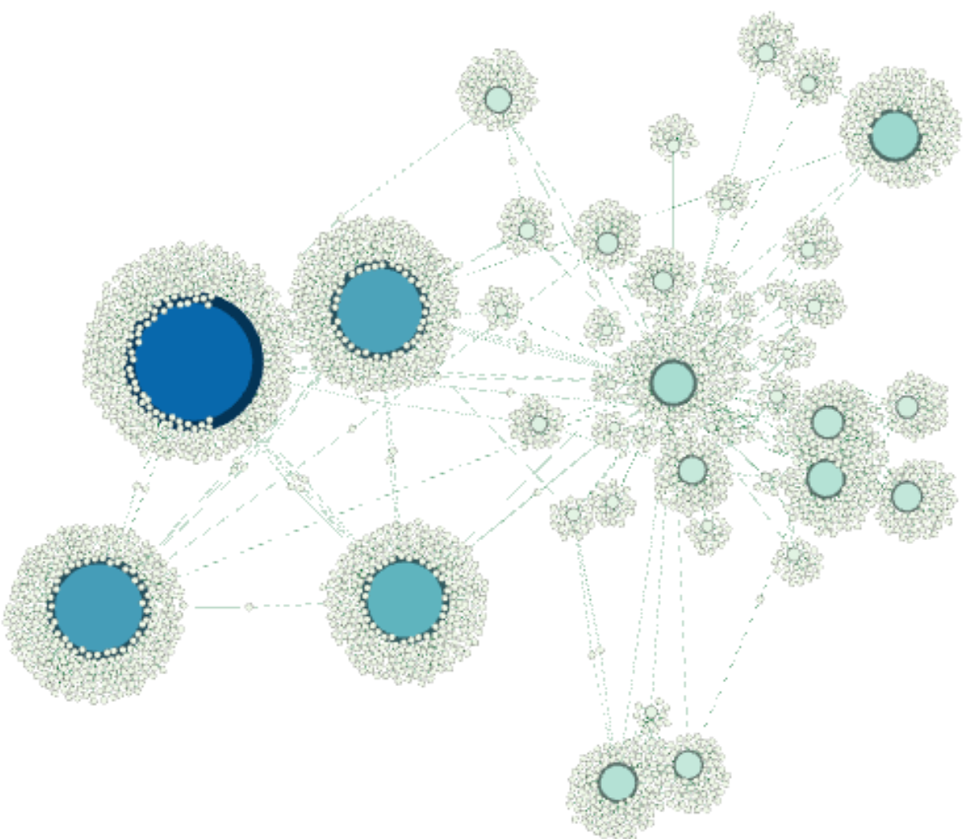
2700 citations of citations to clinical trial with faked data
Schneider & Yi in preparation, updating Fulton et al 2015
Notes:
2698 2nd generation citations

Slide 6
Bibliographic ghosts
“no such article was ever published”
The most influential paper Gerard Salton never wrote
Notes:
https://www.ideals.illinois.edu/bitstream/handle/2142/1697/Dubin748764.pdf?sequence=2
“An often cited overview paper titled “A Vector Space Model for Information Retrieval” (alleged to have been published in 1975) does not exist, and citations to it represent a confusion of two 1975 articles, neither of which were overviews of the VSM as a model of information retrieval.”
“In giving credit to Salton for the vector model, a number of authors cite an overview paper titled “A Vector Space Model for Information Retrieval,” which some show as published in the JASIS in 1975 and others as published in the Communications of the Association for Computing Machinery (CACM) in 1975. In fact, no such article was ever published, and citations to it usually represent a confusion of two 1975 articles (Salton, Wong, & Yang, 1975; Salton, Yang, & Yu, 1975), neither of which were overviews of the VSM as it is generally understood "
“locating papers containing the mistaken citation is very dif- ficult using conventional citation databases such as the Web of Science. But discovery of the errors is greatly aided by search engines such as Google and CiteSeer—systems that employ techniques similar to those that Salton himself refined and recommended.”

Slide 7
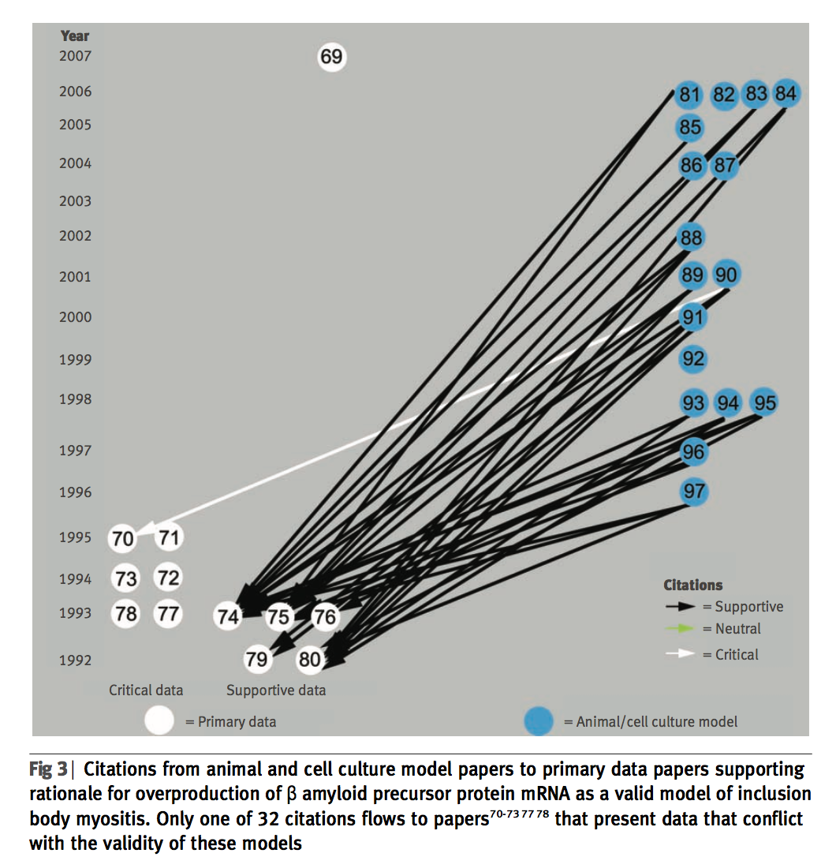
Cherry picking
How citation distortions create unfounded authority: analysis of a citation network
Notes:
Citing supportive but not critical data

Slide 8
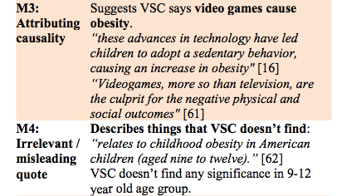
Misrepresenting cited work
Misrepresentation of health research in exertion games literature

Slide 9
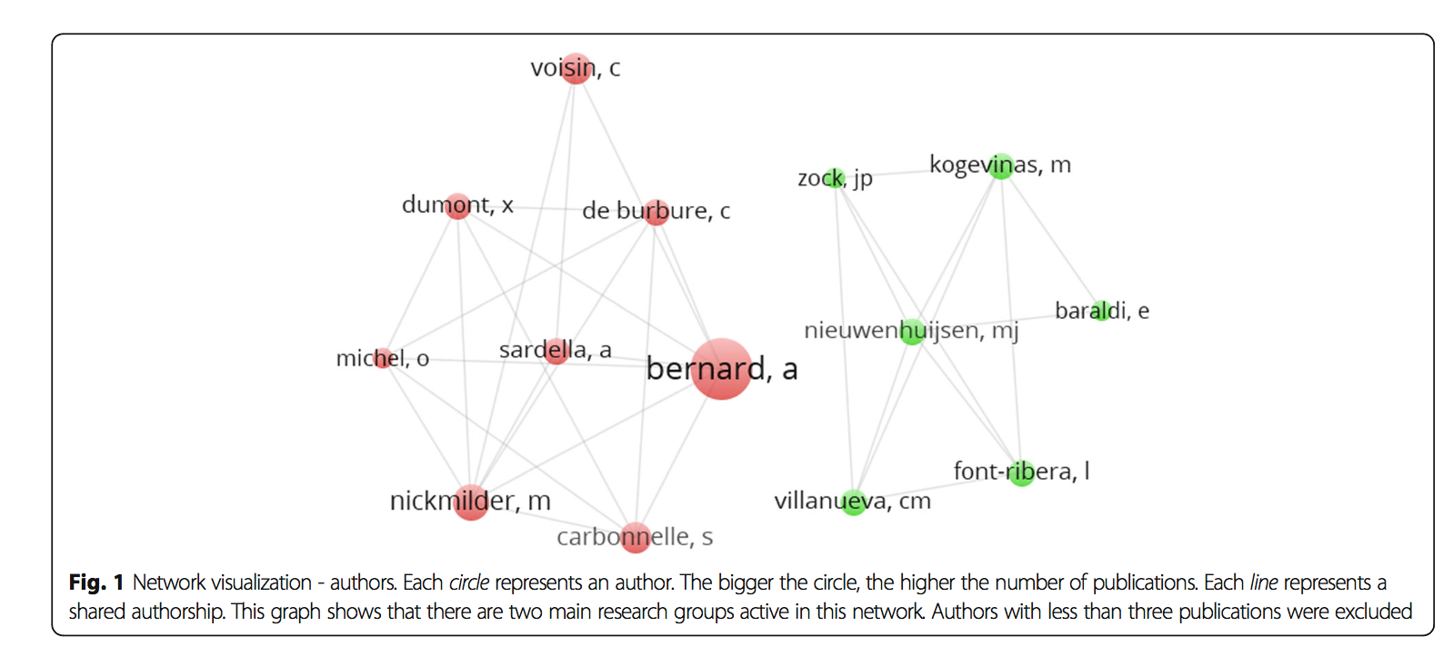
Ignoring related work outside a clique
Selective citation in the literature on swimming in chlorinated water and childhood asthma: a network analysis

Slide 10
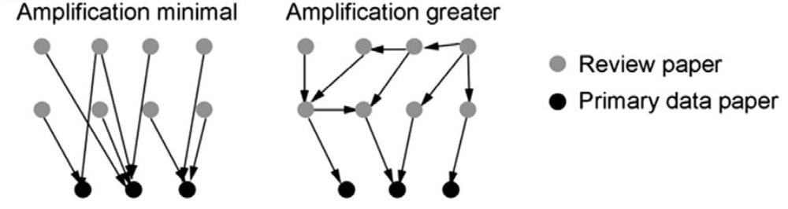
Playing telephone with review papers
Understanding belief using citation networks

Slide 11
Problematic Citation
Citation of retracted literature
Bibliographic ghosts
Misrepresenting cited work
Cherry picking
Ignoring related work outside a clique
Playing telephone with review papers

Slide 12
What is required to address Problematic Citation?
Attributes of cited work (retracted?)
Attributes of citing work (exists?)
Attributes of the topic & author networks (consistent or inconsistent?)
Citation sentences (citances)

Slide 13
What is needed to address Problematic Citation?
Citation of retracted literature
Attributes of cited work (retracted?)
Bibliographic ghosts
Attributes of citing work (exists?)
Misrepresenting cited work
Citing sentence(s)
Cited sentence(s)
Relationship between them

Slide 14
Problematic Citation
Cherry picking
Attributes of the topic network (consistent on this?)
Ignoring related work outside a clique
Attributes of the author network (consistent on this?)
Playing telephone with review papers
Citations to review papers
Citations from review papers

Slide 15
Chen, Chaomei, Zhigang Hu, Jared Milbank, and Timothy Schultz. (2013) "A visual analytic study of retracted articles in scientific literature." Journal of the American Society for Information Science and Technology 64(2): 234-253. https://doi.org/10.1002/asi.22755
Dubin, David. (2004) "The most influential paper Gerard Salton never wrote." Library Trends 52(4):748–764. https://www.ideals.illinois.edu/handle/2142/1697
Duyx, Bram, Miriam JE Urlings, Gerard MH Swaen, Lex M. Bouter, and Maurice P. Zeegers. (2017) "Selective citation in the literature on swimming in chlorinated water and childhood asthma: a network analysis." Research integrity and peer review 2(1): 17. https://doi.org/10.1186/s41073-017-0041-z
Greenberg, Steven A. (2009) "How citation distortions create unfounded authority: analysis of a citation network." BMJ 339: b2680. https://doi.org/10.1136/bmj.b2680
Greenberg, Steven A. (2011) "Understanding belief using citation networks." Journal of evaluation in clinical practice 17(2): 389-393. https://doi.org/10.1111/j.1365-2753.2011.01646.x
Marshall, Joe, and Conor Linehan. (2017) "Misrepresentation of health research in exertion games literature." Proceedings of the 2017 CHI Conference on Human Factors in Computing Systems. 4899-4910. https://doi.org/10.1145/3025453.3025691

