Slide 1
DMS Profession

Slide 2
DEFINITION OF THE PROFESSION
The diagnostic medical sonographer is an individual who provides patient care services using ultrasound and related diagnostic procedures.
Must be educationally prepared and clinically competent as a prerequisite to professional practice .
Demonstration and maintenance of competency through certification by a nationally recognized sonography credentialing organization is the standard of practice in sonography, and maintenance of certification in all areas of practice is endorsed.

Slide 3
DEFINITION OF THE PROFESSION
Functions as a delegated agent of the physician; and does not practice independently.
Committed to enhanced patient care and continuous quality improvement that increases knowledge and technical competence.
Use independent, professional, ethical judgment, and critical thinking to safely perform diagnostic sonographic procedures.

Slide 4
ULTRASOUND
Is a sound frequencies beyond(ultra) the range of human hearing (Frequencies greater 20 KHz)
Sound frequencies between the range of 20hz to 20 KHZ human can hear.
Ultrasound is safe and painless, produces and take pictures of the inside of the body using the returning sound waves.
Ultrasound imaging, also called ultrasound scanning or sonography, involves the use of a small transducer (probe) and ultrasound gel placed directly on the skin.

Slide 5
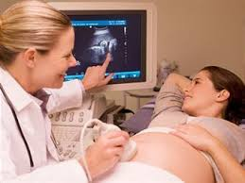
Terminology
Sonographer: Allied health professional.
A sonographer, or ultrasonographer, is a healthcare professional, frequently a radiographer but may be any healthcare professional with the appropriate training, who has:
Specialized education in ultrasound
Successful completion of national boards Registry of Diagnostic Medical Sonography(ARDMS)ARDMS. ​​​​​​​​​​The American Registry for Diagnostic Medical Sonography, administers examinations and awards accreditation to those who pass.
Notes:
5

Slide 6
Terminology
Sonologist: Physician (medical doctor)
  Specialized training in ultrasound .Successful completion of national boards in his or her respective specialty.
  Sonography: Visualizes soft-tissue structures of the body with the help of returning sound waves

Slide 7
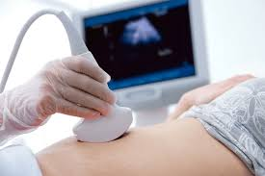
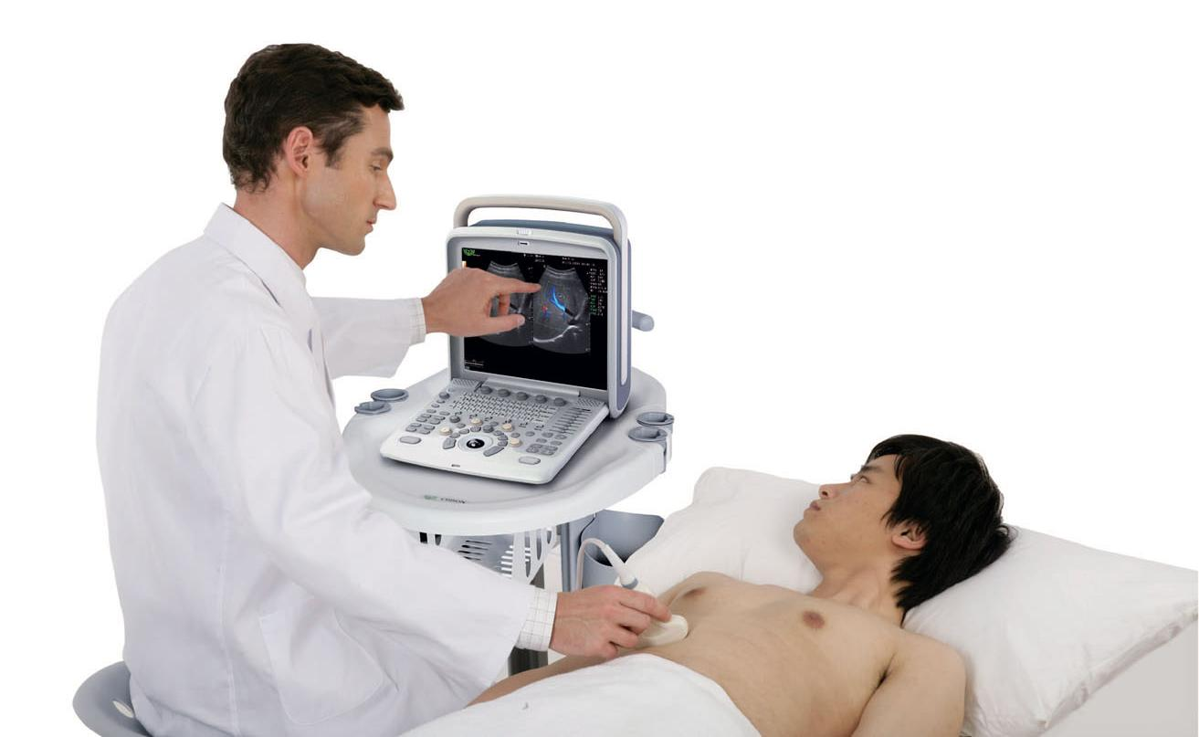
Sonography/sonologist

Slide 8
Clinical Applications
Abdominal, renal, and retroperitoneal
Interventional and therapeutic-guided
Thoracic
Superficial structures (breast, thyroid, scrotum) also known as small parts.
Cardiovascular and endoluminal
Obstetric and gynecologic
Intraoperative
Neonatal and pediatric
Musculoskeletal
Ophthalmologic

Slide 9
Advantages of Ultrasound
No harmful effects
No ionizing radiation.
Portable equipments.
Real time format
Multiplanar imaging: Can “follow” the path of a tortuous vessel, moving cardiac structure, or fetus
Doppler techniques: Allow qualitative and quantitative evaluation of blood flow
Costs less than other imaging systems.
Ultrasound contrast agent based on gas bubble.

Slide 10
Role of the Sonographer
Role → is a specific behavior that an individual demonstrates to others
Works directly with physicians and patients
Interacts with nurses and other members of the medical staff
Reviews patient’s records to assess clinical history and symptoms; interprets laboratory values; should understand other diagnostic examinations
Understands and operates complex ultrasound instrumentation
Notes:
Work directly with physicians and patients as team member in medical facility
Interact with nurses and other medical staff as part of health care team
10

Slide 11
How Is the Sonographer Different from Other Allied Health Professionals?
Talks directly with patients to identify which symptoms relate directly to the examination
Explains procedure to patient, and performs examination.
Uses the protocol established by the department
Notes:
11

Slide 12
How Is the Sonographer Different from Other Allied Health Professionals?
Uses independent judgment about needing to make adjustments on sonogram to answer clinical questions
Reviews previous sonogram.
Provides oral or written summary of technical findings to physician
Alerts physician if dramatic or new changes are found
Notes:
12

Slide 13
Qualities of a Sonographer
Self direction
Sonographer must be creative and able to make independent decision
Emotional stability
Communication skills
Must be effective communicator as well as a good listener
Dedication
Should find satisfaction in working with all types of patients, including children, expecting mothers and elderly patients.
Have normal or corrected vision, hearing and tactile sensitivity. Have physical and mental stamina endurance.

Slide 14
Qualities of a Sonographer
Intellectual curiosity
  Sonographer should be intelligent and challenged by the thoughts of putting it to work to help people
Eagerness
  Willing to train
Quick –thinking and analytic capabilities
  Should be capable of making accurate independent judgment, because patients life may depend on them
    Technical orientation
      Constantly willing to learn new technical skills.
Good Physical Health
Help to work hours, lifting the patient, able to handle the stress and be skilled in helping others

Slide 15
Advantages and Disadvantages of a Sonography Career
Specialized education in ultrasound get respect of other allied health professionals and clinicians.
Face the challenge of performing quality ultrasound examinations on difficult patients.
Notes:
15

Slide 16
Advantages and Disadvantages of a Sonography Career
New applications in ultrasound provide continual positive challenge.
Flexible schedules and varieties in examinations, equipment, patient personalities
Registered Sonographers have more employment opportunities with attractive salaries.
Notes:
16

Slide 17
Advantages and Disadvantages of a Sonography Career
Changes in medical care and decreased staffing have increased workloads.
Hours of continual scanning may lead to tendinitis, arm and shoulder pain, and back strain.
Working with terminally ill patients can lead to fatigue and depression.
Notes:
17

Slide 18
Job Market in Sonography
Is at the top of all medical imaging pay scales
Demand for registered Sonographers exceeds supply nationwide.
Positions at hospital or other health care facilities may include:
  Director of Imaging, Technical Director, Supervisor
  Chief Sonographer, Sonographer Educator
  Research Sonographer, Clinical Staff Sonographer, Clinical Instructor
  Independent business partners
Notes:
18

Slide 19
Art of Scanning
Manual dexterity
Hand-eye coordination
Conceptualization of two-dimensional into three-dimensional anatomy
Understanding of anatomy, physiology, pathology, instrumentation, image artifacts, and transducer characteristics

Slide 20
Responsibilities of the Sonographer
Obtain and record patient data pertinent to the ultrasound
Knowledge of ultrasound system
Provide quality patient care
Knowledge of Universal Precautions

Slide 21
Responsibilities of the Sonographer
Acquire, analyze, modify, and select images to record and present to interpreting physician for diagnosis
Use ultrasound terminology to prepare a written technical summary of ultrasound findings.
Technical report accompanies the recorded ultrasound images.
Notes:
Technical report accompanies the recorded ultrasound images.

Slide 22
Obligations of the sonographer
Become knowledgeable about the equipment.
Review the operator’s manual.
Understand the protocol for examinations.
Know how to read a patient order form and which questions the clinician needs answered.
Check the patient’s identification before each scan.
Introduce yourself to the patient; explain the procedure.
Keep the conversation professional.
Maintain confidentiality.

Slide 23
Research Statistics and Design for
Professional Development
Research statistics and design refers to the structured plan for conducting a study (research design) and the use of statistical methods (research statistics) to collect, analyze, and interpret data in order to answer research questions reliably and validly.
Sonographers can advance their professional development in research, statistics, and design by engaging with continuing education resources that emphasize evidence-based practice, competency milestones, and applied statistical literacy.

Slide 24
Breaking It Down
Research Design:
A blueprint or framework for how a study will be conducted.
Includes decisions about sampling, data collection methods, and analysis procedure.
Ensures the study is systematic, organized, and capable of producing valid results.
Research Statistics: The mathematical tools used to analyze data collected in research.
Helps summarize findings, test hypotheses, and determine whether results are significant.
Includes descriptive statistics (like averages and percentages) and inferential statistics (like regression, correlation, and hypothesis testing)

Slide 25
Why They Matter Together
Validity and reliability: A strong design ensures results are trustworthy, while statistics confirm whether findings are meaningful.
Evidence based practice: In healthcare fields like sonography, combining design and statistics allows practitioners to evaluate new imaging techniques critically.
Decision- making: Research design guides how data is collected; statistics guide how data is interpreted.
Career advancement: Professionals with these skills can contribute to clinical trials, publish research, and shape future training curricula.

Slide 26
Sonography example of research statistics and design
Imagine a sonographer wants to study whether a new ultrasound probe improves image clarity:
Design: They choose a comparative study with two groups (standard probe vs. new probe).
Statistics: They use t-tests or ANOVA (analysis of a variance)to compare image quality scores between groups.
Together, this ensures the study is structured and the results are statistically valid.

Slide 27
Why Research, Statistics, and Design Matter
Evidence-based practice: Statistical literacy ensures sonographers can critically evaluate new imaging techniques. Career advancement: Research skills open opportunities in academia, clinical trials, and leadership roles.
Curriculum innovation: Design-focused training helps shape future sonography education pathways.
Global collaboration: Research competencies connect sonographers to international networks and publications.

Slide 28
Core Resources for Sonographic Research & Design
Clinical Research Roles: Sonographers can expand into research positions, requiring knowledge of study design, data collection, and statistical analysis.
Curriculum Design Pathways: Discussion papers highlight sustainable training models and the importance of work-integrated learning for research-focused sonographers
Continuing Education in Sonography: Continuing educational courses and advanced certifications strengthen skills in methodology, imaging design, and evidence-based practice.
Comparative imaging education: Literature reviews show how sonographers differ from other healthcare professionals in imaging objectives, underscoring the need for specialized statistical and design training.

Slide 29
Practical Development Steps
Enroll in structured CME programs (AIUM, SDMS) with modules on research design
Participate in curriculum design discussions to influence training pathways
Read peer-reviewed journals (Journal of Diagnostic Medical Sonography, JASE) for applied statistical examples.
Pursue advanced certifications in specialized imaging areas to integrate research into practice
Join professional organizations to access mentorship and collaborative research projects.

Slide 30
STANDARD – PATIENT INFORMATION ASSESSMENT AND EVALUATION:
1. Information regarding the patient's past and present health status is essential in providing appropriate diagnostic information.
The diagnostic medical sonographer:
2. Verifies patient identification and that the requested examination correlates with the patient’s clinical history and presentation. In the event that the requested examination does not correlate, either the supervising physician or referring physician will be notified

Slide 31
STANDARD – PATIENT INFORMATION ASSESSMENT AND EVALUATION:
3.In compliance with privacy and confidentiality standards, interviews the patient or their representative, and/or reviews the medical record to gather relevant information regarding the patient's medical history and current presenting indications for the study.
4. Evaluates any contraindications, insufficient patient preparation, and the patient's inability or unwillingness to tolerate the examination and associated procedures.

Slide 32
SDMS Scope of Practice and Clinical Standards for the Diagnostic Medical Sonographer
LIMITATION AND SCOPE
Federal and state laws, accreditation standards, and lawful facility policies and procedures supersede these standards.
A diagnostic medical sonographer, within the boundaries of all applicable legal requirements and restrictions, exercises individual thought, judgment, and discretion in the performance of an examination taking into account the facts of the individual case.

Slide 33
STANDARD - QUALITY OF CARE:
All patients expect and deserve optimal care. The diagnostic medical sonographer:
1. Works in partnership with other healthcare professionals.
2. Reports adverse events.

Slide 34
STANDARD – ANALYSIS AND DETERMINATION OF PROTOCOL FOR THE DIAGNOSTIC EXAMINATION
The most appropriate protocol seeks to optimize patient safety and comfort, diagnostic quality, and efficient use of resources, while achieving the diagnostic objective of the examination. The diagnostic medical sonographer:
1. Integrates medical history, previous studies, and current symptoms in determining the appropriate diagnostic protocol and tailoring the examination to the needs of the patient.
2. Performs the examination under appropriate supervision, as defined by the procedure.
3. Uses professional judgment to adapt the protocol and consults appropriate medical personnel, when necessary, to optimize examination results.

Slide 35
STANDARD – ANALYSIS AND DETERMINATIO OF PROTOCOL FOR THE DIAGNOSTIC EXAMINATION
4. Confers with the supervising physician, when appropriate , to determine if intravenous contrast is necessary to enhance image quality and obtain additional diagnostic information.
5. With appropriate education and training, uses proper technique for intravenous line insertion and administers intravenous contrast according to facility protocol.

Slide 36
STANDARD – IMPLEMENTATION OF THE PROTOCOL:
Quality patient care is provided through the safe and accurate implementation of a deliberate protocol. The diagnostic medical sonographer:
1. Implements a protocol that falls within established procedures.
2. Elicits the cooperation of the patient to carry out the protocol.
3. Adapts the protocol according to the patient's disease process or condition.

Slide 37
STANDARD – IMPLEMENTATION OF THE PROTOCOL:
4. Adapts the protocol, as required, according to the physical circumstances under which the examination must be performed (operating room, sonography department, patient’s bedside, emergency department
5. Monitors the patient's physical and mental status.
6. Adapts the protocol according to changes in the patient's clinical status during the examination.
7. Administers first aid or provides life support in emergency situations.

Slide 38
STANDARD – IMPLEMENTATION OF THE PROTOCOL: Continued
8. Performs basic patient care tasks, as needed.
9. Recognizes sonographic characteristics of normal and abnormal tissues, structures, and blood flow; adapts protocol as appropriate to further assess findings; adjusts scanning technique to optimize image quality and diagnostic information.
10.Analyzes sonographic findings throughout the course of the examination so that a comprehensive examination is completed and sufficient data is provided to the supervising physician to direct patient management and render a final interpretation.
11. Performs measurements and calculations according to facility protocol.

Slide 39
STANDARD – EVALUATION OF THE DIAGNOSTIC EXAMINATION RESULTS:
Careful evaluation of examination results in the context of the protocol is important to determine whether the goals have been met. The diagnostic medical sonographer:
1. Establishes that the examination, as performed, according to protocols and guidelines.
2. Identifies and documents any limitations to the examination.
3. Notifies supervising physician when immediate medical attention is necessary, based on examination findings and patient condition.

Slide 40
STANDARD – IMPLEMENT QUALITY IMPROVEMENT PROGRAMS:
Participation in quality improvement programs is imperative. The diagnostic medical sonographer:
1. Maintains a safe environment for patients and staff.
2. Performs quality improvement procedures to determine that equipment operates at optimal levels and to promote patient safety.
3. Participates in quality improvement programs that evaluate technical quality of images,completeness of examinations, and adherence to protocols.
4. Compares facility quality improvement standards to external metrics, such as accreditation criteria, evidence based literature, or accepted guidelines.

Slide 41
STANDARD – SELF-ASSESSMENT:
Self-assessment is an essential component in professional growth and development. Self-assessment involves evaluation of personal performance, knowledge, and skills.
1. Recognizes strengths and uses them to benefit patients, coworkers, and the profession.
2. Recognizes weaknesses and limitations and performs procedures only after receiving appropriate education and supervised clinical experience in any deficient area.

Slide 42
STANDARD – EDUCATION:
Advances in medical science and technology occur very rapidly, requiring an on-going commitment to professional education. The diagnostic medical sonographer:
1. Obtains and maintains appropriate professional certification/credential in areas of clinical practice.
2. Recognizes and takes advantage of opportunities for educational and professional growth.

Slide 43
Principle I:
The diagnostic medical sonographer shall:
A. Provide information to the patient about the purpose of the sonography procedure and respond to the patient's questions and concerns.
B. Respect the patient's autonomy and the right to refuse the procedure.
C. Recognize the patient's individuality and provide care in a non-judgmental and non-discriminatory manner.

Slide 44
Principle I:
D. Promote the privacy, dignity and comfort of the patient by thoroughly explaining the examination, patient positioning and implementing proper draping techniques.
E. Maintain confidentiality of acquired patient information, and follow national patient privacy regulations as required by (HIPAA).“
F. Promote patient safety during the provision of sonography procedures and while the patient is in the care of the diagnostic medical sonographer.

Slide 45
Principle II:
F. Perform medically indicated ultrasound studies, ordered by a licensed physician or their designated health care provider.
G. Protect patients and/or study subject procedures, including documented informed consent.
H. Refrain from the use of any substances that may alter judgment or skill and thereby compromise patient care.
I. Be accountable and participate in regular assessment and review of equipment, procedures, and protocols.

Slide 46
Principle II:
C. Uphold professional standards by adhering to defined technical protocols and diagnostic criteria established by peer review.
D. Acknowledge personal and legal limits, practice within the defined scope of practice and assume responsibility for his/her actions.
E. Maintain continued competence through lifelong learning, which includes continuing education, acquisition of specialty specific credentials and recredentialing.

Slide 47
Principle III
F. Collaborate with professional colleagues to create an environment that promotes communication and respect.
G. Communicate and collaborate with others to promote ethical practice.
H. Engage in ethical billing practices.
I. Engage only in legal arrangements in the medical industry.
J. Report deviations from the Code of Ethics to institutional leadership

Slide 48
SDMS
Code of Ethics for the Profession of Diagnostic Medical Sonography -
The goal of this code of ethics is to promote excellence in patient care by fostering responsibility and accountability among diagnostic medical sonographers. In so doing, the integrity of the profession of diagnostic medical sonography will be maintained.
To create and encourage an environment where professional and ethical issues are discussed and addressed.
To help the individual diagnostic medical sonographer identify ethical issues.
To provide guidelines for individual diagnostic medical sonographers regarding ethical behavior.

Slide 49
Guiding ethical principles of medical ethics
Principles of the sanctity of life- One cannot make life and death decisions for patients based on personal values. Nobody has the right to conclude that another person’s life is not of value and should be terminated.
Principle of veracity- Refers to the honesty in all aspects of one’s life.
Principle of respect of property- Refers to keeping the patients’ belongings safe and taking care not to damage it

Slide 50
STANDARD – ETHICS:
The diagnostic medical sonographer:
1. Adheres to accepted professional ethical standards.
2. Is accountable for professional judgments and decisions.
3. Provides patient care with equal respect for all.
4. Respects and promotes patient rights, provides patient care with respect for patient dignity and needs, and acts as a patient advocate.
5. Does not perform sonographic procedures without a medical indication, except in educational activities.
6. Adheres to this scope of practice and other related professional documents

Slide 51
STANDARD – COLLABORATION:
Quality patient care is provided when all members of the healthcare team communicate and collaborate efficiently.
The diagnostic medical sonographer:
1. Promotes a positive and collaborative atmosphere with members of the healthcare team.
2. Communicates effectively with members of the healthcare team regarding the welfare of the patient.
3. Shares knowledge and expertise with colleagues, patients, students, and members of the healthcare team.

Slide 52
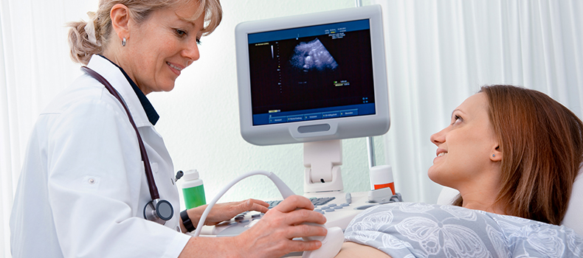


Slide 53
Documents for Ultrasound Studies
Ultrasound requisition / Prescription
Patient chart
Technical observation
Final interpretive report
Notes:
Once universal precautions are mastered, entry-level sonographers should turn their attention to essential documents for ultrasound studies.

Slide 54
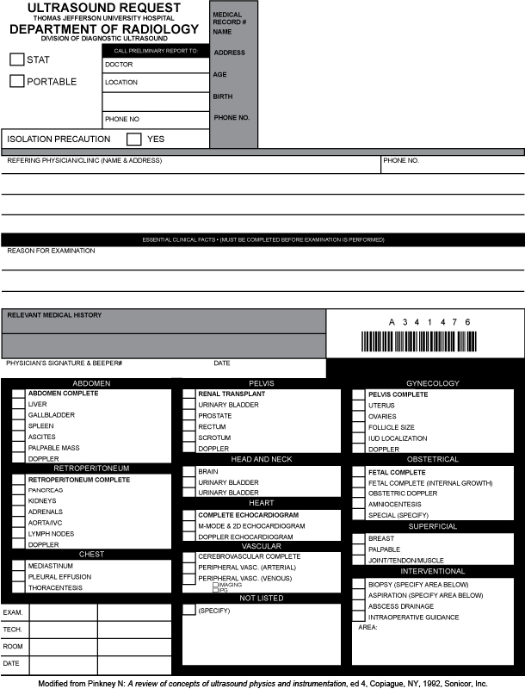
Ultrasound Request Form
Section One
Essential clinical facts
Patient identification—patient name, medical record number, hospital room number if possible
Examination priority and location—Is the examination STAT? Is the examination at the patient bedside (portable)?
Patient precautions—Are there any additional precautions necessary with this patient?
Notes:
Patient identification—patient name, medical record number, hospital room number if possible
Examination priority and location—Is the examination STAT? Is the examination at the patient bedside (portable)?
Patient precautions—Are there any additional precautions necessary with this patient?

Slide 55
Ultrasound Request Form
Section Two
Information provided by referring physician
  Name and address of referring physician
  Essential clinical data explaining the reason for the examination
Notes:
Name—may also include the name of the clinic where the physician saw the patient.
Essential data—patient symptoms, laboratory values, reason for the examination (i.e., rule out)

Slide 56
Ultrasound Request Form
Section Three
Additional information
  Patient history
  Physician signature (to be valid)
  Area for bar code
Notes:
This is the area where the ordering physician can add pertinent clinical information/history on the patient. Examples include abdominal pain, abnormal laboratory findings, family history of … , follow-up examination, thyroid nodules, to name a few.
The request should also include a physician signature to be valid.
Area for bar code

Slide 57
Ultrasound Request Form
Section Four
Examination type check-off boxes
Additional examination information
  Sonographer name
  Exam room/location
  Exam date

Slide 58
Patient Chart
The important items in a patient’s chart for sonographers to review are
  Assessment notes;
  results from the patient’s physical examination, list of their symptoms, and any other notable findings-
  Laboratory results(normal or abnormal)
  Reports of previous ultrasound(s) and correlating image modality studies (CT, MRI . . .)
Notes:
Box 1-1 lists the information found in a patient’s chart.
The important items in a patient’s chart for sonographers to review are
Assessment notes—results from the patient’s physical examination, list of their symptoms, and any other notable findings.
Laboratory findings—Are laboratory findings normal or abnormal?
Imaging modalities—review previous imaging reports pertinent to the ultrasound examination ordered.

Slide 59
Brief Medical History
Common requirement prior to beginning examination:
  Is your pain constant or does it come and go?
  How long have you noticed swelling in your leg?
  Any previous surgeries?
Notes:
In lieu of a detailed history provided on the request form, this may be the only means of obtaining pertinent information for outpatient examinations.

Slide 60
Patient Care During Ultrasound Examination
Universal precautions and isolation policies
Instruct and, if needed, aid the patient in undressing and gowning for the ultrasound exam
Assist patient onto the examination table from wheel chair or stretcher.

Slide 61
Patient Care During Ultrasound Examination (Cont.)
Be prepared to answer patient questions
Explain to the patient that the sonographer does not make the diagnoses but provides information to an interpreting physician
The final result will be sent to the referring physician to explain to the patient.
Notes:
Providing anything beyond that is not sensible, responsible, or legal, unless you are willing to assume the same liability that a physician does. By virtue of their education and training experience, only physicians can legally render a diagnosis. Physicians have the credentials to assume legal liability; sonographers do not.

Slide 62
Patient Care During Ultrasound Examination
See that the patient is as comfortable as possible
Briefly explain the examination process
  A transducer is placed on warm gel and moved in various ways to visualize the area of interest
  You may be asked to hold your breath or change your position

Slide 63
After the Examination

Slide 64
Sonographer Responsibilities
Complete an examination worksheet.
Ultrasound examination data worksheets will vary from institution to institution
  Patient’s medical history
  Clinical symptoms
  Pertinent laboratory test results
  Ultrasound findings
Include any reports from other imaging tests or procedures
Notes:
Ultrasound examination data worksheets will vary from institution to institution.

Slide 65
Sonographer Responsibilities (Cont.)
Provide a written technical observation summary of the ultrasound findings using sonographic terminology
  Permanent part of patient’s chart
  Observations documented in a way as to not be legally compromising

Slide 66
Technical Observations
Based on echo pattern and size
Abnormal findings should include origin or location, number, size, and composition (echo pattern)
Sonographer’s should never provide a diagnosis to the patient
Notes:
Technical observations should be confined to descriptions of the ultrasound findings based on echo pattern and size.
Keep in mind that technical observations are a summary of a sonographer’s findings.

Slide 67
Legal Guidelines
If a sonographer fails to make an accurate description in written observation summary but demonstrates findings on the images, he or she has performed within legal guidelines of scope of practice for diagnostic medical sonographers
The final interpretation of the ultrasound examination will always be the responsibility of the physician. By virtue of education, training, and legal parameters, physicians exclusively render diagnoses
Notes:
The final interpretation of the ultrasound examination will always be the responsibility of the physician. By virtue of education, training, and legal parameters, physicians exclusively render diagnoses.

Slide 68
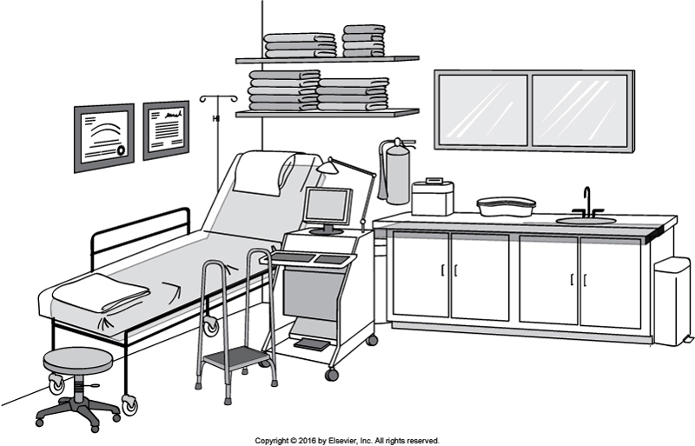
Ultrasound Examination Room
Notes:
A “patient-ready” ultrasound examination room should exemplify a well-equipped medical examination room; it must be clean and organized and convey a professional atmosphere. The room should be free of clutter and all personal items except modestly framed ultrasound training and registry certificates. The room requires an examination table or stretcher, a handled step stool, and the ultrasound machine.
The ultrasound examination room should also be stocked at all times with the following items in Box 3-1.

Slide 69
Ultrasound Examination Room
Stock Items
Patient examination gowns
Paper pillow covers
Scanning gel (bottles and refill containers)
Bottle warmers
Towels and washcloths
Sheets
Blankets

Slide 70
Ultrasound Examination Room
Stock Items (Cont.)
Examination gloves
Drapes
Emesis basins
Alcohol
Covered waste containers
Covered dirty laundry bin
Sharps container

Slide 71
Ultrasound Examination Room
Stock Items (Cont.)
Hand sanitizer
Angled sponges (for patient positioning)
Prepared sterile ultrasound procedure packages
Variety of needles, syringes, and tubing

