Slide 1

Cross-Domain Evaluation of DAViT
Testing Generalisation of a Pretrained Vision Transformer for Pneumonia Detection
Haseeb Arshad (23i-2578) • Haider Farooq (23i-2542) • Mudassir Asghar (23i-2577)
Department of AI & Data Science, FAST-NUCES Islamabad

Slide 2

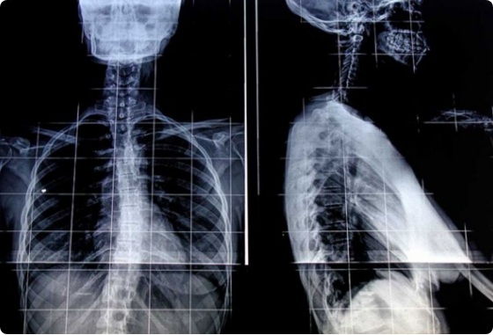
The Domain Gap Challenge
Why it Matters?
•
Clinical Need: Pneumonia kills 740,000+ annually; AI offers scalable diagnosis.
•
The Barrier: Models trained at one hospital (Source) fail at another (Target).
•
DAViT's Claim: Use DINOv2 backbone for "domain robustness."
•
Our Mission: Conduct a Zero-Shot Transfer to test if it survives unseen data.
Fig 1: Pediatric (Kaggle) vs Adult (CoronaHack) Domain Differences

Slide 3
Literature Review: Contemporary Methods
Baseline Papers (2024-25) | Technique | Limitations / Research Gaps
DAVIT (Fu et al., 2025) | DINOv2 + Domain Aug | Only evaluated on in-distribution test sets.
Inception-LSTM (Ghuse, 2025) | Spatial-Sequential Hybrid | Lacks Explainability; restricted to pediatric only.
VGG19 (Ennab, 2025) | Grad-CAM vs Pixel-Level | Dated architecture; high False Positive Rates.
Our Study: First Cross-Dataset Evaluation on CoronaHack for DAVIT.

Slide 4
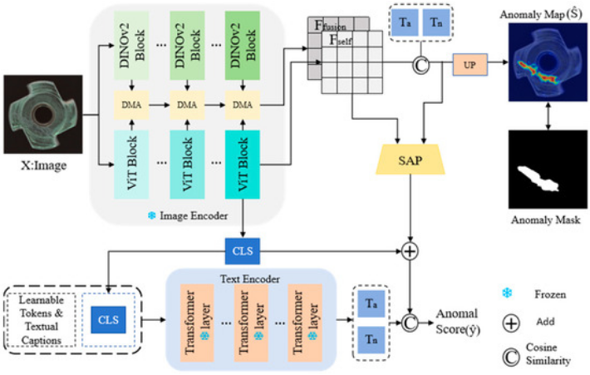
Proposed DANN + GRL Architecture
Objective:

Slide 5
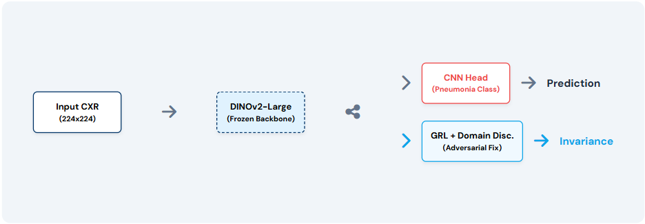
The DAViT Pipeline & Failure Point
Frozen Backbone
DINOv2-Large: 300M params. Frozen to preserve self-supervised general features.
Input: CXR 224x224
Output: 1024-dim [CLS] Token
Failure: The CNN Head
A 3-layer FC head trained on Kaggle. It memorized the texture of pediatric scanners.
Result: Miscalibration when seeing unseen adult imaging domains.

Slide 6
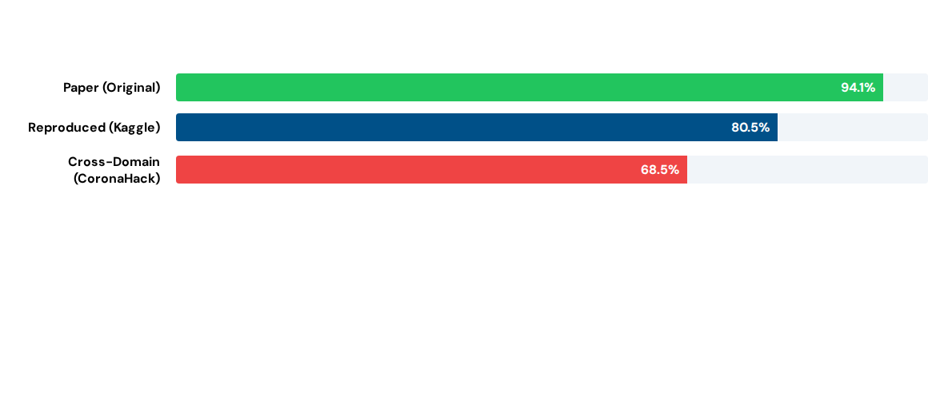


Three-Way Comparison (F1-Score)
-14.9% Drop
10x FP Spike
F1 Degradation under Domain Shift
Increased False Positives on Unseen Data

Slide 7
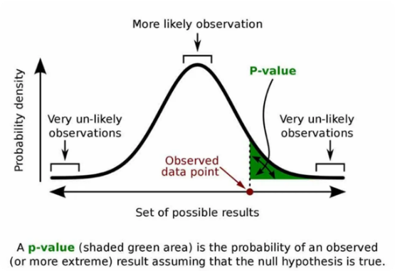

Statistical Significance Analysis
Two-Proportion Z-Test
We tested the null hypothesis: "Recall rates are equal across domains."
•
Z-Score: 2.87
•
Result: Reject H₀ at α = 0.01

Slide 8






Why Does it Fail? (Discussion)
Texture Overfit
Inverted Imbalance
Heterogeneity
CNN Head memorized pediatric scanner calibration. Adult scanners differ in contrast.
Kaggle ratio (0.6:1) vs CoronaHack (1.8:1). Boundary biased toward viral class.
Multi-source hospital systems introduce acquisition noise DINOv2 can't fully fix.

Slide 9
Key Contributions & Outcomes
Evaluation
First Cross-Dataset evaluation of DAViT on an entirely unseen Adult domain.
Failure Analysis
Identified CNN Head as the primary failure point for Vision Transformers in Med-AI.
Domain Shift
Statistically confirmed domain shift with Z-test (p=0.0041).
Architecture
Proposed DANN + GRL architecture as the remedy for hospital-agnostic deployment.

Slide 10
Questions?
Questions?
Thank you for your time and attention
Haseeb Arshad – 23i-2578
Haider Farooq – 23i-2542
Muddassir Asghar – 23i-2577

