Slide 1
Crowdsourcing in Software Engineering Models, Motivations, and Challenges
By,
Latha Muddu
Swetha Chandra Karroti
Pallavi Ramineni
Venkata Govardhan Goli

Slide 2
Introduction
Crowd Sourcing is an approach of how software is being developed through various leading models.
The idea of crowd sourcing is to take work and outsource it to a crowd of workers.
Crowd Sourcing, to get the outcome of a particular problem took less time, which actually did took years for the researchers.
This paper briefly explains the models , motivations and challenges of Crowd Sourcing in software engineering.

Slide 3
Penetration of Crowd Sourcing
Crowd Sourcing had already penetrated into software development practice through
Topcoder – It has hosted more than 427,500 software designs and awarded $25,000 a day to the competitors.
uTest - More than 100,000 testers freelance on uTest (www.utest.com), testing new apps for compatibility with devices, performing functionality testing, and conducting usability inspections and studies.

Slide 4
Penetration of Crowd Sourcing(Cont..)
In addition, more than 16,000,000 answers to programming questions have been provided on StackOverflow.
New platforms for crowdsourcing software engineering are emerging regularly, offering different specialized services— for example, Bountify (bountify.co), AppStori (appstori.com), and Pay- 4Bugs (www.pay4bugs.com).

Slide 5
Crowd Sourcing
Crowdsourcing represents the act of a company or institution taking a function once performed by employees and outsourcing it to an undefined (and generally large) network of people in the form of an open call.
The work is solicited through an open call to which basically anyone can respond.
The workers who volunteer are unknown to the organization needing the work done.
The group of workers can be large. What the open call’s exact nature.

Slide 6
Models of Crowd Sourcing
Peer Production - Control is decentralized and contributions are made without monetary reward.The contributors, rather than a paying client, decide the project’s scope and goals.
Example : Open Source
Competitions - In this model the client requests for the task and the co pilot divides the tasks and assigns to the eligible workers.
Example : 99designs , Bug bounties

Slide 7
Microtasking
This model divides the work into a set of self-supporting microtasks
Each microtask can be done in less time and together aggregate a solution to a big complicated task.
Amazon’s Mechanical Turk- a general platform
Advantage- Scalability
This model is success in Software Testing.
Some of the service providers in labor market
UserTesting
TryMyUI
TestBats

Slide 8
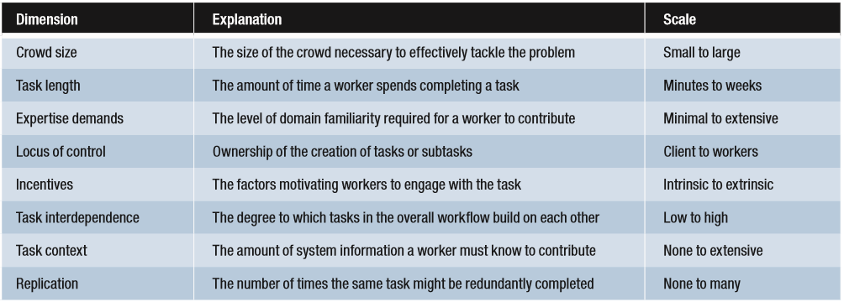
Dimensions of Crowdsourcing
All the three models in Crowdsourcing have major differences.
To demonstrate the differences, Thomas and Hoek listed 8 foundational dimensions.
Table 1: Dimensions of Crowdsourcing

Slide 9
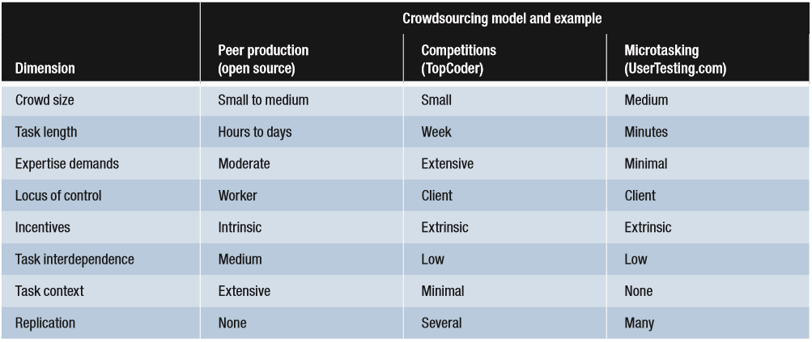
Contd…
Applying the dimensions to concrete example systems for peer production, competitions, and microtasking.
Table 2:

Slide 10
Example
Using the dimensions, we describe the PipeJam game:
crowd size: medium
task length: minutes
expertise demands: minimal
locus of control: client
incentives: intrinsic
task interdependence: medium
task context: none
replication: none
As these examples show, crowdsourcing systems with significantly varying approaches are possible.

Slide 11
Motivations
Now let’s consider the need for existing crowdsourcing models and platforms.
Most of the models are generally different
Their long-term benefits and drawbacks are not well understood.
Businesses, however, must see their actual benefits for adopting and using crowdsourcing. This can be even experimental.
Now, let us review several motives that make software development organizations to adopt crowdsourcing and also motivating developers to participate.

Slide 12
Reduced time to market
Main reason for the development of crowdsourcing is the increased development speed.
The fundamental aspect is parallelism.
The mighty whole is achieved by many workers contributing with small efforts.
This doesn’t mean that every crowdsourced effort is faster.
The crowdsourcing’s speed holds for models with two characteristics.
Work must easily be divided into smaller tasks.
Each task must be self-supported with minimum coordination demands, allowing workers to make a contribution quickly.

Slide 13
Generating alternative solutions
Classifying work into self-supported tasks allows multiple workers to independently complete the same task.
As the workers have diverse perspectives and ideas, selecting the best alternative solution can give high quality results.
Stack Overflow
99designs
Not every task is set up to generate alternatives
Test Bats

Slide 14
Employing specialists
Dividing large development tasks into smaller tasks gives greater flexibility in the use of specialist freelancers.
Crowdsourcing makes it possible to depend less on in-house developers who are generalists.
Freelancers opt to become specialists in specific range of technologies, performing highly specialized tasks for short time across many projects.
Moreover, many organizations need to have sufficient expertise in-house so as to guide the freelancers in their work and to check it once it’s complete. This might create significant new costs.

Slide 15
Democratization of participation
Rather than assigning the work to a team, crowdsourced work offers the open call to all the participants.
Anyone can contribute any work and will be awarded if they are successful.
It has some significant barriers.

Slide 16
Learning Through work
The key reason for developers to contribute to open source is to learn the new technology.
But this is a hurdle for the very developers who has more to learn.

Slide 17
Challenges
Many crowd sourcing benefits requires further decomposition of tasks and greater participation of crowd.
Work flow must address quality issues.
Each participant must precisely informed about the task.

Slide 18
Conclusion
Crowdsourcing has crept into the industry in many ways.
It is worthwhile for a community to develop a deep understanding of how and when to use the crowdsourcing.

Slide 19

Any Queries?

Slide 20


