Slide 1
Cloud Library
Team Number-10
Latha Muddu,
Swarna Kosaraju
SaiJyothi Gudibandi
Haritha Ichapurapu

Slide 2
Use Case
Cloud Library
Upload Books and do basic operations
Edit books, share
Save favorites

Slide 3
Architecture Style
Object Oriented Architectural Style
Modularity
Re-usability
Open-Close principle

Slide 4
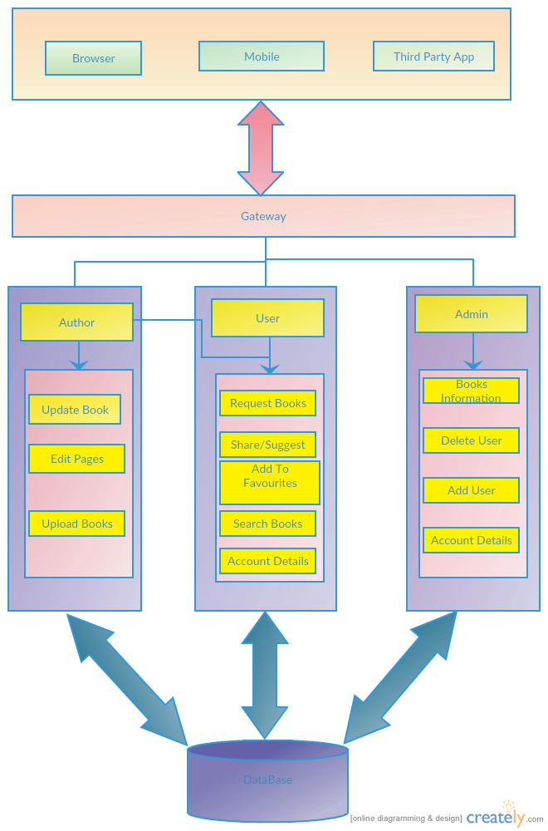
Architecture Diagram

Slide 5
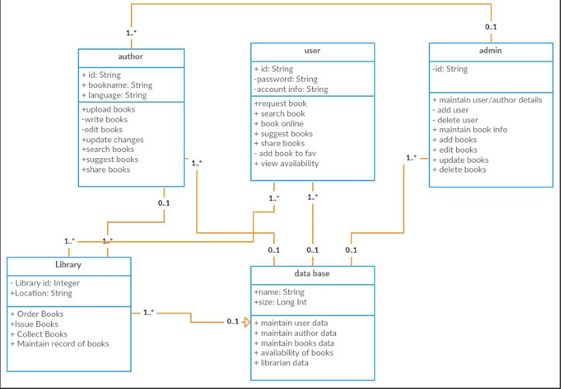
Class diagram

Slide 6
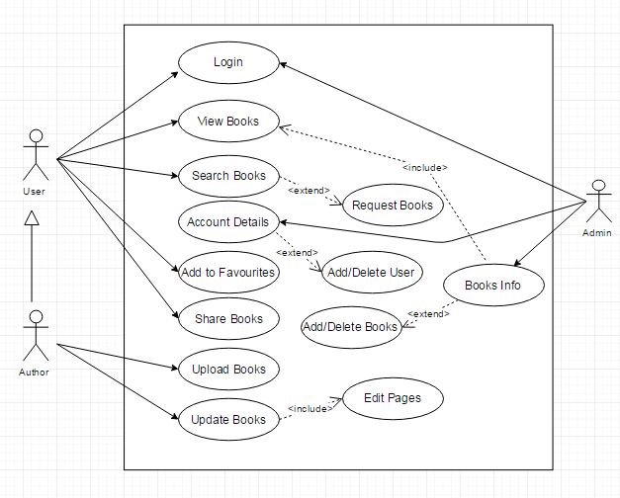
Usecase diagram

Slide 7
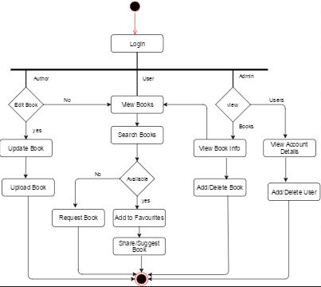
Activity diagram

Slide 8
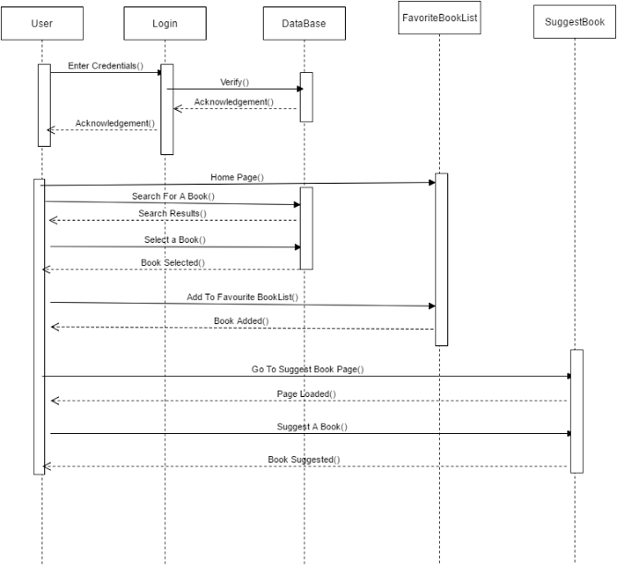
Sequence diagram: Suggest Book

Slide 9
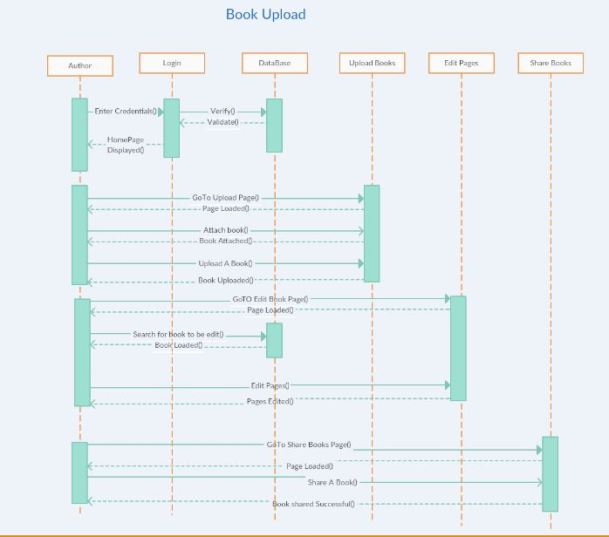
Sequence Diagram: Upload A Book

Slide 10
Design pattern
Abstract Factory Pattern
In our use case we abstract the pattern to only user, author and admin and the inner methods are hidden.

