Slide 1
Twitter Use Case
CALM Coders
Chaitanya Sai Manne
Akhilesh Gattu
Latha Muddu
Manikhanta Maddula

Slide 2
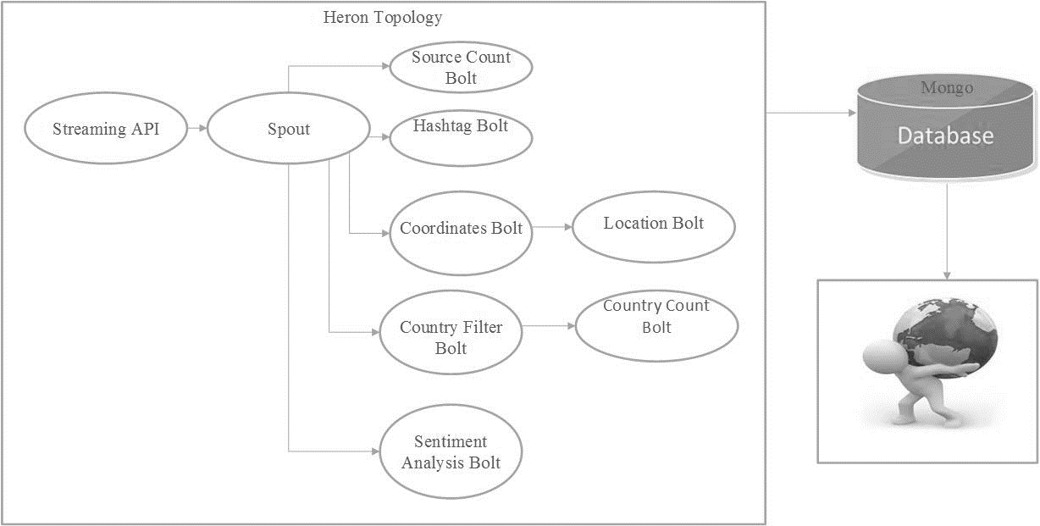
Architecture

Slide 3
Heron Twitter Use Case
Real Time BI : Analyzed the metadata and found the source of the tweet i.e., whether it has come from android device, IPhone or from web. We displayed the count of number of tweets from each source.
Real Time Trends : We identified the top ten hashtags based on number of tweets and calculated their respective count.

Slide 4
Cont.,
Some of the tweets contains latitude and longitude. We got those tweets and updated on the google maps to see where the tweets are coming from with the count of tweets from that location.
We also computed the top 3 countries tweeting for every two minutes.
Sentiment Analysis is done on the tweets collected and a pi-chart is taken showing the positive, Negative or neutral tweets and their respective count.

Slide 5
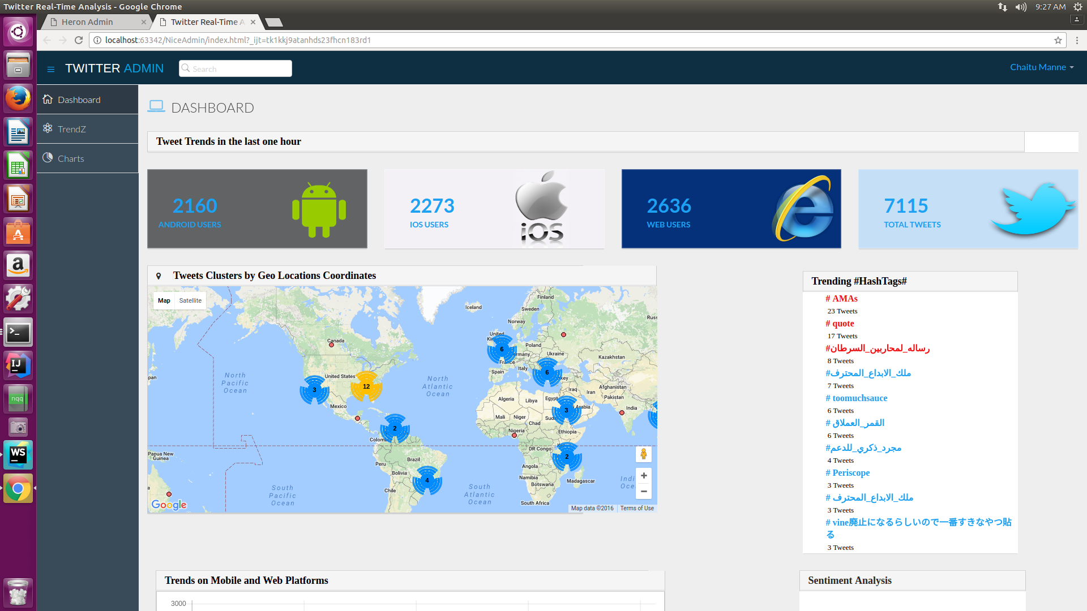
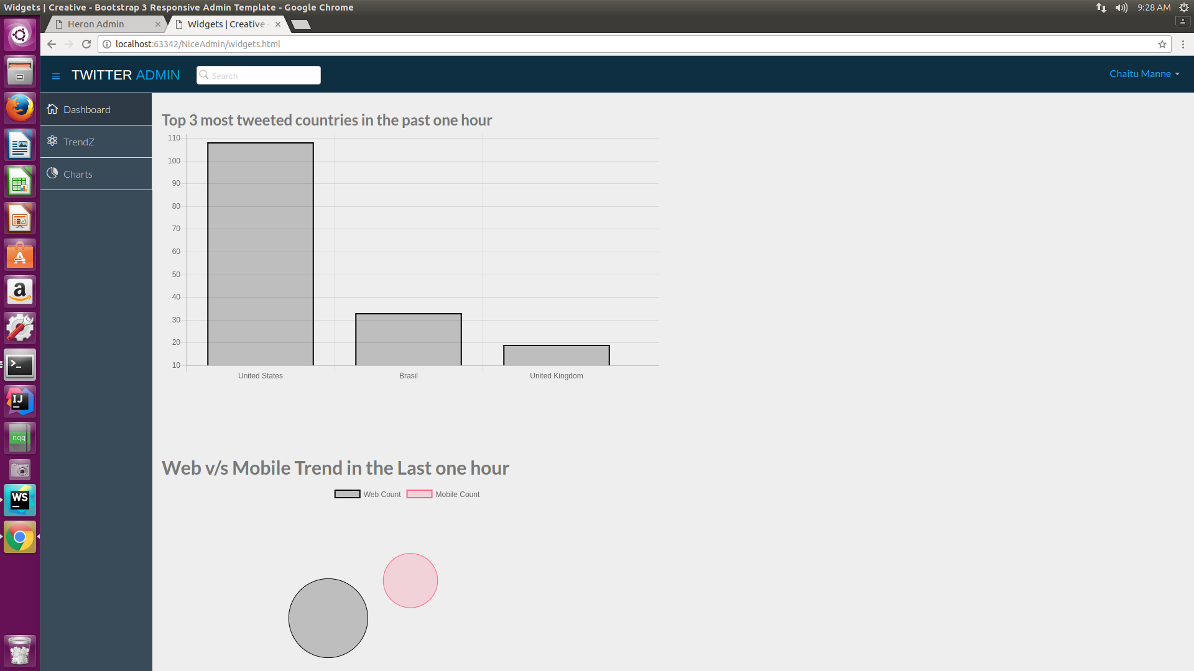
Screenshots

