Slide 1
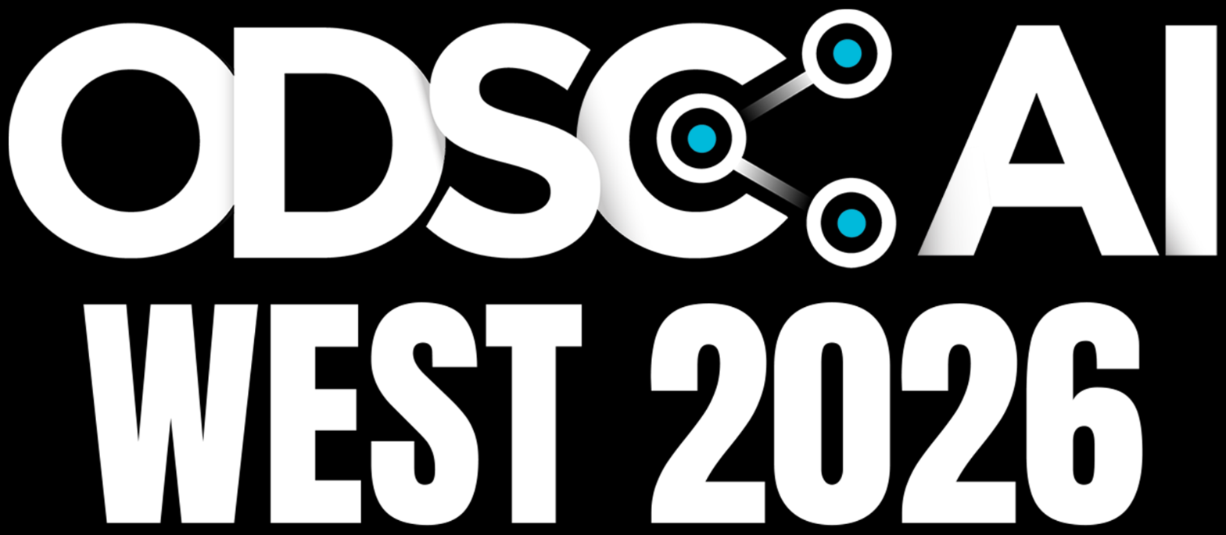
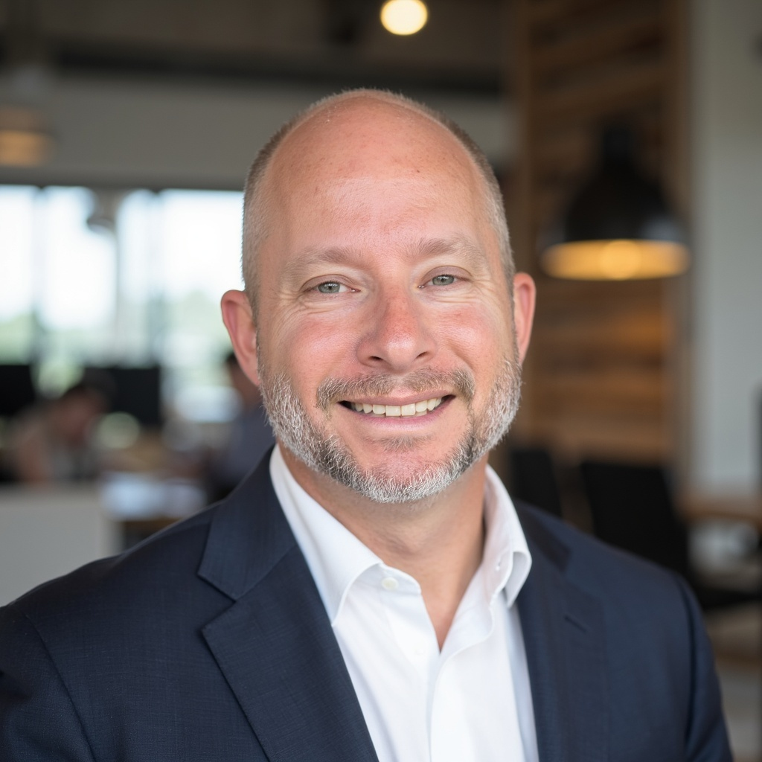
CONTEXT IS
THE TEAM.
How graph ontologies let a solo engineer ship across dams, education, and oil wells
Michael Porter
Founder, Muddy Boots Code
muddybootscode.io
Notes:
- ODSC title card (mandatory as slide 1), restyled to the deck’s colors and fonts. - Up while the room fills and the host introduces you. - Open with the one-line claim: a one-person shop shipping production software in three industries that share nothing. What makes it work isn’t the model. It’s the context I hand it. CUE Before 0:00 · Up during the introduction. Advance to “Context is the team.” when you start.

Slide 2
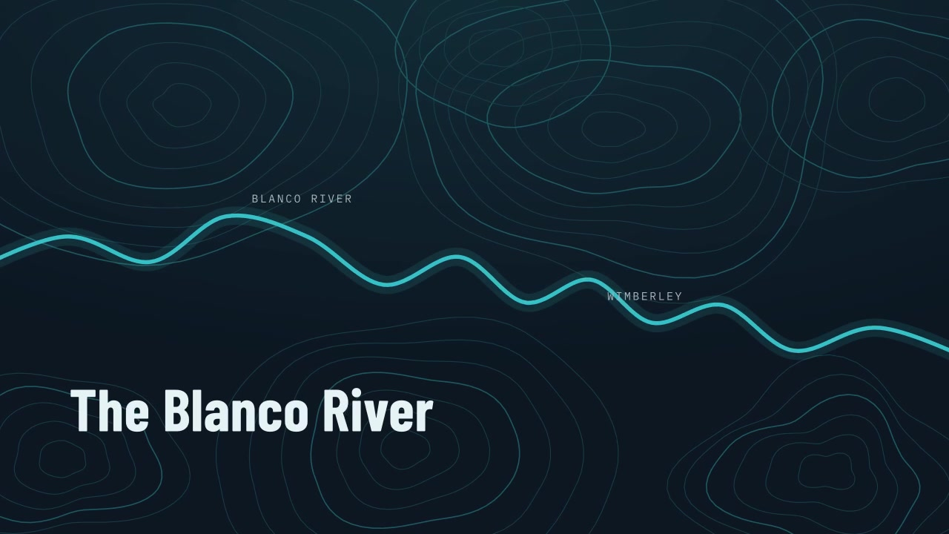
HOW MUCH WARNING DO WE HAVE?
FLOOD MANAGEMENT
Notes:
- Moved from the desert to the Blanco River. A community devastated by flooding. Personal. - The question: when the river rises, what do people need to know, and how soon? - Lives depend on getting it right. - Close word for word: “Before I wrote a line of code, I had to learn to speak the language of the domain.” CUE 1:00–3:00 · Click to play (1:42, with audio, May 2015 event). The last line sets up “The language of flood management.”

Slide 3
THE LANGUAGE OF FLOOD MANAGEMENT
VERTICAL 1 · FLOOD MONITORING
WHAT IS A STAGE?
WHY THIS ANSWERS THE FIRST QUESTION
WHAT IS A FORECAST CREST?
Before anyone can say how much warning we have, the system has to how to create the forcast.
WHAT HAPPENS AT FLOOD STAGE 13 FEET?
I didn’t figure this out alone. I worked it out with the LLM and the people who watch this river for a living.
Notes:
- The language I had to learn before writing anything useful. - Stage: water-surface height against a gauge’s reference. Not depth. - Forecast crest: highest predicted stage for an event, with a time. - Flood stage of 13 ft: not the river’s. It belongs to one forecast point. - Why it matters: the system has to know what a forecast is for. A forecast nobody acts on is no warning. - How the ontology got built, by discovery: – I asked the LLM dumb questions. It read the data and asked me back. – Where neither of us knew → the people who watch this river, my brother included. – Every answer went into the ontology. CUE 7:30–8:30 · Three questions build. Optional: take one answer from the room only if ahead of time. Nothing here calculates a hydrologic forecast or issues an official warning.

Slide 4

THE LANGUAGE OF FLOOD MANAGEMENT
VERTICAL 1 · FLOOD MONITORING · CRAYONS AND GLUE, APPLIED
1 · THE THINGS
2 · THE CONNECTIONS
3 · THE RULE · FLOOD-01
GAUGE · FORECAST POINT · OBSERVED STAGE · FORECAST CREST · FLOOD STAGE
MEASURED AT · UPSTREAM OF · APPLIES TO
A FORECAST AT FLOOD STAGE IS FORECAST FLOODING
Readings are measured at gauges. Each gauge is upstream of the next, with a travel time. A flood stage applies to one point.
Even while the observed stage is below it. Why: waiting for observed flooding loses the chance to warn before the water arrives.
A stage is a height. A crest is a prediction with a time. A flood stage belongs to a place.
BLANCO RIVER AT WIMBERLEY
ACTION 10 FT · MINOR 13 FT · MODERATE 17 FT · MAJOR 26 FT
Published per forecast point by the NWS. Not a universal number.
FORMAL NAME
An ontology provides context the LLM cannot be expected to know or guess.
Notes:
- Crayons and glue, applied. - 1 · The things: gauge, forecast point, observed stage, forecast crest, flood stage. – Stage = a height. Crest = a prediction with a time. Flood stage = belongs to a place. - 2 · The connections: – Readings are measured at gauges. – Each gauge is upstream of the next, and the edge carries a travel time. – Travel time + how fast upstream is rising = what makes a forecast possible. – A flood stage applies to one point. - 3 · The rule, FLOOD-01: a valid forecast at or above flood stage is forecast flooding, even while the observed stage is below. – Why: waiting for observed flooding loses the chance to warn. - Wimberley thresholds are real: action 10, minor 13, moderate 17, major 26 (NWS). Every point has its own. You can’t guess it. - Formal name: an ontology. Context the model can’t be expected to know or guess. CUE 8:30–10:00 · Cards left to right, then the threshold strip, then the formal-name line. Code stays closed. Thresholds are published; the next slide’s readings are invented. SOURCE · NWS water.noaa.gov/gauges/wmbt2 (USGS 08171000 → WMBT2); USGS rating-curve FAQ.

Slide 5


SAME READING. TWO ANSWERS.
VERTICAL 1 · FLOOD MONITORING · HOW MUCH WARNING DO WE HAVE?
11 ft
13 ft
18 ft
RIVER NOW
FLOOD STAGE
FORECAST CREST, 4 P.M.
NOON · GAUGE READS
+2 FT → 13 FT
UPSTREAM GAUGES RISING
THE TRIGGER FIRES
11 FT
FLOOD STAGE
18 FT AT 4 P.M.
WARN AT NOON
WITHOUT THE DOMAIN
WITH THE ONTOLOGY
Is 11 above 13? No.
A forecast at flood stage is flooding. It just hasn’t arrived.
NO WARNING
4 HOURS
until the river itself rises 2 more feet.
before the crest, warned at noon.
Teaching values; the flood stage is Wimberley’s published value
Notes:
- What one rule is worth. Same reading, two answers. - Noon: gauge reads 11 ft. Flood stage is 13. - Upstream gauges rising + known travel time → crest of 18 ft at 4 p.m. - Without the domain: is 11 above 13? No. No warning until the river rises 2 more feet. - With the ontology: a forecast at flood stage is flooding that hasn’t arrived. Warn at noon, 4 hours ahead. - Say: “An ontology doesn’t stop a flood. It stops software from throwing away a warning.” - Why minutes matter: May 2015, Wimberley went from ~5 ft at 9 p.m. to ~41 ft by 1 a.m. Below flood stage to major in 45 minutes. - Next: back home, oil and gas. CUE 10:00–11:30 · Builds: three numbers, four chain links, two answers. - Keep it honest: the graph captures upstream rise and travel time; official NWS crests also use rainfall and hydrologic models. - Don’t imply forecasters failed: NWS issued flash flood warnings at 4:13, 8:23 and 11:13 p.m. and a flash flood emergency at 11:24 p.m. SOURCE · 11 ft, 18 ft and 4 p.m. are invented teaching values; 13 ft is the published Wimberley flood stage (NWS WMBT2); 2015 figures from the NWS Austin/San Antonio event summary, weather.gov/media/ewx/wxevents/ewx-20150524.pdf.

Slide 6

THE FIELD TAUGHT ME THE PROBLEM. THE CODE CAME LATER.
HOW I GOT HERE
WHERE I COME FROM
HOW I GOT STARTED
WHAT CHANGED
THE PATH
THE SHOP
AI
MARINE
↓
SECURITY CONTRACTOR
↓
FEDERAL AGENT
↓
OIL FIELD HAND
AUTOMATED DATA ENTRY
↓
ASKED FRIENDS FOR THEIR PROBLEMS
↓
LARGER SOFTWARE PROJECTS
↓
MUDDY BOOTS CODE, 2018
ON EVERY CREW, SOMEBODY HAD YOUR BACK
↓
SOMEBODY CAUGHT WHAT YOU MISSED
↓
NOW IT’S ONE PERSON AND A CODING AGENT
Notes:
- Michael Porter. Marine → security contractor → federal agent → oil field hand. - Kept meeting people doing hard jobs with tools that made it harder. - Automated data entry → asked friends for their problems → bigger projects → Muddy Boots Code, 2018. - Mission: hand people better tools. - Every crew: somebody had your back, caught what you missed. - Now it’s me and a coding agent. What replaces the crew? Hold that question. CUE 3:00–3:45 · 30–45s. Don’t read the columns. Pays off on “Context is the team.”

Slide 7
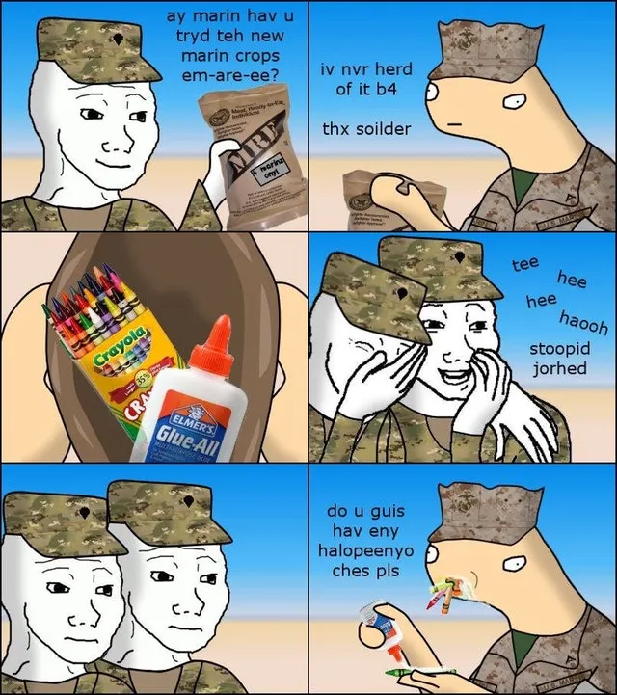
CRAYONS AND GLUE
I HAVE A SIMPLE PHILOSOPHY
1
NAME THE THINGS.
2
DRAW THE CONNECTIONS.
3
WRITE DOWN THE RULES.
Notes:
- Marine habit: break it down to crayons and glue. – What are the things? – How do they connect? – What has to be true, and why? - If I can make it clear to a person, I can make it clear to a coding agent. - How I learn a domain’s language → written down as an ontology → becomes a tool. - But first, a wrong turn. CUE 5:15–6:00 · Let the image land. It’s your method for making meaning clear, not a comment on the audience. Image supplied by Michael Porter.

Slide 8
CONTEXT IS THE TEAM.
How Graph Ontologies Let a Solo Engineer Ship Across Dams, Education, and Oil Wells
IT’S JUST ME.
This year I shipped software across three domains, with an LLM doing the work.
01
02
03
04
ONTOLOGIES
HOOKS & GATES
VERIFICATION
SKILL & MOD
One per project. The domain’s language, its rules, and why.
Lifecycle events and mechanical checks the model can’t talk past.
A harness that proves every change: screenshots before and after, data checks front to back.
The whole process, codified, so I stop doing it by hand.
Notes:
- It’s just me. Solo developer. - This year: three domains, an LLM did most of the writing. - Four pieces, left to right: – Ontologies: one per project. The domain’s language, its rules, and why. – Hooks & gates: lifecycle checks the model can’t talk past. – Verification: before/after screenshots for front end, data checks for back end. – Skill & mod: the whole process, codified. - Today: how the ontologies get built, how the gates hold the model to them, real examples. - You leave with the skill and the mod. CUE 3:45–5:15 · Name each piece as it builds. Don’t explain yet; each gets its own section. ODSC title card precedes this slide if supplied.

Slide 9




I KEPT CORRECTING. I THOUGHT IT WAS MEMORY.
WHAT I TRIED FIRST
WHAT I KEPT DOING
WHAT I BUILT
WHAT I OBSERVED
THE SAME CORRECTIONS
A MEMORY GRAPH
STILL CORRECTING
The same terms, the same relationships, the same rules, explained again on every change.
Years of Neo4j. I thought it kept forgetting, so I reached for a graph. Several versions.
Recall was good. It remembered what we’d discussed. I still had to correct what it understood.
LESSON ONE
Memory gave the model our history. It didn’t give it the language.
Notes:
- Same corrections on every change: what a thing means, how it connects, which rule still holds. - On a crew, that’s the senior hand’s job. I was the senior hand on every change. - Ask: what do you keep correcting your agent about? Hold it; we come back to it at the end. - First diagnosis: it keeps forgetting. Years of Neo4j → built a memory graph, several versions. - Recall was good. It remembered what we’d discussed. Still correcting what it understood. - Lesson one: memory gave it our history, not the language. CUE 6:00–7:30 · Show of hands on the repeated correction. Memory isn’t useless; it solved a different problem. No benchmark claims.

Slide 10
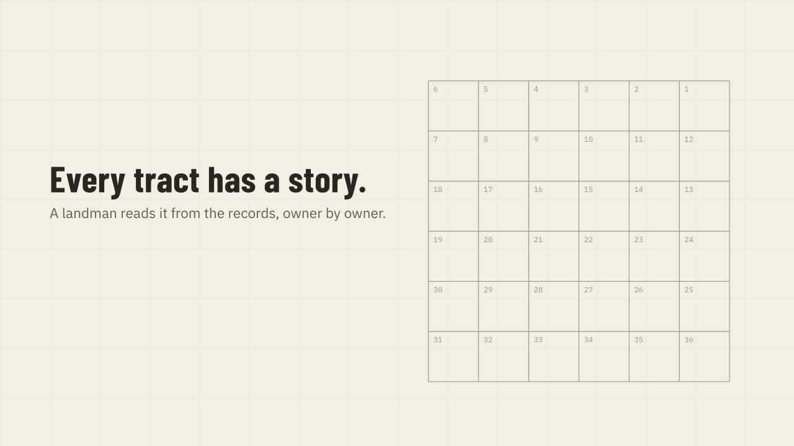
THE LANDMAN’S GRAPH
VERTICAL 2 · OIL & GAS
Notes:
- Watch the family and the interests change. Each event adds something to keep track of. - Ignore the vocabulary. Watch the picture grow. - The answer at the end only makes sense because you watched how we got there. - Hand you the final value with no history → you can’t tell me whether it’s right. CUE 11:30–13:30 · Click to play (~2:06, silent). Cold open, like the flood video: show first, explain after. Don’t explain the ontology yet; that’s two slides on. SOURCE · the-landman-s-graph.mp4, 720p, no audio.

Slide 11
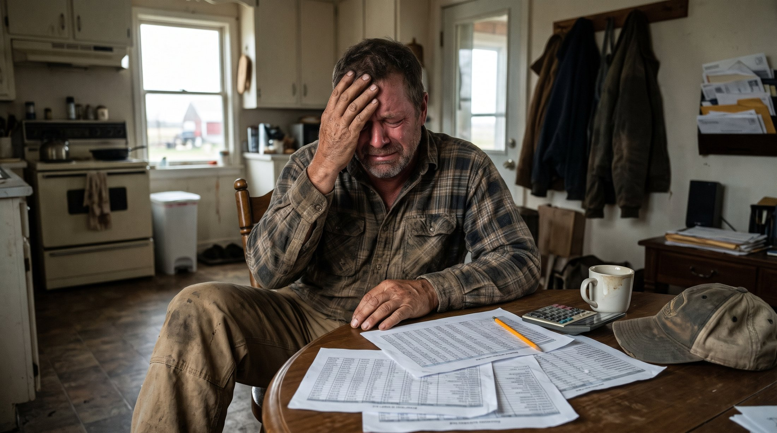
THIS IS A LOT TO KEEP STRAIGHT.
THE LAND PROBLEM
Notes:
- The person I was trying to help: making sense of years of documents and relationships. - Understand the job before building anything. CUE 13:30–13:45 · Let the image carry the burden of the work. Illustrative AI-generated image supplied by Michael Porter, not a client photo.

Slide 12
THE LANDMAN’S LANGUAGE
VERTICAL 2 · OIL & GAS · LAND AND TITLE
WHO OWNS WHAT TODAY?
WHAT’S DIFFERENT FROM THE RIVER
HOW DID THEY GET IT?
The river was about intent: what the number is for. A forecast exists so someone can act before the water arrives.
People and families.
Land is about history: today’s answer only means something if you can trace how it was assembled.
Mineral interests.
Documents and history.
A different thing to make explicit for the agent. A different thing to check.
Notes:
- Same move, new language. - The landman’s question: who owns what today, and how did they get it? - The things: people and families, mineral interests, documents. - As a graph it looked like a family tree. Follow the connections instead of holding them in my head. - River = intent: what the number is for. - Land = history: today’s answer only means something if you can trace how it was assembled. - Different thing to make explicit for the agent. Different thing to check. - Then a third world: higher education. CUE 13:45–14:45 · Domain overview, not a title opinion. Land the word “history” before advancing.

Slide 13

THE LANGUAGE BECOMES SHARED CONTEXT.
THREE DOMAINS, ONE MOVE
FLOOD MONITORING
OIL & GAS
HIGHER EDUCATION
INTENT
HISTORY
OUTCOMES
What a forecast is for decided what the code had to preserve.
The lineage was part of the answer.
Another domain, another ontology. Same method.
CRAYONS AND GLUE
ONTOLOGY
?
LEARN THE LANGUAGE
WRITE IT DOWN
HOLD THE MODEL TO IT
Notes:
- Also higher education and student outcomes. Another domain, another ontology, built the same way. One line; no detail. - Three domains: – Flood: intent. What a forecast is for decided what the code had to preserve. – Oil & gas: history. The lineage was part of the answer. – Higher ed: same method, new language. - Same steps each time: – Crayons and glue → learn the language. – Ontology → write it down. - I handed it to the model. Was that enough? CUE 14:45–15:45 · Name higher ed in one sentence. “A client,” never named. Pause on the “?” box and let the room answer. Next slide: no.

Slide 14
HOLD THE MODEL
TO IT.
STEP 3 OF 3
Turn written rules into checks the model can’t skip.
Notes:
- Was writing it down enough? No. - Step 3: turn the written rules into checks the model can’t skip. CUE 15:45–16:00 · 15 seconds. Let the slide answer the question, then go to the lockout.

Slide 15
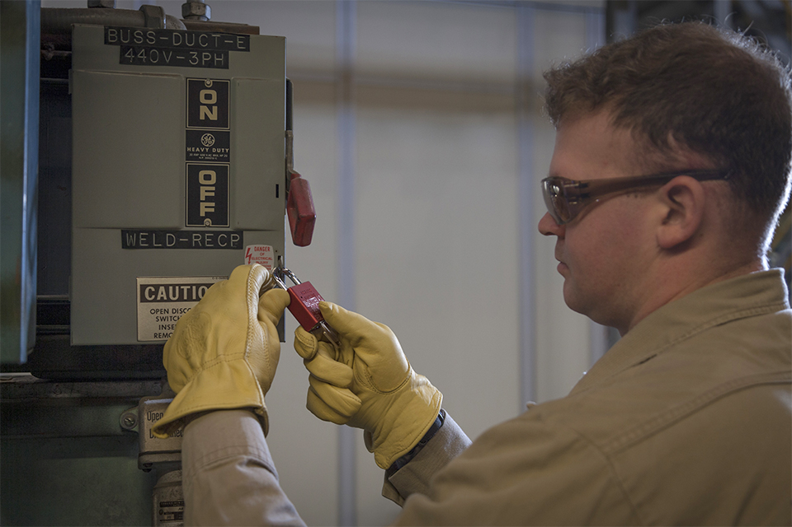


EVEN THE SMARTEST PEOPLE MAKE MISTAKES.
MECHANICAL GATES
LOCKOUT / TAGOUT
The tag says don’t operate it. The lock physically stops you. Different jobs.
WHAT REPLACES THE CREW?
On a crew, the lock is the teammate who can’t forget. I want that for myself and for the model, at the point where we can make a mistake.
Notes:
- Big believer in mechanical gates. Comes from work where a missed step hurts somebody. - Lockout/tagout: – The tag says don’t operate it. – The lock physically stops you. - Smart people still get interrupted, switch jobs, carry five things in their head. - What replaces the crew? Part of it: the lock is the teammate who can’t forget. - I want that for me and the model, at the exact point of the mistake. - Next, the well. Then four parts: the file, the test it names, the moments it’s checked, what the model sees when it’s wrong. CUE 16:00–17:00 · Point to the lock and the tag in the photo. Conceptual analogy, not safety training. SOURCE · OSHA 29 CFR 1910.147(c)(7)(ii)(A). Photo: Y-12 National Security Complex, Scott McAlister.

Slide 16
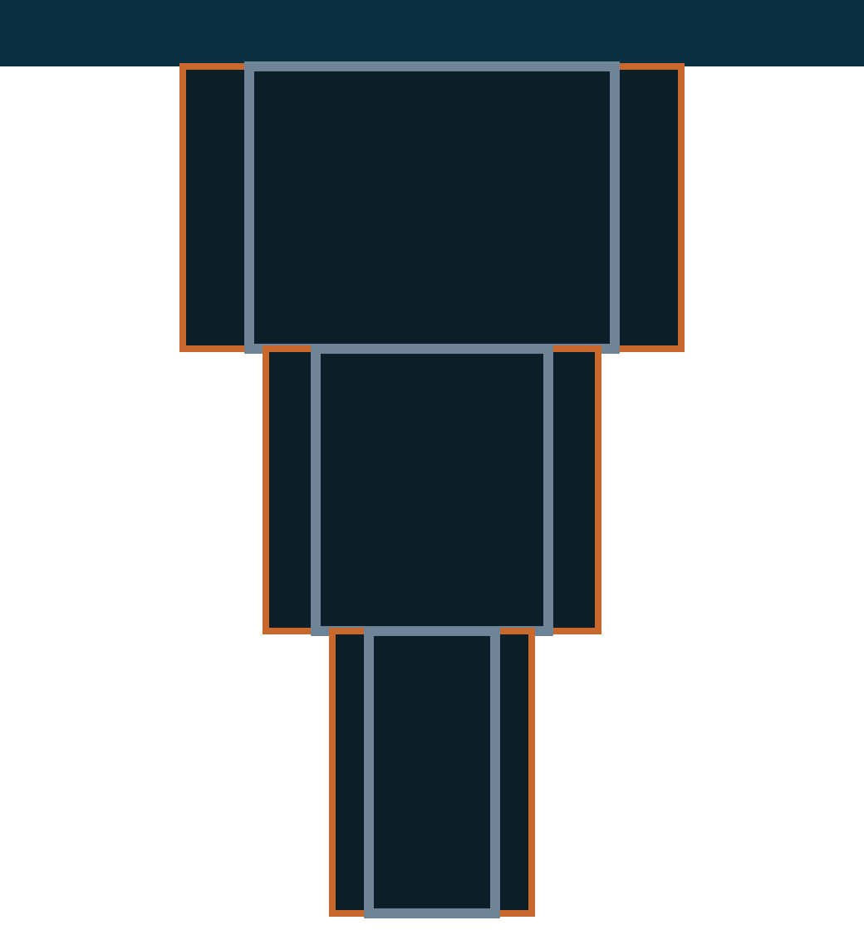
A WELL IS A SERIES OF HOLES.
A RULE WE CAN CHECK
SURFACE
SMALLER AS WE GO DEEPER
HOLE 1
Each hole is narrower than the one above it.
CONNECTED END TO END
HOLE 2
Each hole starts exactly where the one above ends.
CASING FITS THE HOLE
CASING
HOLE 3
The pipe that goes into a hole has to be smaller than that hole.
Notes:
- Here’s how I found out. - Wellbore picture: a well is a series of holes. – Each deeper hole is narrower. – Each starts exactly where the one above ends. – Casing must be smaller than the hole it goes into. - Obvious once you see it. Can’t assume a person knows it, and certainly not the model. - Wrote it down. Handed the model the ontology. - It still accepted casing bigger than the hole. - Lesson two: a description the model can read is not a check the model can’t skip. CUE 17:00–18:00 · Walk surface-down. Point at the grey casing as the third relationship. Simplified teaching model, no dimensions, not to scale.

Slide 17
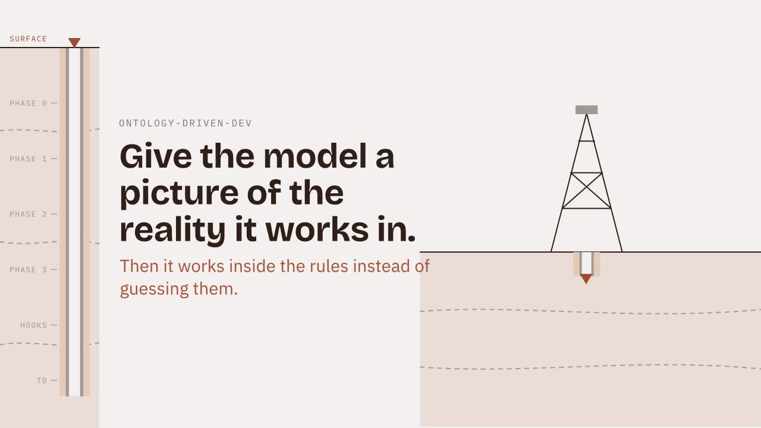
ONTOLOGY-DRIVEN DEVELOPMENT
CODIFIED · THE SKILL
Notes:
- I was doing all of this by hand on every project. Codified it into a skill. - Reads the repo first. Harvests rules the code enforces but never states: – a thrown error, a clamp, a sorted loop, a box drawn inside its parent. - Interviews me for what code can’t say: intent, what a word means here, out of scope, what a missing value means. - I confirm the wording → it writes the ontology → installs the hooks you just saw. - Watch where I supply the meaning. The model maps and implements; I confirm relationships, rules and scope. CUE 25:00–27:30 · Click to play (~2:28, silent). Narrate the workflow. SOURCE · Harvesting line from SKILL.md Phase 1a-ii (refusals, repairs, ordering and containment, projection). ontology-driven-development.mp4, 720p.

Slide 18
HOW A CHANGE FINDS ITS RULE
HOLDING THE MODEL TO IT · THE MAP
1 A CHANGE LANDS
2 IS THE FILE GOVERNED?
3 WHICH FUNCTIONS CHANGED?
Edit, end of turn, commit, CI
governs: in ontology/*.md
Changed lines → functions
Each one triggers a check.
No: ignored. Yes: keep going.
Read with the TypeScript compiler.
steps 3–5 run at the end of the turn
PASS CLEAN, the turn ends
5 RUN THOSE RULES’ TESTS
4 WHICH RULES USE THEM?
fit.test.ts → casing rule
ontology/gates/<rule>.json
FAIL OR NOT RUN blocked, rule quoted back to the model
Only the tests of the rules this change touched.
Built from each rule’s test coverage. Nobody types it.
Every step is logged to .claude/ontology-state.jsonl. The mod shows it.
THE CHECKER NEVER GUESSES. GOVERNS: SAYS WHICH FILES MATTER. THE RULE’S TEST SAYS WHICH FUNCTIONS.
Notes:
- The map, before the file. How does a change find the rule it might break? - 1 A change lands: an edit, the end of the turn, a commit, CI. Same check every time. - 2 Is the file governed? The governs: list in the ontology says which files matter. Not governed → ignored. - 3–5 at the end of the turn: changed lines → functions (TypeScript compiler) → the rules whose gate files list those functions → run only those tests. - The gate files come from running each rule’s test with coverage. Nobody types the list. - Pass → CLEAN. Fail or not run → blocked, and the model reads the rule back. - Every step lands in the state log; the mod reads it. CUE · About 45 seconds. Walk the U, 1 to 6. Next slide: the file that holds governs: and the gate. SOURCE · ODSC-Workshop-Kit-V2: ontology/scripts/ontology_check.py (--touched, --changed), ontology_gates.py (gate_verdicts, --build), .claude/settings.json.

Slide 19
ANATOMY OF AN ONTOLOGY FILE
HOLDING THE MODEL TO IT · 1 OF 4
ontology/fit.md
governs:
---
domain: hole-fit
governs:
- "src/fit.ts"
---
## Intent
Decide whether casing fits the hole at one cross-section.
## Entities · ## Relationships
Hole · Casing · (Casing)-[INSIDE]->(Hole)
## Invariants
- Casing must be strictly smaller than the hole containing it.
Equal diameters do not fit. [gate: `fit.test.ts`]
## Vocabulary
- Fit: strictly smaller. No minimum clearance is added.
## Out of scope
- Input validation, depth overlap, engineering clearance.
The code that must move with this file. Change it without changing the ontology, and the turn is blocked.
[gate: …]
Names the test that enforces the rule. An invariant with no gate is a wish.
VOCABULARY · OUT OF SCOPE
What a word does not mean here, and where scope creep dies.
Every line is something the model could violate.
HOW A RULE FINDS ITS CODE
ontology/fit.md
tests/fit.test.ts
src/fit.ts › fitsHole
[gate: `fit.test.ts`] names the test
npm run gates:build runs it alone, with coverage
the function that test ran through, saved in ontology/gates/
Notes:
- What the model gets: one markdown file per domain. - Six required sections: intent, entities, relationships, invariants, vocabulary, out of scope. - Three parts do the enforcement: – governs: the code that must move with this file. Code changes, ontology doesn’t → turn blocked. – [gate: …] on every invariant names the test that enforces it. No gate = a wish. – Vocabulary: what a word does NOT mean here. Out of scope: where scope creep dies. - Not documentation. Docs describe what was built. An ontology constrains what may be built. - Every line is something the model could violate. - The wiring strip, left to right: – The gate names the test: fit.test.ts. – npm run gates:build runs that test alone with coverage on. – The function it runs through, fitsHole, is saved in ontology/gates/<rule>.json. Nobody types that list. - So when fitsHole changes, the checker knows which rule is at risk and which test to run. Next slide: that test. CUE 18:00–19:45 · File top to bottom, the three callouts, then the wiring strip. SOURCE · Six sections, governs and [gate: …] from the ontology-driven-dev skill (ONTOLOGY.template.md; ontology_lib.py REQUIRED_SECTIONS). The fit.md text is the kit’s ontology/fit.md (ODSC-Workshop-Kit-V2), trimmed: [confirmed: …], evidence and changelog left out. Wiring: ontology/gates/casing-must-be-strictly-584728.json; ontology/scripts/ontology_gates.py --build.

Slide 20
A DOMAIN RULE IN A UNIT TEST
HOLDING THE MODEL TO IT · 2 OF 4
tests/fit.test.ts
expect(fitsHole(15, 15))
.toBe(false);
RUN THE TEST
npm test
Equal diameters do not fit. The expected answer is recorded independently of whatever the model writes.
Your coding agent can run it. So can you. Nothing exotic.
Notes:
- The lock for the casing rule: an ordinary unit test. - Trace the chain from rule to test: – Invariant: casing is strictly smaller than its hole. – Vocabulary: “fit” = strictly smaller. Equal is not a fit. – The gate note points here: tests/fit.test.ts. – The test: fitsHole(15, 15) must be false. - Why equal diameters: it’s the boundary, exactly where a < quietly becomes <=. - The expected answer comes from the ontology, written before the code. Not from whatever the model writes. - Model’s code disagrees with the domain → test fails → gate fails → turn blocked. - Nothing exotic: npm test. Your agent can run it. So can you. - Next: making sure it runs when it matters, without anyone having to remember. CUE 19:45–20:30 · The test the anatomy slide’s gate names. Three supplied cases pass. One example is not complete validation.

Slide 21
THREE MOMENTS THE MODEL IS HELD TO IT
HOLDING THE MODEL TO IT · 3 OF 4
BEFORE THE FIRST EDIT
AFTER EVERY EDIT
BEFORE THE TURN ENDS
SESSIONSTART
POSTTOOLUSE
STOP
ontology_query.py summary
ontology_check.py --touched
ontology_check.py --changed
Intent, entities and the rule count go into context. The model never starts from a blank page.
Ungoverned file: silent. Touched a governed path: logged. Changed what a rule describes: the message goes back to the model.
Runs the tests of every rule whose functions changed. Failed or not run: the turn is blocked. So is governed code that moved without the ontology.
Every check writes a line to .claude/ontology-state.jsonl, test results included. The mod reads that file.
Mid-task, the model can ask: entity · term · invariants · scope.
THE MODEL IS PERSUASIVE. THE GATE IS NOT.
Notes:
- Claude Code gives you lifecycle events. I hang a check on three. - SessionStart: ontology summary into context. Intent, entities, rule count. Never a blank page. - PostToolUse, on every Edit or Write: – Ungoverned file → silent. – Governed, but nothing a rule describes moved → logged. – Touches what a rule describes (a named declaration, a gate file, one side of a must-move-together pair) → exit 2, message goes straight back to the model. - Stop: maps the diff’s changed lines to functions → finds the rules whose gate files list those functions → runs those tests. Fail or not run → turn blocked. Governed code moved and the ontology didn’t → also blocked. – Same check runs as the git commit hook and in CI. Doesn’t depend on the agent. - Mid-task the model can query the file: entity, term, invariants, scope. - Every run writes a line to .claude/ontology-state.jsonl, test results included. The mod reads it; you’ll see that later. - “The model is persuasive. The gate is not.” CUE 20:30–22:30 · Three columns, one line each, then the bottom lines. SOURCE · assets/hooks.settings.json (SessionStart; PostToolUse matcher Edit|Write|MultiEdit; Stop); scripts/ontology_check.py (--touched, --changed, exit 2) in the ontology-driven-dev skill.

Slide 22
WHAT THE MODEL SEES WHEN IT’S WRONG
HOLDING THE MODEL TO IT · 4 OF 4
AFTER THE EDIT · LOGGED, NOT SENT
TWO WAYS OUT
The model changes casingOd < holeId to <=. src/fit.ts is governed, so the edit is logged. Nothing goes back to the model yet.
1 Fix the code until the rule’s test passes.
2 Rule wrong? Change the rule, its test and a Changelog line, together.
AT STOP · THE RULE’S TEST RUNS, THE TURN IS BLOCKED
ERROR Casing must be strictly smaller than the hole containing it. Equal diameters do not fit.
fit.test.ts: fail
A rule’s test fails or could not run after this change:
rule broken: … (fit.test.ts: fail)
A broken rule can’t be skipped.
NEVER EDIT THE HOOK OR THE TEST TO MAKE IT PASS.
Notes:
- What the model sees when it’s wrong, from the kit’s own run. - The change: casingOd < holeId becomes <=. Equal diameters now pass. - After the edit: src/fit.ts is governed, so the check logs it. No rule names that file directly, so nothing goes back to the model yet. - At Stop: the checker maps the changed lines to fitsHole, finds the casing rule, runs fit.test.ts. It fails → exit 2 → Claude Code hands the message to the model. The turn is blocked. - Two ways out: 1. Fix the code until the test passes. 2. If the rule itself is wrong, change the rule, its test and the Changelog together. - ontology-skip doesn’t clear a broken rule; the test has to pass. - Not on the list: editing the hook or the test to get green. - Honest limit: local hooks can be bypassed. The required CI check is the lock; the hooks are the tag. CUE 22:30–24:00 · Read the Stop message aloud, then the two ways out. SOURCE · ODSC-Workshop-Kit-V2: .claude/ontology-state.jsonl (2026-10-25 run: touched record for src/fit.ts; changed record, exit 2, casing rule fail); ontology/scripts/ontology_check.py changed(): skip honored only when no rule is broken. Rule text trimmed with “…” on the last line.

Slide 23



WHAT ACTUALLY PROTECTED THE RULE?
WHAT STOPPED THE MISTAKE?
THE MODEL HAD THE DOMAIN CONTEXT.
THE TEST EXPOSED THE BROKEN BEHAVIOR.
THE REQUIRED GATE CONTROLS ACCEPTANCE.
If the model changes the test to get green, nothing was solved. Rules and tests get reviewed as carefully as the implementation.
Notes:
- What caught it? – The model had the domain context. – The test exposed the broken behavior. – The required gate made the failure matter. - Skill → understanding. Mod → visibility. Gate → acceptance. - Warning: if the model changes the test to get green, nothing was solved. - Rules and tests get reviewed as hard as the implementation. CUE 24:00–25:00 · Ask: why did equal diameters have to fail? Connect to the rule, then the test. A passed test covers its stated cases and scope, no more.

Slide 24
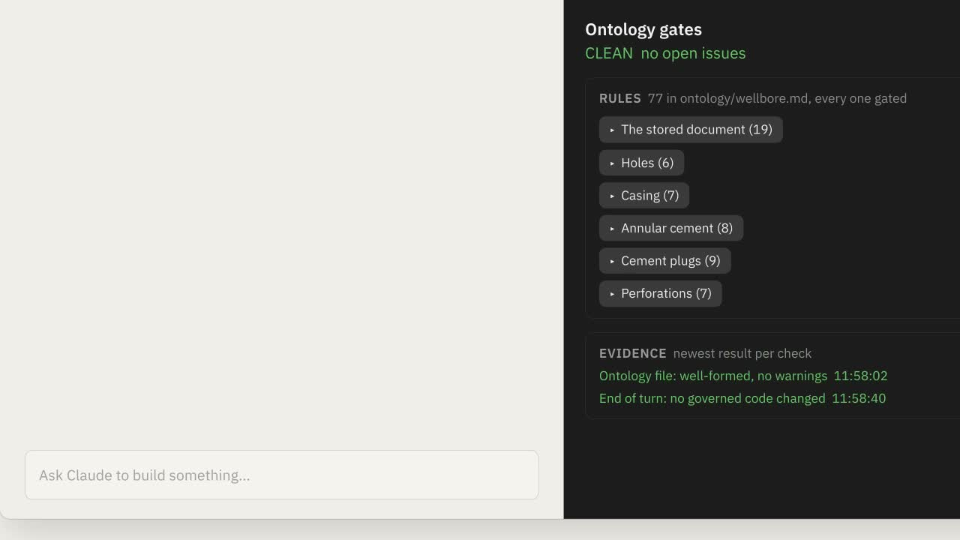
THE CHECK INSIDE CLAUDE CODE
CODIFIED · THE MOD · VIDEO · 1:00
Notes:
- The hooks write every check to a state log. The mod puts it in front of me while I work. - A Claude Code mod I built. - The demo: a 9.625-inch casing in an 8.5-inch hole. Breaks the rule from the diagram. - Watch what shows up, and where: – Observer: the rule and the failing check. – Explore issue → investigate. – Fix it → asks for a repair. – After: test passes, the input rejects the oversized casing. - Keeps my mental model straight: what changed, why it matters, what evidence we have. - A “relevant change” warning alone proves nothing. The test makes it concrete. CUE 27:30–28:45 · Click to play (60s, silent). Narrate the mod’s UI, not the rule. Don’t present the badge or CLEAN result as verified production coverage. SOURCE · Recording uses CasingPlacementInput.tsx and casingFitsHole.test.ts; current source uses different filenames.

Slide 25
CONTEXT IS THE TEAM.
WHAT I LEARNED
DOMAIN KNOWLEDGE
ONTOLOGY
IMPLEMENTATION + GATE
LEARN WHAT THE WORK MEANS.
NAME THE THINGS, RELATIONSHIPS AND RULES.
USE THAT MEANING TO WRITE AND CHECK CODE.
The river, the landman, the school.
What the lock did: catch the mistake when nobody’s looking.
What the senior hand did: correct the understanding before the work starts.
THAT’S WHAT REPLACED THE CREW.
I still define the work and review the result. That part doesn’t get delegated.
Notes:
- Started with a river: learn the language before writing code. - That language → the ontology → guides the code and gives the checks their meaning. - Before: correcting constantly. Now: occasional intervention. My experience, not a benchmark. - What replaces the crew? – The ontology = the senior hand. Corrects the understanding before work starts. – The gate = the lock. Catches the mistake when nobody’s looking. - That’s “context is the team.” - Learn the language. Write it down. Hold the model to it. - I still define the work and review the result. That part doesn’t get delegated. CUE 28:45–29:45 · Three columns left to right. Pause on the last line. A synthesis, not a measured claim.

Slide 26
ONE REPEATED CORRECTION
TAKE IT INTO YOUR PROJECT
WHAT MUST STAY TRUE IN YOUR PROJECT?
1
2
3
Write the rule and why it matters.
Find an example that breaks it.
Choose where its check must run.
Notes:
- Back to the correction you held onto. - Name the things, how they connect, what must stay true. - One example that should pass, one that should fail. - Where does the check have to run? What still needs your judgment? - Start small enough to explain clearly. - 30 seconds. Write it down. CUE 29:45–30:45 · One sentence from the room if time permits. Carry straight into questions.

Slide 27



HARD JOBS DESERVE
BETTER TOOLS.
ONE LEVEL DOWN, ONE VERTICAL AT A TIME
FLOOD MONITORING
OIL & GAS
HIGHER EDUCATION
Remote monitoring of equipment and dams.
Land and mineral rights, Drilling Engineering.
Alumni outcomes analytics.
Notes:
- Hard jobs deserve better tools. One level down, one vertical at a time. - Flood monitoring · oil & gas · higher education. Three domains that share nothing. - Same method every time: build the ontology with the LLM, as discovery. – It reads the code and asks questions. – I supply what the work means. – Together: the domain’s language and the reason behind every rule. - That ontology becomes the context the model works inside. - Start with the one that made it personal. CUE 0:00–1:00 · One line per card.

Slide 28
LET’S TALK ABOUT
YOUR DOMAIN.
QUESTIONS AND DISCUSSION
What do you keep correcting?
What would a useful gate look like?
MICHAEL PORTER · MUDDY BOOTS CODE
muddybootscode.io
Notes:
- What does this look like in your domain? Tell me what you wrote; we’ll work out the rule and a check together. - One takeaway: a clear way to explain the job, and to get help doing it. Crayons and glue. CUE 30:45–60:00 · About 14:15 of slack before the 45-minute mark. Hand out the skill and the mod here. Ontology files and tests available as props.

