Slide 1
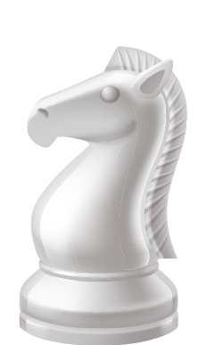
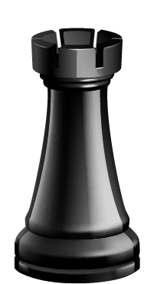
INFO-H417 : Database System Architecture 2023-2024 Mahmoud SAKR & Maxime SCHOEMANS Chess Database Extension
Romain Bennert, Loïc Bermudez Arroyo,
Julien Boistel & Yen Nhi Nguyen

Slide 2
Create a PostgreSQL extension to store Chess games:
DATA TYPES
TO REPRESENT THE DATA
INDEXES
TO SUPPORT
THE PREDICATES
ChessGame :
Sequence of moves
ChessBoard :
Board State
B-Tree (hasOpening())
GIN (hasBoard())
FUNCTIONS
WITH THESE DATA TYPES
getBoard(chessgame, int)
getFirstMoves(chessgame, int)
hasOpening(chessgame, chessgame)
hasBoard(chessgame, chessboard, int)

Slide 3

TABLE OF CONTENTS
DATA TYPES :
FUNCTIONS TO IMPLEMENT:
1
2
3
THE B-TREE INDEX
4
THE GIN INDEX
ChessGame
ChessBoard
getBoard,
getFirstMoves
hasOpening
hasBoard

Slide 4

1
ChessGame structure
typedef struct {
char pgn[MAX_PGN_LENGTH];
SCL_Record record;
} ChessGame;
SCL_Record is set of moves: abxxxxxx cdyyyyyy
ab → store the win info in the last move
xxxxxx → startsquare (A0,A1,…)
cd → pawn promotion
yyyyyy → endsquare

Slide 5
1
ChessBoard structure
typedef struct { char fen[MAX_FEN_LENGTH];
SCL_Board board;
} ChessBoard;
SCL_Board contains:
64 bytes → Board state
4 bits → column of pawn that can be taken by en-passant
4 bits → O-O and O-O-O possibilities for white and black
1 byte → Nb of half-moves played
1 byte → counter for 50 moves rule
1 byte → extra slot for variants of chess
1 byte → 0 for readability when printing

Slide 6
Functions To Implement
2
hasOpening(chessgame, chessgame)
hasBoard(chessgame, chessboard, int)
getBoard(chessgame, int)
getFirstMoves(chessgame, int)
To support
Getters on the chessgames
Output FEN board
Truncate the SAN game
Search operations on big lists
Indexes to speed up queries
B-Tree
GIN

Slide 7
Structure Recap
chess.h
smallChessLib.h
chess_struct
B-TREE INDEX
GIN INDEX
chess.c
chess_make
chess_parse
chessgame_eq
chessgame_le
chessgame_lt
chessgame_ge
chessgame_gt
chessboard_cmp
chessboard_extractValue
chessboard_extractQuery
chessboard_consistent
getBoard
getFirstMoves
hasOpening
hasBoard
chessboard_contains
chessboard_eq
chessgame_cmp
chess_in
chess_out
getBoard
getFirstMoves
hasOpening
hasBoard
chessgame_eq
chessgame_le
chessgame_lt
chessgame_ge
chessgame_gt
chessboard_cmp
chessboard_extractValue
chessboard_extractQuery
chessboard_consistent
chess_in
chess_out
chessboard_contains
chessboard_eq
chessgame_cmp
TYPE Chess
OPERATORS
=, <=, <, >=, >
OPERATORS
&&, @>, @<, =
chess.sql
OPERATOR CLASS btree_chessgame_ops
OPERATOR CLASS gin_chessboard_ops

Slide 8
B-Tree Index & hasOpening function
3
root
Why a B-Tree for hasOpening()?
SAN = string ⇾ order property
Comparison of strings
Suitable for large data sets
Very efficient for reading
1.c4 d5
2.b3 c6
1.e3 d5
2.d4 c6
1.e4 c6
2.d4 g6
1.c4 d5
2.b3 c6
1.d4 d5
2.e3 e6
1.e3 d5
2.d4 c6
1.e4 c5
2.f4 e6
1.e4 c6
2.d4 g6
1.e4 e6 2.f4 d5

Slide 9
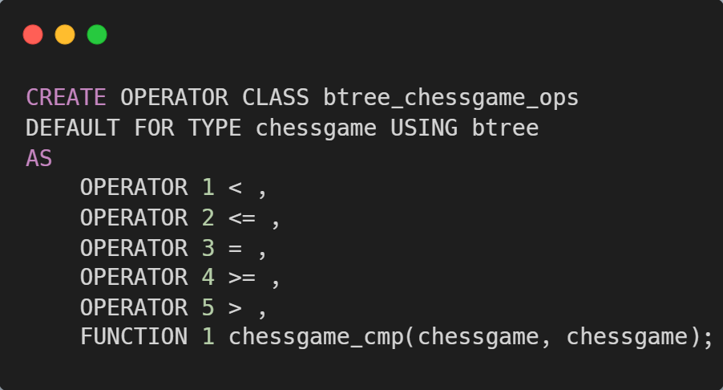
B-Tree Index implementation
3

Slide 10


3
B-Tree Index - tests
p_chessgame > '1. g3 g6 2. Bg2 c5 3. e4 Bg7'
WITHOUT BTREE INDEX - QUERY PLAN
-------------------------------------------------------------------------------------------------------------------------
Aggregate (cost=215.61..215.62 rows=1 width=8) (actual time=1.003..1.004 rows=1 loops=1)
-> Seq Scan on chessgame_table (cost=0.00..211.95 rows=1465 width=0) (actual time=0.042..0.994 rows=44 loops=1)
Filter: (p_chessgame > '1. g3 g6 2. Bg2 c5 3. e4 Bg7'::chessgame)
Rows Removed by Filter: 4172
Planning Time: 0.140 ms
Execution Time: 1.089 ms
WITH BTREE INDEX - QUERY PLAN
--------------------------------------------------------------------------------------------------------------------------------
Aggregate (cost=413.37..413.38 rows=1 width=8) (actual time=0.178..0.179 rows=1 loops=1)
-> Bitmap Heap Scan on chessgame_table (cost=235.30..409.86 rows=1405 width=0) (actual time=0.117..0.167 rows=44 loops=1)
Recheck Cond: (p_chessgame > '1. g3 g6 2. Bg2 c5 3. e4 Bg7'::chessgame)
Heap Blocks: exact=22
-> Bitmap Index Scan on chessgame_btree_index (cost=0.00..234.94 rows=1405 width=0) (actual time=0.086..0.087 rows=44 loops=1)
Index Cond: (p_chessgame > '1. g3 g6 2. Bg2 c5 3. e4 Bg7'::chessgame)
Planning Time: 0.347 ms
Execution Time: 0.222 ms

Slide 11
B-Tree Index – tests with predicate
3
hasOpening(p_chessgame, '1. g3 g6 2. Bg2 c5 3. e4 Bg7’)
WITHOUT BTREE INDEX - QUERY PLAN
-------------------------------------------------------------------------------------------------------------------------
Aggregate (cost=214.24..214.25 rows=1 width=8) (actual time=2.169..2.171 rows=1 loops=1)
-> Seq Scan on chessgame_table (cost=0.00..210.60 rows=1456 width=0) (actual time=0.112..2.159 rows=1 loops=1)
Filter: hasopening(p_chessgame, '1. g3 g6 2. Bg2 c5 3. e4 Bg7'::chessgame)
Rows Removed by Filter: 4203
Planning Time: 0.159 ms
Execution Time: 2.324 ms
WITH BTREE INDEX - QUERY PLAN
--------------------------------------------------------------------------------------------------------------------------------
Aggregate (cost=897.83..897.84 rows=1 width=8) (actual time=3.501..3.503 rows=1 loops=1)
-> Bitmap Heap Scan on chessgame_table (cost=685.78..894.33 rows=1401 width=0) (actual time=2.252..3.493 rows=1 loops=1)
Filter: hasopening(p_chessgame, '1. g3 g6 2. Bg2 c5 3. e4 Bg7'::chessgame)
Rows Removed by Filter: 4203
Heap Blocks: exact=156
-> Bitmap Index Scan on btree (cost=0.00..685.43 rows=4204 width=0) (actual time=2.154..2.154 rows=4204 loops=1)
Planning Time: 0.587 ms
Execution Time: 3.556 ms

Slide 12
GIN Index implementation
4
Some boards are in most of the games
Efficient for redundant data
Efficient for looking for an element in an array
Why a GIN for hasBoard()?
root
3r1r1k/pq3Ppp/3p1R2/8/3Bn1Q1/Pbp5/1PP3PP/1K1R4
r4r1k/ppp1qpb1/7p/4pRp1/1PB1P3/1QPR3P/P4P2/6K1
rnbqkbnr/pp1ppppp/8/2p5/4P3/8/PPPP1PPP/RNBQKBNR
3r1r1k/pq3Ppp/3p1R2/8/3Bn1Q1/Pbp5/1PP3PP/1K1R4
8/5k2/3p4/1p1Pp2p/pP2Pp1P/P4P1K/8/8
r4r1k/ppp1qpb1/7p/4pRp1/1PB1P3/1QPR3P/P4P2/6K1
rnbqkbnr/pp1ppppp/8/2p5/4P3/5N2/PPPP1PPP/RNBQKB1R
rnbqkbnr/pp1ppppp/8/2p5/4P3/8/PPPP1PPP/RNBQKBNR
rnbqkbnr/pppppppp/8/8/8/8/PPPPPPPP/RNBQKBNR
2
1
5
4
3
1, 2, 3, 4, 5

Slide 13
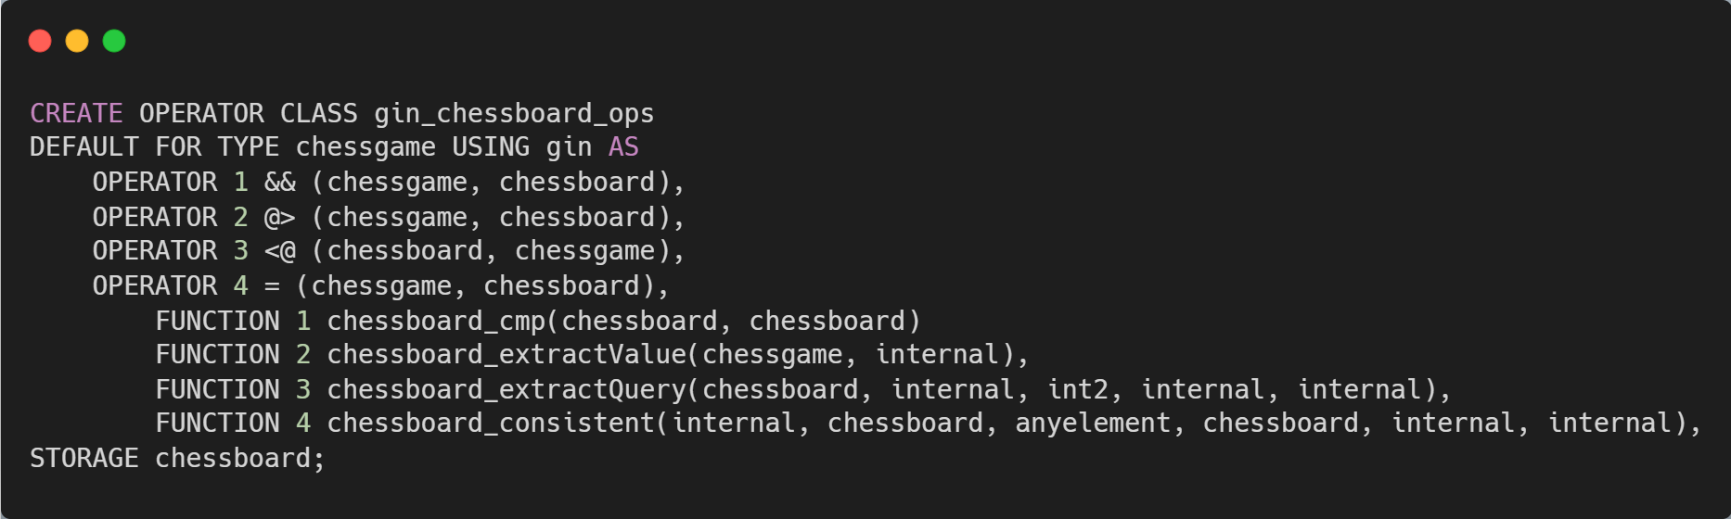
GIN Index implementation
4
Notes:
Est-ce qu’on explique à l’oral le rôle des fonctions 1,2,3 et 4?

Slide 14
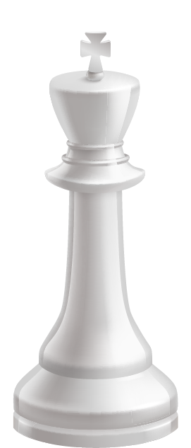

GIN Index - TESTS
4
p_chessgame @> 'rnbqkbnr/pppppppp/8/8/4P3/8/PPPP1PPP/RNBQKBNR QkqK e3 0 1’
WITHOUT GIN INDEX - QUERY PLAN
-------------------------------------------------------------------------------------------------------------------------
Aggregate (cost=217.44..217.45 rows=1 width=8) (actual time=192.444..192.446 rows=1 loops=1)
-> Seq Scan on chessgame_table (cost=0.00..211.95 rows=2198 width=0) (actual time=0.081..191.769 rows=2204 loops=1)
Filter: (p_chessgame @> 'rnbqkbnr/pppppppp/8/8/4P3/8/PPPP1PPP/RNBQKBNR b KQkq e3 0 1'::chessboard)
Rows Removed by Filter: 2012
Planning Time: 0.144 ms
Execution Time: 192.526 ms
WITH GIN INDEX - QUERY PLAN
--------------------------------------------------------------------------------------------------------------------------------
Aggregate (cost=221.03..221.04 rows=1 width=8) (actual time=1.590..1.592 rows=1 loops=1)
-> Bitmap Heap Scan on chessgame_table (cost=32.41..215.76 rows=2108 width=0) (actual time=0.469..1.341 rows=2204 loops=1)
Recheck Cond: (p_chessgame @> 'rnbqkbnr/pppppppp/8/8/4P3/8/PPPP1PPP/RNBQKBNR'::chessboard)
Heap Blocks: exact=157
-> Bitmap Index Scan on gin (cost=0.00..31.88 rows=2108 width=0) (actual time=0.407..0.408 rows=2204 loops=1)
Index Cond: (p_chessgame @> 'rnbqkbnr/pppppppp/8/8/4P3/8/PPPP1PPP/RNBQKBNR'::chessboard)
Planning Time: 0.540 ms
Execution Time: 1.654 ms

Slide 15
4
GIN Index – tests with predicate
hasBoard(p_chessgame,
'rnbqkbnr/pp2pppp/3p4/2p5/3PP3/5N2/PPP2PPP/RNBQKB1R b KQkq d3 0 3', 5)
WITHOUT GIN INDEX - QUERY PLAN
-------------------------------------------------------------------------------------------------------------------------
Aggregate (cost=10000000212.05..10000000212.06 rows=1 width=8) (actual time=330.310..330.312 rows=1 loops=1)
-> Seq Scan on chessgame_table (cost=10000000000.00..10000000208.55 rows=1401 width=0) (actual time=10.012..330.165 rows=97 loops=1)
Filter: hasboard(p_chessgame, 'rnbqkbnr/pp2pppp/3p4/2p5/3PP3/5N2/PPP2PPP/RNBQKB1R b KQkq d3 0 3'::chessboard, 5)
Rows Removed by Filter: 4107
Planning Time: 0.117 ms
Execution Time: 330.363 ms
WITH GIN INDEX - QUERY PLAN
--------------------------------------------------------------------------------------------------------------------------------
Aggregate (cost=10000000212.05..10000000212.06 rows=1 width=8) (actual time=335.970..335.972 rows=1 loops=1)
-> Seq Scan on chessgame_table (cost=10000000000.00..10000000208.55 rows=1401 width=0) (actual time=8.451..335.818 rows=97 loops=1)
Filter: hasboard(p_chessgame, 'rnbqkbnr/pp2pppp/3p4/2p5/3PP3/5N2/PPP2PPP/RNBQKB1R b KQkq d3 0 3'::chessboard, 5)
Rows Removed by Filter: 4107
Planning Time: 0.178 ms
Execution Time: 336.078 ms

Slide 16

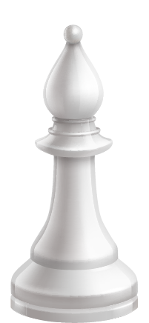
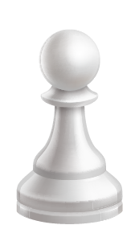

Thank you !

