Slide 1




Group-10
Next Chapter
Intelligent Reading & Book Engagement Platform
www.next-chapter.dev

Slide 2

www.next-chapter.dev
Members
Jhil [202301090]— AI comment moderation, dictionary word search UAT, authentication stories, sprint documentation Yashasvi [202301069]— Ratings, comments, black-box/API testing, elicitation interviews Mudit [202301118] — Reader page, modes, AI chatbot/image generation,audiobook, bookmark/highlight, catalog metadata, elicitation [data analysis, forms] Kirtan [202301098] — AI recommendations, adaptive learning, trending/high-rated pages, unit testing Kavya [202301116] — Authentication, personalization DB, email alerts, offline reading, deployment, mutation testing Namra [202301130] — User dashboard frontend, book detail frontnend, admin stories, class diagrams Sri Sadana [202301121] — Bookmarking/highlighting, GUI + Non-functional testing, payment and subscription stories, elicitation interview, epic documentation Meet [202301073] — Landing frontnend, subscription frontend, object diagrams, elicitation interviews Parv [202301112] — Login/Signup, forgot password, admin UI, sequence diagrams, frontend mutation testing
Team Leader- Prasanna Gupta [202301124]
System architecture Profile & Auth workflows Reading sync + progress Dashboards (User/Admin) Payments & subscriptions Full UI/UX (Figma) Database normalization & RLS Personalization epics

Slide 3
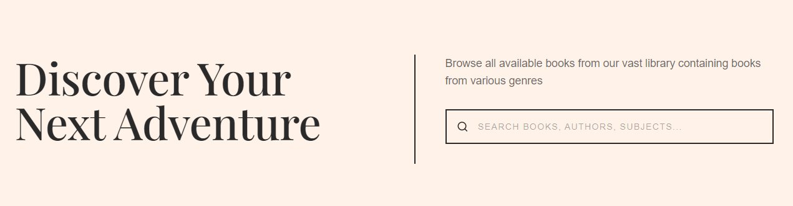

www.next-chapter.dev
Our Objectives
Modern digital library with seamless reading
AI-based personalization & safe content moderation
Reading analytics with progress, goals, insights
Subscription monetization with premium features
Robust admin tools for content & user management
Improved UX for higher reader engagement

Slide 4
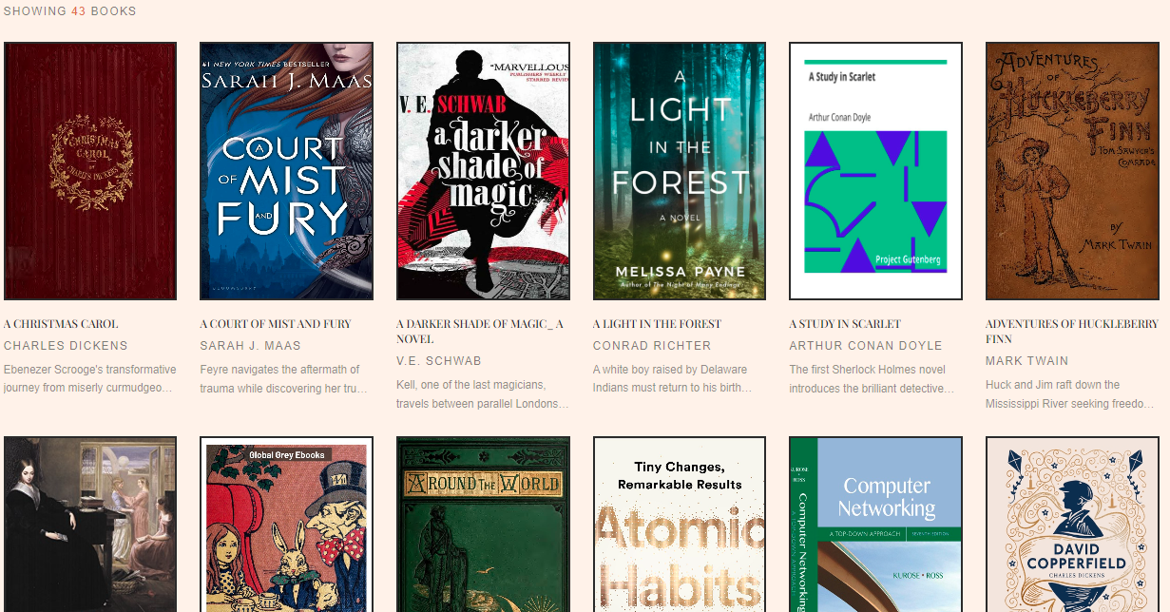
www.next-chapter.dev
The Milestones
Core Authentication + Profile
Personalization + AI
Reading Engine + Sync
Advanced Reading + Offline
Community + Moderation
Payments/Subscriptions
Admin + Analytics + AI Enhancements

Slide 5
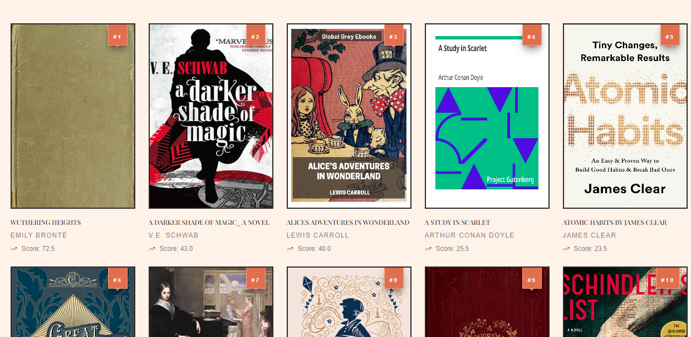
Sprint Backlogs
www.next-chapter.dev
Sprint 1 - Authentication + Catalogue + User Profile
Sprint 2 - Reader + Admin Profile + Filter/Search
Sprint 3 - Comment + Moderation + Rating + Reading Modes + upvote + reply
Sprint 4 - Book Uploads + User profile Stats + Admin Stats
Sprint 5 - Multi-Device sync + Audiobooks + Trending + Highest Rated
Sprint 6 - Add, Delete & Update Books + New Releases + Explore + Gamification
Sprint 7 - Payment & Subscription + Bulk Uploads + AI - [chatbot + image generation & recommendation]

Slide 6
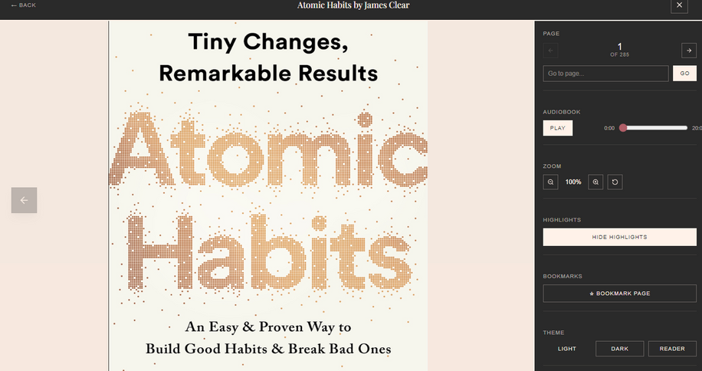
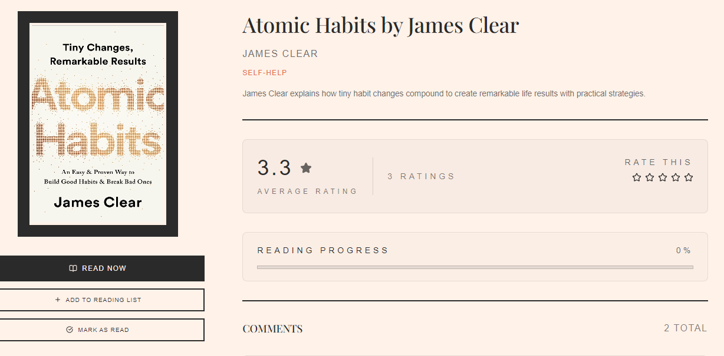
www.next-chapter.dev
Team Communication + Project Alignment
Messy Git workflows + Severe push/pull conflicts
Testing took longer than expected, with unexpected outputs
Lessons
Learned
Wrong estimations that lead to more time in implementing desired features.

Slide 7
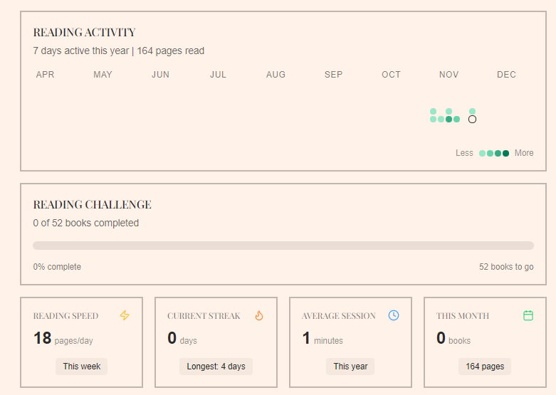
90% functional sprints completed
Normalized DB with RLS and secure access control
Real deployment with Razorpay + Supabase + CI
Implemented cross-device sync for reading engine
Full implementation of all major workflows
Acheivements

Slide 8
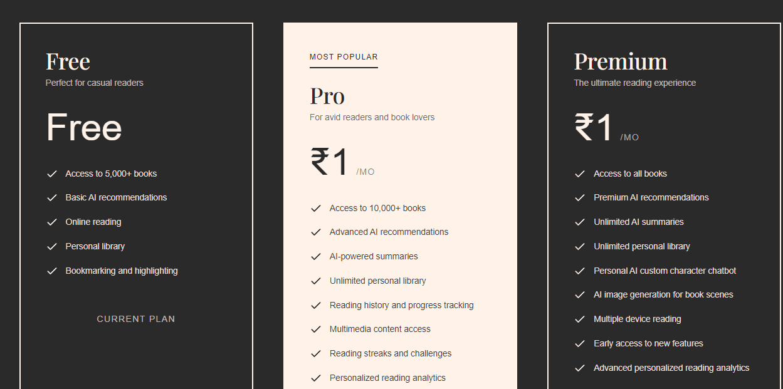
www.next-chapter.dev
Sprint planning wasn’t fully value-driven
Git workflow inconsistencies early on.
Risk management was weak in early sprints.
Not testing the feature just after implementation.
Mistakes We
Made
Some stories lacked clear acceptance criteria

Slide 9
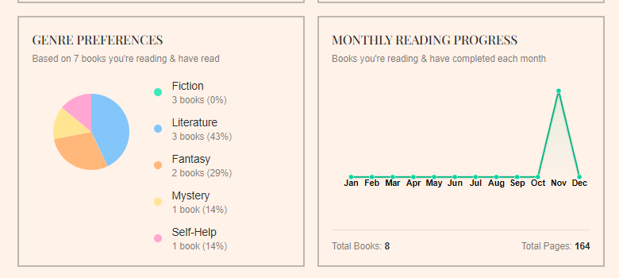
4.5
Requirements
4.5
Code Quality
4
Testing
3.5
Git Workflow
5
Demo Stability
Rating on Artefacts

Slide 10
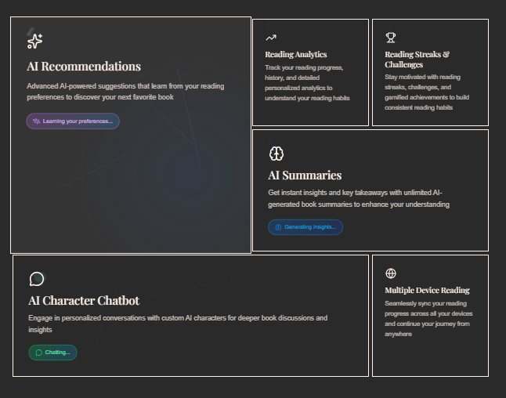
Overall Project Rating
All sprints completed
Extra AI features implemented
9.2/10
Scalable Architecture
We believe that our
project delivers a real
production-level system.

