Slide 1
Presenter : MUDIT TARWAY
Project : Student Performance Prediction
Mentor : Mr. Himanshu Souda
College : Techno India University, West Bengal

Slide 2
Problem Motivation
Manual tracking of student performance is difficult
Early identification of potentially underperforming students lacks
Teachers struggle to analyze extensive academic data
Decisions still rely on observation over data
Automated predictive systems improve data-driven academic decisions
Machine learning identifies patterns enabling early intervention

Slide 3
Dataset Description & Technologies
Features involved in the Dataset:
Attendance(%)
Midterm
Final Score
Assignment Average
Quizzes Average
Participation Score
Projects Score
Total Score
Study per Night
Study per Week
Extra Curricular Activities
Internet Access at Home
Parent Education
Stress Level
Dataset Purpose:
Capture academic performance and engagement factors
Provide meaningful inputs for accurate grade prediction
Target Variable:
Grade
Mapping to the Grade:
A → 0
B → 1
C → 2
D → 3
E → 4
Technologies Used:
Python
Scikit Learn
Pandas
Numpy
Matplotlib
Seaborn

Slide 4
Model Flow & Implementation
Performed data preprocessing to clean and format inputs
Applied Label Encoding to convert grade categories (A–E) into numeric values
Split the dataset using an 80–20 train–test ratio
Trained the model using Random Forest (robust and high-accuracy algorithm)
Evaluated performance using Accuracy (and Precision/Recall for deeper analysis)
Generated predictions based on new student data
Input
Preprocessing
Training
Prediction
Output Display

Slide 5
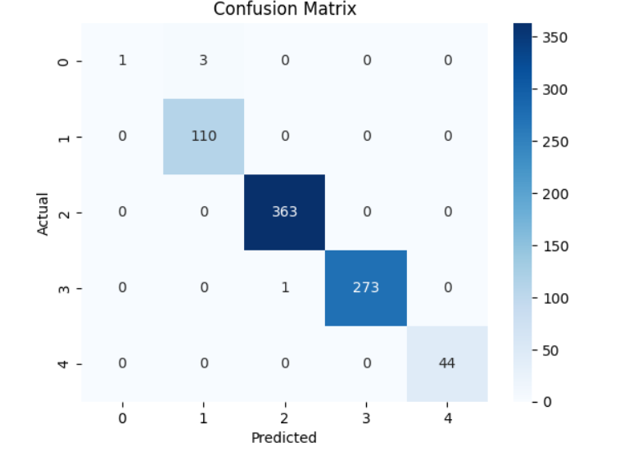
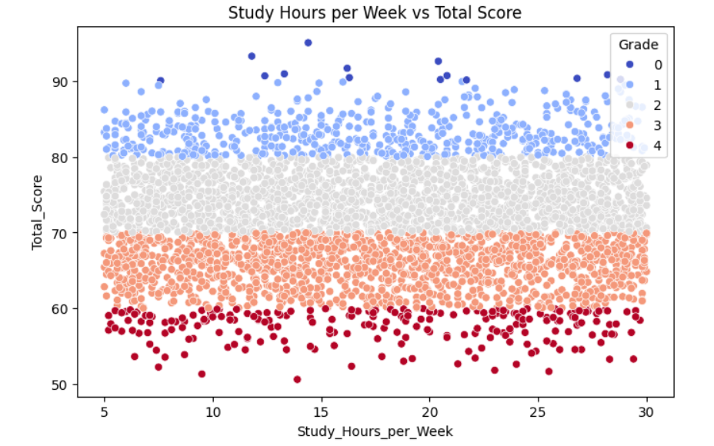
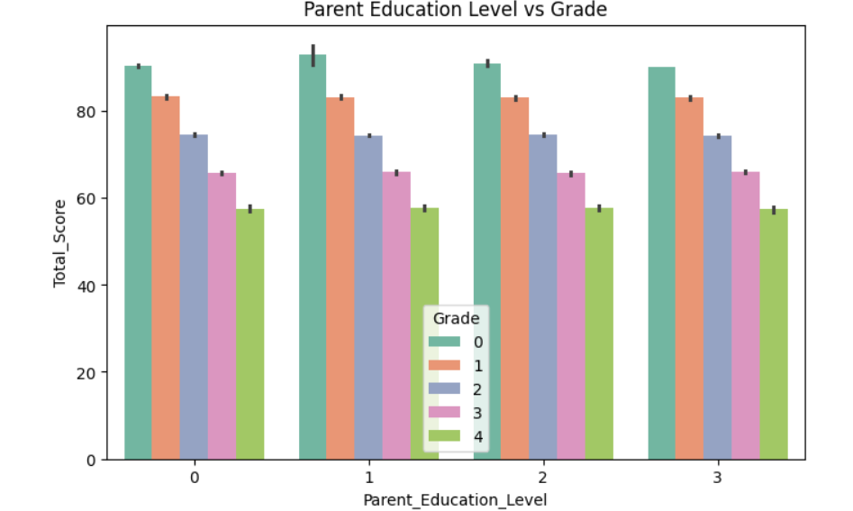
Result and prediction Demo:

Slide 6
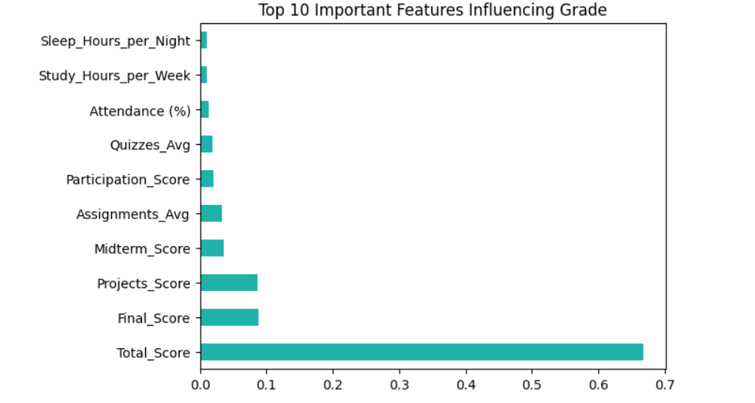
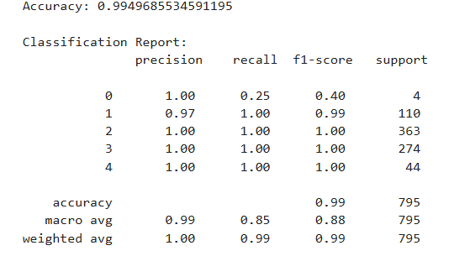
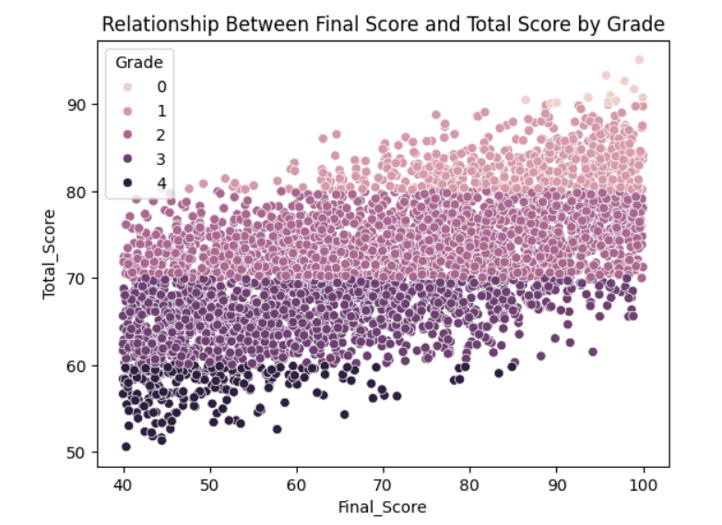
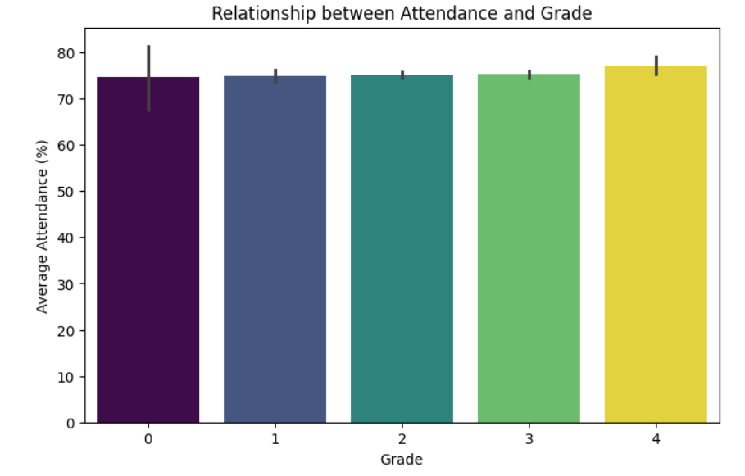
Result and prediction Demo:

Slide 7
Conclusion & Future Scope
Conclusion:
• Efficient prediction of student performance
• Supports data-driven academic insights
• Helps identify at-risk students early
Future Scope:
• Deploy as a full web/mobile application
• Add personalized study recommendations
• Integrate advanced deep learning models

