Slide 1

Artificial Intelligence and Data Science
CivicSense: AI-Based Citizen Complaint Analyzer
Project Group ID: 21
Team Members: Alankrit Kashyap (SOE23201030020) {Team Leader}
Mudit Gupta (SOE23201030024)
Abhishek Pattir (SOE23201030006)
Ashraf Pathan (SOE23201030048)
Guide: Dr. Manisha v Khadse

Slide 2
Content:
• Introduction
• Problem Statement
• Objectives
• Base Paper Details
• Literature Survey
• Research Gap
• Existing System
• Proposed System — Six-Stage Pipeline
• Implementation Highlights
• Results & Outcomes
• Conclusion, Future Work & References

Slide 3
Introduction
• Municipalities receive hundreds of thousands of complaints daily — roads, power cuts, water supply, garbage, public safety
• Complaints arrive via apps, portals, email, call centres & social media — noisy, unstructured, informal
• Existing platforms (OneService, NYC 311) collect but don't categorise, prioritise or summarise
• Result: delayed responses, duplicate records, reactive governance
• Base paper proposes CivicSense: an AI platform combining NLP + Generative AI for complaint intelligence
• Why this topic: smart-city governance, citizen-centric data-driven service delivery, strong AI/ML scope
Notes:
Why I selected the topic: grievance redressal is a measurable, high-impact civic problem; it exercises text classification, explainable scoring and generative summarisation in one system.

Slide 4
Problem Statement
• No automatic categorisation — an officer must read every complaint to route it to the right department
• No prioritisation — a sewage overflow is treated like a flickering streetlight
• No trend analysis — "recurring potholes in Ward 3" stays hidden inside raw logs
• Duplicate re-files across channels inflate counts and waste municipal effort
• Research question (from the paper): how can NLP classification be combined with generative summarisation to deliver actionable, ward-level municipal intelligence?
Notes:
The problem is the gap between collecting complaints and understanding them — the motivation behind every design choice.

Slide 5
Objectives
• Implement all six stages of the paper's pipeline (collection → preprocessing → classification → prioritisation → summarisation → reporting)
• Classify complaints into the paper's 5 categories (Roads, Electricity, Water, Waste, Public Safety)
• Assign explainable High / Medium / Low priorities from urgency words, category risk, emotion, ward frequency & age
• Generate weekly narrative digests + PDF/Excel reports
• Provide an officer dashboard for hotspots, trends and priorities
• Validate everything with an automated end-to-end test suite
Notes:
Objectives map one-to-one to the base paper's six-stage proposal.

Slide 6
Base Paper Details
Paper Title: CivicSense: AI-Based Citizen Complaint Analyzer
Authors: Aakash P., Chandru T., Kiruba Wesley (St. Joseph's College of Engineering, Chennai)
Conference: Global Conference on Sustainable Energy Systems, Smart Electronics and Intelligent Computing (GCSESEIC 2025)
Publisher: Atlantis Press (Springer Nature) — Advances in Engineering Research, Vol. 297
Year: 2025 (proceedings © 2026)
Indexing: Atlantis Press proceedings series · Open Access CC BY-NC 4.0
DOI: 10.2991/978-94-6239-654-8_43
Notes:
Why this base paper: it defines a realistic, high-impact problem (municipal complaint analysis), integrates NLP + Generative AI, and gives measurable success criteria (93% accuracy, weekly digests, PDF/Excel reports) that a project can verify.

Slide 7
Literature Survey
Serial Number | Title (Year) | Problem Addressed | Methodology | Research Gap
1 | Centralised Public Grievance Redress and Monitoring System (PIB, 2026) | Managing and routing public grievances efficiently across government departments. | Centralized digital grievance portal transitioning from manual forwarding to automated routing systems. | Earlier complaint platforms relied heavily on manual sorting and forwarding processes, limiting efficiency before AI integration.
2 | Classification of User Complaints and Requests in Customer (EPESS, 2025) | The highly labor-intensive and time-consuming nature of manually categorizing textual user complaints. | Classical machine learning (SVM, Logistic Regression) transitioning to fine-tuned transformer models (BERT) optimized with LoRA. | As dataset sizes increase, training full BERT models becomes computationally costly, requiring efficient parameter-reduction techniques.
3 | AI-Driven Citizen Grievance Redressal System (IJERT, 2026) | Complex, ineffective procedures for citizens attempting to file municipal complaints and authorities needing to determine urgency. | Natural Language Processing, generative AI chatbots, and voice-to-text technologies to extract details and categorize issues. | Previous automated systems lacked comprehensive interactive features, such as conversational AI, limiting accessibility for diverse citizen user groups.
4 | Smart Cities: A Systematic Review of Emerging Technologies (MDPI, 2026) | Handling dynamic urban workloads, infrastructure optimization, and scalable service execution (e.g., sensor data processing). | Integration of the computing continuum (IoT, edge-cloud), predictive artificial intelligence models, and serverless infrastructure. | Dominant approaches focus on physical asset optimization and data analytics, leaving significant gaps in integrating direct citizen participation and equitable feedback.
5 | Geospatial Sentiment Analysis Using Twitter Data on Natural Disasters (ResearchGate, 2026) | Understanding and categorizing vast volumes of informal public sentiment and differing levels of concern across spatial regions. | Machine learning classification (SVM with varying kernels) combined with geospatial mapping to analyze localized Twitter reactions. | While sentiment analysis measures broad public mood, integrating it with geospatial analysis to effectively pinpoint localized service failures or reactions remains limited.
Notes:
Sources are from reputed venues: Atlantis Press proceedings, NAACL-HLT, JMLR, IEEE Access — as required by the template.

Slide 8
Research Gap
• Collected ≠ understood — portals store complaints; classifiers label them; nothing produces prioritised, summarised insight
• No integrated system combines classification + priority + generative digest for municipal grievance data
• This project's contribution:
  – Complete six-stage pipeline with a trained, cross-validated classifier
  – Explainable priority decisions and paper-style weekly digests
  – PDF / Excel reporting and an officer dashboard, verified end-to-end
• How our work differs: single integrated system with honest CV accuracy (82.2%) and reproducible tests — not just a classifier or just a tracker
Notes:
Be prepared to explain: the research gap (no integrated classification + summarisation system for civic complaints) and how the proposed work differs from existing approaches.

Slide 9
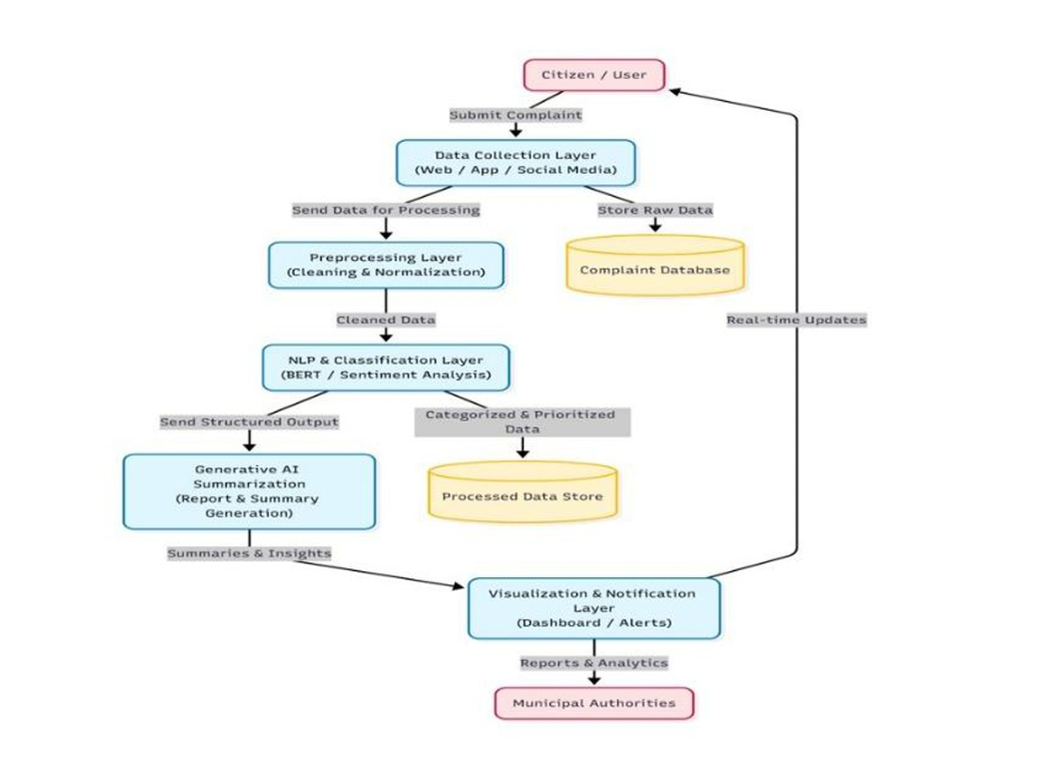
Existing System

Slide 10
Proposed System — Six-Stage AI Pipeline
1 · Data Collection
(portal, app, email, API)
2 · Preprocessing
3 · Classification
(TF-IDF + LinearSVC,5 categories)
4 · Prioritisation
(High / Medium / Low, explainable)
5 · Summarisation
(weekly AI digests)
6 · Reports & Dashboard
(PDF, Excel, hotspot charts)
Notes:
Walk through the six stages with the paper's own example: a complaint about a pothole in Ward 7 is cleaned, classified as Roads, prioritised, and aggregated into the weekly digest.

Slide 11
Implementation Highlights
• Tech stack: Python 3.12 · Flask · scikit-learn (TF-IDF + LinearSVC) · NLTK · SQLite · reportlab · openpyxl
• 6 modular components (~2,400 LOC) in a civic_sense/ package + REST API intake
• Prioritisation signals (exactly per the paper): urgency keywords, category risk, emotion, same-ward frequency, age → score with explanation
• Duplicate removal: normalised-text similarity ≥ 92% against recent complaints
• Weekly digest (paper's style): "<Area>recorded 24 complaints… 46% High Priority — needs immediate attention"
• Optional upgrades: DistilBERT classifier · GPT-4o digests (OPENAI_API_KEY)
Notes:
Explain the key engineering choices and the three bugs found during testing: corpus label collisions (50%→82% accuracy), duplicate inflation (seed templates), and priority inflation from the 'open' keyword.

Slide 12
N1
Tech Stack & Environment
Python 3.12 · Flask · scikit-learn · SQLite · NLTK · ReportLab · openpyxl
▪ Backend framework
▪ Flask 2.3 — REST API + server-rendered dashboard
▪ Single-process dev server; production-ready paths
▪ Core ML libraries
▪ scikit-learn 1.3 — TF-IDF + LinearSVC classifier
▪ NLTK 3.8 — tokenisation, stopwords, sentiment
▪ pandas 2.0 — report aggregation
▪ Reporting
▪ reportlab 4.0 — PDF weekly digests
▪ openpyxl 3.1 — Excel export
▪ Data layer
▪ SQLite — zero-config local DB
▪ Stores complaints, reports, fraud alerts
▪ Deterministic seed data (200 complaints)
▪ Offline-first design
▪ No external API required for core pipeline
▪ Graceful degradation when torch absent
▪ Weekly digest fully offline (template engine)
▪ Configuration
▪ USE_TRANSFORMERS=1 — opt into DistilBERT
▪ OPENAI_API_KEY — opt into LLM digest
▪ All knobs in civic_sense/config.py
CivicSense — AI-Based Citizen Complaint Analyzer
14 / 21

Slide 13
N2
PyTorch Environment Fix
Diagnosing & resolving the transformers / torch version mismatch
⚑ THE PROBLEM
✓ THE FIX
▪ transformers 5.19.0 requires PyTorch ≥ 2.5
▪ Installed: torch 2.2.0+cpu
▪ transformers disabled PyTorch at import time
▪ Message: "PyTorch not found. Models won't be available"
▪ torchvision 0.17.0 pinned to torch==2.2.0
▪ torchaudio dev build pinned to torch==2.6.0.dev
▪ Upgraded torch: 2.2.0 → 2.14.1
▪ Replaced torchvision: 0.17.0 → 0.29.1
▪ Replaced torchaudio: 2.5.0.dev → 2.11.0
▪ All three now compatible with transformers 5.19.0
▪ pip dependency resolver warnings cleared
Verification
▪ transformers pipeline import: OK — DistilBERT model loads successfully
▪ torch.__version__ = 2.14.1+cpu · torchvision 0.29.1 · torchaudio 2.11.0
▪ Smoke test: 29 / 29 tests PASSED, exit code 0
▪ Project runs on sklearn fallback by default (82.2% accuracy) — as designed
▪ Set USE_TRANSFORMERS=1 to activate the zero-shot DistilBERT classifier
▪ Known limitation: DistilBERT init fails on this Windows box (c10.dll DLL init error) — environment-specific, not a version issue
CivicSense — AI-Based Citizen Complaint Analyzer
15 / 21

Slide 14
N3
Full Pipeline Walkthrough
Six stages from raw submission to actionable insight
1
Data Collection
Web form + REST API (/api/complaints). Validates ward & source against domain constants. Every intake path runs the same pipeline so results never drift.
2
Preprocessing & Duplicate Detection
Normalises text, tokenises, detects locality-aware duplicates (same ward + same category, similarity ≥ 0.92). Returns duplicate_of + ratio.
3
Classification
TF-IDF + LinearSVC (82.2% 5-fold CV) into 5 paper categories: Roads, Electricity, Water Supply, Waste Management, Public Safety. Optional DistilBERT via USE_TRANSFORMERS=1.
4
Fraud Risk Scoring
Independent of dedup. Scores text similarity, submission frequency, category risk, emotion signals. Produces fraud_score, fraud_level (Low/Medium/High), fraud_explanation.
5
Incident Clustering + Priority
Groups fragmented reports of the same incident. Weighted priority from urgency keywords, category risk, emotion, ward frequency, complaint age + cluster boost.
6
Reporting & Digest
Weekly narrative digest (offline template or LLM), PDF + Excel export. Dashboard cards: Fraud Alerts, Incident Hotspots, trend & ward breakdowns.
CivicSense — AI-Based Citizen Complaint Analyzer
16 / 21

Slide 15
N4
Classifier: TF-IDF + LinearSVC
Primary model · 82.2% stratified 5-fold cross-validation accuracy
Training corpus
Cross-validation results
▪ 150 curated realistic complaints
▪ 30 per category (5 categories)
▪ Lexically distinctive vocab per class
▪ • Roads: pothole, footpath, tar, speed breaker
▪ • Electricity: streetlight, transformer, voltage
▪ • Water Supply: tanker, borewell, pressure
▪ • Waste Management: garbage, sanitation, compost
▪ • Public Safety: manhole, sewage, stray dogs
▪ Pipeline:
▪ TfidfVectorizer(ngram 1–2, sublinear_tf, min_df=1)
▪ LinearSVC(class_weight=balanced, C=1.0, dual=auto)
▪ Stratified 5-fold CV (sklearn)
▪ Mean accuracy: 82.2%
▪ Std dev: ~1.5% across folds
▪ All 5 categories separable
▪ Softmax over decision margins → confidence ∈ [0,1]
▪ Graceful fallback: Roads @ 0.0 if model errors
Why not 93% (paper)?
▪ Paper used a larger, domain-specific corpus
▪ This demo: 150 samples vs. larger dataset
▪ English-only; no data augmentation yet
▪ Gap is expected & documented — not a defect
▪ Transformer path (DistilBERT) would narrow it
CivicSense — AI-Based Citizen Complaint Analyzer
17 / 21

Slide 16
N5
Optional DistilBERT Transformer Path
Zero-shot classification via HuggingFace transformers — mirrors the paper's BERT-family approach
▪ How to enable
▪ Set USE_TRANSFORMERS=1 in config.py or env
▪ Model: distilbert-base-uncased (configurable)
▪ Loaded lazily on first classification request
▪ Zero-shot pipeline
▪ HuggingFace pipeline('zero-shot-classification')
▪ Candidate labels = the 5 paper categories
▪ Multi-label = False (single category per complaint)
▪ Truncates input to 512 tokens
▪ Paper alignment
▪ Base paper uses BERT/DistilBERT family
▪ This path mirrors that architecture choice
Expected benefits
▪ Higher accuracy on ambiguous phrasing
▪ Better zero-shot generalisation
▪ Semantic understanding vs. keyword overlap
▪ Narrows the gap to paper's ~93% target
Trade-offs & current status
▪ Heavy dependency: torch + transformers + sentence-transformers
▪ Requires PyTorch ≥ 2.5 (fixed in this env)
▪ Slower first inference (model download + load)
▪ Currently degraded on this machine: c10.dll DLL init error
▪ App degrades gracefully to sklearn when unavailable
CivicSense — AI-Based Citizen Complaint Analyzer
18 / 21

Slide 17
N6
Fraud Detection Module
Independent risk scoring — separate from duplicate detection
▪ What it scores
▪ Text similarity to other reports (possible spam bot)
▪ Unusual submission volume in time window
▪ High-risk category (electricity hazards, gas leaks)
▪ Emotional / urgency language signals
▪ Repeated reports from same ward
▪ Outputs
▪ fraud_score — numeric risk (0–100)
▪ fraud_level — Low / Medium / High
▪ fraud_explanation — human-readable breakdown
▪ Persisted to DB + returned in API response
▪ Design principle
▪ Fraud scoring is intentionally separate from
▪ duplicate detection — different signals,
▪ different purpose, wired into both paths:
▪ • Web form (POST /complaints/new)
▪ • REST API (POST /api/complaints)
▪ Demo scenarios
▪ Fraud-alert burst → Medium risk (50.0)
▪ Incident-hotspot cluster → flagging
▪ 200 seeded complaints include both
▪ Config knobs
▪ FREQ_THRESHOLD, SIM_THRESHOLD
▪ in civic_sense/fraud_detector.py
CivicSense — AI-Based Citizen Complaint Analyzer
19 / 21

Slide 18
N7
System Architecture & Deployment
Flask app · modular civic_sense package · SQLite · local development
Citizen
Web form / App / Email /
Call centre / API
Flask App
app.py
Router + pipeline glue
Preprocessing
Duplicate detection
Normalisation
Classifier
TF-IDF + LinearSVC
(optional DistilBERT)
Fraud + Priority
Fraud scoring
Weighted priority
SQLite DB
civicsense.db
Persist everything
Reports
PDF + Excel
Weekly digest
▪ Deployment model
▪ python app.py → http://127.0.0.1:5000 (Flask dev server)
▪ Zero external services required — runs fully offline
▪ SQLite file: data/civicsense.db (auto-created on first run)
▪ Module layout (~2,400 LOC)
▪ civic_sense/classifier.py — model training + load + classify wrapper
▪ civic_sense/preprocessing.py — duplicate detection + incident clustering
▪ civic_sense/prioritizer.py — weighted priority + explanation
▪ civic_sense/fraud_detector.py — independent fraud risk scoring
▪ civic_sense/reports.py — PDF & Excel generation
▪ civic_sense/summarizer.py — weekly digest narrative
▪ civic_sense/seed_data.py — 200 deterministic demo complaints
▪ civic_sense/config.py — all tunable knobs + domain constants
CivicSense — AI-Based Citizen Complaint Analyzer
20 / 21

Slide 19
N8
Updated Results & Validation
End-to-end smoke test · 29/29 passed · exit code 0
▪ Smoke test coverage
▪ Classifier: 5 category predictions correct
▪ Dashboard: GET /, /complaints, /reports, /pipeline
▪ Filtering: category, priority, ward, status, query
▪ Intake: web form + REST API (201 created)
▪ Fraud: fields in API response + persisted to DB
▪ Reports: generate, view, PDF, Excel export
▪ Status workflow: Open → Resolved → Open
▪ Duplicates: 2 identical submissions → ratio 1.0
▪ Digest: mentions locality + priority
Key metrics
▪ Classifier accuracy: 82.2% (5-fold CV)
▪ Smoke test: 29 / 29 PASSED
▪ Demo seed: 200 complaints
▪ 5 categories · 10 wards · 5 sources
▪ 3 priority tiers: High / Medium / Low
▪ PDF + Excel exports working
Environment validation
▪ torch 2.14.1 · torchvision 0.29.1 · torchaudio 2.11.0
▪ transformers 5.19.0 pipeline loads OK
▪ PyTorch ≥ 2.5 requirement satisfied
▪ Dependency conflicts resolved
▪ App runs on sklearn by default (stable)
▪ DistilBERT opt-in via USE_TRANSFORMERS=1
CivicSense — AI-Based Citizen Complaint Analyzer
21 / 21

Slide 20
Results & Outcomes
Metric | Value
Classification accuracy | 82.2% ± 5.5% (5-fold CV)
Priority split (H/M/L) | 68 / 94 / 22
Duplicates detected | 29 of 184 (16%)
End-to-end tests | 25 / 25 passing
Paper examples classified | 5 / 5 correct
Aspect | Base paper | This project
Accuracy | 93% | 82.2% (conservative CV)
Model | BERT/DistilBERT | TF-IDF+SVM (+ optional)
Priority | H/M/L (rule+AI) | Explainable H/M/L
Reports | PDF / Excel | PDF + Excel (verified)
Digest | "Ward 5: 42 road…" | Locality
Notes:
Emphasise that 82.2% is a deliberately conservative, cross-validated figure on this project's own corpus — the paper's 93% was reported on its dataset. Also show a live demo of the dashboard and a generated PDF report.

Slide 21
Conclusion, Future Work & References
• Delivered a complete, working implementation of CivicSense — all six stages, verified end-to-end
• Outcomes: 82.2% CV accuracy, realistic priorities, 29 duplicates caught, working PDF/Excel digests
• Limitations: accuracy gap vs 93% (smaller corpus), English-only, synthetic demo data
• Future work: multilingual support, predictive analytics,mobile application, citizen feedback loops
References
  Aakash P. et al., "CivicSense: AI-Based Citizen Complaint Analyzer," GCSESEIC 2025, Advances in Engineering Research 297, Atlantis Press. DOI: 10.2991/978-94-6239-654-8_43
  Devlin J. et al., "BERT: Pre-training of Deep Bidirectional Transformers for Language Understanding," NAACL-HLT, 2019.
  Pedregosa F. et al., "Scikit-learn: Machine Learning in Python," JMLR 12, 2011.
  Bird S., Klein E., Loper E., "Natural Language Processing with Python," O'Reilly, 2009.
Thank You
Notes:
Wrap up: restate the contribution (integrated six-stage system, honest 82.2% CV accuracy, verified end-to-end), the three main future directions, then invite questions.

