Slide 1
MAVEN ANALYTICS
At Maven, we are building a better online learning experience. Our Guided learning model gives you the flexibility to create your perfect path, with live support and expert coaching to keep you on track every step of the way.
Our flexible learning platform features unique tools to help you find your path, build skills, and track your progress, all from your own private dashboard.
We are building database management system for an analytics training center which Is a platform to learn and excel in Business Intelligence.
Maven Analytics provides learning experience and develop experience guide to have a successful career in the field of Data Analytics.

Slide 2
SERVICES
Maven Analytics Provides:
Unlimited support from Mentors
Personalized Dashboard
Progress Tracking and Skills Assessments
Free Practice Dataset
Career support

Slide 3
USER REQUIRMENTS
We can classify a Person into
Student
Instructor
There can be more types of Person.
For every student we store the data of course enrolled, exam taken, fee Payment and placement.
A student should need to enroll in at least one course. A course may have none, one or many students enrolled in it.
A student can apply for job in more than one organization.
An organization may or may not provide a job to a student.
For every course student needs to give only one final exam. As student can enroll in more than one course , so one student can give more than one exam. A particular exam can be given by none , one or many students. For every exam conducted, exam date is recorded.

Slide 4
USER REQUIREMENTS(CONTINUED)
A student can make one or more payments, one for every course and the payment should be a one-time payment. Every payment is associated with only particular student.
An Instructor can only teach one course at a time, but a course can be taught by more than one instructor.
For every instructor, the Salary has to be recorded.
Every student can have access to only one dashboard.

Slide 5
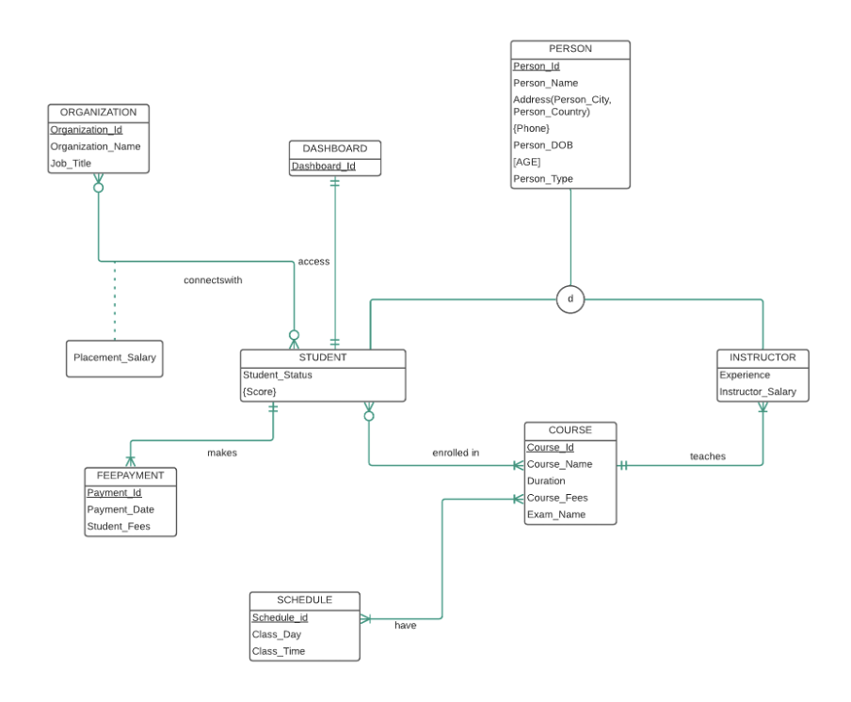
ERD
Notes:
Primary key : schedule_id ?

Slide 6
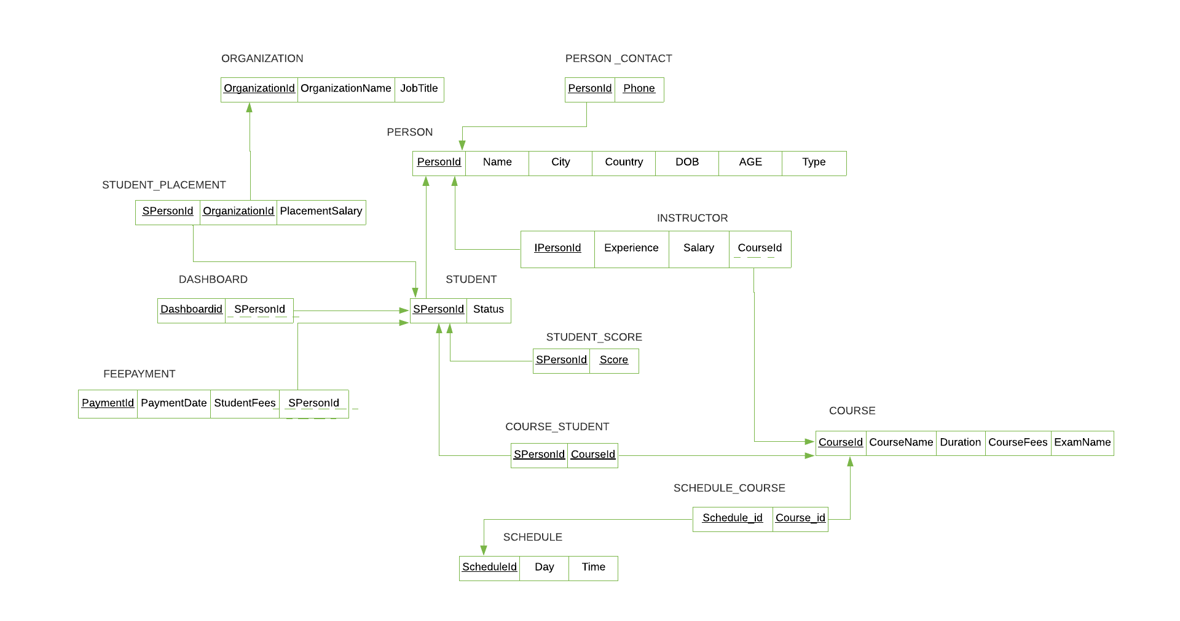
RELATIONAL DATA MODEL

Slide 7
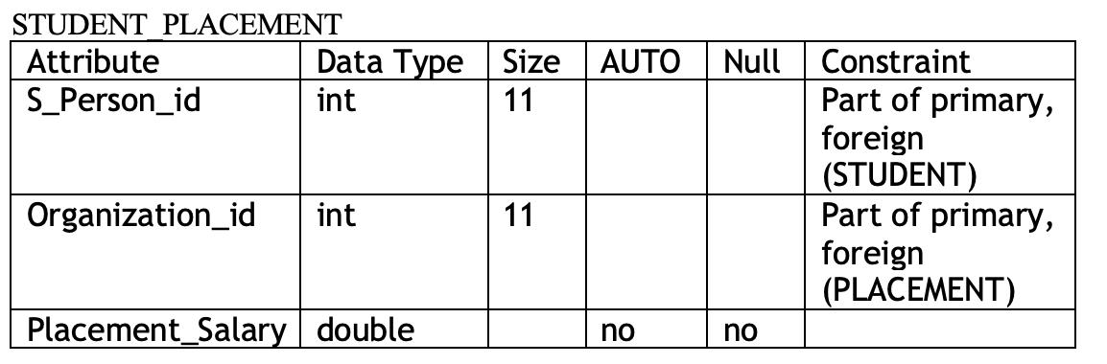
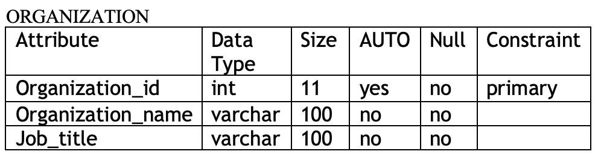
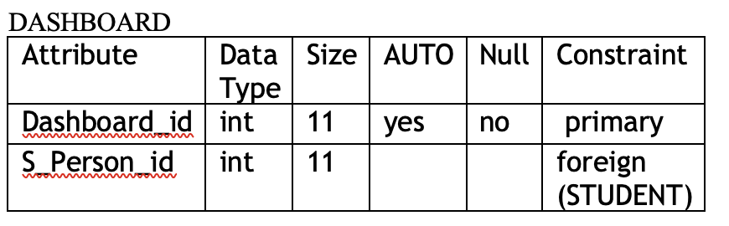
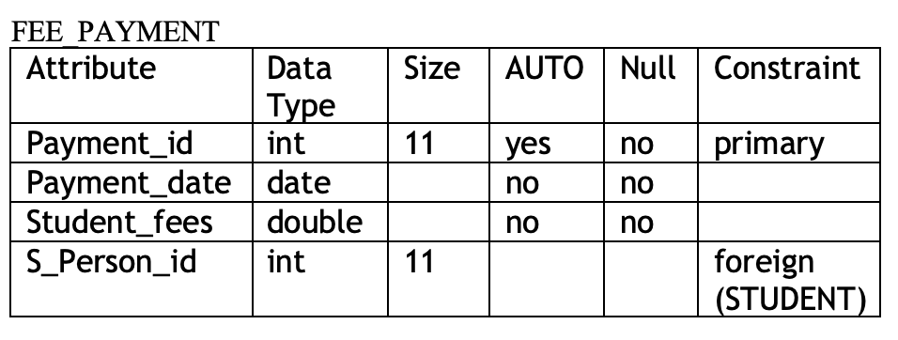
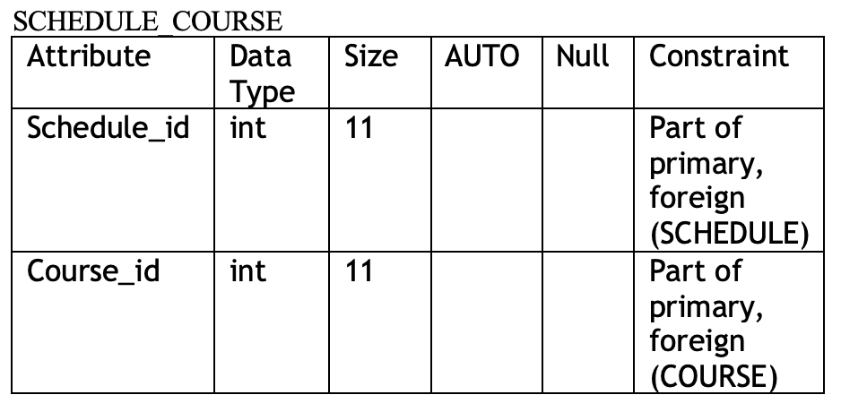
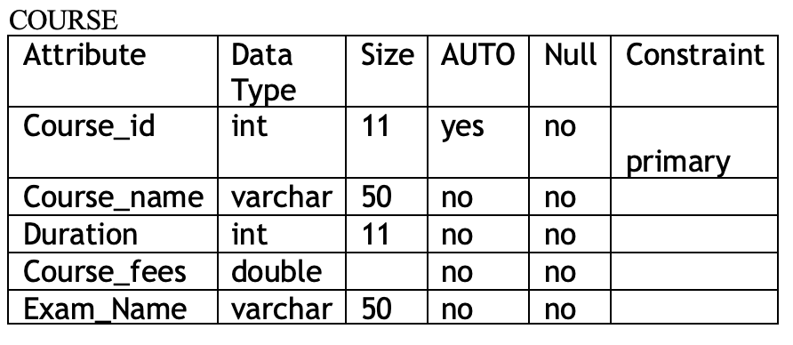
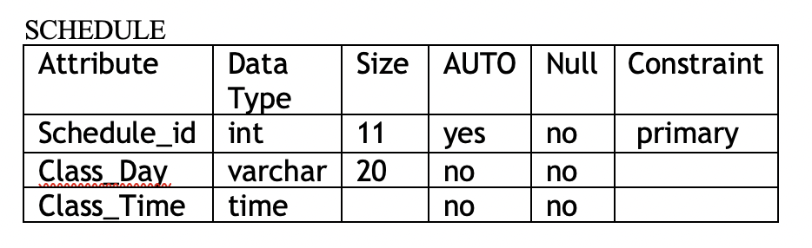
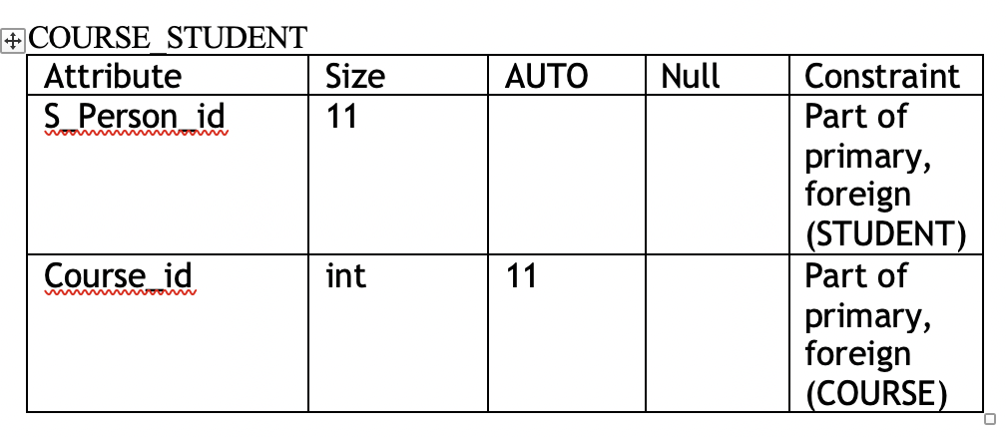
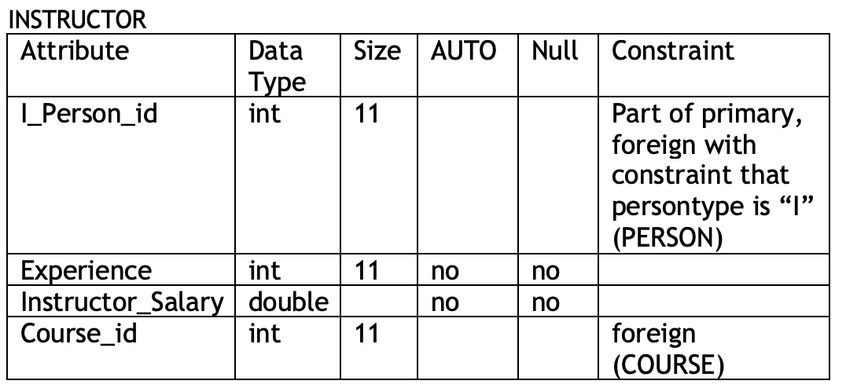
META DATA
Notes:
We have also createdc meta data for all the relations where we have the information on the data types, size, wheatger the field is auto incremented or not , weather the null values are allowed for that attribute or not nad primary and fk constraints.

Slide 8
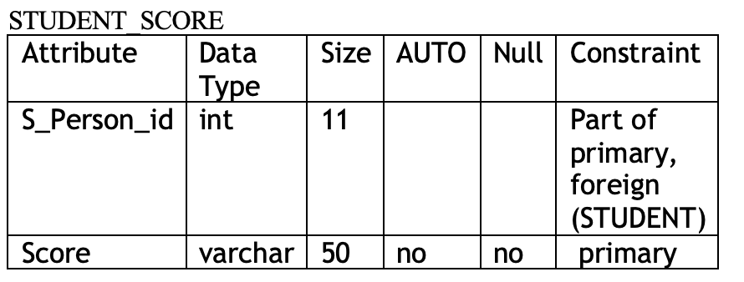
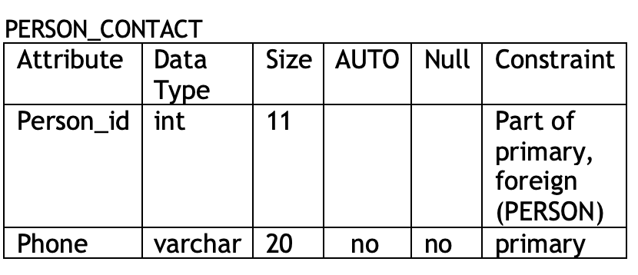
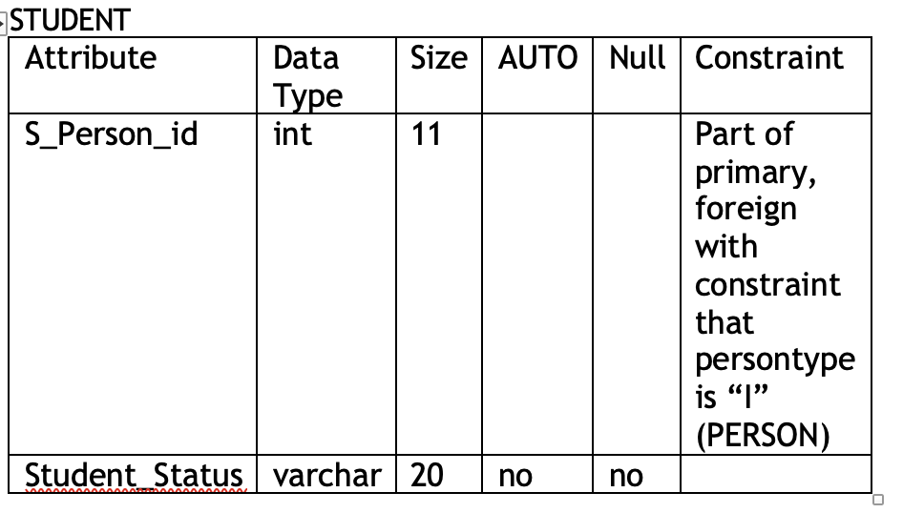
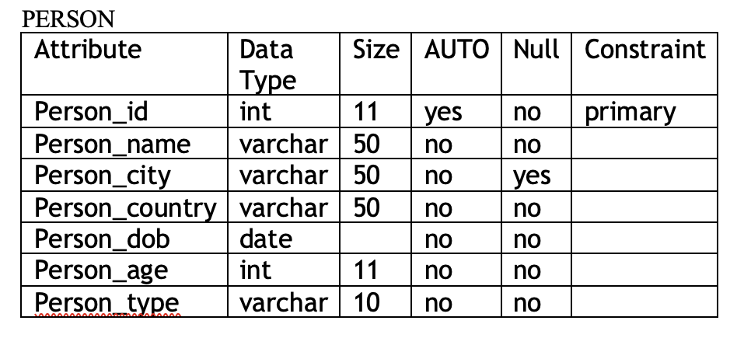

Slide 9
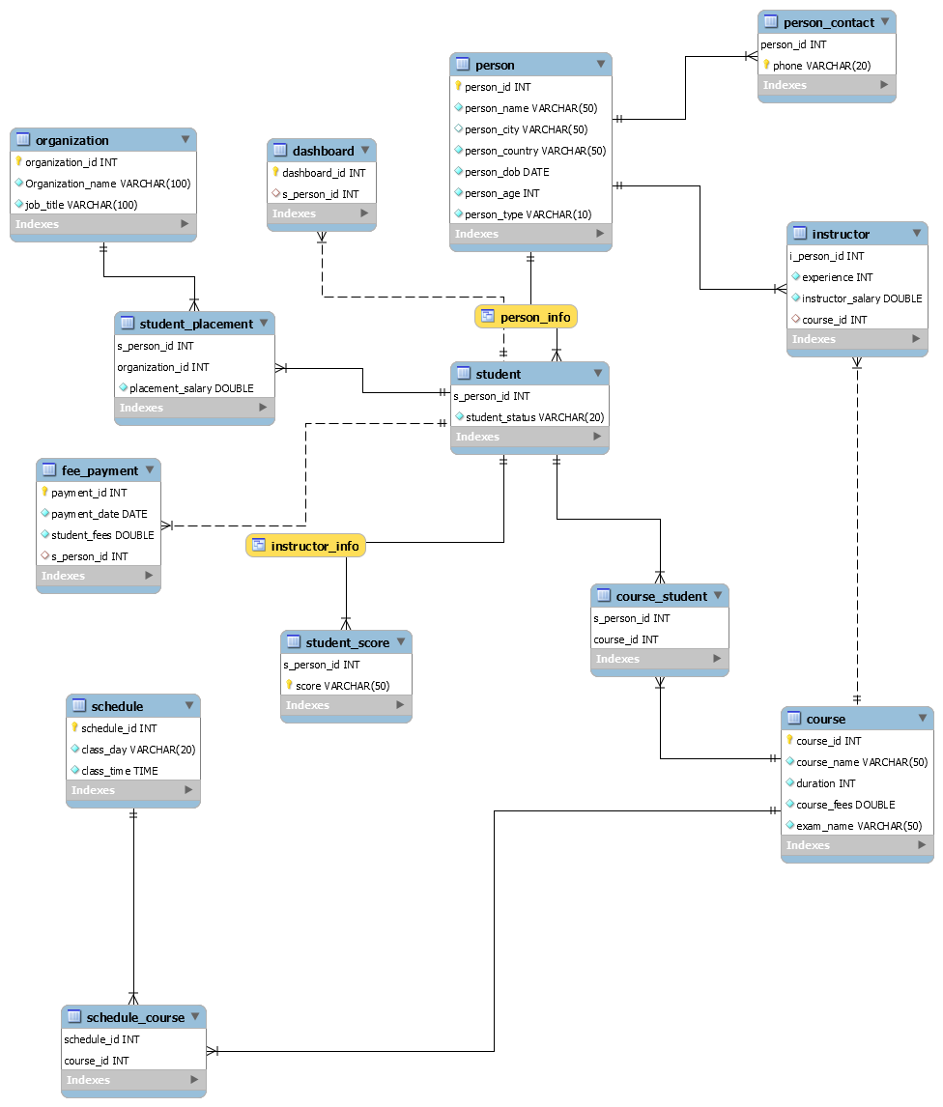
LOGICAL DATA MODEL

Slide 10
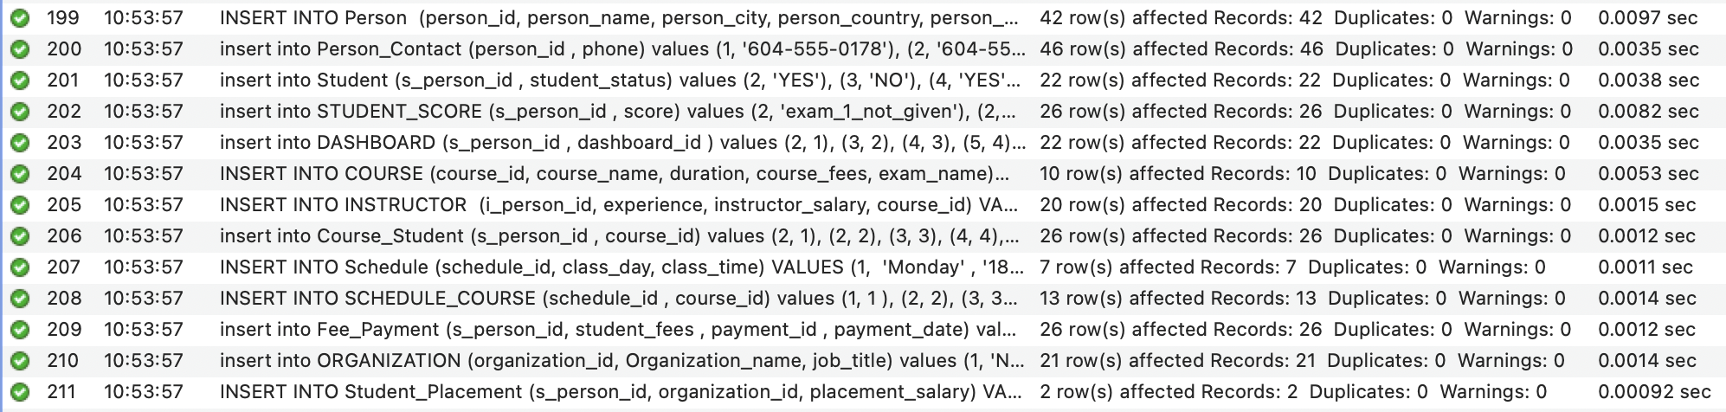
POPULATING & INSERTING SAMPLE DATA

Slide 11
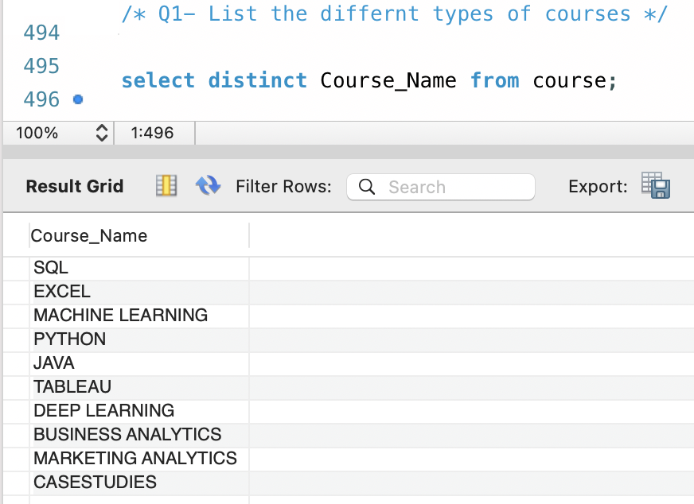
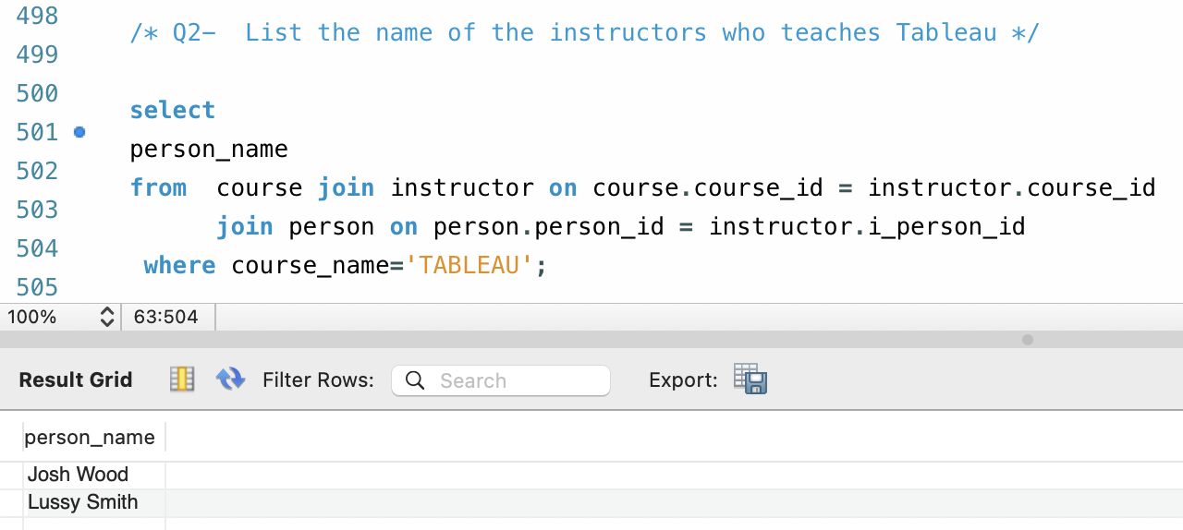

Slide 12
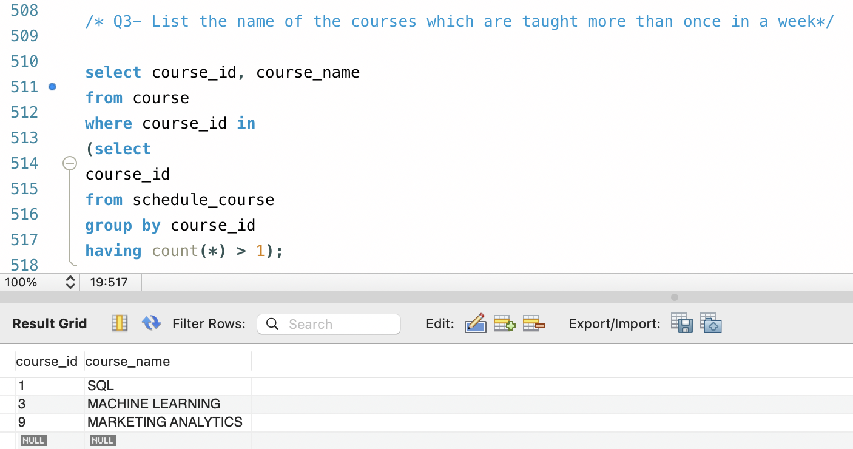
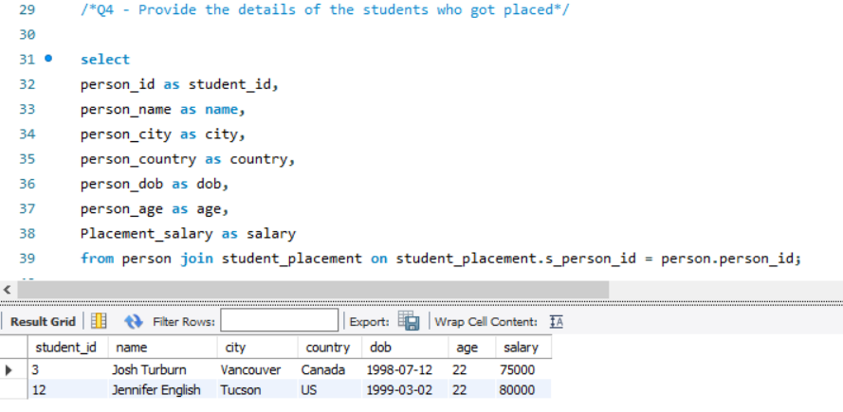

Slide 13
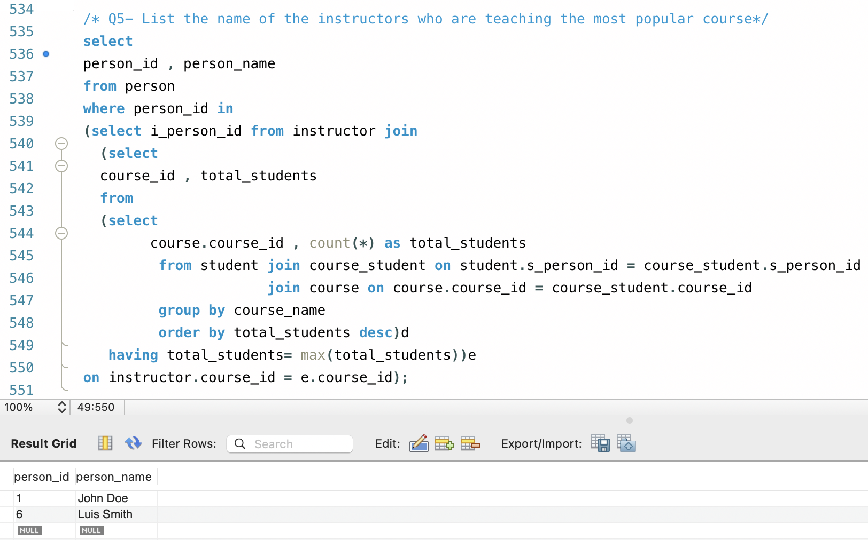
We derive the most popular course among students and the instructor who is teaching the most popular course.
Assumption: the most popular course is determined by the maximum number of students enrolled in the course.

Slide 14
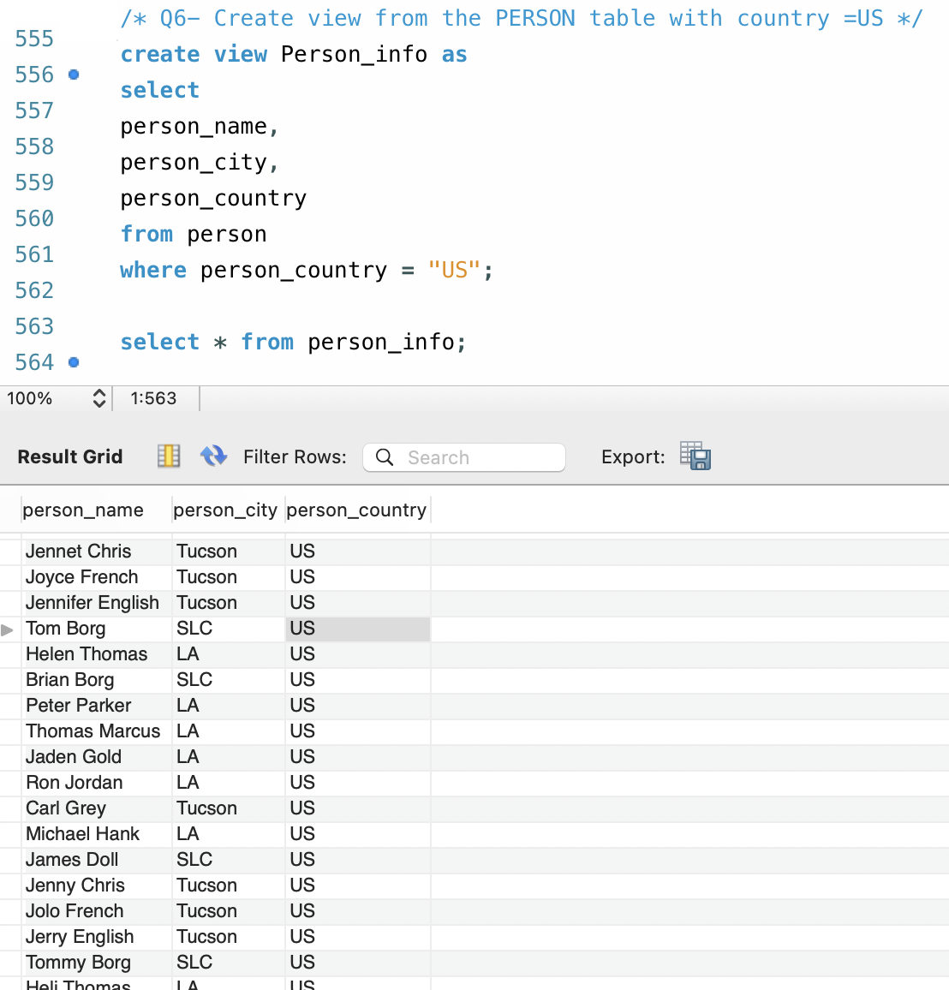
CREATE VIEW
The view is created Person_info to select name of the person, city and the country.
We have set the value for the country as US and this lists the names of persons who reside in US only.

Slide 15
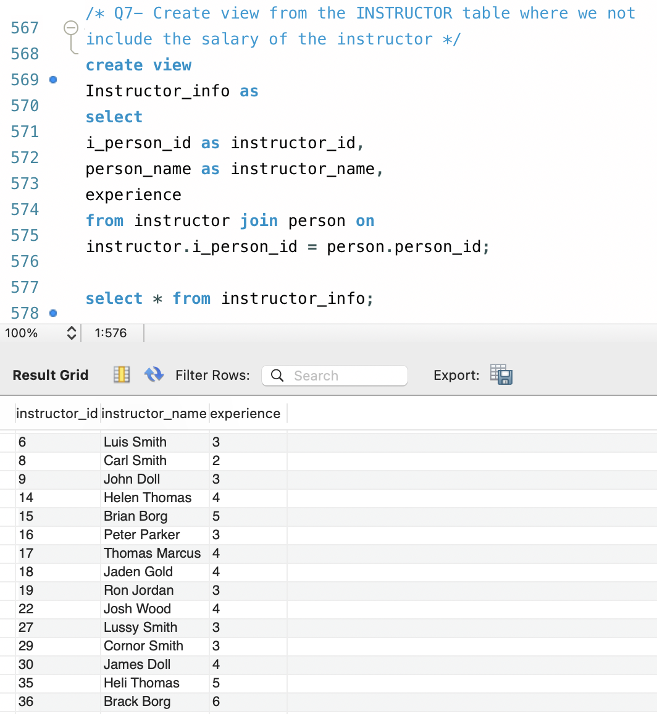
CREATE VIEW
The Instructor_info view is created, we set the person_id as instructor_id, person name as instructor_name and experience.
This lists all the instructors with the relevant instructor id’ s and the number of years of experience.

Slide 16
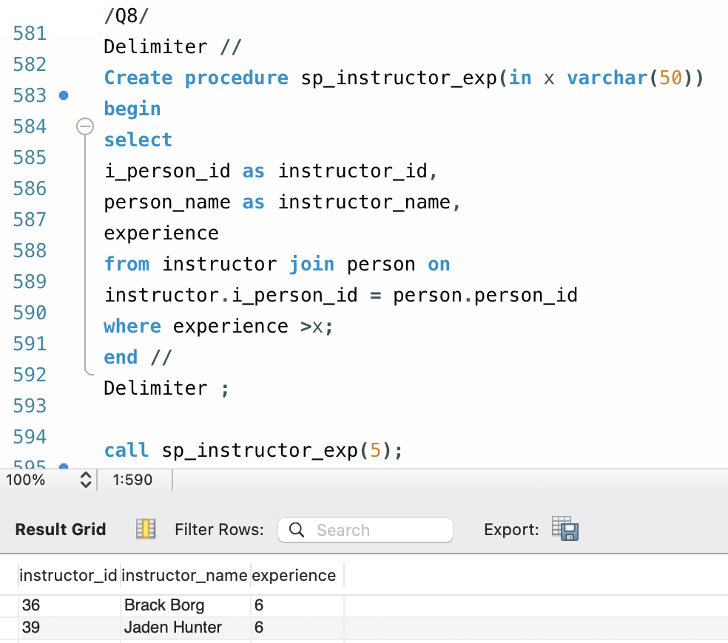
STORED PROCEDURE
We created a new stored procedure named sp_instructor_exp.
The stored procedure takes the number of years of experience of an instructor as an input.
The output is the instructor’s Name along with the years of experience of an instructor.
It gives the information of the instructor whose experience is greater than the specified number.

Slide 17
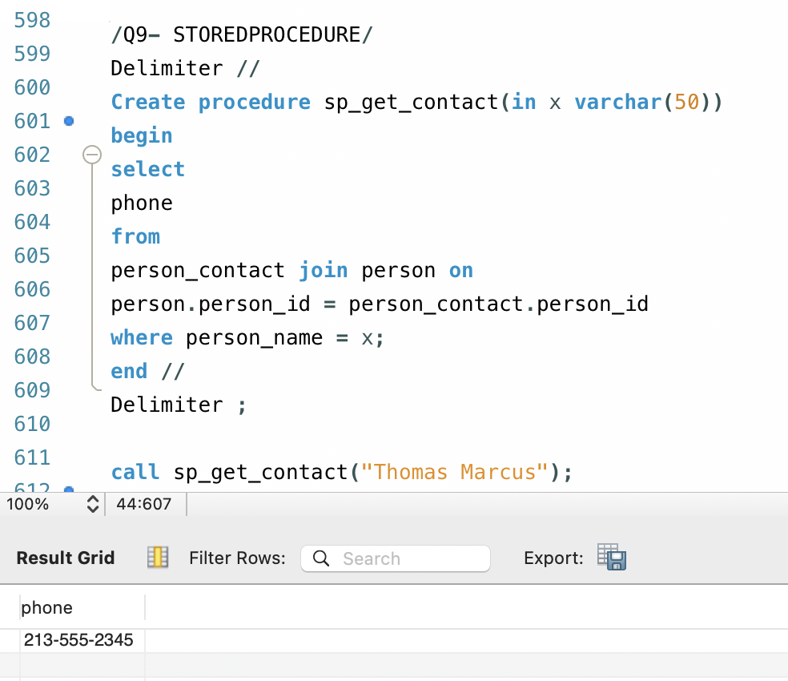
STORED PROCEDURE
We created a new stored procedure named sp_get_contact.
This stored procedure takes input as person name and contact information as the output.

