Slide 1
AGENDA
1. Motivation & Surprisal Theory
2. The Cognitive Phenomena
3. Language Models as Proxies
4. The Subword Alignment Problem
5. Measuring Reading Difficulty
6. Formulation & Hypotheses
7. Datasets & Preprocessing (Nb 1)
8. Classical N-gram Surprisal (Nb 2)
9. Transformer Context Limits (Nb 3)
10. Main Findings & Visuals
11. Why did BERT fail?
12. Future Directions
Predicting Human Reading Difficulty
using Language Model Surprisal
Computational Psycholinguistics — Course Project
Mudit Gupta | Roll: 2024201058

Slide 2
BACKGROUND
Background & Motivation
Cognitive load is not distributed evenly across a sentence
Why do some words take longer to read than others?
Key Mechanisms
Core concept: Surprisal Theory (Hale, 2001; Levy, 2008)
Predictive Processing
The brain constantly guesses the next word.
Cost of Update
When predictions fail, reading time spikes.
Logarithmic Scaling
Processing difficulty scales linearly with the negative log probability (bits).
RT = α * S(w) + β
S(wᵢ) = −log₂ P(wᵢ | context)
• Information Theory meets Cognition:
• A word that is highly predictable carries little information, thus requiring little processing effort.
• Conversely, an unexpected word (high surprisal) forces the brain to update its syntactic/semantic trace rapidly, causing a delay.
• The Question:
• Can artificial neural networks predict human cognitive load?
• Do large language models (which implicitly learn syntax and semantics) align better with human reading behavior than classical statistical approaches?

Slide 3
COGNITIVE LINGUISTICS
The Target Phenomena: Syntactic Complexity
What specifically causes surprisal spikes?
1. Garden-Path Sentences
• The complex houses married and single soldiers.
• At first glance, 'complex' is read as an adjective and 'houses' as a noun.
• By 'married', the parse fails. Regression happens. 'complex' is actually a noun, 'houses' is a verb.
• → Massive reading time spike at 'married'. Models should predict high surprisal here.
2. Center-Embedding
• The rat the cat the dog chased killed ate the malt.
• Working memory is overwhelmed maintaining multiple open syntactic dependencies.
• Reading times increase linearly with embedding depth.
• → Does a Transformer's self-attention mechanism replicate this memory strain via surprisal?

Slide 4
PREREQUISITES
Prerequisites — Language Models
Three distinct architectures for estimating P(w|context)
📊 N-gram (KN)
⚡ GPT-2 (Autoregressive)
🎭 BERT (Masked LM)
Predicts next word using ONLY the last N−1 words.
P(wᵢ | wᵢ₋₁, wᵢ₋₂)
Kneser-Ney Smoothing:
Handles unseen n-grams gracefully by backing off to lower orders based on continuation probabilities.
Strengths:
Extremely robust locally.
Weakness:
Has no concept of long-range syntax (subject-verb agreement over distance).
Causal Transformer.
Predicts each token using dense representations of ALL prior tokens via self-attention.
P(wᵢ | w₁...wᵢ₋₁)
Strengths:
Context window of 1024 tokens. Can track characters and complex grammar.
Close analog to human sequential reading.
Weakness:
Only single-direction context.
Bidirectional Transformer.
Not designed for left-to-right prediction. Uses Pseudo-Log-Likelihood (PLL).
Mask target word, then read log P from [MASK] logit.
Strengths:
Sees future context. Superior for semantic embedding.
Weakness:
Not physiologically plausible (humans don't see the end of the sentence first).
Computationally heavy (1 pass per word).

Slide 5
METHODOLOGY CHALLENGES
The Subword Alignment Problem
Reconciling model tokenizers with human reading data
The Mismatch:
Psycholinguistic corpora (like Natural Stories) record reading times per WORD.
Modern transformers (GPT-2, BERT) use Byte Pair Encoding (BPE) or WordPiece.
A single word is often split into a sequence of subword tokens.
Example:
Corpus word: 'unbelievable' → RT: 450 ms
GPT-2 output: ['un', 'bel', 'iev', 'able'] → We have 4 separate log probabilities.
Mathematical Resolution (Joint Probability):
The probability of the full word is the joint probability of its subwords.
Because probabilities multiply, log-probabilities ADD.
S(word) = −( log₂ P('un' | ctx) + log₂ P('bel' | ctx + 'un') + ... )
Implementation detail:
We must carefully track token indices back to the original text sequence to ensure every subword's log-prob is rolled up accurately into the final CSVs.

Slide 6
MEASUREMENT
Measuring Human Reading Difficulty
Self-paced reading vs Eye-tracking
📖 Self-Paced Reading (SPR)
👁️ Eye-Tracking
Mechanism:
Participant sits at a computer. Text is hidden by dashes ('--- ---').
Pressing spacebar reveals next word and hides previous word.
RT = time between spacebar presses (ms).
Pros:
Forces strict serial processing. Cannot look back.
Very clear measure of localized difficulty.
Cons:
Unnatural reading format. Slower than normal reading.
Spillover effects common (delayed reaction on word i+1).
Used in: Natural Stories Corpus
Mechanism:
Infrared camera tracks pupil/corneal reflection at 1000 Hz.
Records 'saccades' (jumps) and 'fixations' (resting).
We use First-Pass Fixation Duration (FDUR).
Pros:
Highly naturalistic. Participants read paragraphs normally.
Allows studying regressions (looking back).
Cons:
Word skipping (short words often have 0 ms fixation).
Highly complex data requiring parsing.
Used in: Dundee Corpus

Slide 7
RESEARCH QUESTIONS
Research Questions & Hypotheses
RQ1
Does language-model surprisal correlate with human reading time?
Hypothesis: Higher surprisal → longer reading time (RT ∝ Surprisal). We expect positive r.
RQ2
Do transformer LMs (GPT-2/BERT) predict reading difficulty better than n-gram LMs?
Hypothesis: Transformers capture long-range context → higher correlation with RT than Bigrams.
RQ3
Do syntactic constructions produce surprisal spikes matching RT increases?
Hypothesis: Garden-path & center-embedded sentences → local surprisal peaks at disambiguation points.

Slide 8
DATASETS
Datasets Used in This Project
📗 Natural Stories Corpus
📘 Dundee Corpus
Futrell et al. (2018)
• 10 natural language stories
• 180 participants
• 10,256 unique word tokens
• Designed to contain complex syntactic
structures (garden-path, embeddings)
Cleaning steps:
• Limit RT to 100–3000 ms to filter out slips
• The Z-Score Imperative:
Some people read fast, some slow.
We z-score log(RT) per participant to isolate
relative difficulty of specific words.
DV: mean log(RT) per word
Kennedy et al. (2003)
• 20 UK newspaper article texts
• 10 participants (but dense data)
• 50,650 word-level observations
• General domain text (not crafted)
Cleaning steps:
• Keep Pass-1 fixations only. Why?
Re-reading (regression) signifies failure of
surprisal predictions. First-pass isolates
local predictability.
• FDUR bounded 50–1200 ms
• Z-score log(FDUR) per subject
DV: mean log(FDUR) per word

Slide 9
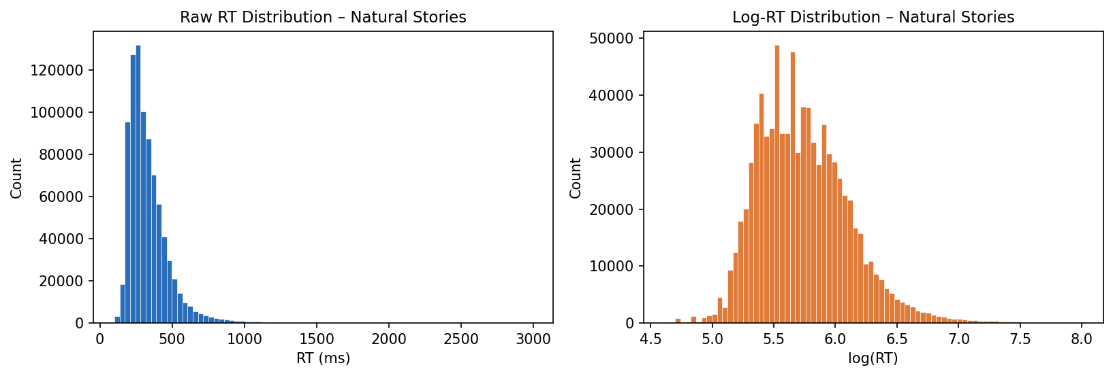
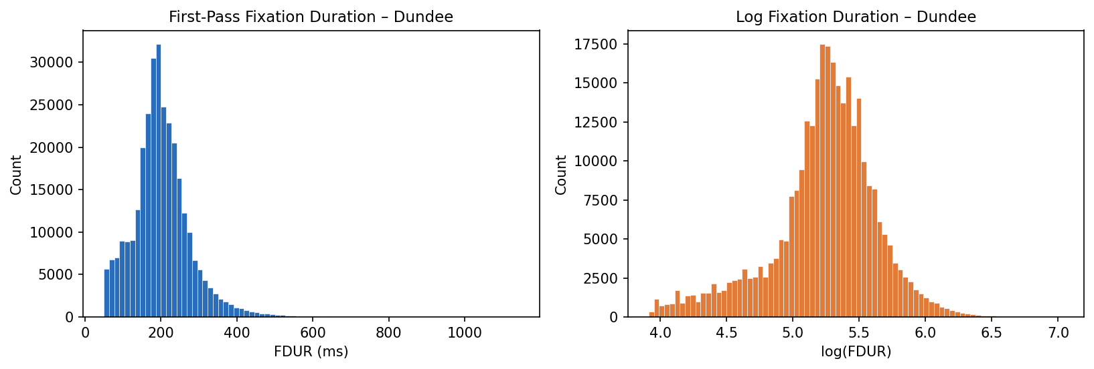
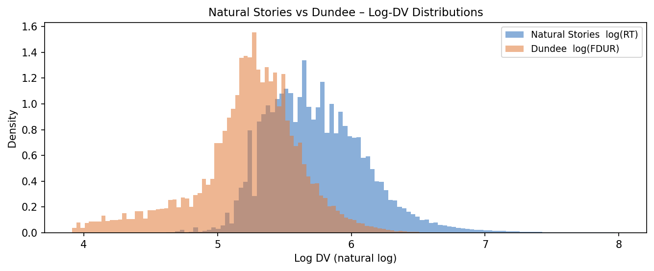
NOTEBOOK 1 — PREPROCESSING
Notebook 1: Distributions & Skew Rectification
Natural Stories RT
Dundee Fixation Duration
Log-DV Overlay
Right-Skew Issue:
Reaction times naturally have a strict lower bound (0 ms) but an infinite upper tail.
OLS Regression assumes normality. Without a logarithmic transform, outliers pull the trend line.
Log-transformation normalizes the data as shown in the orange distributions.

Slide 10
NOTEBOOK 2
Notebook 2: Classical N-gram Surprisal
Establishing the baseline with Kneser-Ney smoothing
Method
Results
Training corpus:
NLTK Brown corpus — 57,340 sentences. Generic domain.
Models trained:
• Bigram (n=2)
• Trigram (n=3)
Implementation:
NLTK's `KneserNeyInterpolated` pipeline.
Computed sequentially across texts. OOV tokens smoothed.
Output generated:
ns_ngram_surprisal.csv (10k rows)
dundee_ngram_surprisal.csv (50k rows)
Baseline Correlation with log-DV:
Model
NS r(log RT)
Dundee r(logFDUR)
Bigram KN
r = 0.2149
r = 0.1732
Trigram KN
r = 0.1928
r = 0.1715
Why did Bigram beat Trigram?
Sparsity. Trigrams suffer more from data sparsity on a small training corpus (Brown), introducing noise.

Slide 11
NOTEBOOK 3 — FIXES
Notebook 3: Transformer Context Limits
Engineering around CUDA / Memory crashes
The Problem:
BERT max sequence length is 512 subwords.
GPT-2 max sequence length is 1024 subwords.
Dundee articles are often 2000+ words. Passing the whole text yields a CUDA Device Assert on indexing.
GPT-2 Solution (Autoregressive Context Tracking):
We built a chunker that grabs words greedily until subword tokens hit 512.
Only the first word of the chunk loses left context. This minimizes data loss across the vast sequence.
BERT Solution (PLL Tracking):
Created 80-word windows. In each window, loop through every word, MASK it, do a forward pass, and sum
local subword logits. Extends runtime significantly but avoids out-of-bounds truncation.

Slide 12
RESULTS
Main Results: 4-Model Correlation Table
Pearson r between model surprisal and human log reading time — all p < 0.001
Model
Type
NS r(log RT)
Dundee r(logFDUR)
Verdict
Bigram KN
Classical N-gram
0.2149 ⭐
0.1732
Best on NS (1st)
Trigram KN
Classical N-gram
0.1928
0.1715
GPT-2
Transformer (AR)
0.2094
0.1929 ⭐
Best on DU (1st)
BERT (PLL)
Transformer (MLM)
0.1572
0.1554
Weakest (4th)
⭐ = best in column AR = autoregressive MLM = masked language model
RQ1 ✓
All 4 models show significant positive correlation with reading time. Surprisal IS a reliable predictor of reading difficulty.
RQ2 ~
MIXED result: GPT-2 outperforms n-grams on Dundee but Bigram KN marginally outperforms GPT-2 on Natural Stories (0.215 vs 0.209).

Slide 13
ANALYSIS: THE ANOMALIES
Why did BERT fail? Why did Bigram win NS?
Why did BERT score the worst?
Why did Bigram win on Natural Stories?
Bidirectional cheating:
BERT PLL calculates P(w | Left Context + Right Context).
Humans read strictly Left-to-Right. The right context is not available during an actual surprisal event in the brain.
Noise introduced by Masking:
Using the [MASK] token alters the sentence dynamics compared to GPT-2's smooth autoregression.
Local Syntactic Traps:
Natural Stories is filled with deliberate, tricky transitions (e.g. Noun directly adjacent to Verb where an Adjective was expected).
Bigrams are hypersensitive locally:
A Bigram model reacts disastrously to adjacent weird pairs. This harsh local reaction correlates perfectly with the human brain's sudden confusion at that exact boundary.
GPT-2 buffers this by using massive context width to 'smooth out' expectations.

Slide 14
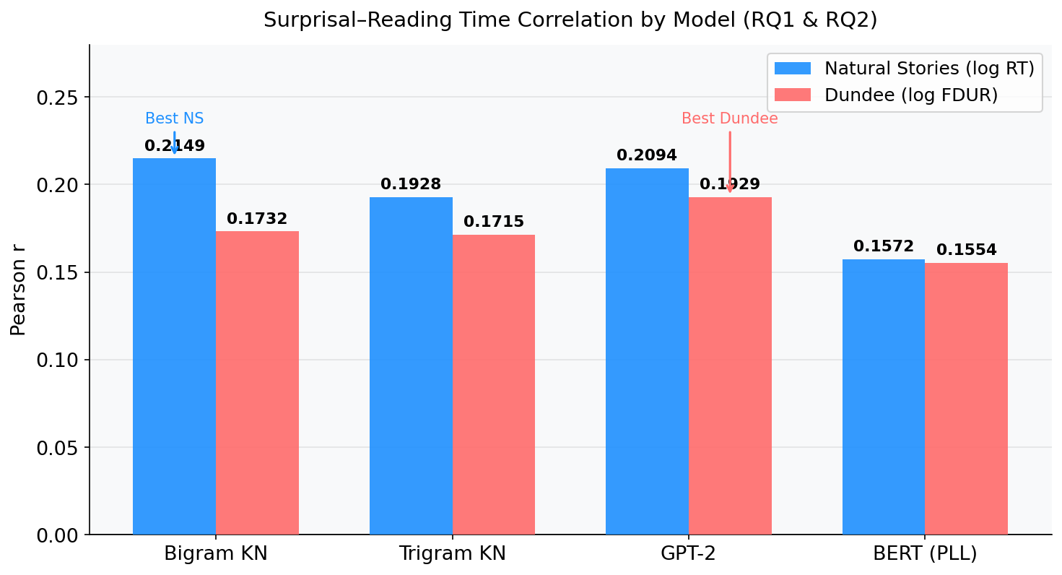
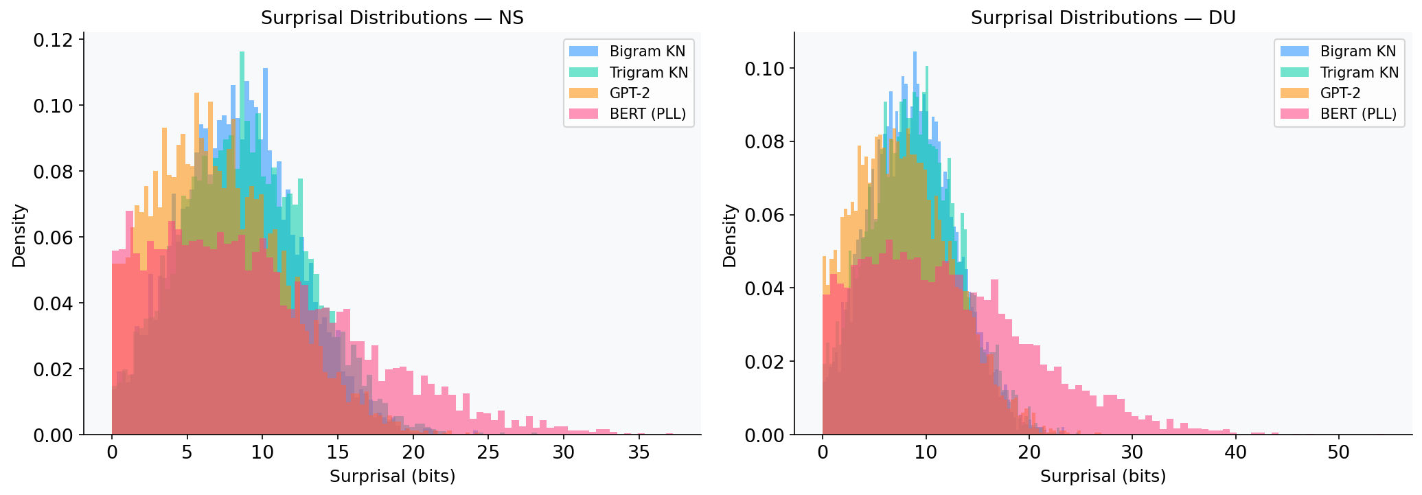
RESULTS — VISUAL
Results: Correlation Bar Chart & Distributions
Pearson r by model — both corpora
Surprisal distributions — all 4 models
Key visual findings:
• Bigram KN produces the highest NS correlation bar (steelblue, left-most pair)
• GPT-2 wins on Dundee (coral bar, 3rd pair) — extends bigram on broader domain text
• BERT (PLL) scores heavily shifted left toward 0 bits — predicting masked words given surrounding context is 'too easy'.

Slide 15
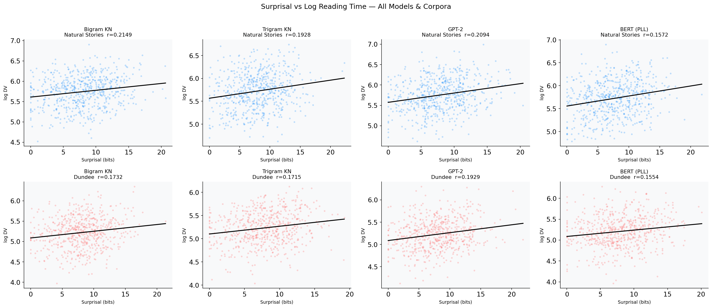
RESULTS — SCATTER PLOTS
Surprisal vs. Log Reading Time — All Models × Corpora
Each panel: one model × one corpus. Black line = OLS fit. r value shown in title.
Positive slopes in all 8 panels visually confirm: higher surprisal → longer reading time (RQ1 ✓)

Slide 16
CONCLUSIONS
Discussion & Conclusions
✅ RQ1 — Confirmed
All LM surprisal measures positively correlate with human reading time (r=0.15–0.21). Higher surprisal reliably predicts longer reading times / fixation durations.
⚠️ RQ2 — Mixed
GPT-2 outperforms n-grams on Dundee but not on Natural Stories. Classical Bigram models are surprisingly competitive at detecting local structural ambiguity.
🔍 BERT Failure
Bidirectional context is not physiologically valid for sequential reading measurement. Masked LM produces flawed surprisal metrics for psycholinguistics.
📌 Replication
Results replicate across both corpora (Self-Paced Reading and Eye-Tracking), proving standard linear association holds independent of tracking mechanism.

Slide 17
FUTURE WORK & REFERENCES
What's Next & References
🔮 Remaining Work (50% → 100%)
📚 References
Notebook 4 — Mixed-Effects Regression:
Fit lmer-style models: logRT ~ surprisal + word_len +
word_freq + position + (1|subject) + (1|item)
Compare β-coefficients across models
Notebook 5 — Control Variables:
Partial out word length, frequency (log), POS,
sentence position — isolate pure surprisal effect.
Length and Frequency are huge confounds.
Notebook 6 — Syntactic Analysis (RQ3):
Locate specific garden-path sentences.
Plot word-by-word line chart: Surprisal vs RT.
Non-linear models: Random Forest / XGBoost
Smith & Levy (2013).
Predictability effects on
reading time.
Hale (2001).
A probabilistic Earley parser
as a psycholinguistic model.
Levy (2008).
Expectation-based syntactic
comprehension.
Demberg & Keller (2008).
Eye-tracking evidence for
sentence processing.
Salazar et al. (2020).
Masked LM scoring.
Kennedy et al. (2003).
Dundee eye-tracking corpus.

