Slide 1

SMART INDIA HACKATHON 2026
WeatherGPT
Problem Statement ID - SIH26068
Problem Statement Title - WeatherGPT: Conversational AI for Weather Forecasting, Alerts and Climate Information
Theme - Disaster Management
PS Category - Software
Team ID -
Team Name- TheHonouredOne

Slide 2
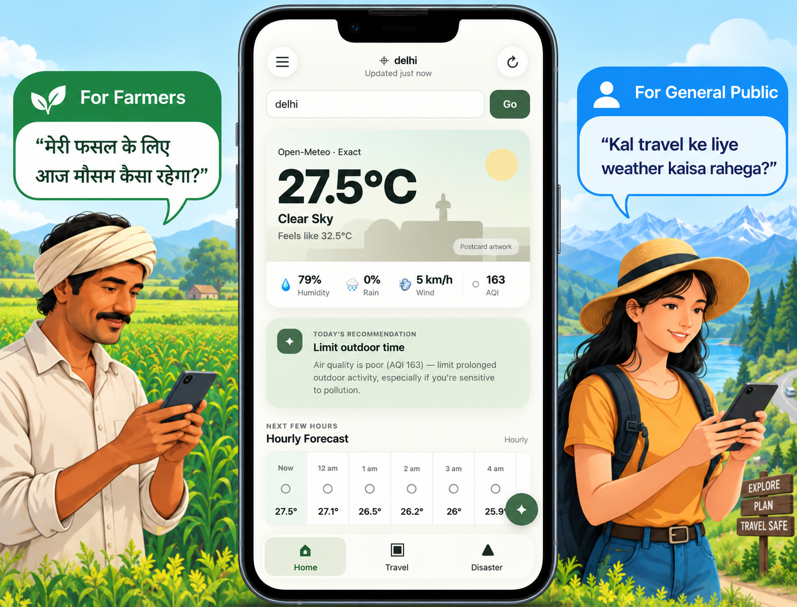
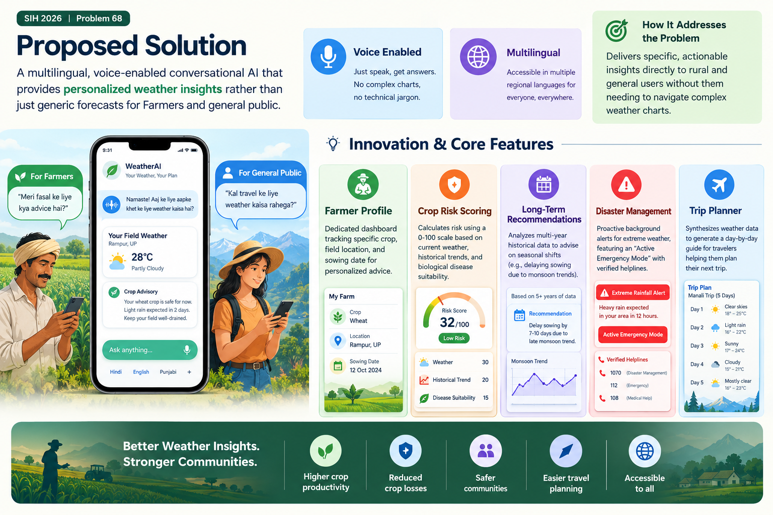
WeatherGPT
The
Honoured
One
Proposed Solution:
Detailed Explanation: A multilingual, voice-enabled conversational AI that general public. provides personalized, actionable weather intelligence for farmers, travelers, disaster stakeholders and the general public.
How it Addresses the Problem: Delivers specific, actionable insights directly to rural and general users without them needing to navigate complex weather charts.
Innovation & Core Features:
Farmer Profile : Dedicated dashboard tracking specific crop, field location and sowing date for personalized advice.
Crop Risk Index : Calculates risk using a 0-100 risk score using temperature, soil moisture, crop growth stage, weather-linked disease suitability and historical anomalies.
Trend-Informed Advisory: Analyzes multi-year historical data to advise on seasonal shifts (e.g - delaying sowing due to monsoon trends).
Disaster Management : Proactive background alerts for extreme weather, featuring an "Active Emergency Mode" with verified helplines.
Trip Planner : Synthesizes weather data to generate a day-by-day guide for travelers helping them plan their next trip.

Slide 3
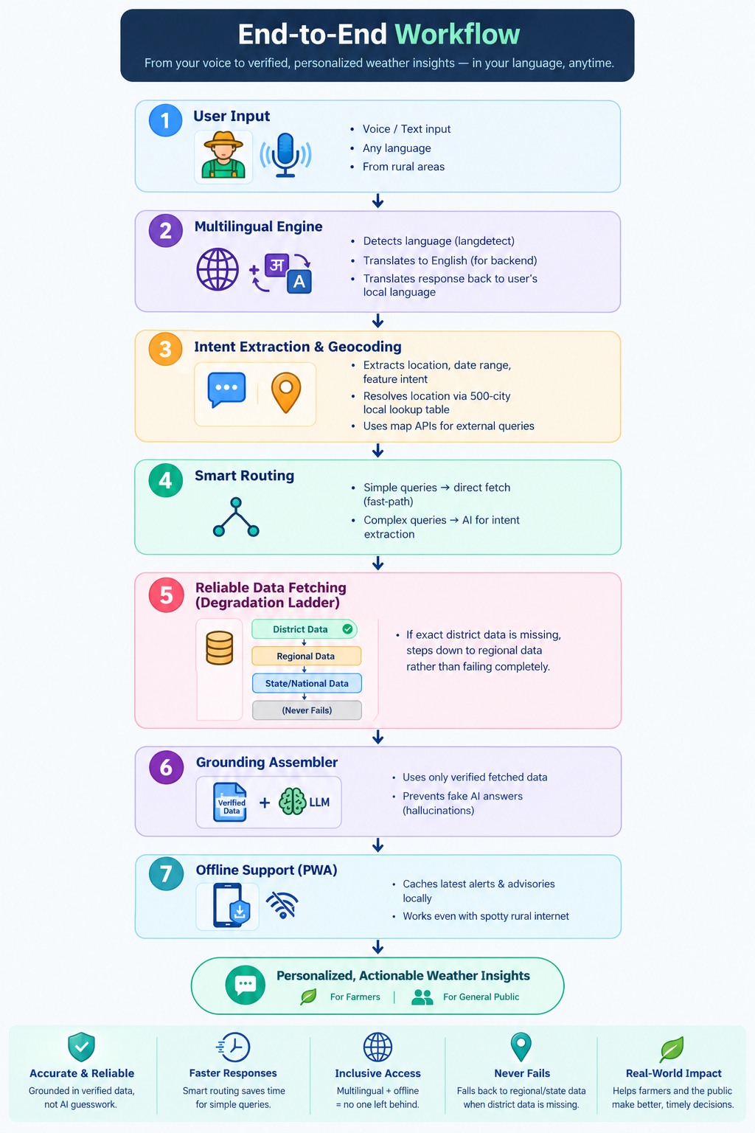
TECHNICAL APPROACH
The
Honoured
One
Tech Stack:
Frontend: React, Tailwind CSS, PWA (Web Speech API, IndexedDB).
Backend: Python (FastAPI), PostgreSQL, APScheduler (scheduled background jobs).
AI & Data: Gemini Flash + Groq fallback (LLM), WeatherAPI.com (Primary), Open-Meteo (Fallback), IMD alerts/public data.
Implementation Methodology & System Workflow
Grounding Assembler: To prevent fake AI answers (hallucinations), the AI is forced to read only from verified fetched data before generating a response.
Smart Routing: A fast-path handles simple queries directly to save time, while complex queries use AI for intent extraction.
Reliable Data Fetching (Degradation Ladder): If exact district data is missing, the system automatically steps down to regional data rather than failing completely.
Offline Accessibility: Caches recent weather pulls locally (PostgreSQL/Redis) to speed up responses, laying the groundwork for a full offline PWA.
Multilingual Engine: Uses langdetect and the LLM to instantly translate regional voice queries into backend data requests, and then synthesizes the grounded answer back into the user's local language.
Intent Extraction & Geocoding: For complex queries, the system extracts the location, date range, and specific feature intent. Locations are resolved locally via a 500-city static lookup table before querying external map APIs.
End to end Workflow

Slide 4
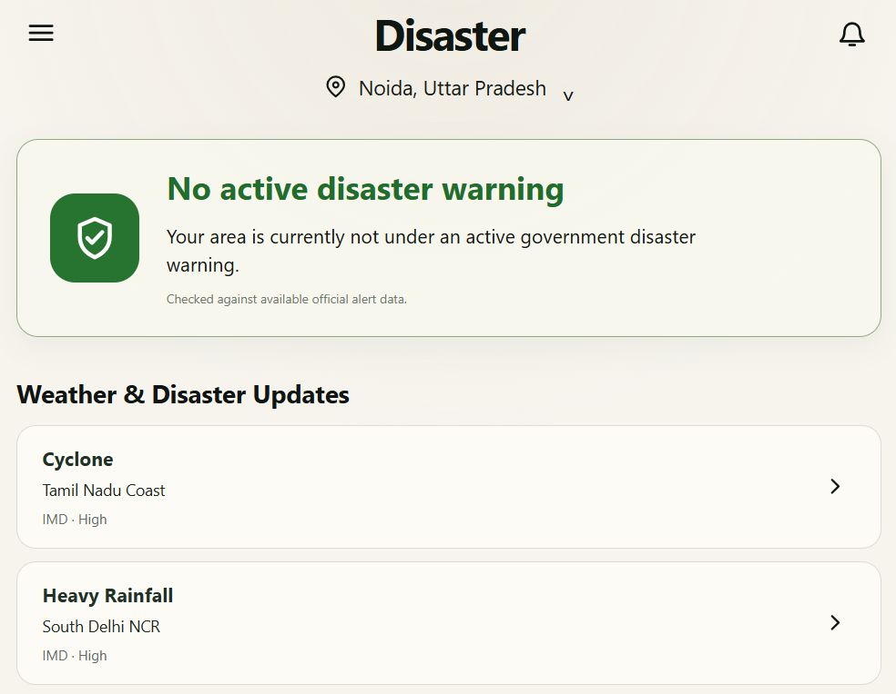
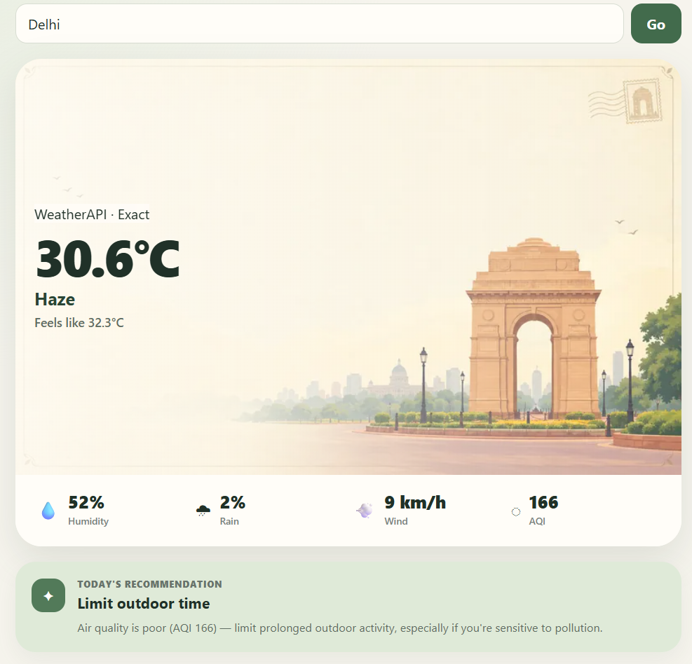
FEASIBILITY AND VIABILITY
The
Honoured
One
RISK → MITIGATION
WEBSITE MOMENT
WHY IT IS FEASIBLE
Design choices are paired directly with the failure modes judges will care about.
Three proof points keep the build lean without weakening the pitch.
RISK
MITIGATION
01
Deploy now
LLM hallucination
Deterministic grounding
FastAPI + Supabase + Gemini Flash + Open-Meteo → free-tier friendly
Wrong temperature / unsafe advice
LLM can only rephrase retrieved data
RISK
MITIGATION
Rural connectivity
Cache-first offline path
02
Low compute
Patchy 2G / 3G round-trips
Cached forecast + emergency rules
Lightweight Python logic → target response latency < 1.5 s
RISK
MITIGATION
Remote data gaps
High-resolution fallback
Device agnostic
Missing local weather feeds
Interpolate 1–11 km Open-Meteo grids
03
WHAT WE ARE ACTUALLY SHIPPING
Responsive web + browser Web APIs → no app-store download
RISK
MITIGATION
API bottlenecks
Dual caching + fast paths
Grounded chat • Hindi + English Voice input/output • live weather Proactive severe-weather alerts
Traffic spikes during judging
Static geocoding + fewer LLM calls
Real data in → grounded context → safe answer out.

Slide 5
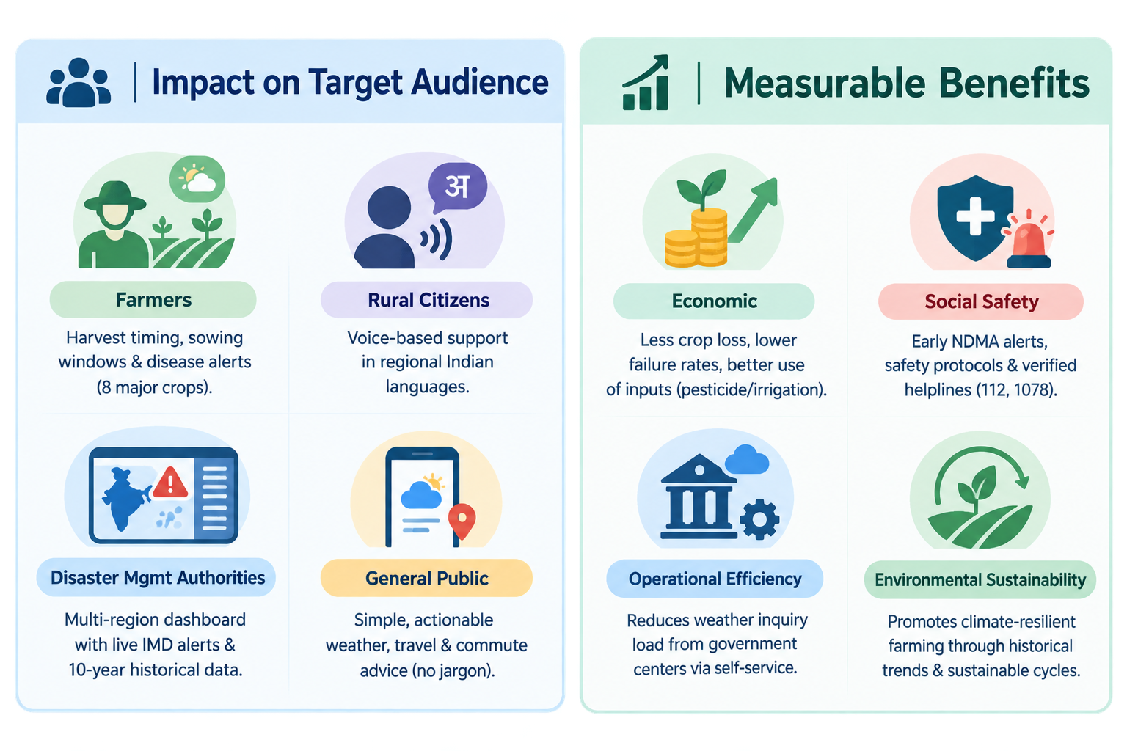
IMPACT AND BENEFITS
The
Honoured
One
Impact on Target Audience
Farmers: Prevents severe crop loss by providing harvest-timing guidance, sowing windows and disease alerts across 12-15 major Indian crops (Rabi & Kharif).
Rural Citizens: Overcomes literacy barriers through direct voice conversations in regional Indian languages.
Disaster Management Authorities: Offers a unified, multi-region dashboard categorizing live IMD alerts alongside 10-year historical climate baselines.
General Public: Provides actionable daily commute, travel and extreme weather planning without technical jargon.
Measurable Benefits
Economic: Protects agricultural investments by mitigating climate risks, cutting crop failure rates, and optimizing pesticide/irrigation timing.
Social Safety: Enhances disaster readiness through early dissemination of NDMA-verified safety protocols and verified helplines (112, 1078).
Operational Efficiency: Offloads public weather inquiry loads from government meteorological centers through automated self-service.
Environmental Sustainability: Fosters climate-resilient farming practices through historical trend tracking and conservation-friendly crop cycles.
Supporting fact : NCAER 2020 Survey Validation
High Adoption Rate: 98% of surveyed Indian farmers across 121 districts modified at least one agricultural practice (such as changing crop varieties or managing irrigation) when provided with timely weather advisories.
Proven Income Multiplication: Farming households that adopted weather-based advisories saw their average annual income increase from ₹1.98 Lakh to ₹3.02 Lakh.
Macro-Economic Scale: Timely weather advisories generate an estimated total income gain of ₹13,331 crore per annum.

Slide 6
RESEARCH AND REFERENCES
The
Honoured
One
Institutional Domain References
Indian Council of Agricultural Research (ICAR) & CRIDA: District-level Crop Weather Calendars, pest-weather relationship matrices and stage-specific thresholds.
National Disaster Management Authority (NDMA): Standard Operating Procedures (SOPs), verified Do’s & Don’ts for cyclones, floods, heatwaves and lightning.
Technical References & Data Sources
WeatherAPI + OpenMeteo: Open-access global Numerical Weather Prediction (NWP) model interpolation (ECMWF, GFS) and historical climate datasets.
W3C Web APIs: Service Worker API, IndexedDB API and Web Speech API standards for progressive offline access and accessibility.
Retrieval-Augmented Generation (RAG): Best practices for factual consistency and structured schema outputs in production LLM workflows.

