Slide 1
Predicting Ozone Nonattainment in US Counties with Supervised Learning
UE24CS352A – Machine Learning
Section 5E | Team 28
Mueez Ahmed — PES2UG24CS286
Merwyn Prince Lobo — PES2UG24CS276

Slide 2

Problem: classify counties as nonattainment or not
Ground-level ozone is an important air-quality pollutant
Counties are classified by compliance with the 2015 8-hour ozone NAAQS
Goal: supervised models for a binary classification problem
Class 1
Class 0
Nonattainment
Not labelled nonattainment under our processing rule

Slide 3
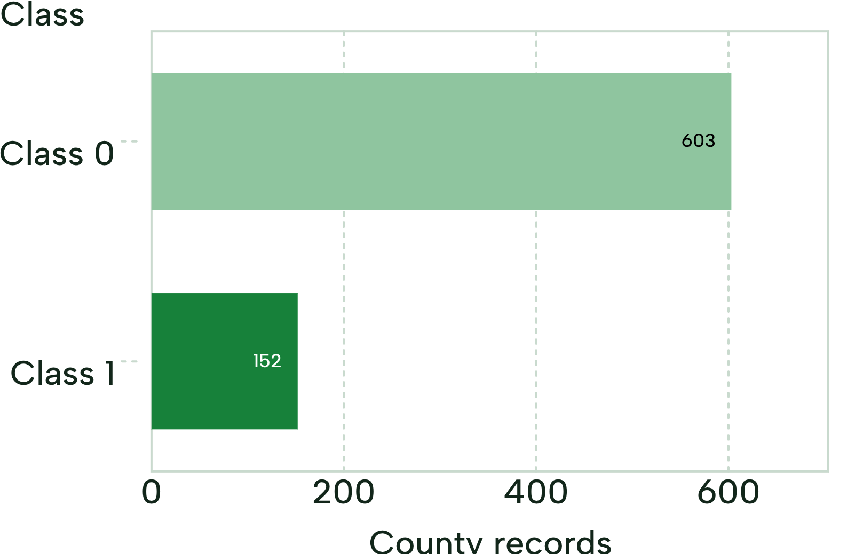
755 county records, five input features
Sources: US EPA AirData (daily ozone, 2025, parameter code 44201) and EPA Green Book (county status)
Features
Number of daily ozone records
Mean daily ozone concentration
Maximum daily ozone concentration
Mean daily AQI
Mean observation percentage
755 total; 603 Class 0, 152 Class 1

Slide 4
Methodology: from EPA data to evaluated models
01
02
03
04
EPA Data Collection
Data Preprocessing
Model Training
Model Evaluation
AirData + Green Book
County aggregation, merging and label construction
Logistic Regression, Decision Tree, Random Forest
Stratified 5-fold cross-validation and performance metrics

Slide 5
Three models, four metrics
Logistic Regression
Decision Tree
Random Forest
Linear model; standardized inputs, class weighting
Feature-based decision rules
200 trees, class weighting
Metrics: accuracy, precision, recall, F1-score
Last three for the nonattainment class

Slide 6
Random Forest leads on accuracy and F1; Logistic Regression on recall
Mean scores from stratified 5-fold cross-validation.
Model | Accuracy | Precision | Recall | F1-score
Logistic Regression | 0.781 | 0.476 | 0.770 | 0.588
Decision Tree | 0.818 | 0.554 | 0.533 | 0.542
Random Forest | 0.871 | 0.737 | 0.566 | 0.638
Highlighted cells: best score per column.
Random Forest: highest accuracy and F1-score
Logistic Regression: highest nonattainment recall
Models trade off finding nonattainment counties against avoiding false positives

Slide 7
Conclusion and limitations
Conclusion
Limitations
Supervised learning can classify county-level ozone status
Three models were implemented and evaluated; Random Forest had the highest mean F1-score
Results depend on data quality, feature selection and label construction
Class 0 means not labelled nonattainment by our rule, not that a county never had nonattainment status
Uses 2025 measurements and status labels; not a future-year forecast

