Slide 1


PREDICTING OZONE NONATTAINMENT IN US COUNTIES WITH SUPERVISED LEARNING
UE24CS352A – Machine Learning
Section 5E | Team 28
Mueez Ahmed — PES2UG24CS286
Merwyn Prince Lobo — PES2UG24CS276

Slide 2
PROBLEM: CLASSIFY COUNTIES AS NONATTAINMENT OR NOT
  Ground-level ozone is an important air-quality pollutant
  Counties are classified by compliance with the 2015 8-hour ozone NAAQS
  Goal: supervised models for a binary classification problem
Class 0
Not labelled nonattainment under our processing rule
Class 1
Nonattainment

Slide 3
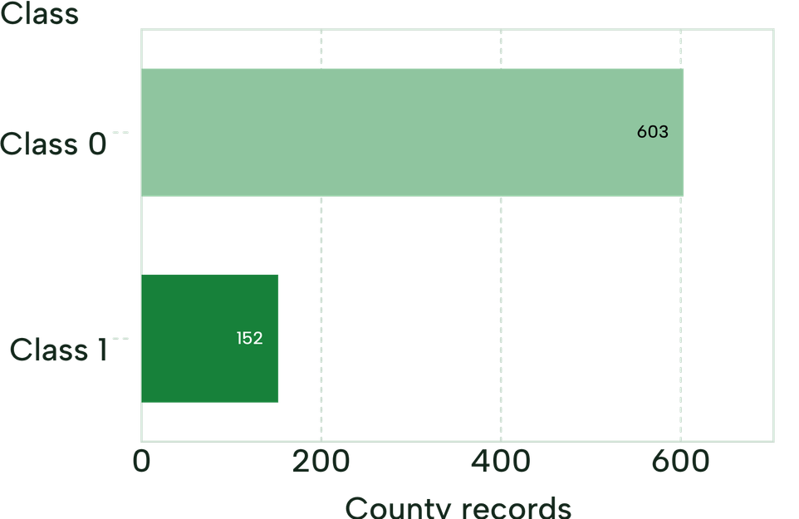
755 COUNTY RECORDS, FIVE INPUT FEATURES
Sources: US EPA AirData (daily ozone, 2025, parameter code 44201) and EPA Green Book (county status)
755 total; 603 Class 0, 152 Class 1
Features
  Number of daily ozone records
  Mean daily ozone concentration
  Maximum daily ozone concentration
  Mean daily AQI
  Mean observation percentage

Slide 4
METHODOLOGY: FROM EPA DATA TO EVALUATED MODELS
EPA Data Collection
AirData + Green Book
Data Preprocessing
County aggregation, merging and label construction
01
02
Model Training
Logistic Regression, Decision Tree, Random Forest
Model Evaluation
Stratified 5-fold cross-validation and performance metrics
03
04

Slide 5
THREE MODELS, FOUR METRICS
Logistic Regression
Decision Tree
Random Forest
Linear model; standardized inputs, class weighting
Feature-based decision rules
200 trees, class weighting
Metrics: accuracy, precision, recall, F1-score
Last three for the nonattainment class

Slide 6
RANDOM FOREST LEADS ON ACCURACY AND F1; LOGISTIC REGRESSION ON RECALL
Mean scores from stratified 5-fold cross-validation.
Model | Accuracy | Precision | Recall | F1-score
Logistic Regression | 0.781 | 0.476 | 0.770 | 0.588
Decision Tree | 0.818 | 0.554 | 0.533 | 0.542
Random Forest | 0.871 | 0.737 | 0.566 | 0.638
Highlighted cells: best score per column.
  Random Forest: highest accuracy and F1-score
  Logistic Regression: highest nonattainment recall
  Models trade off finding nonattainment counties against avoiding false positives

Slide 7
THANK YOU

