Slide 1
Magnetic Human Hand Motion Reconstruction
Master thesis
Daniel Müller
Embedded Systems Engineering
22.03.2016

Slide 2
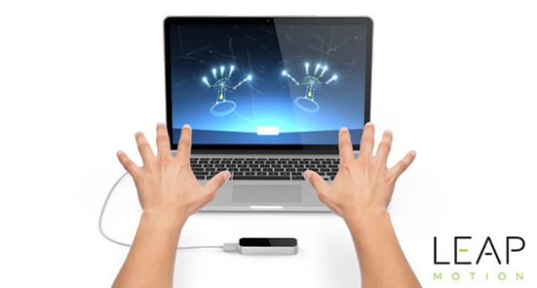
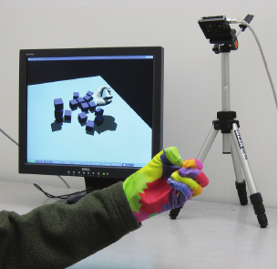
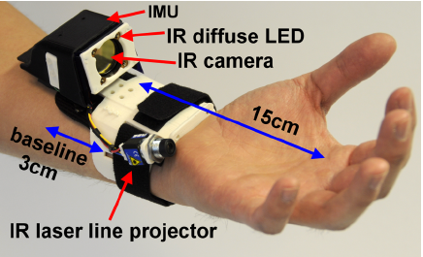
Systems for Hand Motion Reconstruction
Vision based
High accuracy possible, often used as ground truth
Usually big and static systems
Price and number of cameras rises with demanded accuracy [1, 2]
Notes:
- Try to get a feeling for the existing approaches
- Vison:
- Very accurate → Ground truth
- Static, big/bulky setup
- Glove based:
- IMU: many sensors needed, each sensor representes the orientation of the corresponding bone
- Bend sensors
- Bridge: another, not yet well explored approach: Magnets!

Slide 3
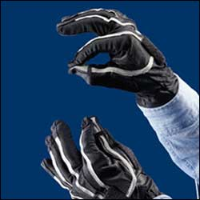
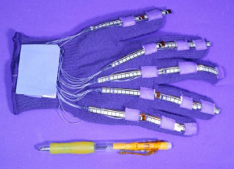
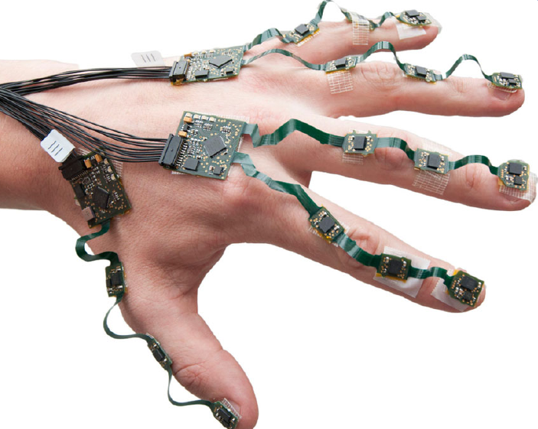
Systems for Hand Motion Reconstruction
Data gloves
Mobile system
IMUs or bend sensors used
Accuracy is dependent on number of utilized sensor units [3]
Placement of sensors is crucial
Average error to vision based system around 7.1° [4]
Notes:
- Try to get a feeling for the existing approaches
- Vison:
- Very accurate → Ground truth
- Static, big/bulky setup
- Glove based:
- IMU: many sensors needed, each sensor representes the orientation of the corresponding bone
- Bend sensors
- Bridge: another, not yet well explored approach: Magnets!

Slide 4
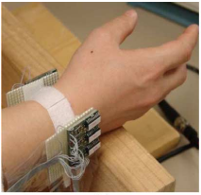
Systems for Hand Motion Reconstruction
Magnetic approach
Passive magnetic system using magnets on fingertips [6]
→ Few publications on this
→ Promising approach to build a system which is:
    Wearable
    Cheap
    Easy to use
Notes:
- Try to get a feeling for the existing approaches
- Vison:
- Very accurate → Ground truth
- Static, big/bulky setup
- Glove based:
- IMU: many sensors needed, each sensor representes the orientation of the corresponding bone
- Bend sensors
- Bridge: another, not yet well explored approach: Magnets!

Slide 5
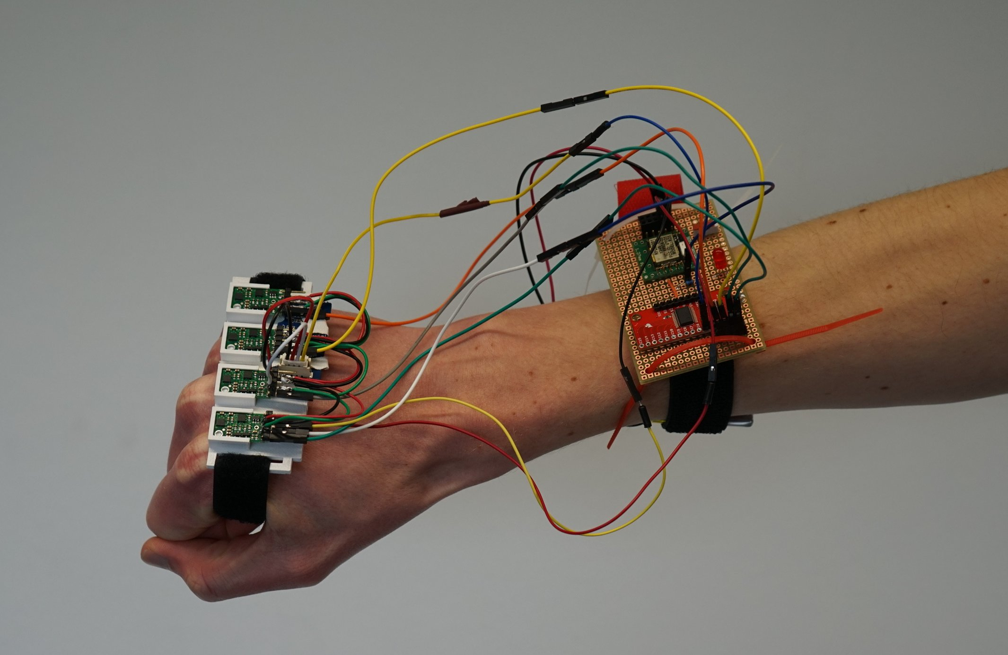
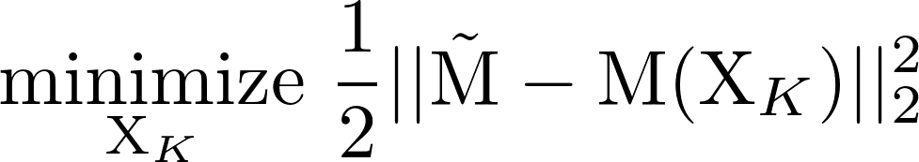
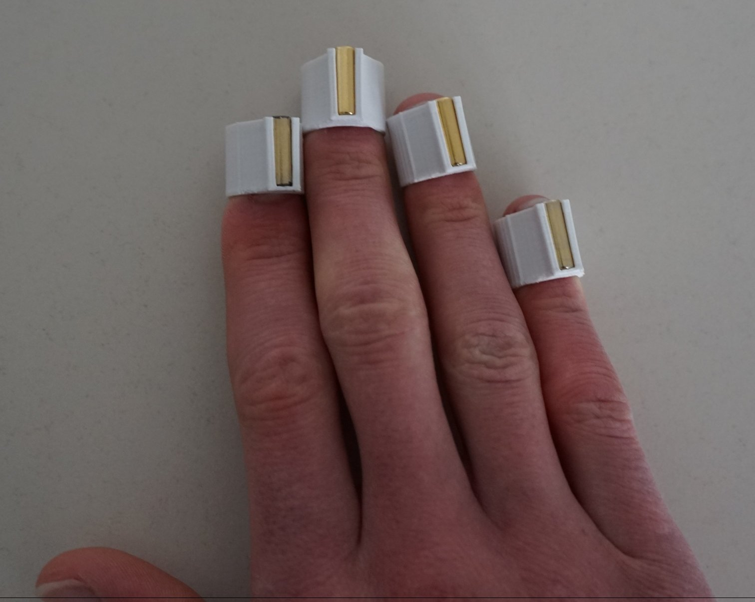
Passive Magnetic Hand Motion Reconstruction
Finger postures are determined by joint angles
Minimizing a nonlinear objective function for estimating K fingers with N magnets
With : sensor measurements
: magnetic flux density for system state
Notes:
Explain approach briefly
Magnets on fingertips, sensors on back of hand
Picture of my system
Try to minimize error between model representation and measurements (Sketch it visualy...)
Make statement about system size / state size (dependent on how many measurements/fingers you use)
Accompanied challenges (just name them?)
Communication OK
Sensor calibration OK
Earth Cancellation NOT OK

Slide 6
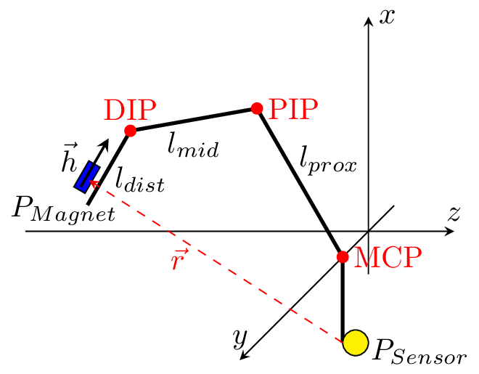
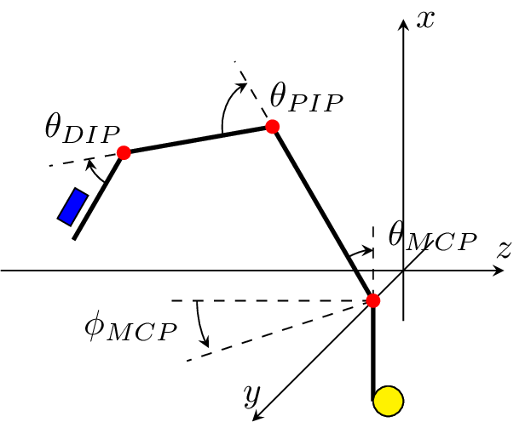
Modeling the Human Hand
Position and orientation of magnet relative to sensor unit is given by the joint angles of the kinematic chain
  → Exact determination of hand dimensions is important!
Anatomics constrain range of motion and set and into relation [7, 8]
  → (single) Finger state vector
  → State vector size for estimating K fingers
Notes:
- Make clear, that a finger posture is represented by the 3 angle values

Slide 7
Modeling the static magnets
Calculation of magnetic flux density by cylindrical model (numerical) [9]
M is a cumulative sum over the K magnets for each of the N sensors
Size of M:
Nonlinearities introduced by position/orientation determination and magnetic models
To get a fully determined system and unique solutions:
Notes:
Mention magnetic foundations briefly
From S to N, ...
Dipole model
assuming bar magnet is a dipole with small distance between S and N
shape of magnet in magnetic moment
Cylindrical model
exact way
approximate elliptical integral
Transformation between Cartesian and Cyl. coordinates
→ you can plug in the positions and orientations calculated with hand model for each finger posture

Slide 8
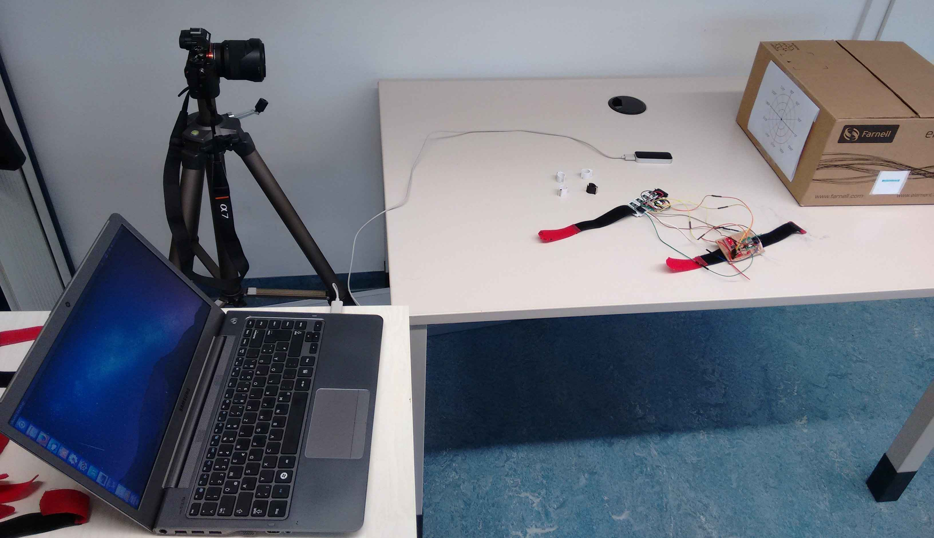
Evaluation of the System
Comparison to vision based system (Leap Motion)
Post processing of recorded magnetic data for comparing different minimization formulations
Notes:
Picture of setup
Recording procedure, Leap comparison, offline - estimation

Slide 9
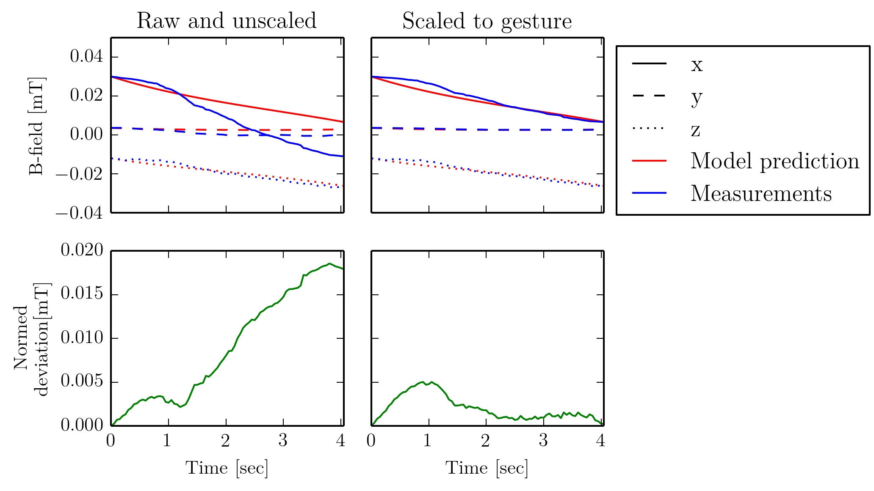
Results
Preliminary – Scaling the measurements
High difference between model prediction and measurements
→ Induced by hand measured anatomic parameters
For estimating 1 finger with 1 sensor already 9 values have to be determined
  → Estimation and tuning by trial-and-error not applicable
  → Linear scaling of measurements to model prediction leads to reasonable results
Max deviation unscaled:
Max deviation scaled:
Notes:
Picture of setup
Recording procedure, Leap comparison, offline - estimation

Slide 10
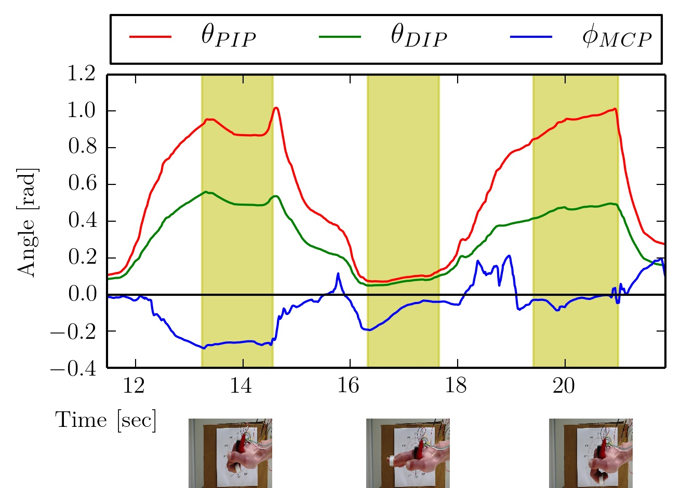
Results
Preliminary – Characteristics of Leap Motion
Minimum
Maximum
Often false interpretation of lateral movement, which did not occur
→ Possibly introduced by direction estimation of Leap
→ Lateral movement of Leap has to be handled with care
Notes:
Picture of setup
Recording procedure, Leap comparison, offline - estimation

Slide 11
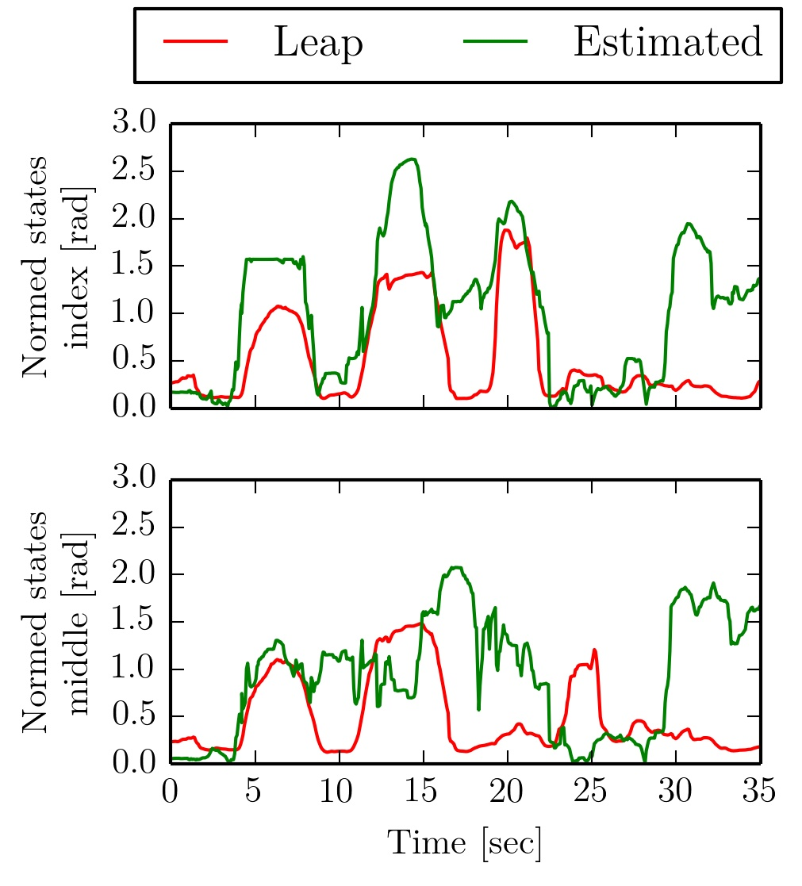

Results
Estimating four fingers
Individual movements not detectable by magnetic system with this configuration due to:
→ False measured hand dimensions
Estimation takes 0.837s per measurement set
→ No real time behaviour
Notes:
Individual movements not detectable
Experiments with perfect data showed, that it should be possible and that the system has to be overdetermined
So better results expected by using more sensors

Slide 12
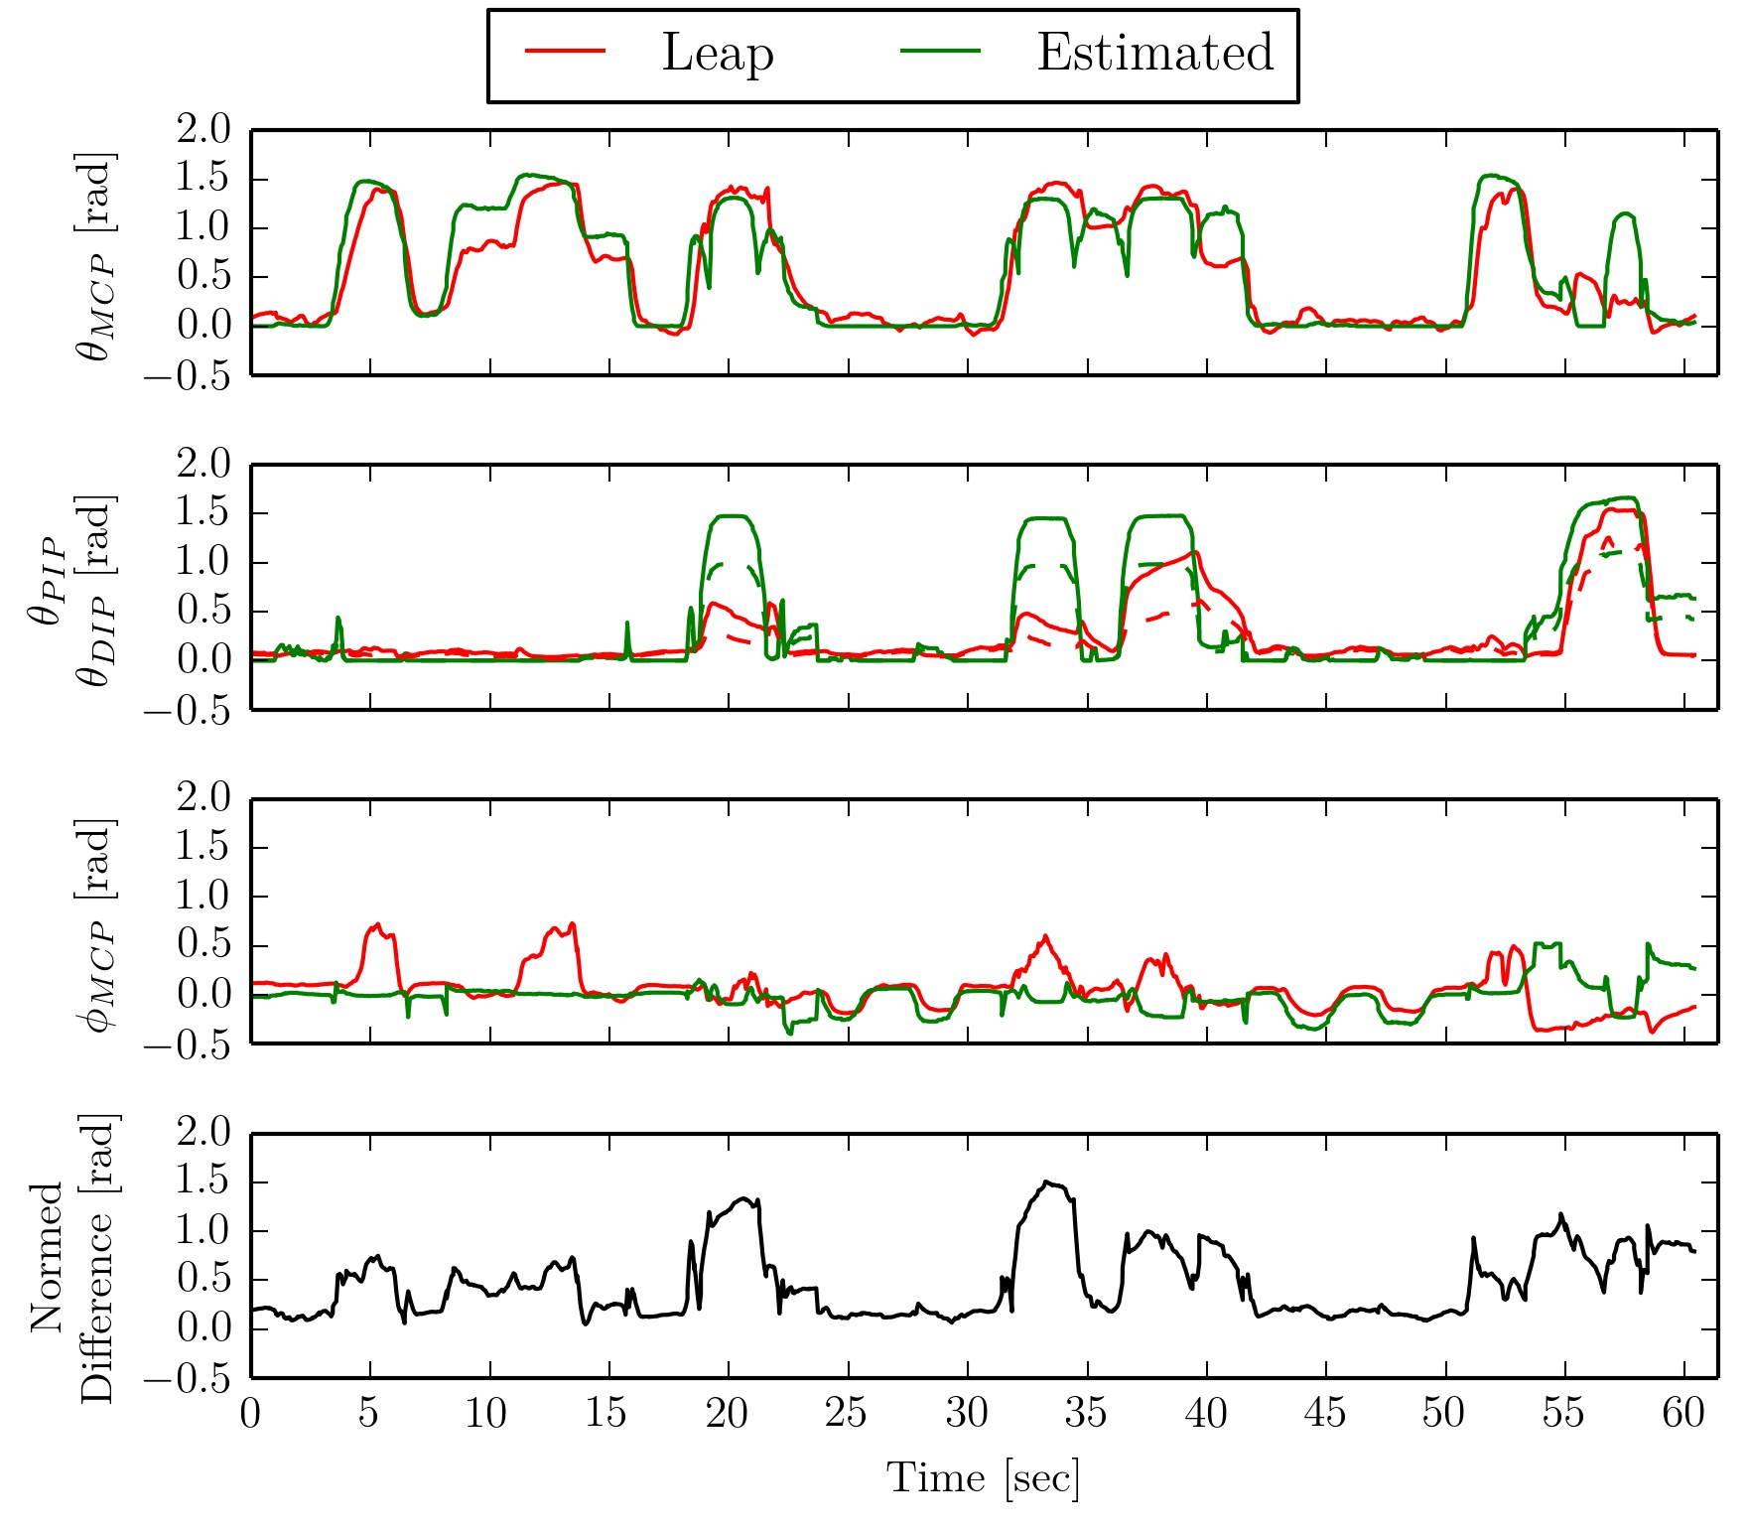

Results
Estimating one finger – best set
Flexion-extension of MCP joint:
→
Adduction-abduction of MCP joint:
→
Bending to fist:
→
→
Notes:
Plot set 4 (= best set from thesis)
Explain all the capabilities and limits of the system
Intention of movement is trackable
Ad-Ab is trackable
Limits due to:
Accurance of hand dimensions
→ Fitting gesture is not perfect but it is a repeatable movement
Influence of earth field
Acquisition frequency (too low)
Also limits of Leap

Slide 13
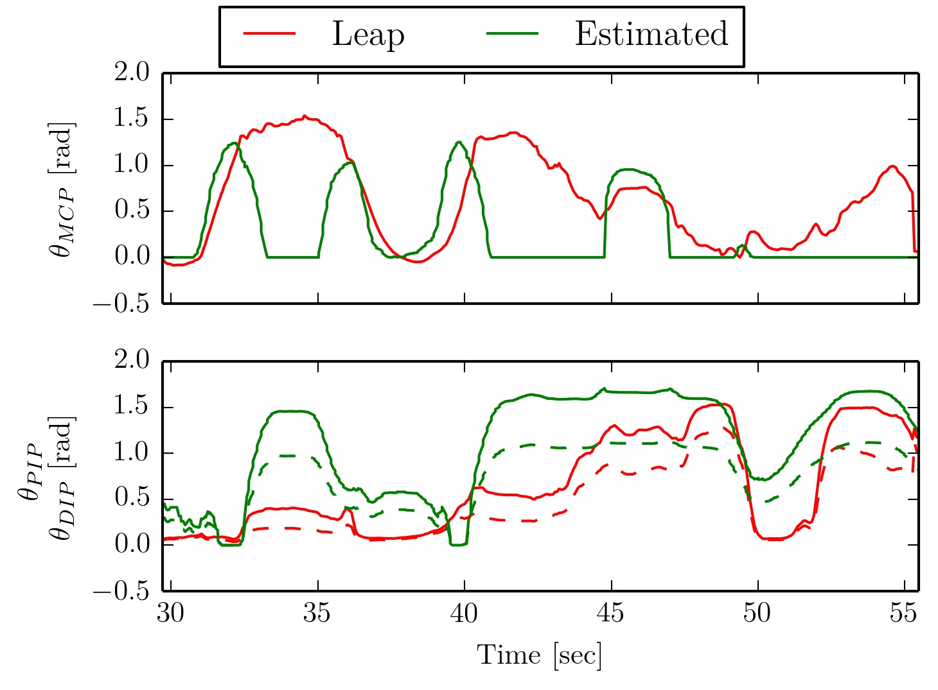

Results
Estimating one finger – bending to fist
“0-cases” for values occur because no solution is found by the minimizer
This is introduced by:
- Bad accuracy of hand dimensions
- Fitting gesture scales linearly for stretched finger only
Notes:
Plot set 4 (= best set from thesis)
Explain all the capabilities and limits of the system
Intention of movement is trackable
Ad-Ab is trackable
Limits due to:
Accurance of hand dimensions
→ Fitting gesture is not perfect but it is a repeatable movement
Influence of earth field
Acquisition frequency (too low)
Also limits of Leap

Slide 14
Results
Estimating one finger – Observations and Limitations
Motion trackable for single flexion-extension of and lateral movement of MCP joint
Results while bending to fist lead to bad values for
Critical influence factors:
  Accuracy of hand dimensions
  → Can not totally be compensated by fitting gesture
  Constant position of hand
  System frequency → Motion speed
Objective function formulation:
  Cylindrical model
  System has to be overdetermined
Notes:
Plot set 4 (= best set from thesis)
Explain all the capabilities and limits of the system
Intention of movement is trackable
Ad-Ab is trackable
Limits due to:
Accurance of hand dimensions
→ Fitting gesture is not perfect but it is a repeatable movement
Influence of earth field
Acquisition frequency (too low)
Also limits of Leap

Slide 15
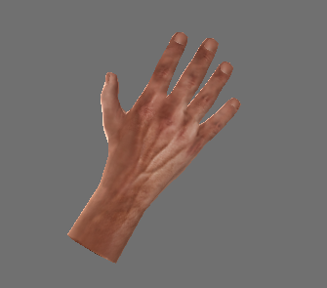
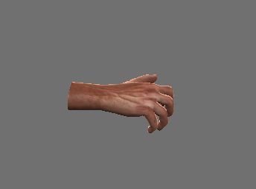
Demo

Slide 16
Conclusion and Future Work
Reconstruction of a single finger is possible, dependent on several influence factors:
  Error prone determination of hand dimensions
  → Find a more exact measuring method
  Influence of earth magnetic field
  → Find a method to cancel the surrounding field dynamically
  Data acquisition rate of sensor system
  → Employ faster sensors and microcontroller
→ Lowest mean difference to Leap Motion over all 3 finger states for a whole set:
Basic HCI could be one field of application for the presented system
  Navigating cursor in two directions
  Detecting gestures

Slide 17
Bibliography
[1] Northern Digital: Optrak Certus Brochure
[2] Vicon Motion Systems LTD: Vicon Vantage Brochure
[3] Synertial Labs: Synertial, Glove Systems overview
[4] Zecca, Massimiliano et al.: On the development of the bioinstrumentation system WB-1R for the evaluation of human-robot interaction. In: Advanced intelligent mechatronics, 2007 IEEE/ASME
[5] Huang, Jiawei et al.: IM3D: magnetic motion tracking system for dexterous 3D interactions.
In: ACM SIGGRAPH 2014 Emerging Technologies ACM
[6] Ma, Yanru et al.: Magnetic hand motion tracking system for human-machine interaction.
In: Electronics letters 46 (2010)
[7] Bullock, Ian M. et al.: Assesing assumptions in kinematic hand models: a review.
In: Biomedical Robotics and Biomechatronics (BioRob)
[8] Lin, John et al.: Modeling the constraints of human hand motion.
In: Human Motion, 2000. Proceedings. Workshop on IEEE
[9] Derby, Norman et al.: Cylindrical magnets and ideal solenoids.
In: Amercan Journal of Physics 78 (2010)

Slide 18
Kinematic Hand Model

Slide 19
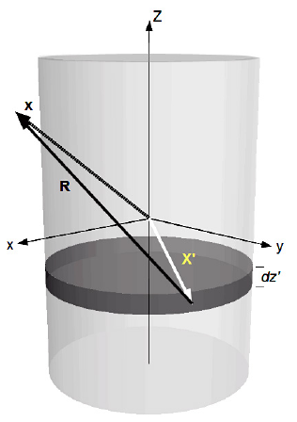
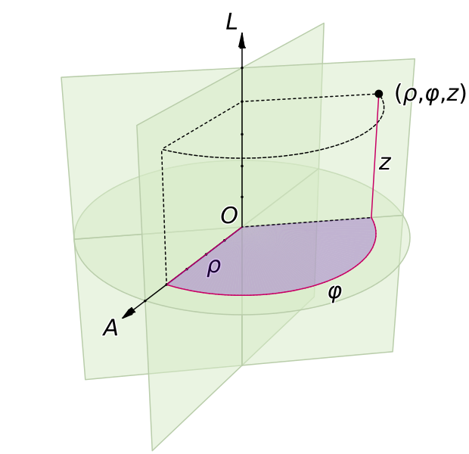
Cylindircal Magnetic Model

Slide 20
Dynamic Cancellation of Earth Magnetic Field
Hold the hand with the sensors attached in a stable and calm position
The magnets for the fingertips are absent
Measure the orientation of the sensors and the corresponding surrounding earth magnetic field
After this calibration phase, track the orientation of the hand
Calculate the relative orientation
Convert into a rotation matrix and apply this to
Subtract the rotated earth magnetic field from your actual measurement:

