Slide 1
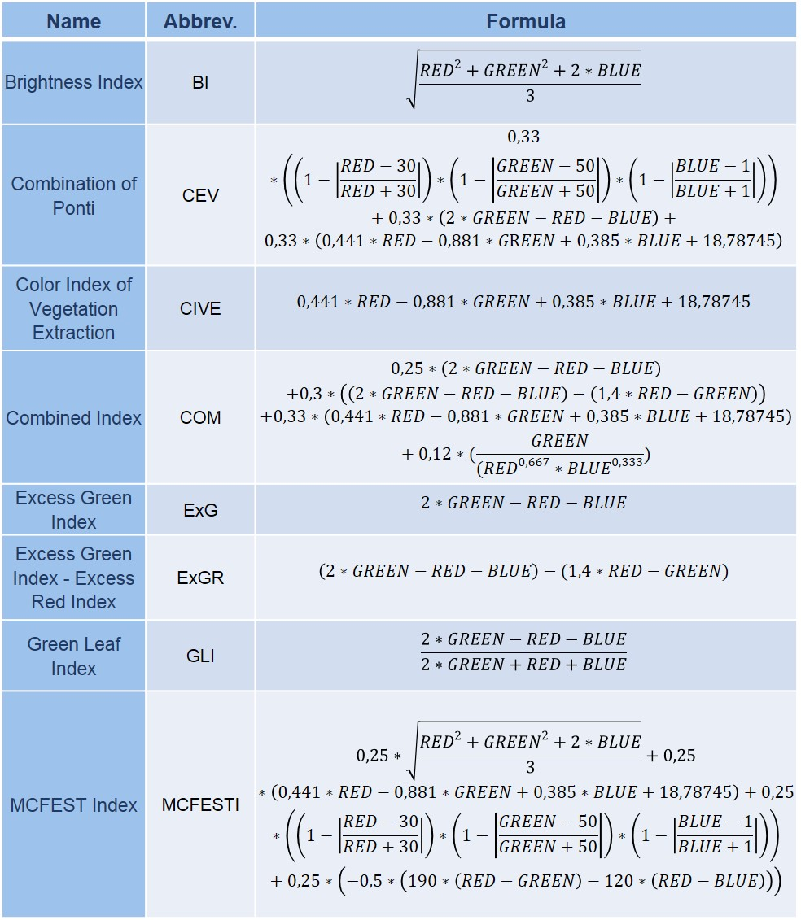
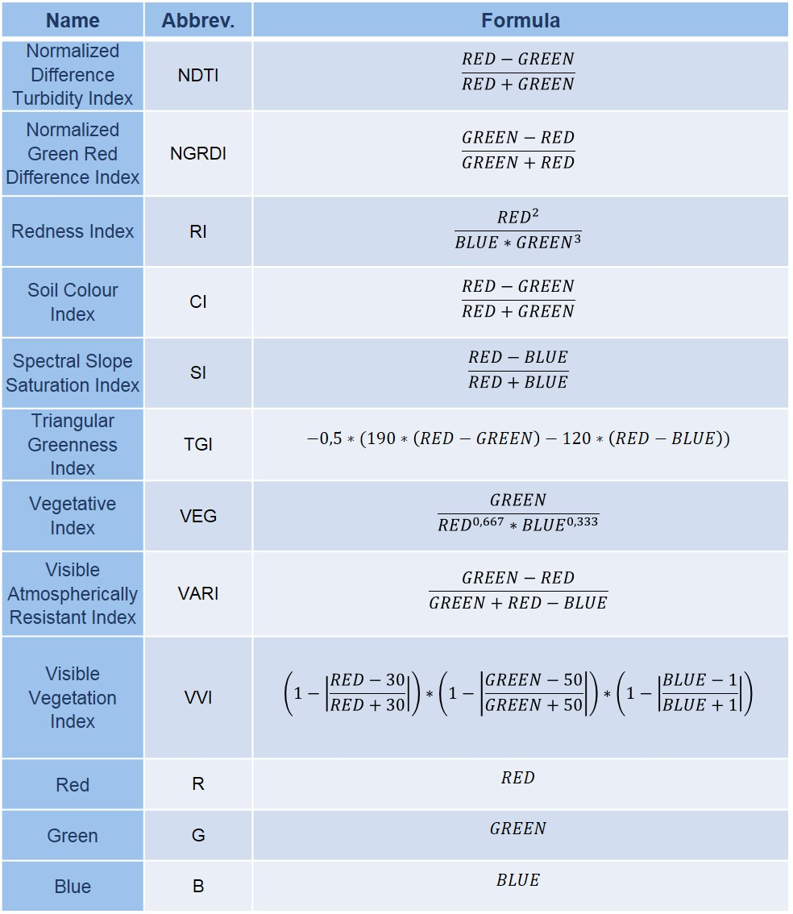
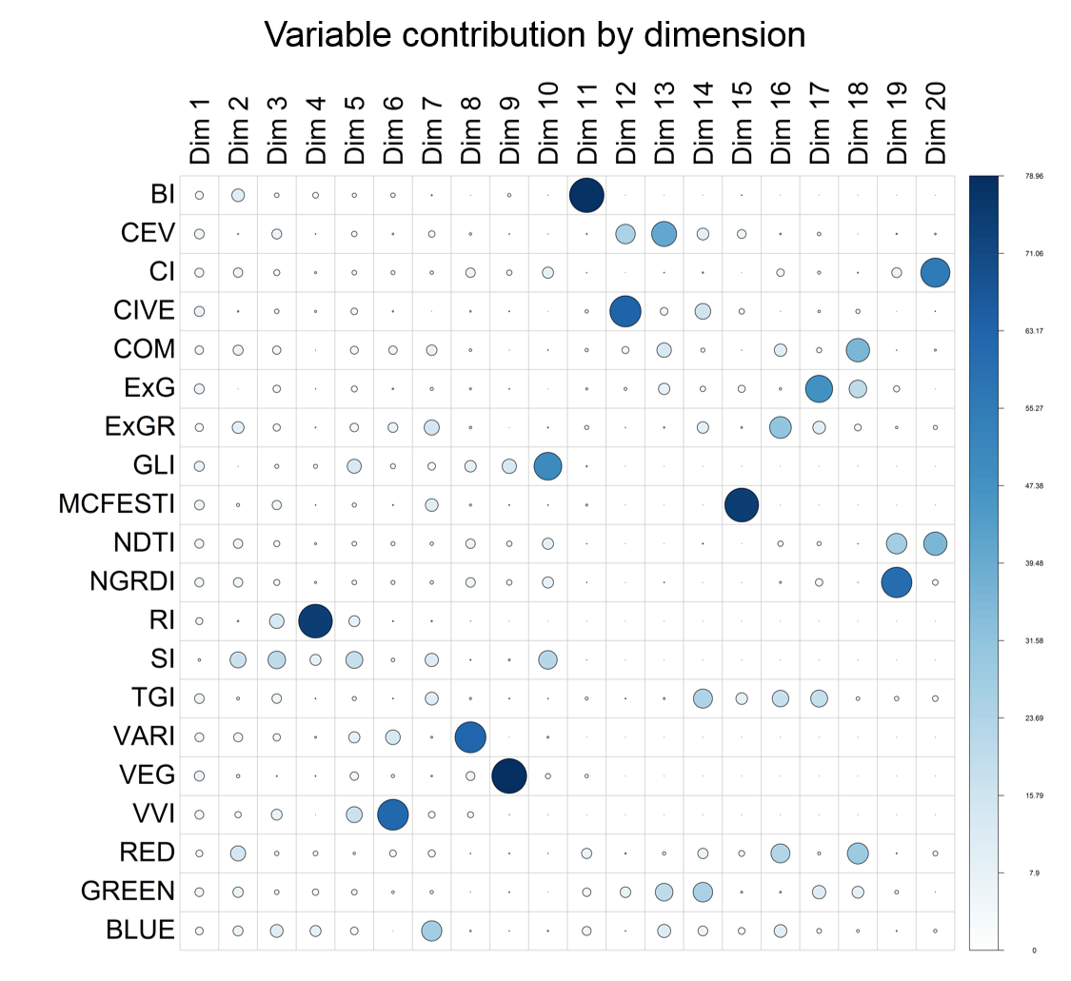
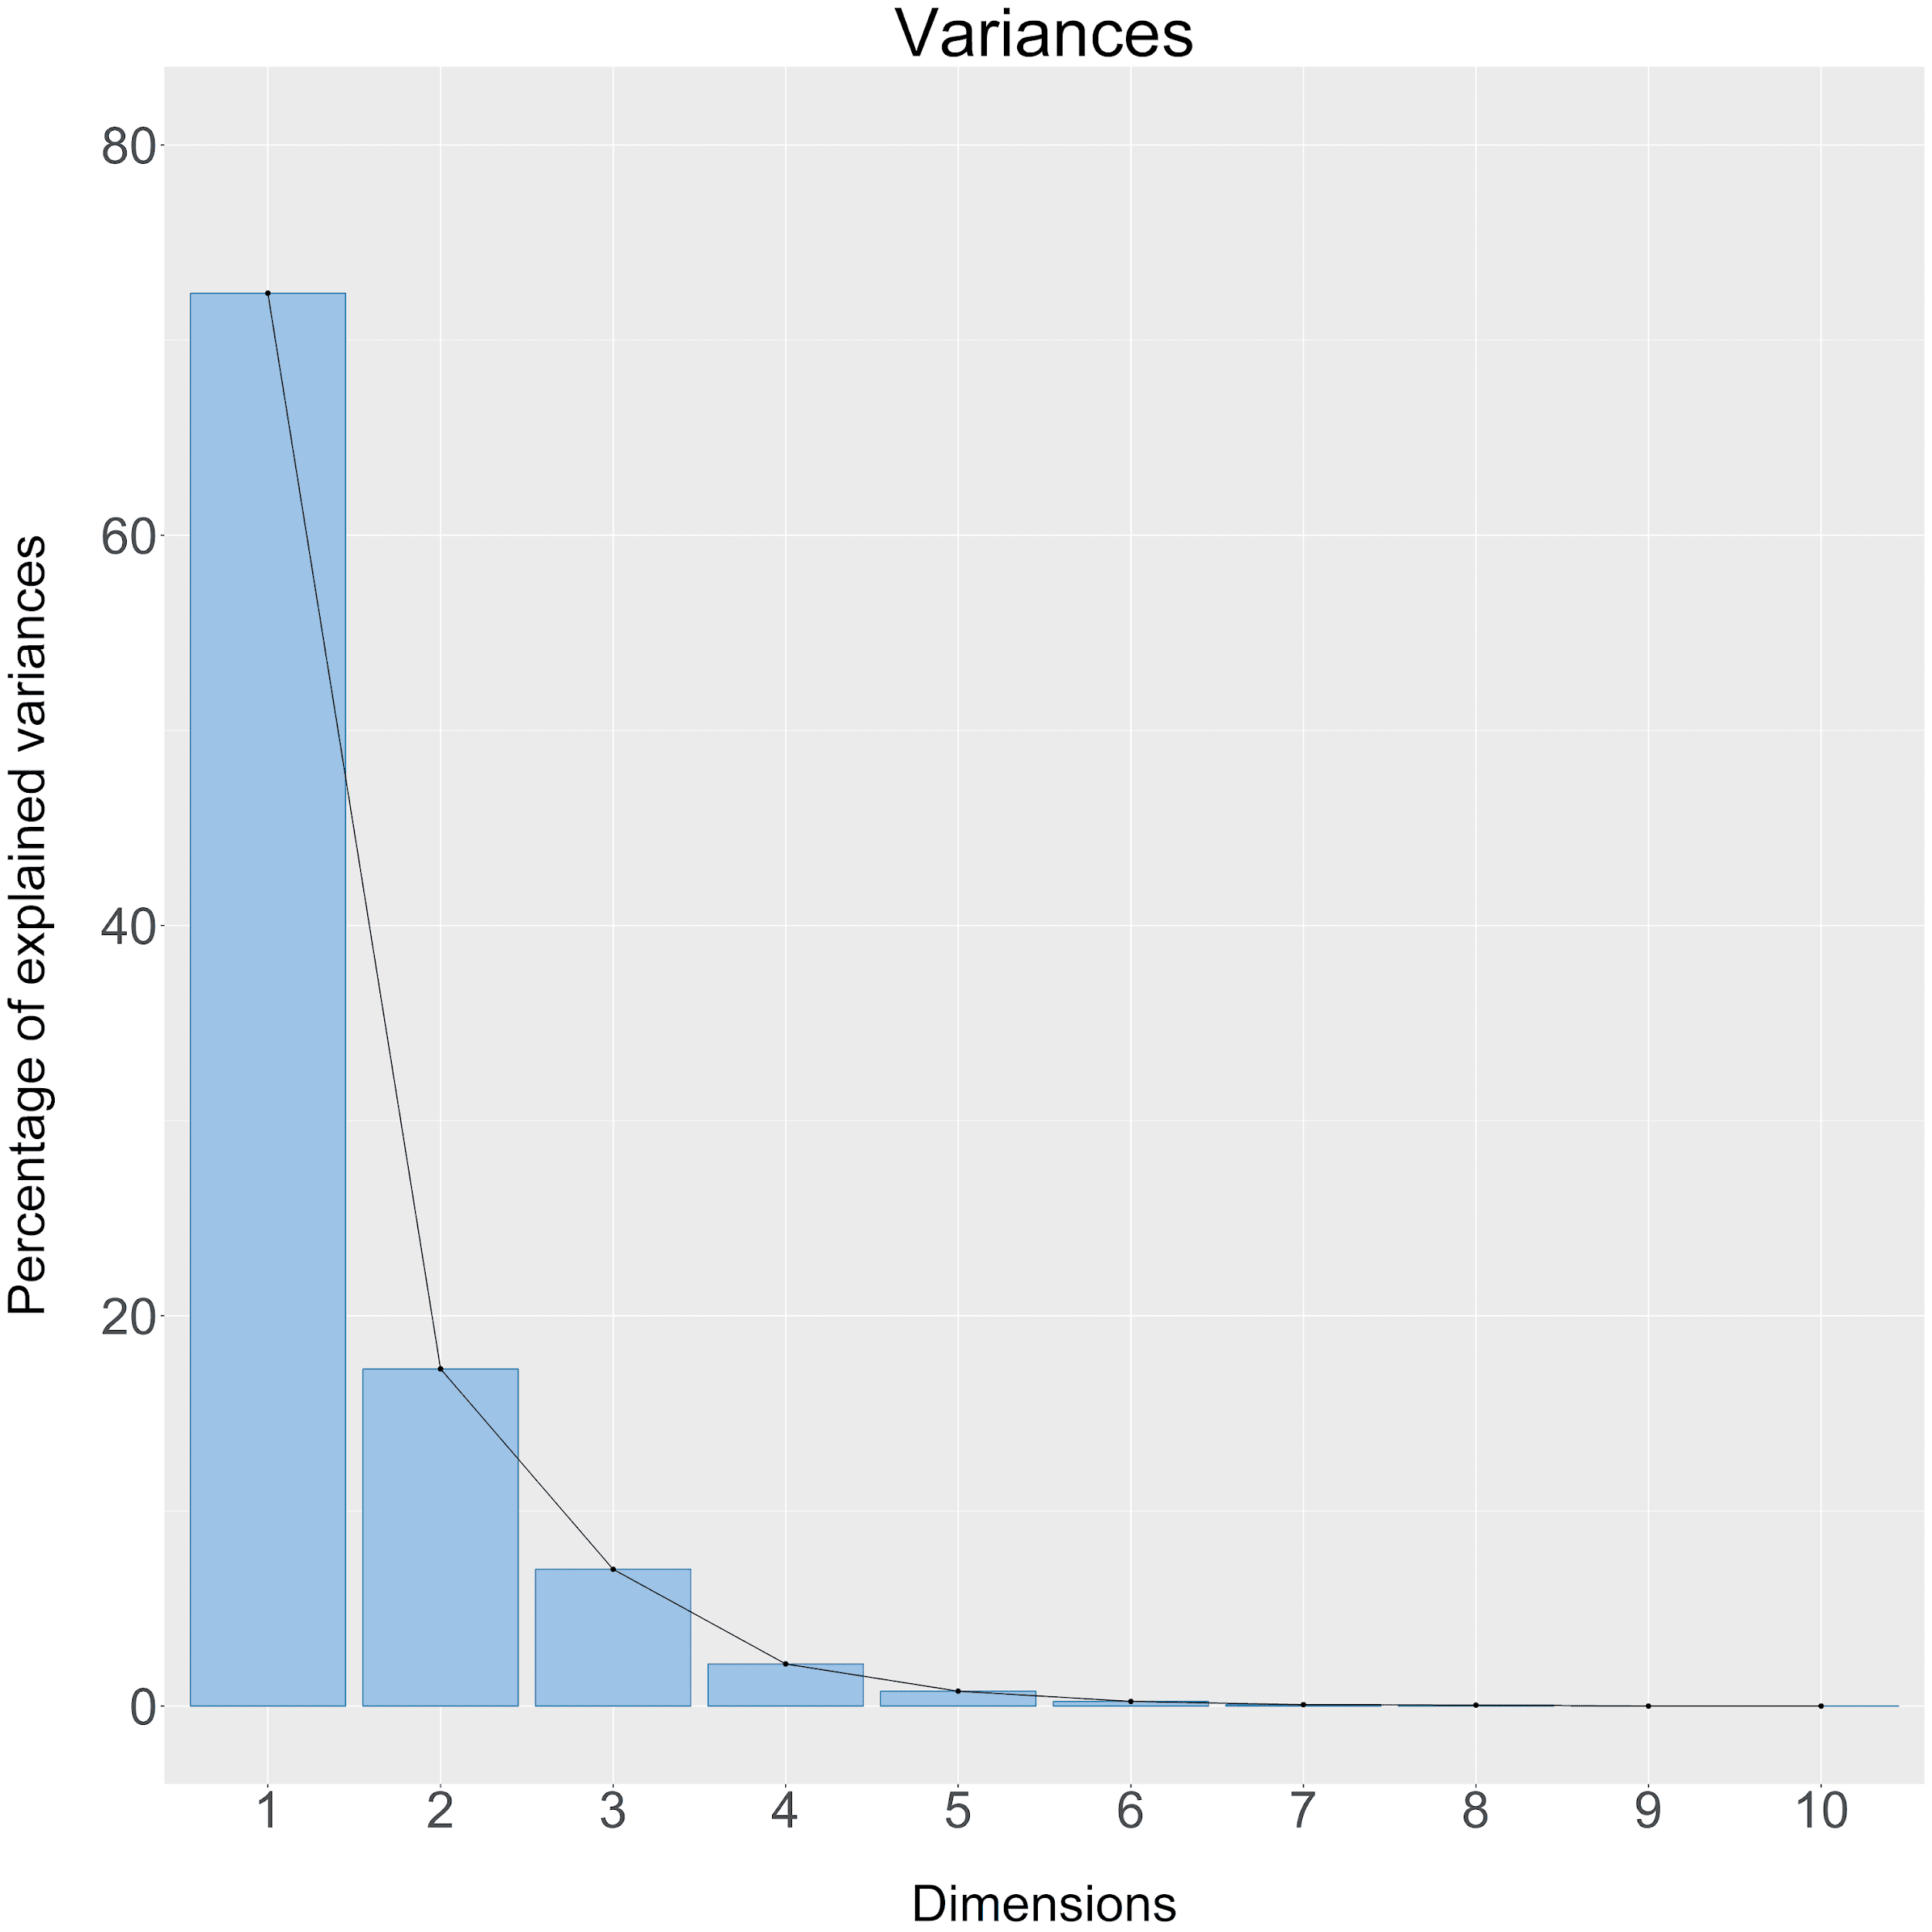
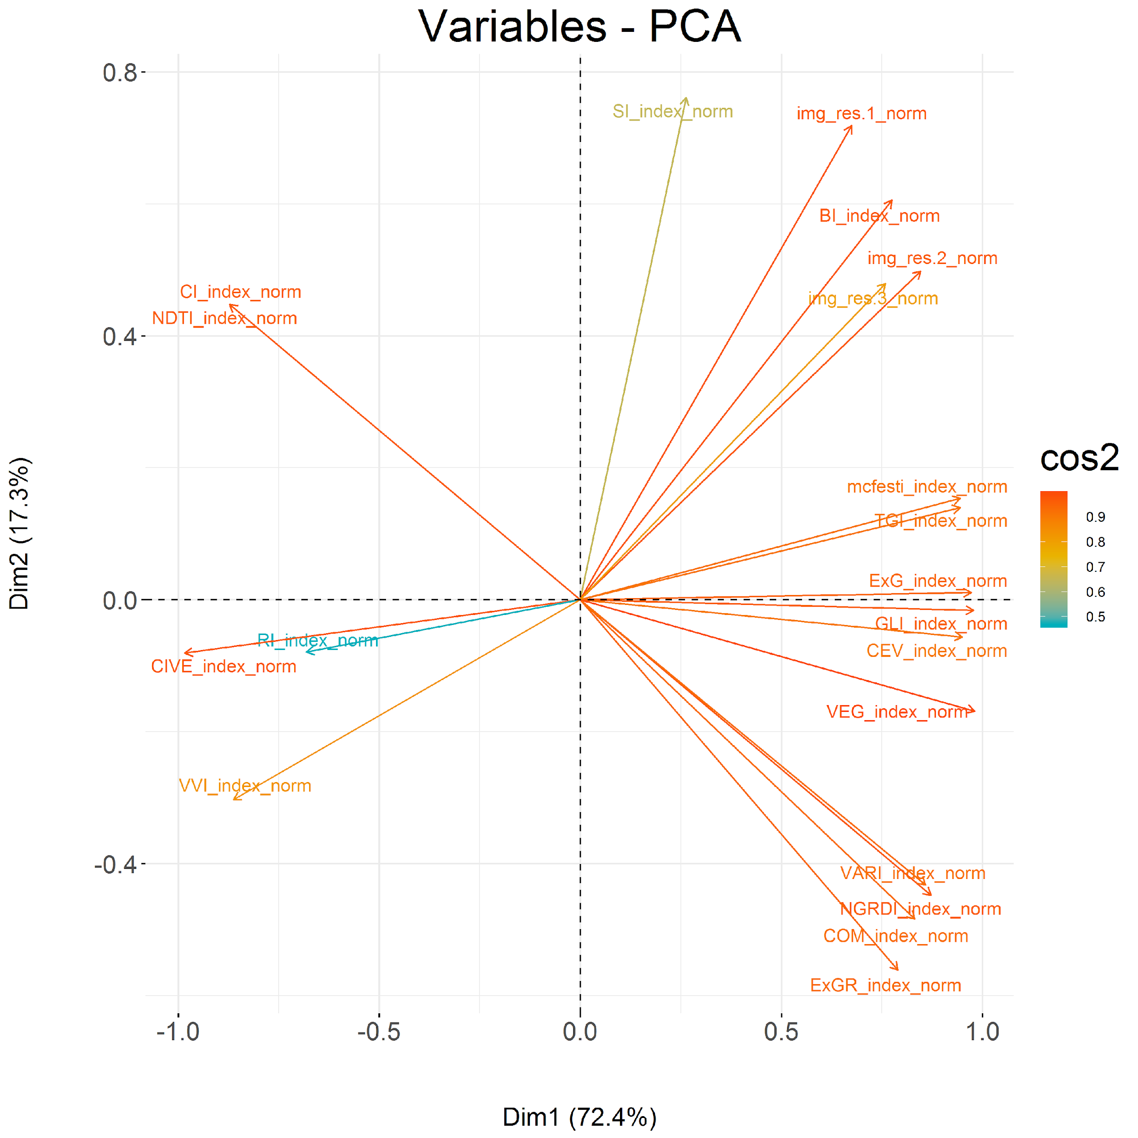
Project I: Comprehensive Image Collection
Names: Sarah Brüning, Tobias Koch, Marvin Müsgen, Eike Schott, Frauke von den Driesch
Umweltinformatik | Philipps-Universität Marburg
Background
The study area is located in the forest of Marburg University which is located southeast of Caldern in the west of Marburg. During the process the Marburg Open Forest will be established as an area for open research and education in the research field of environmental observation. Conservation of nature requires a detailed observation and assessment of landscape. This marks the starting point of the LOEWE Nature 4.0 project. With the combination of powerful data integration and data
analysis methods it builds a modular environmental monitoring system for the high-resolution observation of conservation-relevant species, habitats and processes. The research includes the work of scientists from several disciplines in order to achieve not only a more effective monitoring but also to develop early warning indicators (Philipps-Universität Marburg, 2018). While the final objective of Nature 4.0 is to develop a sustainable biodiversity protection and securing ecosystem functions
the primary focus of this project is to build a comprehensive remote sensing dataset. First of all, the following project work provides information on spectral and structural properties as well as spatial patterns for the study area using multi-channel aerial datasets. Afterwards, the results will be used for further research of a comprehensive image collection for tree delineation, species prediction and heterogeneity mapping.
Methods
The LiDAR data and the RGB images were recorded in 2009 and, respectively, in 2016. The datasets were allocated by the Hessische Verwaltung für Bodenmanagement und Geoinformation. The provided RGB image was clipped to the extend of the Marburg Open Forest area. To match the spatial resolution of the LIDAR data the RGB image was resampled to a spatial resolution of .5 meter. The spectral channels (red, green and blue) were extracted in order to calculate sixteen indices as shown in table 1. As they provide additional information on spectral properties it’s on the principal components analysis (PCA) to reduce the amount of variables while preserving a large portion of information (Jolliffe, 2002).
RGB Indices
Table 1:RGB Indices.
Table 2:RGB Indices.
PCA
Figure 1: Variable contribution by Dimension.
Figure 2:
Variances PCA.
Figure 3: Variables PCA.
Filter
Filters were applied on principal components 1 and 2
Results
Conclusion and outlook
The finalized product is a raster stack containing the first and second component of the principal component analysis which combined explain 89.8% of the variation in the data. Additionally all sixteen filters were applied to both components. Furthermore all sixteen indices as well as the three RGB channels are included. In order to save computing resources the filters were not applied to every RGB index. This leaves us with a total of 53 single raster layers.
This project provides a comprehensive dataset consisting of spectral and structural properties. This was done by calculating several RGB indices, performing a principal components analysis and applying numerous structural filters on the first and second component of the PCA. For further projects such as the prediction of tree species and analysis of forest structures and tree competition this dataset will be essential.
Discussion
It’s up for discussion if it’s necessary to include the already in the PCA processed indices. On one hand this approach hits harder on processing time and computing resources. Also the PCA already includes partially all sixteen indices. On the other hand the loss of information is minimized by including the original indices. Considering future goals of this project saving information has a higher priority than keeping processing time as short as possible.
Literature
Jolliffe, I. (2002): Principal Components Analysis. Berlin/Heidelberg: Springer.
Philipps-Universität Marburg (2018): Ziele und Leitidee. <https://www.uni-marburg.de/de/fb19/natur40/ueber-uns/ziele> abgerufen am 11.12.2018.

