Slide 1
WILL THEY CLAIM IT?
GreyAtom Hackathon by The PiedPipers
Shahidraza Sheikh
Mufaddal Kapadia

Slide 2
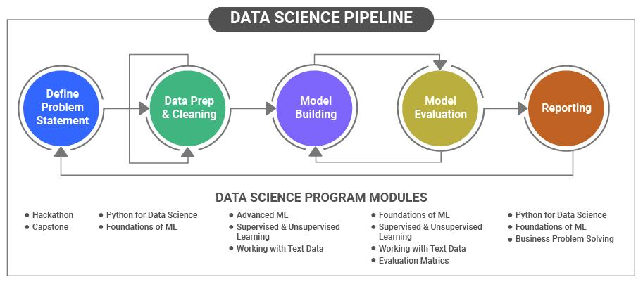
Data Science Pipeline
Steps to follow:
Defining Problem Statement
Data Pre-Processing and EDA
Selecting model
Evaluating the model and hyperparameter tuning
Testing the precision of our model on test data

Slide 3
Problem Statement
For an insurance company, the forecasting of claims is important for successful operation.
Insurance companies take risks over customers. Risk management is an integral aspect of the insurance industry.
If the claims can be forecasted precisely and accurately, premiums can be adjusted accordingly, thereby creating the opportunity to be one step ahead of the competitors.
Insurers consider every factor to create profiles of high and low insurance risks.
Charging a lower premium than the competitors, while simultaneously maintaining a sufficient buffer to make profit, leads to more customers, which in turn leads to more profit.
Insurers collect information about policyholders and then analyze the data.

Slide 4
Stakeholders and who will benefit from the analysis and findings?
CEO
Finance Department
Processing Department
Insurance Underwriter
Insurance underwriters are professionals who evaluate and analyze the risks involved in insuring people and assets.
Insurance underwriters establish pricing for accepted insurable risks.
The term underwriting means receiving remuneration for the willingness to pay a potential risk.
Underwriters use specialized software and actuarial data to determine the likelihood and magnitude of a risk.

Slide 5
About the Dataset
The training dataset consists of data corresponding to 52310 customers and the test dataset consists of 22421 customers.
Following are the features of the dataset
Target: Claim Status (Claim)
Name of agency (Agency)
Type of travel insurance agencies (Agency.Type)
Distribution channel of travel insurance agencies (Distribution.Channel)
Name of the travel insurance products (Product.Name)
Duration of travel (Duration)
Destination of travel (Destination)
Amount of sales of travel insurance policies (Net.Sales)
The commission received for travel insurance agency (Commission)
Age of insured (Age)
The identification record of every observation (ID)

Slide 6
Data Science Metric
Precision Score
Precision is a metric that quantifies the number of correct positive predictions made.
For every predicted class, it is the fraction of the correct predictions to the total number of predictions for that class. It answers the question of all the values predicted as belonging to the class "X", what percentage is correct?
Mathematically,
Precision(P) = TP/(TP + FP)​
We are trying to reduce the number of instances where we have predicted that a person will claimed insurance(Target = 1) but he has not claimed(Target = 0).

Slide 7
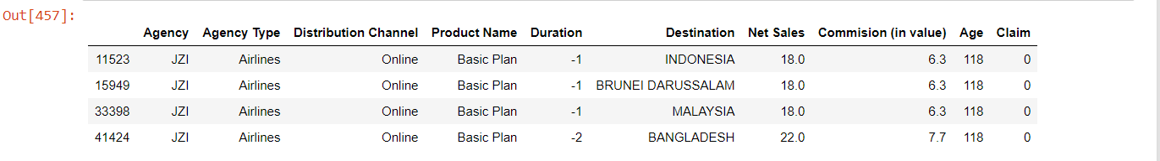
Data Pre-Processing
To find out missing values in the dataset -
Our dataset doesn’t have any null or missing values
To find out outliers in the dataset and treat them -
Duration column in our dataset has negative values, we replace -1 and -2 values with 0.

Slide 8
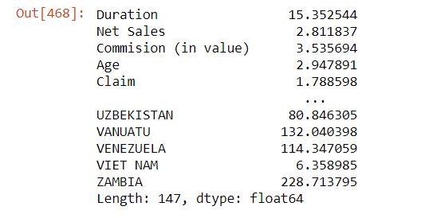
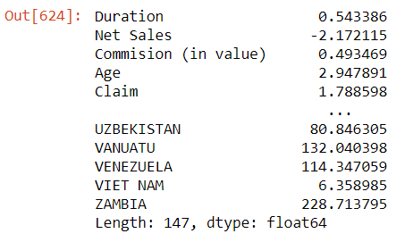
Treating skewness in the given data
Before removing skewness:
The columns Duration, Net Sales and Commission(in value) are right skewed, we need to treat skewness in those columns so that model can be trained properly and precisely.
To remove skewness in numerical features we tried different methods such as using log transform, square root, cube root, transforming using power.
We got the best results when we used power to treat skewness in the data.
For Net Sales, to transform negative net sales values we applied power transform on absolute values and then turned them into negative values again.
After treating skewness:

Slide 9
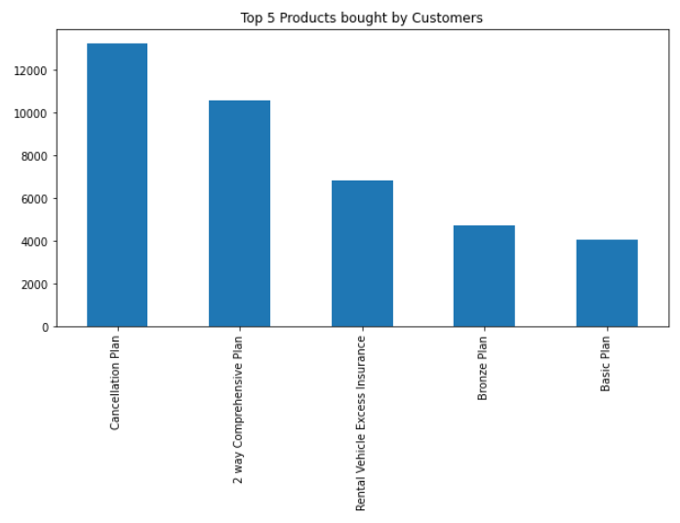
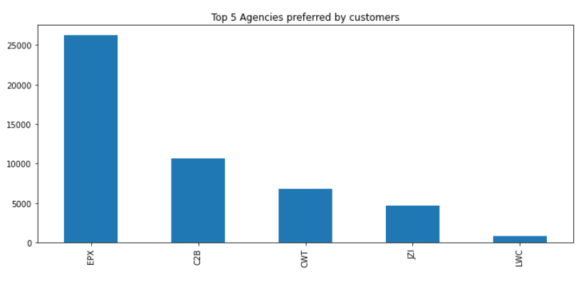
Analysis of Products bought most by customers
As evident from the graph, Cancellation Plan is bought most by the customers.
Followed by 2 way comprehensive plan.
Agency EPX is the most preferred among all agencies.

Slide 10
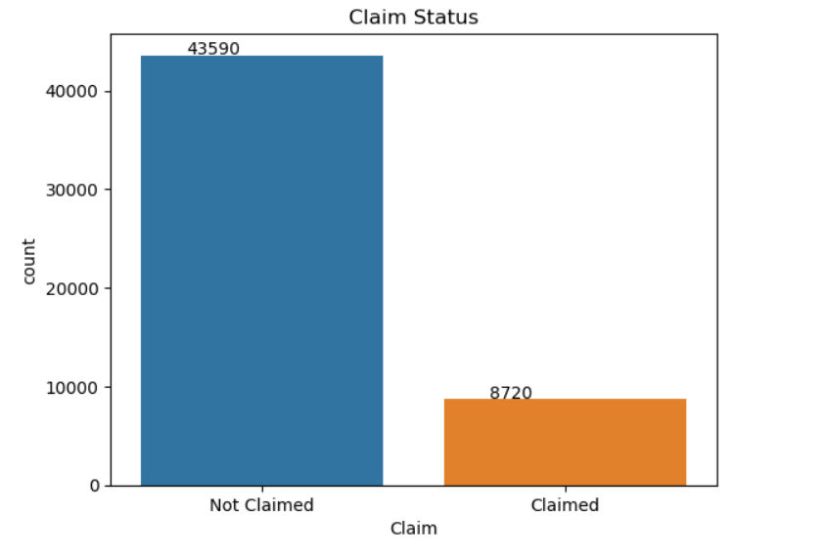
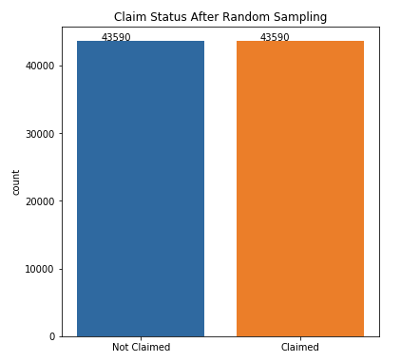
Analysis of Target variable(Claim Status)
Before Over-sampling
After Over-sampling
It is observed that data is highly imbalanced here,
Number of not claimed records are in the ratio of 5:1 with respect to number of claimed records.
Such imbalance in data was resulting in decent precision score(75%-85%) for different models, but there was room for improvement, so we applied different techniques such as Undersampling and Oversampling to treat data imbalance in order to get desired and better results.

Slide 11
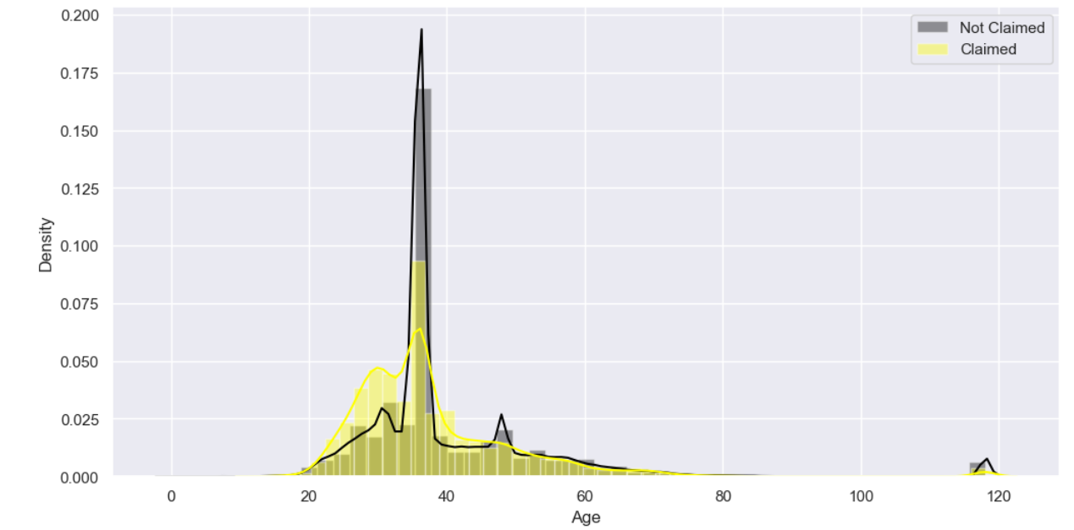
Effect of Age on Claim
Age group of 25-40 have made the most number of claims.
On the other hand, customers older than 70 years and younger than 15 years have not opted for insurance.

Slide 12
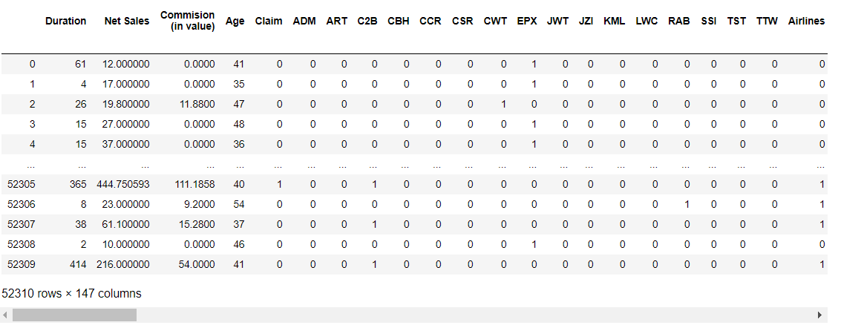
One Hot Encoding Categorical Features
We performed One Hot Encoding on categorical features(5 in our dataset):
Name of agency (Agency)
Type of travel insurance agencies (Agency Type)
Distribution channel of travel insurance agencies (Distribution Channel)
Name of the travel insurance products (Product Name)
Destination of travel (Destination)
In One Hot encoding, integer encoded variable is removed and a new binary variable is added for each unique integer value.

Slide 13
Model Building and Approaches
Initially, we used different models such as Logistic regression, K-NN and Decision tree.
Without treating the class imbalance, precision score received on these models was between 65%-85%. Apart from Logistic regression where we got a poor precision score of 42%
AUC score for the models was also between 0.85 - 0.97
Random Forest gave the best precision score(0.84) and AUC score(0.966) among all the models.
Classifier Used | Precision Score | AUC Score
Logistic Regression | 0.42 | 0.866
K-NN Classification(5 neighbours) | 0.67 | 0.937
Decision Tree | 0.76 | 0.867
Random Forest | 0.84 | 0.966

Slide 14
Techniques applied to treat Class Imbalance
Under- Sampling - Random undersampling involves randomly selecting examples from the majority class to delete from the training dataset. This has the effect of reducing the number of examples in the majority class in the transformed version of the training dataset. This process can be repeated until the desired class distribution is achieved, such as an equal number of examples for each class.
NearMiss 1
NearMiss 3
Over-sampling - Random oversampling involves randomly duplicating examples from the minority class and adding them to the training dataset. Examples from the training dataset are selected randomly with replacement. This means that examples from the minority class can be chosen and added to the new “more balanced” training dataset multiple times; they are selected from the original training dataset, added to the new training dataset, and then returned or “replaced” in the original dataset, allowing them to be selected again.

Slide 15
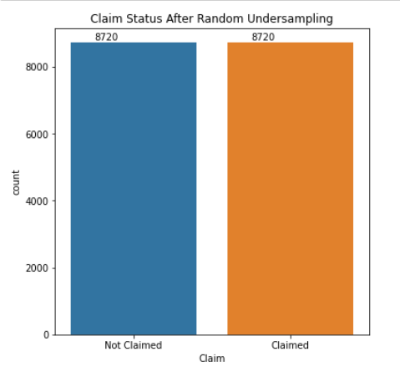
Undersampling Techniques applied
NearMiss-1: Majority class examples with minimum average distance to three closest minority class examples.
NearMiss-3: Majority class examples with minimum distance to each minority class example.
Undersampling Technique | Precision Score | AUC score
NearMiss-1 | 0.875 | 0.943
NearMiss-3 | 0.80 | 0.86

Slide 16
Oversampling
On applying Random oversampling on different models, we observer the increase in precision score and all other metrics.
Random forest gave the best results for all metrics.
And with the precision score of 0.96 we chose to model our data using Random forest.
Classification model | Precision Score | AUC Score
Logistic Regression | 0.78 | 0.866
K-NN Classifier(5 neighbours) | 0.88 | 0.965
Decision Tree | 0.95 | 0.975
Random Forest | 0.96 | 0.995

Slide 17
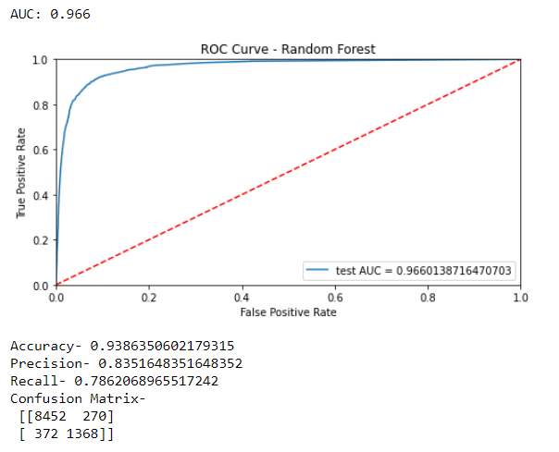
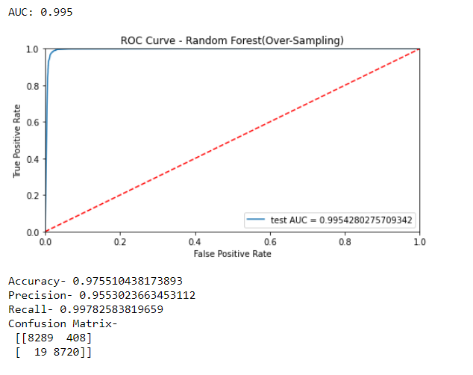
Comparison of ROC curves, Precision Score and other metrics before and after Oversampling on best model
ROC Curve - Random Forest(Before Oversampling)
ROC Curve - Random Forest(After Oversampling)

Slide 18







Threshold values for predictions
> 0.85
> 0.98
> 0.90
> 0.99
> 0.95
As evident threshold value >0.99 gave us the best precision score and better results on all metrics.Hence we have selected >0.99 as our final value for threshold in the model.
> 0.96
> 0.97

Slide 19
Observations
We observed the following after analysing the data:
To make payments more affordable we need to have customers with low risk profile. They will claim less and so the business will make more profit.
Customers in age group 25-40 claim more, so the policies should be made keeping that in mind, in a way that company can profit from those customers as well.
Customers using Airlines claim more than those who use Travel Agencies.
Commission for offline distribution channel is not negative i.e., offline channels don’t work without commissions. On the other hand, online channel work on negative commissions possibility is they might be providing discounts, more than half of the entries for online work on 0% commission.

Slide 20


