Slide 1
ICT mini project
Done by:
Mervyn Chiong
Pratyush
Jing Da
Notes:
Please edit your names lol
7 mins presentation inclusive of a test run
Content of presentation:
State the contribution of each team member clearly
Program design ( flow chart of top level)
Follow rubric to show if all the requirements have been fulfilled and how you did that in programming
Indicate the external library/module used if available

Slide 2
Members contribution
Members | Contribution
Mervyn | Back end functions like wait time function and file management using .json files. The dictionaries for time and menu for each stall was generated through these files.
Pratyush | Developed the GUI and function for current date and time, generating menus for stalls and also made all the classes.
Jing Da | Helped in making back buttons,entry labels and function for custom date and time. Contributed towards exception handling

Slide 3
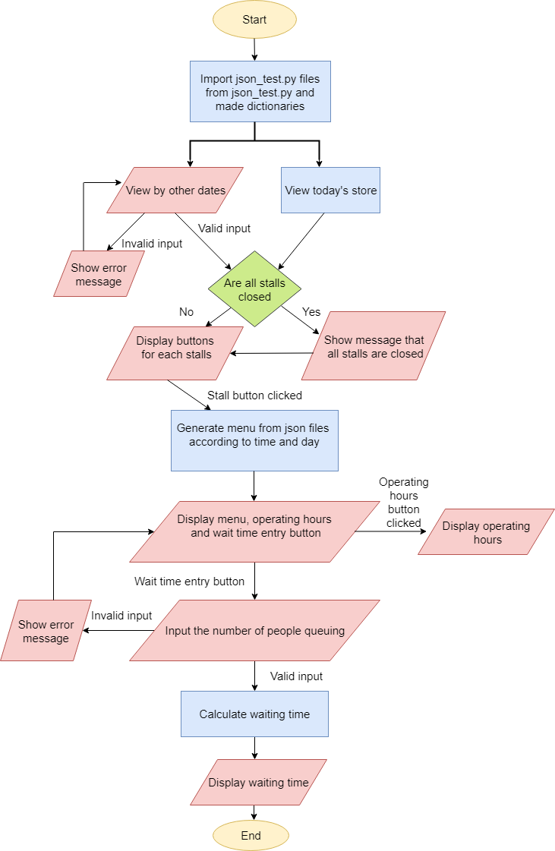
Flow chart

Slide 4
Table of contents
Test run of the program
Contribution of each member
Comparison with rubrics
External library/module used

Slide 5
Test Run

Slide 6
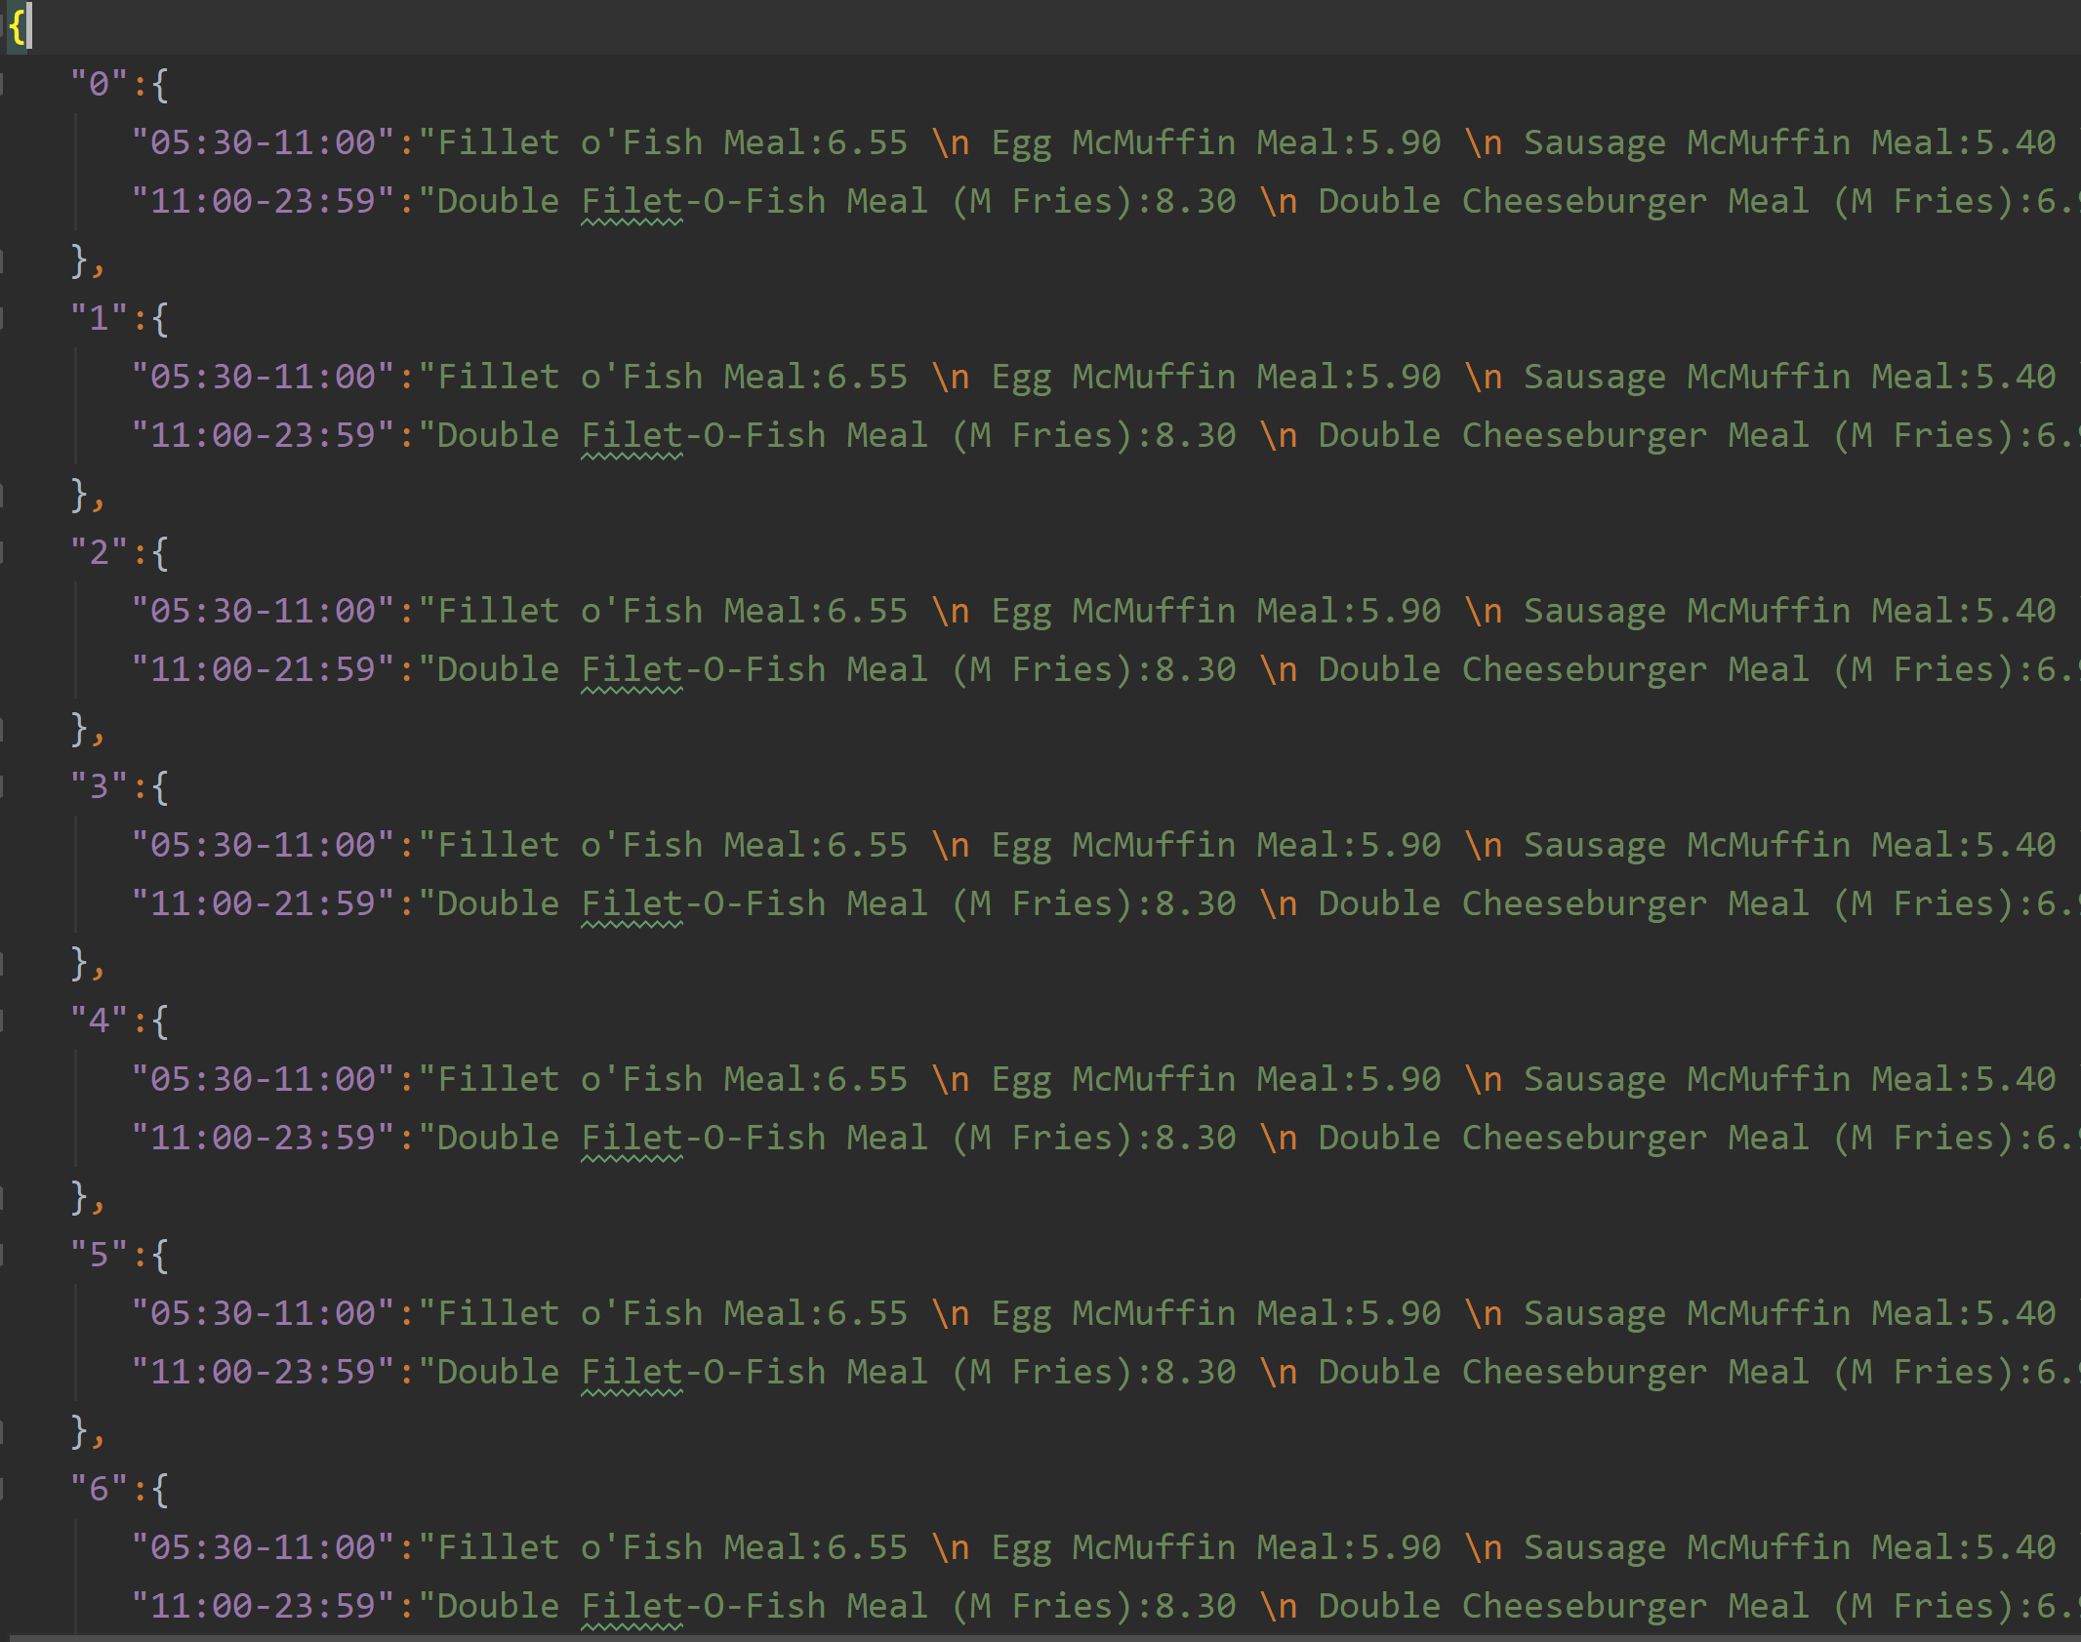
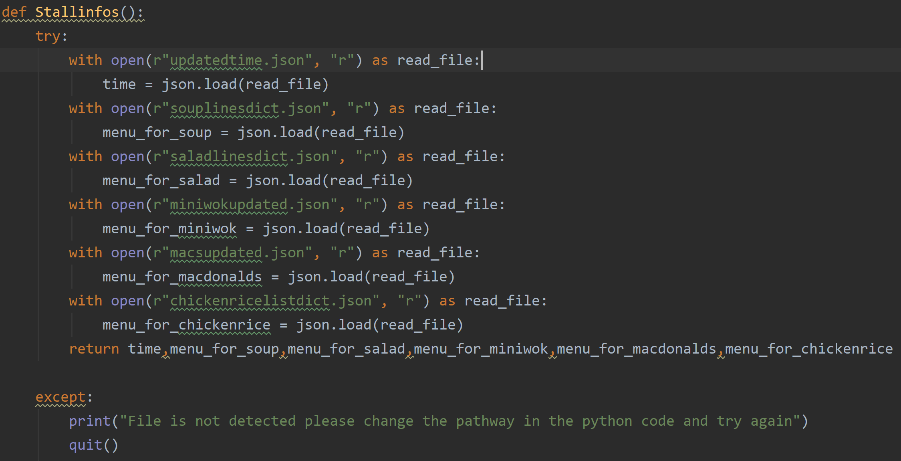

File importing with json
Data in .json files that are in dictionary format
The code to parse json files into dictionaries,Try and except block for exception handling
Finally, importing this code as a module and the function into the main program

Slide 7
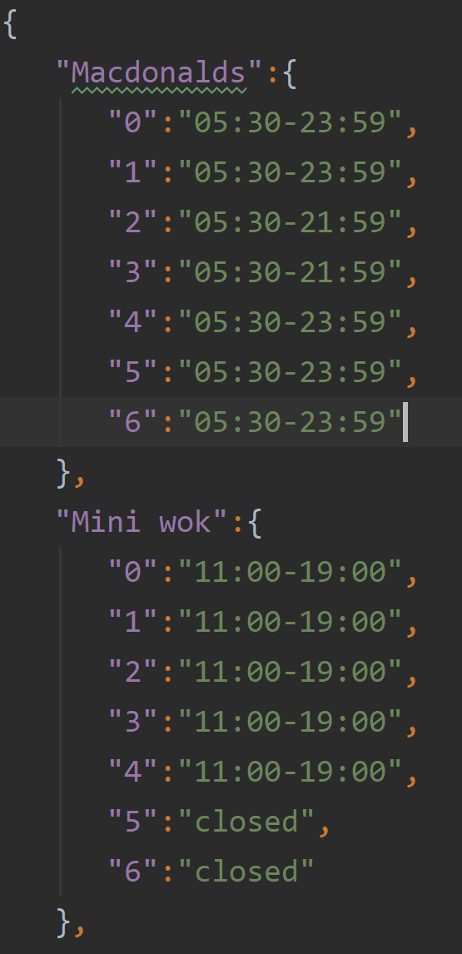
Usage of Dictionaries
Nested dictionaries have been used to store the operation hours according to the stall and the menu for each stall according to the day and time

Slide 8
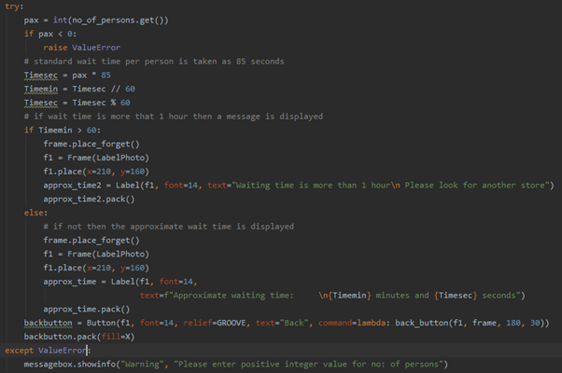
Exception handling
We have 3 Try Except blocks to handle multiple exceptions cause due to invalid input by the user.This is one try and except block code snippet for the estimate wait time function.

Slide 9
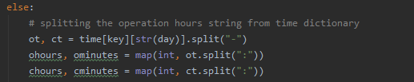
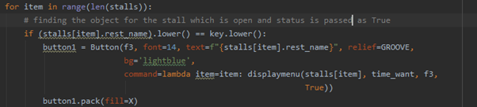
Use of string operations
Also using .split() to split certain elements within a string so that we are able to compare a specific value
Usage of .lower to ensure that the strings are in lower case
Concatenation with + operators

Slide 10
USe of tuple/list
Use of list to store the objects created for all the stalls. This is mutable as a new stall can be appended
2. Use of tuple to store the weekdays this is immutable as weekdays cannot change.

Slide 11
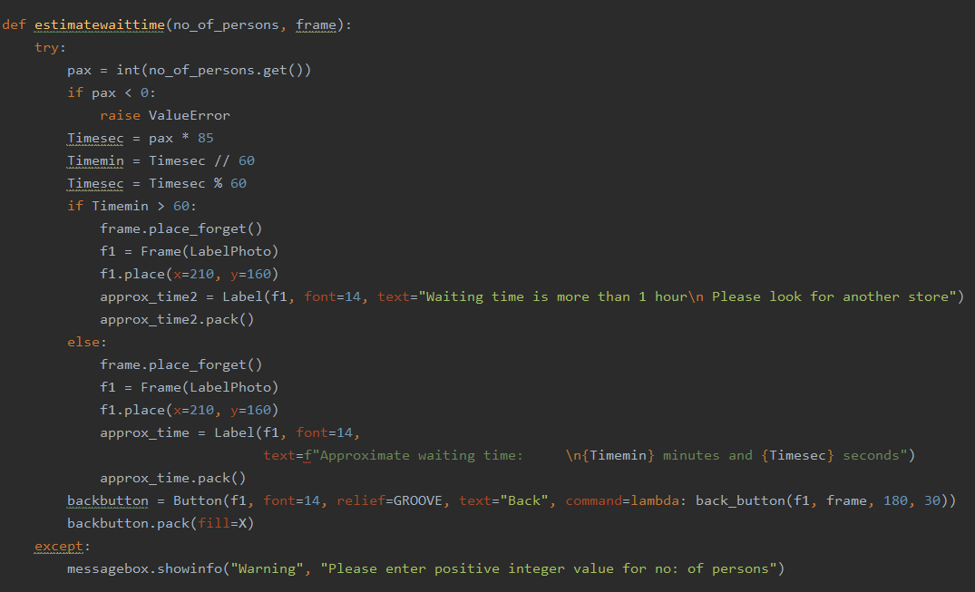
Program correctness
Shown by a live demo
Usage of the try and except block in order to produce the right action when the input is invalid

Slide 12
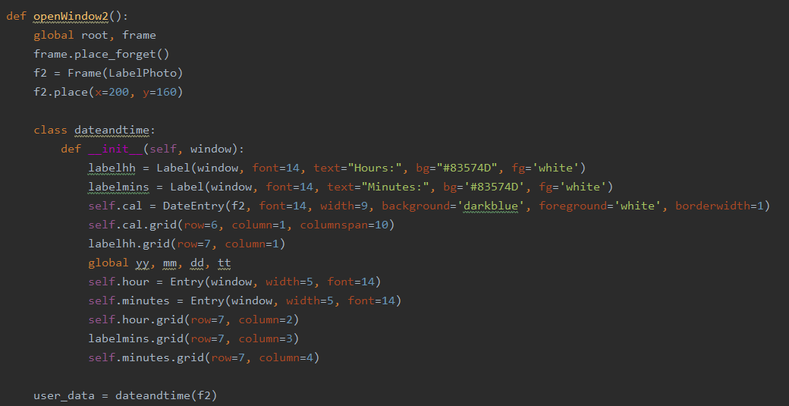
Program correctness
Adding of the calendar for the selection of date to prevent invalid inputs by users

Slide 13
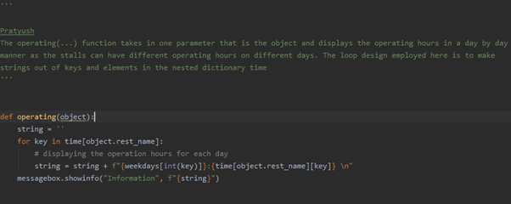
Program organisation: function, module
We have used functions for almost all features. For example, the code snippet below shows the operating hours function
We have separated file handling in a different module, which is imported in the main program

Slide 14
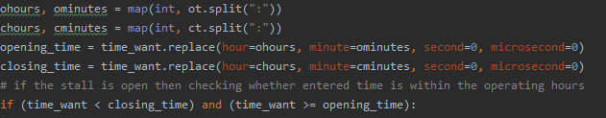
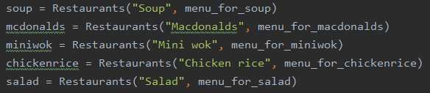
Programming style
Creating suitable variables names, for example name for opening and closing hours
Object declaration and the passing of values to these variables
Notes:
Ji

Slide 15
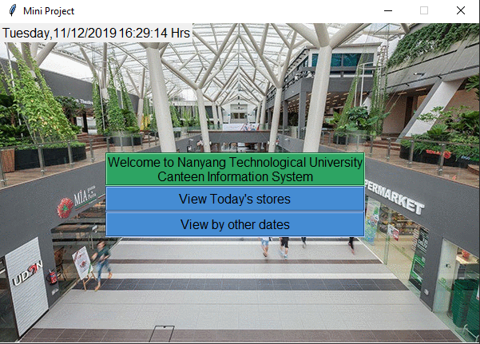
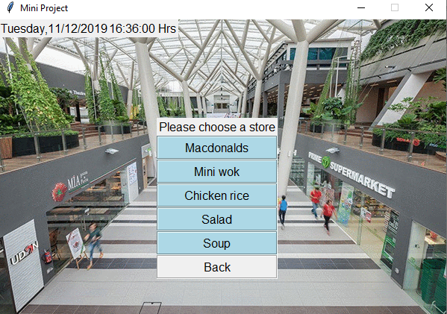
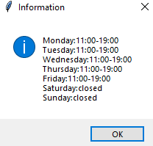
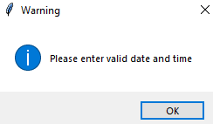

Interface design

Slide 16
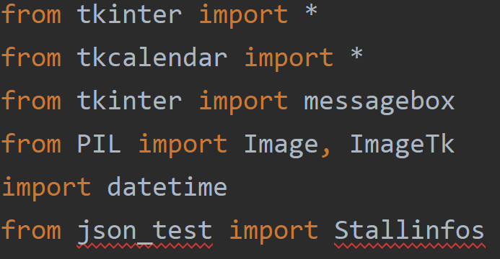
External library/module used
tkinter and tkcalendar library are for multiple gui related functions that are in the main code.
PIL is basically allowing the usage of the background image for the main gui.
Date time module is so that we are able to store the current and custom day and time to be used for comparison in the code.
json_test is a module housing the Stallinfos function that is used solely to import the dictionaries stored in .json file.

Slide 17
Thank You!

