Slide 1
RSA
Encryption
CEP146 NBB
Adrian Stanciu - Seneca Student ID: 111272266
Ignacio Morales Hermosilla - Seneca Student ID: 122079262
Muffin Aybar - Seneca Student ID: 107362253
Summer Chang - Seneca Student ID: 148482243

Slide 2
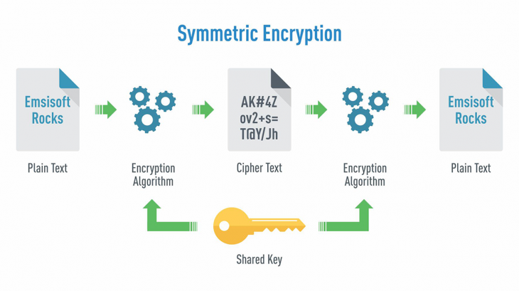
How RSA Encryption Works
RSA is an asymmetric encryption algorithm.
Uses two mathematically linked keys: public and private.
The public key can be shared openly.
The private key must remain secret.
The sender encrypts data using the recipient's public key.
The recipient decrypts data using their private key.
Both parties can use their own key pairs for two-way communication.
  (GeeksforGeeks, 2025; Ireland, n.d.)
  (Castelli Lluch & Tallarico, 2019)

Slide 3
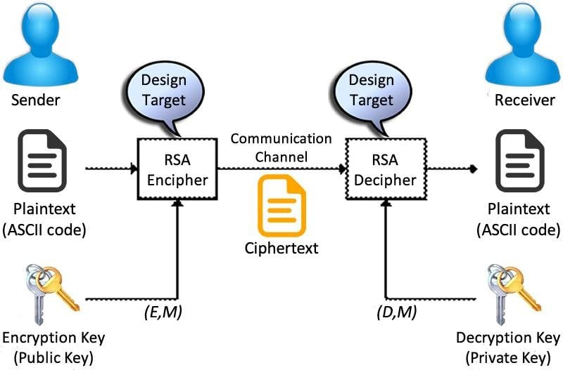
How They're Used and Made
  (Transitioning to PQC, 2024)

Slide 4
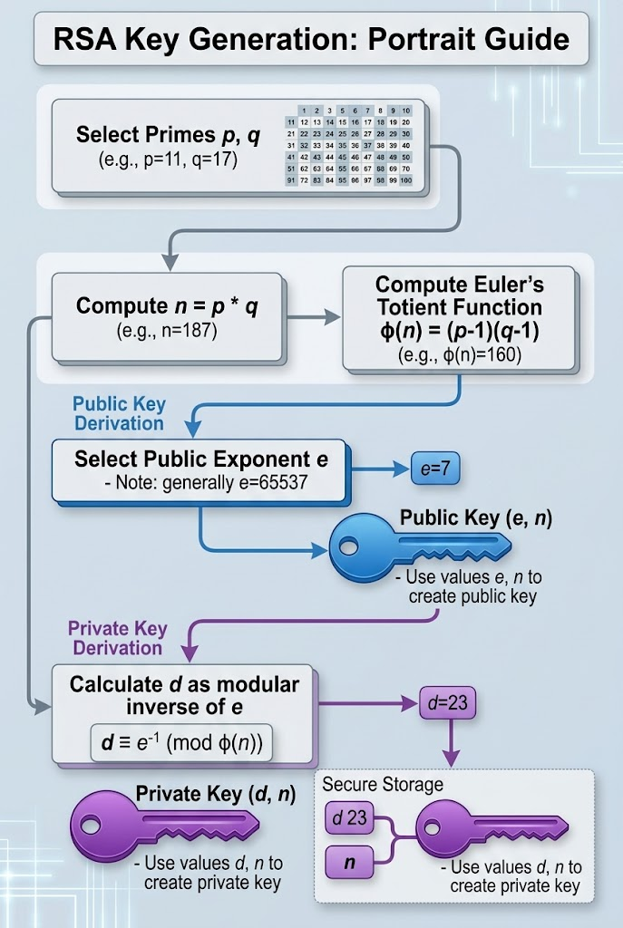
RSA Key Generation
Public and Private Keys
Step 1: Select Prime Numbers
  Generate two large random prime numbers: p and q.
  Calculate n = p × q.
  RSA keys are commonly 2048 bits.
  (GeeksforGeeks, 2025; Ireland, n.d.)
Step 2: Generate the Public Key
Step 3: Generate the Private Key
  Calculate Euler's totient: φ(n) = (p − 1)(q − 1).
  Select public exponent e, usually 65537.
  Ensure e is coprime with φ(n).
  Public key: (e, n).
  Calculate d as the modular inverse of e modulo φ(n).
  Private key, in simplified mathematical notation: (d, n).
  Image generated using OpenAI's ChatGPT (2026)

Slide 5
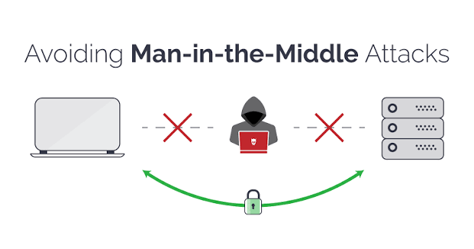
Practicality in the Real World
Digital Certificates
  Encryption alone cannot verify a server's identity.
  Attackers can attempt Man-in-the-Middle (MITM) attacks by substituting public keys.
  Digital certificates are signed by trusted Certificate Authorities (CAs).
  Certificates bind public keys to verified identities.
  Proper certificate validation helps prevent MITM attacks.
  (Tucker, 2024; Rescorla, 2018)
  (DecisionTele, n.d.)

Slide 6
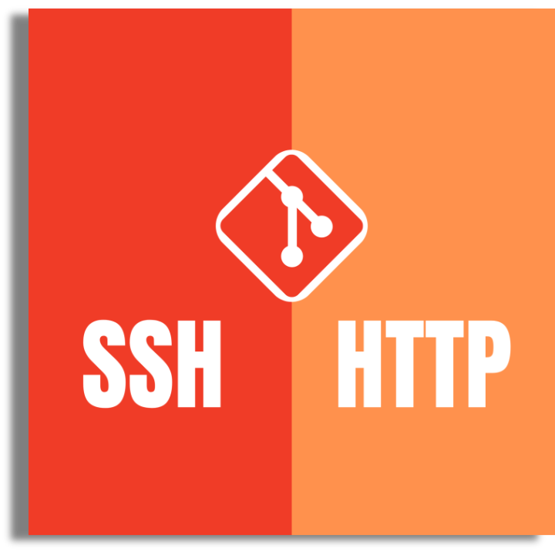
Practicality in the Real World
SSH and HTTPS
SSH (Secure Shell)
Security Benefits
  Connects users securely to remote servers.
  Can use RSA key pairs for authentication.
  Protects against unauthorized access and impersonation.
  Public keys can be shared without revealing private keys.
HTTPS (Hypertext Transfer Protocol Secure)
  Uses TLS to establish secure connections.
  Uses digital certificates for server authentication.
  RSA can be used for digital signatures.
  Modern HTTPS encrypts transmitted data using symmetric encryption.
  (Balogun, 2024)
  (DigitalOcean, n.d.; Rescorla, 2018)

Slide 7
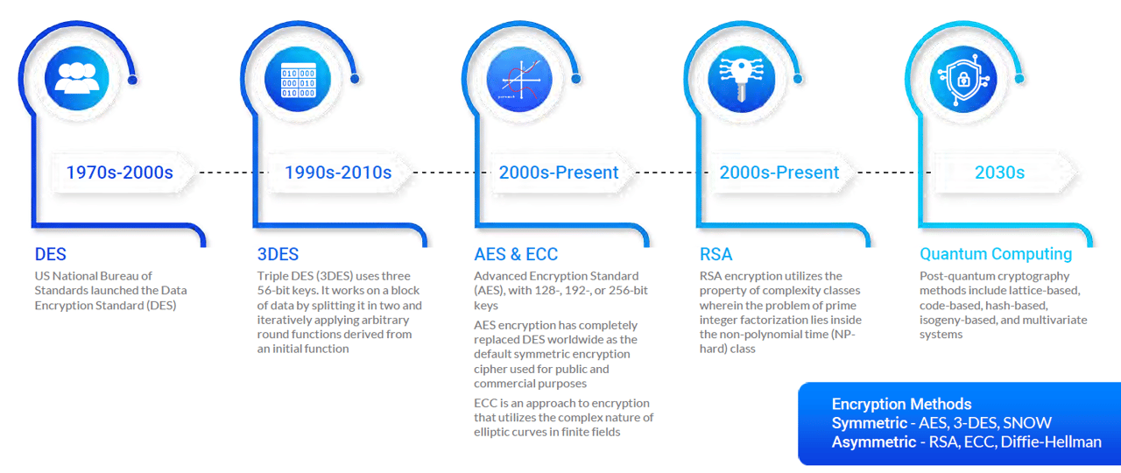
The Future of RSA Encryption
  RSA remains widely used today.
  Quantum computing presents a potential future security threat.
  Sufficiently powerful quantum computers could break RSA encryption.
  NIST is guiding the transition to post-quantum cryptography.
  Major proposed transition milestones: 2030 and 2035.
  (Lebeaux, 2026; Moody et al., 2024)
  (PreScouter, 2022)

Slide 8
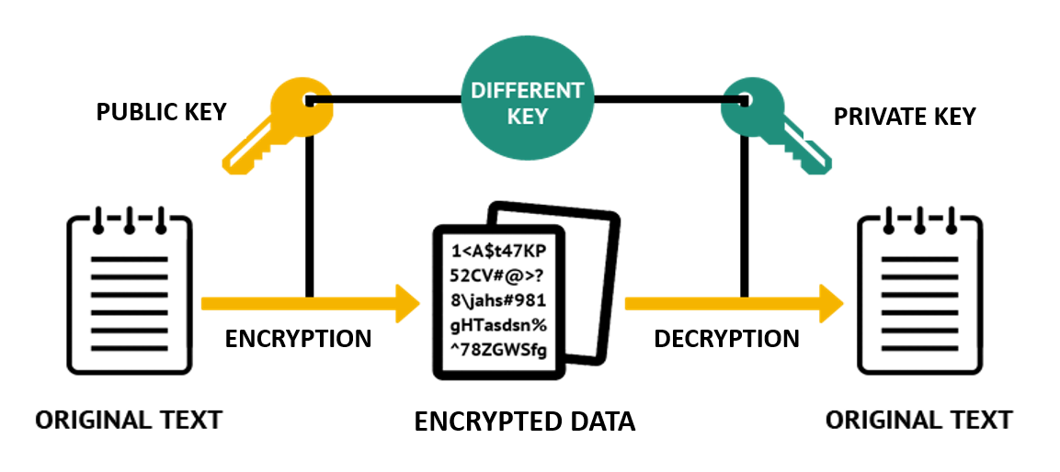
Closing Off
  (Simplilearn, n.d.)

Slide 9
Bibliography
  Castelli Lluch, C. D., & Tallarico, A. (2019). BlockGuitars: Herramienta para las transacciones de instrumentos musicales mediante blockchain [Undergraduate thesis, Universidad Nacional de La Plata]. SEDICI. https://sedici.unlp.edu.ar/handle/10915/119581
  DigitalOcean. (n.d.). Understanding the SSH encryption and connection process. https://www.digitalocean.com/community/tutorials/understanding-the-ssh-encryption-and-connection-process
  GeeksforGeeks. (2025, July 23). RSA algorithm in cryptography. https://www.geeksforgeeks.org/computer-networks/rsa-algorithm-cryptography/
  Ireland, D. (n.d.). RSA algorithm. DI Management Services Pty Limited. https://di-mgt.com.au/rsa_alg.html
  Lebeaux, B. (2026, September 17). Setting the record straight on quantum computing and RSA encryption. RSA. https://www.rsa.com/resources/blog/zero-trust/setting-the-record-straight-on-quantum-computing-and-rsa-encryption/
  Moody, D., Perlner, R., Regenscheid, A., Robinson, A., & Cooper, D. (2024). Transition to post-quantum cryptography standards (NIST IR 8547, Initial Public Draft). National Institute of Standards and Technology. https://doi.org/10.6028/NIST.IR.8547.ipd
  PreScouter. (2022). Quantum computing and cybersecurity: Preparing for post-quantum cryptography [Report]. https://pswordpress-production.s3.amazonaws.com/2022/04/Quantum-Computing-and-Cybersecurity_-Preparing-for-Post-Quantum-Cryptography-PreScouter.pdf

Slide 10
Bibliography
  Rescorla, E. (2018). The Transport Layer Security (TLS) Protocol Version 1.3 (RFC 8446). Internet Engineering Task Force. https://doi.org/10.17487/RFC8446
  RSA Community. (n.d.). RSA cryptography and NIST guidance. https://community.rsa.com/s/article/RSA-cryptography-and-NIST-guidance
  Simplilearn. (n.d.). Digital signature algorithm (DSA): A complete guide. https://www.simplilearn.com/tutorials/cryptography-tutorial/digital-signature-algorithm
  Transitioning to PQC [Presentation slides]. (2024). Minority Serving-Cyberinfrastructure Consortium. https://ms-cc.org/wp-content/uploads/2024/05/Transitioning-to-PQC.pdf
  Tucker, A. (2024, September 30). RSA encryption: How the RSA algorithm works and why it matters. SecureW2. https://securew2.com/blog/what-is-rsa-asymmetric-encryption

