Slide 1
Information Theory

Slide 2
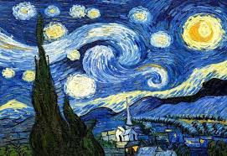
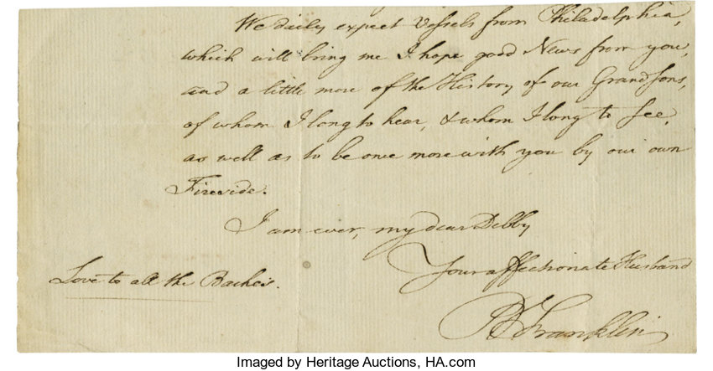

What is Information ?

Slide 3
What makes Information?
Is it order ?
00000000000000000000000000
11111111111111111111111111
AAAAAAAAAAAAAAAAAAAAAAA
So I guess No.

Slide 4

What makes Information?
Is it Absence of Order “chaos ?
Also I guess not.

Slide 5
Example
How Are You ?
How R U
H R U

Slide 6
conclusion
I
P
I = 0
I = infinity
So I is the inverse of P
information
Probability of a given event
P = 1
P = 0

Slide 7
