Slide 1



D. Y. Patil College Of Engineering Department of information technology
MITRA
Depression Fighting Chatbot
Presented By: Guide:
Mugdha Sutar (B150088642) Dr. Preeti Patil
Rutuja Sose (B150088638)
Sumit Tekawade (B150088646)
Vedansh Shrivastav (B150088649)

Slide 2
Content
Abstract
Introduction
Literature Survey
Proposed System
PHQ-9 test
Proposed Treatment
Technology Used
System Architecture
Data Flow Diagram
Use Case Diagram
Timeline Chart
Work Done
Overview
Conclusion
Published Paper
References

Slide 3

Abstract
Depression is a widely discussed topic of the decade. But, the ground work is left to psychologists alone. People employed in this profession has seen a regular increase over the years but the rates of suicide has seen an alarming growth. There’s a gap that exists between the two ends. If not attended firmly, this issue can take a catastrophic form. So, in order to tackle this issue we propose an idea of an intelligent chat bot that can help the person in need by understanding their emotions and providing solutions accordingly.

Slide 4
Introduction
Suicide due to depression has become the second leading cause of death in 15-29-year-olds. Between 76% and 85% of people in low- and middle-income countries receive no treatment for their disorder. Barriers to effective care include a lack of resources, lack of trained health-care providers and social stigma associated with mental disorders. Another barrier to effective care is inaccurate assessment. Depression results from a complex interaction of social, psychological and biological factors. People who have gone through adverse life events (unemployment, bereavement, psychological trauma) are more likely to develop depression. Depression can, in turn, lead to more stress and dysfunction and worsen the affected person’s life situation and depression itself.

Slide 5
Literature Survey
A novel method Design for Diagnosis of Psychological Symptoms of Depression using Speech analysis- Xiaoyong Lu, Aibao Zhou, Hongwu Yang - 2018
Depression speaker speech features showing personality as input data of computational model such as fundamental frequency, energy, speech rate,etc.

Slide 6
Literature Survey
Conversational Assistant based on Sentiment Analysis: Suraj D M 1 , Varun A Prasad 2 , Shirsa Mitra 3 , Rohan A R 4 , Dr. Vimuktha Evangeleen Salis 5
To determine the emotional context of a conversation sample, a chat sample is selected. From the sample we extract a set of features that give us information about the emotion present in the sample. Then using the features selected, emotional state present in the sample is predicted.

Slide 7
Literature Survey
Framework for depression dataset to build automatic diagnosis in clinical depressed saudi patients - Ohoud Mohammad Albadin, Abeer Abdulaziz Aldahash, Luban Yousef AlKhalil -2016
Depression shows different symptom pattern in different societies. few studies in recent year have investigated how cultures influence mental disorders such as depression.

Slide 8
Proposed system
A one-stop destination to handle Depressive episodes. The Mental State of the user will be categorized into A,B,C,D,E by the chatbot(A being the primary and E being the Emergency). According to the category, remedies(tasks) will be assigned to the user. The remedies are focused on behavioral activation. In case of category D&E a professional help will be provided and the client will be handed over to the expert with a detailed report of depressive episodes.

Slide 9
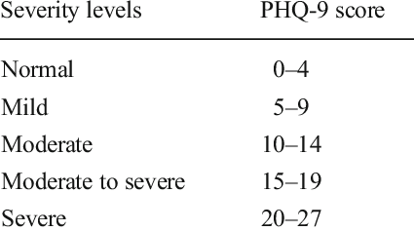
PHQ-9 TEST
The PHQ-9 is the 9-item depression module from the full PHQ. As a severity measure, the PHQ-9 score can range from 0 to 27, since each of the 9 items can be scored from 0 (not at all) to 3 (nearly every day). The results are categorized into various Severity levels.
Based on these standard levels of Severity we’ve categorized into A,B,C,D,E

Slide 10
Proposed Therapy
Music Therapy
Dance Therapy
Meditation
Physical Activity Therapy

Slide 11
Technology Used
Chat Bot : RASA 2.0
Integration : Rasa Chat Room
GUI : Website
Frontend : HTML,CSS
Backend : Python Framework (Django)

Slide 12
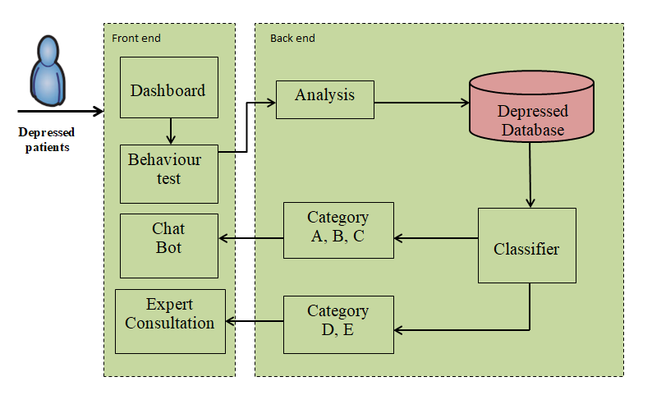
System Architecture

Slide 13
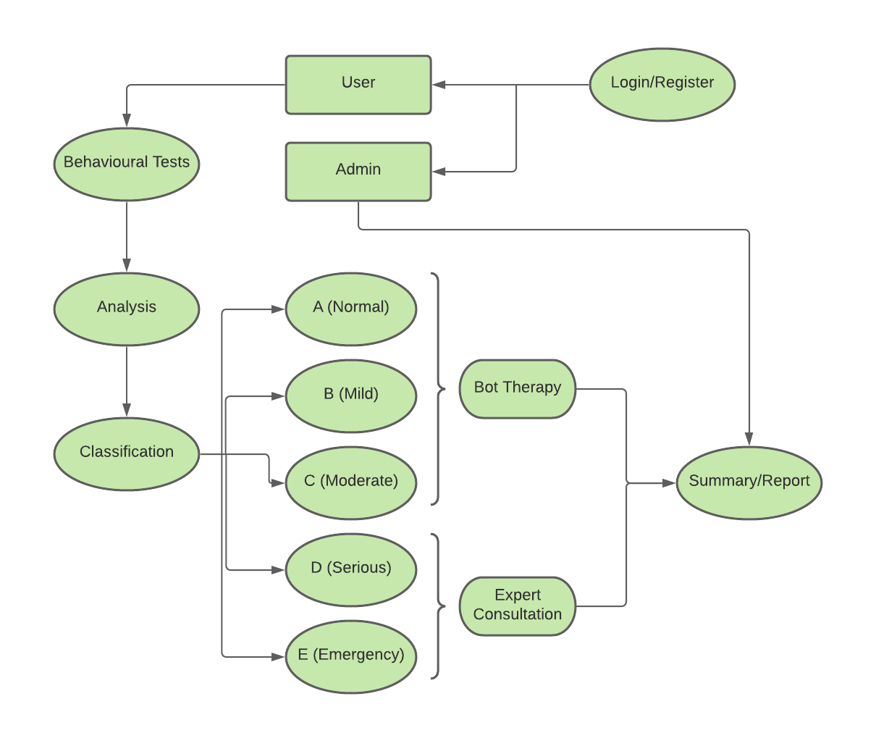
Data Flow Diagram

Slide 14
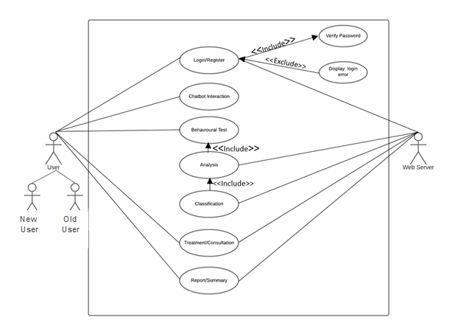
Use Case

Slide 15
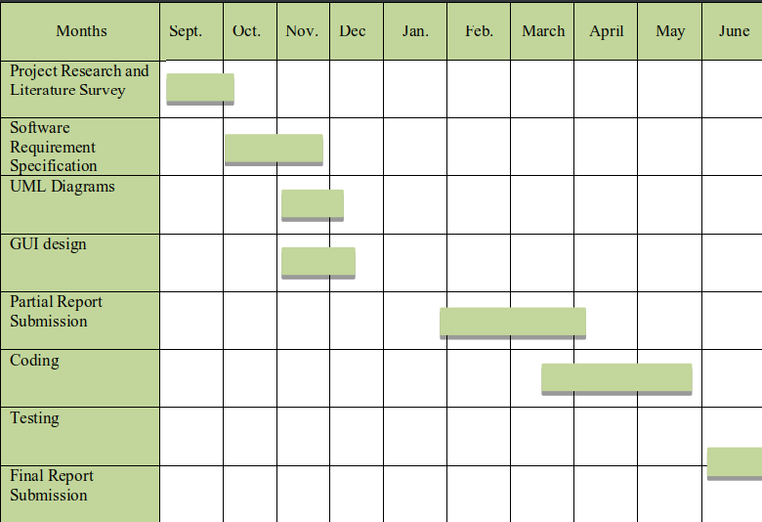
TimeLine Chart

Slide 16
Work done till Date
Study of existing bots
System Design
System WorkFlow
Study on RASA
Research on virtual Therapies
Study of Web Based Tools
Implementation of RASA Chat Bot
Implementing Behavioural Tests
Implementing PHQ-9 test
Created Patient Database
Website creation using Django
Interactive UI

Slide 17
Overview

Slide 18
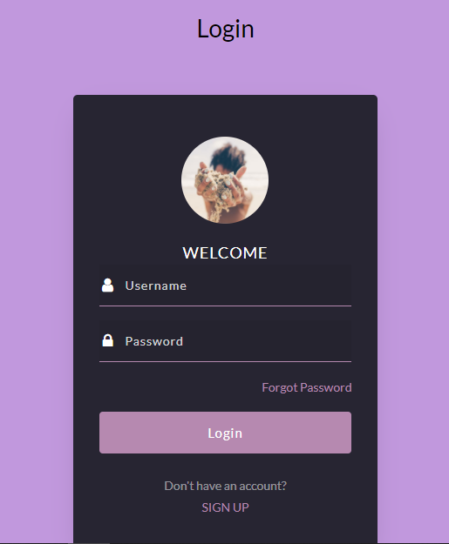
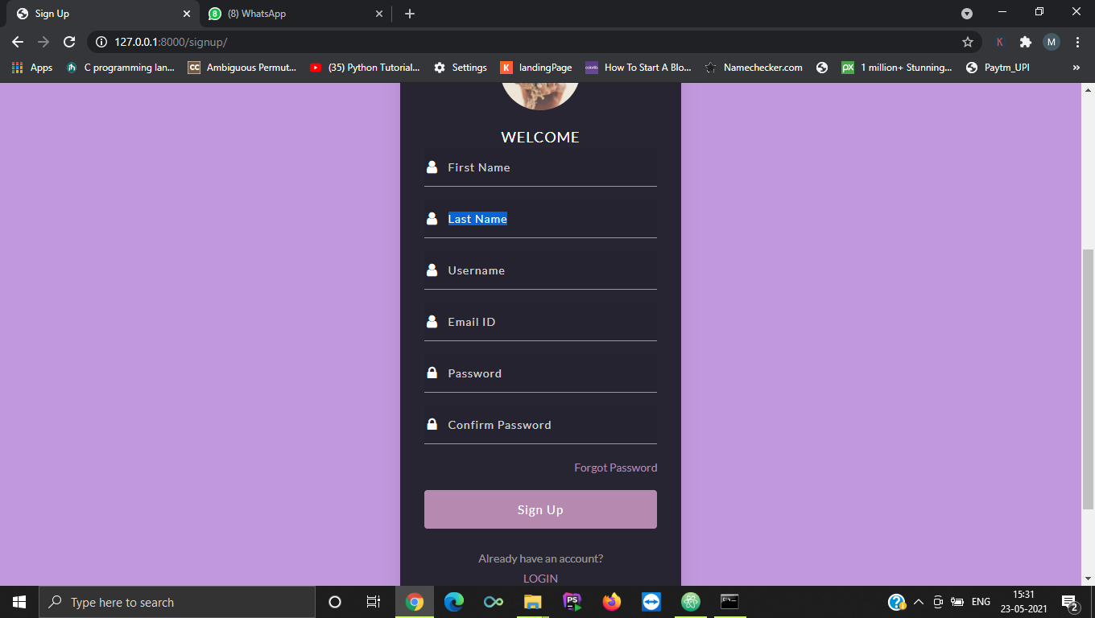
MITRA UI

Slide 19
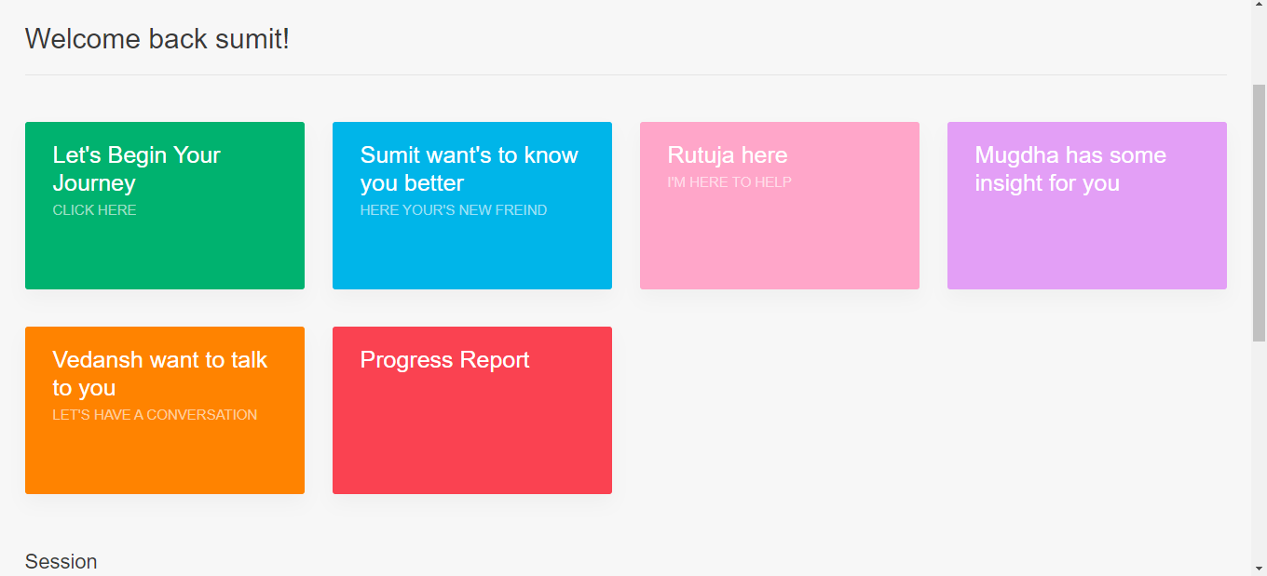
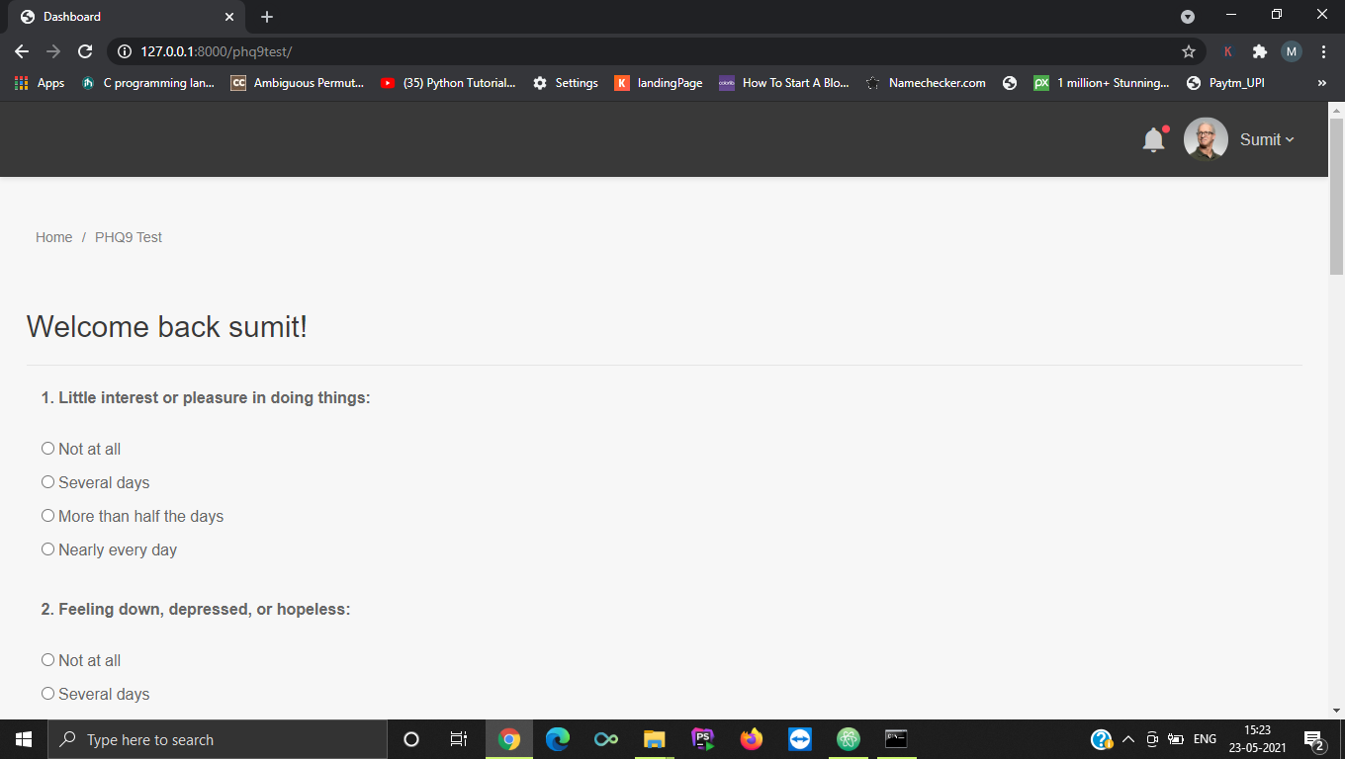
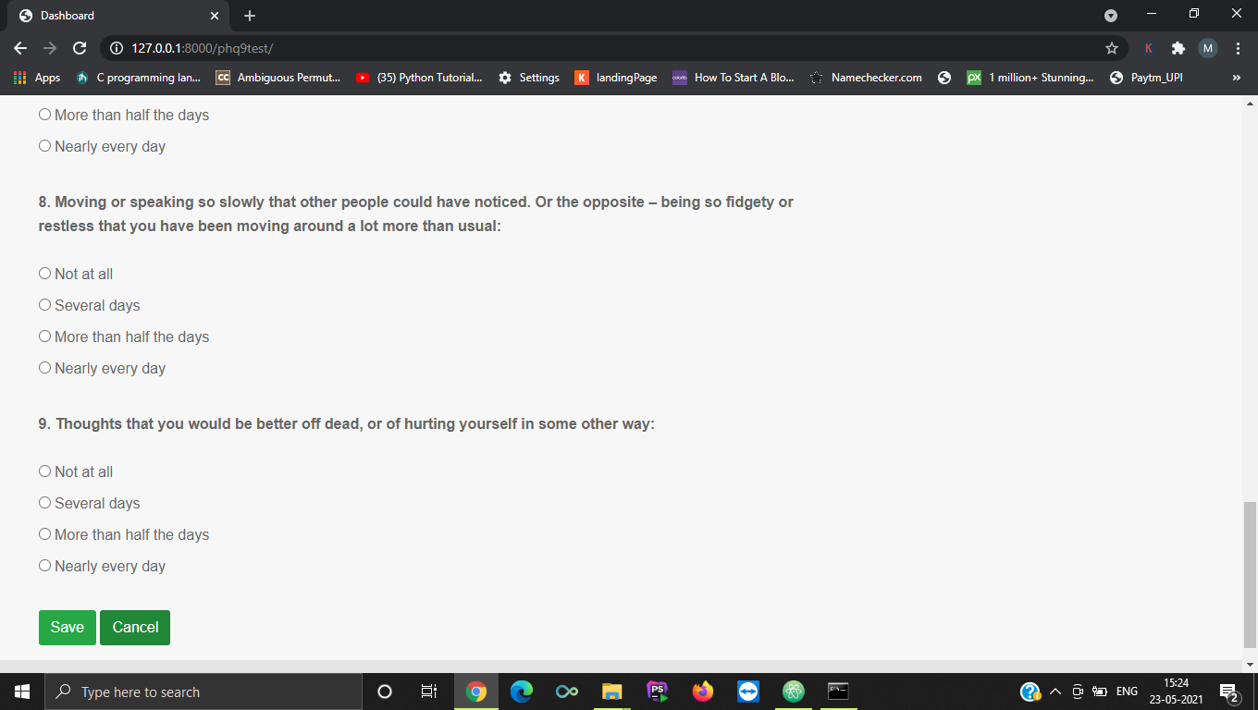
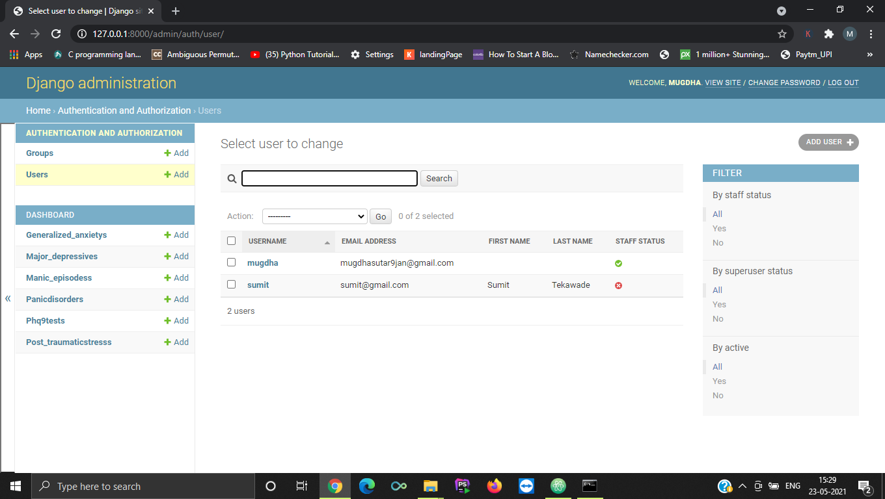
1
2
3
4

Slide 20
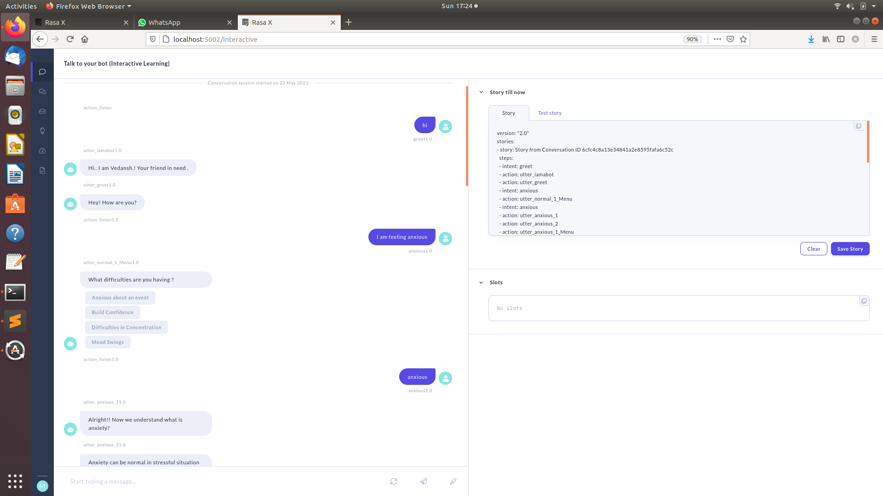
ChatBot Implementation

Slide 21
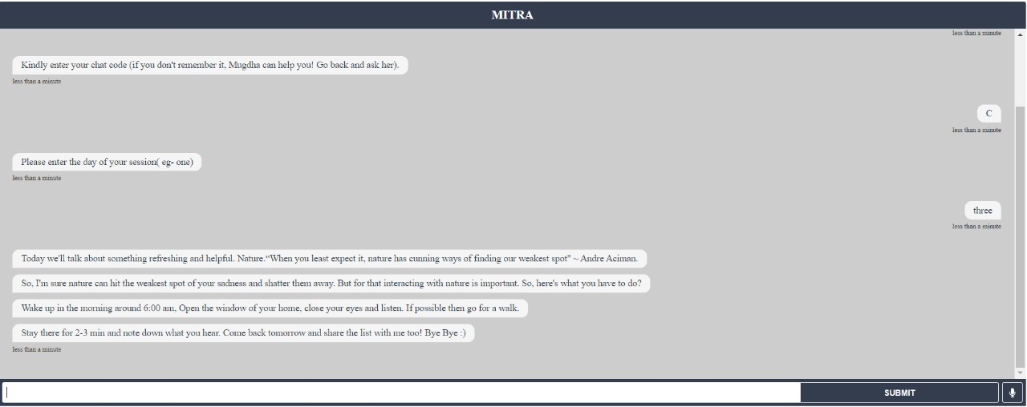
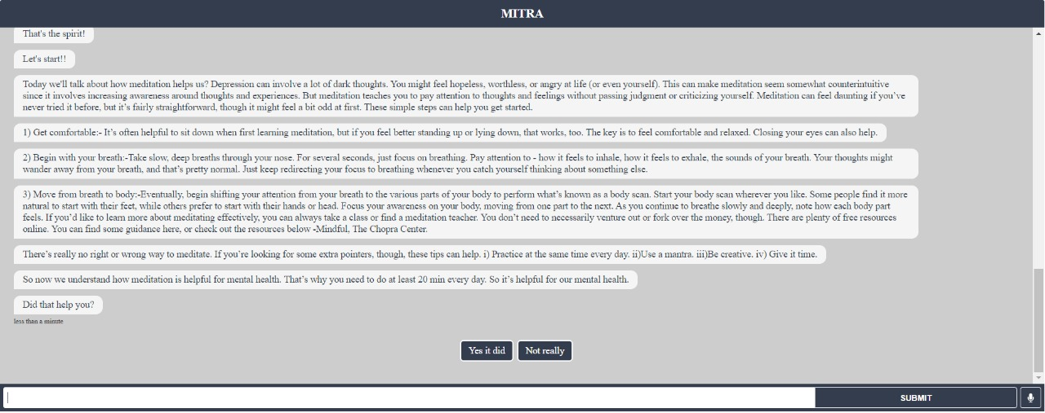

Slide 22
Conclusion
Human speech and conversational style is a complex structure of words and emotions. Every word when expressed in different moments can convey a different meaning. Every user will have their state of mind, their input hence will be difficult to comprehend. Their emotions can provide extra insight into what they’re going through. This also helps in deciding the therapies and making the schedule. With this, we ask the user to start the conversation and then the bot starts with the therapy. To understand the user well, before interacting with the bot, the user gives some tests and that helps in determining the therapy for the particular user. The sessions are planned on similar grounds.

Slide 23
References
Clinical Depression Detection in adolescents by face - Prajakta Bhalchandra Kulkarni, Minakshee Patil - 2018
A novel method Design for Diagnosis of Psychological Symptoms of Depression using Speech analysis- Xiaoyong Lu, Aibao Zhou, Hongwu Yang
Classifying depression patients and normal subjects using ML - Behshad Hosseinifard, Mohammad Hassan Moradi, Reza Rostami -2018
A Django Based Educational Resource Sharing Website: Shreic -Adamya Shyam*1, Nitin Mukesh2

Slide 24
References
Framework for depression dataset to build automatic diagnosis in clinical depressed saudi patients - Ohoud Mohammad Albadin, Abeer Abdulaziz Aldahash, Luban Yousef AlKhalil -2016
World Health Organization. Geneva: World Health Organization; 2017. Depression and Other Common Mental
Disorders: Global Health Estimates
Clinical Depression Detection in adolescents by face - Prajakta Bhalchandra Kulkarni, Minakshee Patil - 2018

Slide 25
Published Paper

Slide 26
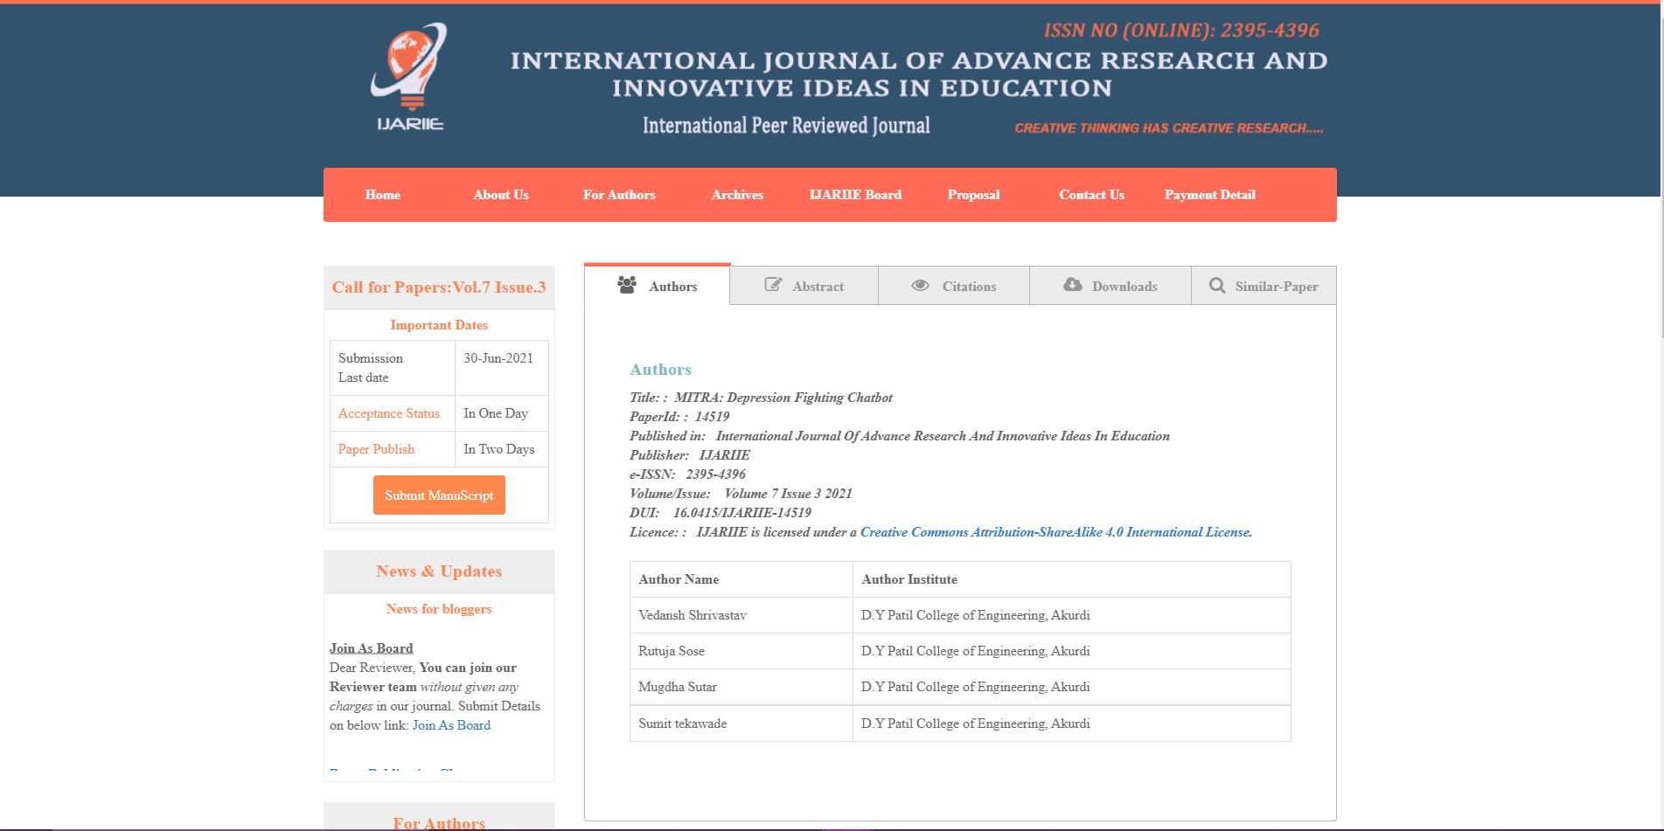
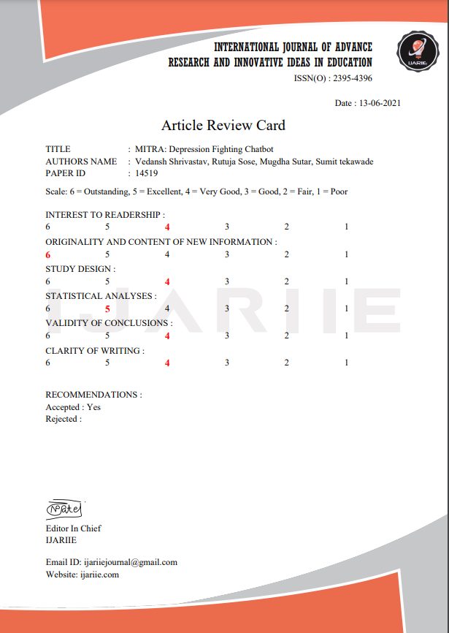

Slide 27
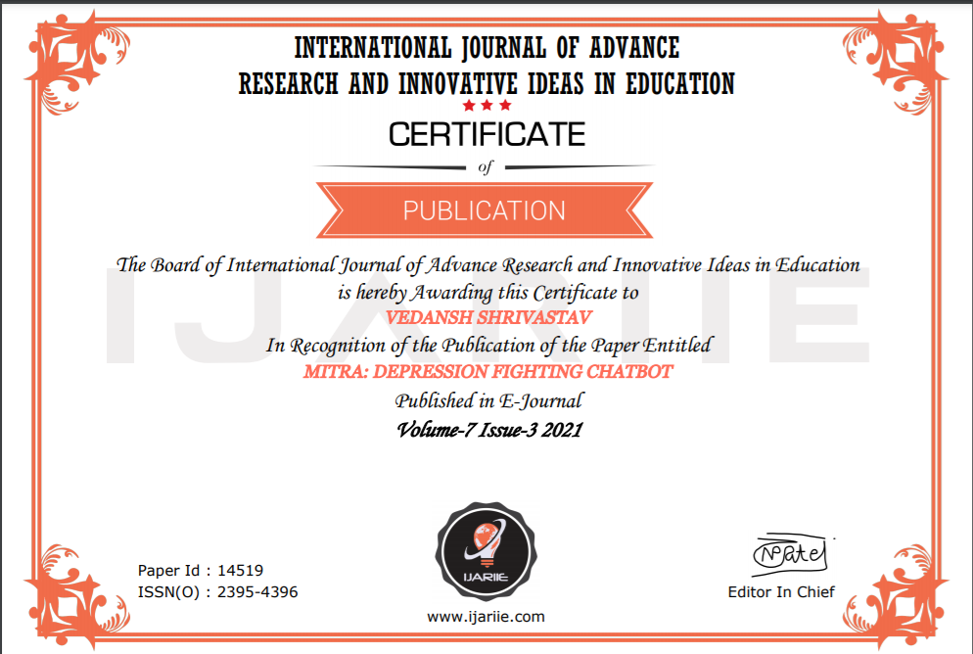
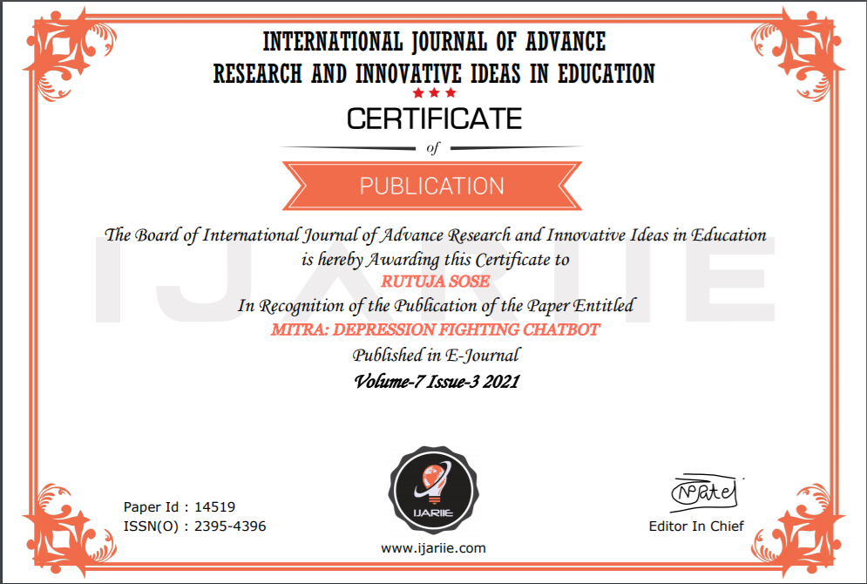
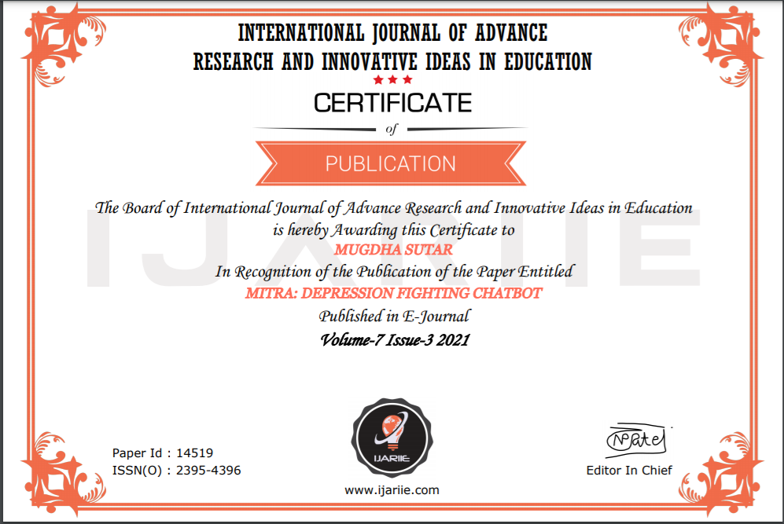
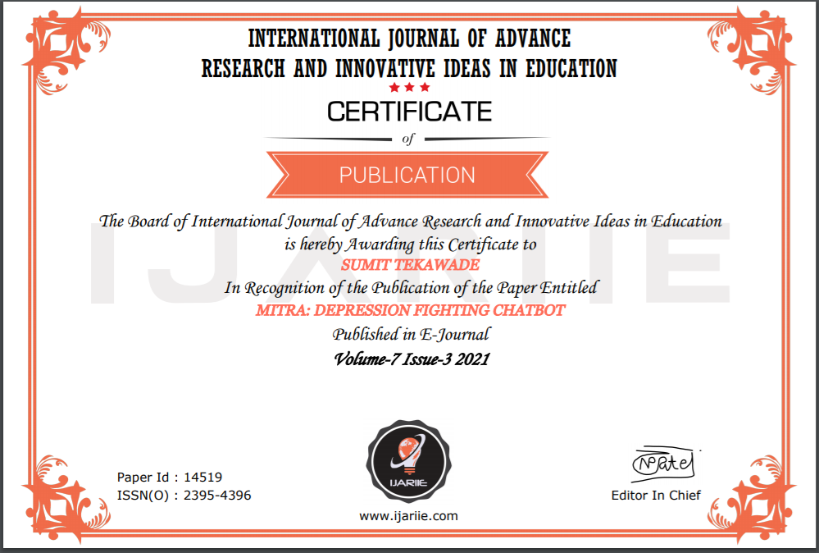
Published Paper

Slide 28
References
A novel method Design for Diagnosis of Psychological Symptoms of Depression using Speech analysis- Xiaoyong Lu, Aibao Zhou, Hongwu Yang.
Classifying depression patients and normal subjects using ML - Behshad Hosseinifard, Mohammad Hassan Moradi, Reza Rostami -2018
Framework for depression dataset to build automatic diagnosis in clinical depressed Saudi patients - Ohoud Mohammad Albadin, Abeer Abdulaziz Aldahash, Luban Yousef AlKhalil -2016

Slide 29
References
World Health Organization. Geneva: World Health Organization; 2018. Mental Health Atlas 2017.
Patel V. SUNDAR: mental health for all by all. BJPsych Int 2015 Feb;12(1):21-23
Suraj DM, Varun A Prasad, Shira Mitra, Rohan A R, Dr. Vimuktha Evangeleen Salis: Conversational Assistant based on Sentiment Analysis; Volume: 06 Issue: 09 | Sep 2019
An Analytical Study and Review of open Source Chatbot framework, RASA-Rakesh Kumar Sharma Scientist-D National Informatics Center (NIC) India Manoj Joshi Scientist-E National Informatics Center (NIC) India

Slide 30
References
Wysa
WHO
Blogspot

