Slide 1

AI-based Yoga Guru App
Abhishek Ranjane - B150234201
Mugdha Chindhe - B150234239
Rachana Deodhar - B150234244
Palash Gangamwar - B150234265
Guided by :
Prof. G.G. Chiddarwar

Slide 2
Contents
1.Motivation and Objectives
2.Problem statement
3.Existing Systems
5.Literature Survey
6.Methodology
6.1 Pre-Processing
6.2 OpenCV
6.3 GUI
6.4 Native
6.5 PoseNet
6.6 Comparison of Extracted Features
6.7 Displaying Values
6.8 Speech Recognition
6.9 Text to Speech
7.Technologies used
8.Conclusion
9.References

Slide 3
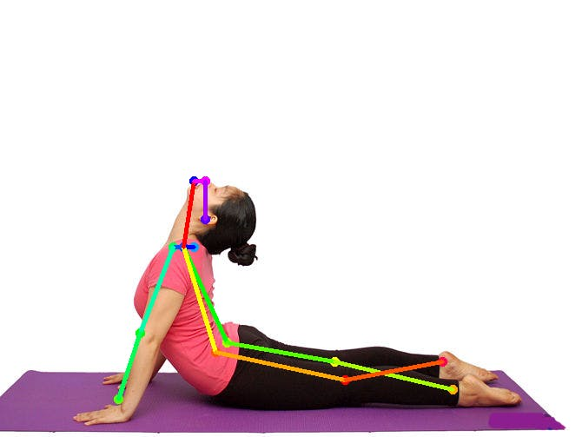
Motivation and Objectives
Unavailability of yoga classes due to COVID-19
Expensive yoga classes.
Yoga causes musculoskeletal pain in 10% of people and exacerbates 21% of existing injuries - Improper form.

Slide 4
Problem Statement
To develop an Android application which guides the user to perform yoga poses by displaying their angles of joints and giving voice command once the pose is performed correctly.

Slide 5
Existing Systems
Existing apps are based on only static data ,that is they only provide instruction manual to perform Yoga.
Existing Systems using similar approach are developed for applications in Gaming and for Dance Tutorials.

Slide 6
Literature Survey
Sr. No. | TITLE | DESCRIPTION | AUTHOR
1 | Machine learning gesture analysis of yoga for exergame development | Machine learning algorithm in a basic computer video exergame can assess yoga skill acquisition in targeted select populations as a means to promote healthy physical activity. | Paula Pullen, William Seffens.
2 | 3D Human Pose Estimation with Relational Networks | Each pair of different body parts generates features, and the average of the features from all the pairs are used for 3D pose estimation. | Sungheon Park, Nojun Kwak
3 | Human Pose Co-Estimation and Applications | PCE leads to better pose estimation in such images, and it learns meaningful prototypes which can be used as priors for pose estimation in novel images | Marcin Eichner, Vittorio Ferrari

Slide 7
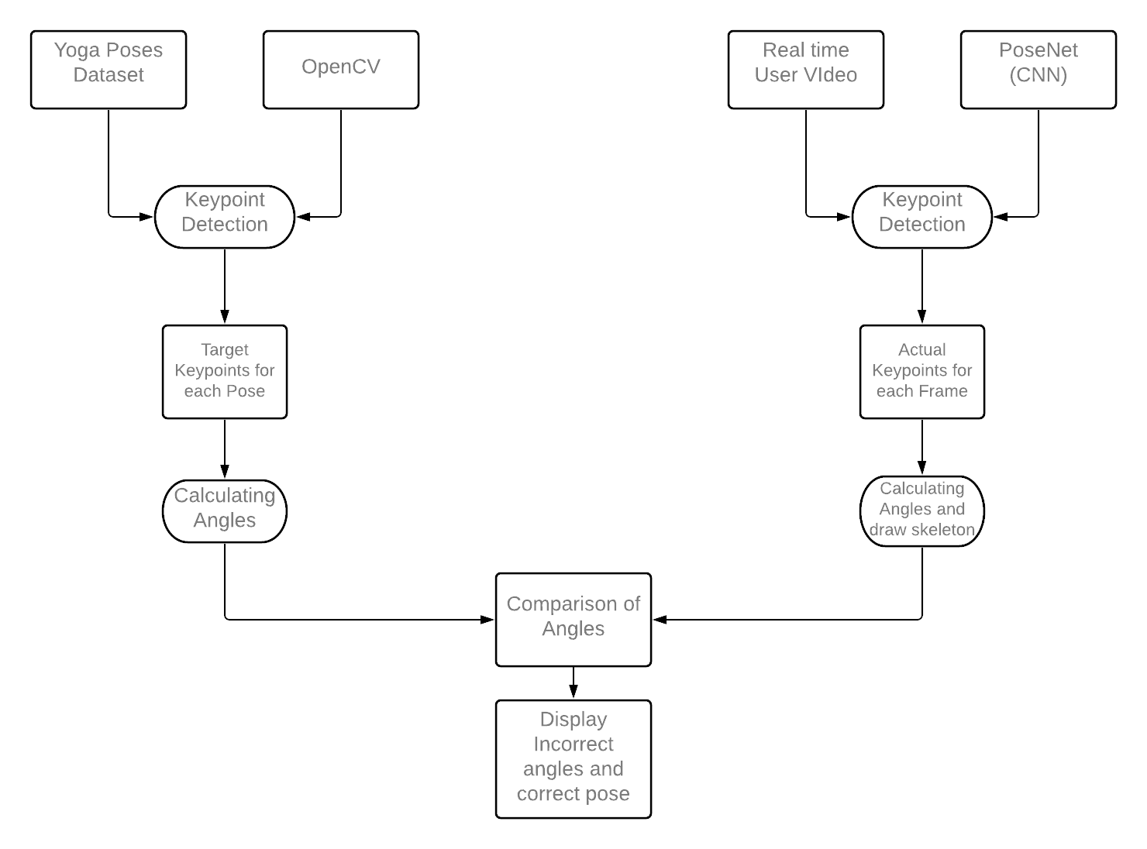
Methodology
Pre-Processing
Native (Real-Time)

Slide 8
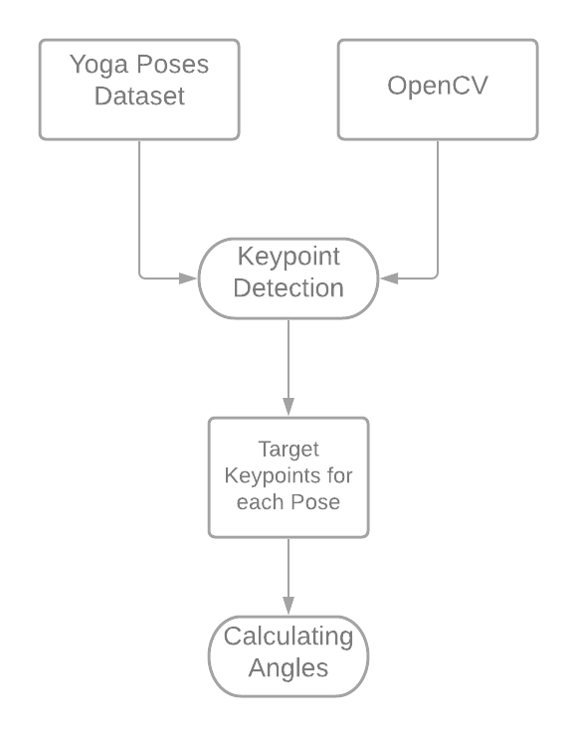
Pre-Processing part of the system
Yoga Poses Dataset
OpenCv (Open Source Computer Vision Library)
Getting Target Values for each pose

Slide 9
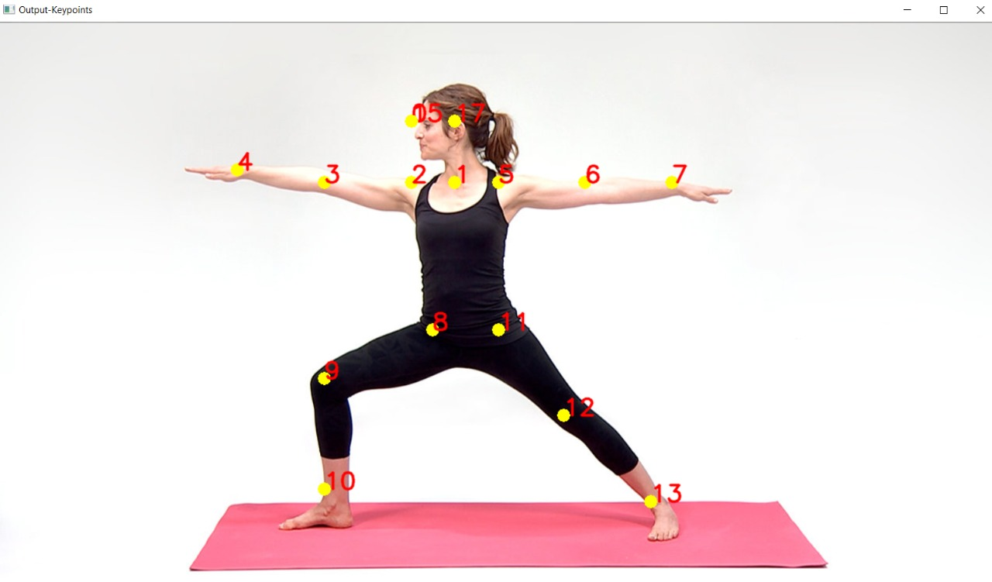
OpenCV
We collected images of different yoga poses - create our own dataset.
Process these images using OpenCV
Get the 17 essential target keypoints for comparison.

Slide 10

Graphical User Interface
Menu:
Navigation Drawer
Menu-driven Interface
Gives the user a set of options to select from, available together on the screen.
Instructions:
Guide for using the app
About Us:
Contact information

Slide 11
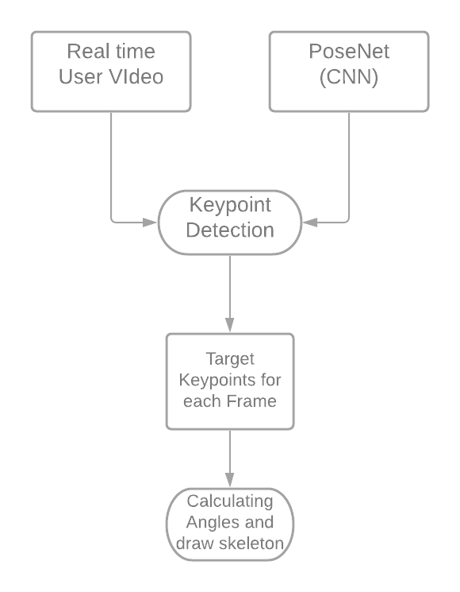
Native (Real-Time) part of the system
User Video (Input) - Camera
Conversion to individual frames
CNN (PoseNet) to get keypoints
Draw skeleton

Slide 12
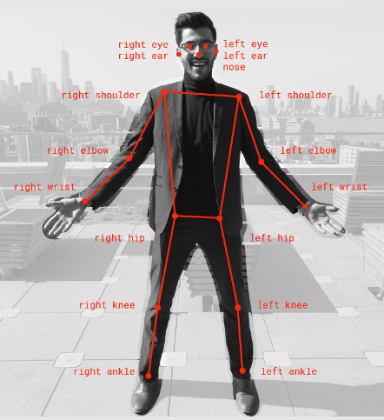
PoseNet
Adjustable architectures for neural networks - MobileNet, ResNet-34/50.
Keypoint detection - COCO dataset
TensorFlow Lite - easy to use with Android
Customizable strides for slower or faster performance

Slide 13
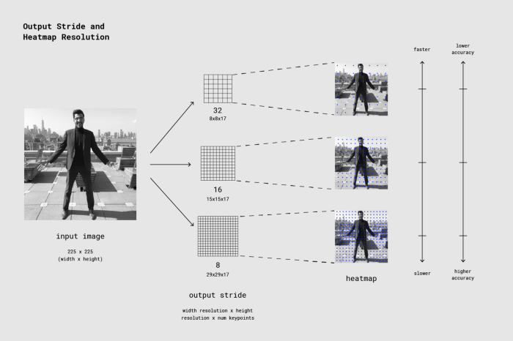
PoseNet

Slide 14
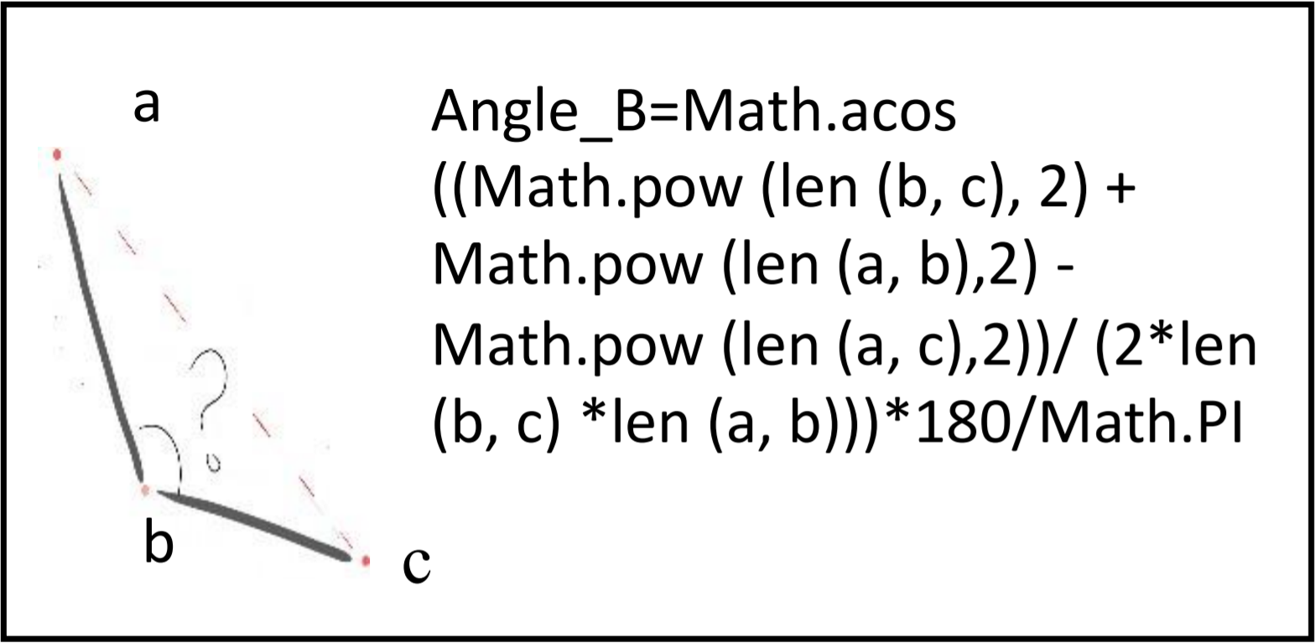
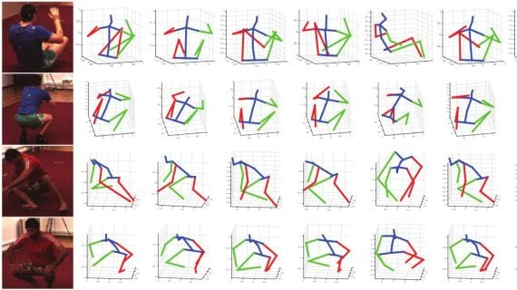
Comparison of Extracted Features
To Calculate angles:
Calculate the distance between keypoints : Euclidean Distance
Calculate the angle between keypoints :
where:
acos, pow and PI are rounding, cosine, power and π respectively
Compared using Angel range of +/- 10 degrees

Slide 15
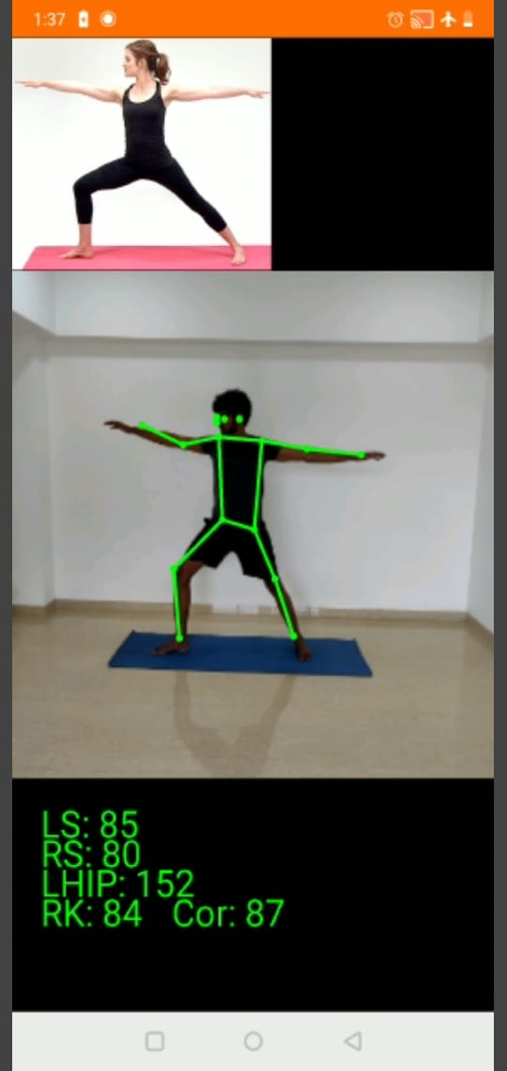
Display Corresponding Values
Accuracy is shown by displaying correctness percentage by comparing the target values obtained from dataset and the actual values obtained from video.
Calculated Angle!
Correction : 87%

Slide 16
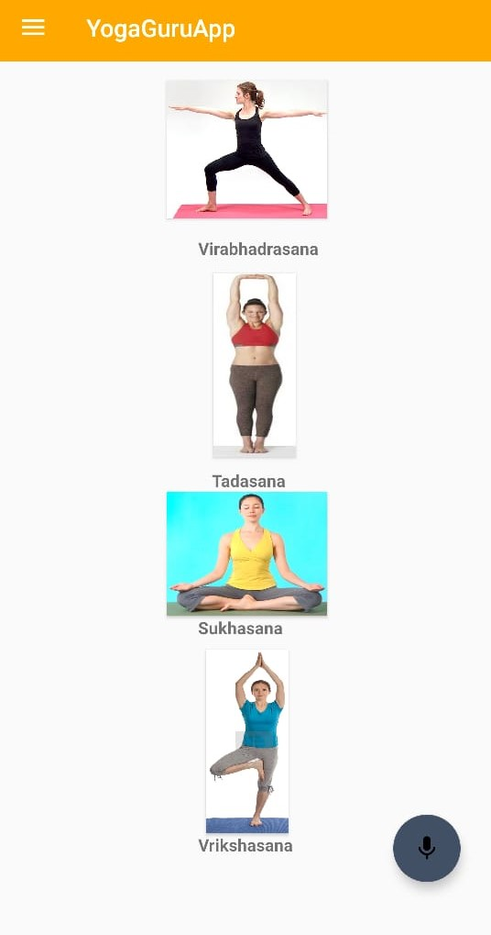
Speech Recognition
MODULE USED :
KontinuousSpeechRecognizer
Google’s speech-to-text engine
Speech Recognition:
Voice Button
Press the button to activate voice commands
Navigate the app using just your voice!

Slide 17
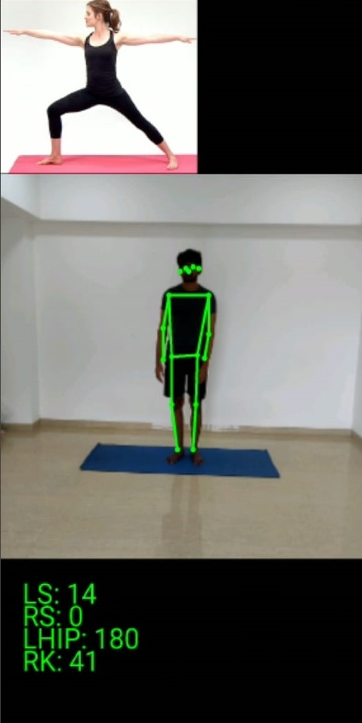
Text to speech
MODULE USED :
Google’s text-to-speech engine
Voice Correction:
voice commands tell the user when correct pose is performed.

Slide 18

Technologies
Machine Learning TensorflowLite, PoseNet.
Hardware Phone camera,
Android Android Studio
API level 28 or higher
OpenCv
Kotlin

Slide 19
Conclusion
Thus, implementing an exercise instructor can help people learn new exercises with correct form.
The application can highly influence the health of an individual and can prove to be highly beneficial.
It can help prevent injuries by describing the correct form.

Slide 20
References
[1] Sungheon Park and Nojun Kwak, 3D Human Pose Estimation with Relational Networks, 2018.
[2] Marcin Eichner and Vittorio Ferrari, Human Pose Co-Estimation and Applications, IEEE TRANSACTIONS ON PATTERN ANALYSIS AND MACHINE INTELLIGENCE, 2012.
[3] Paula Pullen , William Seffens, Machine learning gesture analysis of yoga for exergame development, 2018.
[4] Rıza Alp Güler , DensePose: Dense Human Pose Estimation In The Wild, 2018.

