Slide 1


Energy Efficiency in Smart Building
Team Members
1.MUESH.M
2)KARTHIKEYAN.S
3).ELANGO.P
4)JAYASURYA.K
5).KARTHI.R

Slide 2
Content
Abstract
Problem Statement
Objective
Data Collection and Preparation
Proposed Solution (Methodology)
Model Performance Evaluation
Screenshots / Demonstration (video)
Future Scope
Conclusion
Notes:
Abstract
Problem Statement (Clearly define the challenge)
Objective (State your project's goal)
Background and Research (Discuss existing solutions, trends, and gaps)
Data Collection and Preparation (Focus on data sources, cleaning, and augmentation)
Proposed Solution (Methodology)
Model Architecture (e.g., CNN, U-Net, YOLOv5)
Key Techniques (e.g., Transfer Learning, Image Augmentation)
Model Performance Evaluation
Metrics (Accuracy, Precision, Recall, IoU, etc.)
Graphs (Confusion Matrix, ROC Curve, etc.)
Screenshots / Demonstration (Visual proof of system functionality)
Future Scope (Improvements, scalability, and integration ideas)
Conclusion (Summarize results and impact)
Q&A Session

Slide 3
Abstract
Model predictions
- Interface/dashboard (if applicable)
- Pipeline overview

Slide 4
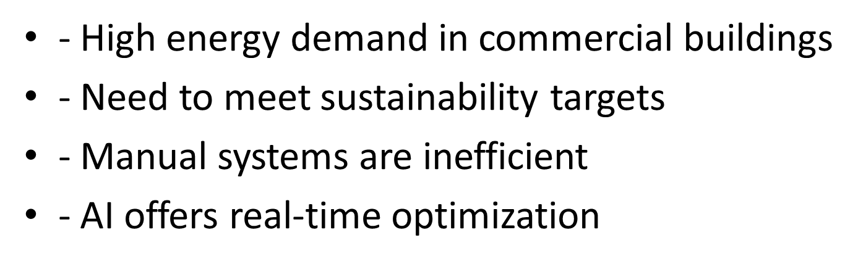
Problem Statement

Slide 5
Objective
Predict building energy consumption
- Identify inefficiencies
- Recommend energy-saving actions

Slide 6
Data Collection and Preparation
Data: Energy usage, occupancy, weather (2 years)
- Cleaning, handling missing values
- Normalization and feature selection
- Tools: Python, Pandas, Scikit-learn

Slide 7
Proposed Solution (Methodology)
- EDA to find patterns
- Feature engineering
- Train/test split
- Regression models: Random Forest
- Hyperparameter tuning

Slide 8
Model Performance Evaluation
Metrics: R² Score, MAE, RMSE
- Visualization: Predicted vs Actual
- Insights into model accuracy

Slide 9
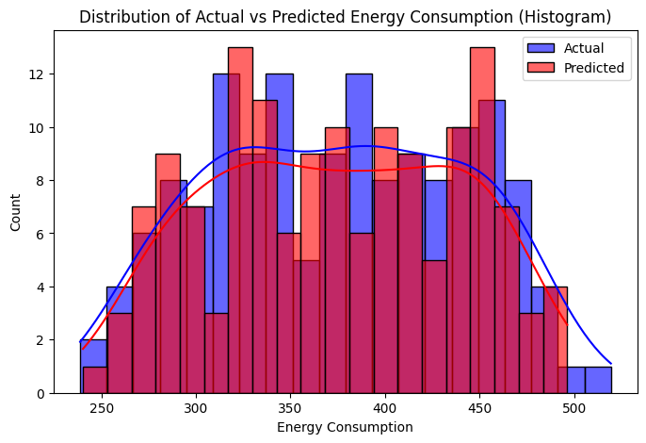
Screenshots /
Git hub link: https://github.com/Mugesh12342jxhghh/per131_S4F_CP_Team_11905
Collab link: https://colab.research.google.com/drive/1vt58eDQmtw5DvJgoWc_EHs_xF6Q7ORwX?usp=sharing

Slide 10
Future Scope
Integrate with IoT sensors
- Use deep learning for demand forecasting
- Expand to multiple buildings

Slide 11
Conclusion
AI helps reduce energy use and cost
- Smart HVAC control is effective
- Supports sustainable, net-zero goals

