Slide 1
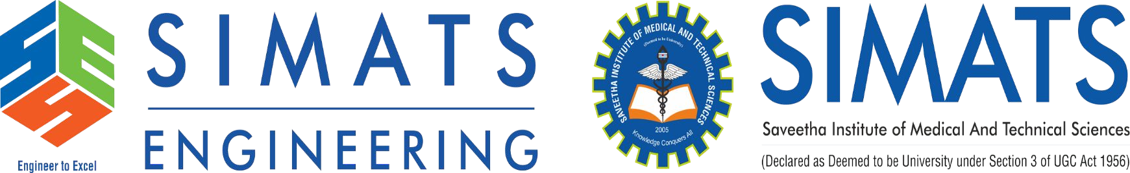
An Intelligent AI Coding Mentor for Guided Programming Learning CAPSTONE PROJECT CSA1707-Artificial Intelligence
Supervisor
Dr. Veeramani R
Saveetha School of Engineering
Student
Mugesh R(192524454)
Pritham(192572014)
Vasanthanithi D Y(192424137)
Department of AIDS and CSE Saveetha School of Engineering
1

Slide 2


INTRODUCTION
AI coding assistants have made programming faster and more accessible.
Most existing tools generate complete solutions instead of promoting learning.
Beginners often struggle with logical errors and programming concepts.
This system is designed to act as an intelligent programming mentor rather than a code generator.
The system focuses on improving logical thinking through guided explanations and hints.
2

Slide 3
ABSTRACT
The system analyzes the user's code to identify logical and conceptual mistakes and understands the intended purpose of the code.
Instead of immediately providing the correct solution, MentorAI gives contextual explanations and progressive hints to help the student discover the solution independently.
A floating desktop interface allows the mentor to assist users while they work across different coding environments and editors.
The system combines rule-based code analysis with the Gemini API to provide intelligent, personalized, and adaptive programming guidance.
2

Slide 4
PROBLEM STATEMENT
Students rely heavily on AI-generated code without understanding the logic.
Existing coding assistants prioritize productivity over education.
Logical mistakes are difficult for beginners to identify and correct.
Lack of conceptual guidance reduces problem-solving ability.
There is a need for an AI mentor that teaches instead of simply providing answers.

Slide 5
OBJECTIVE
Develop an AI-powered coding mentor for beginner programmers.
Detect logical and conceptual errors in source code.
Explain the purpose of programming constructs before suggesting fixes.
Provide progressive hints instead of direct solutions.
Enhance programming skills through guided learning.

Slide 6
EXISTING SYSTEM
Existing AI coding assistants mainly focus on code generation, auto-completion, and debugging.
Students may depend on generated code without understanding the underlying programming logic.
Traditional IDEs mainly provide syntax errors and compiler feedback, with limited conceptual guidance.
There is limited focus on an AI system that understands the learner's intent and teaches through guided explanations.

Slide 7
EXISTING SYSTEM DRAWBACK
Over-dependence on AI: Students may rely on generated code instead of developing their own problem-solving skills.
Direct Solutions: Most tools provide the answer or corrected code rather than guiding students toward it.
Limited Conceptual Learning: They often focus on fixing errors without explaining the reasoning behind the mistake.
Lack of Personalization: Guidance is generally not adapted to the student's learning level or previous mistakes.

Slide 8
PROPOSED SYSTEM
Uses rule-based code analysis and Gemini AI to identify logical and conceptual mistakes.
Provides contextual explanations that describe what the code is trying to achieve and where the reasoning goes wrong.
Uses a progressive hint system, guiding students from conceptual understanding to stronger hints instead of immediately revealing the solution.
Maintains learning history to adapt explanations and guidance according to the user's recurring mistakes and learning progress.

Slide 9
PROPOSED SYSTEM FEATURES
Intelligent Code Analysis – Analyzes code to identify logical, conceptual, and common programming mistakes.
Guided Hints – Provides progressive hints instead of directly revealing the solution.
Intent-Based Explanation – Explains what the user's code is trying to achieve and how each section contributes to that goal.
Floating AI Mentor – Provides assistance through an always-accessible floating window while coding in different editors.
Adaptive Learning – Tracks recurring mistakes and adjusts the difficulty and style of explanations based on the user's learning progress.

Slide 10
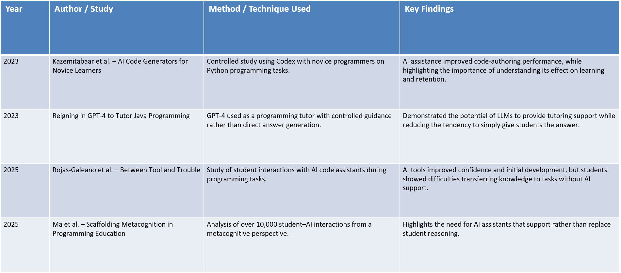
LITERATURE REVIEW

Slide 11
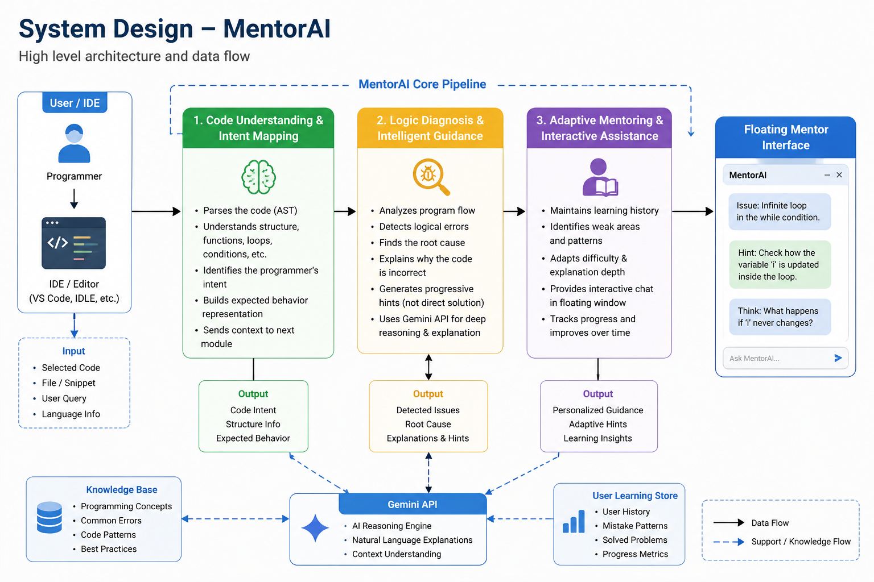
SYSTEM DESIGN

Slide 12
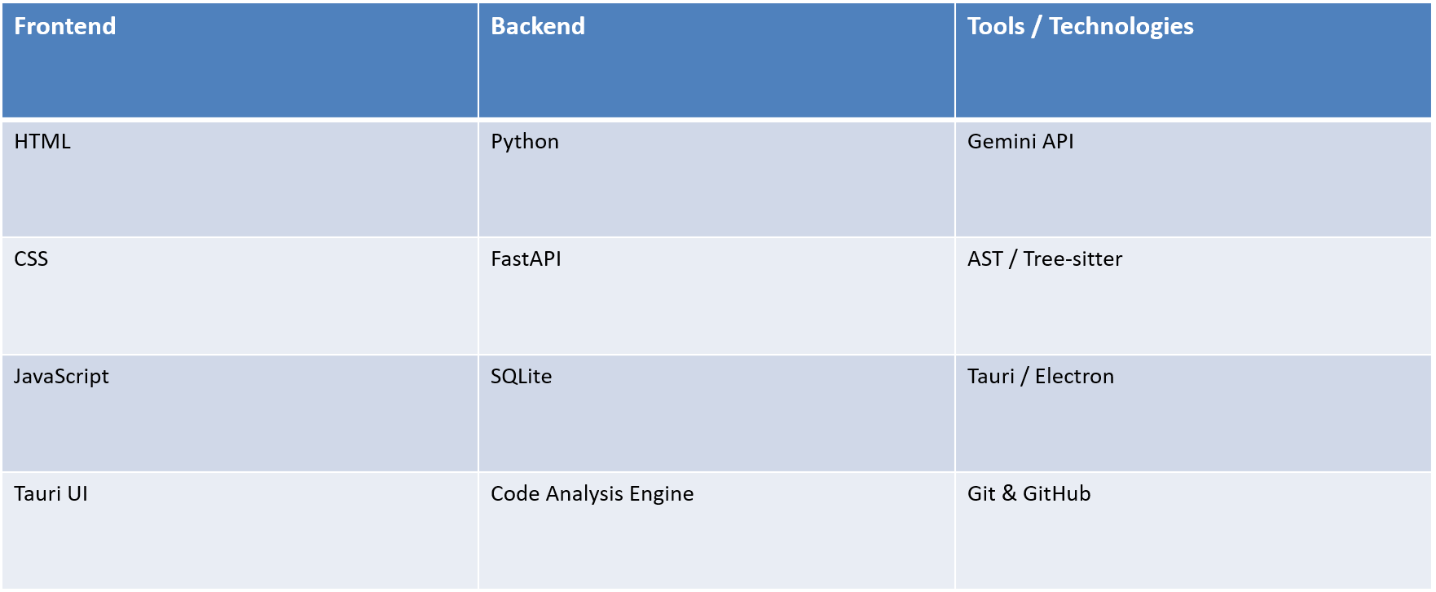
TECHNOLOGIES

Slide 13
MODULE 1: Code Understanding & Intent Mapping
Analysis the user's source code and identifies its overall purpose.
Understands what individual loops, conditions, functions, and operations are intended to accomplish.
Builds a representation of the expected behaviour of the program.
Compares the intended behaviour with the actual implementation.
Provides the context required for deeper AI analysis.

Slide 14
MODULE 2: Logic Diagnosis & Intelligent Guidance
Detects logical mistakes and identifies the reason behind the incorrect behaviour.
Uses program flow and code context to determine where the user's reasoning went wrong.
Explains the code's intended operation before explaining the mistake.
Generates progressive hints instead of immediately providing corrected code.
Uses Gemini AI to turn technical analysis into clear, learner-friendly explanations.

Slide 15
MODULE 3: Adaptive Mentoring & Interactive Assistance
Maintains the user's learning history, including recurring mistakes and concepts that require improvement.
Adjusts explanation depth and hint difficulty based on the user's progress.
Provides the mentor through a floating desktop interface while the user codes.
Allows users to request further explanation, stronger hints, or eventually a solution.
Tracks learning patterns to provide increasingly personalized programming guidance.

Slide 16
METHODOLOGY
User writes code in any supported code editor.
The selected code is analysed using rule-based techniques and AI.
The system identifies the programmer's intent and detects logical issues.
Gemini AI generates conceptual explanations and guided hints.
The user learns, modifies the code, and requests further guidance only if needed.

Slide 17
CONCLUSION AND FUTURE SCOPE
MentorAI provides an AI-powered programming mentor that focuses on understanding and guided learning.
It identifies logical mistakes and explains the intended behaviour and reasoning behind the user's code.
Progressive hints help students develop independent problem-solving and programming skills.
Future development can include multiple programming languages, IDE extensions, voice-based mentoring, and personalized learning analytics.

Slide 18
REFERENCES
Russell, S. J., & Norvig, P. — Artificial Intelligence: A Modern Approach, 3rd Edition, Pearson Education.
Alpaydın, E. — Introduction to Machine Learning, 4th Edition, MIT Press, 2020.
Kazemitabaar, M. et al. — Studying the Effect of AI Code Generators on Programming Education, 2023.
Reigning in GPT-4 to Tutor Java Programming, 2023.
Rojas-Galeano, S. et al. — Between Tool and Trouble: Student Experiences with AI Coding Assistants, 2025.
Ma, Q. et al. — Scaffolding Metacognition in Programming Education with AI, 2025.
Google — Gemini API Documentation.

Slide 19
Thank You

