Slide 1

Reverse Marketing
A Strategic Methodology

Slide 2

What is Reverse Marketing
Reverse marketing involves a reversal of traditional buyer-supplier roles. Traditionally, the supplier has taken the initiative. In reverse marketing the buyer tries to convince the supplier to provide exactly what the buyer’s organization needs
Leading
Convincing
Guiding

Slide 3
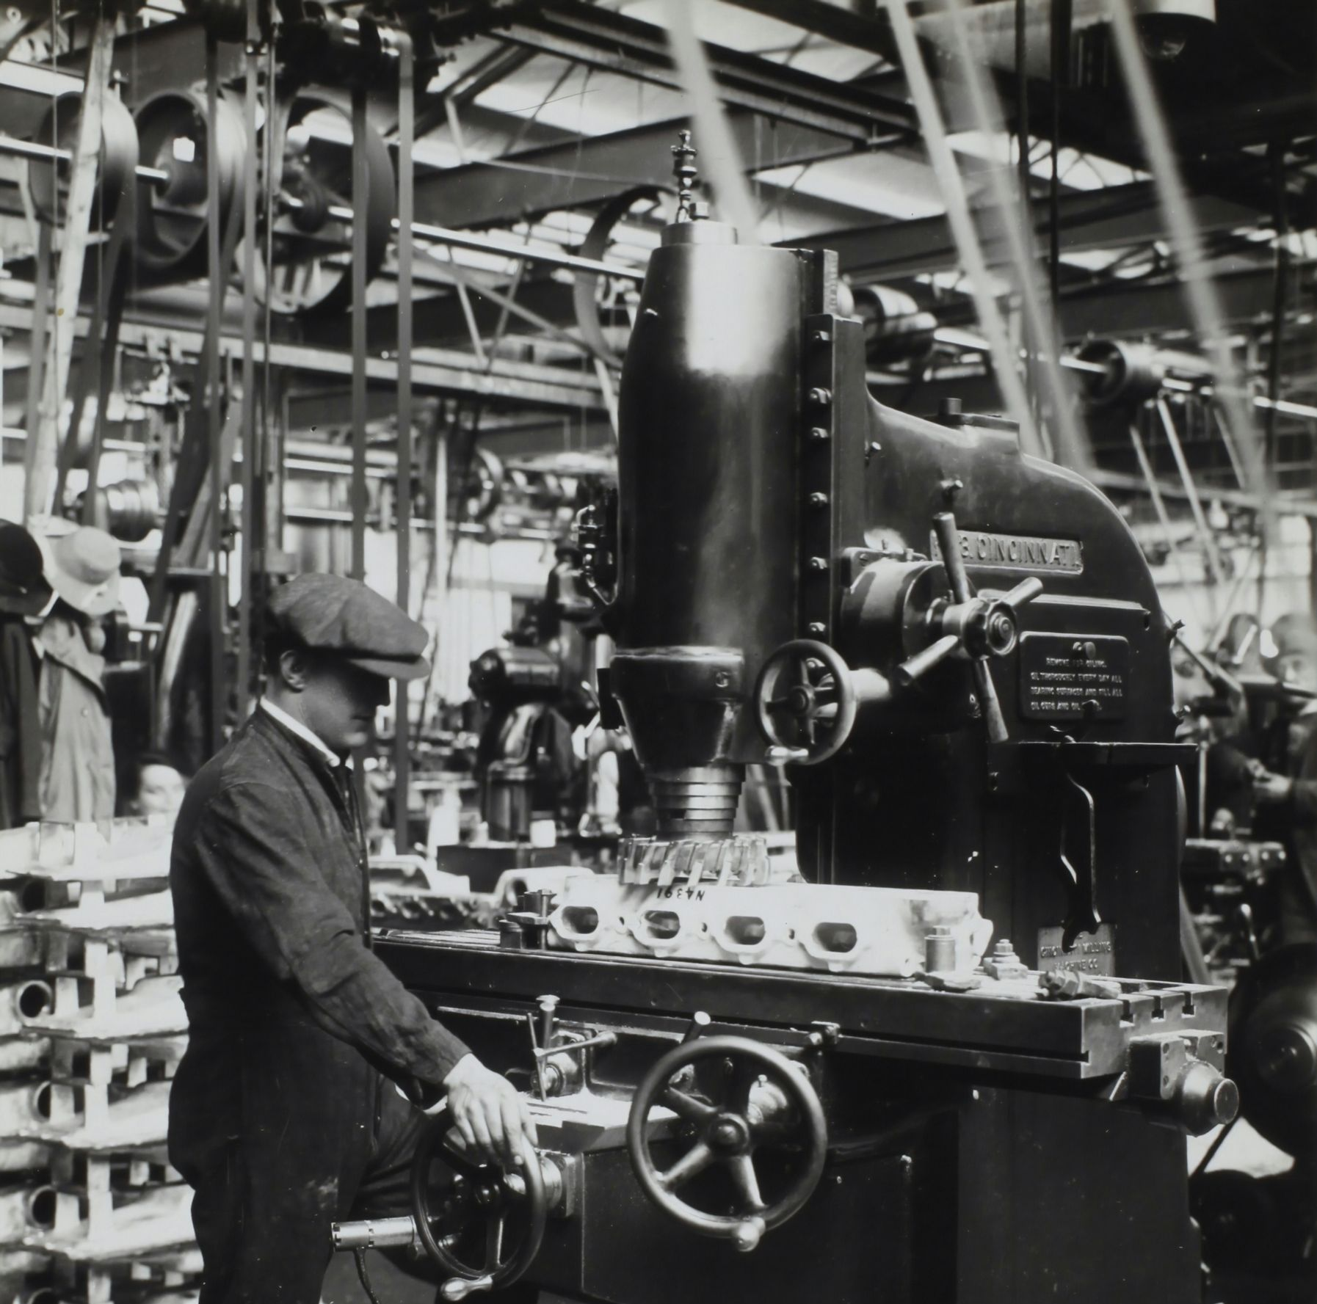
Overview of this article
Asian vs. U.S. Supplier Development
Major improvements and drastic changes (Asia) vs. incremental changes (U.S.).
Emergence of RMAW
Extensive investment in cultivating new supplier bases.
Focus on domestic and international supplier development.
Impact of Korean Government's Policies
Rapid economic growth leads to an unbalanced domestic supply chain.
LKF's Reverse Marketing Activities
Technical capability enhancement.
Financial support provision.
Training and education initiatives.
International expansion strategies.
Objective
Upgrade suppliers for global competitiveness.
Results
Significant quality and productivity improvements.
Company's Approach
Proactive and comprehensive.
Emphasis on major improvements and long-term capabilities.

Slide 4
Important Aspect: Technical Capability
Supplier Development
Quality Control: identification of quality issues ----- Implementation of corrective measures
Lead Time Reduction:
assess production processes
----- Identifying opportunities
Relationship Building: Face-to-face interactions -----
relationships & Trust
Problem-Solving: Troubleshoot issues -> Quicker problem resolution -> Minimize disruptions in the supply chain
Continuous Improvement: Support ongoing improvement initiatives -> Driving innovation and efficiency throughout the supply chain

Slide 5
Toyota (Asian)
COMPETITIVE APPROACH
General Motors(US)
* Lean manufacturing
*Efficiency and continuous improvement
*Long-term relationships with suppliers emphasizing collaboration and kaizen (continuous improvement) principles
*They emphasize mutual growth and development, fostering innovation and cost reduction initiatives together
*Follows a more traditional procurement model
*Focusing on cost efficiency and short-term gains
*They may prioritize cost-cutting measures and tend to engage in transactional relationships with suppliers
*While General Motors values supplier performance, their relationships may be more transactional, with less emphasis on long-term collaboration or joint innovation efforts compared to Toyota

Slide 6


Reverse Marketing Europe vs RMAW:
European Way: | RMAWA:
TARGET SUPPLIERS
Prioritize cost reduction initiatives more prominently in their supplier development efforts. | Improving suppliers' technical capabilities and quality standards, prioritizing these aspects over cost reduction
BUYER COMMITMENT
Usually moderate technical assistance | Very high financial, technical & Strategic leadership commitment
TYPE OF IMPROVEMENT
Minor Improvements, Incremental changes | Moderate Improvements, Drastic changes
STAGES OF BUYER – SUPPLIER RELATIONSHIP
Two firms have worked together for some time | Two firms are beginning to work together in a new Area

Slide 7

Areas of Application Concerning RMAW in General
Reverse marketing extends beyond basic aspects to develop disadvantaged suppliers.
Real case scenarios involve companies engaging in reverse marketing to uplift minority or depressed region suppliers.
Multinational buyers may engage in reverse marketing to develop local supplier bases in less developed countries.
Foreign governments may mandate the development of domestic suppliers as a condition for business.
Reverse marketing aids suppliers in making drastic improvements to meet required performance levels.
It involves special measures to support disadvantaged suppliers, contributing to economic development and social inclusion.
Additional areas of application concerning reverse marketing can include environmental sustainability and social responsibility within supply chains.
For example, companies may engage in supplier development activities that focus on promoting environmentally sustainable practices and social responsibility within their supply chains, contributing to a more sustainable and ethical supply chain.

Slide 8


Team Members: Mugesh M Smit Shethna Linh Nguyen Edwin Roy

