Slide 1


Base R Cheat Sheet
by Todin via cheatography.com/174736/cs/36706/
Language itself
To go further
R is a free software environment for statistical computing and graphics.
It's a compiled language.
R is a dynamically-typed,that means the type of a variable is determined at runtime, and that variables do not have to be explicitly declared with a specific type.
R is weakly-typed, which means that it will automatically convert between types when necessary, without the need for explicit type casting.
R is a garbage-collected language. This means the R runtime system automatically manages the memory used by the program. R is both a functional an object oriented language but it doesn't support inheritance, polymorphism, and encapsulation.
In R, functions call by value. This means that when a function is called, the values of the arguments passed to the function are passed to the function's local scope, and any changes made to the arguments within the function do not affect the original values of the arguments outside the function.
R is an integrated suite of software facilities for data manipulation, calculation and graphical display. It includes:
-An effective data handling and storage facility,
-A suite of operators for calculations on arrays, in particular matrices,
-A large, coherent, integrated collection of intermediate tools for data analysis,
-Graphical facilities for data analysis and display either on-screen or on hardcopy, and
-A well-developed, simple and effective programming language which includes conditionals, loops, user-defined recursive functions and input and output facilities.
The people who mainly use R are data scientist / engineer
Syntax and data structures
Variable Assignment
a <- 'bonjour' : string
a <- 6 : integer
Loop
For loop :
for (variable in sequence){ Do something }
While loop :
while (condi tion){ Do something }
Condition
if (condi tion){ Do something } else { Do something a == b : Are equal
a > b : Greater than
a >= b : Greater than or equal to
is.na(a) : Is missing
a != b : Not equal
a < b : Less than
a <= b : Less than or equal to is.null(a) : Is null Functions
functi on_name <- function (var){ Do something retu
) }
Maths Functions
log(x) : Natural log / sum(x) : Sum
exp(x) : Exponential / mean(x) : Mean
max(x) : Largest element / median(x) : Median
min(x) : Smallest element / quanti le(x) : Percentage quantiles
round(x, n) : Round to n decimal places
rank(x) : Rank of elements
signif(x, n) : Round to n significant figures var(x) : The variance / cor(x, y) : Correlation sd(x) : The standard deviation
Language environment
To code in R you can install the extension in your IDE like VSC or install its own IDE R Studio :
R for Windows R for Linux
Then to run it you can run it with the IDE if you don't have one you can use R Studio server, which is a web-based version of R Studio that can be accessed through a web browser. The command for R Studio is Rscript myscript.R .
When installed R Studio it would have a minimal impact impact on the local machine but if you runs large R scripts or using R for data analysis and machine learning tasks, which require a lot of memory,it may have a bigger impact on the local machine. But in the end it does not modify something in your machine that would block you in it's use.
Library
Code
instal l.p ack age s(' dplyr') : Download and install a package from CRAN.
librar y(d plyr') : Load the package into the file.
dplyr: :select : Use a function from the package Commonly used library
stringr for string manipulation dplyr for data frame manipulation ggplot2 for plotting graphs lubridate for date
By Todin cheatography.com/todin/
Published 25th January, 2023. Last updated 25th January, 2023. Page 1 of 2.
Sponsored by Readable.com Measure your website readability! https://readable.com

Slide 2
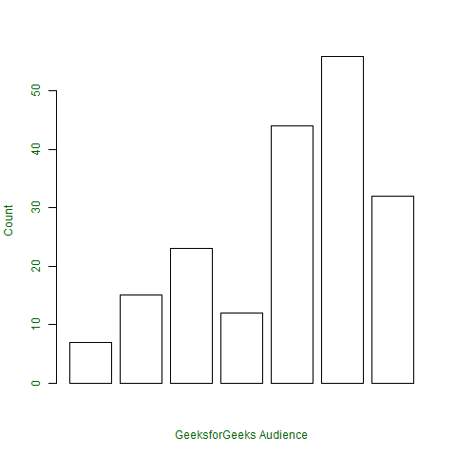
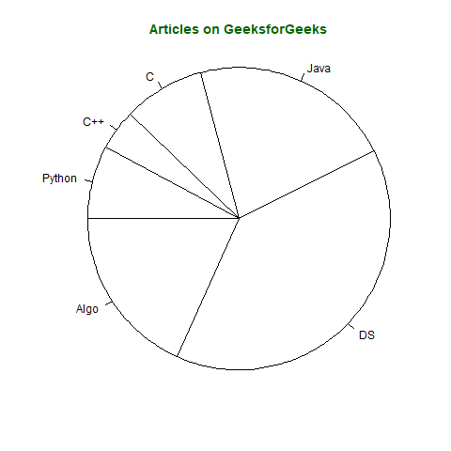
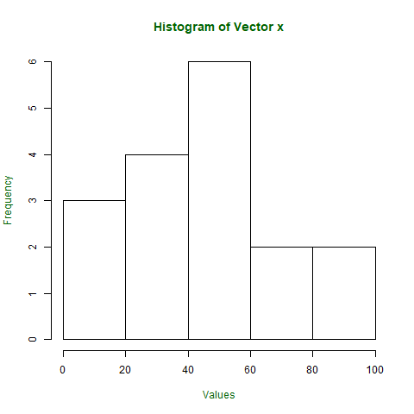
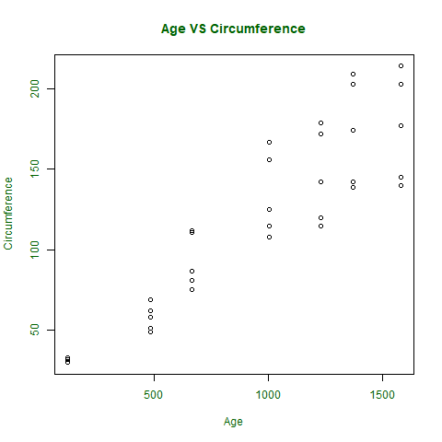
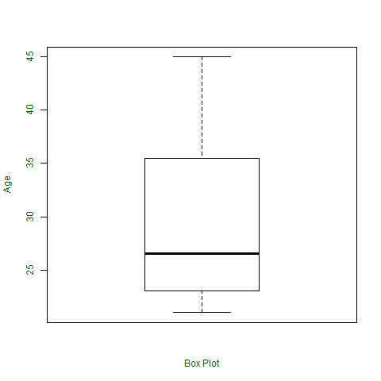
Base R Cheat Sheet
by Todin via cheatography.com/174736/cs/36706/
Charts and Graphs
Bar Charts
x <- c(7, 15, 23, 12, 44, 56, 32)
png(file = "barplot.png")
barplot(x, xlab = "Audience", ylab = "Count", col = "white", col.axis = "darkgreen", col.lab = "darkgreen") dev.off()
x <- c(21, 23, 56, 90, 20, 7, 94, 12,
57, 76, 69, 45, 34, 32, 49, 55, 57)
png(file = "hist.png")
xlab = "Values",
col.lab = "darkgreen",
col.main = "darkgreen")
dev.off()
Histograms
Pie Charts
x <- c(210, 450, 250, 100, 50, 90)
names(x) <- c("Algo", "DS", "Java", "C", "C++", "Python")
png(file = "piechart.png") pie(x, labels = names(x), col = "white", main = "Articles ", radius = -1,
col.main = "darkgreen") dev.off()
Scatter Plot
orange <- Orange[, c('age', 'circumference')]
png(file = "plot.png")
plot(x = orange$age, y = orange$circumference, xlab = "Age",
ylab = "Circumference", main = "Age VS Circumference",
col.lab = "darkgreen", col.main = "darkgreen",
col.axis = "darkgreen"
dev.off()
Box Plot
x <- c(42, 21, 22, 24, 25, 30, 29, 22, 23, 23, 24, 28, 32, 45, 39, 40) png(file = "boxplot.png")
boxplot(x, xlab = "Box Plot", ylab = "Age", col.axis = "darkgreen", col.lab = "darkgreen")
dev.off()
By Todin cheatography.com/todin/
Published 25th January, 2023. Last updated 25th January, 2023. Page 2 of 2.
Sponsored by Readable.com Measure your website readability! https://readable.com

